Slide 1
Combined Heat and Power
Bob Gemmer, Technology Manager
Advanced Manufacturing Office
AMO Peer Review
June 2020 | Washington, DC
manufacturing.energy.gov

Slide 2
Combined Heat and Power (CHP) Background
Definition
  CHP is the concurrent production of electricity or mechanical power and useful thermal energy (for heating, cooling, and/or process uses) from a single energy input
Market space
  CHP has largely saturated large industrial plants (> 20 MW electricity)
    Provide demand reduction to the grid primarily in recent years
    Engineering and operating staff have the needed technical expertise to support cost-effective installation and operation of CHP systems
    Considering adding capacity and providing ancillary services to the grid when needed
  Small/midsized industrial enterprises (SMEs) represent an important area of “white space” due to their large electric load (1-20 MW) and familiarity with self-generation
    Electric suppliers in select markets are looking at SME generation for capacity and ancillary services due to increases in variable generation
    SMEs are limited currently by technology barriers with available technologies in addition to regulatory and business barriers
    Additional technologies are needed to integrate these generation resources to the grid
The Opportunity: Flexible industrial CHP systems
  Traditional CHP systems are sized to match the host facility’s own electricity load, but don’t typically meet the thermal needs of the host
  An “oversized” CHP system could generate additional revenue for the host site by providing additional electricity and other services to the grid

Slide 3
CHP Challenges and Barriers
Cost and complexity of installation and operation: capital investments can often be cost prohibitive, particularly in a rapidly changing policy and economic environment.
Reliability, availability, maintainability, and durability: need for improved performance characteristics verification for CHP systems.
System packaging: need for pre-packaged CHP solutions that harmonize multiple components and can be easily selected and installed.
Scalability: need for higher-efficiency CHP systems in the 1-5 MW size range.
Fuel flexibility: lack of versatility to use a variety of input fuels, including renewable fuels.
High power-to-heat ratios: lack of high P/H ratios to enable broader adoption in end-use sectors.
Materials challenges: lack of economical materials that can operate at higher temperatures and resist corrosion.
Combined-cycle integration: need for balance of power distribution between cycles and optimization of internal mass and heat flows.
Hybrid CHP-renewable energy: need for commercially proven and available hybrid CHP-renewable energy systems.
Regulatory barriers: inconsistent interconnection requirements and standards; need to quantify CHP’s full energy and non-energy value in utility procurement and resource planning and incentives, and accurately apportion rates based on cost of service; unfavorable standby rates.

Slide 4
CHP Objectives and Targets (AMO MYPP)
OBJECTIVE
Advance technologies and develop strategies that accelerate the adoption of combined heat and power through streamlined installation processes; operating improvements; increased flexibility of fuel use; and reduced cost, emissions, and perceived customer risk.
TARGETS
Achieve a ten-fold cumulative increase in direct CHP technical support activities to potential commercial, institutional, and industrial end-users.
Advance the development of cost-effective CHP systems that are responsive to site demands as well as grid requirements.
Develop cost effective, high power-to-heat (P/H) ratio CHP systems with >65% electric generation efficiency, >75% system efficiency (HHV), and P/H greater than or equal to one (>= 1).
Support a 20% reduction in installed cost of commercially available, packaged (<10 MW) CHP systems (while maintaining >75% system efficiency at HHV).

Slide 5
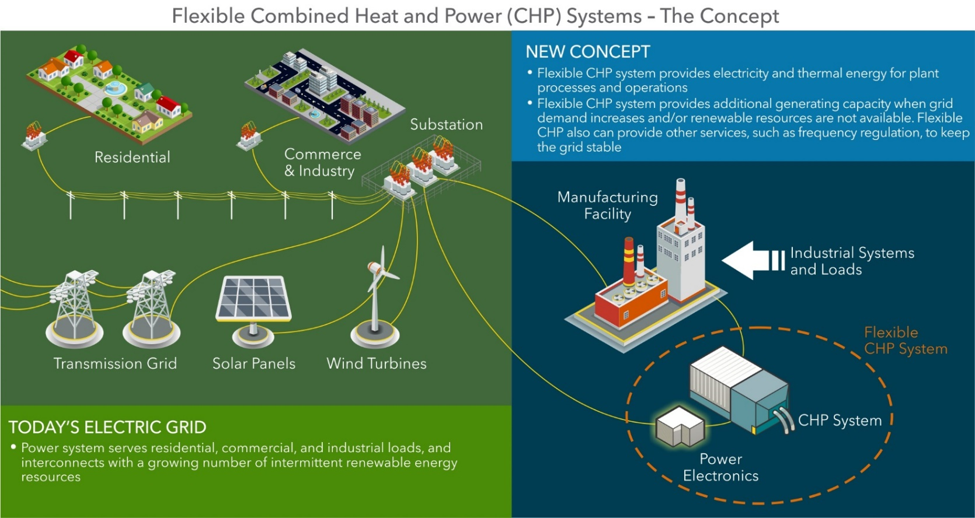
Key Concept: Flexible CHP Systems (the Basics)
Concept can improve grid reliability and resiliency, along with providing economic benefits to manufacturing facilities
Technology advancements are needed to bring the concept to fruition

Slide 6
CHP Current R&D Portfolio
Flexible CHP Systems to Support Grid Modernization, 2018 selections. (Target #2 - cost)
  7 awards from 2 topics ($9.2 million in AMO funding, 20% cost share)
    4 awards in Power Electronics and Control Systems (strong connection with Power Electronics technical topic area)
    3 awards in Electricity Generation Components
2018 Lab Call
  4 awards from 2 topics ($7.9 million in AMO funding)
    2 awards in Highly Efficient Turbines (Target #2 - cost)
    1 awards in District Energy and Microgrids, Congressionally directed (Target #1 - TA)
AMO FY19 Multi-Topic FOA (awards announced February 2020)
  8 awards from 2 sub-topics ($17.6 million in AMO funding, 20% cost share)
    3 awards in High Power to Heat Ratio, High Efficiency CHP (Target #3 – high P/H)
    5 awards in Verification and Validation of CHP and District Energy. Congressionally directed. (Target #1 - TA)
AMO FY20 Multi-Topic FOA (released on May 20, 2020): CHP Demonstration in a District Energy System Integrated with a Renewably-Fueled Municipal Generating Station. Congressionally directed. (Target #2 - cost)

Slide 7
CHP Current Deployment Portfolio
Address Targets #1 and Targets #4
Technical Assistance Partnerships (TAPs) (Congressionally directed activity)
  10 regional centers across the country
  Competitively selected every 5 years
Lawrence Berkeley Laboratory Support
  CHP eCatalog
  Packaged CHP Accelerator
  CHP Market Resources Support
Deployment Budget | Budgets | Doe Funding | Cost Share
Techncial Assistance Partnerships | Available Funds | $24,998,700 | 20%
 | Approved Budget | $9,917,685 | 20%
LBNL Support | Carry-over Funds | $3,691000 | 0%
 | 2020 Budget | $2,000,000 | 0%

Slide 8
CHP Deployment Activities
TAPs
  End User Engagement: Partner with strategic End Users to advance technical solutions using CHP as a cost effective and resilient way to ensure American competitiveness, utilize local fuels, and enhance energy security. CHP TAPs offer fact-based, non-biased engineering support to manufacturing, commercial, institutional and federal facilities and campuses.
  Stakeholder Engagement: Engage with strategic Stakeholders, including regulators, utilities, and policy makers, to identify and reduce the barriers to using CHP to advance regional efficiency, promote energy independence, and enhance the nation’s resilient grid. CHP TAPs provide fact-based, non-biased education to advance sound CHP programs and policies.
  Technical Services: As leading experts in CHP (as well as microgrids, waste heat to power, and district energy) the CHP TAPs work with sites to screen for CHP opportunities as well as provide advanced services to maximize the economic impact and reduce the risk of CHP from initial CHP screening to installation.
Packaged CHP
  eCatalog: Reduce risks for end-users and vendors through a national web-based catalog (eCatalog) of DOE-recognized packaged systems and suppliers, and a partnership with state/utility partners with CHP market engagement programs
  Accelerator: Work with utilities, states and federal agencies committed to promoting
  packaged CHP to characterize packaged CHP system performance in small/medium industrial, commercial, institutional and government markets.
Market Resources
  Help assure messaging consistent with AMO CHP strategy
  Publications, tools, analyses and technical materials to support CHP TAP mission; educate state and local policy makers, regulators, end users, trade associations, and CHP stakeholders; and inform AMO CHP program planning

Slide 9
CHP Collaborations and Outreach
Upcoming Outreach
  Packaged CHP eCatalog and Accelerator Program Session at DOE Better Buildings/Better Plants Virtual Summit (June 10, 2020)
  CHP TAP Booth at FEMP Energy Exchange (August 11-13, 2020 in Atlanta, GA)
  Workshop on the Role of CHP in Industry and the Grid
    Potential partnership with CHP Alliance and Council of Industrial Boiler Owners
  CHP TAP Directors Meetings (recurring; next one Fall 2020)
Major Past Outreach Events
  Dispatchable Distributed Generation: Manufacturing’s Role in Support of Grid Modernization workshop (February 2016 in Austin, TX)
  Flexible CHP Portfolio meeting (October 2019 in Charleston, SC)
Regular collaboration with partners and stakeholders (regional energy organizations, state energy offices, utilities, nonprofits, trade organizations, manufacturers, suppliers, end users)

Slide 10
Accomplishments: Impact of Flexible CHP Concept on the Grid (Modeling of the California Market)
Analysis Results
Objective: Estimate value of added flexible CHP at California industrial and institutional sites due to increased revenue from grid services and lower CHP costs.
Three scenarios modeled: Added flexible CHP systems on the CA grid in 2024:
Baseline: 33% renewables on grid, 3,400 MW existing CHP for site loads
Traditional CHP: Serves site loads + 10% capacity for grid services <500 hr/yr
Advanced CHP: Serves site loads + large flexible capacity for grid services
Combined Scenario: Selects most profitable option (between traditional and advanced) at each site
Key findings:
Reduced grid operating costs:
  All scenarios reduce grid operating costs by $1 Billion or more.
Increased generation capacity: Alleviates need for new centralized power plants.
Lowers site energy costs and provides additional revenue stream:
  Sites receive average additional revenue of $40,000 - $780,000 / MW surplus capacity.
Reduction in grid stress:
  Eliminates hours when reserves may not be met or transmission ratings exceeded.

Slide 11
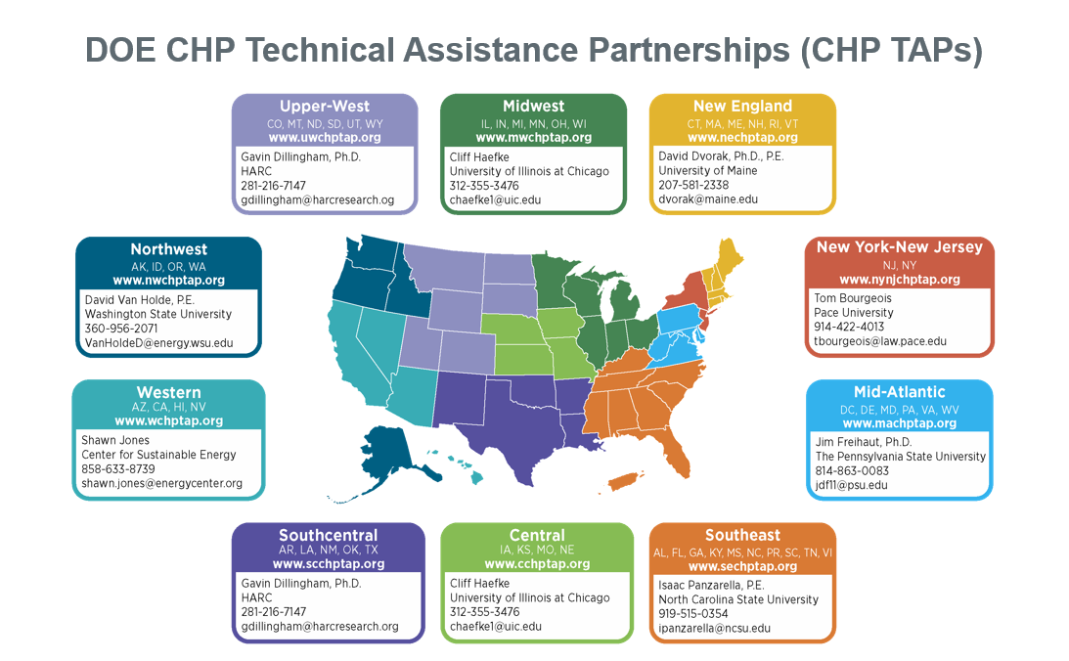
CHP TAP Regions

Slide 12
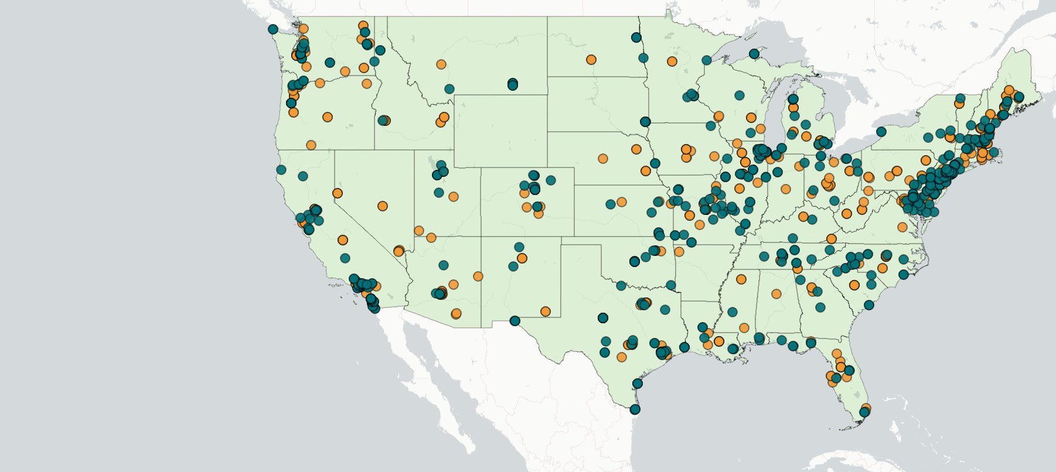

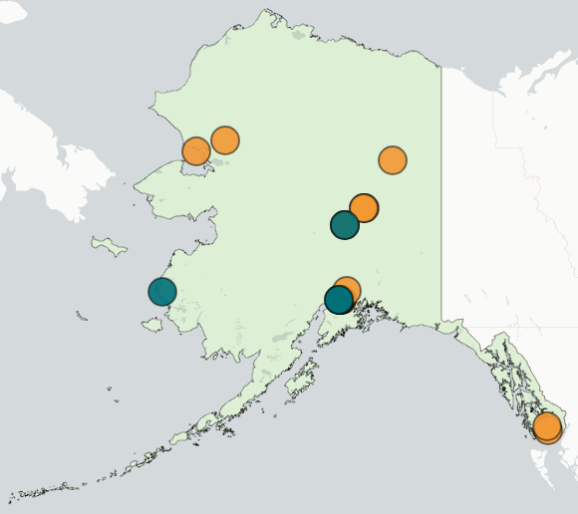
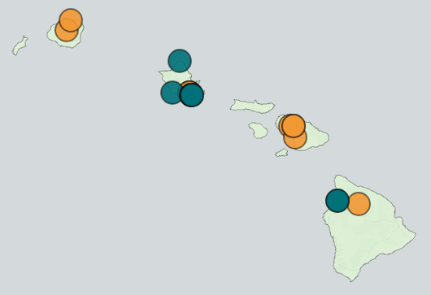
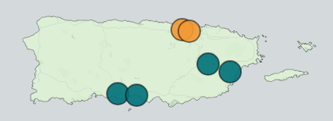
CHP TAP Accomplishments: FY19 and FY20 [through March 2020]
Completed over 502 TA activities with an estimated capacity of ~800 MW
Identified 75 end-user partners and completed 247 engagements
Identified 120 stakeholder partners and completed 165 engagements
Some partner engagements physically occur in a single state and engage representatives from multiple states (e.g. at regional conferences, workshops, etc.). These engagements are reflected once in the map in the state where they occurred, even if they impacted other states. For example, multiple engagements occurred with representatives from Wyoming and South Dakota, although these are not reflected in the map because the engagements occurred outside their states.

Slide 13
AMO CHP Team & Additional Program Presentations
Federal Staff:
  Bob Gemmer, Technology Manager, CHP Program
  Jamey Evans, Technical Project Officer (TPO) for CHP TAPs
Contractor Support:
  Tommi Makila, Technical and Program Support
  Patti Garland, DOE CHP TAP Coordinator
Detailed presentations on the CHP Program are available on the Peer Review website
  Individual R&D projects
  CHP TAPs
  CHP Deployment Program
THANK YOU!

