Slide 1
Advanced Turbine Airfoils for Efficient CHP Systems DE-LC-000L059 National Energy Technology Laboratory/Oak Ridge National Laboratory October 1, 2019 – September 30, 2022
Doug Straub
National Energy Technology Laboratory (NETL)
U.S. DOE Advanced Manufacturing Office Program Review Meeting
Washington, D.C.
June 2-3, 2020
This presentation does not contain any proprietary, confidential, or otherwise restricted information.

Slide 2
Overview
Project Title: Advanced Turbine Airfoils for Efficient CHP Systems
Project Budget and Costs:
Timeline:
Project Start Date: 10/01/2019
Budget Period End Date: 09/30/2020
Project End Date: 09/30/2022
Budget | DOE Share | Cost Share | Total | Cost Share %
Overall Budget | $2,800,000 | -- | $2,800,000 | --
Approved Budget (BP-1) | $887,576 | -- | $887,576 | --
FY20 (BP-1) Plan | $1,000,000 | -- | $1,000,000 | --
Barriers and Challenges:
Benefit of advanced cooling architectures cannot be quantified without a common baseline and test protocol
R&D investments lag for small (<20MW) gas turbines
AM steps have not been optimized, or defined in terms of yield, resolution, and performance potential for gas turbine applications
Project Team and Roles:
National Energy Technology Laboratory (NETL) – Lead
Develop baseline and quantify benefits of advanced cooling designs
Evaluate economic benefits for small-scale (<20MW) combined heat and power gas turbine applications
Oak Ridge National Laboratory (ORNL)
AM processing of baseline and advanced designs
Materials selection and processing
Technical Advisory Panel (industry experts)
Provide feedback and consultation
Technology adoption for Phase 2
AMO MYPP Connection:
Combined Heat and Power (CHP) Systems
Advanced Materials
Additive Manufacturing

Slide 3
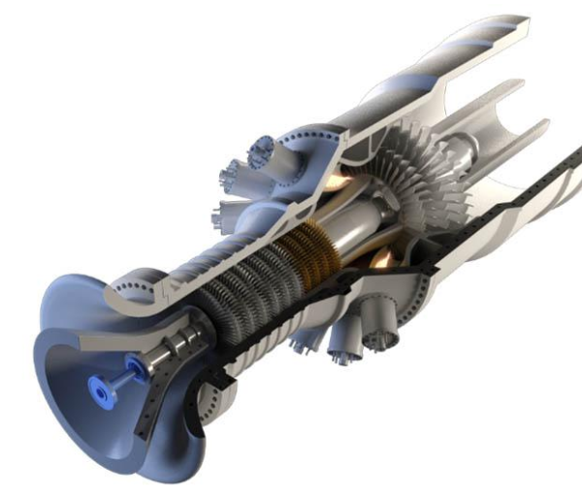
Project Objectives
CHP technical market potential is large (~100GW)
Higher efficiency/lower cost → growth of CHP market
Higher productivity and energy efficiency for US manufacturing (AMO strategic goal)
Research Target: Increase turbine inlet temperature by 100°C over 2015 baseline
Phase 1 – Demonstrate potential of advanced cooling, AM materials, and AM processing to temperature/efficiency improvements
Phase 2 (Option) – Establish CRADA with turbine manufacturer for follow-on development, testing, and deployment
Technology adoption challenges:
Additive manufacturability limitations
Package advanced cooling concepts into airfoils
Assess cost/benefit tradeoffs for AM airfoils
Source: NETL

Slide 4
Technical Approach
Current limitations:
Efficiencies for small GT’s have not increased significantly over the last decade
Investment casting → Long lead times/high tooling costs
Prior “AM/cooling” studies have not addressed entire airfoil
No public baseline for small GT’s
Proposed Approach:
Initially focus on cooling improvements
Establish baseline conditions, airfoil geometry, cooling design
Incorporate advanced cooling enabled by AM into airfoils
Develop baseline engine performance model
Use model to predict engine performance improvements from cooling
Experimentally validate cooling assumptions in model
Investigate other AM material options for small gas turbines
Identify potential advanced material options
Fabricate test airfoils for NETL
Public baseline designs can be leveraged for future studies
Commercial Gas Turbine Gensets
Ref: “2019 GTW Handbook,” Gas Turbine World, pp. 47–56, 2019
“Baseline” Definition:
Representative of engines in the target size range, but not identical to any specific engine

Slide 5

Technical Approach
Task | 2019 |  |  |  |  |  | 2020 |  |  |  |  |  |  |  |  |  |  |  | 2021 |  |  |  |  |  |  |  |  |  |  |  | 2022
Advisory Panel
Establish Test Plans and Approach
Modeling and Validation Testing
Reporting
Target engine size and conditions
Baseline and advanced cooling designs
Model efficiency based on cooling improvements
Market and benefits studies
Identify AM material options
Fabricate test articles
Validate integrated cooling performance in test rigs
Identify commercial interest
Establish Technical Advisory Panel for Constructive Guidance/Feedback
1
7
Baselines
Adv cooling options
Industrial Interest in Phase 2
PH2 Req’ts
Phase 2 CRADAs
AM Options
Advanced AM Options
2
5
CHP Benefits and Market Analysis
CGT Model
Predict Efficiency
3
Validate Preliminary Model
Complete Validation Tests
Final Perf. Testing
8
Airfoil Prelim. Design
Predict Efficiency
6
1st AM Build
4
2nd AM Build
Final Report
Analysis of 1st Build
AM fidelity checks
AM cost analysis
Analysis 2nd Build
Chart Key
NETL
NETL &
ORNL
Go / No-Go
Decision
Project Milestone
ORNL

Slide 6
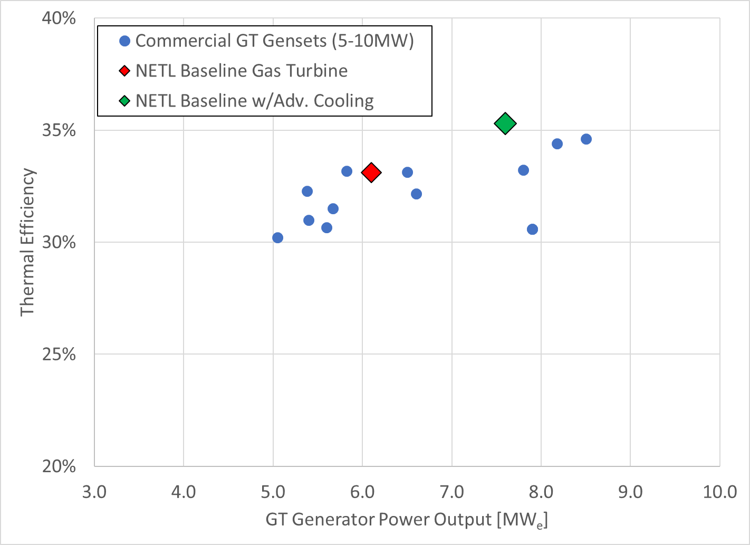
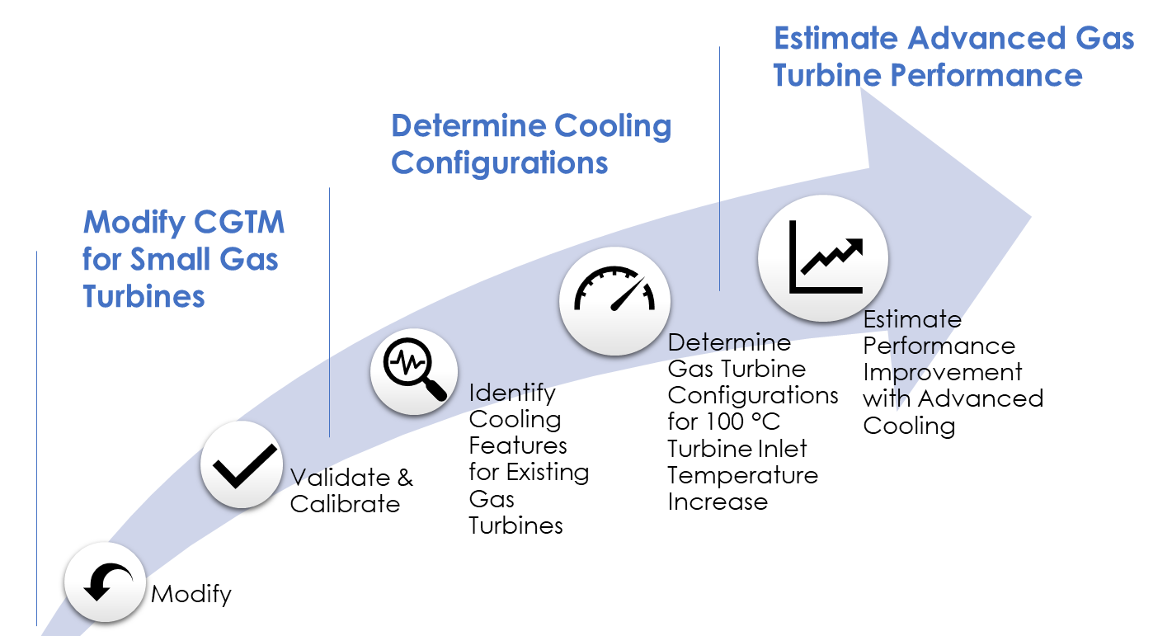
Results and Accomplishments
Preliminary Cooled Gas Turbine Model (CGTM) Predictions
Efficiency improvement: ~2 percentage points
Power increase: ~1.5 MWe (~20-25%)

Slide 7
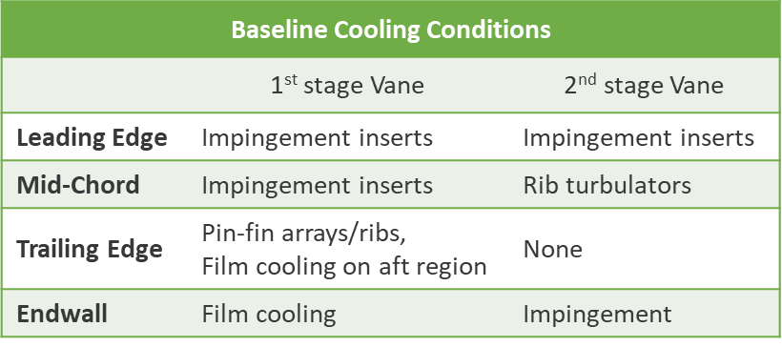
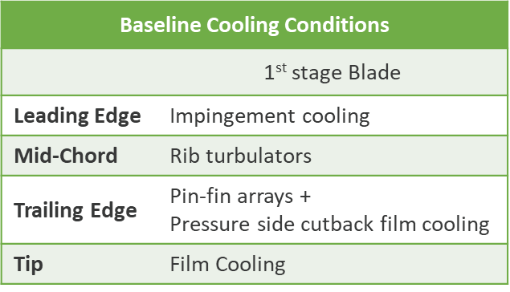
Results and Accomplishments
Symmetric public airfoil geometry (NACA-0024) selected for testing and cooling performance validation
1st Stage Vane Baseline Cooled Airfoil Design
1st Stage Rotor Blade Baseline Cooled Airfoil Design

Slide 8
Transition (beyond DOE assistance)
Strategy for commercial adoption:
Engage turbine OEM’s and suppliers at the beginning of the project
Task 1 – Technology Advisory Panel
Provide feedback and research focus on issues needed to accelerate commercial adoption
At the end of Phase 1,
CRADA’s will be established with commercialization partners with the intent of pursuing a strategy to increase TRL through engine testing
DOE role would transform into a consultant/advisory role
Leverage DOE expertise and capabilities to accelerate commercial deployment

