Slide 1
High-Efficiency Modular SiC-based Power-Converter for Flexible Combined Heat and Power Systems with Stability-Enhanced Grid-Support Functions EE0008411 Virginia Tech, Siemens 2019-2021
PI, Rolando Burgos
Center for Power Electronics Systems (CPES)
Virginia Tech
U.S. DOE Advanced Manufacturing Office Virtual Program Review
June 2-3, 2020]
This presentation does not contain any proprietary, confidential, or otherwise restricted information.

Slide 2
Overview
Project Title: High-Efficiency Modular SiC-based Power-Converter for Flexible
Combined Heat and Power Systems with Stability-Enhanced
Grid-Support Functions
Timeline:
Project Start Date: 01/01/2019
Budget Period 1 End Date: 12/31/2019
Budget Period 2 End Date: 12/31/2020
Project End Date: 12/31/2021
Project Budget and Costs:
Budget | DOE Share | Cost Share | Total | Cost Share
Overall Budget | $1,500,000 | $375,000 | $1,875,000 | 20 %
Approved Budget (BP-1 & BP2) | $1,061,133 | $265,335 | $1,326,468 | 20 %
Costs as of 4/31/20 | 639,744 | 296,347 | $935,821 | 32 %
AMO MYPP Connection:
3.1.13 Combined Heat and Power Systems
Project Team and Roles:
Virginia Tech
System design, integration, and testing
Grid support functions development
Siemens
Microgrid controller programming
Barriers and Challenges:
Control system complexity
Communication and integration with microgrid
Online measurement of microgrid
Availability and cost of SiC

Slide 3
Project Objectives
Problem: Renewable energy integration with its inherent and fast-transient variability is increasingly stressing the electric power grid. Tapping into industrial sites with electricity and heat demand by deploying combined heat and power (CHP) generation plants may become economically viable when using power electronics to provide for a flexible (F-CHP) grid-interface with support functionality.
Objectives:
To develop an F-CHO power converter with stability-enhanced grid-support functions avoiding the onset of dynamic interactions with grid and other system components.
To enable the local system for both microgrid and standalone operation.
To develop a modular, scalable power converter concept with lab demonstration in a low-voltage power-hardware-in-the-loop system.
Challenges:
Complex control system to enable grid-support functions
Advanced algorithm to enable system stability monitoring
High power conversion efficiency requires design iterations

Slide 4
Technical Innovation
Present CHP systems have been sized to match the facility’s own energy needs, not to support the grid.
Very few cases of power converters used between CHP systems and the grid
Grid-connected power converters work as grid-following mode without participating in grid voltage and frequency regulation, i.e., grid-forming mode
This project is developing a power converter with stability-enhanced grid-support functions, including:
Reactive power generation
Voltage regulation
Frequency regulation
Respond to abnormal conditions
Standalone operation
Monitors the grid stability
Grid inertia emulation
Phasor measurement unit
Synchronous D-Q Frame Impedance

Slide 5
Technical Approach
Scalable to increase operating voltage
Project is using a modular, scalable power converter topology used for High-Voltage Direct Current (HVDC) systems
Adapted for high switching frequency operation
Uses 10 kV SiC MOSFET devices
Can achieve 98 % ac-to-ac efficiency
Converter design and tests to be done by Virginia Tech
Flexible-CHP power converter

Slide 6
Technical Approach
Virginia Tech team designs control systems for grid-support functions with full compliance with the IEEE Standard 1547-2018, category B, for operation in local areas with high aggregated renewable resources
Virginia Tech team designs on-line grid impedance measurement functions to enable grid stability monitoring using the CHP power converter
Virginia Tech and Siemens design communication system to enable connection between CHP power converter and microgrid controller fulfill the IEEE Standard 2030

Slide 7
Results and Accomplishments
BP1 Milestones met on time
Control system design, digital control HW & SW, impedance measurement methodology, compliance with IEEE Std 2030.7
G/NG BP1 passed on time
Design of F-CHP ac-dc-ac converter meets design targets and demonstrates grid-support functions
Training on microgrid controller for Virginia Tech team was offered by Siemens Corporate Technology
Construction of F-CHP converter delayed, but close to completion
Models developed for power-hardware-in-the-loop system
Simulation model completed and in use to develop stability-enhanced grid-support functions and grid-forming synchronization model

Slide 8
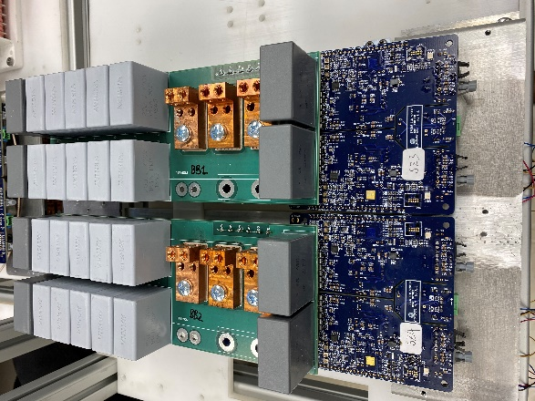
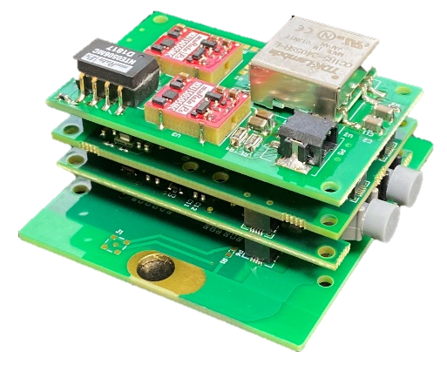
Results and Accomplishments
Digital Sensor
Digital Controller
Power Module

Slide 9
Transition
Technology Readiness Level (TRL) -4 will be achieved by the end of the project.
Experimental prototype will be constructed in a laboratory environment and tested using a power hardware-in-the-loop approach
The market transformation plan relies primarily on the DOE CHP Technical Assistance Partnerships, the collaboration with Siemens, as well as the Virginia Tech Center for Power Electronics System (CPES) industrial consortium and Power and Energy Center (PEC) collaborators
The CPES industry consortium has more than 80 members

Slide 10
Power-Hardware-in-the-Loop System
P-HIL environment
F-CHP converter prototype

