Slide 1
Converter-Interfaced CHP Plant for Improved Grid-Integration, Flexibility and Resiliency DE-EE0008412 GE Research/GE Renewable 10/1/2018 – 12/31/2020
Ibrahima Ndiaye, GE Research
U.S. DOE Advanced Manufacturing Office Program Review Meeting
Washington, D.C.
June 2-3, 2020
This presentation does not contain any proprietary, confidential, or otherwise restricted information.

Slide 2
Overview
Project Title: Converter-Interfaced CHP Plant for Improved Grid-Integration, Flexibility and Resiliency
Timeline:
Project Start Date: 10/01/2018
Budget Period End Date: 12/31/2020
Project End Date: 12/31/2020
Project Budget and Costs:
Budget | DOE Share | Cost Share | Total | Cost Share %
Overall Budget | $1,499,533 | $374,883 | $1,874,416 | 20%
Approved Budget (BP-1) | $916,338 | $229,084 | $1,145,422 | 20%
Approved Budget (BP-2) | $583,174 | $145,799 | $728,973 | 20%
Costs as of 3/31/2020 | $907,558 | $226,890 | $1,134,448 | 20%
Barriers and Challenges:
Economic viability of converter-interface CHP
Comprehensive modeling of reciprocating engines controls
Complexity of integrating controls of engines, converter and plant controller
Integration of evolving grid code requirements, energy markets dynamics and other economic factors
Project Team and Roles:
GE Research: project management, economic and technical feasibility analysis, development of the control platform, validation tests
GE Renewable: cost share, steering committee, technical support with converter controls
National Grid: advisory, support on user cases applications and grid code requirements
AMO MYPP Connection:
Combined Heat and Power (CHP) systems

Slide 3
Project Objective
Simplify the interconnection process of small-to medium sized CHP systems (1-20 MWe) to the distribution grid while providing a higher ROI for CHP.
Grid code requirements are more stringent and are constantly evolving
Limited flexibility of current CHP systems discourages their participation in ancillary services markets which limits their potential revenue streams
Objective: Develop a grid-interface converter controls and plant controller for a seamless interconnection of small to medium sized CHP plants to the distribution grid
Approach: Confirm both the technical and economic benefits, Develop and size the converter; Integrate, test and validate the controls of the engine, generator, converter and plant controller, Validate compliance with IEEE 1547-2018 and IEEE 2030.7
Targets: ROI > 10%, meet IEEE 1547 requirements, islanding mode operation
(Converter-Interfaced CHP Plant for Improved Grid-Integration, Flexibility and Resiliency)

Slide 4
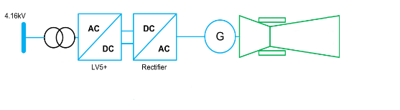
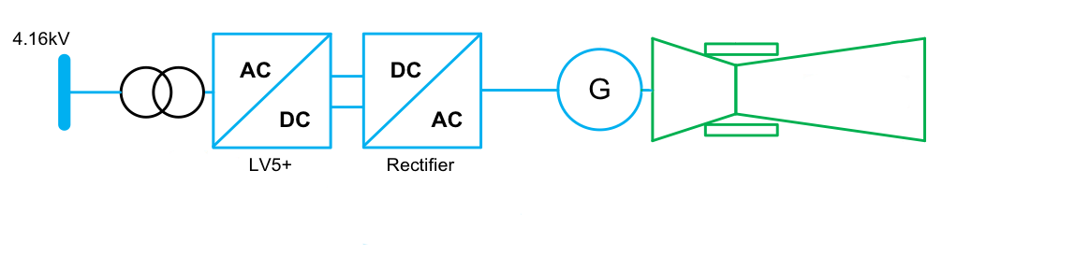
Technical Innovation
Utility
Utility
Microgrid controller
IEEE 1547
Plant controls
IEEE 2030.7
POI
POI
NEW
G
Heat loads
NEW
G
Heat loads
Critical loads with Standby Emergency Generator
Critical loads with Standby Emergency Generator
Engine controls
Controllable loads
Shed-able loads
Controllable loads
Shed-able loads
G
Existing technology
G
Proposed technology
CHP engine
CHP engine
Limitations with current practice:
lengthy interconnection process with comprehensive system studies to demonstrate compliance with utility requirements
high fault contribution that limits hosting capacity of the feeder
generator oversized for harmonics and reactive power
limited reactive power flexibility
high interconnection costs limiting ROI and discouraging projects to go to commissioning
Proposed approach:
interconnect CHP systems using a grid-ready inverter which already incorporates the key grid functions.
plant controller for energy management and protection
Critical innovations
reduce required size of the generator by 25%
significantly limit the short-circuit fault contribution of CHP eliminating a key barrier to higher penetration
decouple the CHP frequency from the grid dynamics
streamline the interconnection process of CHP in the distribution grid with the grid-ready inverter
(Converter-Interfaced CHP Plant for Improved Grid-Integration, Flexibility and Resiliency)

Slide 5
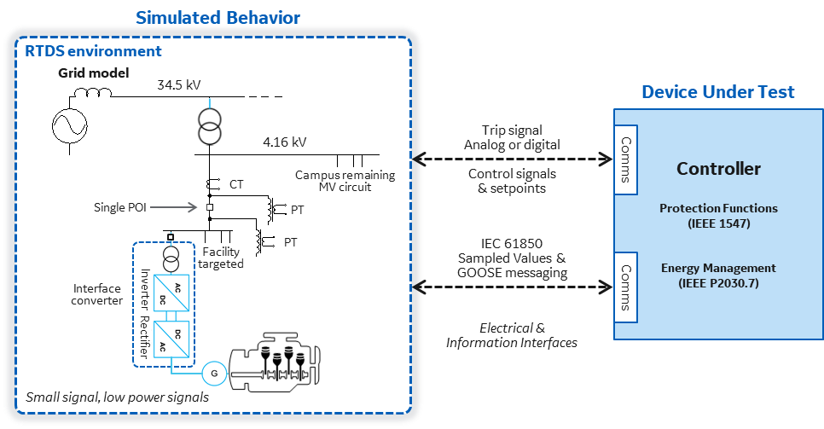
Technical Approach
Confirm the economic feasibility of converter-interfaced CHP
study 5 user-cases (applications, size, ISO)
compare ROI between directly-coupled and converter-interfaced CHP
sensitivity analysis of the ROI
Confirm the technical performance
design the converter and its controls
develop a hardware-in-the-loop simulations platform to validate system performance and compliance with IEEE 1547
Validate the system performance
develop a power hardware-in-the-loop with a +1MW converter
test performance for active and reactive power dispatch and connection and disconnection to grid
Key technical challenges
integration of the different controls from the engine, the generator, the converter and the plant controller
demonstrate ride-through capabilities that meet IEEE 1547 category II DER performances
develop controls for islanding mode operation
fault selectivity in islanding mode
(Converter-Interfaced CHP Plant for Improved Grid-Integration, Flexibility and Resiliency)

Slide 6
Results and Accomplishments
Milestone | Description | Status
Budget Period 1
Comparison of the technical merit between converter-interfaced and directly-coupled CHP plants completed | A detailed evaluation of the technical merit of converter-interfaced CHP is completed and compared with directly-coupled CHP. A validated list of the technical specifications for selecting and sizing the converter for the CHP | Achieved
Comparison of the economical merit between converter-interfaced and directly-coupled CHP plants completed | The business case study for converter-interfaced CHP is completed and compared with directly-coupled CHP plants. Detailed ROI calculations | Achieved
Load meters installed | Load meters installed for real-time testing of the interface converter; Real-time load data readings available at the microgrid controller | Partially achieved
Control algorithms validated | Hardware-in-loop (HIL) simulations results confirming compliance with IEEE 1547 and P2030.7 | Partially achieved
Calculated ROI for converter-interfaced CHP | To justify the continuation of the project the ROI for converter-interfaced CHP in at least one of the use cases studied must be higher than 15%. Moreover, the ROI for converter-interfaced CHP should be in the majority of cases higher than that of baseline directly-coupled CHP | Achieved
Budget Period 2
Power hardware-in-loop (PHIL) test setup completed | The testbed controllability must be demonstrated. Inverter output data and system protection functions should match load and trip commands from the microgrid controller | In progress
System performance validated | PHIL tests and simulations results confirming compliance with IEEE 1547 and P2030.7 | In progress
Controls integration and full operation of the Inverter | Controls integration and full operation of the inverter should be met. Moreover, the design should demonstrate the ability to meet IEEE 1547 requirements | In progress
(Converter-Interfaced CHP Plant for Improved Grid-Integration, Flexibility and Resiliency)

Slide 7
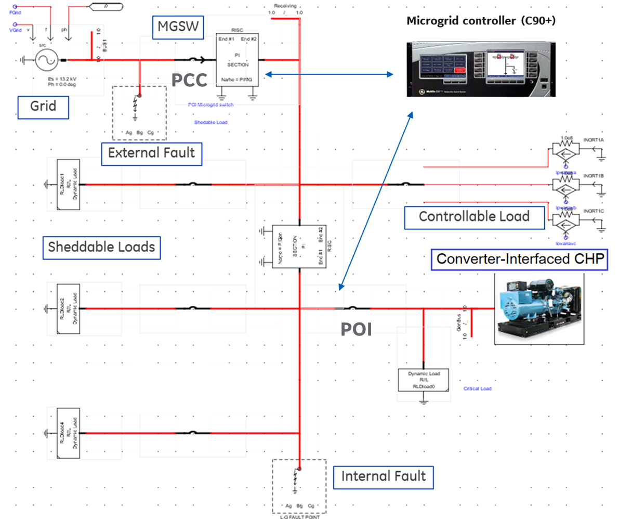
Results and Accomplishments (1 slide max)
HIL simulations:
System components | Max Pow [MW] | Min Pow [MW] | Voltage [kV] | Up Ramp [MW/s] | Dwn Ramp [MW/s]
CHP engine | 1.06 | 0.15 | 0.48 | 0.070 | 0.070
Interface Converter | 1.25 | 0.15 | 0.48 | 25 | 25
Grid model | n/a | n/a | 0.48 | n/a | n/a
Main Breaker (PCC) | n/a | n/a | 0.48 | n/a | n/a
Sheddable load #1 | 1.6 | 0.8 | 0.48 | 0.1 | 0.1
Sheddable load #2 | 0.8 | 0.4 | 0.48 | 0.1 | 0.1
Controllable load | 0.4 | 0 | 0.48 | 0.1 | 0.1
Critical load | 0.3 | 0.2 | 0.48 | 0.1 | 0.1
Test cases for the validation of the control platform
Planned disconnection from the grid in normal operation
Synchronization and reconnection to the grid
Voltage and Frequency ride-through following faults
Active power dispatch
Power factor correction at PCC
Internal and external faults
25 test cases successfully passed!
(Converter-Interfaced CHP Plant for Improved Grid-Integration, Flexibility and Resiliency)

Slide 8
Transition
Technology Readiness Level (TRL) is anticipated to be 6 by project end
GE Renewable will be the commercialization partner.
GE Renewable manufactures and commercialize inverters and microgrid controllers (through its Grid Solutions sub-business)
has a strong presence and large existing customer base in the US commercial and industrial manufacturing markets
GE Renewable is a key project stakeholder and will provide technical support for final on the converter controls
National Grid expresses interest for future demonstration phase to validate potential for grid support services
(Converter-Interfaced CHP Plant for Improved Grid-Integration, Flexibility and Resiliency)

Slide 9
Questions?
Contact:
Ibrahima Ndiaye (Principal Investigator), GE Research, ndiaye@ge.com

