Slide 1
Managing the Release of Scientific and Technical Reports with Protected Data
September 10, 2019
Joanna Martin
Department of energy
Office of scientific and technical information (OSTI)

Slide 2
Context
Final Scientific and Technical Reports (FTRs – to be called “reports” throughout) are required to be submitted to OSTI at the end of an award per the terms and conditions of most financial assistance agreements.
The expectation is that the report will be released as broadly as possible, e.g., to the public, as long as the data are not restricted.
Data in these reports may have certain distribution limitations “limiting” the release of the report for a period of time. After that period of time, the data are no longer protected, and should be made publicly accessible. SBIR/STTR awards produce these types of reports, and so do awards where data is protected under EPAct.
Managing the transition from “protected” to “unlimited” for SBIR/STTR reports, as well as reports with EPAct protected data, will be discussed.

Slide 3
Handling of protected reports at OSTI – The Landscape
Reports submitted to OSTI with distribution limitations other than “unlimited” (not to include classified) are submitted through E-Link and are disseminated through a product called the Science Research Connection (SRC).
SRC, however, only supports access to DOE federal and contractor employees.
The full-text of the report may be protected in SRC, as well, relying on the user to request a document for a result. Staff at OSTI then determine whether the document can be released to the requestor. Previously, information about SBIR/STTR reports were only found through SRC.

Slide 4
Handling of protected reports at OSTI – Changes for SBIR/STTR
In 2014, an IG Audit, Public Dissemination of Research Results (DOE/IG-0912), reported that SBIR/STTR reports were not being released to the public because the information about these reports were only available in SRC.
Because of this, the public would have no way of knowing about the results of SBIR/STTR research even after the data protection period had expired.
The SBIR/STTR office asked OSTI to work with them to find a solution to manage the SBIR/STTR reports so that after the data protection period, the report would be released to the public like any other unlimited report – broadening discoverability of the research when the data became available for public use.

Slide 5
How did we change the handling of SBIR/STTR reports?
First, needed to address challenges of extendable release dates
SBIR/STTR reports submitted at this time had data protection periods that were extendable – meaning that if a Phase I, received a Phase II, Phase III, the data protection period would be extended by another 4 years.
We determined that the best way to address the extendable protection period would be by emailing the PI, and the Business Official at the SBC about their options (how) to extend the release dates, and their right to do so, and would automate that process.

Slide 6
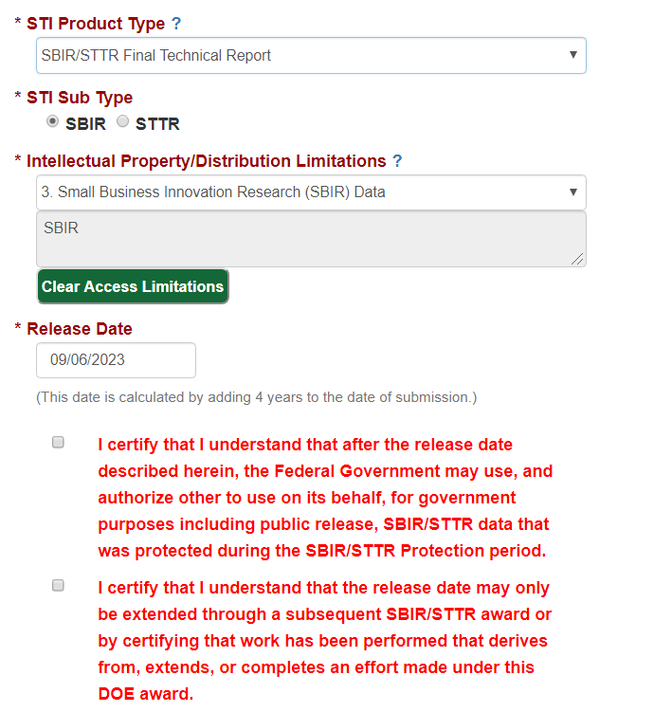
The process for submission and notifications
We created a new product type in E-Link to align with the distinct nature of the SBIR/STTR award type. SBIR/STTR recipients now use this type to submit their reports through E-Link.
The release date for the report is automatically calculated by adding 4 years to the date of submission, and the submitter is notified of this date on the interface.
Two certifications were added to make clear what the Federal Government will do with the data, after the release date, and what steps are needed to extend the release date.
After submission, the email process kicks off to effectively handle communications about the release date and to notify recipients about the steps to extend the release date, if needed.

Slide 7
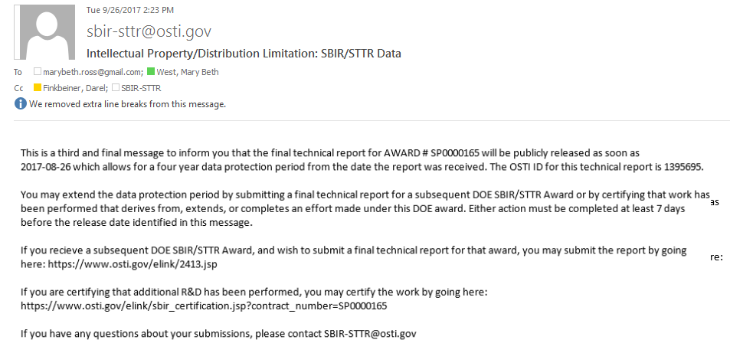
Email Notifications
Emails are sent at time of submission, then at 1 year, 3 months, and 2 weeks prior to the release of the report. All email communications provide similar information and are automated.
Notification of release date and instructions for extending the date

Slide 8
Dissemination
Upon submission, the OSTI systems (E-Link and OSTI.GOV) handle the reports by making the metadata available (before the report is released) letting the public know when the report may be available. Screenshot next slide.
After submission, the releasing official is notified that the report is in E-Link ready for review and release (although “release” in this sense isn’t the same as release to the public).
The releasing official will follow normal closeout steps for review and release, and will check the markings on the report (data rights notice) and distribution limitations to ensure they are aligned. Once the releasing official “releases” the report in E-Link, the metadata is released in OSTI.GOV, and then the report will sit, on hold, until the release date, or until any further reports are submitted to OSTI for the award, or the SBC certifies that R&D is continuing under the award.
Therefore, for the report to be released in OSTI.GOV, the report must be 1) “released” by the releasing official, and 2) neither of the two events described (subsequent report submitted or certification of ongoing R&D) will have occurred. The system handles these processes automatically to ensure that the report is released to the public in accordance with the data rights of the SBC, and the Federal Government.

Slide 9
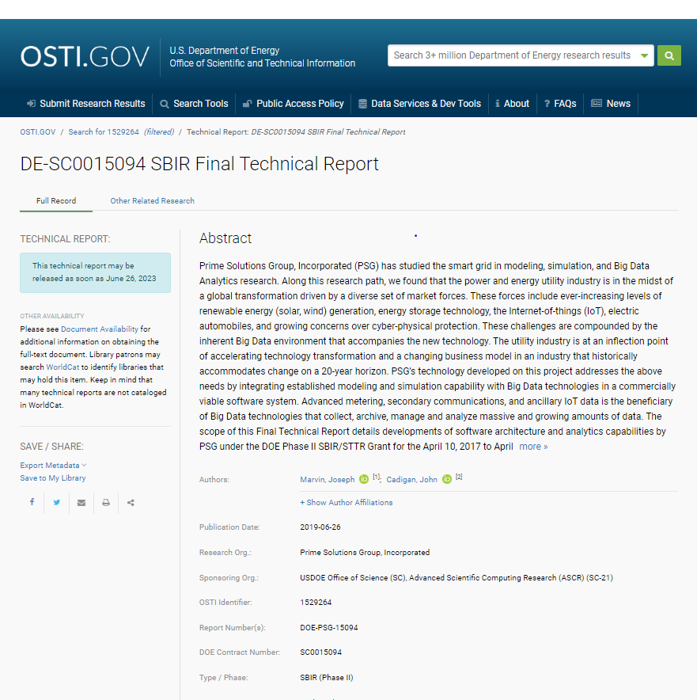
How the SBIR/STTR data is released in OSTI.GOV
Once the releasing official “releases” the report, the metadata is released in OSTI.GOV immediately.
After the release date, the report is released to OSTI.GOV.

Slide 10
SBA Updates to the Data Protection Period
Most recently, the SBA updated its policy guidance to change the data protection period to a FIXED 20 year period eliminating the need for managing extendable periods in the long-term.
SBIR/STTR Awards issued before May 1, 2019 are still impacted by the extendable protection periods requiring the need to manage reports submitted under those award terms using the current system functionality.
SBIR/STTR Awards issued on/after May 1, 2019, have updated T&Cs to reflect the FIXED 20 year data protection period. Currently, we are working with SBIR/STTR and CH to update the system workflow to accommodate the data protection changes for those awards.
E-Link implementation, to address these changes, is scheduled ~December 2019 where reports submitted with either type of protection period will be automatically managed and released accordingly.

Slide 11
Other work to release reports with Protected Data (EPAct)
In addition to management of the release of SBIR/STTR reports, reports with EPAct protected data are next to be managed leveraging off the relevant workflow described for SBIR/STTR (but will accommodate a different data protection period - no more than 5 years).
Reports with EPAct protected data are currently in SRC and not being released automatically after the data protection period creating a similar need (as with SBIR/STTR reports).
Specific E-Link workflow is being determined with primary stakeholders from EERE and NETL.
It is expected that E-Link will accommodate the automatic release process for reports with EPAct data by Q2 of FY 2020.

Slide 12
For More Information
Questions?
Contact:
Joanna Martin
Office of Scientific and Technical Information (OSTI)
Joanna.martin@science.doe.gov

