Slide 1
Trademarks
Pepsi, Gatorade vs. SportFuel, Inc.
Marianne Lynch, Patent Attorney | Marianne.lynch@hq.doe.gov
DOE IP DAY
Sept 10, 2018

Slide 2
Lawsuit: SportFuel Trademark - Gatorade The Sports Fuel Company
In August 2016, SportFuel, a sports nutrition consulting firm, sued Pepsi and Gatorade, alleging trademark infringement, unfair competition and false designation of origin in violation of the Lanham Act.
Suit was brought after Gatorade rebranded with “Gatorade The Sports Fuel Company” slogan.
On June 14, 2018, the the District Court of Illinois granted Gatorade’s motion for summary judgment.
SportFuel appealed to the 7th U.S. Circuit Court of Appeals.

Slide 3
Summary Judgment Request of 7th Circuit Court
Gatorade moved for summary judgment on two grounds and argued:
  First, that SportFuel failed to provide evidence that allowed a jury to find a likelihood of confusion—a necessary element to each of SportFuel’s claims.
  Second, that Lanham Act protected its use of “Sports Fuel” as a fair use.

Slide 4
SportFuel, Inc. Background
SportFuel, founded in 1993, is a nutrition consultant for athletes, including the NHL’s Chicago Blackhawks, and sells branded dietary supplements.
First “SportFuel” mark was prior to 2013 for "food nutrition consultation," "nutrition counseling," and "providing information about dietary supplements and nutrition" and the
Second mark in 2015 for "dietary supplements" and "sports drinks enhanced with vitamins".
Sport Fuel founder, Julie Burns, served as a nutritionist on the Gatorade Sports Science Institute’s Sports Nutrition Advisory Board from 1995 until 2003.

Slide 5
Gatorade Background
Gatorade, founded in 1965, is more widely known and is the official sports drink of the NBA, PGA, MLB, MLS, and other organizations.
In 2015, Gatorade began using the slogan "Gatorade The Sports Fuel Company" on its products.
In 2016, Gatorade registered the words "Gatorade The Sports Fuel Company" as a trademark.
The USPTO told Gatorade it viewed the term “sports fuel” as descriptive and not appropriate for trademark use.
Gatorade disclaimed the exclusive use of “The Sports Fuel Company” after the PTO advised the company that the phrase was merely descriptive of its products.

Slide 6
The Lanham Act
The Lanham Act:
  Codifies common law trademark protections. Allows those who use trade or service marks to register them for exclusive use in commerce.
  The holder of a registered mark has a civil action against anyone employing an imitation of it in commerce when such use is likely to cause confusion, or cause mistake, or to deceive, or against those who make a false designation of origin for a mark.
  To prevail on either claim, a plaintiff must establish that (1) its mark is protectable and (2) the defendant’s use of the mark is likely to cause confusion among consumers.”
Under the fair use defense, parties may use trademarked language in descriptions that do not create confusion about the source of a product.
The defending party needs to show they are not using the word or phrase as a trademark, but as a descriptive of its goods, and is used fairly and in good faith.

Slide 7
Fair Use Under The Lanham Act
The exclusivity can be limited by the “fair use” defense.
  Parties may use trademarked language in descriptions that do not create confusion about the source of a product.
  The defending party needs to show they are not using the word or phrase as a trademark, but as a descriptive of its goods, and is used fairly and in good faith.

Slide 8
Image Showing Smaller Print for Sports Fuel

Slide 9
Example of Gatorade Logo

Slide 10
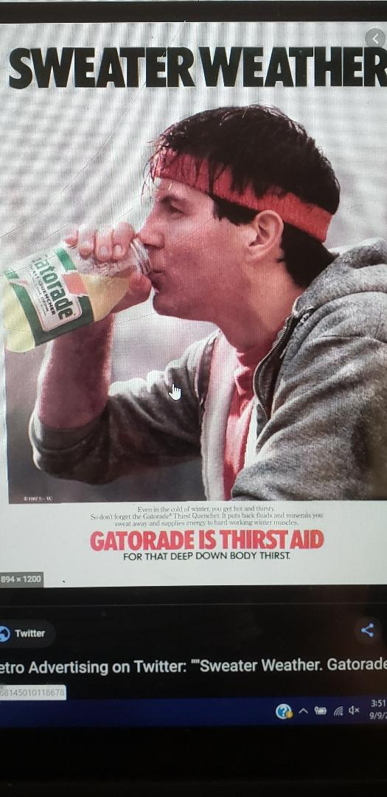
GATORAID IS Thirst Aid for deep down body thirst

Slide 11
7th Circuit Decision
On August 2, 2019, a unanimous three-judge panel of the 7th U.S. Circuit Court of Appeals granted Gatorade’s motion for summary judgment. The court concluded Gatorade met the fair use requirements.
  Gatorade’s slogan was a fair use of the term “sports fuel” because the company didn’t use the term “sports fuel” as a trademark but as a description of its products.
  Gatorade used the “sports fuel” slogan fairly and in good faith.

Slide 12
7th Circuit Decision (continued)
Court included numerous images in its opinion to justify its position that Gatorade's use of its own name is always emphasized and often larger than the slogan.
Gatorade’s own trademarks were more prominently displayed than the term Sports Fuel and although they had trademarked the phrase “The Sports Fuel Company” they hadn’t used the term “Sports Fuel” in a manner that would suggest an indication of source or as an “attention‐getting symbol.”
The panel said producers of sports nutrition products for athletes regularly use the term “sports fuel” to describe the products they sell.
Because the court concluded that Gatorade successfully raised a fair use defense against Sport‐Fuel’s claims, they did not consider whether Gatorade’s use of the slogan presented a risk of confusion to SportFuel’s mark.

Slide 13
Trademark Questions?
Jennifer Mahalingappa, Patent Attorney | jennifer.mahalingappa@hq.doe.gov
Rob Burns, Patent Attorney | robert.burns@hq.doe.gov
Brighton Springer, Attorney Advisor Marianne Lynch, Patent Attorney | brighton.springer@hq.doe.gov marianne.lynch@hq.doe.gov
Reference herein to any specific commercial product, process, or service by trade name, trademark, manufacturer, or otherwise, does not necessarily constitute or imply its endorsement, recommendation, or favoring by the United States Government or any agency thereof or its contractors or subcontractors.

