Slide 1
EERE Web Coordinators Meeting
June 21, 2018

Slide 2
Agenda
Around the Room – Alex, Carolyn
New CMS releases– Ernie, Ryon or Maura
Subscription blocks being deprecated
EERE Timeline—Alex and Carolyn
Communication Standards—Elizabeth and Carolyn

Slide 3
Agenda
Around the Room – Alex, Carolyn
New CMS releases– Ernie, Ryon or Maura
Subscription blocks being deprecated
EERE Timeline—Alex and Carolyn
Communication Standards—Elizabeth and Carolyn

Slide 4
New CMS Releases
New Subscription paragraph type to replace the Block Reference paragraphs that reference subscription block types (mostly SilverPop Form and a few JavaScript blocks). All block types will be deprecated as we prepare for migration from Drupal 7 to Drupal 8.
See instructions in the Online User Guide for the Subscription paragraph and contact DOECMS-Support@hq.doe.gov, if you have questions.

Slide 5
Agenda
Around the Room – Alex, Carolyn
DOE Web Council notes
New CMS releases– Ernie, Ryon or Maura
Subscription blocks being deprecated
EERE Timeline—Alex and Carolyn
Communication Standards—Elizabeth and Carolyn

Slide 6
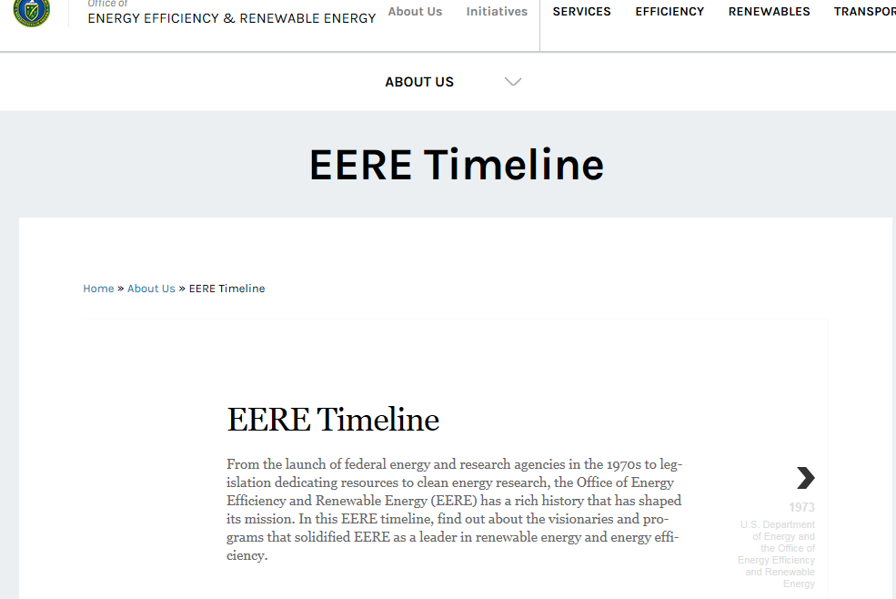
EERE Timeline
https://www.energy.gov/eere/timeline/eere-timeline

Slide 7
Timeline Criteria
Major events in EERE’s history that have shaped the agency:
Programs being initiated, changed or recognized;
Major awards;
Major new leaders or major changes in organization;
Significant legislation

Slide 8
Agenda
Around the Room – Alex, Carolyn
DOE Web Council notes
New CMS releases– Ernie, Ryon or Maura
Subscription blocks being deprecated
EERE Timeline—Alex and Carolyn
Communication Standards—Elizabeth and Carolyn

Slide 9
Surveys

Slide 10
Surveys, cont.

Slide 11
Surveys URLs
For a basic overview of the survey guidelines, go to:
https://www.energy.gov/eere/communicationstandards/web-survey-requirements-and-best-practices
For a step-by-step guide on the OMB approval process, go here:
https://www.energy.gov/eere/communicationstandards/paperwork-reduction-act-surveys-and-user-research
You can also contact Elizabeth Spencer (Elizabeth.spencer@nrel.gov) or Carolyn Hinkley (Carolyn.Hinkley@ee.doe.gov) for more information

Slide 12
Next meeting: July 19, 2018 1:00-2:00 EST 11:00-12:00 MST Golden: X300 & HQ: 5E-069

