Slide 1
Transformative Heat Exchanger Concepts: Heat Pipes
Innovation - Lunch and Learn
Jim Black
March 9, 2018

Slide 2
Project Team
Fossil Energy Headquarters
  Darren Mollot
Ames National Laboratory/ Iowa State
  Jun Cui
Oak Ridge National Laboratory
  Adrian Sabau
  Lonnie Love
  Yarom Polsky
  Stefani Pemberton
  Ryan Dehoff
  William Peter
  Abas Abdoli
National Energy Technology Laboratory
  Omer Dogan
  Erik Shuster
  Jim Black

Slide 3
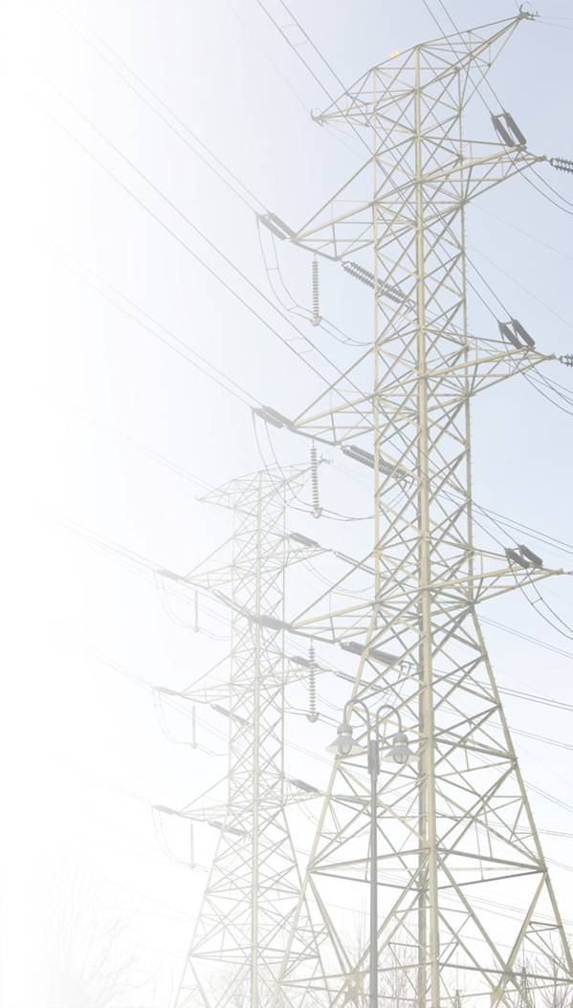
Presentation Outline
sCO₂ Power Cycles
Recuperator Development
Heat Pipes and Thermosyphon
Heat Exchanger Resistance Networks
Thermosyphon Numerical Model
Project Steps

Slide 4
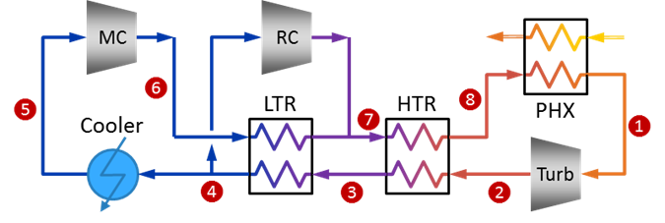
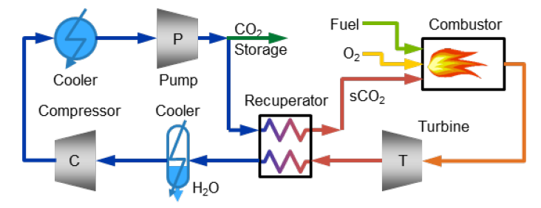
Basic sCO₂ Power Cycle Configurations
Indirect-Fired
  PR ~3:1
  TIT ~715°C (or higher)
  Cooler Temp ~35°C (or lower)
  HTR inlet temp ~ 580°C
Indirect sCO₂ Recompression Brayton Cycle
(Source: NETL)
Direct-Fired
  PR ~ 9:1
  TIT ~ 1200°C (or higher)
  Cooler Temp ~27°C
  Recuperator inlet temp ~ 800°C. This limits the firing temperature and cycle efficiency.
Direct sCO₂ Cycle
(Source: NETL)

Slide 5
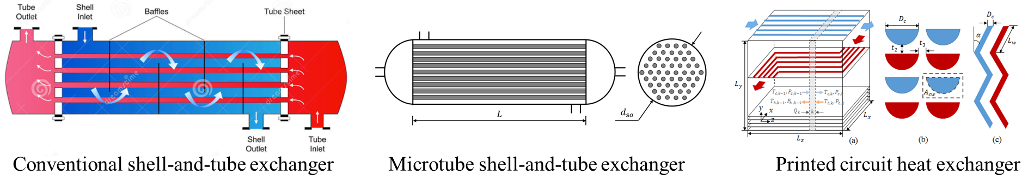
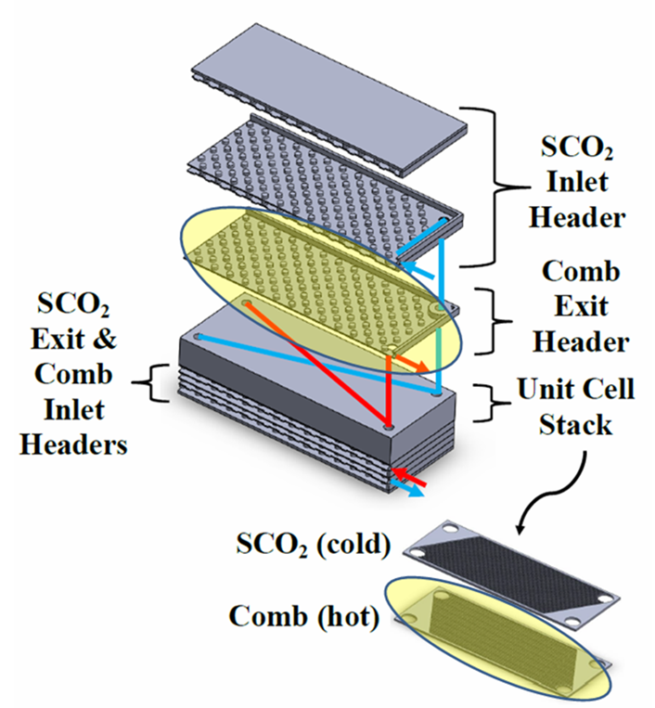
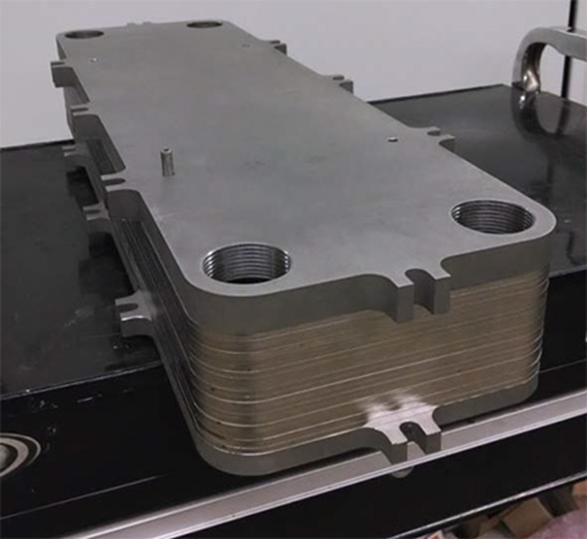
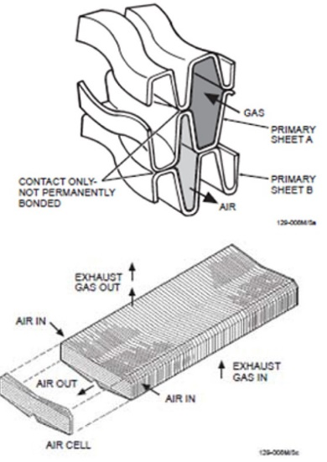
Recuperators Configurations
Oregon State University Microchannel exchanger
SwRI – Thin film primary exchanger
Altex – Plate exchanger

Slide 6
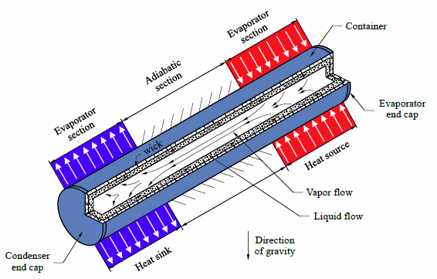
Heat Pipe
Basic Functions
Heat applied at evaporator end
Working fluid boils/vaporizes and flows through core to the condenser end
Heat removed at condenser end causes working fluid to condense
Combination of capillary force from wick and gravitational force cause liquid working fluid to flow to evaporator end
Cycle repeats
Condenser
section
Ref: Amir Faghri, “Heat Pipes: Review, Opportunities and Challenges

Slide 7
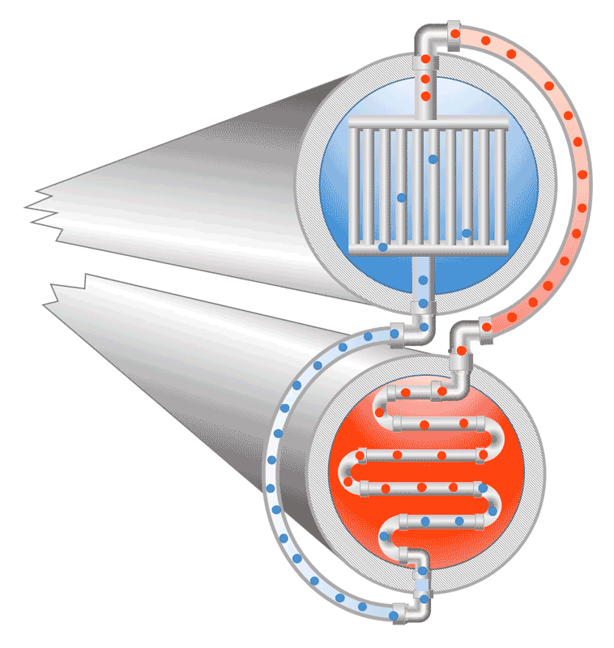
Thermosyphon
Basic Functions
Condensed fluid exits condenser and enters downcomer providing hydrostatic head to drive flow
Liquid enters evaporator and absorbs heat and vaporizes in a flow boiling regime
Vapor flows through riser to condenser
Heat rejected in condenser causing film wise condensing
Cycle repeats
Thermosyphon Condenser – Heat Process Fluid
Thermosyphon Evaporator – Cool Process Fluid

Slide 8
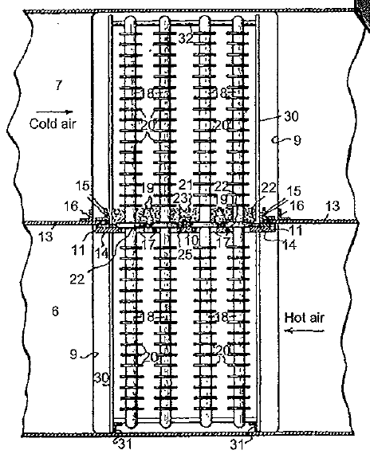
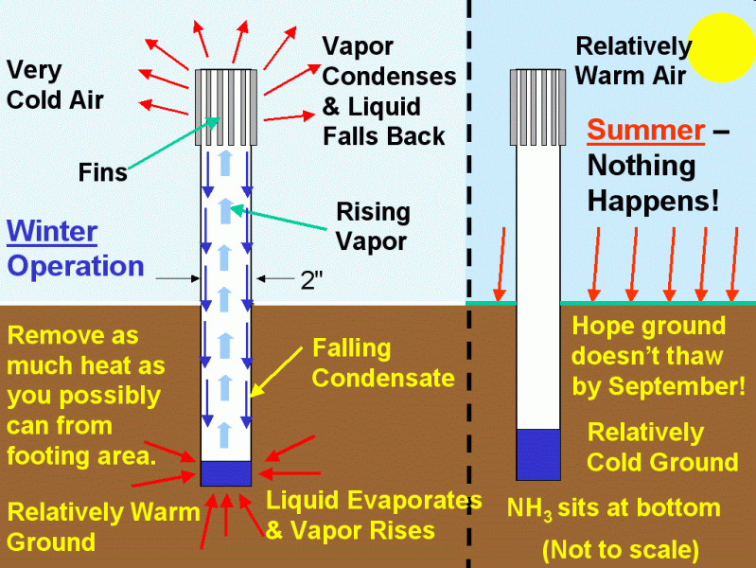
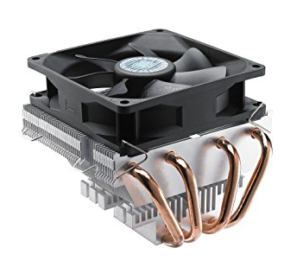
Heat Pipe and Thermosyphon
Select Applications
Thermosyphon Enhanced Heat Exchanger
Thermosyphon Support Columns for trans-Alaska Pipeline
CPU Cooler
Internet image, Amazon
Internet image, faculty Web sites at University of Virginia
F.W.Gay, “Thermosyphon heat exchanger”, 1929 U.S. patent

Slide 9
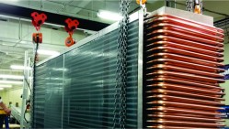
Heat Pipe and Thermosyphon
Application – Passive Energy Recovery for HVAC
Precooler/Heat Pipe Evaporator
Reheater/Heat Pipe Condenser
Cooler
Conditioned Air 65°F dry bulb, 50°F dew point
Ambient Air 90°F
80°F
50°F
Condensate
Condensate
Advanced Cooling Technologies web site
Vapor
Liquid
Heat Flow Direction
Heat Pipe

Slide 10
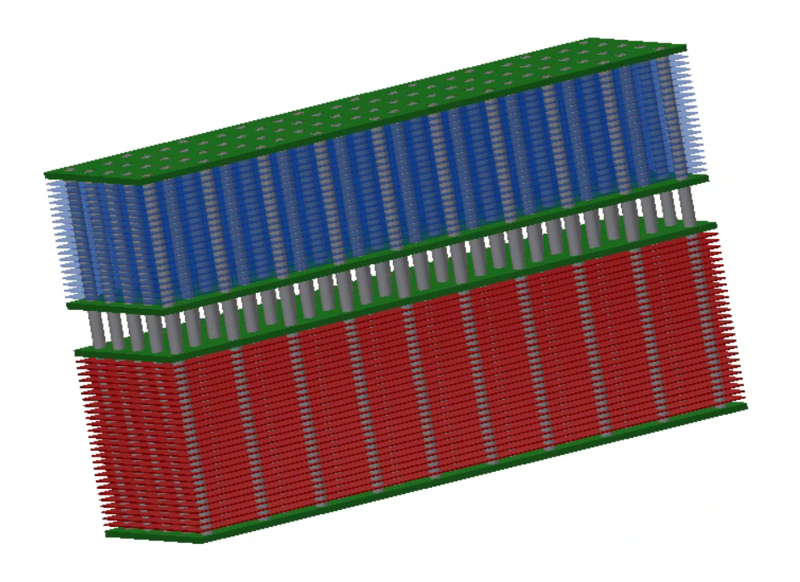
Heat Pipe Enhanced Recuperator Concept
533°C (991°F)
23.86 MPa (3,460 psi)
Cold Side
Cold Stream In
194°C (381°F)
23.99 MPa (3,479 psi)
Hot Stream In
581°C (1,078°F)
8.96 MPa (1,299 psi)
204°C (399°F)
8.83 MPa (1,280 psi)
Hot Side

Slide 11
Heat Pipe and Thermosyphon
Design Consideration
Working Fluid
  Operating temperature must be between triple point and critical point of fluid (phase change region)
  High figure of merit required – M = ρ_{l}σ_{l}h_{fg}/μ_{l}
    ρ_{l} - liquid density – high
    σ_{l} - surface tension – high
    h_{fg} - latent heat – high
    μ_{l} - liquid viscosity – low
Low
  Working fluid will be at saturation pressure for working temp
Container
  Material must be compatible with working fluid and process fluid
Wick – not necessary for pure thermosyphon
  Wick type can be selected for high capillary pumping, high thermal conductivity, or high permeability
Ref: Amir Faghri, “Heat Pipes: Review, Opportunities and Challenges

Slide 12
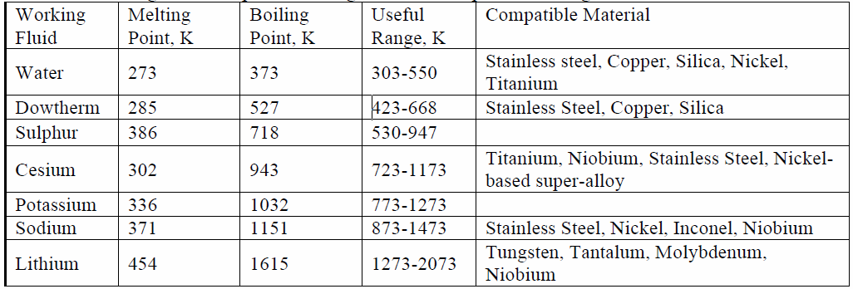
Working Fluid Options
Working Fluid Options for High Temperature Recuperator
Cold End
  ~470K – 550K (200°C - 280°C, 400°F - 530°F)
  Water is suitable working fluid
Hot End
  ~723K - 830K (450°C - 560°C, 840°F - 1,040°F)
  Cesium is suitable working fluid
Intermediate
  ~550K – 723K (280°C - 450°C, 400°F - 840°F)
  Working fluid ???
  Sulfur polymerizes around 190°C creating startup challenge
  Hydrocarbons are unstable at higher temperatures making upsets problematic
  Advanced Cooling Technologies (Heat Pipe manufacturer and developer) suggests that cesium could be used to lower temperature.
Temperature range overlap is required for operability
Working Fluid Temperature Range and Compatible Envelope Materials

Slide 13
Heat Pipe and Thermosyphon
Capacity
The capacity is determined by the most restrictive of the following physical aspects of the heat pipe.
  Heat transfer resistance network – next slide
  Capillary limit – flow through wick - consideration only for heat pipe
  Sonic limit – gas velocity is too high
  Entrainment limit – consideration only for heat pipe
  Boiling limit – high boiling flux prevents liquid from contacting wall in evaporator section

Slide 14
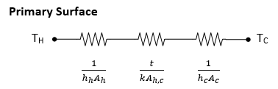
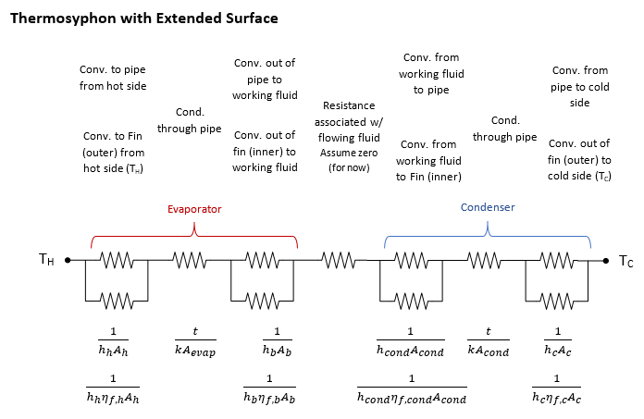
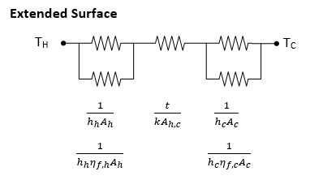
Heat Exchanger Resistance Networks

Slide 15
Heat Pipe/Thermosyphon Enhanced Recuperator
Advantages
Process fluids can be housed in separate vessels transferring the heat between vessels using the heat pipe or thermosyphon. Individual vessels can be designed for minimum required pressure.
Extended surface can be attached to heat pipe that is not a pressure boundary allowing for thinner and less costly materials of construction.
Headering requirements are minimal if any since process fluids are in separate vessels.

Slide 16
Heat Pipe/Thermosyphon Enhanced Recuperator
Challenges
Identify a medium temperature working fluid or extending the range of the high temperature fluid
Develop a configuration that addresses the additional heat transfer resistances
Develop a configuration with extended surface on the process fluid side that is conducive to manufacture
Develop high capacity heat pipe/thermosyphon – likely need a design that transfers 10’s of kW per unit at recuperator conditions

Slide 17
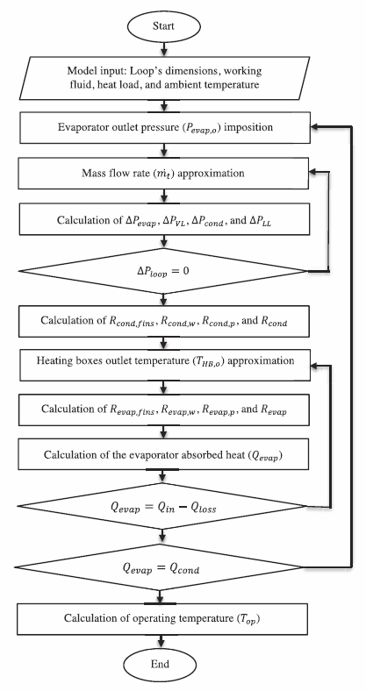
Thermosyphon
Numerical Model
Evaporator section
  Flow boiling through dispersed bubbly (<20% quality) and annular (20% < quality < 90%) flow regimes. Fluid will exit evaporator section as mist flow (quality > 90%)
Condenser section
  Film wise condensation inside vertical tubes
Vapor riser and liquid downcomer
  Assume single phase flow
Ref: Chehade et al, “Experimental investigation and modeling of a loop thermosyphon for cooling with zero electrical consumption”

Slide 18
Project Approach
Develop thermosyphon model
Develop heat exchanger model
Merge thermosyphon and heat exchanger models
Develop a conceptual design for the high temperature recuperator for the STEP (10 MWe) project
Estimate the material requirements
Compare with other recuperators under development
Go/no go decision
If “go” then design and test a prototype thermosyphon loop

Slide 19
Questions

Slide 20
Backup Slides

Slide 21
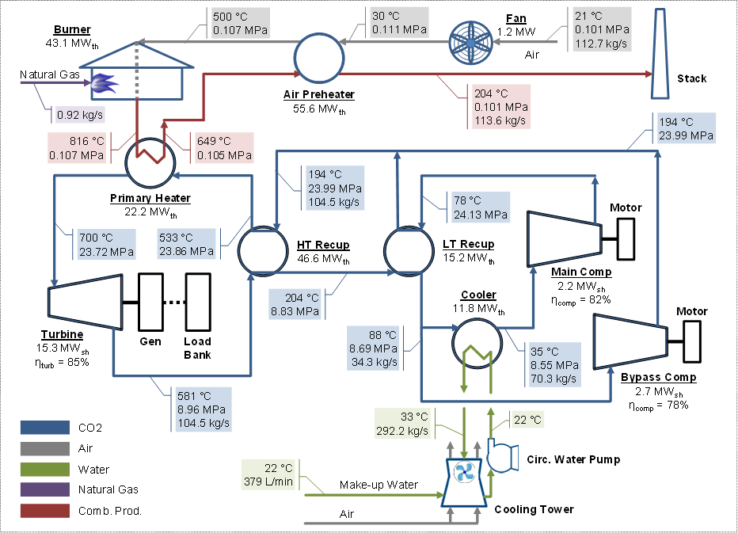
sCO$2$ Power Cycle - Indirect
10 MWe
(Source: NETL)

