Slide 1
EERE Web Coordinators Meeting
April 19, 2018

Slide 2
Agenda
Around the Room – Alex, Carolyn
DOE Web Council notes
New Changes to the CMS and Deprecated Fields – Atiq
Introducing Digital Director Robbie Myers – Carolyn, Atiq
Key Metrics Takeaways for March – Drew
Funding Site FY18 Update - Elizabeth

Slide 3
DOE Web Council Notes
NNSA site launched in energy.gov CMS (/nnsa)
Lots of redirects (over 3,000)
Limited blogs & press releases to 3 years old
Made great use of accordions, judicious content editing
Still going through some orphan pages
Love the update on the download nodes, for single PDF
Office of Science is next up
Digital dashboard
GSA portal to benchmark websites against other agencies
Access is through the MAX system
See digital dashboard topic in Powerpedia

Slide 4
DOE Web Council Notes, cont.
Cloud sandbox initiative: A secure location to evaluate new technologies and methodologies while limiting risks associated with introducing new apps, services.
See Cloud Sandbox Initiative in Powerpedia
Can look up government wide analytics on analytics.USA.gov
GSA is looking into developing a set of tools similar to what Siteimprove does that would be available for use government wide.

Slide 5
Agenda
Around the Room – Alex, Carolyn
Introducing Digital Director Robbie Myers – Carolyn, Atiq
New Changes to the CMS and Depreciated Fields – Atiq
Key Metrics Takeaways for March – Drew
Funding Site FY18 Update – Elizabeth

Slide 6
Robbie Myers—DOE’s New Digital Director
Former Digital Director for Senate Conference Committee
Now serving as the DOE Digital Director in PA

Slide 7
Agenda
Around the Room – Alex, Carolyn
Introducing Digital Director Robbie Myers – Carolyn, Atiq
New Changes to the CMS and Depreciated Fields – Atiq
Key Metrics Takeaways for March – Carolyn (maybe Drew)
Funding Site FY18 Update – Elizabeth

Slide 8
Changes to the CMS
Reminder on deprecated fields
Accordions will be purged (4 for EERE, 1 For GTO -EGS) - new deadline
Column 2 content type to be done by the end of May - still saw some EERE content in the list. ~30 pages I could see
Siteimprove shows that overall we’re improving quickly on accessibility, not so much on QA. Mostly broken links are the bugaboo. (Overall on DOE- may vary with program offices)

Slide 9
Agenda
Around the Room – Alex, Carolyn
Introducing Digital Director Robbie Myers - Carolyn
New Changes to the CMS and Depreciated Fields – Atiq
Key Metrics Takeaways for March –Drew
Funding Site FY18 Update - Elizabeth

Slide 10
Key Metrics Takeaways for March
Traditional Media
4 News Releases in February.
3 Media Inquiries
2 media pitches in February
2 media interviews
EERE in the News: Solar had the most news articles (28), followed by Vehicles (23) and Advanced Manufacturing (16).
Digital Media
Blog: 1 blog post in March, with 1,196 total page views and 1,073 unique page views.
Facebook: Most popular post was a #DidYouKnow about 3% of nation’s dams generating energy. It had 66 reactions (e.g., “likes”) and 20 shares.
Video: No new videos in March, but we posted video content from Wind, Solar and Vehicles to Facebook.
EERE’s March Facebook video posts had more than 8,200 views.

Slide 11
Key Metrics Takeaways for March, cont.
Web
Traffic: EERE and Energy Saver websites made up more than 52% of all page views on energy.gov in March 2018.
9 of the top 10 most viewed pages across energy.gov were from EERE and Energy Saver.
EERE Corporate and Office sites: EERE websites had almost 815,000 users, an 8.13% increase from March 2017; there were more than 2.3 million page views, up less than 1% compared to the previous year.
Energy Saver : The Energy Saver website had almost 500,000 users, a 12.08% decrease from March 2017; there were more than 850,000 page views, down 11.45% compared to the previous year.
Correspondence
Public Correspondence: 100 public mail, email and letters came into EERE; nine were classified as ‘prepare response’ and routed through eDOCS.
Controlled Correspondence: EERE received 3 Congressional or high-level government correspondences.

Slide 12
Agenda
Around the Room – Alex, Carolyn
Introducing Digital Director Robbie Myers - Carolyn
New Changes to the CMS and Depreciated Fields – Atiq
Key Metrics Takeaways for March –Drew
Funding Site FY18 Update - Elizabeth

Slide 13
EERE Funding Opportunities Update

Slide 14
EERE Funding Opportunities Update
EERE Funding Opportunities (energy.gov/eere/funding/) explains the Funding Opportunity Announcement application, review, and reporting processes.
It’s primarily geared toward research-focused organizations and researchers who are most likely to apply for FOAs.
This fiscal year, we finished some quality of life updates that will make the content more useful.

Slide 15
EERE Funding Opportunities Update
Simpler Landing Pages
The landing pages used to be content-rich, which didn’t matter when we had left navigation.
Now each section opens with a “directory-style” landing page that links to all of the subpages in that section.
This does push the content down a level, but since Funding Opportunities only has 23 pages, this didn’t hurt readability.

Slide 16
EERE Funding Opportunities Update

Slide 17
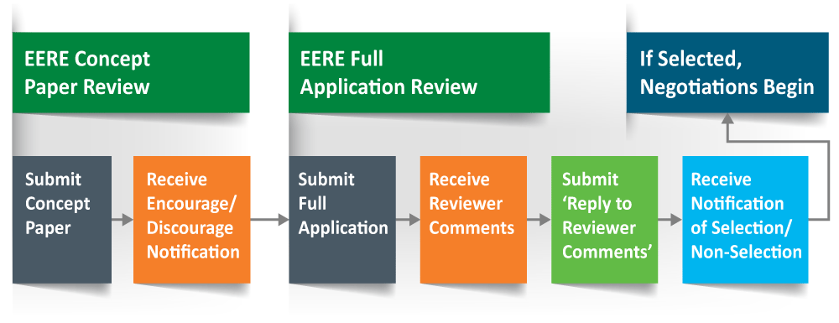
EERE Funding Opportunities Update
Updated Images
The site had old images using the old (pre-refresh) color scheme. We brought those up to date:

Slide 18
EERE Funding Opportunities Update
Content for More Audiences
And, in the future, we’ll have a brand-new page that explains what funding options are available for the audiences who often can’t apply for FOAs—or who just don’t know much about EERE’s funding at all. People like:
Inventors
Consumers purchasing EE/RE technology
Small business owners
Foreign entities
State and local government
And more!
This page will point people toward other EERE resources.

Slide 19
EERE Funding Opportunities Update
Questions?

Slide 20
Next meeting: May 17, 2018 1:00-2:00 EST 11:00-12:00 MST Golden: X300 & HQ: 5E-069

