Slide 1
EERE Web Coordinators Meeting
February 15, 2018

Slide 2
Agenda
Around the Room
Key Metrics Takeaways for January - Adrienne
New Changes to the CMS and Depreciated Fields - Atiq
Multifactor Authentication Requirement - Alex
Communication Standards FY18 Update - Elizabeth

Slide 3
Agenda
Around the Room
Key Metrics Takeaways for January - Adrienne
New Changes to the CMS and Depreciated Fields - Atiq
Multifactor Authentication Requirement - Alex
Communication Standards FY18 Update - Elizabeth

Slide 4
Key Takeaways for January Metrics
Notes:
*More than half of all page views across energy.gov took place on Energy Saver (27.94%) and EERE (26.75%) websites in January 2018.
• The Cold Weather "Bomb Cyclone" helped Energy Saver's Insulation page log more than 38,800 page views, while leading the site to its best month in over a year. We updated all of that insulation content in January as well.
*On January 11, Facebook announced changes to the news feed algorithm that will limit the reach of public pages and video content in favor of more interactive, engaging posts from friends and family.
Two editions of the BTO Digest were in the top three issues of 89 total bulletins sent with the most bulletin link clicks in January. The message titled, "Digest: BTO Year in Review, Buildings and the Grid 101 - How Much it Matters," had the most engagements at 2,384 clicks, while "Energy Code Commentator: Compliance for Metal Buildings," earned 1,967.

Slide 5
Key Takeaways for January Metrics
WEB
• Both EERE and Energy Saver saw website users increase by more than 7% over the previous year, combining for 1.4 million total visitors in January.
• The Solar, Hydrogen and Fuel Cells, and Vehicles websites had the biggest year-over-year increases in traffic among EERE offices.
EMAIL
• EERE's 264 email lists are approaching 430,000 subscribers.
• The 89 email bulletins sent by EERE in January received more than 215,000 unique opens • Email referrals drove about 14,000 site visits to EERE websites, or about 2% of all EERE site traffic.
SOCIAL MEDIA
• EERE's most liked Facebook post in January was a #DidYouKnow post linking to the new blog titled, "Using Deep Geothermal to Heat and Cool Buildings and Reduce Energy Bills."
• Social media platforms referred more than 7,000 sessions to EERE websites, or about 1% of all EERE site traffic.
VIDEO
• The "Energy Talks: Advanced Research, Nuclear Energy, Water Power" had the most watch time of new content posted this month, receiving almost 24 hours of viewership.

Slide 6
Agenda
Around the Room
Key Metrics Takeaways for January - Adrienne
New Changes to the CMS and Depreciated Fields - Atiq
Multifactor Authentication Requirement - Alex
Communication Standards FY18 Update - Elizabeth

Slide 7
Agenda
Around the Room
Key Metrics Takeaways for January - Adrienne
New Changes to the CMS and Depreciated Fields - Atiq
Multifactor Authentication Requirement - Alex
Communication Standards FY18 Update - Elizabeth

Slide 8
Agenda
Around the Room
Key Metrics Takeaways for January - Adrienne
New Changes to the CMS and Depreciated Fields - Atiq
Multifactor Authentication Requirement - Alex
Communication Standards FY18 Update - Elizabeth

Slide 9
Communication Standards FY18 Update
We’ve done a lot of work on Standards this fiscal year!
We surveyed federal employees
We did a content review on all the content.
We updated the content that our subject matter experts flagged.

Slide 10
Communication Standards Survey
We started with an internal survey.
We surveyed 30 federal communications contacts.
We couldn’t survey any contractors—not without having to go through OMB!
Nine individuals responded.
The results were pretty interesting!
Everyone we contacted was familiar with the Communication Standards website. And…

Slide 11
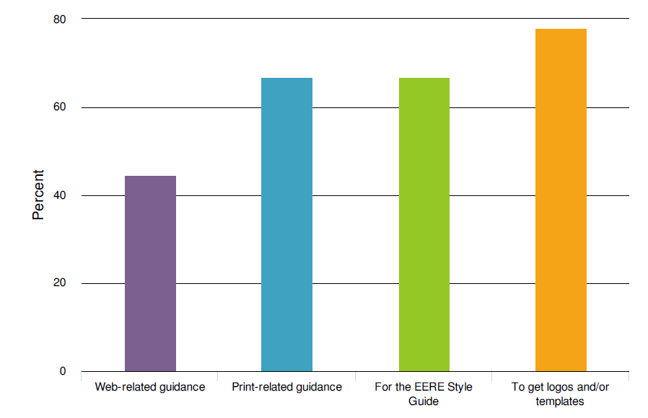
Communication Standards Survey
Our respondents primarily visited the site for print templates, logos, and the style guide.

Slide 12
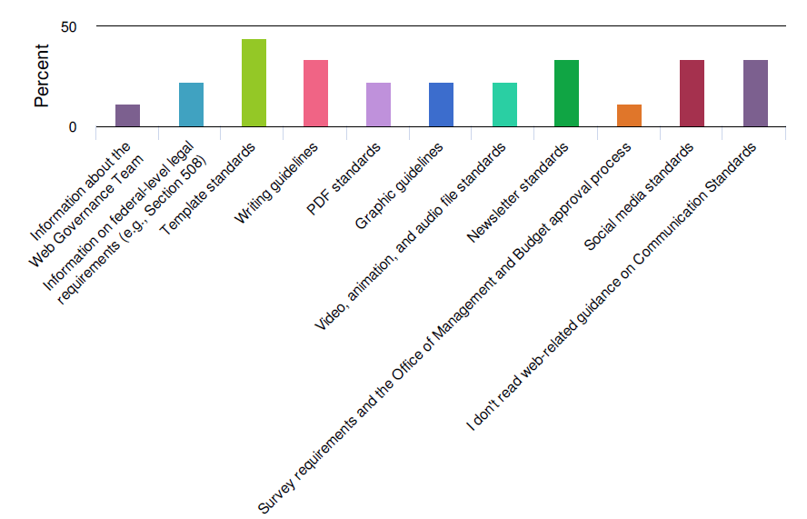
Communication Standards Survey
Templates were the most popular web-related content (and newsletters, writing guidelines, and social media!)

Slide 13
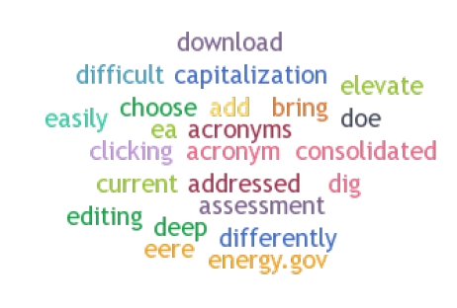
Communication Standards Survey
One pain point people talked a lot about was the Asset Management System—the log-in system you have to use to access the templates and logos.

Slide 14
Communication Standards Survey
While we couldn’t formally survey the contractors, you can still pass along your “wish list” for big changes or new content that you’d like to see.
If you have a suggested change, send it to elizabeth.spencer@nrel.gov.

Slide 15
Content Review
We had subject matter experts review all the sections we didn’t get to update in FY17. This means we have brand-new updates to:
The Print Section: Complete with new PGT process!
The Social Media Page: With updated contacts and processes!
The Web Process and Approvals Pages
The Web Writing Pages
A lot of technical pages about creating web pages
And the newsletter content!

Slide 16
Newsletter Page
In December 2017, I gave a presentation about GovDelivery at the DOE Community of Practice meeting. A lot of that information wasn’t on the website.
https://energy.gov/eere/communicationstandards/creating-and-promoting-email-distribution-and-govdelivery-lists
This page now includes information on promoting and building email lists.

Slide 17
Newsletter Page
https://energy.gov/eere/communicationstandards/creating-emails-email-distribution-lists-and-govdelivery
Includes more information about how to add preheader information to your emails.
Explains what preheader text is for and how to update it.
Explains the View in Browser link—and includes the code that lets you link to the GovDelivery HTML version of your email.

Slide 18
Communication Standards FY18 Update
Questions?

Slide 19
Next meeting: March 15, 2018 1:00-2:00 EST 11:00-12:00 MST Golden: X300 & HQ: 5E-069

