Slide 1
EERE Web Coordinators Meeting
October 19, 2017

Slide 2
Agenda
Around the room – Alex, Carolyn
DOE Web Council Summary
The DOE Cyber Conference
Energy.gov Social Media Sharing
Section 508: Web Standards Overview
Share Your Successes With the Web Coordinators!

Slide 3
Agenda
Around the room – Alex, Carolyn
DOE Web Council Summary
The DOE Cyber Conference
Energy.gov Social Media Sharing
Section 508: Web Standards Overview
Share Your Successes With the Web Coordinators!

Slide 4
Agenda
Around the room – Alex, Carolyn
DOE Web Council Summary
The DOE Cyber Conference
Energy.gov Social Media Sharing
Section 508: Web Standards Overview
Share Your Successes With the Web Coordinators!

Slide 5
Agenda
Around the room – Alex, Carolyn
DOE Web Council Summary
The DOE Cyber Conference
Energy.gov Social Media Sharing
Section 508: Web Standards Overview
Share Your Successes With the Web Coordinators!

Slide 6
Agenda
Around the room – Alex, Carolyn
DOE Web Council Summary
The DOE Cyber Conference
Energy.gov Social Media Sharing
Section 508: Web Standards Overview
Share Your Successes With the Web Coordinators!

Slide 7
Why Section 508?
20% of the U.S. population has some type of disability
Types of disabilities include
Visual
Hearing loss
Motor
Cognitive
50% of seniors (65 years+) have a disability
Section 508 requires federal government websites to be accessible to people with disabilities
Notes:
Section 508 is an amendment to the Workforce Rehabilitation Act of 1973, signed into law by President Clinton in 1998.

Slide 8
Section 508 Update
First signed into law in 1998. Since then a lot has changed.
Tablets and smart phones have come of age
508 Update
Focuses on functionality rather than products
Standardizes practices between industry and government
Revised Section 508 Standards use WCAG 2.0
Notes:
Web Content Accessibility Guidelines produced by the World Wide Web Consortium (W3C)
Low contrast text
Must meet a specific contrast ration between foreground & background colors
Meaningful sequence
Fixed size text
Text must be able to be resized up to 200 percent
Clarity and consistency
Site navigation
Help users correct mistakes

Slide 9
Dates for Revised Section 508 Standards
Publication in Federal Register: January 18, 2017
Effective Date: March 21, 2017
Compliance Date: January 18, 2018

Slide 10
The Standards

Slide 11
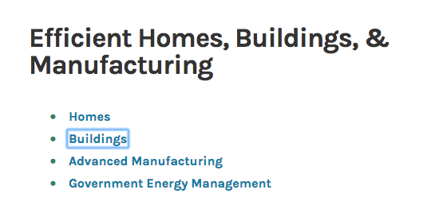
Keyboard Access
All interface elements that can be accessed by mouse must also be accessible by keyboard
Notes:
Check for visual focus that moves with the keyboard

Slide 12
Web Forms
Keyboard accessible
Text labels for each form field
Sufficient cues and instructions
Helpful error messages
Notes:
Required fields are indicated

Slide 13
Dynamic Content from JavaScript
Keyboard accessible
Available to screen reader
Examples
Accordions
Pop up windows

Slide 14
Images
Alternative text (alt text)
Read by screen readers in place of images allowing the content and function of the image to accessible to those with visual or cognitive disabilities.
Can be in the alt attribute of the image element
Can be within the content surrounding the image itself.
All images must have an alt attribute. If the alt text is given in the main content, the alt attribute can be empty.

Slide 15
Images
Alt attribute should typically
Be accurate and equivalent
Be succinct
Not be redundant
Not use the phrases “image of...” or “graphic of...”

Slide 16
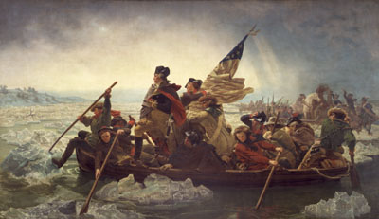
Alt Text: Context is Everything
Which would you choose?
George Washington
Painting of George Washington
Painting of George Washington crossing the Delaware River.
A classic painting demonstrating the use of light and color to create composition.
Painting of George Washington crossing the Delaware River. Swirling waves surround the boat where the majestic George Washington looks forward out of the storm and into the rays of light across the river as he leads his weary troops to battle.
Notes:
Does not adequately describe the content of the image
May be adequate, but does not provide much additional content.
Provides more information that may help the user identify the content itself.
Might be okay if the purpose is to present an art technique
May be okay if a detailed examination of the painting is in order.
No one right answer. Depends on the context.

Slide 17
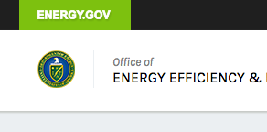
Functional Images
Is the image used as a link?
Alt text should describe the destination
Alt=“Department of Energy”

Slide 18
Charts, Graphs, and Maps
What information do you want the user to understand about the image?
In a graph, you may just want the user to know a certain statistic is trending upward.
When alt text can’t be succinct and is NOT presented within the context of the page, provide a link to a separate page with a longer description. Do not include it in the alt text.

Slide 19
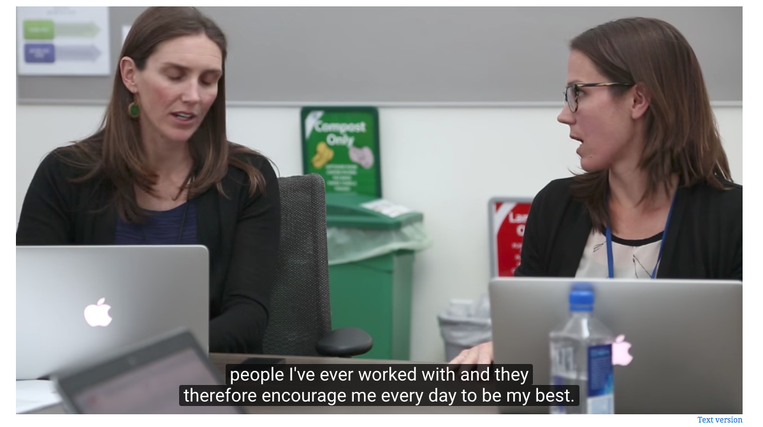
Audio/Video
Synchronized captions
No autoplay

Slide 20
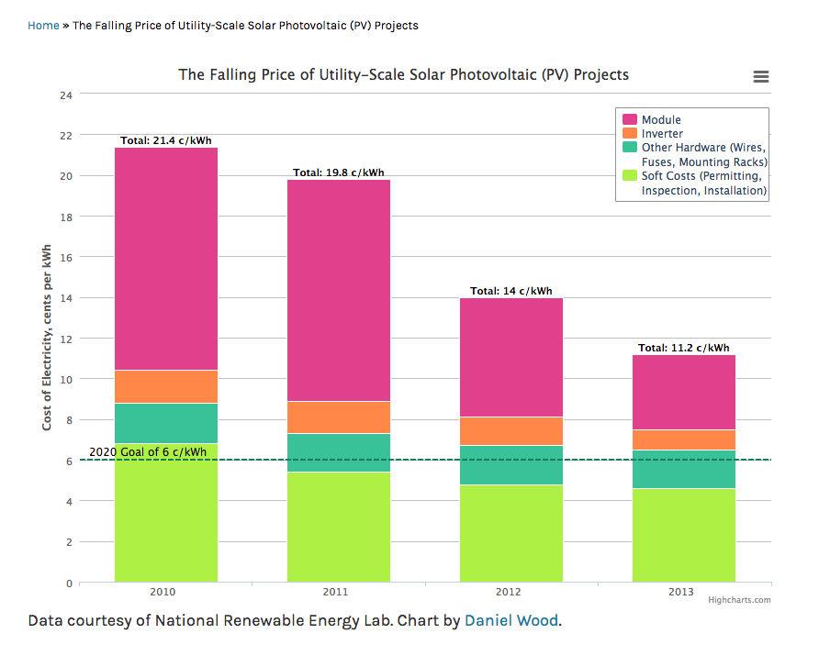
Color & Other Sensory Dependencies
Color, sound, or shape is not exclusively used to convey important information
Contrast

Slide 21
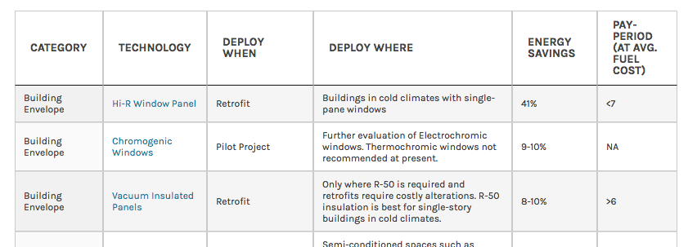
Data Tables
Header cells must be coded as such

Slide 22
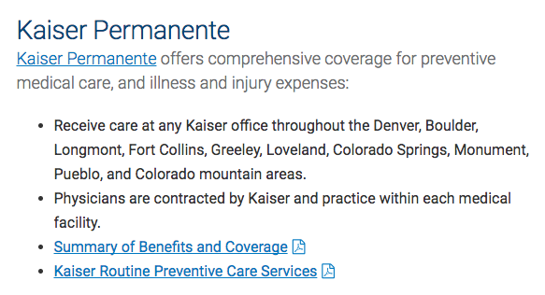
Text
Page title is descriptive
Link text tells you where it’s going
Page headings and form labels are meaningful
Can resize text up to 200% without losing functionality

Slide 23
Documents
Should follow the same rules as HTML
Good alt text, headers, accessible tables, page flow, etc.
PDFs should be tagged for accessibility
EERE Standards for PDFs

Slide 24
Resources
Web Accessibility in Mind

Slide 25
Questions?

Slide 26
Agenda
Around the room – Alex, Carolyn
DOE Web Council Summary
The DOE Cyber Conference
Energy.gov Social Media Sharing
Section 508: Web Standards Overview
Share Your Successes With the Web Coordinators!

Slide 27
Next meeting: November 16, 2017 1:00-2:00 EST 11:00-12:00 MST Golden: X300 & HQ: 5E-069

