Slide 1
Weatherization Assistance Program
WPN 17-7 Health & Safety Guidance – What’s New?

Slide 2
Using this presentation
This presentation includes notes that are necessary to understanding the slides.
Please view the presentation in a mode that allows the notes to be seen and be sure to read all the way to the bottom of the notes for each slide.
This is the “skinny” version of the presentation and is meant for those already familiar with the previous WAP Health and Safety Program Notice.
If you would like a ore complete version of this presentation, use the “WPN 17-7 Master File”

Slide 3
Purpose
Highlight updates in WPN 17-7 compared to 11-6
Highlight where H&S Plans can be updated
Review support materials to go along with 17-7
Notes:
By now, everyone should be very familiar with the H&S Guidance contained in WPN 11-6. For that reason, we won’t review the entire WPN 17-7, but just go over the updates that changed from 11-6 to 17-7. If something is NOT mentioned here, it’s safe to assume that it has not changed since 11-6.
After the training, participants will be able to:
List the 3 pieces of the guidance, the “Guidance,” the “Table of Issues,” and the “Attachment A.”
State which of the 3 guidance documents one would look to for answers to various issue-specific questions, for example, “Where would one look to find guidance specific to fireplaces?”
Correctly identify topics that are covered in the table of issues from a list of topics
Identify issue-specific updates to the Table of Issues compared to 11-6
Identify budget-related updates in the Guidance document related to 11-6
Using the guidance documents, be able to correctly answer questions related to: required training, testing and allowability, and client education and notification requirements
List specific portions or issues that will need to be updated in the Grantees’ H&S Plans

Slide 4
Overview of WPN 17-7
Drafted from 2012 - 2017 to put all H&S guidance in one place.
Describes most common issues encountered during weatherization, what is allowed, what is required, and what is prohibited in terms of dealing with these issues.
Outlines how grantees must address H&S in their grantee plan, and where more guidance may be needed at the local level.
Notes:
Weatherization Program Notice (WPN) 17-7 describes the most common issues encountered during weatherization - what is allowed, what is required, and what is restricted.
The guidance also outlines how grantees must address H&S in their grantee plan, and allows for or at times requires additional direction to be passed down to the local level. The grantee’s H&S plan is meant to be the enforceable implementation document of 17-7 for their local programs and should take care to include all of the relevant information from the guidance.
This presentation covers WPN 17-7 in detail, but it is not intended to provide full training on each of the issues outlined in the guidance. For example, we will discuss how mold and moisture must be addressed in the plan, but will not go into detail about how to identify and mitigate moisture issues. The intended audience for this presentation is program directors and others involved in drafting program policy and the grantee health and safety plans. This presentation will also be useful for those implementing or enforcing weatherization H&S guidance.
This presentation is intended for staff who are familiar with WPN 11 – 6. For those who have not worked with 11-6 already, there is a longer presentation that reviews the entire guidance.

Slide 5
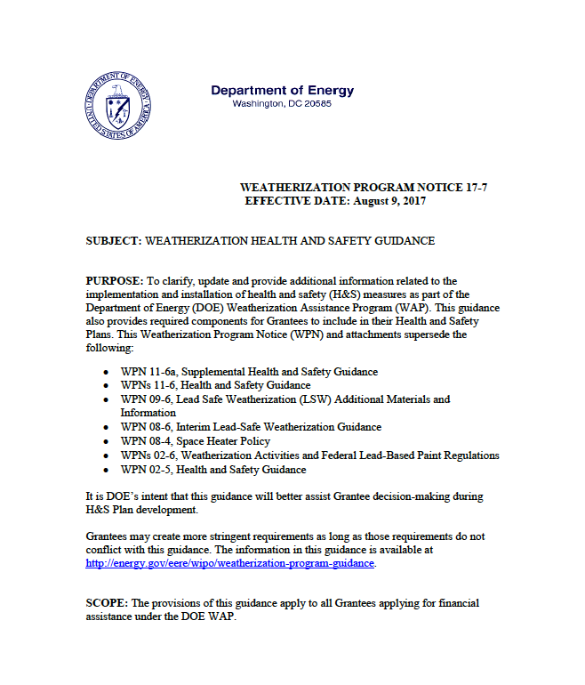
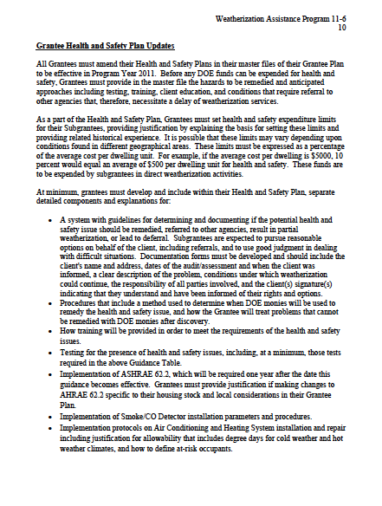
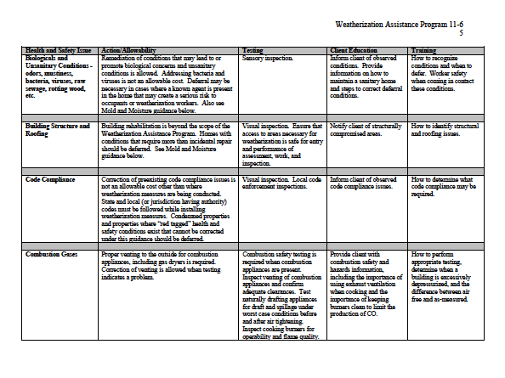
WPN 11-6 Organization – 1 Document
Grantee H&S Plan Updates
Preamble and budget discussion
Table of Issues
Notes:
WPN 11-6 was one document. The first part was the preamble and a discussion about budget categories. Then came the “Table of Issues” where we laid out specifics around client education, training, testing and allowability on each of the identified issues faced in WAP – asbestos, lead-based paint, etc. After the table, there was a section detailing specific updates Grantees may need to make to their H&S Plans.

Slide 6
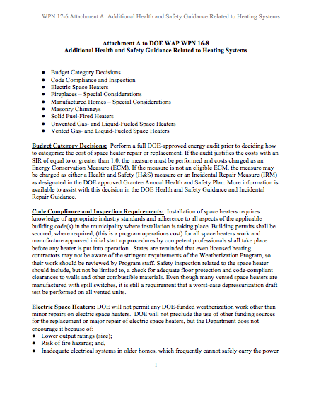
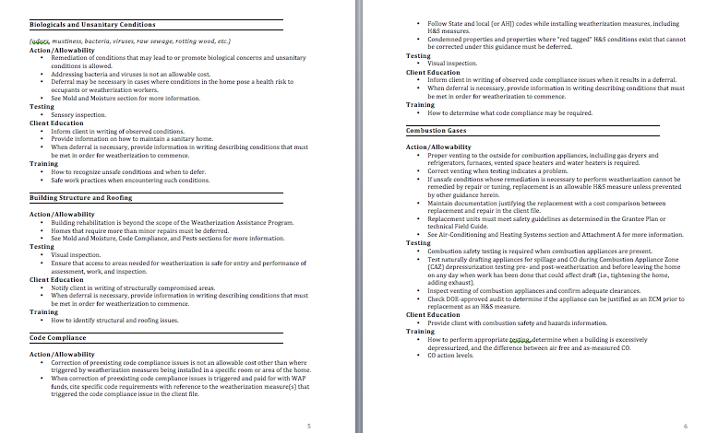
WPN 17 – 6 Organization – 3 Pieces
New to 17-7
Table of Issues – re-formatted
Attachment A –
Special Considerations re: Heating Systems
Guidance Narrative:
Preamble
Budget discussion
Plan updates
Notes:
In 17-7, we pulled all the language about plan updates up into the front, before the “Table of Issues.” The Guidance Narrative, as we’re calling it, includes all the information about what’s required in the Grantee’s H&S Plan, considerations around defining H&S versus IRM versus ECM, and budget formulas.
The table of Issues has been reformatted, but still contains all the same information – client education, training, testing and allowability for each issue identified.
Attachment A is Additional Guidance Related to Heating Systems/Units. We created Attachment A to capture all the miscellaneous recommendations that came out over the course of the H&S committee meetings. Things that didn’t quite fit into any of the categories in the table, or that were making the table too long. For example, recommendations for combustion safety testing in homes with fireplaces.
We also pulled all the space-heater related language out of the table and put that into attachment A.

Slide 7
WPN 17 – 6 Piece by Piece
New to 17-7
Guidance Narrative:
Preamble
Budget discussion
Plan updates
New in 17-7:
Removed language about deferral/referral policy requirements
Removed language about measure skipping
Added requirement for policy about life-threatening hazards requiring immediate attention
Notes:
Removed language requiring a deferral/referral policy in the H&S Plan as redundant. The deferral/referral policy is a separate piece that covers a broader range of issues than just H&S issues, and is part of the master file. H&S Plan must still identify specific action levels related to certain issues that trigger deferral, but mustn’t detail deferral and referral policies for each specific issue in the table.
Added language requiring H&S Plans to include a policy for dealing with H&S issues identified that are life threatening and require an immediate response.
Removed language about measure skipping. This issue is bigger than H&S and will be addressed in the FAQs.
That’s it for this one.

Slide 8
Guidance Narrative – Budget Management
New to 17-7
Client file documentation must show costs in
appropriate budget categories.
Notes:
The client file must include documentation that separates all costs into the appropriate budget category, including H&S.

Slide 9
Hazard Identification and Notification
New to 17-7
Client/landlord/property manager must be notified
in writing of:
Any hazards identified which will lead to deferral, and
All testing results,* regardless if they will lead to deferral.
* Testing results does not refer to standard combustion safety and other regular testing. Testing results refers to things like lead paint testing, testing of suspected asbestos containing materials (ACMs), and radon testing.
Notes:
An H&S assessment must be performed to identify hazards in the home.
Where hazards are identified, appropriate testing must be performed when required by this guidance. The client/landlord/property manager must be informed, in writing, of
All testing results, regardless if they will lead to deferral, (these can be sent by certified mail separately if testing timeline does not match with weatherization timeline, as with radon), and
Any identified hazards that will lead to deferral.
The notification must be signed by the client and the assessor/auditor and a copy maintained in the client file.
The notification of testing results is new to 17-7, though it was standard practice for most agencies before now.

Slide 10
Emergency Procedures
New to 17-7
New to 17-7
Procedures detailing how crews handle problems discovered during testing
Applies to Combustion Gases, and when other life-threatening hazards are observed
Specific protocols for hazards requiring immediate response
Notes:
Procedures detailing how crews will handle problems discovered during testing of Combustion Gases and when other life threatening hazards are observed, with specific protocols for addressing serious hazards that require an immediate response.
This is new to 17-7.

Slide 11
WPN 17 – 6 Piece by Piece – Table of Issues
Updates to Issue Titles
Updates to specific issues
Notes:
In the table, other than reformatting, we did some reorganization.
There are new rows, and some of the old rows have been removed or consolidated. We’ll go through those changes so you know where to find information if there is a Grantee request.

Slide 12
Table of Issues – 11-6 Issues List
Air-Conditioning and Heating Systems/Units
Appliances and Water Heaters
Asbestos - in siding, walls, ceilings, etc.
Asbestos - in vermiculite
Asbestos - on pipes, furnaces, other small covered surfaces
Biologicals and Unsanitary Conditions
Building Structure and Roofing
Code Compliance
Combustion Gases
Drainage – gutters, down spouts, extensions, flashing, sump pumps, landscape, etc.
Electrical – other than knob and tube wiring
Electrical – knob and tube wiring
Fire Hazards
Formaldehyde, Volatile Organic Compounds (VOCs), Flammable Liquids and other Air Pollutants
Injury Prevention of Occupants and Weatherization Workers
Lead Based Paint
Mold and Moisture
Occupant Pre-existing or Potential Health Conditions
Pests
OSHA and Crew Safety
Smoke and Carbon Monoxide Alarms, Fire Extinguishers
Solid Fuel Heating
Space Heaters, stand alone electric
Space Heaters, unvented combustion
Space Heaters, vented combustion
Spray Polyurethane Foam
Ventilation
Window and Door Replacement, Window Guards
Notes:
This is the list from 11-6 that we are all familiar with.

Slide 13
Removed Rows
New to 17-7
Appliances and Water Heaters
Drainage
Solid Fuel heating
Space Heaters, stand alone electric
Space Heaters, unvented combustion
Space Heaters, vented combustion
Spray polyurethane Foam

Slide 14
Altered Rows
New to 17-7
Electrical - other than K&T Wiring
Electrical – K&T Wiring
Mold & Moisture
Drainage
OSHA and Crew Safety
Electrical
Mold & Moisture
Worker Safety

Slide 15
Added Rows
New to 17-7
Fuel Leaks
Gas Ovens/Stovetops/Ranges
Hazardous Materials Disposal

Slide 16
Table of Issues Headings – 17-7
Air-Conditioning and Heating Systems/Units
Asbestos - in siding, walls, ceilings, etc.
Asbestos - in vermiculite
Asbestos - on pipes, furnaces, other small covered surfaces
Biologicals and Unsanitary Conditions
Building Structure and Roofing
Code Compliance
Combustion Gases
Electrical
Formaldehyde, Volatile Organic Compounds (VOCs), Flammable Liquids and other Air Pollutants
Fuel Leaks
Gas Ovens/Stovetops/Ranges
Hazardous Materials Disposal
Injury Prevention of Occupants and Weatherization Workers
Lead Based Paint
Mold and Moisture
Occupant Pre-existing or Potential Health Conditions
Pests
Safety Devices: Smoke and Carbon Monoxide Alarms, Fire Extinguishers
Ventilation
Window and Door Replacement, Window Guards
Worker Safety
Notes:
Here’s our new line-up. We go over the categories so you’ll know where to look when you have questions, or where to address certain things in your H&S Plan.
Though it seemed like there was a lot of change in the reorganization, actual treatment of the issues didn’t change for every area listed here.

Slide 17
Issue Specific Updates
New to 17-7
Asbestos
Code Compliance
Gas Ovens/Stovetops/Ranges
Injury Prevention
Lead Based paint
Occupant Pre-existing or Potential Health Conditions
Radon
Ventilation and Indoor Air Quality
Worker Safety
Notes:
These are the issues which were changed enough in the guidance update to cause a review of H&S Plans.
Other categories are highlighted in the presentation as “New to 17-7” wherever categories were combined, added or changed, even if the actual guidance in terms of what you need to include in your H&S Plans, hasn’t changed substantially.
Now let’s get to specific topics.

Slide 18
Asbestos – General
New to 17-7
Blower Door testing – Grantees must state their policy for blower door testing when suspected Asbestos Containing Materials (ACMs) are present.
Documentation - When asbestos is the cause for deferral, and client addresses the issue, they must provide documentation that the asbestos removal or encapsulation was conducted by a certified professional before the home is eligible for weatherization.
Notes:
Added requirement for H&S Plan to include the policy for blower door testing when suspected asbestos containing materials (ACM) are identified.
Added requirement that client provide documentation that a certified professional performed the removal or remediation in cases where a home was deferred due to ACM and then later approached for weatherization. This is to discourage clients from trying to do this hazardous work themselves.

Slide 19
Code Compliance
New to 17-7
What’s New?
Cite specific code in client file if:
Code issue leads to deferral, or
Extra work is done due to code compliance being triggered.
Notes:
Added a requirement to cite specific code reference if extra work is done due to code compliance being triggered by weatherization work.

Slide 20
Combustion Gases
New to 17-7
Appliance-specific information on:
Unvented space heaters,
Vented space heaters,
Abandoned masonry chimneys,
Fireplaces,
And more…
was moved to Attachment A.
Notes:
Attachment A now contains the information that was previously in the table under the headings of specific appliances.

Slide 21
Gas Ovens/Stovetops/Ranges
New to 17-7
What’s New?
Testing requirement, previously in “Combustion Gases” row, updated to match BPI & SWS – Stovetop burner CO testing no longer required, still allowed.
Notes:
Action/Allowability
When testing indicates a problem, entities may perform standard maintenance on or repair gas cooktops and ovens.
Replacement is not allowed.
Note: This is a new heading on the table, but the guidance is relatively unchanged. The replacement restriction was already in place, previously in the “Appliances and Water Heaters” section of WPN 11-6.
The testing requirements were loosened, to align with current BPI and SWS.

Slide 22
Hazardous Materials Disposal
New to 17-7
What’s New?
The category is new, was previously covered in “Refrigerant.” Now applies to all hazardous materials.
Notes:
Action/Allowability
Hazardous Waste Materials generated in the course of weatherization work shall be disposed of according to all local laws, regulations and/or Federal guidelines, as applicable.
Document proper disposal requirements in contract language with responsible party.
Refer to Lead and Asbestos sections for more information on those topics.
Note: This is a new heading, but the guidance is the same as what we had under “Refrigerant” in WPN 11-6. This expands the category to cover all hazardous materials potentially generated or handled on site.
From the Guidance Narrative document:
When hazardous materials (refrigerant, mercury thermostats, lead paint dust/chips, etc.) are generated in the course of weatherization work, proper disposal is required, and removal/disposal costs must be included

Slide 23
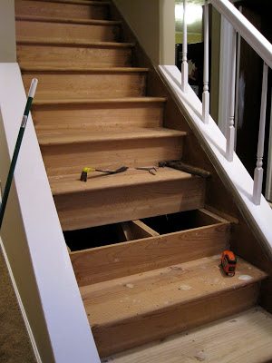
Injury Prevention
New to 17-7
What’s New?
“Minor” repairs must be defined in Grantee H&S Plan.
Injury prevention refers to minor installations needed to let workers safely access work areas, like replacing a missing or unsafe stair tread on the stairs leading to the attic. This would only be done if work was being done in the attic.
Notes:
Action/Allowability
When necessary to effectively weatherize the home, workers may make minor repairs and installations, as defined by the Grantee; otherwise these measures are not allowed.

Slide 24
Lead-Based Paint
New to 17-7
What’s New?
LSW no longer required training, still optional
Client file documentation clarified, must include:
Certified Renovator certification,
any training provided on-site,
description of specific actions taken,
lead testing and assessment documentation, and
photos of site and containment set up (or link to photos)
Economic feasibility of testing method
Grantee must verify lead-safe work practices
Notes:
What’s new in 17-7?
Removed requirement for Lead Safe Weatherization training. This is still allowed, but minimum requirement is the EPA RRP.
Added clarification of documentation that is required in the client file.
Clarified that only the testing and lead safe work practices should be charged to the H&S budget.
Added language to testing requirement related to the economic feasibility of the chosen testing method.
Added requirement for Grantee to verify lead safe work practices.

Slide 25
Occupant Pre-Existing or Potential Health Conditions
New to 17-7
What’s New?
Previously had to screen clients at intake AND during the energy audit, now you must only screen them once.
Notes:
Action/Allowability
When a person’s health may be at risk and/or WAP work activities could constitute an H&S hazard, the occupant at risk will be required to take appropriate action based on severity of risk.
Failure, or the inability, to take appropriate actions must result in deferral.
What’s New?
Removed language around temporary relocation of occupants if they have health issues that may be exacerbated by weatherization work. This was deemed unnecessary by the network during review.
Changed client health screening from being required at intake AND audit to being required only at one or the other. Screening at both times is still allowed.
“Screening” the clients simply means letting them know that the work may cause dust, and asking them if they or anyone in the house has conditions that might be irritated by the work. Then working with them to make sure weatherization doesn’t make it worse.

Slide 26
Radon – New to 17-7
New to 17-7
Clarified that radon mitigation is not an allowable H&S expense.
Added specifications to the vapor barrier installations requirement.
Added that WAP should consider installing radon-related precautionary measures (sealing foundation penetrations, covering open sump pits, etc.) in Zones 1 & 2.
Added an informed consent requirement for clients in all Zones. Requirements of the consent form are outlined in the guidance.
Added proper vapor barrier installation to training requirements for workers.
Notes:
The EPA Radon map uses 3 “zones” to indicate the likelihood of radon being present and levels determined to be potentially dangerous.
Zone 1 indicates average indoor screening levels above the recommended maximum of 4 pCi/L.
Zone 2 ranges from 2 – 4 pCi/L.
Zone 3 average indoor screening levels are less than 2 pCi/L.
What’s New in 17-7?
Clarified that radon mitigation is not an allowable H&S expense.
Added specifications to the vapor barrier installations requirement.
Added that WAP should consider installing radon-related precautionary measures (sealing foundation penetrations, covering open sump pits, etc.) where radon may be present. (Zones 1 & 2)
Added an informed consent requirement for clients. Requirements of the consent form are outlined in the guidance. (All zones)
Added proper vapor barrier installation to training requirements for workers.
Radon maps for each state are available at:
www.epa.gov/radon/whereyoulive.html

Slide 27
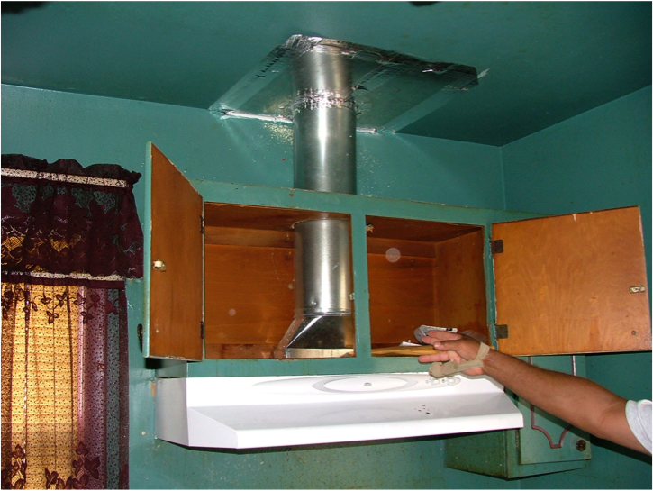
Ventilation and Indoor Air Quality
New to 17-7
What’s New?
Previous guidance required adoption of most current standard; This ends at 62.2 – 2016.
Added language about 3 Pa pressure difference.
Clarified Climate Zone 1 partial exemption.
Client Education now includes “location of switch and cleaning instructions.”
Removed reference to ASHRAE 62.2 FAQS, these will be part of overall H&S FAQs.
Grantees may propose variances to 62.2
Scientific justification improves odds of approval
Clients cannot refuse mechanical ventilation
Notes:
From the Guidance Narrative Document:
“Implementation of ASHRAE 62.2-2016 is required. Client refusal of mechanical ventilation, when evaluated and called for pursuant to the Standard, must result in deferral. If the Grantee proposes to make changes to ASHRAE 62.2, they must submit a variance request. If the Grantee chooses to request a variance, they must provide scientific justification specific to their housing stock and local considerations in their Annual Plan submittal for DOE to consider during plan review. Plans lacking sufficient justification, or containing inadequate justification (as determined by DOE), shall not be approved and must be amended. For variance approvals concerning ASHRAE 62.2, DOE is the AHJ.”
What’s New?
Added “and Indoor Air Quality” to the title. ASHRAE 62.2 covers more than ventilation.
Updated policy – DOE WAP no longer requires adopting most current version within one year of publication. Grantees must adopt and implement 62.2 version 2016, but after that, adoption of future versions will be voluntary.
Added language from the standard about avoiding pressure differences greater than 3 Pascals across closed doors.
Clarified that in Climate Zone 1 where homes are designed to have free air movement between indoors and outdoors, the ventilation requirements of ASHRAE 62.2 are not required, but other requirements of the standard apply.
Added to client education portion “including location of service switch and cleaning instructions.”
Removed reference to ASHRAE 62.2 FAQs, will include these in overall H&S FAQs.

Slide 28
Worker Safety
New to 17-7
What’s New?
Previously titled OSHA and Crew Safety
Removed OSHA 10 requirement, still allowed.
Removed OSHA 30 requirement for Crew Leaders
Not new, but a reminder that Grantees must monitor for safe work practices.
Notes:
This was previously OSHA row.
Added reference to OSHA Hazard Communication Standard and updated reference to MSDS (now SDS).
Removed OSHA 10 as a requirement, although safety training is still required.
Removed OSHA 30 requirement for crew leaders (this had already been waived, but was still in the WPN table until now).
Also, this isn’t new, but bears repeating. From the Narrative document:
“Workers must follow OSHA standards where required and take precautions to ensure the H&S of themselves and other workers.
All Subgrantees and contractors must maintain compliance with the current OSHA Hazard Communication Standard, including on-site organized Safety Data Sheets (SDS) (formerly called MSDS).”

Slide 29
WPN 17 – 6 Piece by Piece – Attachment A
Attachment A – Additional Health and Safety Guidance Related to Heating Systems
Covers:
Budget Category Decisions
Code Compliance and Inspection
Electric Space Heaters
Fireplaces – Special Considerations
Manufactured Homes – Special Considerations
Masonry Chimneys
Solid Fuel-Fired Heaters
Unvented Gas- and Liquid-Fueled Space Heaters
Vented Gas- and Liquid-Fueled Space Heaters
Notes:
Over the course of updating the H&S Guidance, a lot of issues were raised around heating systems. To include everything in the Table of Issues would have made that document less useful. Some of the issues were so specific, like how to test homes with fireplaces, or what to do with masonry chimneys that were no longer attached to functioning heating systems, that we decided to pull the guidance out into a separate document.
This is the table of contents of Attachment A.
There isn’t anything really new here, but we’ve finally written down the guidance around these specific issues. It shouldn’t change anything going on in the field if agencies were already following existing guidance and best practices.
We’ll go through the list to review what’s included.

Slide 30
Attachment A – Fireplaces
New to 17-7
Special Considerations
Describes CO dangers, requires CO alarm in zone.
Inspection/Evaluation
Fireplace testing options
Grantee-proposed testing and depressurization limits, or
Venting must meet code or it’s considered unsafe
Testing other combustion equipment where fireplaces are present
Simulate fireplace operation with blower door depressurization.
Notes:
Fireplaces – Special Considerations: Fireplaces present special hazards that are affected by weatherization. If draft is poor, smoke may downdraft into the living space causing poor indoor air quality. It is likely the occupants will ventilate in these situations. Near the end of a wood fire, glowing coals will remain, radiating heat, while the draft lowers and allows the top of the chimney to cool, further reducing draft. The reduced oxygen available to the glowing coals causes production of CO without the smoke that encourages space ventilation. This is a dangerous situation as the CO enters the living space due to the lowered draft, causes drowsiness of occupants, and sometimes worse. For this reason it is extremely important to make sure there is a CO alarm installed in this combustion zone and occupants are educated to the danger signs and what to do.
Fireplaces - Inspection/Evaluation:
Assessing solid fuel fired appliances involves inspecting the venting/chimney and the overall installation to ensure it adheres to the applicable code: NFPA 211 or other as determined by the authority having jurisdiction. Appliances should be inspected pre- and post-weatherization.
Conduct pre- and post- weatherization worst case CAZ depressurization testing in spaces having a fireplace. Since there is no consensus method for verifying safe operation of fireplaces, Grantees can propose testing policies and limits (e.g., one Grantee uses a depressurization limit of -5 in the CAZ of any wood-burning combustion appliances, including fireplaces). If the Grantee does not propose a policy, if fireplaces are left operational, the vent must meet code or the home cannot be weatherized.
To evaluate operation of other combustion appliances, the blower door can be set to run at 300 CFM (set up as for depressurization testing), or other Grantee-approved flow, to mimic the airflow dynamics likely when the fireplace is in use.

Slide 31
Attachment A – Masonry Chimneys
New to 17-7
Where WAP installs new equipment, it must meet local venting requirements. Liners may be needed.
Retired Masonry Chimneys
Suggested policy for addressing “open-top-in-attic” retired masonry chimneys.
Notes:
Masonry Chimneys: Masonry chimneys used by vented space heaters should be properly lined in compliance with the IFGC. Where WAP installs new equipment, it must meet local code requirements.
Retired Masonry Chimneys:
Dwelling owners are increasingly removing older furnaces and wood stoves and replacing them with high efficiency furnaces, vented space heaters, and electric furnaces (where electricity is cheap). There are incidences where the building roof has been replaced after a masonry chimney has been retired and the roofer removes the chimney top into the attic because of lower cost compared with re-flashing an unused chimney. Grantees should develop a policy on treatment of these open-top-in-attic chimneys as they represent a potential heat sink in the middle of the home. Assuming the policy (with the goal to save energy) is to plug the open top in the attic and install attic insulation without fire stop and insulation dam, the client must be informed in case of an attempt to reuse the chimney.

Slide 32
WPN 17 - 7 – Support Materials
“What’s New” summary document
H&S Plan Template
H&S FAQs
Radon Consent Form Sample Language
More upon request
Notes:
The new guidance covers a lot of material, so DOE has developed some support materials to assist Grantees as they incorporate the guidance into their next Plan.
H&S Plan Template
H&S FAQs
Sample Radon Consent Form language

Slide 33
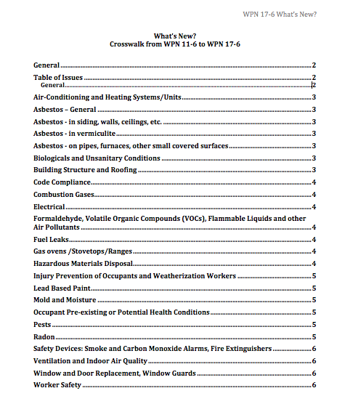
WPN 17 - 7 – What’s New Summary Document
6 Pages
Covers all substantial updates
Helpful when updating Plan

Slide 34
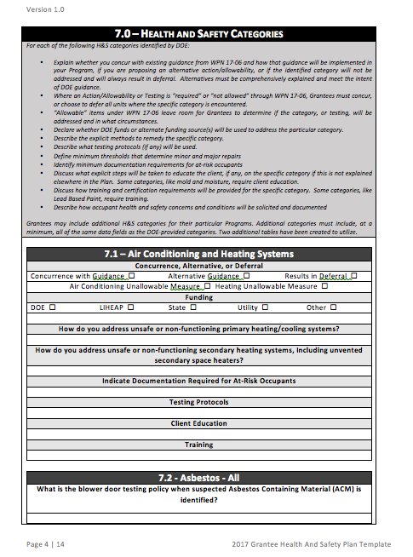
WPN 17 – 7 Health and Safety Plan Template
Optional
Includes budget calculator tool
Prompts for developing policy that complies with WPN
Streamlines DOE review

Slide 35
WPN 17 – 7 Health and Safety FAQs
Almost 40 pages of Q&A, and growing
Intended to address common policy and implementation questions
Used to address comments submitted during review process – WAP network comments
Living document, will add Q&A as issues arise

Slide 36
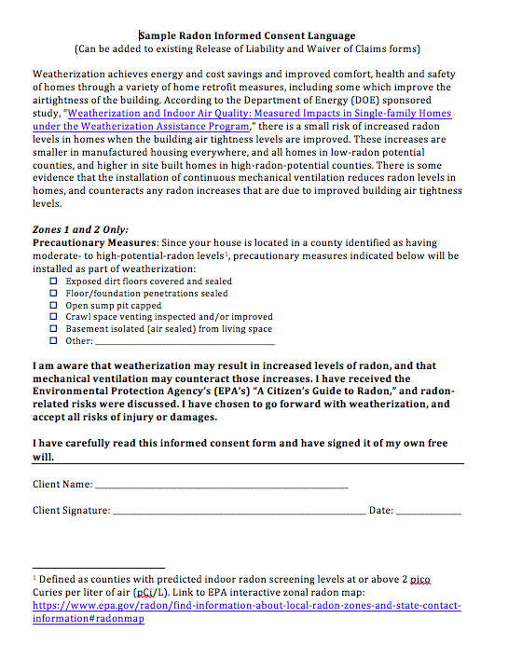
Radon Consent Form – Sample Language
Optional
Editable
Meets requirements outlined in guidance

Slide 37
WPN 17 – 7 – Support Materials
If you think of more resources, let your Project Officer know.
Thank You

