Slide 1
Weatherization Assistance Program
WPN 17-7 Health & Safety Guidance – What’s New?

Slide 2
Using this presentation
This presentation includes notes that are necessary to understanding the slides.
Please view the presentation in a mode that allows the notes to be seen and be sure to read all the way to the bottom of the notes for each slide.
This is the full version of the presentation and is meant for those requiring a comprehensive review of both the overall purpose of the health and safety guidance and a full training on the changes in the current version.
If you would like a shorter version of this presentation, use the “WPN 17-7 Skinny Version”

Slide 3
Purpose
Review WPN 17-7 – Health & Safety Guidance
Highlight updates in WPN 17-7 compared to 11-6
Highlight where H&S Plans can be updated
Review support materials to go along with 17-7
Notes:
By now, everyone should be very familiar with the H&S Guidance contained in WPN 11-6. For that reason, we won’t review the entire WPN 17-7, but just go over the updates that changed from 11-6 to 17-7. If something is NOT mentioned here, it’s safe to assume that it has not changed since 11-6.
After the training, participants will be able to:
List the 3 pieces of the guidance, the “Guidance,” the “Table of Issues,” and the “Attachment A.”
State which of the 3 guidance documents one would look to for answers to various issue-specific questions, for example, “Where would one look to find guidance specific to fireplaces?”
Correctly identify topics that are covered in the table of issues from a list of topics
Identify issue-specific updates to the Table of Issues compared to 11-6
Identify budget-related updates in the Guidance document related to 11-6
Using the guidance documents, be able to correctly answer questions related to: required training, testing and allowability, and client education and notification requirements
List specific portions or issues that will need to be updated in the Grantees’ H&S Plans

Slide 4
Overview of WPN 17-7
Drafted from 2012 - 2017 to put all H&S guidance in one place.
Describes most common issues encountered during weatherization, what is allowed, what is required, and what is prohibited in terms of dealing with these issues.
Outlines how grantees must address H&S in their grantee plan, and where more guidance may be needed at the local level.
Notes:
Weatherization Program Notice (WPN) 17-7 describes the most common issues encountered during weatherization - what is allowed, what is required, and what is restricted.
The guidance also outlines how grantees must address H&S in their grantee plan, and allows for or at times requires additional direction to be passed down to the local level. The grantee’s H&S plan is meant to be the enforceable implementation document of 17-7 for their local programs and should take care to include all of the relevant information from the guidance.
This presentation covers WPN 17-7 in detail, but it is not intended to provide full training on each of the issues outlined in the guidance. For example, we will discuss how mold and moisture must be addressed in the plan, but will not go into detail about how to identify and mitigate moisture issues. The intended audience for this presentation is program directors and others involved in drafting program policy and the grantee health and safety plans. This presentation will also be useful for those implementing or enforcing weatherization H&S guidance.
This presentation is intended for staff who are not familiar with WPN 11 – 6. For those who have worked with 11-6 already, there is a shorter presentation that highlights only the changes made in 17-7 that will affect H&S plans and policies.

Slide 5
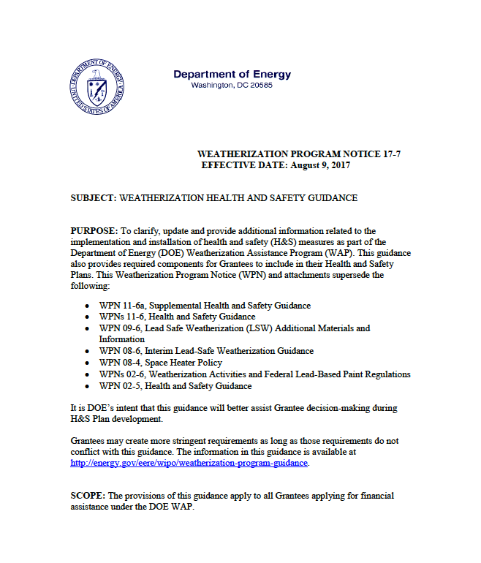
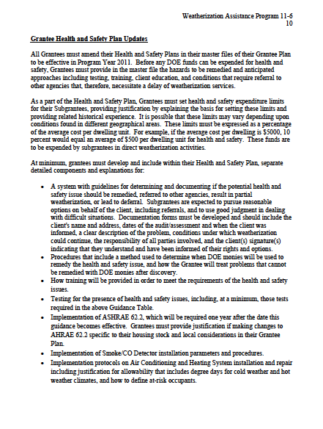
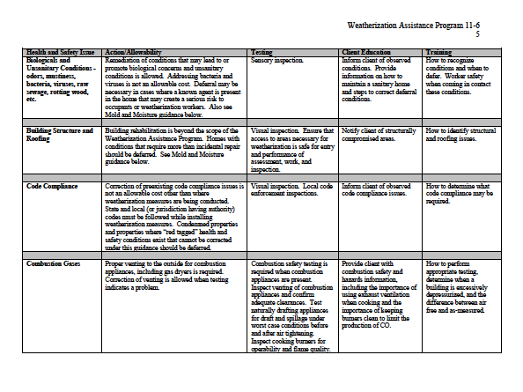
WPN 11-6 Organization – 1 Document
Grantee H&S Plan Updates
Preamble and budget discussion
Table of Issues
Notes:
WPN 11-6 was one document. The first part was the preamble and a discussion about budget categories. Then came the “Table of Issues” where we laid out specifics around client education, training, testing and allowability on each of the identified issues faced in WAP – asbestos, lead-based paint, etc. After the table, there was a section detailing specific updates Grantees may need to make to their H&S Plans.

Slide 6
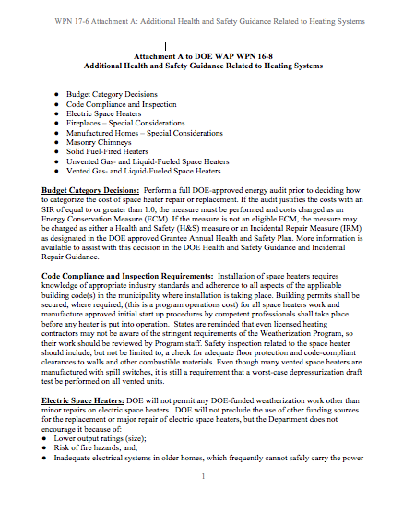
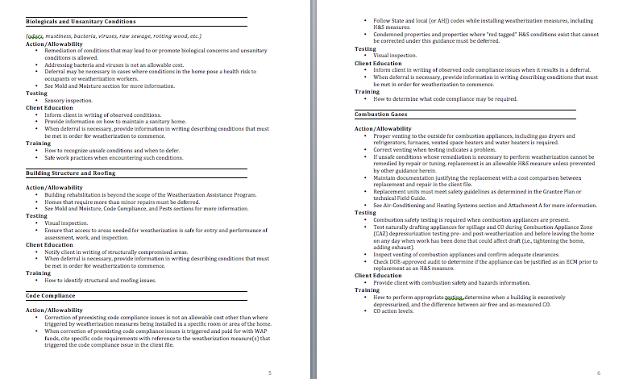
WPN 17 – 6 Organization – 3 Pieces
New to 17-7
Table of Issues – re-formatted
Attachment A –
Special Considerations re: Heating Systems
Guidance Narrative:
Preamble
Budget discussion
Plan updates
Notes:
In 17-7, we pulled all the language about plan updates up into the front, before the “Table of Issues.” The Guidance Narrative, as we’re calling it, includes all the information about what’s required in the Grantee’s H&S Plan, considerations around defining H&S versus IRM versus ECM, and budget formulas.
The table of Issues has been reformatted, but still contains all the same information – client education, training, testing and allowability for each issue identified.
Attachment A is Additional Guidance Related to Heating Systems/Units. We created Attachment A to capture all the miscellaneous recommendations that came out over the course of the H&S committee meetings. Things that didn’t quite fit into any of the categories in the table, or that were making the table too long. For example, recommendations for combustion safety testing in homes with fireplaces.
We also pulled all the space-heater related language out of the table and put that into attachment A.

Slide 7
WPN 17 – 6 Piece by Piece
New to 17-7
Guidance Narrative:
Preamble
Budget discussion
Plan updates
New in 17-7:
Removed language about deferral/referral policy requirements
Removed language about measure skipping
Added requirement for policy about life-threatening hazards requiring immediate attention
Notes:
Removed language requiring a deferral/referral policy in the H&S Plan as redundant. The deferral/referral policy is a separate piece that covers a broader range of issues than just H&S issues, and is part of the master file. H&S Plan must still identify specific action levels related to certain issues that trigger deferral, but mustn’t detail deferral and referral policies for each specific issue in the table.
Added language requiring H&S Plans to include a policy for dealing with H&S issues identified that are life threatening and require an immediate response.
Removed language about measure skipping. This issue is bigger than H&S and will be addressed in the FAQs.
That’s it for this one.

Slide 8
Guidance Narrative – Superseded Guidance
WPN 11-6a, Supplemental Health and Safety Guidance
WPNs 11-6, Health and Safety Guidance
WPN 09-6, Lead Safe Weatherization (LSW) Additional Materials and Information
WPN 08-6, Interim Lead-Safe Weatherization Guidance
WPN 08-4, Space Heater Policy
WPNs 02-6, Weatherization Activities and Federal Lead-Based Paint Regulations
WPN 02-5, Health and Safety Guidance
Notes:
This Weatherization Program Notice (WPN) and attachments supersede the following:
WPN 11-6a, Supplemental Health and Safety Guidance
WPNs 11-6, Health and Safety Guidance
WPN 09-6, Lead Safe Weatherization (LSW) Additional Materials and Information
WPN 08-6, Interim Lead-Safe Weatherization Guidance
WPN 08-4, Space Heater Policy
WPNs 02-6, Weatherization Activities and Federal Lead-Based Paint Regulations
WPN 02-5, Health and Safety Guidance

Slide 9
Guidance Narrative – H&S Plan Requirements
Overview:
Defining measures
Budgeting & Expenditure Limits
Hazard identification and notification policy
“Emergency” procedures
Issue Specific:
Deferral action levels
Training/testing
Client Education
And more…
Notes:
To implement 17-7 in the DOE WAP, grantees need to draft a Health & Safety plan that addresses all of the issues outlined in the guidance, identifies average spending limitations, and more.
Items listed in the overview are part of the general approach to H&S that the grantee will take. The issue specific items may be different for each of the identified H&S issues in the Table, and we’ll cover those in detail during review of that portion of the guidance.
Refer to the optional Health and Safety Plan Template for further guidance.

Slide 10
Guidance Narrative – Definition of H&S
WAP is primarily an energy efficiency program.
Health & Safety measures must meet criteria:
Elimination of hazards is necessary before, or as a result of, the installation of weatherization materials; and
H&S spending is limited (expressed as a percent of average dwelling unit costs), and the limit is reasonable in light of the primary energy conservation purpose of the Weatherization Assistance Program.
Notes:
According to 10 CFR Part 440.18(d)(15), allowable energy related H&S actions are those actions necessary to maintain the physical well-being of both the occupants and weatherization workers where:
Costs are reasonable, as determined by DOE, and are in accordance with the Grantee’s approved Annual Plan; AND
The actions must be taken to effectively perform weatherization work; OR
The actions are necessary as a result of weatherization work.
When considering what activities make sense as a health and safety expense, consider these two questions:
1. What must we do within reasonable costs to get the home to a point where we can go forward with weatherizing, where the weatherization work will be lasting and effective?
2. What must we do to ensure that the weatherization work we conducted does not create a health or safety problem for the occupant?

Slide 11
Guidance Narrative – H&S vs. IRM
Default budget category for issues is H&S
Grantees can define certain issues, and under specific conditions, as IRM
Definition must be consistently applied for full grant period
Notes:
Certain H&S measures may be removed from the H&S budget category and performed as Incidental Repair Measures (IRM). Examples include: moisture repairs, vapor barrier installation, flue repair and electrical repairs. For such measures, the Grantee may choose to specify in the H&S Plan the specific conditions under which the measure is to be considered an IRM for the covered grant period. For example, repairing a small roof leak could be considered an H&S measure (remediating mold-creating conditions) or an IRM (protecting installed measures, if attic insulation is installed). If the Grantee wishes to charge such repairs to H&S when no attic insulation is being installed, but charge them as IRM when attic insulation is installed, this must be included in the plan. Unless specified otherwise, the default budget category for all issues listed in the table is H&S.
Once the Plan is approved by DOE, the specified treatment of such measures must be applied consistently throughout the Grantee area for the full grant period per the Plan. The decision to charge these measures as H&S or IRM may not be made in the field.

Slide 12
Guidance Narrative – H&S vs. ECM
Some measures may qualify as H&S or ECM (i.e., unsafe heating systems)
MUST test cost-effectiveness first
If SIR >1, charge as ECM
If SIR <1, charge to H&S budget
Notes:
There are some instances where, depending on circumstances, the measure can qualify as either an H&S measure OR an ECM, e.g., heating or cooling system replacement. When the measure can be cost-justified, the measure must be treated as an ECM. Program staff may conduct a site-specific audit in order to cost-justify ECMs that are not included in their DOE-approved priority list. The measure may be considered for H&S repair or replacement only after it is determined that the measure is not cost-effective.
(Josh: Insert language here about splitting costs, if applicable.)

Slide 13
Guidance Narrative – Budget Management
H&S can be a separate budget category or included in regular program operations.
As regular program operations | As separate H&S budget category
Included in cost per unit calculations Must be cost-justified by energy audit | H&S measures can be isolated from energy efficiency costs during program evaluations Must not be cost-justified Not included in per unit calculations
Set average expenditure limits as percentage of average cost per dwelling.
Notes:
If Grantee Does NOT Create Separate H&S Budget Category:
Related H&S costs must be included in the ACPU calculation, charged to the Program Operations budget, and cost-justified through the audit, and/or, if applicable, incorporated into all savings-to-investment ratio (SIR) calculations for all priority lists. The H&S Plan must state this.
If H&S issues cannot be addressed as required by this guidance with other funding sources and cannot be performed within the SIR, then the home must be deferred.

Slide 14
Guidance Narrative – Budget Management
H&S Plans must include justification for H&S expenditure limit.
DOE does not impose a spending cap on H&S.
Even if the request is 0, justification is required.
Provide past H&S budget request and actual spent.
Include a cost breakdown of what would normally be done for H&S in the average home.
Show any changes from previous years.
DOE will determine if costs are reasonable based on each grantee’s justification.
Notes:
DOE does not require a per unit cap, rather encourages an average H&S expenditure limit so that costs can be adjusted based on the need for each home. The Grantee is responsible for developing mechanisms for managing their cost limitations and staying within the overall H&S budget for the program year. In the event, during a grant period, it is determined that approved H&S budgets will be insufficient, the Grantee must submit a justified request for a higher limit to the Project Officer as soon as possible.
See the optional H&S Plan Template for a helpful budget calculator tool.

Slide 15
Guidance Narrative – Budget Management
New to 17-7
Client file documentation must show costs in
appropriate budget categories.
Notes:
The client file must include documentation that separates all costs into the appropriate budget category, including H&S.

Slide 16
Hazard Identification and Notification
New to 17-7
Client/landlord/property manager must be notified
in writing of:
Any hazards identified which will lead to deferral, and
All testing results,* regardless if they will lead to deferral.
* Testing results does not refer to standard combustion safety and other regular testing. Testing results refers to things like lead paint testing, testing of suspected asbestos containing materials (ACMs), and radon testing.
Notes:
An H&S assessment must be performed to identify hazards in the home.
Where hazards are identified, appropriate testing must be performed when required by this guidance. The client/landlord/property manager must be informed, in writing, of
All testing results, regardless if they will lead to deferral, (these can be sent by certified mail separately if testing timeline does not match with weatherization timeline, as with radon), and
Any identified hazards that will lead to deferral.
The notification must be signed by the client and the assessor/auditor and a copy maintained in the client file.
The notification of testing results is new to 17-7, though it was standard practice for most agencies before now.

Slide 17
Emergency Procedures
New to 17-7
New to 17-7
Procedures detailing how crews handle problems discovered during testing
Applies to Combustion Gases, and when other life-threatening hazards are observed
Specific protocols for hazards requiring immediate response
Notes:
Procedures detailing how crews will handle problems discovered during testing of Combustion Gases and when other life threatening hazards are observed, with specific protocols for addressing serious hazards that require an immediate response.
This is new to 17-7.

Slide 18
Guidance Narrative Review
Which of these document is the BEST place to look for guidance specific to special considerations re: space heaters?
17-7 Guidance Narrative
08-4 Space Heater Policy
17-7 Table of Issues
17-7 Attachment A
Notes:
Answer – 17-7 – Attachment A. 08-4 is superseded by this WPN 17-7. Table of issues deals with general heating system related issues, but Attachment A addresses special considerations.

Slide 19
Guidance Narrative Review
According to 10-CFR 440, what criteria must measures meet to qualify as H&S measures?
____________________________
____________________________
Notes:
Answer:
The actions must be taken to effectively perform weatherization work; OR
The actions are necessary as a result of weatherization work.

Slide 20
Guidance Narrative Review
A primary heating system is found to be unsafe. What must be done before the unit can be replaced with H&S dollars?
Notes:
Answer: The measure must be tested for cost-effectiveness first. If it achieves an SIR >1, it must be replaced as a regular ECM. If it isn’t cost-effective, it may be replaced as a H&S measure.

Slide 21
WPN 17 – 6 Piece by Piece – Table of Issues
Updates to Issue Titles
Updates to specific issues
Notes:
In the table, other than reformatting, we did some reorganization.
There are new rows, and some of the old rows have been removed or consolidated. We’ll go through those changes so you know where to find information if there is a Grantee request.

Slide 22
Table of Issues – 11-6 Issues List
Air-Conditioning and Heating Systems/Units
Appliances and Water Heaters
Asbestos - in siding, walls, ceilings, etc.
Asbestos - in vermiculite
Asbestos - on pipes, furnaces, other small covered surfaces
Biologicals and Unsanitary Conditions
Building Structure and Roofing
Code Compliance
Combustion Gases
Drainage – gutters, down spouts, extensions, flashing, sump pumps, landscape, etc.
Electrical – other than knob and tube wiring
Electrical – knob and tube wiring
Fire Hazards
Formaldehyde, Volatile Organic Compounds (VOCs), Flammable Liquids and other Air Pollutants
Injury Prevention of Occupants and Weatherization Workers
Lead Based Paint
Mold and Moisture
Occupant Pre-existing or Potential Health Conditions
Pests
OSHA and Crew Safety
Smoke and Carbon Monoxide Alarms, Fire Extinguishers
Solid Fuel Heating
Space Heaters, stand alone electric
Space Heaters, unvented combustion
Space Heaters, vented combustion
Spray Polyurethane Foam
Ventilation
Window and Door Replacement, Window Guards
Notes:
This is the list from 11-6 that we are all familiar with.

Slide 23
Table of Issues – 17-7 Issues List Updates
New to 17-7
Air-Conditioning and Heating Systems/Units
Appliances and Water Heaters
Asbestos - in siding, walls, ceilings, etc.
Asbestos - in vermiculite
Asbestos - on pipes, furnaces, other small covered surfaces
Biologicals and Unsanitary Conditions
Building Structure and Roofing
Code Compliance
Combustion Gases
Drainage – gutters, down spouts, extensions, flashing, sump pumps, landscape, etc.
Electrical – other than knob and tube wiring
Electrical – knob and tube wiring
Fire Hazards
Formaldehyde, Volatile Organic Compounds (VOCs), Flammable Liquids and other Air Pollutants
Injury Prevention of Occupants and Weatherization Workers
Lead Based Paint
Mold and Moisture
Occupant Pre-existing or Potential Health Conditions
Pests
OSHA and Crew Safety
Smoke and Carbon Monoxide Alarms, Fire Extinguishers
Solid Fuel Heating
Space Heaters, stand alone electric
Space Heaters, unvented combustion
Space Heaters, vented combustion
Spray Polyurethane Foam
Ventilation
Window and Door Replacement, Window Guards
Notes:
We got rid of the “Appliances and Water Heaters row. The material is covered in Combustion Gases and Mold and Moisture rows, as applicable.

Slide 24
Table of Issues – 17-7 Issues List Updates
New to 17-7
Air-Conditioning and Heating Systems/Units
Appliances and Water Heaters
Asbestos - in siding, walls, ceilings, etc.
Asbestos - in vermiculite
Asbestos - on pipes, furnaces, other small covered surfaces
Biologicals and Unsanitary Conditions
Building Structure and Roofing
Code Compliance
Combustion Gases
Drainage – gutters, down spouts, extensions, flashing, sump pumps, landscape, etc.
Electrical – other than knob and tube wiring
Electrical – knob and tube wiring
Fire Hazards
Formaldehyde, Volatile Organic Compounds (VOCs), Flammable Liquids and other Air Pollutants
Injury Prevention of Occupants and Weatherization Workers
Lead Based Paint
Mold and Moisture
Occupant Pre-existing or Potential Health Conditions
Pests
OSHA and Crew Safety
Smoke and Carbon Monoxide Alarms, Fire Extinguishers
Solid Fuel Heating
Space Heaters, stand alone electric
Space Heaters, unvented combustion
Space Heaters, vented combustion
Spray Polyurethane Foam
Ventilation
Window and Door Replacement, Window Guards
Notes:
We got rid of the “drainage” row and added that language to the Mold and Moisture row.

Slide 25
Table of Issues – 17-7 Issues List Updates
New to 17-7
Air-Conditioning and Heating Systems/Units
Appliances and Water Heaters
Asbestos - in siding, walls, ceilings, etc.
Asbestos - in vermiculite
Asbestos - on pipes, furnaces, other small covered surfaces
Biologicals and Unsanitary Conditions
Building Structure and Roofing
Code Compliance
Combustion Gases
Drainage – gutters, down spouts, extensions, flashing, sump pumps, landscape, etc.
Electrical – other than knob and tube wiring
Electrical – knob and tube wiring
Fire Hazards
Formaldehyde, Volatile Organic Compounds (VOCs), Flammable Liquids and other Air Pollutants
Injury Prevention of Occupants and Weatherization Workers
Lead Based Paint
Mold and Moisture
Occupant Pre-existing or Potential Health Conditions
Pests
OSHA and Crew Safety
Smoke and Carbon Monoxide Alarms, Fire Extinguishers
Solid Fuel Heating
Space Heaters, stand alone electric
Space Heaters, unvented combustion
Space Heaters, vented combustion
Spray Polyurethane Foam
Ventilation
Window and Door Replacement, Window Guards
Notes:
We combined the 2 electrical rows into one that includes Knob & Tube (K&T) and non-K&T hazards.

Slide 26
Table of Issues – 17-7 Issues List Updates
New to 17-7
Air-Conditioning and Heating Systems/Units
Appliances and Water Heaters
Asbestos - in siding, walls, ceilings, etc.
Asbestos - in vermiculite
Asbestos - on pipes, furnaces, other small covered surfaces
Biologicals and Unsanitary Conditions
Building Structure and Roofing
Code Compliance
Combustion Gases
Drainage – gutters, down spouts, extensions, flashing, sump pumps, landscape, etc.
Electrical – other than knob and tube wiring
Electrical – knob and tube wiring
Fire Hazards
Formaldehyde, Volatile Organic Compounds (VOCs), Flammable Liquids and other Air Pollutants
Injury Prevention of Occupants and Weatherization Workers
Lead Based Paint
Mold and Moisture
Occupant Pre-existing or Potential Health Conditions
Pests
OSHA and Crew Safety
Smoke and Carbon Monoxide Alarms, Fire Extinguishers
Solid Fuel Heating
Space Heaters, stand alone electric
Space Heaters, unvented combustion
Space Heaters, vented combustion
Spray Polyurethane Foam
Ventilation
Window and Door Replacement, Window Guards
Notes:
The Fire Hazards row is removed.

Slide 27
Table of Issues – 17-7 Issues List Updates
New to 17-7
Air-Conditioning and Heating Systems/Units
Appliances and Water Heaters
Asbestos - in siding, walls, ceilings, etc.
Asbestos - in vermiculite
Asbestos - on pipes, furnaces, other small covered surfaces
Biologicals and Unsanitary Conditions
Building Structure and Roofing
Code Compliance
Combustion Gases
Drainage – gutters, down spouts, extensions, flashing, sump pumps, landscape, etc.
Electrical – other than knob and tube wiring
Electrical – knob and tube wiring
Fire Hazards
Formaldehyde, Volatile Organic Compounds (VOCs), Flammable Liquids and other Air Pollutants
Injury Prevention of Occupants and Weatherization Workers
Lead Based Paint
Mold and Moisture
Occupant Pre-existing or Potential Health Conditions
Pests
OSHA and Crew Safety
Smoke and Carbon Monoxide Alarms, Fire Extinguishers
Solid Fuel Heating
Space Heaters, stand alone electric
Space Heaters, unvented combustion
Space Heaters, vented combustion
Spray Polyurethane Foam
Ventilation
Window and Door Replacement, Window Guards
Notes:
All of these rows about specific heating equipment have been removed. They are addressed generally in Combustion Gases, and more specifically in Attachment A.

Slide 28
Table of Issues – 17-7 Issues List Updates
New to 17-7
Air-Conditioning and Heating Systems/Units
Appliances and Water Heaters
Asbestos - in siding, walls, ceilings, etc.
Asbestos - in vermiculite
Asbestos - on pipes, furnaces, other small covered surfaces
Biologicals and Unsanitary Conditions
Building Structure and Roofing
Code Compliance
Combustion Gases
Drainage – gutters, down spouts, extensions, flashing, sump pumps, landscape, etc.
Electrical – other than knob and tube wiring
Electrical – knob and tube wiring
Fire Hazards
Formaldehyde, Volatile Organic Compounds (VOCs), Flammable Liquids and other Air Pollutants
Injury Prevention of Occupants and Weatherization Workers
Lead Based Paint
Mold and Moisture
Occupant Pre-existing or Potential Health Conditions
Pests
OSHA and Crew Safety
Smoke and Carbon Monoxide Alarms, Fire Extinguishers
Solid Fuel Heating
Space Heaters, stand alone electric
Space Heaters, unvented combustion
Space Heaters, vented combustion
Spray Polyurethane Foam
Ventilation
Window and Door Replacement, Window Guards
Notes:
Spray Polyurethane Foam row is gone, that’s part of overall worker safety.

Slide 29
Table of Issues – 17-7 Issues List Updates
New to 17-7
Air-Conditioning and Heating Systems/Units
Appliances and Water Heaters
Asbestos - in siding, walls, ceilings, etc.
Asbestos - in vermiculite
Asbestos - on pipes, furnaces, other small covered surfaces
Biologicals and Unsanitary Conditions
Building Structure and Roofing
Code Compliance
Combustion Gases
Drainage – gutters, down spouts, extensions, flashing, sump pumps, landscape, etc.
Electrical – other than knob and tube wiring
Electrical – knob and tube wiring
Fire Hazards
Formaldehyde, Volatile Organic Compounds (VOCs), Flammable Liquids and other Air Pollutants
Injury Prevention of Occupants and Weatherization Workers
Lead Based Paint
Mold and Moisture
Occupant Pre-existing or Potential Health Conditions
Pests
OSHA and Crew Safety
Smoke and Carbon Monoxide Alarms, Fire Extinguishers
Solid Fuel Heating
Space Heaters, stand alone electric
Space Heaters, unvented combustion
Space Heaters, vented combustion
Spray Polyurethane Foam
Ventilation
Window and Door Replacement, Window Guards
Notes:
OSHA and Crew Safety is now called “Worker Safety.”

Slide 30
Removed Rows
New to 17-7
Appliances and Water Heaters
Drainage
Solid Fuel heating
Space Heaters, stand alone electric
Space Heaters, unvented combustion
Space Heaters, vented combustion
Spray polyurethane Foam

Slide 31
Altered Rows
New to 17-7
Electrical - other than K&T Wiring
Electrical – K&T Wiring
Mold & Moisture
Drainage
OSHA and Crew Safety
Electrical
Mold & Moisture
Worker Safety

Slide 32
Table of Issues – 17-7 Issues List Updates
Air-Conditioning and Heating Systems/Units
Asbestos - in siding, walls, ceilings, etc.
Asbestos - in vermiculite
Asbestos - on pipes, furnaces, other small covered surfaces
Biologicals and Unsanitary Conditions
Building Structure and Roofing
Code Compliance
Combustion Gases
Electrical
Formaldehyde, Volatile Organic Compounds (VOCs), Flammable Liquids and other Air Pollutants
Injury Prevention of Occupants and Weatherization Workers
Lead Based Paint
Mold and Moisture
Occupant Pre-existing or Potential Health Conditions
Pests
Safety Devices: Smoke and Carbon Monoxide Alarms, Fire Extinguishers
Ventilation
Window and Door Replacement, Window Guards
Worker Safety
Notes:
This is what we had once those rows were removed and re-named. Then we added some rows.

Slide 33
Table of Issues – 17-7 Issues List – Added Rows
New to 17-7
Air-Conditioning and Heating Systems/Units
Asbestos - in siding, walls, ceilings, etc.
Asbestos - in vermiculite
Asbestos - on pipes, furnaces, other small covered surfaces
Biologicals and Unsanitary Conditions
Building Structure and Roofing
Code Compliance
Combustion Gases
Electrical
Formaldehyde, Volatile Organic Compounds (VOCs), Flammable Liquids and other Air Pollutants
Fuel Leaks
Gas Ovens/Stovetops/Ranges
Hazardous Materials Disposal
Injury Prevention of Occupants and Weatherization Workers
Lead Based Paint
Mold and Moisture
Occupant Pre-existing or Potential Health Conditions
Pests
Safety Devices: Smoke and Carbon Monoxide Alarms, Fire Extinguishers
Ventilation
Window and Door Replacement, Window Guards
Worker Safety
New Rows
Notes:
Then we added some rows.

Slide 34
Added Rows
New to 17-7
Fuel Leaks
Gas Ovens/Stovetops/Ranges
Hazardous Materials Disposal

Slide 35
Table of Issues Headings – 17-7
Air-Conditioning and Heating Systems/Units
Asbestos - in siding, walls, ceilings, etc.
Asbestos - in vermiculite
Asbestos - on pipes, furnaces, other small covered surfaces
Biologicals and Unsanitary Conditions
Building Structure and Roofing
Code Compliance
Combustion Gases
Electrical
Formaldehyde, Volatile Organic Compounds (VOCs), Flammable Liquids and other Air Pollutants
Fuel Leaks
Gas Ovens/Stovetops/Ranges
Hazardous Materials Disposal
Injury Prevention of Occupants and Weatherization Workers
Lead Based Paint
Mold and Moisture
Occupant Pre-existing or Potential Health Conditions
Pests
Safety Devices: Smoke and Carbon Monoxide Alarms, Fire Extinguishers
Ventilation
Window and Door Replacement, Window Guards
Worker Safety
Notes:
Here’s our new line-up. We go over the categories so you’ll know where to look when you have questions, or where to address certain things in your H&S Plan.
Though it seemed like there was a lot of change in the reorganization, actual treatment of the issues didn’t change for every area listed here.

Slide 36
WPN 17-7 Topics with Notable Changes to Guidance
Air-Conditioning and Heating Systems/Units
Asbestos - in siding, walls, ceilings, etc.
Asbestos - in vermiculite
Asbestos - on pipes, furnaces, other small covered surfaces
Biologicals and Unsanitary Conditions
Building Structure and Roofing
Code Compliance
Combustion Gases
Electrical
Formaldehyde, Volatile Organic Compounds (VOCs), Flammable Liquids and other Air Pollutants
Fuel Leaks
Gas ovens /Stovetops/Ranges
Hazardous Materials Disposal
Injury Prevention of Occupants and Weatherization Workers
Lead Based Paint
Mold and Moisture
Occupant Pre-existing or Potential Health Conditions
Pests
Radon
Safety Devices: Smoke and Carbon Monoxide Alarms, Fire Extinguishers
Ventilation and Indoor Air Quality
Window and Door Replacement, Window Guards
Worker Safety
Notes:
Only the items listed in red had enough change that it may require a review of your H&S Plan.
A lot of the treatment of issues stayed pretty much the same from 11 – 6 to 17 – 6. The language was cleaned up and clarified, but only the topics highlighted red above underwent change that would require an update to the H&S Plans. For all the others, if you were in compliance with WPN 11-6, you will be in compliance with 17-7.

Slide 37
Review: Table of Issues 17-7
Cross out Headings not used in in the Updated Table of Issues:
Air-Conditioning and Heating Systems/Units
Appliances and Water Heaters
Asbestos
Biologicals and Unsanitary Conditions
Building Structure and Roofing
Code Compliance
Combustion Gases
Drainage
Electrical
Formaldehyde, VOCs, Flammable Liquids and other Air Pollutants
Fuel Leaks
Gas ovens/Stovetops/Ranges
Hazardous Materials Disposal
Injury Prevention of Occupants and Weatherization Workers
Lead Based Paint
Mold and Moisture
Occupant Pre-existing or Potential Health Conditions
OSHA & Crew Safety
Pests
Radon
Safety Devices: Smoke and CO Alarms, Fire Extinguishers
Space Heaters – Unvented
Space Heaters – Stand alone, electric
Spray Polyurethane Foam
Ventilation and Indoor Air Quality
Window and Door Replacement, Window Guards
Worker Safety

Slide 38
Review: Table of Issues 17-7
Cross out Headings not used in in the Updated Table of Issues:
Air-Conditioning and Heating Systems/Units
Appliances and Water Heaters
Asbestos
Biologicals and Unsanitary Conditions
Building Structure and Roofing
Code Compliance
Combustion Gases
Drainage
Electrical
Formaldehyde, VOCs, Flammable Liquids and other Air Pollutants
Fuel Leaks
Gas ovens/Stovetops/Ranges
Hazardous Materials Disposal
Injury Prevention of Occupants and Weatherization Workers
Lead Based Paint
Mold and Moisture
Occupant Pre-existing or Potential Health Conditions
OSHA & Crew Safety
Pests
Radon
Safety Devices: Smoke and CO Alarms, Fire Extinguishers
Space Heaters – Unvented
Space Heaters – Stand alone, electric
Spray Polyurethane Foam
Ventilation and Indoor Air Quality
Window and Door Replacement, Window Guards
Worker Safety

Slide 39
Review: Table of Issues 17-7
Circle Headings That are New or Updated:
Air-Conditioning and Heating Systems/Units
Appliances and Water Heaters
Asbestos
Biologicals and Unsanitary Conditions
Building Structure and Roofing
Code Compliance
Combustion Gases
Drainage
Electrical
Formaldehyde, VOCs, Flammable Liquids and other Air Pollutants
Fuel Leaks
Gas ovens/Stovetops/Ranges
Hazardous Materials Disposal
Injury Prevention of Occupants and Weatherization Workers
Lead Based Paint
Mold and Moisture
Occupant Pre-existing or Potential Health Conditions
OSHA & Crew Safety
Pests
Radon
Safety Devices: Smoke and CO Alarms, Fire Extinguishers
Space Heaters – Unvented
Space Heaters – Stand alone, electric
Spray Polyurethane Foam
Ventilation and Indoor Air Quality
Window and Door Replacement, Window Guards
Worker Safety

Slide 40
Review: Table of Issues 17-7
Circle Headings That are New or Updated:
Air-Conditioning and Heating Systems/Units
Appliances and Water Heaters
Asbestos
Biologicals and Unsanitary Conditions
Building Structure and Roofing
Code Compliance
Combustion Gases
Drainage
Electrical
Formaldehyde, VOCs, Flammable Liquids and other Air Pollutants
Fuel Leaks
Gas ovens/Stovetops/Ranges
Hazardous Materials Disposal
Injury Prevention of Occupants and Weatherization Workers
Lead Based Paint
Mold and Moisture
Occupant Pre-existing or Potential Health Conditions
OSHA & Crew Safety
Pests
Radon
Safety Devices: Smoke and CO Alarms, Fire Extinguishers
Space Heaters – Unvented
Space Heaters – Stand alone, electric
Spray Polyurethane Foam
Ventilation and Indoor Air Quality
Window and Door Replacement, Window Guards
Worker Safety

Slide 41
Review: Table of Issues 17-7
You have a question about drainage and want to find out what DOE allows with H&S funds. Where in the Table of Issues will you find the answer?
Notes:
Answer – Mold & Moisture. Previously Drainage was a separate row, but as it all has to do with moisture, the material was added to the Mold & Moisture row.

Slide 42
Review: Table of Issues 17-7
Where in the table of issues will you find guidance on Knob & Tube wiring?
Notes:
Answer – Electrical. Previously we had two rows addressing electrical issues, they have been combined.

Slide 43
Table of Issues – Issue Specific
For each issue, table identifies:
Action/Allowability
Testing requirements
Client Education requirements
Training requirements
This presentation will focus on the Action/Allowability, referencing the other areas only where it has changed since WPN 11-6
Attending this presentation is no substitute for reading the Guidance, WPN 17-7.
Notes:
For each issue listed in the table, specifics are organized by:
Action/Allowability
Testing
Client Education
Training
This presentation covers the main action/allowability for every topic, and it covers the testing, client education, and training requirements only where they have been substantially updated compared to the 11-6 guidance. This presentation is no substitute for reading the guidance document.
Before we get into the issue-specifics, though, there are some overarching ideas that apply to the entire table and should inform the grantees’ approach to the H&S plan.

Slide 44
Table of Issues – Overall Approach 1 of 2
For each issue listed, and any additional issues added:
All work installed is installed to meet local codes
When required, licensed professionals will be employed to install work or conduct tests
Client education is only required where issue exists
Manuals for installed equipment will ALWAYS be provided to client
Training to perform required testing and correctly apply Grantee policy is implied
Notes:
For each issue listed, and any additional issues added:
All applicable State and local (or authority having jurisdiction [AHJ] codes must be followed and manufacturer approved materials and instructions must be used while installing any weatherization measures.
Workers shall know the limits of their knowledge, and when the AHJ requires a licensed professional to perform a certain task. Workers must be qualified and adequately trained to implement the DOE Standard Work Specifications as well as state and local (or AHJ) codes specific to the work being conducted (electrical, plumbing, etc.).
Client education outlined in the table is required only where said issue exists. For example, client education regarding drainage issues is only required where drainage problems are identified.
Whenever new equipment is installed – ventilation fans, HVAC, etc., - the paperwork that comes with the unit, including the user’s manual, must be provided to the client.
Though not written out in every case, it is implied that workers responsible for carrying out the required tests described throughout the guidance will receive the training needed to competently perform those tests, as applicable. On the same note, where workers will have to make decisions in the field, it is understood that they will receive training on applicable policies that should inform those decisions.
These things come up over and over in the table, but we won’t repeat them for every issue. Make note that these apply to every issue.

Slide 45
Table of Issues – Overall Approach 2 of 2
For each issue in “Table of Issues,” define parameters for performing specific H&S measures.
Include proper action when issue cannot be addressed.
Example: Where exterior drainage issues are causing mold/moisture creating conditions in the basement, and the basement will be treated as part of weatherization, drainage work can be completed where a crew of 3 using hand-tools for 4 hours can satisfactorily correct the issue. Otherwise the home must be deferred.
Notes:
Parameters for performing specific H&S measures, including proper action when the issue may not be addressed.
For example, if exterior drainage issues may be addressed only where work can be completed with hand tools and a maximum of 12 labor hours this should be described in the Plan.
When any of the issues listed in the table is cause for deferral, the client must be notified in writing, including the conditions that must be met in order for weatherization to move forward. This is included in the “Client Education” portion of the table, but will not be repeated over and over throughout the presentation.

Slide 46
WPN 17-7 Table of Issues
Air-Conditioning and Heating Systems/Units
Asbestos - in siding, walls, ceilings, etc.
Asbestos - in vermiculite
Asbestos - on pipes, furnaces, other small covered surfaces
Biologicals and Unsanitary Conditions
Building Structure and Roofing
Code Compliance
Combustion Gases
Electrical
Formaldehyde, Volatile Organic Compounds (VOCs), Flammable Liquids and other Air Pollutants
Fuel Leaks
Gas ovens /Stovetops/Ranges
Hazardous Materials Disposal
Injury Prevention of Occupants and Weatherization Workers
Lead Based Paint
Mold and Moisture
Occupant Pre-existing or Potential Health Conditions
Pests
Radon
Safety Devices: Smoke and Carbon Monoxide Alarms, Fire Extinguishers
Ventilation and Indoor Air Quality
Window and Door Replacement, Window Guards
Worker Safety
Notes:
We’ll go through the issues one by one to review action/allowability, and discuss testing and training requirements, and client education if those requirements have changed substantially since 11-6.

Slide 47
Issue Specific Updates
New to 17-7
Asbestos
Code Compliance
Gas Ovens/Stovetops/Ranges
Injury Prevention
Lead Based paint
Mold & Moisture
Occupant Pre-existing or Potential Health Conditions
Radon
Ventilation and Indoor Air Quality
Worker Safety
Notes:
These are the issues which were changed enough in the guidance update to cause a review of H&S Plans.
Other categories are highlighted in the presentation as “New to 17-7” wherever categories were combined, added or changed, even if the actual guidance in terms of what you need to include in your H&S Plans, hasn’t changed substantially.
Now let’s get to specific topics.

Slide 48
Air Conditioning and Heating Systems/Units
Action/Allowability – Primary Units
Primary heating system repair, replacement or installation
Primary cooling system repair, replacement or installation ONLY where clients meet Grantee definition of “at risk.”
Proper sizing based on post-wx characteristics
If unsafe primary units can’t be repaired, replaced, removed or rendered inoperable, deferral is a must
An attempt to cost-justify the measure must be made prior to replacing/repairing with H&S funds.
Notes:
Action/Allowability
“Red tagged,” inoperable, or nonexistent primary heating system replacement, repair, or installation is allowed where climate conditions warrant, unless prevented by other guidance herein.
Primary air conditioning system replacement, repair, or installation is allowed only in homes where current occupants meet Grantee’s definition of “at-risk” AND climate conditions warrant. “System” can mean a central unit or several individually operating units; however, when a central unit is in place, it shall be considered the primary unit, and all other units are to be considered secondary.
The reason for this is that building codes often require functional heating systems, but not cooling systems, so we must justify any non-cost-effective work on cooling systems by doing the extra step of defining “at risk” for the area.
Use proper sizing protocols (Manual J, State Approved sizing protocols, NEAT/MHEA outputs, etc.) based on post-weatherization housing characteristics (including installed mechanical ventilation) for installations and replacements.
Unsafe primary units must be repaired, or replaced and removed or rendered inoperable, or deferral is required.

Slide 49
Air Conditioning and Heating Systems/Units
Action/Allowability – Secondary Units
Replacement or installation of secondary units is not allowed.
Unsafe units must be repaired, removed, or rendered inoperable, or deferral is required
Notes:
Replacement or installation of secondary units is not allowed.
Unsafe secondary units, including space heaters, must be repaired, removed or rendered inoperable, or deferral is required.
See Hazardous Materials Disposal section for more information.

Slide 50
Primary versus Secondary - Definition
Grantees can further clarify, but general approach:
Primary system (or system of units) – most relied upon to provide heating/cooling throughout the season
Secondary system/unit – employed only in extreme weather
Notes:
This is from the language in the FAQs and is only included here to provide clarification if needed.
The primary system is generally understood to be the system (or system of units) most relied upon to provide heating/cooling throughout the season.
Secondary units or systems may be employed only in extreme weather.
If Grantees wish to further clarify the definitions, they are encouraged to in their Program resources.

Slide 51
Asbestos – General
New to 17-7
Blower Door testing – Grantees must state their policy for blower door testing when suspected Asbestos Containing Materials (ACMs) are present.
Documentation - When asbestos is the cause for deferral, and client addresses the issue, they must provide documentation that the asbestos removal or encapsulation was conducted by a certified professional before the home is eligible for weatherization.
Notes:
Added requirement for H&S Plan to include the policy for blower door testing when suspected asbestos containing materials (ACM) are identified.
Added requirement that client provide documentation that a certified professional performed the removal or remediation in cases where a home was deferred due to ACM and then later approached for weatherization. This is to discourage clients from trying to do this hazardous work themselves.

Slide 52
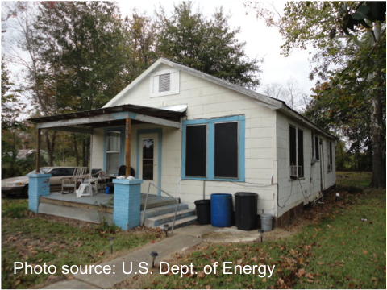
Asbestos – In siding, walls, ceilings
Asbestos siding does not mean you can’t insulate walls from the exterior, it can be removed to access the sheathing, then reinstalled.
Never cut, drill or sand suspected ACMs.
General abatement of asbestos siding or replacement with new siding is not an allowable H&S measure.
When asbestos siding is present, as on the home shown above, it may be removed and replaced, but it must not be cut, sanded, or drilled.
Notes:
Action/Allowability
Take all reasonable and necessary precautions not to damage suspected asbestos containing material (ACM).
Never cut or drill suspected ACM in siding, or on floor, wall, and ceiling coverings.
Grantees must state in the H&S Plan the policy on blower door testing where friable suspected ACM is present. “Friable” means the material can be crumbled, pulverized, or reduced to powder by the pressure of an ordinary human hand. Grantees seeking guidance on safe policies and procedures may consider contacting their training providers or local asbestos action office for technical support.
The existence of asbestos siding that is in good condition does not prevent installing dense-pack insulation from the exterior.
Some siding may be removed and reinstalled in order to perform the ECM, and the associated costs may be charged as part of the ECM.
General abatement of asbestos siding or replacement with new siding is not an allowable H&S cost.

Slide 53
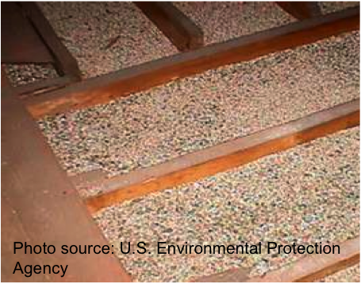
Asbestos – in Vermiculite
When vermiculite is present, unless testing proves otherwise, assume it contains asbestos and take precautionary measures.
Encapsulation by an appropriately trained/certified individual is allowed.
Removal is not allowed.
Much of the vermiculite mined in the U.S. before 1990 came from a mine contaminated with asbestos. When vermiculite insulation is discovered, as shown in the attic below, precautions must be taken, and it may not be removed.
Notes:
Action/Allowability
When vermiculite is present, assume it contains asbestos unless testing determines otherwise.
Take precautionary measures such as not disturbing the vermiculite, not using blower door tests where it may disturb the vermiculite, and using proper respiratory protection while in areas containing vermiculite.
Grantees must state in the H&S Plan the policy on blower door testing where friable suspected ACM is present. “Friable” means the material can be crumbled, pulverized, or reduced to powder by the pressure of an ordinary human hand.
Encapsulation by an appropriately trained asbestos control professional is allowed.
Removal is not allowed.
When deferral is necessary due to asbestos, occupant must provide documentation that a certified professional performed the remediation before work continues.

Slide 54
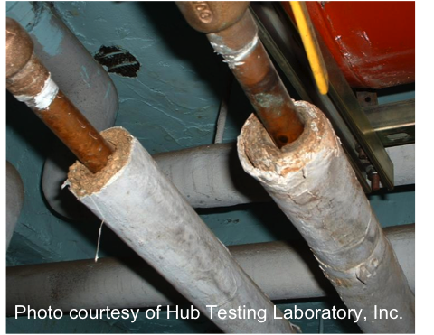
Asbestos – on pipes, furnaces, etc.
When friable suspected ACMs are present, unless testing proves otherwise, assume they contain asbestos and take precautionary measures such as not disturbing the materials and wearing respirators in the area.
Encapsulation is allowed.
Removal may be allowed on a case-by-case basis.
Some heating pipes and heating appliances are wrapped with asbestos insulation. Encapsulation and/or removal is allowed by certified professionals on a case-by-case basis.
Notes:
Action/Allowability
Assume asbestos is present in suspect covering materials.
When friable suspected ACMs are present, unless testing determines otherwise, take precautionary measures as if they contain asbestos.
Grantees must state in the H&S Plan the policy on blower door testing when friable suspected ACM is present. “Friable” means the material can be crumbled, pulverized, or reduced to powder by the pressure of an ordinary human hand.
Encapsulation is allowed by an appropriately trained asbestos control professional and should be conducted prior to blower door testing if the materials are friable.
Grantee may allow removal by an appropriately trained professional on a case-by-case basis.
Charge only those costs directly associated with the testing, encapsulation, or removal to the H&S budget category.
When deferral is necessary due to asbestos, occupant must provide documentation that a certified professional performed the remediation before work continues.

Slide 55
Biologicals and Unsanitary Conditions
Remediation of conditions that may lead to or promote biological concerns and unsanitary conditions is allowed.
Addressing bacteria and viruses is not an allowable cost.
Deferral may be necessary in cases where conditions in the home pose a health risk to occupants or weatherization workers.
Notes:
Action/Allowability
Remediation of conditions that may lead to or promote biological concerns and unsanitary conditions is allowed.
Addressing bacteria and viruses is not an allowable cost.
Deferral may be necessary in cases where conditions in the home pose a health risk to occupants or weatherization workers.
See Mold and Moisture section for more information.

Slide 56
Building Structure and Roofing
Building rehabilitation is beyond the scope of the Weatherization Assistance Program.
Homes that require more than minor repairs must be deferred.
Notes:
Action/Allowability
Building rehabilitation is beyond the scope of the Weatherization Assistance Program.
Homes that require more than minor repairs must be deferred.
See Mold and Moisture, Code Compliance, and Pests sections for more information.

Slide 57
Code Compliance
Correcting preexisting code compliance issues is only allowed where triggered by weatherization measures being installed in a specific room or area.
When correction of preexisting code compliance issues is triggered and paid for with WAP funds, cite specific code requirements in the client file.
Follow codes while installing weatherization measures, including H&S measures.
Condemned properties and properties where “red tagged” H&S conditions exist that cannot be corrected under this guidance must be deferred.
Notes:
Action/Allowability
Correction of preexisting code compliance issues is not an allowable cost other than where triggered by weatherization measures being installed in a specific room or area of the home.
When correction of preexisting code compliance issues is triggered and paid for with WAP funds, cite specific code requirements with reference to the weatherization measure(s) that triggered the code compliance issue in the client file.
Follow State and local (or AHJ) codes while installing weatherization measures, including H&S measures.
Condemned properties and properties where “red tagged” H&S conditions exist that cannot be corrected under this guidance must be deferred.

Slide 58
Code Compliance
New to 17-7
What’s New?
Cite specific code in client file if:
Code issue leads to deferral, or
Extra work is done due to code compliance being triggered.
Notes:
Added a requirement to cite specific code reference if extra work is done due to code compliance being triggered by weatherization work.

Slide 59
Combustion Gases
All combustion appliances must be properly vented to the outdoors.
When testing indicates a problem, correct the venting.
When replacing an appliance for H&S, test for cost-effectiveness first and install as ECM if possible.
If replacing as H&S, document comparison of costs of replacement versus repair, keep in client file.
More specific information moved to Attachment A.
Notes:
Action/Allowability
Proper venting to the outside for combustion appliances, including gas dryers and refrigerators, furnaces, vented space heaters and water heaters is required.
Correct venting when testing indicates a problem.
If unsafe conditions whose remediation is necessary to perform weatherization cannot be remedied by repair or tuning, replacement is an allowable H&S measure unless prevented by other guidance herein.
Maintain documentation justifying the replacement with a cost comparison between replacement and repair in the client file.
Replacement units must meet safety guidelines as determined in the Grantee Plan or technical Field Guide.
See Air-Conditioning and Heating Systems section and Attachment A for more information.

Slide 60
Combustion Gases
New to 17-7
Appliance-specific information on:
Unvented space heaters,
Vented space heaters,
Abandoned masonry chimneys,
Fireplaces,
And more…
was moved to Attachment A.
Notes:
Attachment A now contains the information that was previously in the table under the headings of specific appliances.

Slide 61
Review the Updates
New to 17-7
The guidance around these 3 topics has changed enough to prompt a review of H&S Plans. What is the change for each issue?
Asbestos
Code Compliance
Combustion Gases
Notes:
Answers:
Asbestos
Grantees must state a policy for blower door testing when suspected ACMs are present.
If a home is deferred due to asbestos and the client gets it taken care of, the client must provide documentation that a properly certified professional did the remediation/removal. This is to discourage clients from putting themselves in harm’s way by doing the work themselves.
Code Compliance
If code issues are cause for deferral, or if code compliance work is triggered by weatherization work (i.e., you do repairs that you wouldn’t have done otherwise, due to code requirements) you must cite the specific code in the client file.
Combustion Gases
Appliance-specific information was moved to Attachment A.

Slide 62
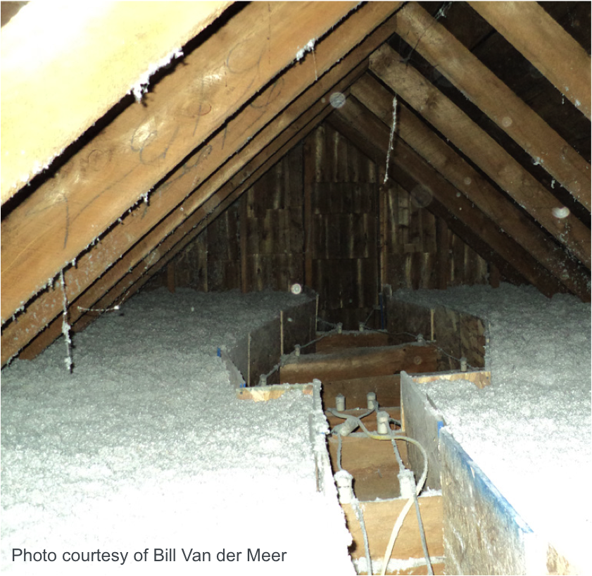
Electrical
New to 17-7
When the H&S of the occupant/worker(s) is at risk, minor repairs, as defined by the Grantee, are allowed when necessary for weatherization measures.
Provide sufficient over-current protection and/or damming prior to insulating building components containing knob and tube wiring, as required by the AHJ.
What’s New?
Combined “Electrical” and “Knob & Tube” into one category.
H&S funds may be used to replace a circuit, if required for insulation. It would likely costs less than labor for this treatment, and will provide better insulation value for attic.
Notes:
Action/Allowability
When the H&S of the occupant/worker(s) is at risk, minor repairs, as defined by the Grantee, are allowed when necessary for weatherization measures.
Provide sufficient over-current protection and/or damming prior to insulating building components containing knob and tube wiring, as required by the AHJ.
What’s New in 17-7?
Nothing, really. The 2 previous headings were combined into one.

Slide 63
Formaldehyde, VOCs, Flammable Liquids, and other Indoor Air Pollutants
Removal of pollutants is allowed and is required if they pose a risk to workers.
If pollutants pose a risk to workers and removal cannot be performed or is not allowed by the client, the unit must be deferred.
Refer to Hazardous Materials Disposal section for more information.
Notes:
Action/Allowability
Removal of pollutants is allowed and is required if they pose a risk to workers.
If pollutants pose a risk to workers and removal cannot be performed or is not allowed by the client, the unit must be deferred.
Refer to Hazardous Materials Disposal section for more information.

Slide 64
Fuel Leaks
New to 17-7
When a minor gas leak is found on the utility side of service, the utility service must be contacted before work may proceed.
Fuel leaks that are the responsibility of the client (vs. the utility) must be repaired before weatherizing a unit.
Notify utilities and temporarily halt work when leaks are discovered that are the responsibility of the utility to address.
Notes:
Action/Allowability
When a minor gas leak is found on the utility side of service, the utility service must be contacted before work may proceed.
Fuel leaks that are the responsibility of the client (vs. the utility) must be repaired before weatherizing a unit.
Notify utilities and temporarily halt work when leaks are discovered that are the responsibility of the utility to address.
Note: This is a new heading on the Table of Issues, but workers were likely already conducting fuel leak testing.

Slide 65
Gas Ovens/Stovetops/Ranges
New to 17-7
When testing indicates a problem, entities may perform standard maintenance on, or repair, gas cooktops and ovens.
Replacement is not allowed.
What’s New?
Testing requirement, previously in “Combustion Gases” row, updated to match BPI & SWS – Stovetop burner CO testing no longer required, still allowed.
Notes:
Action/Allowability
When testing indicates a problem, entities may perform standard maintenance on or repair gas cooktops and ovens.
Replacement is not allowed.
Note: This is a new heading on the table, but the guidance is relatively unchanged. The replacement restriction was already in place, previously in the “Appliances and Water Heaters” section of WPN 11-6.
The testing requirements were loosened, to align with current BPI and SWS.

Slide 66
Hazardous Materials Disposal
New to 17-7
Hazardous Waste Materials generated in the course of weatherization work shall be disposed of according to all local laws, regulations and/or Federal guidelines, as applicable.
Document proper disposal requirements in contract language with responsible party.
What’s New?
The category is new, was previously covered in “Refrigerant.” Now applies to all hazardous materials.
Notes:
Action/Allowability
Hazardous Waste Materials generated in the course of weatherization work shall be disposed of according to all local laws, regulations and/or Federal guidelines, as applicable.
Document proper disposal requirements in contract language with responsible party.
Refer to Lead and Asbestos sections for more information on those topics.
Note: This is a new heading, but the guidance is the same as what we had under “Refrigerant” in WPN 11-6. This expands the category to cover all hazardous materials potentially generated or handled on site.
From the Guidance Narrative document:
When hazardous materials (refrigerant, mercury thermostats, lead paint dust/chips, etc.) are generated in the course of weatherization work, proper disposal is required, and removal/disposal costs must be included

Slide 67
Review the Updates
New to 17-7
The guidance around these 3 topics has changed enough to prompt a review of H&S Plans. What has changed for each issue?
Fuel Leaks
Gas Ovens/Stovetops/Ranges
Hazardous Materials Disposal
Notes:
Answers:
Fuel Leaks
This issue wasn’t mentioned previously. Most people were already doing this, but now Grantees will need to address it in their H&S Plans.
Gas Ovens/Stovetops/Ranges
Testing requirements of burners was revised to match BPI and SWS. Co testing of burners is no longer required, visual inspection is enough.
Hazardous Materials Disposal
It has been expanded. Now the requirements previously listed under the “Refrigerant” handling and disposal (i.e., that proper disposal be written into contracts with appropriate parties) has been applied to any hazardous materials with specific disposal requirements.

Slide 68
Review the Updates
New to 17-7
Bonus Question:
What is the update in “Electrical?”
Notes:
Answer:
“Electrical, other than knob & tube” and “Electrical, knob & tube” have been combined into “Electrical.”

Slide 69
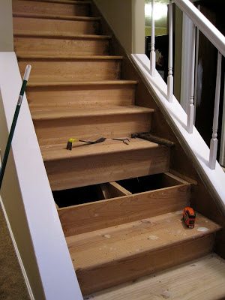
Injury Prevention
New to 17-7
When necessary to effectively weatherize the home, workers may make minor repairs and installations, as defined by the Grantee; otherwise these measures are not allowed.
What’s New?
“Minor” repairs must be defined in Grantee H&S Plan.
Injury prevention refers to minor installations needed to let workers safely access work areas, like replacing a missing or unsafe stair tread on the stairs leading to the attic. This would only be done if work was being done in the attic.
Notes:
Action/Allowability
When necessary to effectively weatherize the home, workers may make minor repairs and installations, as defined by the Grantee; otherwise these measures are not allowed.

Slide 70
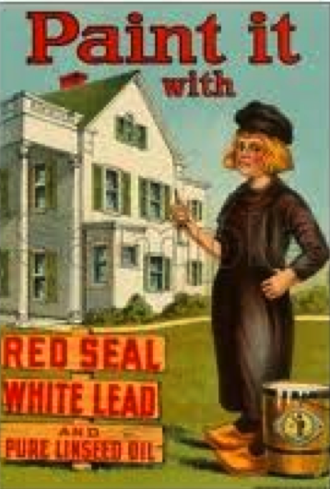
Lead-Based Paint
Crews must follow EPA's Lead; RRP Program in pre-1978 units unless testing confirms the work area to be lead free.
Deferral is required when lead-based paint in the house could create further H&S hazards.
According to 1930’s advertisements, 8 out of every 10 painters used this brand lead-based paint, but there were plenty of lead paint brands to choose from. Lead paint was valued for it’s “stretch-ability”, it could be thinned and thinned, and still provide great coverage.
Notes:
Action/Allowability
Crews must follow EPA's Lead; Renovation, Repair and Painting Program (RRP) when working in pre-1978 housing unless testing confirms the work area to be lead free.
Deferral is required when the extent and condition of lead-based paint in the house would potentially create further H&S hazards.
Only those costs directly associated with the testing and lead safe practices for surfaces directly disturbed during weatherization activities are allowable.
Documentation in the client file must include Certified Renovator certification; any training provided on-site, description of specific actions taken, lead testing and assessment documentation, and photos of site and containment set up (location of photos referenced if not in file).

Slide 71
Lead-Based Paint
New to 17-7
What’s New?
LSW no longer required training, still optional
Client file documentation clarified, must include:
Certified Renovator certification,
any training provided on-site,
description of specific actions taken,
lead testing and assessment documentation, and
photos of site and containment set up (or link to photos)
Economic feasibility of testing method
Grantee must verify lead-safe work practices
Notes:
What’s new in 17-7?
Removed requirement for Lead Safe Weatherization training. This is still allowed, but minimum requirement is the EPA RRP.
Added clarification of documentation that is required in the client file.
Clarified that only the testing and lead safe work practices should be charged to the H&S budget.
Added language to testing requirement related to the economic feasibility of the chosen testing method.
Added requirement for Grantee to verify lead safe work practices.

Slide 72
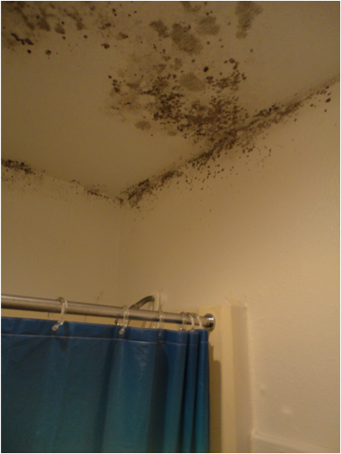
Mold & Moisture
Limited water damage repairs and source control are allowed when necessary in to weatherize the home and ensure the long-term durability of the measures.
Where severe Mold and Moisture issues cannot be addressed, deferral is required.
Mold cleanup is not an allowable H&S cost.
Mold, shown here in a bathroom, may not be removed, but the conditions causing it can be addressed. In this case, adding a bathroom exhaust fan on a timer should improve the situation.
Notes:
Action/Allowability
Limited water damage repairs that can be addressed by weatherization workers are allowed when necessary in order to weatherize the home and to ensure the long-term stability and durability of the measures.
Source control (i.e. correction of moisture and mold creating conditions) is allowed when necessary in order to weatherize the home and to ensure the long-term stability and durability of the measures. Source control is independent of latent damage and related repairs.
Where severe Mold and Moisture issues cannot be addressed, deferral is required.
Mold cleanup is not an allowable H&S cost.
Surface preparation where weatherization measures are being installed (e.g., cleaning mold off window trim in order to apply caulk) must be charged as part of the ECM, not to the H&S budget category.

Slide 73
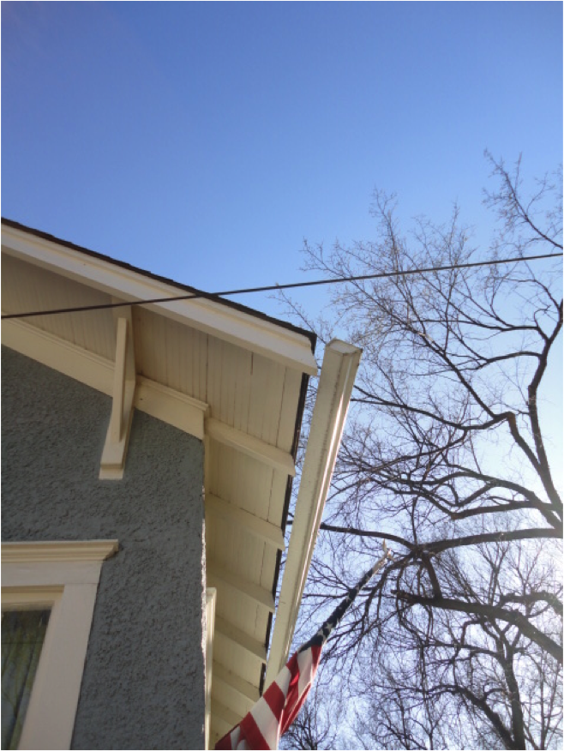
Mold & Moisture
New to 17-7
What’s New?
Added information previously included in “Drainage”
Repairing gutters and downspouts is often an easy, inexpensive way to relieve bulk moisture issues.
Notes:
Note: the two headings, “Mold & Moisture,” and “Drainage,” have been combined into the one “Mold & Moisture” row, but there were no substantial changes to the guidance.

Slide 74
Occupant Pre-Existing or Potential Health Conditions
New to 17-7
When a person’s health may be at risk and/or WAP work activities could constitute an H&S hazard, the occupant at risk will be required to take appropriate action based on severity of risk.
Failure, or the inability, to take appropriate actions must result in deferral.
What’s New?
Previously had to screen clients at intake AND during the energy audit, now you must only screen them once.
Notes:
Action/Allowability
When a person’s health may be at risk and/or WAP work activities could constitute an H&S hazard, the occupant at risk will be required to take appropriate action based on severity of risk.
Failure, or the inability, to take appropriate actions must result in deferral.
What’s New?
Removed language around temporary relocation of occupants if they have health issues that may be exacerbated by weatherization work. This was deemed unnecessary by the network during review.
Changed client health screening from being required at intake AND audit to being required only at one or the other. Screening at both times is still allowed.
“Screening” the clients simply means letting them know that the work may cause dust, and asking them if they or anyone in the house has conditions that might be irritated by the work. Then working with them to make sure weatherization doesn’t make it worse.

Slide 75
Review the Updates
New to 17-7
The guidance around these 3 topics has changed enough to prompt a review of H&S Plans. What has changed for each issue?
Injury Prevention
Lead-based Paint
Occupant Pre-existing or Potential Health Conditions
Notes:
Answers:
Injury Prevention
Grantees must define what is meant by “minor” repairs in their H&S Plans. This is to clarify at what point the needed repairs are beyond the scope of weatherization. It could be a square footage of roof repair, a percentage of the overall job cost, or any quantifiable means of clarifying that distinction for their network.
Lead-based Paint
Removed requirement for Lead Safe Weatherization training.
Clarified client file documentation requirements.
Clarified that only the testing and lead safe work practices should be charged to the H&S budget.
Added language to testing requirement related to the economic feasibility of the chosen testing method.
Added requirement for Grantee to verify lead safe work practices.
Occupant Pre-existing or Potential Health Conditions
Previously we had to screen the clients twice, at intake and during the audit. Now it’s only required once, and it can be either at intake or at the audit.

Slide 76
Pests
Pest removal is allowed only where infestation would prevent weatherization.
Infestation of pests may be cause for deferral where it cannot be reasonably removed or poses H&S concern for workers.
Screening of windows and points of access, and incorporating pest exclusion into air sealing practices to prevent intrusion to prevent intrusion is allowed.
Notes:
Action/Allowability
Pest removal is allowed only where infestation would prevent weatherization.
Infestation of pests may be cause for deferral where it cannot be reasonably removed or poses H&S concern for workers.
Screening of windows and points of access, and incorporating pest exclusion into air sealing practices to prevent intrusion to prevent intrusion is allowed.

Slide 77
Radon
Radon mitigation is not an allowable H&S cost.
Clients must sign an informed consent form prior to receiving weatherization services.
In homes where radon may be present, work scope should include precautionary measures.
Whenever site conditions permit, cover exposed dirt floors within the pressure/thermal boundary.
Other precautions may include, but are not limited to, sealing any observed floor and/or foundation penetrations, including open sump pits, isolating the basement from the conditioned space, and ensuring crawl space venting is in place or installed.
Notes:
Action/Allowability
Radon mitigation is not an allowable H&S cost.
Clients must sign an informed consent form prior to receiving weatherization services. This form must be kept in the client file.
In homes where radon may be present, work scope should include precautionary measures based on EPA Healthy Indoor Environment Protocols for Home Energy Upgrades, to reduce the possibility of making radon issues worse.
Whenever site conditions permit, cover exposed dirt floors within the pressure/thermal boundary with 6 mil (or greater) polyethylene sheeting, lapped at least 12” and sealed with appropriate sealant at all seams, walls and penetrations.
Other precautions may include, but are not limited to, sealing any observed floor and/or foundation penetrations, including open sump pits, isolating the basement from the conditioned space, and ensuring crawl space venting is in place or installed.

Slide 78
Radon – New to 17-7
New to 17-7
Clarified that radon mitigation is not an allowable H&S expense.
Added specifications to the vapor barrier installations requirement.
Added that WAP should consider installing radon-related precautionary measures (sealing foundation penetrations, covering open sump pits, etc.) in Zones 1 & 2.
Added an informed consent requirement for clients in all Zones. Requirements of the consent form are outlined in the guidance.
Added proper vapor barrier installation to training requirements for workers.
Notes:
The EPA Radon map uses 3 “zones” to indicate the likelihood of radon being present and levels determined to be potentially dangerous.
Zone 1 indicates average indoor screening levels above the recommended maximum of 4 pCi/L.
Zone 2 ranges from 2 – 4 pCi/L.
Zone 3 average indoor screening levels are less than 2 pCi/L.
What’s New in 17-7?
Clarified that radon mitigation is not an allowable H&S expense.
Added specifications to the vapor barrier installations requirement.
Added that WAP should consider installing radon-related precautionary measures (sealing foundation penetrations, covering open sump pits, etc.) where radon may be present. (Zones 1 & 2)
Added an informed consent requirement for clients. Requirements of the consent form are outlined in the guidance. (All zones)
Added proper vapor barrier installation to training requirements for workers.
Radon maps for each state are available at:
www.epa.gov/radon/whereyoulive.html

Slide 79
Safety Devices: Smoke Alarms, CO Alarms, Fire Extinguishers
Smoke alarms may be installed where alarms are not present or are inoperable.
CO alarms must be installed where alarms are not present or are inoperable.
Where solid fuel burning equipment is present, fire extinguishers may be provided as an allowable H&S measure.
Notes:
Action/Allowability
Smoke alarms may be installed where alarms are not present or are inoperable.
CO alarms must be installed where alarms are not present or are inoperable.
Where solid fuel burning equipment is present, fire extinguishers may be provided as an allowable H&S measure.

Slide 80
Ventilation and Indoor Air Quality
Install ventilation as required by ASHRAE 62.2 - 2016.
Grantees may voluntarily elect to adopt the most recent version of ASHRAE.
If an existing fan is being replaced or upgraded, take actions to prevent zonal pressure differences greater than 3 pascals across closed doors.
In Climate Zone 1: Ventilation exemption in certain conditions, rest of standard applies.
Notes:
Action/Allowability
Install ventilation as required by ASHRAE 62.2 - 2016.
Grantees may voluntarily elect to adopt the most recent version of ASHRAE 62.2 as soon as they are prepared to implement the Standard.
If the ASHRAE normative Appendix A is employed and an existing fan is being replaced or upgraded to meet whole-house ventilation requirements, take actions to prevent zonal pressure differences greater than 3 pascals across the closed door, if one exists.
In Climate Zone 1: Homes that are designed to have free movement of air between the indoors and outdoors where no effort is being made through weatherization to establish an air barrier are NOT required to meet the ventilation requirements outlined in ASHRAE 62.2, except in any room that may be enclosed and contain a source of water or combustion. No other ASHRAE 62.2 requirements are exempt for Climate Zone 1.

Slide 81
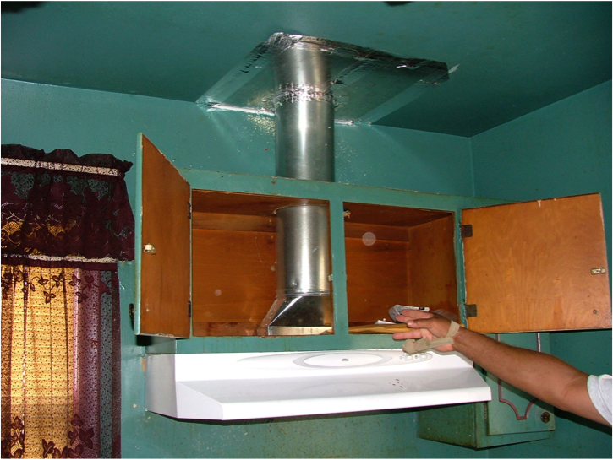
Ventilation and Indoor Air Quality
New to 17-7
What’s New?
Previous guidance required adoption of most current standard; This ends at 62.2 – 2016.
Added language about 3 Pa pressure difference.
Clarified Climate Zone 1 partial exemption.
Client Education now includes “location of switch and cleaning instructions.”
Removed reference to ASHRAE 62.2 FAQS, these will be part of overall H&S FAQs.
Grantees may propose variances to 62.2
Scientific justification improves odds of approval
Clients cannot refuse mechanical ventilation
Notes:
From the Guidance Narrative Document:
“Implementation of ASHRAE 62.2-2016 is required. Client refusal of mechanical ventilation, when evaluated and called for pursuant to the Standard, must result in deferral. If the Grantee proposes to make changes to ASHRAE 62.2, they must submit a variance request. If the Grantee chooses to request a variance, they must provide scientific justification specific to their housing stock and local considerations in their Annual Plan submittal for DOE to consider during plan review. Plans lacking sufficient justification, or containing inadequate justification (as determined by DOE), shall not be approved and must be amended. For variance approvals concerning ASHRAE 62.2, DOE is the AHJ.”
What’s New?
Added “and Indoor Air Quality” to the title. ASHRAE 62.2 covers more than ventilation.
Updated policy – DOE WAP no longer requires adopting most current version within one year of publication. Grantees must adopt and implement 62.2 version 2016, but after that, adoption of future versions will be voluntary.
Added language from the standard about avoiding pressure differences greater than 3 Pascals across closed doors.
Clarified that in Climate Zone 1 where homes are designed to have free air movement between indoors and outdoors, the ventilation requirements of ASHRAE 62.2 are not required, but other requirements of the standard apply.
Added to client education portion “including location of service switch and cleaning instructions.”
Removed reference to ASHRAE 62.2 FAQs, will include these in overall H&S FAQs.

Slide 82
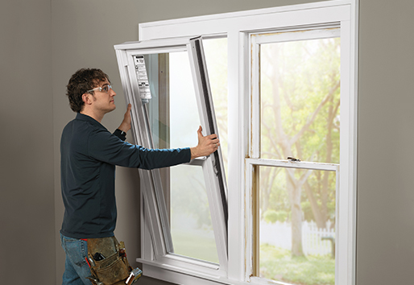
Window and Door Replacement, Window Guards
Replacement, repair, or installation is not an allowable H&S cost.
Notes:
Action/Allowability
Replacement, repair, or installation is not an allowable H&S cost.

Slide 83
Worker Safety
Workers must follow OSHA standards where required and take precautions to ensure the H&S of themselves and other workers.
All Subgrantees and contractors must maintain compliance with the current OSHA Hazard Communication Standard, including on-site organized Safety Data Sheets (SDS) (formerly called MSDS).
Notes:
Action/Allowability
Workers must follow OSHA standards where required and take precautions to ensure the H&S of themselves and other workers.
All Subgrantees and contractors must maintain compliance with the current OSHA Hazard Communication Standard, including on-site organized Safety Data Sheets (SDS) (formerly called MSDS).

Slide 84
Worker Safety
New to 17-7
What’s New?
Previously titled OSHA and Crew Safety
Removed OSHA 10 requirement, still allowed.
Removed OSHA 30 requirement for Crew Leaders
Not new, but a reminder that Grantees must monitor for safe work practices.
Notes:
This was previously OSHA row.
Added reference to OSHA Hazard Communication Standard and updated reference to MSDS (now SDS).
Removed OSHA 10 as a requirement, although safety training is still required.
Removed OSHA 30 requirement for crew leaders (this had already been waived, but was still in the WPN table until now).
Also, this isn’t new, but bears repeating. From the Narrative document:
“Workers must follow OSHA standards where required and take precautions to ensure the H&S of themselves and other workers.
All Subgrantees and contractors must maintain compliance with the current OSHA Hazard Communication Standard, including on-site organized Safety Data Sheets (SDS) (formerly called MSDS).”

Slide 85
Review the Updates
New to 17-7
The guidance around these 3 topics has changed enough to prompt a review of H&S Plans. What has changed for each issue?
Radon
Ventilation and Indoor Air Quality
Worker Safety
Notes:
Answers:
Radon
Clarified that radon mitigation is not an allowable H&S expense.
Added specifications to the vapor barrier installations requirement.
Added that WAP should consider installing radon-related precautionary measures (sealing foundation penetrations, covering open sump pits, etc.) where radon may be present. (Zones 1 & 2)
Added an informed consent requirement for clients. Requirements of the consent form are outlined in the guidance. (All zones)
Added proper vapor barrier installation to training requirements for workers.
Ventilation and Indoor Air Quality (just listing the key items)
Updated policy – DOE WAP no longer requires adopting most current version within one year of publication. Grantees must adopt and implement 62.2 version 2016, but after that, adoption of future versions will be voluntary.
Clarified that in Climate Zone 1 where homes are designed to have free air movement between indoors and outdoors, the ventilation requirements of ASHRAE 62.2 are not required, but other requirements of the standard apply.
Worker Safety
The OSHA training requirements were removed. Grantees must still ensure workers are able to safely perform their jobs, but the requirement can be met with OSHA training or other offerings.

Slide 86
Review the Updates
New to 17-7
List the topics that have significant enough changes in guidance to require updates to the H&S Plans.
Notes:
Answers: (also shown on next slide)
Asbestos
Code Compliance
Gas Ovens/Stovetops/Ranges
Injury Prevention
Lead Based paint
Mold & Moisture
Occupant Pre-existing or Potential Health Conditions
Radon
Ventilation and Indoor Air Quality
Worker Safety

Slide 87
Issue Specific Updates
New to 17-7
List the topics that have significant enough changes in guidance to require updates to the H&S Plans.
Asbestos
Code Compliance
Gas Ovens/Stovetops/Ranges
Injury Prevention
Lead Based paint
Mold & Moisture
Occupant Pre-existing or Potential Health Conditions
Radon
Ventilation and Indoor Air Quality
Worker Safety
Notes:
Here are the issues which were changed enough in the guidance update to cause a review of H&S Plans.
Other categories are highlighted in the presentation as “New to 17-7” wherever categories were combined, added or changed, even if the actual guidance in terms of what you need to include in your H&S Plans, hasn’t changed substantially.

Slide 88
Issue Specific Updates
New to 17-7
Bonus Question: Which 4 of these topics have changed in
a way to become LESS stringent?
Asbestos
Code Compliance
Gas Ovens/Stovetops/Ranges
Injury Prevention
Lead Based paint
Mold & Moisture
Occupant Pre-existing or Potential Health Conditions
Radon
Ventilation and Indoor Air Quality
Worker Safety
Notes:
Answers:
Gas Ovens, Stovetops/Ranges – reduced testing requirements (no more burner CO testing)
Lead-based Paint – reduced training requirements (no more LSW)
Occupant Pre-existing or Potential Health Conditions – Reduced screening from 2 to 1 time.
Worker Safety – opened up options for meeting training requirement.

Slide 89
WPN 17 – 6 Piece by Piece – Attachment A
Attachment A – Additional Health and Safety Guidance Related to Heating Systems
Covers:
Budget Category Decisions
Code Compliance and Inspection
Electric Space Heaters
Fireplaces – Special Considerations
Manufactured Homes – Special Considerations
Masonry Chimneys
Solid Fuel-Fired Heaters
Unvented Gas- and Liquid-Fueled Space Heaters
Vented Gas- and Liquid-Fueled Space Heaters
Notes:
Over the course of updating the H&S Guidance, a lot of issues were raised around heating systems. To include everything in the Table of Issues would have made that document less useful. Some of the issues were so specific, like how to test homes with fireplaces, or what to do with masonry chimneys that were no longer attached to functioning heating systems, that we decided to pull the guidance out into a separate document.
This is the table of contents of Attachment A.
There isn’t anything really new here, but we’ve finally written down the guidance around these specific issues. It shouldn’t change anything going on in the field if agencies were already following existing guidance and best practices.
We’ll go through the list to review what’s included.

Slide 90
Attachment A - Budget Category Decisions
Repeats cost-effectiveness testing requirement for space heater repair/replacement:
MUST test cost-effectiveness first
If SIR >1, charge as ECM
If SIR <1, charge to H&S budget
Notes:
Budget Category Decisions: Perform a full DOE-approved energy audit prior to deciding how to categorize the cost of space heater repair or replacement. If the audit justifies the costs with an SIR of equal to or greater than 1.0, the measure must be performed and costs charged as an Energy Conservation Measure (ECM). If the measure is not an eligible ECM, the measure may be charged as either a Health and Safety (H&S) measure or an Incidental Repair Measure (IRM) as designated in the DOE approved Grantee Annual Health and Safety Plan. More information is available to assist with this decision in the DOE Health and Safety Guidance and Incidental Repair Guidance.

Slide 91
Attachment A – Code Compliance and Inspection
Any space heater installations shall meet local code requirements.
Program staff will inspect installations. Inspections include but are not limited to:
Adequate floor protection
Clearance to combustibles and walls
Worst-case depressurization testing
Notes:
Code Compliance and Inspection Requirements: Installation of space heaters requires knowledge of appropriate industry standards and adherence to all aspects of the applicable building code(s) in the municipality where installation is taking place. Building permits shall be secured, where required, (this is a program operations cost) for all space heaters work and manufacture approved initial start up procedures by competent professionals shall take place before any heater is put into operation. States are reminded that even licensed heating contractors may not be aware of the stringent requirements of the Weatherization Program, so their work should be reviewed by Program staff. Safety inspection related to the space heater should include, but not be limited to, a check for adequate floor protection and code-compliant clearances to walls and other combustible materials. Even though many vented space heaters are manufactured with spill switches, it is still a requirement that a worst-case depressurization draft test be performed on all vented units.

Slide 92
Attachment A – Electric Space Heaters
Minor repairs are allowed.
Replacement is not allowed.
Notes:
Electric Space Heaters: DOE will not permit any DOE-funded weatherization work other than minor repairs on electric space heaters. DOE will not preclude the use of other funding sources for the replacement or major repair of electric space heaters, but the Department does not encourage it because of:
Lower output ratings (size);
Risk of fire hazards; and,
Inadequate electrical systems in older homes, which frequently cannot safely carry the power required to operate an electric heater.
Work on such systems may make local agencies liable for inadequate electric wiring and any damages that result.

Slide 93
Attachment A – Fireplaces
New to 17-7
Special Considerations
Describes CO dangers, requires CO alarm in zone.
Inspection/Evaluation
Fireplace testing options
Grantee-proposed testing and depressurization limits, or
Venting must meet code or it’s considered unsafe
Testing other combustion equipment where fireplaces are present
Simulate fireplace operation with blower door depressurization.
Notes:
Fireplaces – Special Considerations: Fireplaces present special hazards that are affected by weatherization. If draft is poor, smoke may downdraft into the living space causing poor indoor air quality. It is likely the occupants will ventilate in these situations. Near the end of a wood fire, glowing coals will remain, radiating heat, while the draft lowers and allows the top of the chimney to cool, further reducing draft. The reduced oxygen available to the glowing coals causes production of CO without the smoke that encourages space ventilation. This is a dangerous situation as the CO enters the living space due to the lowered draft, causes drowsiness of occupants, and sometimes worse. For this reason it is extremely important to make sure there is a CO alarm installed in this combustion zone and occupants are educated to the danger signs and what to do.
Fireplaces - Inspection/Evaluation:
Assessing solid fuel fired appliances involves inspecting the venting/chimney and the overall installation to ensure it adheres to the applicable code: NFPA 211 or other as determined by the authority having jurisdiction. Appliances should be inspected pre- and post-weatherization.
Conduct pre- and post- weatherization worst case CAZ depressurization testing in spaces having a fireplace. Since there is no consensus method for verifying safe operation of fireplaces, Grantees can propose testing policies and limits (e.g., one Grantee uses a depressurization limit of -5 in the CAZ of any wood-burning combustion appliances, including fireplaces). If the Grantee does not propose a policy, if fireplaces are left operational, the vent must meet code or the home cannot be weatherized.
To evaluate operation of other combustion appliances, the blower door can be set to run at 300 CFM (set up as for depressurization testing), or other Grantee-approved flow, to mimic the airflow dynamics likely when the fireplace is in use.

Slide 94
Attachment A – Manufactured Homes
Clarifies Manufactured Home Construction and Safety Standards requirements.
Fuel-burning, heat-producing appliances:
Must be vented to outside (except ranges/ovens)
Must draw combustion air from outside*
* Some exceptions apply.
Notes:
Manufactured Homes – Special Considerations: The Manufactured Home Construction and Safety Standards require all fuel-burning, heat-producing appliances in mobile homes, except ranges and ovens, to be vented to the outside.
All fuel-burning appliances in mobile homes, except ranges, ovens, illuminating appliances, clothes dryers, solid fuel-burning fireplaces and solid fuel-burning stoves, must be installed to provide for the complete separation of the combustion system from the interior atmosphere of the manufactured home (i.e., to draw their combustion air from outside).

Slide 95
Attachment A – Masonry Chimneys
New to 17-7
Where WAP installs new equipment, it must meet local venting requirements. Liners may be needed.
Retired Masonry Chimneys
Suggested policy for addressing “open-top-in-attic” retired masonry chimneys.
Notes:
Masonry Chimneys: Masonry chimneys used by vented space heaters should be properly lined in compliance with the IFGC. Where WAP installs new equipment, it must meet local code requirements.
Retired Masonry Chimneys:
Dwelling owners are increasingly removing older furnaces and wood stoves and replacing them with high efficiency furnaces, vented space heaters, and electric furnaces (where electricity is cheap). There are incidences where the building roof has been replaced after a masonry chimney has been retired and the roofer removes the chimney top into the attic because of lower cost compared with re-flashing an unused chimney. Grantees should develop a policy on treatment of these open-top-in-attic chimneys as they represent a potential heat sink in the middle of the home. Assuming the policy (with the goal to save energy) is to plug the open top in the attic and install attic insulation without fire stop and insulation dam, the client must be informed in case of an attempt to reuse the chimney.

Slide 96
Attachment A – Solid Fuel-Fired Heaters
Primary Heating Appliances | Secondary Heating Appliances
Assess safe operation
Repair or removal is allowed
Replacement is allowed
Applies to wood stove, coal stoves, pellet stoves and fireplaces.
Notes:
Solid-Fueled Space Heaters: Solid fueled space heaters include wood stoves, coal stoves, pellet stoves, and fireplaces. Wood, coal, and pellet fired furnace and boiler systems should be treated as vented heating systems and are not covered here.
Assess solid fuel-fired appliances to ensure safe installation prior to weatherization activities taking place. Repair or removal is an allowed H&S measure for primary and secondary solid fuel-fired heating appliances. Replacement is allowed for primary solid fuel heating appliances but replacement is not allowed for secondary heating appliances. Repair of flues and proper installation (e.g. protection of combustibles), is required for both primary and secondary solid fuel heating appliances. Install replacement primary heaters and/or flues according to applicable codes, standards and manufacturer’s instructions. Provide adequate combustion air.

Slide 97
Attachment A – Unvented Gas – and Liquid-Fueled Space Heaters 1 of 2
DOE will not permit any DOE-funded weatherization work where the completed dwelling unit is heated with an unvented gas- and/or liquid-fueled space heater as the primary heat source.
The primary heat source must be replaced with a vented unit prior to weatherization.
The replacement unit should be sized so it is capable of heating the entire dwelling unit, consistent with audit requirements described in 10 CFR 440.21(e)(2).
Notes:
Unvented Gas- and Liquid-Fueled Space Heaters: This policy applies to unvented space heaters fueled by natural gas, propane or kerosene. This policy is consistent with the IRC and the IFGC and is divided to address primary and secondary heat sources.
Primary Heat Sources:
DOE will not permit any DOE-funded weatherization work where the completed dwelling unit is heated with an unvented gas- and/or liquid-fueled space heater as the primary heat source. The primary heat source must be replaced with a vented unit prior to weatherization. The replacement unit should be sized so it is capable of heating the entire dwelling unit, consistent with audit requirements described in 10 CFR 440.21(e)(2).

Slide 98
Attachment A – Unvented Gas – and liquid-Fueled Space Heaters 2 of 2
Secondary unvented units that conform to the safety standards of ANSI Z21.11.2 may remain as back-up heat sources.
Secondary unvented units that do not meet ANSI Z21.11.2 must be removed and properly disposed of prior to weatherization but may remain until a replacement heating system is in place.
Repair of secondary unvented units is not allowed.
Secondary unvented units that meet the ANSI Z21.11.2, but are not operating safely, must be removed and properly disposed of.
Notes:
Secondary Heat Sources:
Secondary unvented units that conform to the safety standards of ANSI Z21.11.2 may remain as back-up heat sources. DOE is allowing this flexibility primarily to provide low-income clients an emergency back-up source of heat in the event of electrical power outages. When selecting items to leave behind, give preference to code-compliant units that do not require electricity.
Secondary unvented units that do not meet ANSI Z21.11.2 must be removed and properly disposed of prior to weatherization but may remain until a replacement heating system is in place. Repair of secondary unvented units is not allowed. Secondary unvented units that meet the ANSI Z21.11.2, but are not operating safely, must be removed and properly disposed of.
Specifically, any unvented gas- and liquid-fueled space heaters that remain in a completed single-family house after weatherization shall:
Not have an input rating in excess of 40,000 Btu/hour;
Not be located in, or obtain combustion air from sleeping rooms, bathrooms, toilet rooms, or storage closets, unless:
Where approved by the authority having jurisdiction, one listed wall-mounted space heater in a bathroom:
Has an input rating that does not exceed 6,000 Btu/hour;
Is equipped with an oxygen-depletion sensing safety shut-off system; and
The bathroom meets required volume criteria to provide adequate combustion air;
Where approved by the authority having jurisdiction, one listed wall-mounted space heater in a bedroom:
Has an input rating that does not exceed 10,000 Btu/hour;
Is equipped with an oxygen-depletion sensing safety shut-off system; and
The bedroom meets required volume criteria to provide adequate combustion air.

Slide 99
Attachment A – Vented Gas- and Liquid-Fueled Space Heaters
Treat vented gas- and liquid-fueled space heaters the same as furnaces in terms of combustion safety testing, repair and replacement.
Notes:
Vented Gas- and Liquid-Fueled Space Heaters: Treat vented gas- and liquid-fueled space heaters the same as furnaces in terms of combustion safety testing, repair and replacement. This policy applies to vented space heaters fueled by natural gas, propane, or oil.

Slide 100
Review – 3 Pieces
What are the 3 documents that make up the official WPN 17-7 Guidance?
Notes:
Answer:
Guidance Narrative
Table of Issues
Attachment A

Slide 101
Review – 3 Pieces
You have a question about combustion safety in homes with fireplaces. Which piece of the guidance is the best place to look for answers?
Notes:
Answer:
Attachment A

Slide 102
Review – 3 Pieces
Which document provides information about budget categories and definitions of H&S versus IRM?
Notes:
Answer:
Guidance Narrative

Slide 103
Review – 3 Pieces
You need guidance around asbestos siding. Which document is most likely to provide answers?
Notes:
Answer:
Table of Issues

Slide 104
WPN 17 - 7 – Support Materials
“What’s New” summary document
H&S Plan Template
H&S FAQs
Radon Consent Form Sample Language
More upon request
Notes:
The new guidance covers a lot of material, so DOE has developed some support materials to assist Grantees as they incorporate the guidance into their next Plan.
H&S Plan Template
H&S FAQs
Sample Radon Consent Form language

Slide 105
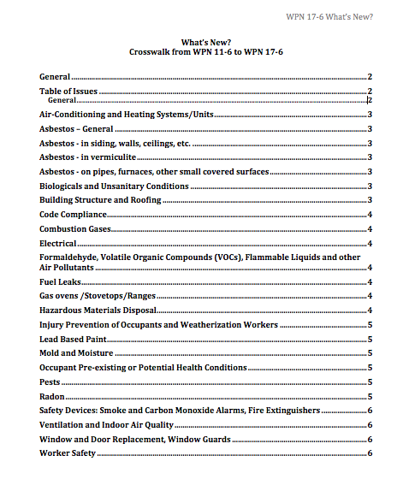
WPN 17 - 7 – What’s New Summary Document
6 Pages
Covers all substantial updates
Helpful when updating Plan

Slide 106
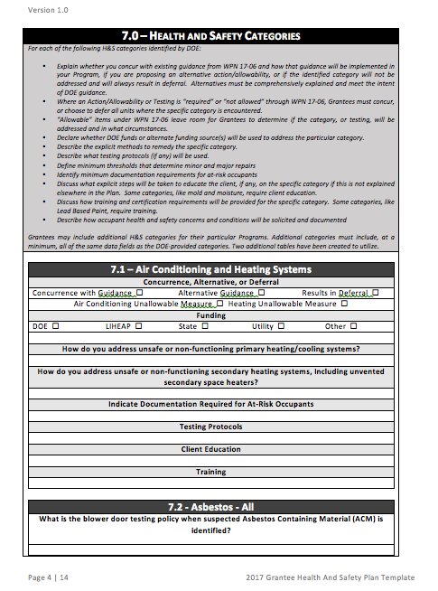
WPN 17 – 7 Health and Safety Plan Template
Optional
Includes budget calculator tool
Prompts for developing policy that complies with WPN
Streamlines DOE review

Slide 107
WPN 17 – 7 Health and Safety FAQs
Almost 40 pages of Q&A, and growing
Intended to address common policy and implementation questions
Used to address comments submitted during review process – WAP network comments
Living document, will add Q&A as issues arise

Slide 108
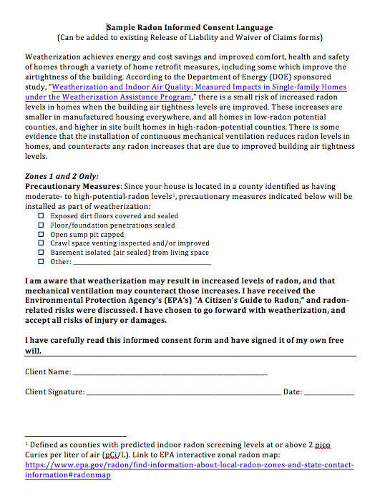
Radon Consent Form – Sample Language
Optional
Editable
Meets requirements outlined in guidance

Slide 109
WPN 17 – 7 – Support Materials
If you think of more resources, let your Project Officer know.
Thank You

