Slide 1
EERE Web Coordinators Meeting
September 21, 2017

Slide 2
Agenda: Happy 100th Web Coordinators Meeting!
Around the room – Alex, Carolyn
Deprecated Fields & Disaster Recovery – Atiq
Drew’s Views – Drew Bittner
Crazy Egg Findings – Adrienne, Greg, David
EERE home
FEMP
SunShot
Communication Standards updates – Elizabeth
GovDelivery updates – Elizabeth
Energy Saver promotion – Adrienne
DOE Web Council updates -- Carolyn

Slide 3
Agenda: Happy 100th Web Coordinators Meeting!
Around the room – Alex, Carolyn
Deprecated Fields & Disaster Recovery – Atiq
Drew’s Views – Drew Bittner
Crazy Egg Findings – Adrienne, Greg, David
EERE home
FEMP
SunShot
Communication Standards updates – Elizabeth
GovDelivery updates – Elizabeth
Energy Saver promotion – Adrienne
DOE Web Council updates -- Carolyn

Slide 4
Agenda: Happy 100th Web Coordinators Meeting!
Around the room – Alex, Carolyn
Deprecated Fields & Disaster Recovery – Atiq
Drew’s Views – Drew Bittner
Crazy Egg Findings – Adrienne, Greg, David
EERE home
FEMP
SunShot
Communication Standards updates – Elizabeth
GovDelivery updates – Elizabeth
Energy Saver promotion – Adrienne
DOE Web Council updates -- Carolyn

Slide 5
Agenda: Happy 100th Web Coordinators Meeting!
Around the room – Alex, Carolyn
Deprecated Fields & Disaster Recovery – Atiq
Drew’s Views – Drew Bittner
Crazy Egg Findings – Adrienne, Greg, David
EERE home
FEMP
SunShot
Communication Standards updates – Elizabeth
GovDelivery updates – Elizabeth
Energy Saver promotion – Adrienne
DOE Web Council updates -- Carolyn

Slide 6
EERE Home Crazy Egg Findings
Timeframe measured: July 10-August 10
Search is most popular
Users are browsing the Blog and News sliding features arrows, but not clicking the articles
Users are finding the action buttons (arrows) and calls-to-action text links, i.e., “View All,” for News/Blog, “View More Videos,” “View More” for Success Stories
Users are navigating to tech office sites via the text links vs. the drop downs more often

Slide 7
EERE Home Crazy Egg Findings
Top 10 most clicked
Search box
Slider arrow – News
Slider arrow – Blog
Homes (text link)
About Us (main navigation)
SunShot (text link)
Hamburger menu (mobile)
Buildings (text link)
Wind (text link)
Video feature play arrow

Slide 8
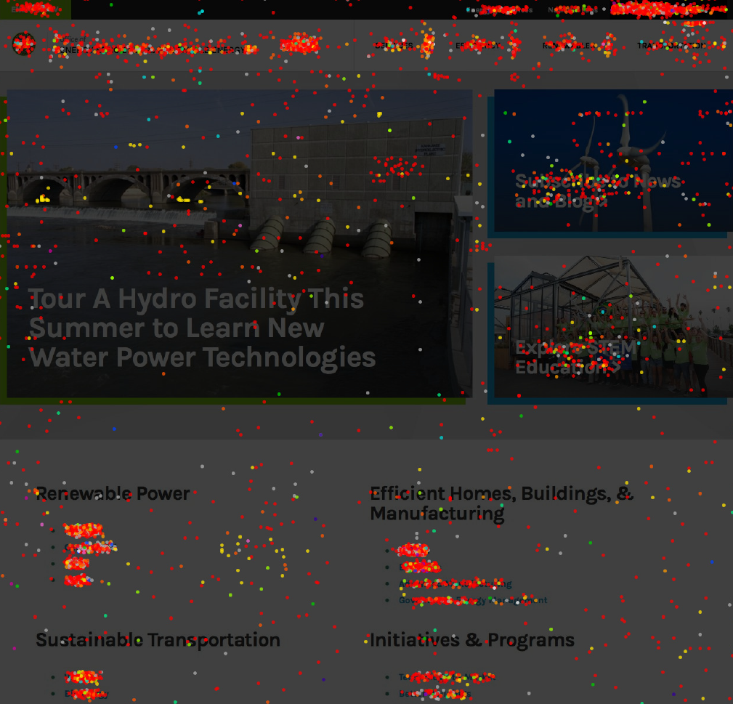
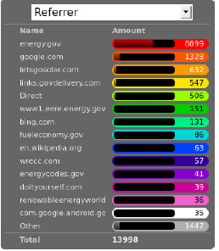
EERE Home Crazy Egg Findings

Slide 9
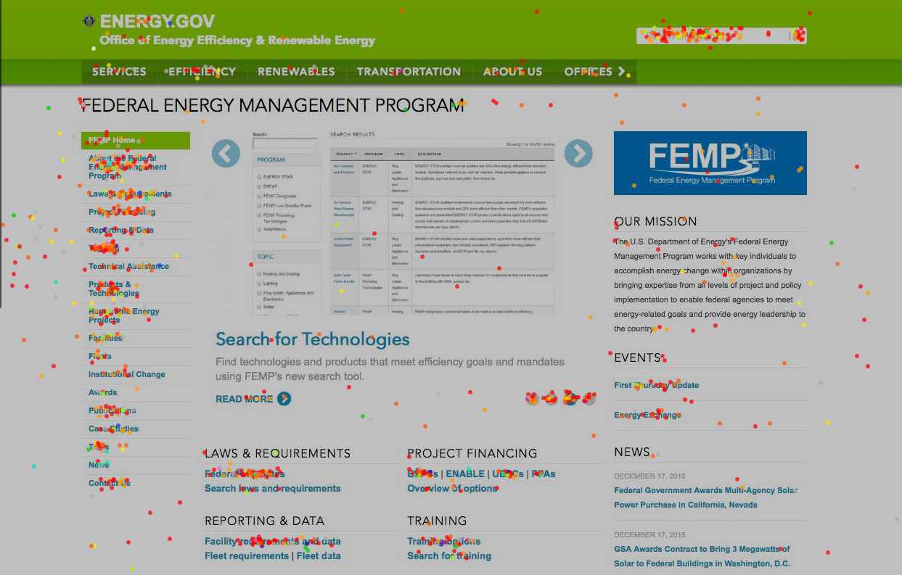
FEMP Crazy Egg Findings
Old FEMP home page

Slide 10
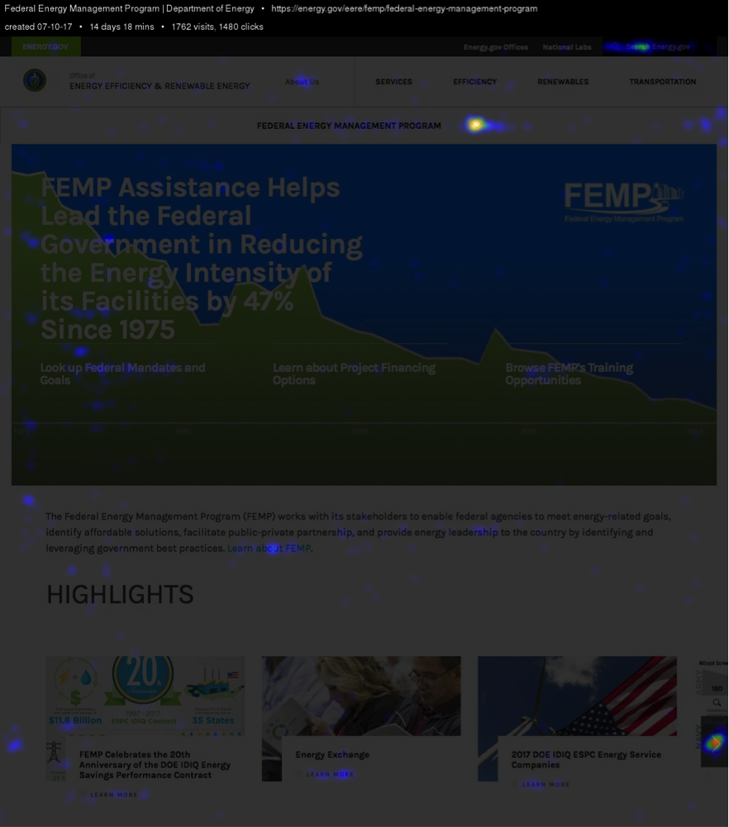
FEMP Crazy Egg Findings
Current FEMP home page

Slide 11
FEMP Crazy Egg Findings
Timeframe measured: July 10-July 24
Visitors are finding and using the new navigation (!)
Users are scrolling the length of the pages
Users are browsing the scrolling-right Highlights and New Training Courses paragraph types (but not clicking the links to go to the items)
Visitors tend to click on features that don’t contain descriptive text (i.e. headline only – more scannable items)
Visitors are clicking some non-linking subheads.

Slide 12
SunShot’s Crazy Egg Findings
Timeframe measured: June 17-30
Drop-down menu is being clicked
Slight confusion on homepage 4-up
Subprogram links under 4-up are heavily utilized
Lots of clicks for horizontal listings
“About Us” header confusion

Slide 13
SunShot’s Crazy Egg Findings

Slide 14
SunShot’s Crazy Egg Findings
While new formatting makes pages longer, visitors typically make it to the bottom
Video engagement is mixed

Slide 15
Agenda: Happy 100th Web Coordinators Meeting!
Around the room – Alex, Carolyn
Deprecated Fields & Disaster Recovery – Atiq
Drew’s Views – Drew Bittner
Crazy Egg Findings – Adrienne, Greg, David
EERE home
FEMP
SunShot
Communication Standards updates – Elizabeth
GovDelivery updates – Elizabeth
Energy Saver promotion – Adrienne
DOE Web Council updates -- Carolyn

Slide 16
Communication Standards Updates
The Office, Subprogram, and Specialty Logos page has been updated!
energy.gov/eere/communicationstandards/eere-office-subprogram-and-speciality-logos
Remember, you need a login to download them!

Slide 17
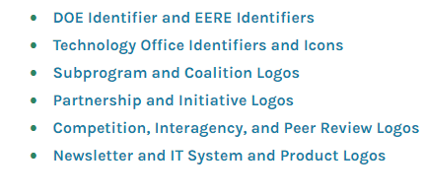
Communication Standards Updates
The new page splits the logos over six separate pages:
Why did we make that change?

Slide 18
Communication Standards Updates
The CMS does not function if you add too many paragraphs to one page. PA estimates this happens around 50 paragraphs. At this point:
The linking tool stops functioning.
The page may hang when you try to save.
The page may become impossible to edit. Even trying to open the page or its workflow page may time out.
The live page may time out.
Data may be lost.

Slide 19
Communication Standards Updates
It’s time to update the Communication Standards Contacts page again!
This page lists who is the official web coordinator and contractor for each office. It goes out of date very quickly!
energy.gov/eere/communicationstandards/eere-communications-contacts
Send updates to elizabeth.spencer@nrel.gov.

Slide 20
Agenda: Happy 100th Web Coordinators Meeting!
Around the room – Alex, Carolyn
Deprecated Fields & Disaster Recovery – Atiq
Drew’s Views – Drew Bittner
Crazy Egg Findings – Adrienne, Greg, David
EERE home
FEMP
SunShot
Communication Standards updates – Elizabeth
GovDelivery updates – Elizabeth
Energy Saver promotion – Adrienne
DOE Web Council updates -- Carolyn

Slide 21
GovDelivery Updates
GovDelivery has a feature called “Featured Content”—and you might want to use it!
Lets you feature specific email lists
These are prioritized to get network referrals—referrals you get when someone signs up for a different list and gets your list suggested, too.
Only account administrators (like Elizabeth Spencer) can add lists—so tell us when you want to promote them!

Slide 22
GovDelivery Updates
Questions?
Contact elizabeth.spencer@nrel.gov

Slide 23
Agenda: Happy 100th Web Coordinators Meeting!
Around the room – Alex, Carolyn
Deprecated Fields & Disaster Recovery – Atiq
Drew’s Views – Drew Bittner
Crazy Egg Findings – Adrienne, Greg, David
EERE home
FEMP
SunShot
Communication Standards updates – Elizabeth
GovDelivery updates – Elizabeth
Energy Saver promotion – Adrienne
DOE Web Council updates -- Carolyn

Slide 24
Agenda: Happy 100th Web Coordinators Meeting!
Around the room – Alex, Carolyn
Deprecated Fields & Disaster Recovery – Atiq
Drew’s Views – Drew Bittner
Crazy Egg Findings – Adrienne, Greg, David
EERE home
FEMP
SunShot
Communication Standards updates – Elizabeth
GovDelivery updates – Elizabeth
Energy Saver promotion – Adrienne
DOE Web Council updates -- Carolyn

Slide 25
Next meeting: October 19, 2017 1:00-2:00 EST 11:00-12:00 MST Golden: X300 & HQ: 5E-069

