Slide 1
WISP
Western Interconnection Synchrophasor
Program
Vickie VanZandt
NASPI Work Group Meeting
October 12-13, 2011

Slide 2


Western Electricity Coordinating Council
Assuring reliability in the Western Interconnection
Key Activities
WECC’s “Western Interconnection Synchrophasor Program” is installing more than 300 phasor measurement units (PMUs) and 60 phasor data concentrators (PDCs) across the Western Interconnection.
Aims and Strategies
Provide grid operators and reliability coordinators with more frequent and time-synchronized system information.
Better system visibility will help system operators avoid large-scale regional outages, better utilize existing system capacity, and enable greater utilization of intermittent renewable generation resources.
Results and Benefits
  19 organizations are participating in the project, providing 100% coverage for the Western Interconnection.
  Real-time information and automated controls being deployed will enable grid operators to allow an additional 100 MW of operational capacity on the California-Oregon Intertie (COI). Similar system benefits are possible in other parts of the system.
Transmission System
Modernization
Phasor Measurement Unit
Facts & Figures
Total Project Budget:
$107,780,000
Federal Share:
$53,890,000
Project Area:
Western Interconnection,
1.8 million square miles
Project Team:
19 utility organizations
Notes:
Talking Points:
Project team consists of 9 cost-sharing organizations that were part of the original proposal.
Ten additional entities have joined the project. This enables the project to cover 100% of the Western Interconnection. These additional partners also leverage ARRA funding, as these utilities are using their own funds to install additional devices and further the goals of the project.
An example of how the project will benefit the West is found on the California-Oregon Intertie (COI), a critical transmission pathway in the Western Interconnection, that delivers available power from the northwest to meet demand in California. Presently, grid operators have set an operating ceiling for power flow on the COI to meet reliability standards determined through various engineering studies. Real-time information and automated controls available from synchrophasor technology will permit grid operators to eventually raise operating limits on the intertie and allow up to an additional 100 MW of operational capability, equivalent to providing enough power to supply over 100,000 homes.
The advanced capability of synchrophasor technology will be used to support numerous solutions like this throughout the U.S., which would not have occurred for many years without funding from the Recovery Act.
Project facts and figures:
Total budget: $107.8 million
Federal share: $53.9 million
Project area:
Whole Western Interconnection, covering ~1.8 million square miles (12 U.S. states; WECC area also includes 2 Canadian provinces, one Mexican state)
Equipment to be installed:
- Over 300 phasor measurement units
- 60 phasor data concentrators
- 2 data centers expanded
- Wide Area Network (WAN) and other communication infrastructure
- Software applications for system analysis and control

Slide 3
Program Participants
WECC – Program Awardee
  Program Director:
    Linda Perez lperez@wecc.biz
  Program Manager:
    Vickie VanZandt vrvanzandt@gmail.com
  Technical Delivery Manager:
    Eric Whitley ericwhitley@wecc.biz
  Technical Architect:
    Dan Brancaccio dbrancaccio@wecc.biz
  Participant Liaison:
    Vic Howell vhowell@wecc.biz

Slide 4
Program Participants (cont.)
Cost Share Participants PMUs PDCs
  Bonneville Power Administration 132 4
  California ISO/CEC 0 2
  Idaho Power Corporation 4 1
  NV Energy 14 5
  Pacific Gas & Electric 158 26
  PacifiCorp 3 2
  Salt River Project 21 2
  Southern California Edison 32 gateways
  WECC 6
  TOTAL 364 48

Slide 5
Program Participants (cont.)
10 Additional Participants in WISP PMUs PDCs
    Alberta Electric System Operator 6 1-2
    Arizona Public Service 21 1-2
    British Columbia Hydro 9 1-2
    Los Angeles Dept of Water & Power 6 1-2
    Northwestern Energy 4 1-2
    Public Service of New Mexico 4 1-2
    San Diego Gas and Electric 16 1-2
    Tri-State G&T 1 1-2
    Tucson Electric 2 1-2
    Western Area Power Admin 6 1-2
    TOTAL 75 10-20

Slide 6
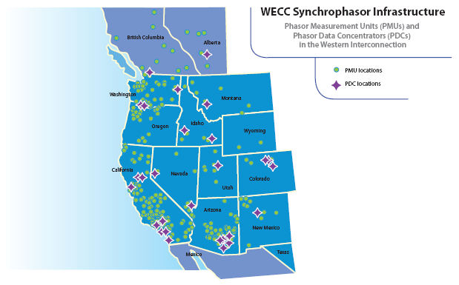

Slide 7
WISP Milestone Schedule

Slide 8
PMUs
18 Transmission Owners will deploy over 400 PMUs (some outside the WISP grant)
  Each entity will select its own vendor
100% coverage of Western Interconnection
  Coverage depends on application
Variety of Types
  Stand alone
  DFR
  Relay-based

Slide 9
PMUs (cont.)
244 Substations with PMUs
Sampling Rate 30-120 sps
Installation Rate:
  2011 Q3 22
  2011 EOY 38
  2012 EOY 267
  2013 Q1 362

Slide 10
PDCs

Slide 11
Communications

Slide 12
PMU/PDC/Signal Registry &
Wide Area View (WAV)

Slide 13
PMU/PDC/Signal Registry &
Wide Area View (WAV) – (cont.)

Slide 14
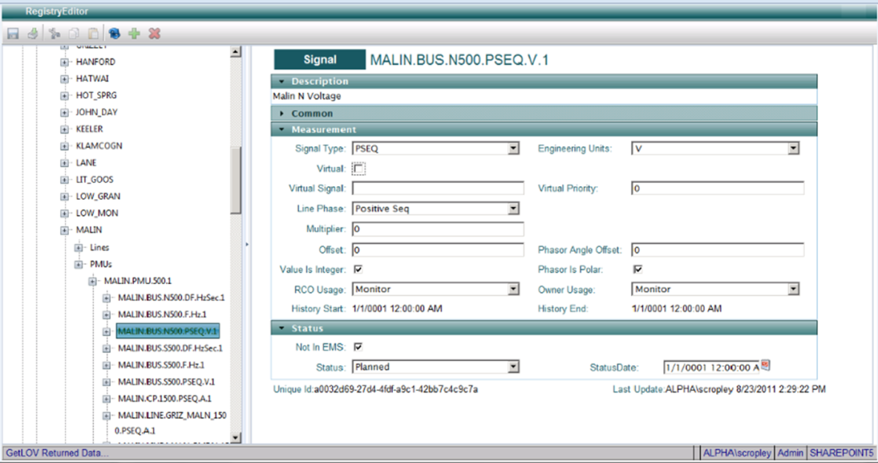
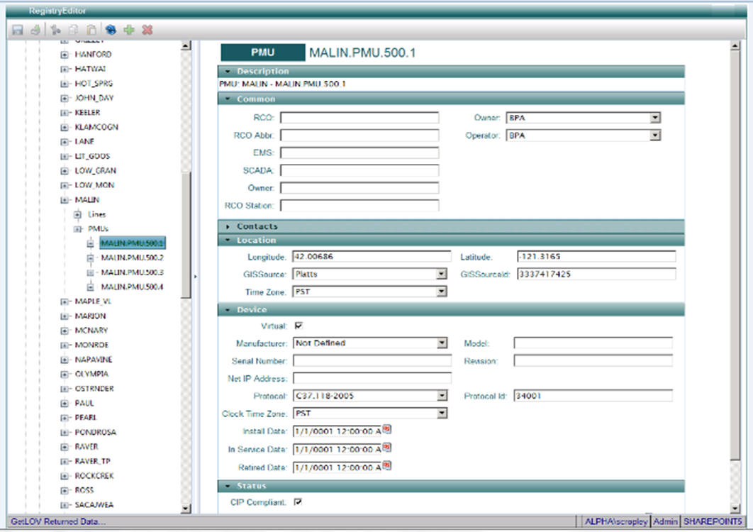
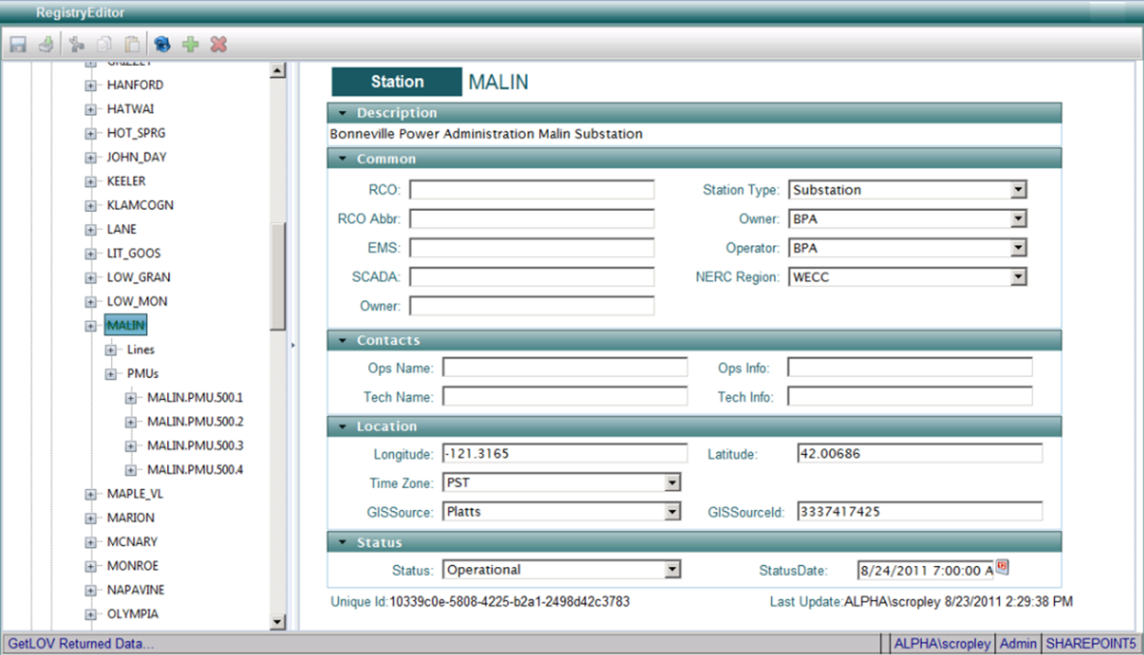
PMU Registry
Demonstration Tomorrow

Slide 15
Major Operational Applications

Slide 16
Major Operational Applications

Slide 17
Challenges and lessons learned

Slide 18
Acknowledgement and Disclaimer

