Slide 1
Duke Energy Carolinas
Smart Grid Investment Grant
Tim Bradberry
Tim. Bradberry@duke-energy.com
NASPI Work Group Meeting
October 12-13, 2011

Slide 2
Project participants
Duke Energy Carolinas
  Megan Vutsinas, Megan.Vutsinas@duke-energy.com, 704-382-0855
  Tamara Harrison, Tamara.Harrison@duke-energy.com, 704-384-7723
  104 PMUs and 2 PDC systems to be installed
Vendors: Alstom Grid, SEL, Cisco, OSIsoft

Slide 3
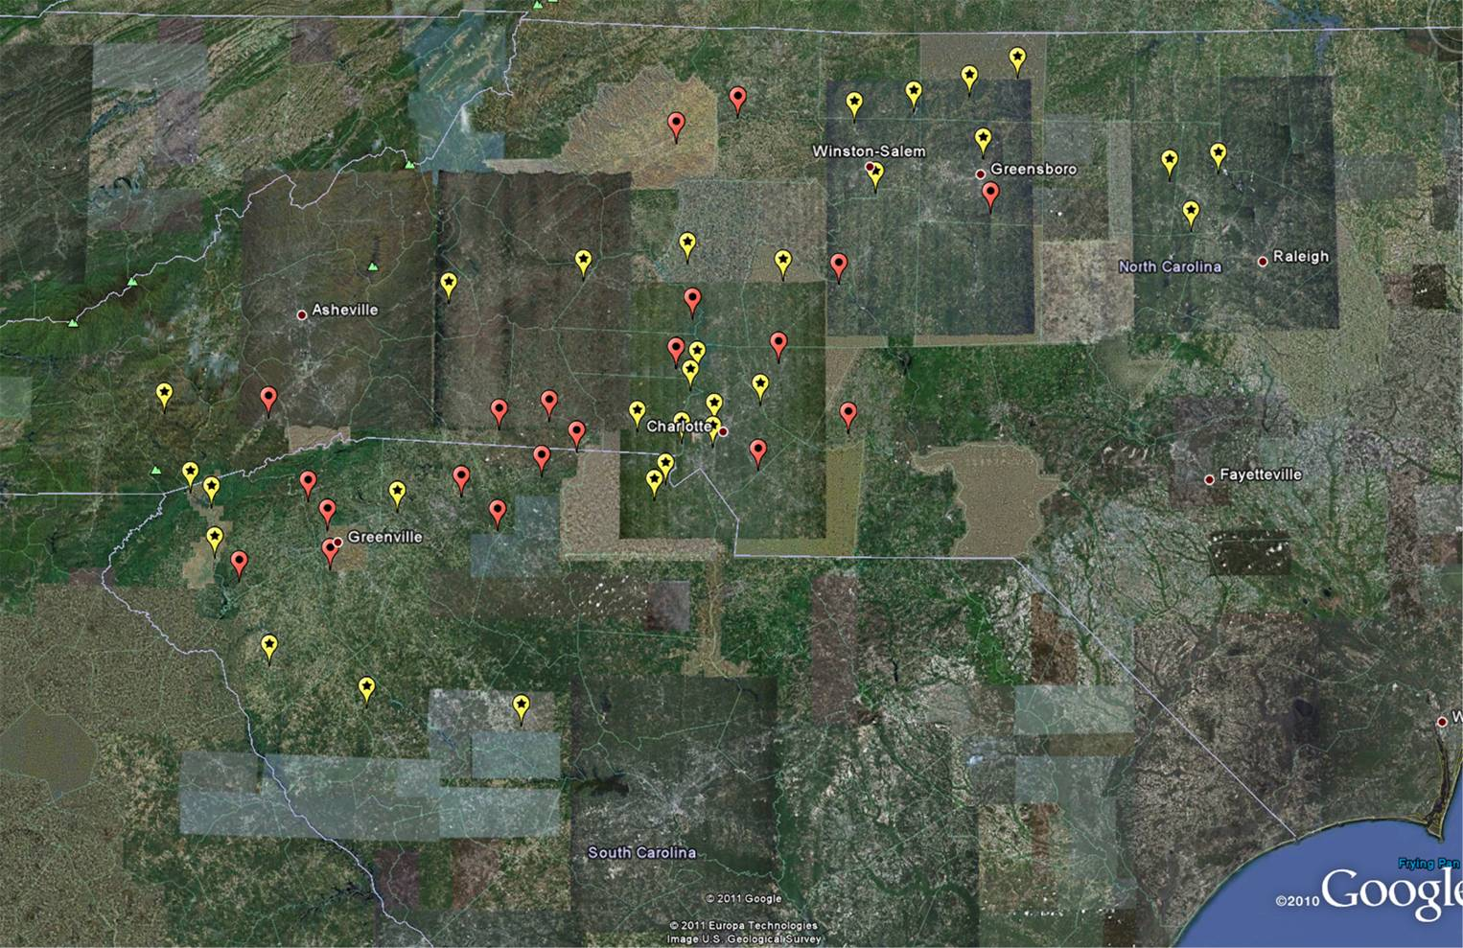
Project Map

Slide 4

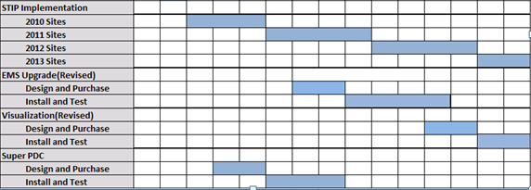
Project Timeline

Slide 5
PMUs
[Total (completed) project data except for installation pace]
1 transmission owner in project and 104 PMUs
Transmission elements monitored by PMUs
  12 elements >345 kV (500 kV)
  92 elements ≥230 – 345 kV (230 kV)
  0 elements < 230 kV
100% of TOs regional footprint monitored by PMUs (based on load)
52 substations with PMUs
  2 PMUs/substation monitoring different elements
30 Samples/second PMU sampling rate
Stand Alone SEL 351A
PMU installation rate (stations)
  # installed: 14 total, 13 new, 1 replacement by 9/30/11
  22 total, 20 new, 2 replacement by EOY 2011
  # installed: 48 total, 45 new, 3 replacement by EOY 2012
  # installed: 52 total, 49 new, 3 replacement by May 2013

Slide 6
PDCs and Communications
[data below for completed project]
PDCs
  2 BA/TO control centers with PDCs (using openPDC); each center has 1 primary and 2 regional clusters (see next slide)
  Archive/database status
    70 terrabyte
    12 months of data to be readily accessible
Communications system
  Communication across TO’s private network
  Utilize fiber or microwave for high bandwidth (≥512 kbps)
  Primarily owned by TO with some leased circuits
  Interested in Phasor Gateway

Slide 7
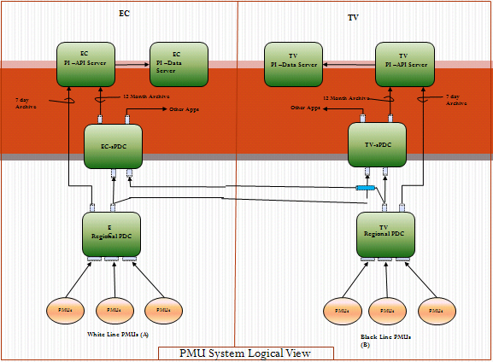
PDC System Design

Slide 8
Major operational applications using phasor data
Plan to share data with external RCs & TOs as requested
Wide-area situational awareness*
  Proposal is to use Alstom e-terravision
  Would integrate into the Alstom EMS
  Evaluating options to ensure tool(s) implemented increases SA
  Spring 2013 operational date
State estimation*
  Alstom EMS being upgraded to allow PMU data to be used in State Estimation
  Fall 2012 operational date
Near term (less than three years) applications
  Post-Event Analysis*
  Model Validation
Long term (beyond three years) POTENTIAL applications
  Angle and Voltage Stability
  Other applications not yet mature, but will be monitored and revisited
*Applications that we are focused on and feel provide the greatest initial benefit

Slide 9
Challenges and lessons learned
What have been your biggest technical challenges to date?
  Overwhelming amounts of data
  Data hard to read when raw, needs to be scrubbed for users to look at
  Getting the data into our historian (PI)
What have been your biggest programmatic or execution challenges to date?
  Dealing with unfamiliar regulations (e.g. Davis-Bacon)
  Mechanics of metrics reporting
Other lessons or insights about
  PMU performance, installation experience or cost
    Sometimes difficult to tell if getting bad data or event occurred
    Signals dropping randomly, determined happened when train went by
  Communications system design and performance
    Hard to have full redundancy with the amount of data & bandwidth required
  Interoperability
    Clock and PMUs need same parity, or firmware update required
    Data extraction in a format that can be used as input to other apps
  Physical or cyber-security
    Stand alone PMUs because of cyber
    Deployment slowed because tie to communications upgrade
    In-the-field inspections after install lead to some changes for better security
  Data archiving
    What to archive (raw vs. compressed, compression settings, duration, etc)

Slide 10
Other things we should know about your project?
Finalizing agreement with university and data analytics company for data manipulation and advanced applications (e.g. visualization, base lining, event detection, stability)
Evaluating best support of the openPDC

