Slide 1
American Transmission Company
Smart Grid Investment Grant
Update
Jim Kleitsch
jkleitsch@atcllc.com
NASPI Work Group Meeting
October 12-13, 2011

Slide 2
Project Participant Information
American Transmission Company
  Project Manager
    Carl “Chip” Harper
      CHarper@atcllc.com
      608.877.3634
  Project Liaison to DOE
    Jessica Basilio
      JBasilio@atcllc.com
      262.832.8725
  Operations Lead
    Jim Kleitsch
      JKleitsch@atcllc.com
      608.877.8102

Slide 3
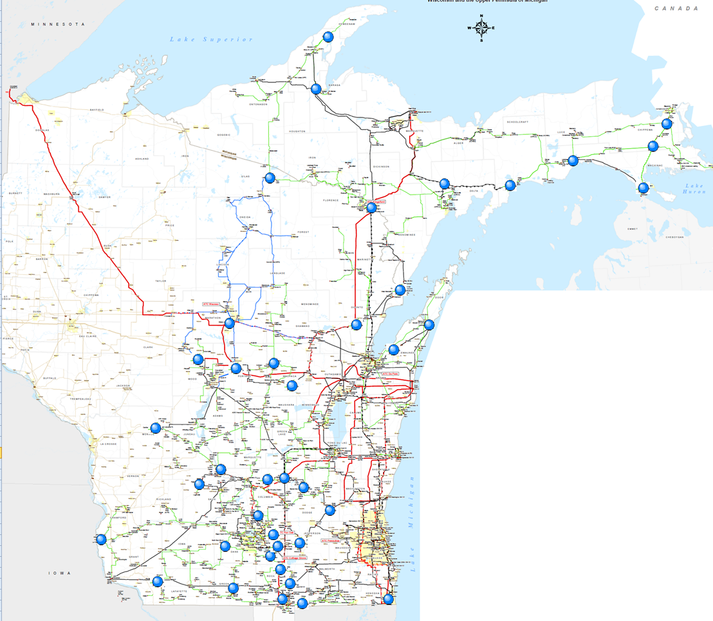

Legacy Project Map
42 PMUs in service (2 DFRs, 40 relays)
Most data sourced from capacitor bank protection relays
Sending data from 5 PMUs at 345 Kv stations to Midwest ISO.

Slide 4
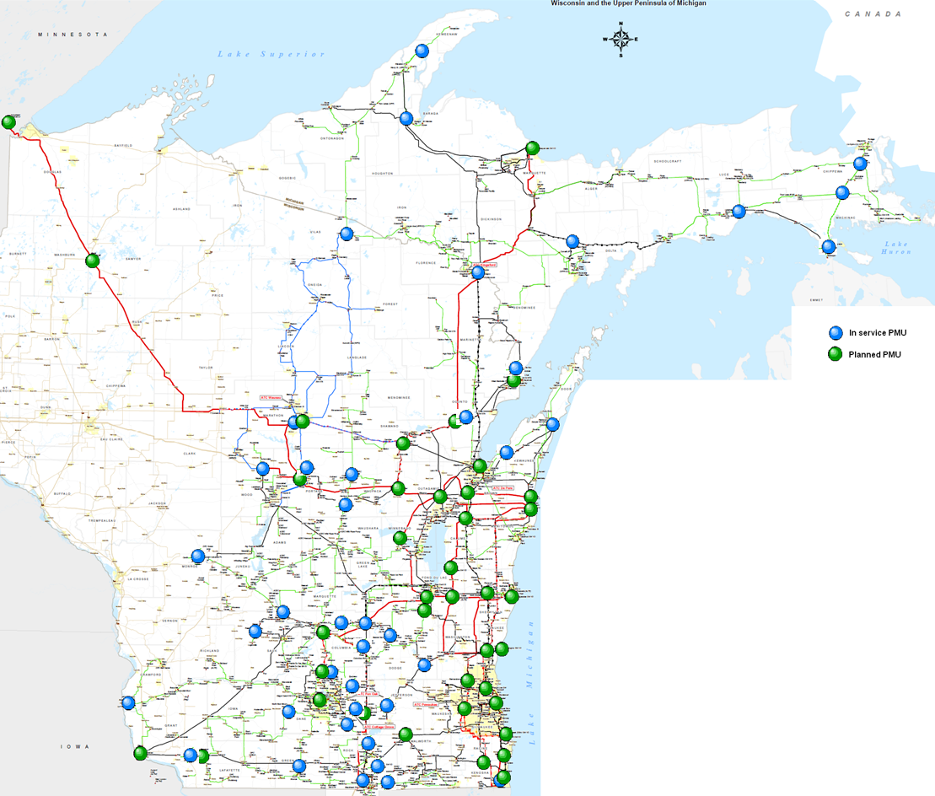
Combined DOE and Legacy Project Map
DOE Project Planned Installations
Stations with interconnected generation exceeding 200 MW gross capability
Stations with interconnected wind generation greater than 50 MWs
345 Kv stations

Slide 5
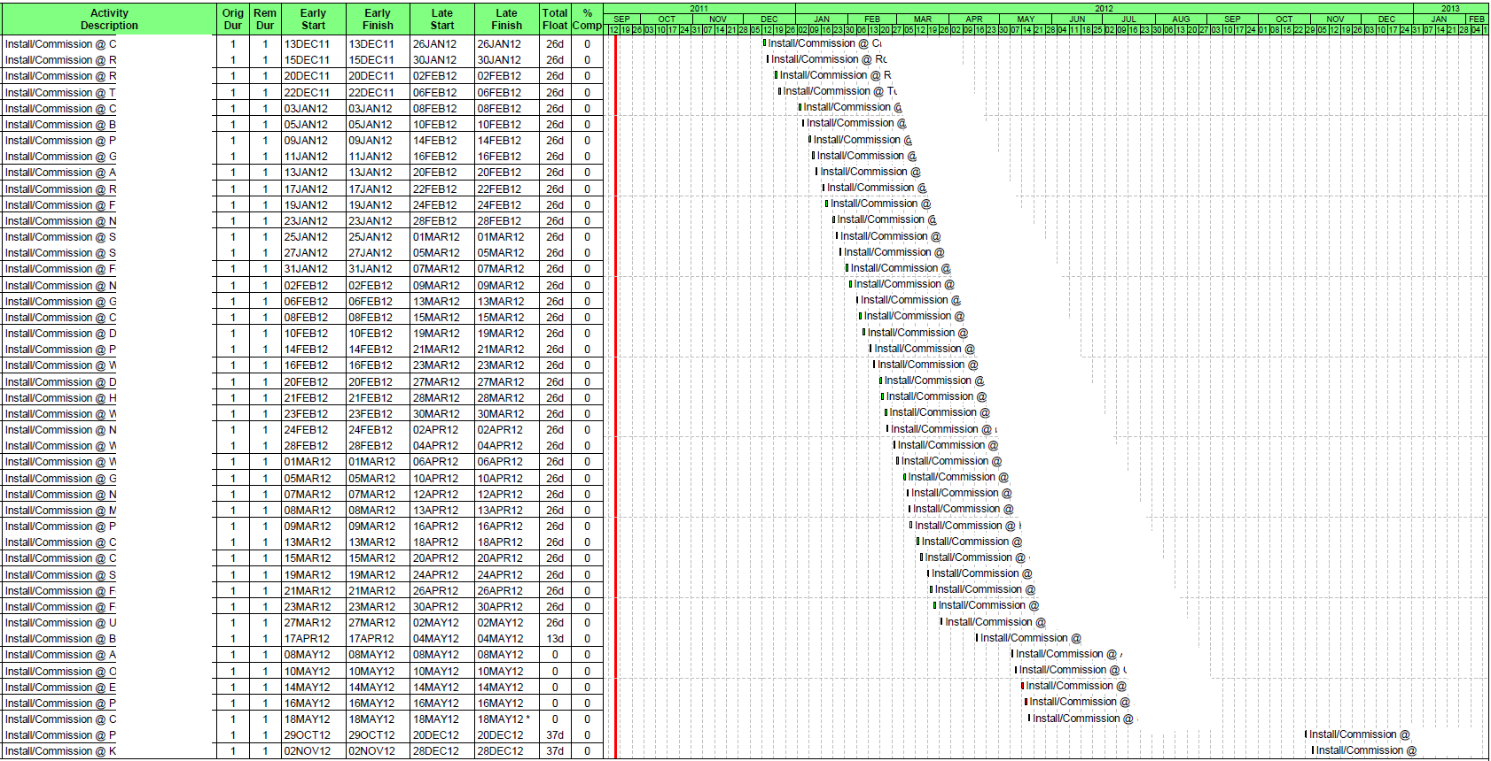
Project Timeline – PMU Installs
We will begin PMU installations in December 2011. The sanitized schedule is shown below:

Slide 6
Project Timeline – Other
We have two legacy PDCs in service and operational. We will transition to newer PDCs when technical issues have been addressed. (Planning for Q2 2012)
Existing communications allow us to implement now. Our SCADA enhancement project will extend our fiber optic network to improve reliability and performance of the communications network.
Some applications already developed in house using our OSI Soft – PI tools. Looking at other applications when more data is available 4Q 2012.

Slide 7
PMU Installation Statistics
We are the sole transmission owner involved in this project and will be installing a total of 45 PMUs
Elements monitored by PMUs Today (legacy plus DOE)
  5 stations operated at 345 Kv (0 from DOE project)
  37 stations operated between 69 Kv and 230 Kv (0 from DOE project)
  36 capacitor banks / 1 transformer tertiary / 5 - 345 Kv lines / 0 generators monitored
8% of our system substations (those operated at or above 69 Kv) are now monitored by PMUs (42 substations with PMUs). We expect to see that increase to close to 25% at project completion.

Slide 8
PMU Installation Statistics (cont’d)
Minimum PMU sampling rate will be 30 samples/second
PMU installation rate
  42 units have been installed as of 9/30/2011 over a 3 year period. 2 of these were DFR upgrades. The remainder were new installations where the PMU data was made available from a dual function relay/PMU.
  We expect to have 4 DOE installs completed between now and year end. This will be a mix of stand alone PMUs and DFR upgrades
  We expect to have all 45 DOE projects completed by year end 2012. Approximately half of these projects involve new installations of stand alone PMUs. The remaining units involve upgrades of existing Digital Fault Recorders
  Any installations in 2013 will be done as part of our legacy project. We do not have any specific plans at this time.

Slide 9
PDCs and Communications
When our project is complete we will have the following in service equipment:
PDCs
  One redundant PDC pair at our offices in southeastern Wisconsin
  One cold standby PDC at our offices in south central Wisconsin
    The above reflects MISO PDC expectations and is beyond what we anticipated when we originally scoped our project
  Archive/database status
    Currently Storing ~4 GBytes per day to our PI Historian database
    All data is available since we began scanning (no compression)
    We will store all data until such time that we determine what data we do not need
Communications system
  Communication link to MISO – highly available and redundant
  Retired our link to TVA – MISO now providing that data
  No direct links to other TOs anticipated at this time. We envision MISO as our “PMU data hub” if we need data from others in our region

Slide 10
Major operational applications using phasor data
We will be making all our PMU data available to MISO. We do not envision any direct connects to other TOs to share data at this time.
Wide-area situational awareness
  ALSTOM eterraVision in development for overall wide area view. Looking at ways to leverage those capabilities with our non-standard PMU data configuration to enable use of PMU data.
  Also looking at RTDMS and PGDA applications from Electric Power Group. Need to figure out how our project fits with the MISO project
  PI ProcessBook prototype displays already created. Need to get Operations buy in and further direction.
State estimation
  ALSTOM EMS already has capability to use phase angle data as an input.
  We are already feeding angle data to our EMS at 1 sample/second rate from our legacy sites but it is not used as an input to SE.
  Plan to test SE once we have the majority of our 345 Kv sites in service. Currently that puts us out to 4Q 2012 / 1Q 2013

Slide 11
Challenges and lessons learned
Execution challenges
  We are still struggling with buy in from Operations to make this a real time decision making tool. Some forward movement but we haven’t been able to get what we’ve developed to be considered “screen worthy” by Operations
  We have completed all site visits and have specified installation work to be done but have yet to install one PMU under the project
  Longer lead times from some of our vendors than expected causing installation delays
  Review cycle for drawing updates taking longer than planned
  Problems getting the work scheduled on this non-standard project. We don’t normally have projects that span many stations scattered across our footprint like this project
Other challenges
  PMU performance has been good but we have yet to determine acceptable downtime
  Managing our data archives as we grow our PMU network will require that we get smarter about what data we need to keep and for how long

Slide 12
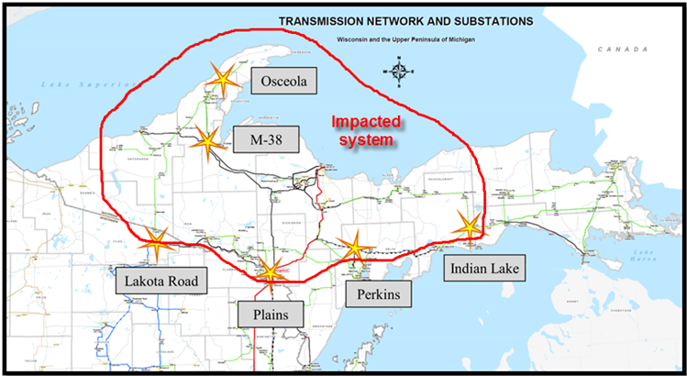
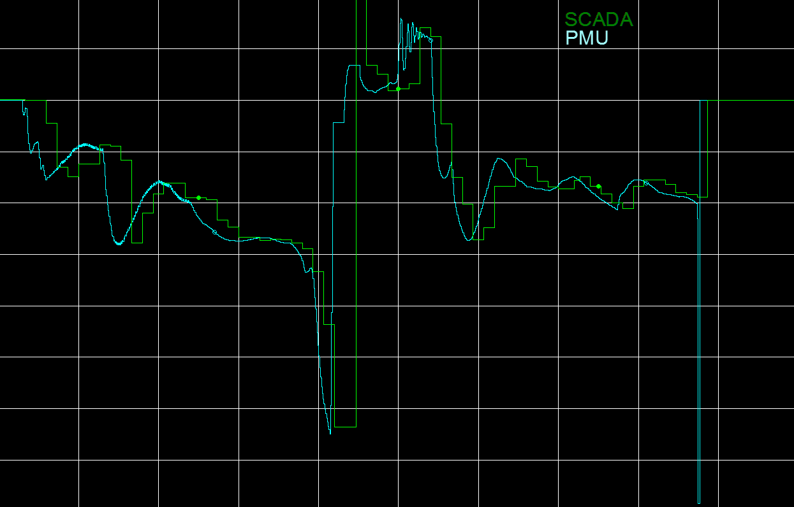
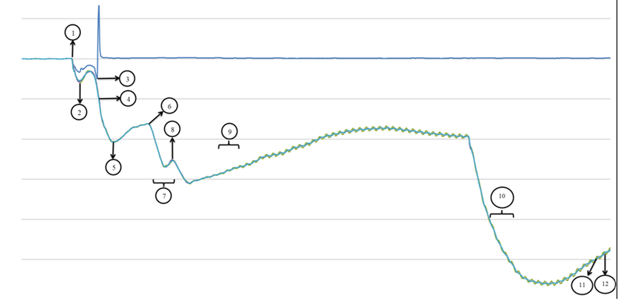
Other things we should know about your project?
Already using the PMU data we have to help with post event analysis - 5/10/2011 event example

Slide 13
Other things we should know about your project?
(cont’d)
System protection requesting data to assist in post event fault analysis especially in areas where older electromechanical relays are used
Operations requesting data periodically to address operational questions (Did you see any voltage spikes on the transmission system at this time, etc…
Using the data to validate generator models in isolated areas where events have occurred.

Slide 14
Questions?

