Slide 1
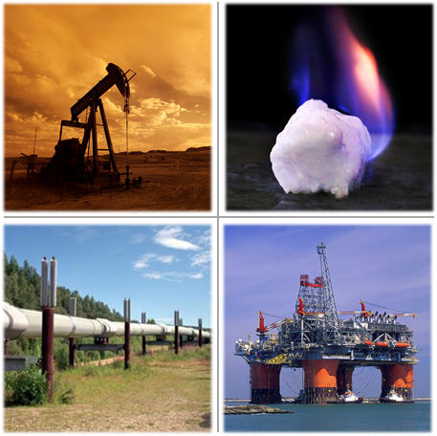
FE Methane Hydrate Research Program
Jared Ciferno – Oil and Gas Technology Manager
2016 Methane Hydrate Advisory Committee Meeting
Washington, DC
October 18, 2016

Slide 2
Mission and Stakeholders
Program Mission
Determine the potential for methane hydrates as an energy source, the environmental impacts associated with production, and it’s role in the global climate cycle.
Drivers/Stakeholders
Driver: Domestic & International Energy Security
Driver: Global Climate Change
Stakeholders: Interagency (BOEM, USGS, NSF, NOAA, DOI), International (Japan, S. Korea, India, Mexico), Industry, Academia
POCs
FE-HQ Program Manager: Lou Capitanio
Technology Manager: Jared Ciferno
Senior Fellow(s): Grant Bromhal
R&IC Technical Project Lead(s): Yongkoo Seol
TD&IC Senior Project Managers: Ray Boswell, Rick Baker
BLUF
A National Program led by DOE/NETL. Critical to understand and quantify the GLOBAL environmental impact!

Slide 3
Technical Overview
What is the problem?
Uncertain scale of viable resource (100s or 10,000s of tcfs?)
No demonstration of commercial production rate
Unclear environmental implications of production
No consensus on potential neg. feedback to ongoing climate change
What are the barriers to solve this problem?
Lack of scientific drilling in arctic/deepwater
Difficulties in remote detection/sample collection
High costs of field programs
Lack of industry support/access to field sites
How will the barriers be overcome?
Leveraging of external interests/resources
Continued international program leadership
What is the capability being developed?
World-leading prospecting capability
World-leading numerical simulation capability
World-class laboratory sample analysis capability
What is the result/product for the effort?
Expanded domestic energy options
Greater global energy security
More informed climate/ocean policy
6. What are the quantitative metrics?
7. How are other technology efforts being leveraged?
Effort fully integrated with 6 federal agencies
Collaboration with leading Int’l programs
Collaboration with AK state gov
Coordination in numerical simulation/field sample analysis with National labs and Fed agencies
Leveraging NSF/IODP drilling capabilities
What is the level of confidence that metrics will be met?
Budgets, technical and logistical complexity
 | Current | 2020 Target | 2025 Target
Certainty in Resource Assessment | +- 1,000s of tcf | +- 100s GoM | +- 100s of tcf US OCS
Demonstrated Production Rate | 700 MMcf/d |  | 2000MMcfd
Consensus on GCC Feedback | None | Global
Base Mission Need
Note: Base budget difficult to define

Slide 4
Research Objectives and Approach
OBJECTIVES
By 2020
Completed Long-term Production Test
Completed GoM Drilling and Coring Programs
By 2025:
Completed Atlantic Exploration: Confirmation of scale of US resource base
Confirmation of Production Approach for marine accumulations (International Collaborations)
Consensus view on GH/Climate linkages
APPROACH
Early Applied (TRL 2-4): Drilling/sampling programs to characterize resource base and assess system dynamics in climate-sensitive regions. Initial technological base for exploration and production technologies established. Field tests now required to test concepts and gain needed samples and data. Tests to be planned and conducted with broad international/interagency collaboration.
Development (TRL 5-7): Initial scientific-focused field experiment, followed by initial integration to production systems in Alaska (site access dependent), then tailored to marine settings with tests both domestically (budget dependent) and via international collaboration.
PARTNERS & ROLES
Japan – partner in Alaska field programs
State of Alaska – key facilitator of AK field programs
BP; Alaska Industry – Key partner in AK field programs
India – potential partner in deepwater production testing
USGS – key geologic/project development partner
U. Texas - lead in next phase marine driling program
BOEM – key geologic partner in marine programs
LBNL; PNNL – sample evaluation; numerical simulation
Universities – prime contributors to climate research
IODP – primary owner of deep drilling capabilities
S. Korea, New Zealand, others – field sampling testing
KEY MILESTONES
FY 16: Establish viable testing program structure in Alaska
FY 17: Complete coring program at GC955 in GOM; Conduct stratigraphic test drilling on the ANS; Contribute to deepwater test preparation in India.
FY 18: Initiate long-term production test in AK.
FY 19: Complete multi-site drilling and coring program in the GoM
FY 20: Establish as needed follow-on demonstration tests in AK
FY 25: Participate as possible in marine production testing conducted by other nations. Conduct resource characterization programs on the Atlantic OCS

Slide 5
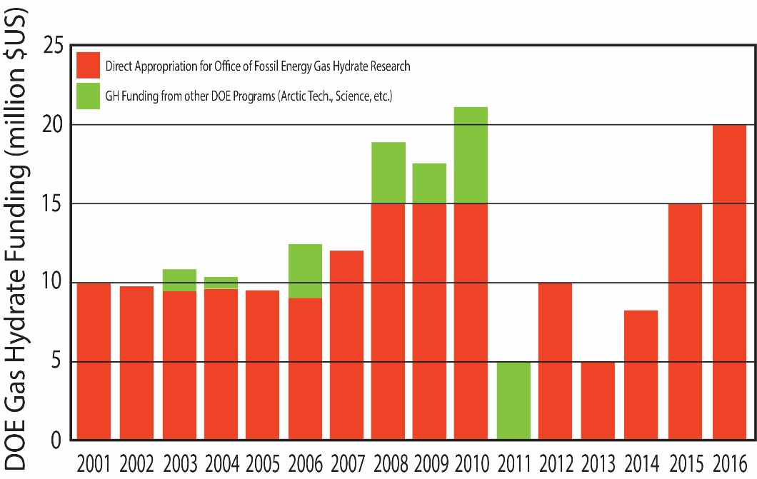
Budget and Major Accomplishments
GH Program Funding ($M)
FY 14-FY 16 Cum. | FY 16 Enacted | FY 17 Request
42.8 | 19.8 | 2.5
GH Program (2015 – 2016)
Initiation of new coring program in Gulf of Mexico w/ UT. 2017 and 2019 operations planned.
Developing long-term testing options in Alaska with Japan, SoA, USGS.
Collaborating in the development and execution of marine drilling programs with India and Korea
Conducting field programs to constrain GH-global climate linkages
GoM JIP Leg 1 (2005)
Addressed issues with safe drilling through gas hydrates
DOE-BP Milne Pt Test Well (2007)
Confirmed GH resources on AK north slope
Addressed key geophysical and petrophysical issues
GoM JIP Leg 2 (2009)
Confirmed occurrence of resource-quality GH in the GOM
Confirmed viability of DOE-developed GH prospecting approach
Ignik Sikumi- AK (2011/2012)
Field test of CO2 injection into GH reservoirs
Confirmed superiority of depressurization for GH production
Notes:
See attached notes.

Slide 6
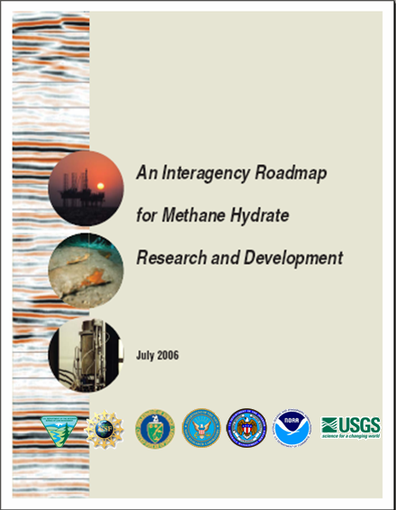
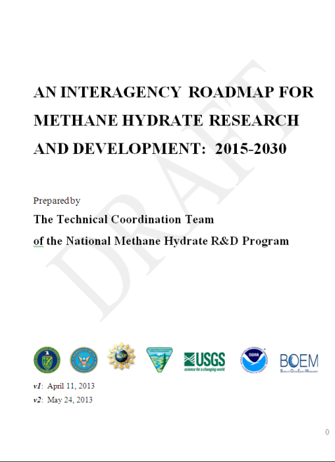
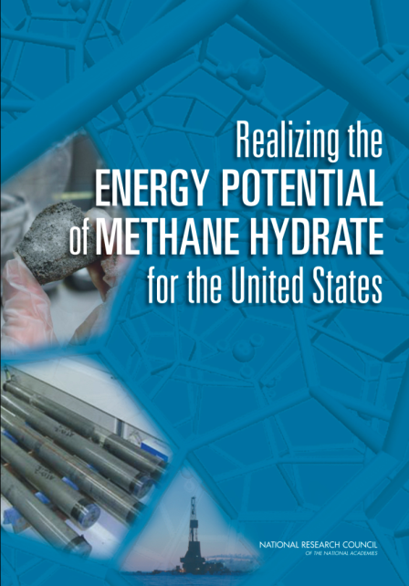
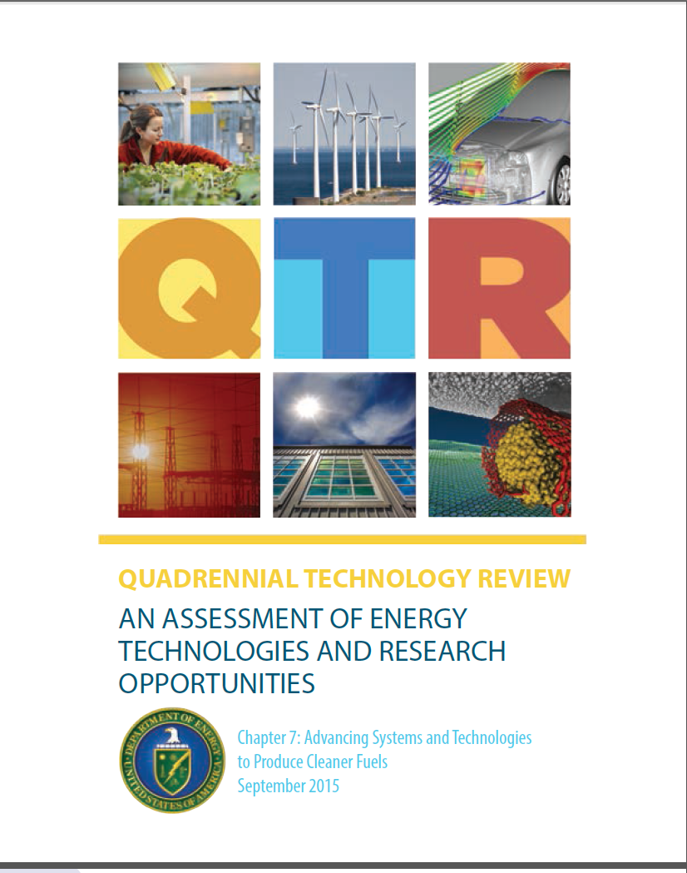
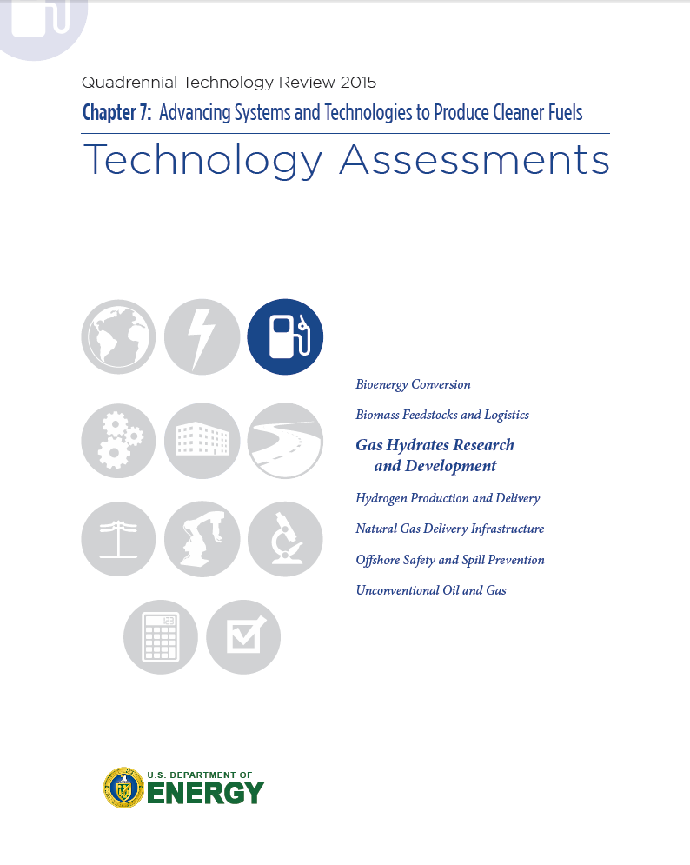
Program Goals
Current Program Goals Established with 2006 Interagency Roadmap (assumed funding at auth. levels)
Goals continually refined via
Federal Advisory Committee (~ every 9 months)
Interagency Technical Coordination Team (Bi-annual)
National Academies Reviews (2005 & 2010)
DOE QTR (2015)
Secretary of Energy Advisory Board (2016)
NEAR-TERM GOALS (2020)
Demonstrate long-term Technical Recoverability (Alaska)
Confirm Gulf of Mexico Resource Assessment
Continue International Collaborations
LONG-TERM GOALS (2025)
Confirm scale of US resource base (+ Atlantic)
Demonstrate Production Approach (Alaska + International)
Consensus view on GH/Climate linkages via field programs + modeling
Notes:
See attached notes

Slide 7
Technology Development Schedule
Wide ranging TRL development from basic science to initial technology development
Confirmed U.S. Resources: Gulf of Mexico
Confirmed U.S. Resources: Atlantic Margin
Resource Confirmation – marine drilling and coring programs throughout US Outer-continental Shelf
TRL 2-4 Alaska Site Reviews
TRL 6-7 Alaska Strat. Well
TRL 7-8 Production Test Well
Exploration & Production Technology – geophysics, experimentation, simulation, field production tests, International collaborations
GH global climate linkages – marine sampling programs, numerical simulation
2014
2015
2016
2017
2018
2019
2020
2021
2022
2023
2024
2025

Slide 8
2017 Key Activities
Characterization--Gulf of Mexico and Alaska
(GoM) Complete a sea test of DOE hydrate pressure coring system with UT-Austin
(GoM) Pursue opportunity for 2nd expedition through the Integrated Ocean Discovery Program
(AK) Conduct stratigraphic test drilling at a Prudhoe Bay site with Japan and industry partners. Confirm occurrence of suitable reservoirs for long-term testing.
NETL-RIC to characterize samples/update production models (with collaborating labs).
Production Technology
Upon success of AK field test, initiate logistics for Long-term production test. Confirm funding for test with Japanese collaborators.
NETL RIC to complete numerical simulation modeling in collaboration with India and Korea in preparation for international field opportunities (collaboration with LBNL, USGS)
NETL RIC to increase numerical simulation modeling in preparation for Alaska production test (collaboration with Japan) → Design test parameters
NETL RIC to complete development of integrate reservoir THM modeling capabilities (with collaborating labs).
Role in the Natural Environment
Investigate, through the acquisition of field data and development of predictive models, the nature of hydrate response to warming climates and implications for ocean and atmospheric chemistry.

Slide 9
Risk Analysis
Top 5 Risks and Mitigation | Outlook | Comments
Risk 1: NETL is unable to formulate a viable contract vehicle for international & industrial collaboration to pursue the Alaska PBU hydrate production test wells
Mitigation: Work with NETL AAD & legal to formulate a successful mechanism to conduct the tests.
Risk 2: Prudhoe Bay Unit industry (Exxon, BP..) do not enable project access to identified site
Mitigation: Review opportunities for new site exploration on state lands (at a higher cost and risk)
Risk 3: Prudhoe Bay Unit stratigraphic well test fails to encounter producible methane hydrate deposits
Mitigation: Review opportunities for new site exploration on state lands (at a higher cost and risk)
Risk 4: Hydrate pressure corer fails to recover viable hydrate samples in the GoM
Mitigation: Further tool refinements. Reliance on international collaborations for testing and sample acquisition.
Risk 5: IODP rejects UT proposal for use of the Joides Resolution drillship for the FY19 drilling program
Mitigation: Likely to end the UT Project and hydrate characterization in the GoM.
R
Y
Y
Y
R
Mitigation unlikely to succeed
Partial mitigation expected
Mitigation likely to succeed
R
=
Y
=
G
=

Slide 10
2017-2018 Desired Outcomes
Alaska
Safe and successful drilling of stratigraphic test well on the Alaska North Slope.
Gain partner approvals to move on to long-term testing program. Gain Japanese agreement to fund bulk of the test (or obtain sufficient budgets directly).
Gulf of Mexico
Acquisition of ~10 full pressure cores from hydrate bearing sand at the GC955 site.
Successful transfer of samples to analytical devices at NETL and collaborating labs.
Determine of key petrophysical/geomechanical aspects of marine hydrate-bearing sand.
International
Full participation enabled in extended-duration offshore production test in India.
Completion of 2nd round of collaborative studies with Korea.

