Slide 1
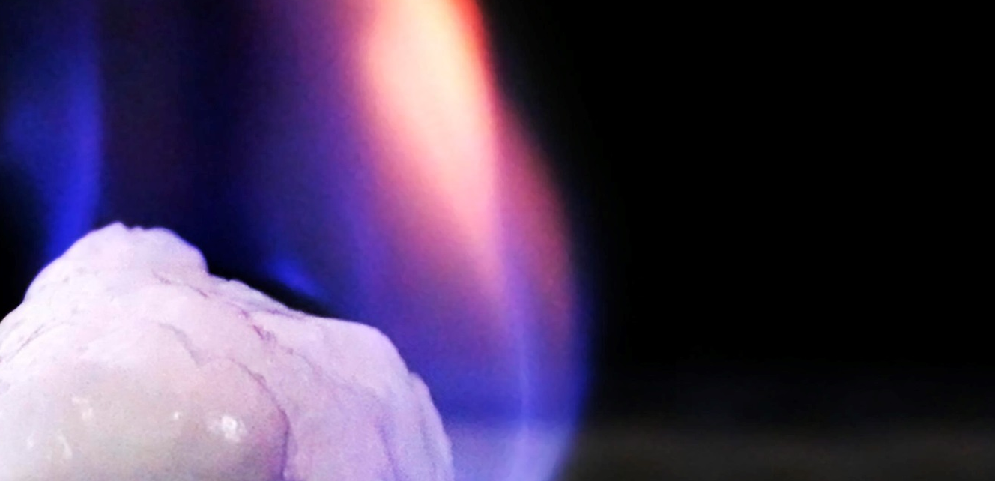
FY2016 Methane Hydrates — New Projects
DOE-FOA-0001536
Topic Area 1:
Hydrate System Response to Production Activities (Induced Changes)
Topic Area 2:
Response of Methane Hydrate Systems to Natural Environmental Change
A burning sample of methane hydrate. (Source: U.S. Department of Energy)
Selected Applicants
Notes:
Sources:
U.S. Department of Energy, National Energy Technology Laboratory, FY2016 Methane Hydrates, April 13, 2016, accessed October 4, 2016.
Image sources:
https://www.flickr.com/photos/departmentofenergy/20663471669/in/photolist-o8V7uA-fP9gz4-nsJ44v-oaXLCn-nSPq7T-o8V7to-oaXLEg-o8V7c1-o9ZEGc-o8V7qs-ocJ5Sx-nvCAZp-nsJ3Pc-oaXLy4-ocJ5ST-nL5K27-fULXuh-nTuM6t-fQ8toF-fAoNpy-nqXeXT-oaXLDV-o8V7hb-ocJ5Tz-oaXLBR-ocJ5GT-nvCRn3-nPUVaB-nN8sac-o8V7qC-nvDiKv-oc58x8-nvDjVX-oc57Zz-gaqUkq-nL5NHq-fUTH3F-nPUT7Z-nN5psd-nqZ7ad-mp59Qn-xtXGdV-pkRTUb-nsJ1YZ-iimHUC-xM75vz-Hrv5TT-nqZETQ-nqXne6-nqETZ4

Slide 2
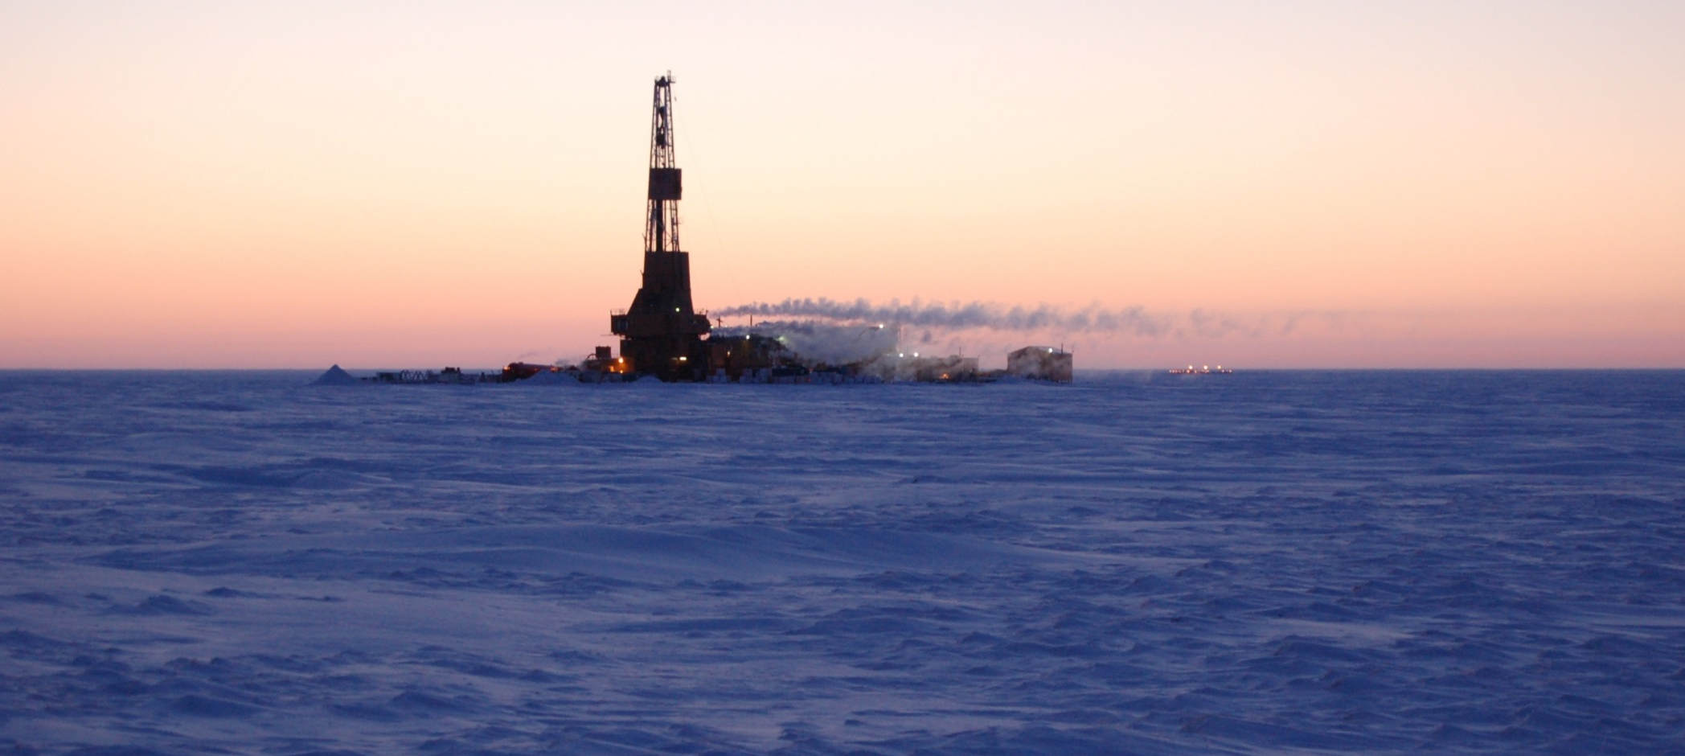
FY2016 Methane Hydrates
DOE-FOA-0001536
Gas hydrate well. (Source: U.S. Department of Energy)
Topic Area 1:
Hydrate System Response to Production Activities (Induced Changes)
Louisiana State University
Texas A&M Engineering Experimental Station
University of Texas at Austin
Notes:
Image sources:
https://www.flickr.com/photos/netlmultimedia/28150792560/in/photolist-e8pz3x-pmGyEX-oM4ch3-e8veVm-e8pytR-e8pyrP-pmWPbU-pjX4ej-e8oNez-e8oNdc-e8oNbk-zy9k6Z-yB7kYo-yCv33v-yCv2Nn-zhLm5j-zAeYQR-zhMKNu-e8py2K-e8veW3-e8pze8-e8pzka-e8pzf2-e8py4r-e8vf8E-yBfK6t-Jo81dh-Jo9A1V-Jo9zRB-JTAaSq-KcD276

Slide 3
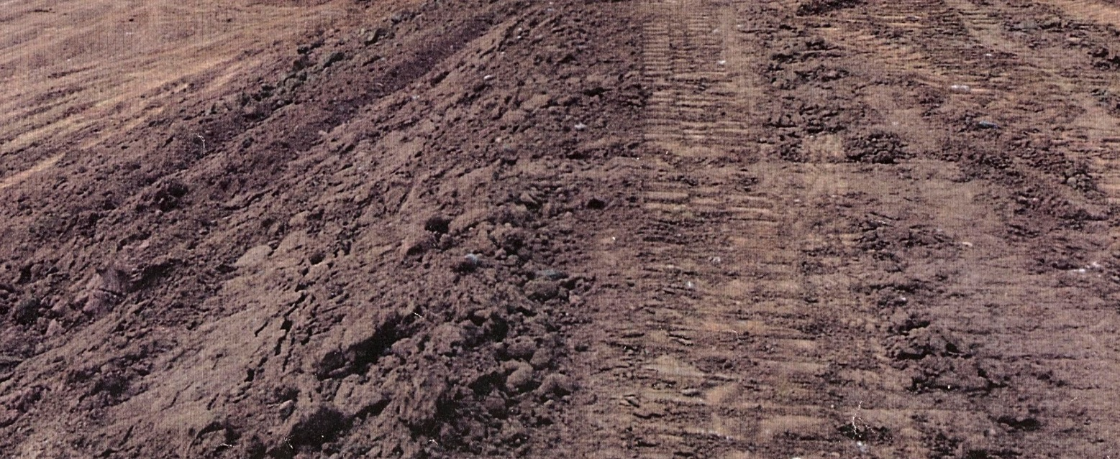

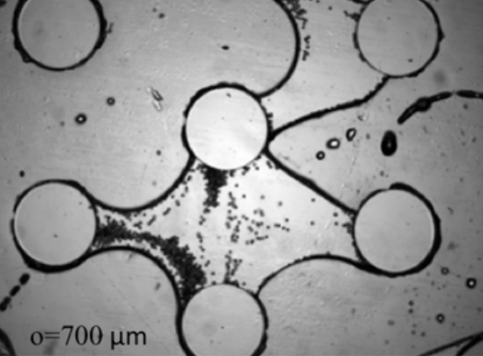


Louisiana State University
Topic Area 1 |
Project: Impact of Clays on the Compressibility and Permeability of Sands During Methane Extraction from Gas Hydrates
Objective: Provide a quantitative basis for reservoir models to account for the impact of clays and other fine-grained materials (‘fines’) on hydrate reservoir compressibility and permeability, two key factors controlling the flow of gas and fluids toward a gas hydrate production well.
Duration:
36 Months
Start:
October 1, 2016
Total Funding
$402,867
End:
September 30, 2019
Microfluidic model image of sediment grains (circles) with 700 μm spacing between
grains. (Source: Project Narrative)
Project Partner: USGS
Notes:
Project Abstract:
The quantity of methane potentially recoverable from gas hydrate is large enough to have prompted, and continue to prompt, federally-supported production tests in several countries. A transition from federal to commercial pursuit of methane from gas hydrate will require demonstrating not only that methane can be extracted from hydrate safely, but also profitably.
Evaluating the long-term viability of a production well involves modeling the evolution of permeability in the reservoir sediments around the production well because processes reducing the flow of gas into the production well also reduce the long-term economic viability of the well.
Fine particles, such as clays, exist nearly ubiquitously in the permafrost and marine settings that typically host gas hydrate, and these particles can react to fluid flow by migrating and clogging pore throats, reducing flow toward the production well. Many fines are also sensitive to variations in pore-fluid chemistry, and will swell in reaction to the in situ pore brine being displaced by fresh water liberated from hydrates during dissociation. Additionally, fine particles tend to collect at gas/water interfaces created by the multiphase flow of gas and water. Thus, as methane and fresh water flow from the hydrate-dissociation front toward the production well, fine particles in the reservoir sands, interbedded fine-grained layers and seal layers can be swelled, migrated (or both), potentially clogging pathways and limiting flow to the production well.
Currently there is no quantitative link between the types or concentration of fines present, and their long-term impact on productive flow through the reservoir.
The project proposed here provides a quantitative basis for modeling how pore-water
freshening and multiphase flow interact with fines to alter reservoir compressibility and
permeability. The project approach includes a site-specific test of compressibility and
permeability dependence on pore-water chemistry in sediment from a recent gas-hydrate research
cruise offshore India (NGHP-02) where an upcoming hydrate-reservoir production test is being
considered. To provide more broadly-applicable insight, a fundamental study of pure, single
component fines will be conducted. The study, involving the endmembers: illite, kaolinite,
montmorillonite (or bentonite), diatoms and silica silt is organized into three components with
which to distinguish between chemical effects, such as fines swelling in response to pore-water
freshening, and physical effects, such as fines migration in response to multiphase flow. The first
experimental component measures the dependence of liquid limits on pore-water chemistry in the
endmember fines, expressed as an electrical sensitivity index, SE, and tests the compressibility
and permeability of the endmember fines in the presence of different pore-fluid chemistries. The
second experimental component is a 2D microfluidic model study of fines migration and
clogging, an objective of which will be identifying the most significant parameters responsible for
clogging and permeability reduction. The final experimental component ties the pore-water
sensitivity and the 2D clogging parameter studies together in a systematic 3D study of fines type,
fines concentration, pore-water chemistry, and fluid-flow rates. For this experimental
component, compressibility, permeability and relative permeability will be measured in fines bearing
sands. Micro X-ray CT scanning of the specimens will provide insight as to how
clogging, fracturing and sediment disturbance contribute to the measured geomechanical
parameters. Together, these fundamental studies provide a quantitative database relating
mineralogy (fines type), through their sensitivity index, SE, to estimates of compressibility,
permeability and relative permeability in fines-bearing sediment exposed to the pore-water
freshening and multiphase flow expected while extracting methane from hydrate in situ.
The central theme and primary impact of this project is providing a quantitative connection
that allows researchers to connect mineralogy (fines type) and fines concentration data from a
given site into an estimate of the long-term evolution of reservoir permeability due to the
presence of those fines. Though the site-specific study will produce data of immediate use to the
ongoing production test plans offshore India, a full understanding of the role of fines in the long term
evolution of reservoir permeability requires a fundamental study over a full suite of fines
types and testing conditions.
The first component of the fundamental study, measuring the sensitivity of a range of fines to pore-water chemistry, has an impact beyond the hydrate community. The study provides a new method of classifying fine-grained material. Current soil classification schemes do not capture information about property changes resulting from pore water chemistry changes. This omission can result in misleading mineralogy-based property estimates applied to fluid-replacement applications ranging from methane extraction from
hydrates to water-flooding of oil reservoirs, CO2 sequestration and even soil stability predictions in areas affected by groundwater pollution. This study addresses that knowledge gap. The second component of the fundamental study, microfluidic model tests of fines clogging in 2D porous media, impacts the hydrate community as well as oil recovery, CO2 sequestration and other multiphase flow applications by showing how significant the type of fines present is, relative to the significance of fines of any kind concentrating at fluid/fluid interfaces, in terms of clogging and permeability reduction. If interfacial mechanisms dominate the clogging process and fines type can be largely ignored, this would greatly simplify the prediction of reservoir permeability over time. The third component of the fundamental study, compressibility evolution in fines-bearing sands, contributes to reservoir behavior predictions in two ways: the study of clog fracturing provides an initial indication as to the effectiveness of a mechanism that could be exploited to mitigate a portion of the permeability loss due to fines clogging; the systematic study over the full range of fines and fines concentrations adds to the fines pore-water sensitivity results to provide a database with which to link mineralogy and fines concentration data to compressibility and permeability in fines-bearing sands. The site-specific results from the NGHP-02 portion of this project will be used to evaluate the effectiveness of this fundamental database in predicting the compressibility and permeability parameters which influence a reservoir’s productivity over the life of a production well.
Image sources:
https://www.flickr.com/photos/departmentofenergy/26658462524/in/photolist-cqfTdy-cqfTJU-nKXQZq-hxjhUr-jQYTcR-jQYSwx-hxjhfv-hxjfKC-hxjfLu-hxjixR-hxmiTV-hxjhva-fEQKzt-H31BJj-H3b77x-H37p9s-HUVHaW-Hp5GVL-GC7DJc-HrbpuZ-w2g2K5-HXSsBV-GiX33X-GgCyPY-GnuPZS-HGANXW-JCQKZF-JCLUqg-JtQvLw-JCz3PV-GYqJAG-Jzx8Ww-HfQX9f-mqA7xc-GBHA9d-mqA7bk-HiWu3k-L8qDFm-LhH1Pk-Km6DDX-K7KLYq

Slide 4
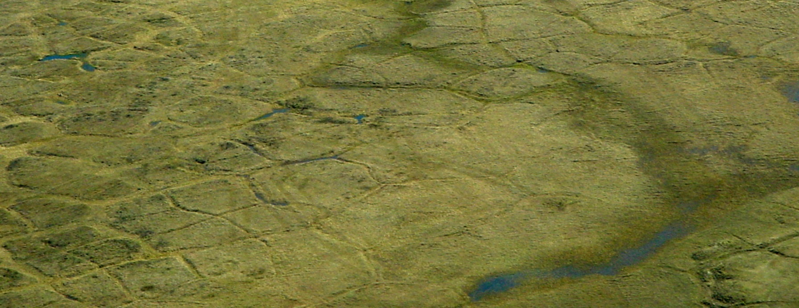
Texas A&M Engineering Experiment Station
Topic Area 1 |
Project: Simulation and Experiments of Strongly-Coupled Geomechanics and Flow for Gas Hydrate Deposits: Validation and Field Application
Objective: Investigate, experimentally and numerically, the geomechanical responses induced in hydrate-bearing sediments by depressurization, enhance numerical simulation technology in order to simulate complex physically coupled processes, and perform numerical analyses of field sites in the deep ocean (South Korea) and in permafrost areas (Alaska).
Duration:
36 Months
Start:
January 1, 2017
Total Funding
$1,331,414
End:
December 31, 2019
Aerial view of Alaska North Slope, Summer 2002 (Source: U.S. Geologic Survey)
Project Partner: LBNL, Korea Institute of Geoscience and Mineral Resources (KIGAM)
Notes:
Depressurization is typically used in order to extract methane from gas hydrates, but it may cause geomechanical problems such as subsidence, well failure, sanding, and fracturing. To predict reservoir behavior accurately, numerical modeling as well as advanced experiments that can properly reflect field-conditions is needed.
This project will focus on: 1.) advanced laboratory experiments, 2.) rigorous modeling and validation of the computer codes, and 3.) prediction from field-wide simulation. For the experimental study, we will consider various scales of depressurization tests, which can reflect the physical conditions of the Ulleung Basin area. Also, we will perform additional laboratory experiments to identify geomechanical responses induced by effective stress change, sanding, formation of secondary hydrates and capillary pressure.
For numerical simulation, a coupled flow-geomechanics simulator, T+MAM, in order to accurately model induced changes by depressurization and/or gas replacement, will be employed. We will develop additional capabilities for large deformation, strong capillarity, frost heave, induced fracturing, and enhanced permeability. Then, T+MAM will be validated with the aforementioned experimental data of coupled flow and geomechanics. In addition, we will extend the capability of the flow simulator to consider gas replacement, i.e., exchange between gas mixture and methane in hydrates. We will perform molecular simulation in order to capture accurate thermodynamic behavior of gas replacement, which can construct constitutive relationships for the reservoir flow simulation.
Finally, we will apply the serial and parallel T+MAM to the fields of the Ulleung Basin and PBU-L106/Ignik Sikumi. We will first specifically perform in-depth analysis on geomechanical behavior of the Ulleung Basin and PBU-L106 areas. For both areas, we will revisit previous numerical simulations, focusing on potential plastic failure and sanding. Additionally, we will investigate the potential for gas replacement for both fields, which might reduce geomechanical hazards and waste water.
The proposed research is based on international collaboration between the United States (Texas A&M University, Lawrence Berkeley National Laboratory) and South Korea (Korea Institute of Geoscience and Mineral Resources). Thus, the research outcomes can directly be used for development of the Ulleung Basin in South Korea and PBU-L106/Ignik Sikumi in Alaska, US. Broadly, the field-oriented experiments of the
Ulleung Basin will be able to interpret complex physical process in other oceanic gas hydrate deposits clearly. More importantly, the developed coupled flow-geomechanics simulator, T+MAM, will be available to other non-profit organization or academic institutions for the research of gas hydrate deposits.
Image sources:
https://www.flickr.com/photos/usgeologicalsurvey/10554252504/in/photolist-ogvPnb-h5DiyL-qFUErS

Slide 5
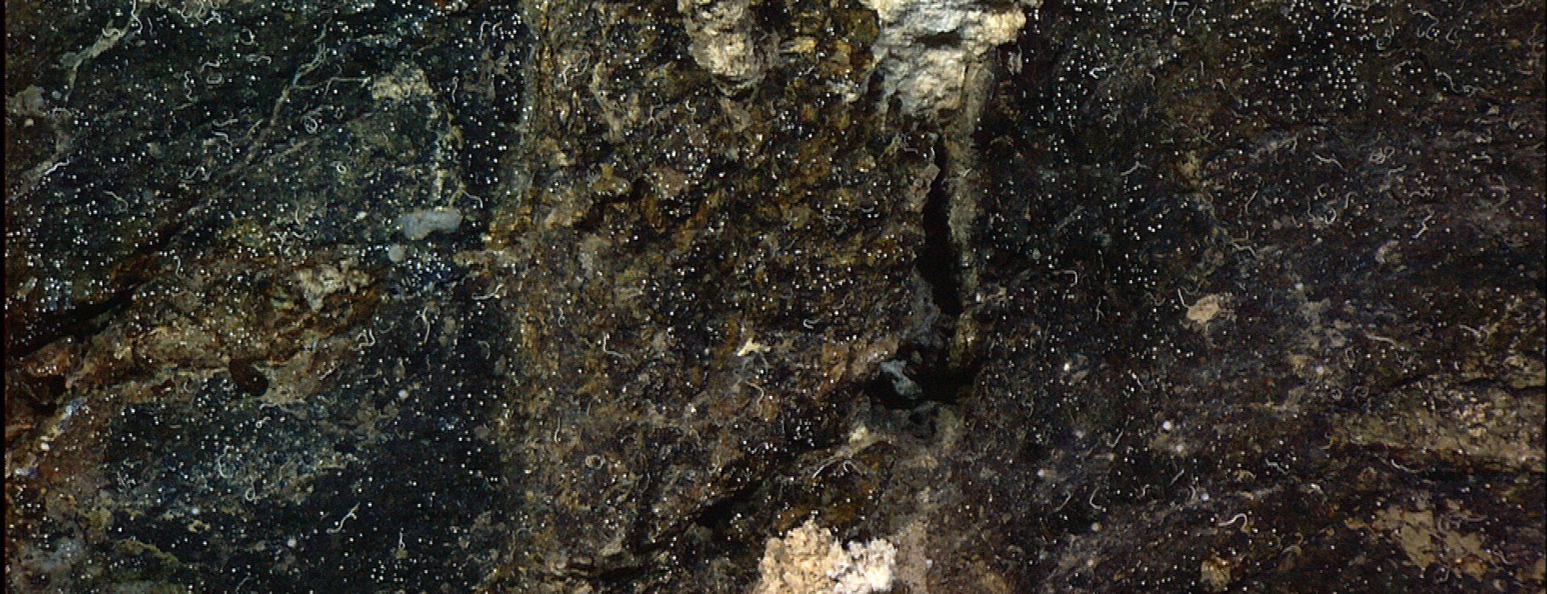
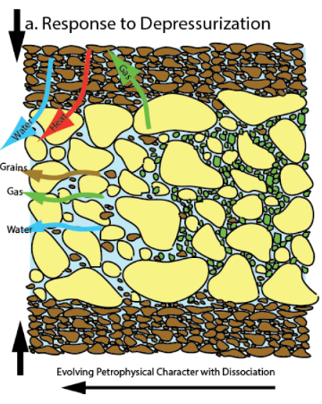
University of Texas at Austin
Topic Area 1 |
Project: A Multi-Scale Experimental Investigation of Flow Properties in Coarse-Grained Hydrate Reservoirs During Production
Objective: Quantify response of coarse-grained methane hydrate deposits to perturbation through analysis of the relative permeability behavior and depressurization response of methane hydrates from the micro (pore) scale to the the macro (core).
Duration:
36 Months
Total Funding
$1,499,991
Start:
September 1, 2016
End:
August 31, 2019
Depressurization of coarse-grained gas-bearing reservoirs, involving multiple coupled processes.
Notes:
Project Abstract:
Project Objectives:
We propose an interdisciplinary, multi‐scale, experimental investigation of flow properties in coarse‐grained hydrate reservoirs. Our ultimate objective is to provide a systematic understanding of relative permeability and dissipation behavior in these reservoirs. The results will inform reservoir simulation efforts, which will be critical to determining the viability of the coarse‐grained hydrate reservoir as an energy resource. We will perform our investigation at the macro‐ (core) and micro‐ (pore) scale.
At the macro‐ (core) scale, we will: 1) measure the relative permeability of the hydrate reservoir to gas and water flow in the presence of hydrate at various pore saturations; and 2) depressurize the hydrate reservoir at a range of initial saturations to observe mass transport and at what time scale local equilibrium describes disassociation behavior. Simultaneously, at the micro (pore) scale, we will 1) use micro‐CT to observe the habit of the hydrate, gas, and water phases within the pore space at a range of initial saturations and then image the evolution of these habits during dissociation, and 2) use optical micro‐Raman Spectroscopy to image phases and molecules/salinity present both at initial saturations and at stages of dissociation. We will use our micro‐scale observations to inform our macro‐scale observations of relative permeability and dissipation behavior.
Project Description & Methods:
This 36 month project will be conducted in two phases that will last 18 months each. In Phase 1, we will first demonstrate our ability to systematically manufacture sand‐pack hydrate samples at a range of hydrate saturations. We will then 1) measure the permeability of the hydrate‐saturated sand pack flow of a single phase (water or gas), 2) depressurize the hydrate-saturated sand packs and observe the kinetic (time‐dependent) behavior. Simultaneously we will build a micro‐CT pressure container and a micro‐Raman Spectroscopy chamber to image the pore‐scale habit, phases, and pore fluid chemistry of our sand‐pack hydrate samples. We will then make these observations on our hydrate‐saturated sand‐packs.
In Phase 2, we will measure relative permeability to water and gas in the presence of hydrate in sand‐packs using co‐injection of water and gas. We will also extend our measurements from sand‐pack models of hydrate to observations of actual Gulf of Mexico material. We will also measure relative permeability in intact samples to be recovered from the upcoming Gulf of Mexico 2017 hydrate coring expedition. We will also perform dissipation experiments on intact Gulf of Mexico pressure cores. At the micro‐scale we will perform micro‐Raman and micro‐Ct imaging on hydrate samples composed from Gulf of Mexico sediment.
Project Impact:
Methane hydrates within coarse‐grained marine reservoirs are a potentially enormous reservoir for methane. Previous and ongoing efforts are characterizing the concentration, distribution, and nature of these deposits. Now, the critical question is whether these hydrate reservoirs can be efficiently and environmentally produced. One of the most fundamental questions we must answer is how these reservoirs respond to perturbation induced by production. Perhaps the most critical behavior that we must understand is how the flow properties evolve during production: 1) what is the relative permeability of gas and water in the presence of hydrate? and 2) what are the local time non‐equilibrium behaviors that occur during perturbation? By answering these questions, this project will provide critical input to reservoir simulation efforts, which will help determine the viability of the hydrate resource. Furthermore, insights gained through this study may guide production strategies for this resource.
Image sources:
https://www.flickr.com/photos/noaaphotolib/5277864244/in/photolist-93orao-fQaJT6-8DcnYd-8DDouy-93or2E-8DDwdG-fUSXdp-93kigc-8EMk6y-8S57Mx-fQtUVU-w9c4LZ-8DtThw-8DcH4h-8TVr3b-8MVo7a-8DqMqx-93kimr-8S5aMi-jddves-8LWPqs-fQv2p3-8DcGWm-fNyTbz-8NJFHo-93kj3r-fNyT3x-fQcnVR-93oSbw-8RMCNK-fQbrST-8MVm7x-fQbtgx-fK67he-93kj4i-8TVrpL-8D9zE1-9gFhiA-fQtY5j-8LSyZm-fQdkF2-8TVpMC-fKf4x2-fKnvr7-8TSjqP-8TSjtP-9hfa5S-fQt2yS-fKwxt1-fQbChg

Slide 6
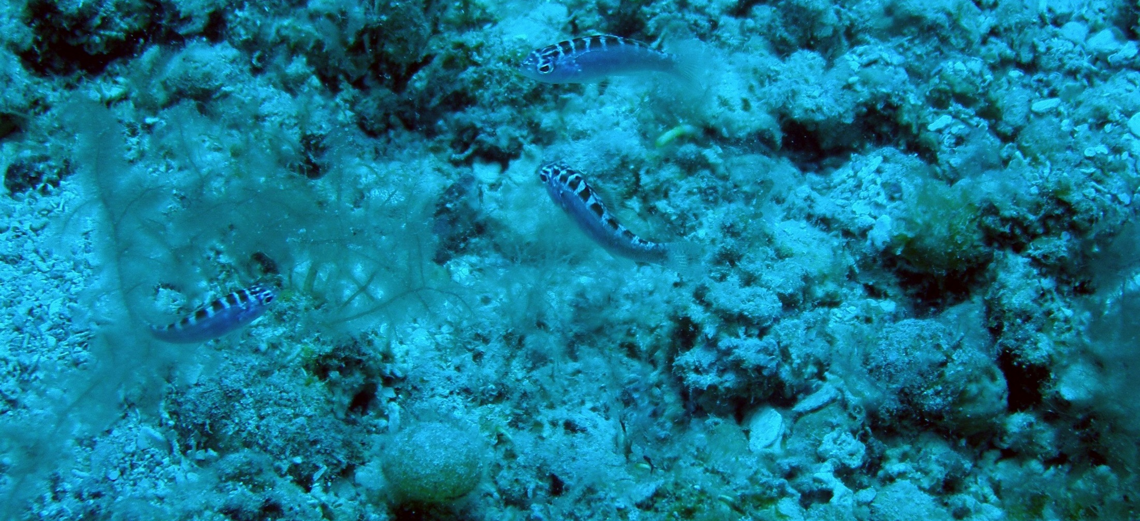
FY2016 Methane Hydrates
DOE-FOA-0001536
Corals, crucial to the marine ecosystem, are threatened by ocean acidification. (Source: National Oceanographic and Atmospheric Administration)
Topic Area 2:
Response of Methane Hydrate Systems to Natural Environmental Change
Texas A&M Engineering Experimental Station
University of California
University of Rochester
Notes:
Image sources:
https://www.flickr.com/photos/noaaphotolib/9730830221/in/photolist-fPT3NR-fNK31d-8Da43T-93mjuz-fUBmYn-93mkQX-93mk6D-fKJPtT-fNJ1yb-fKJNu4-fPT3hc-93mTMZ-fQbKTy-93mnUH-fUA5Ro-fL2reW-93pro5-jdbzvf-93prAf-fPSYnn-93mk4r-93osk1-93mngp-93mo7n-fNsZwe-fNsqKn-fQbLsy-jd9kmD-fQbJZ1-8MVnhZ-fPT6mX-93mjjk-fQbJU5-fNK933-fNr4tk-93pvHN-fPUFit-fNHBWQ-fPUW2H-fNHF8G-8MYtFo-fQbKhu-9fcqzU-8MVeQx-8JHtGa-fQaBmf-fJg3Dj-8MYtMy-93pvfs-fUBfKH

Slide 7
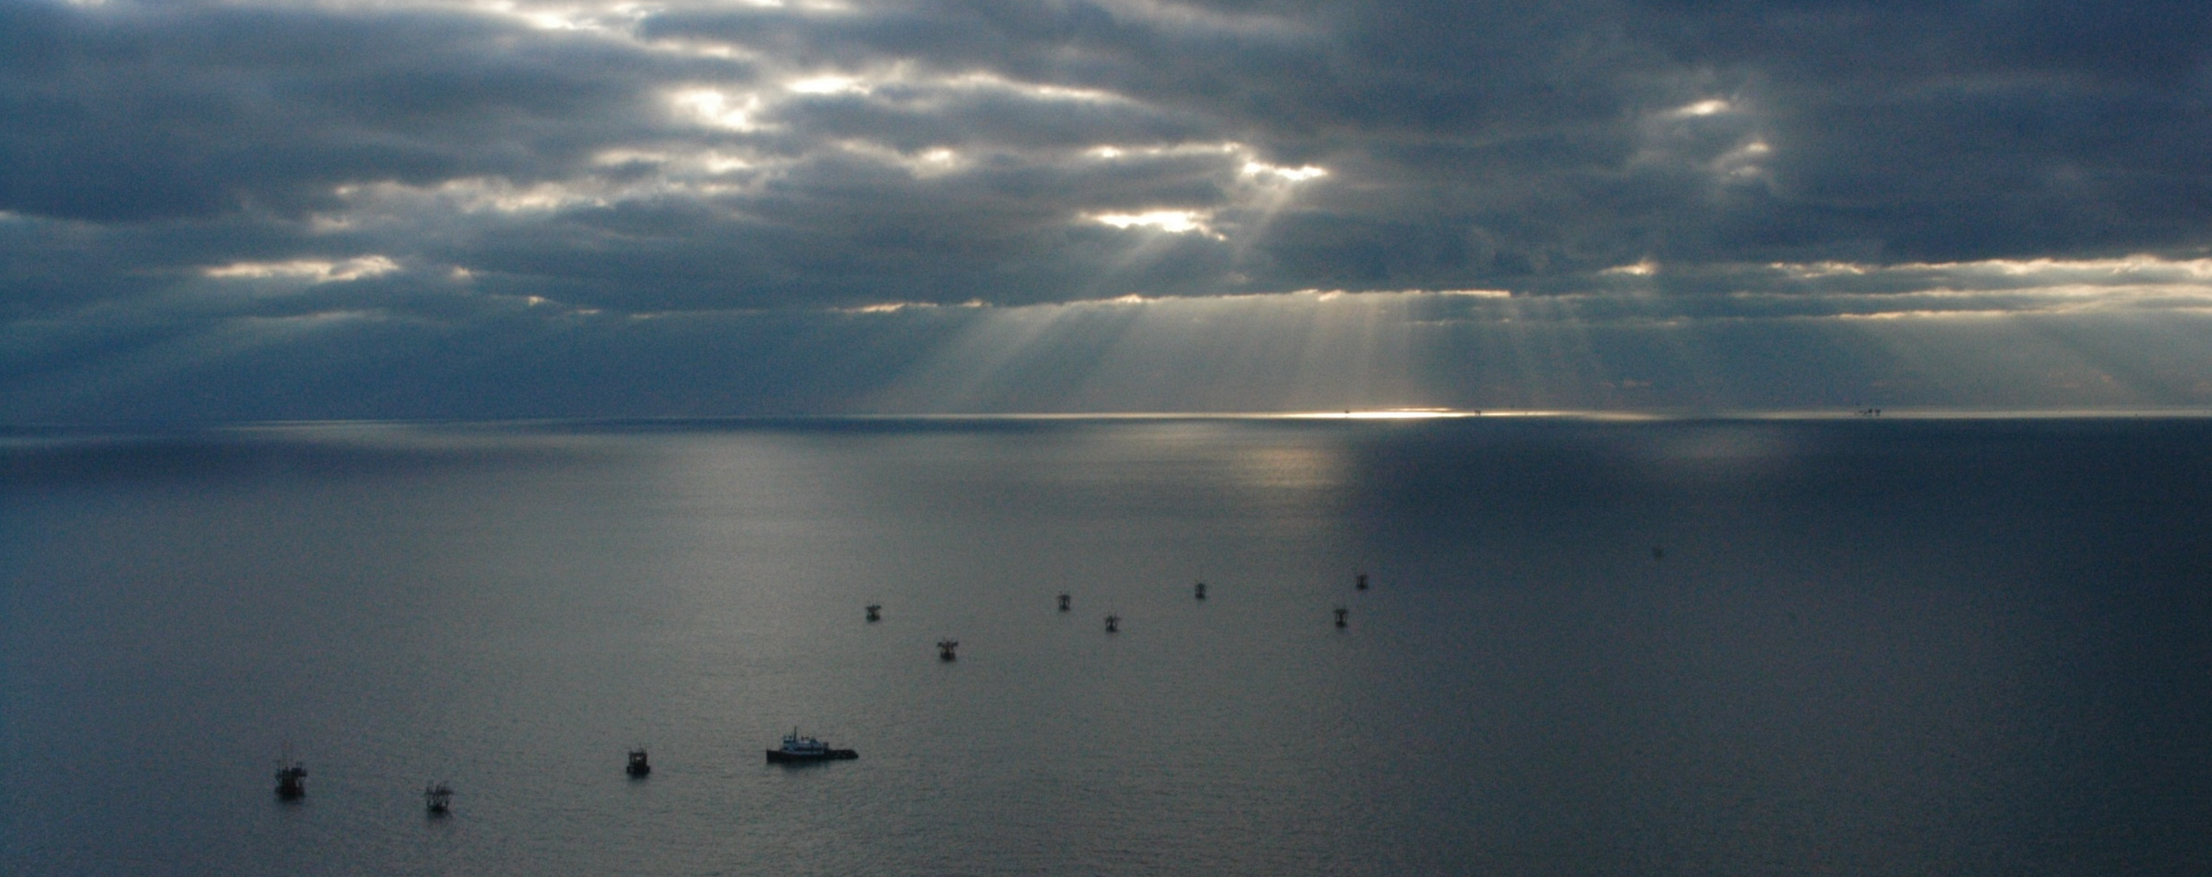
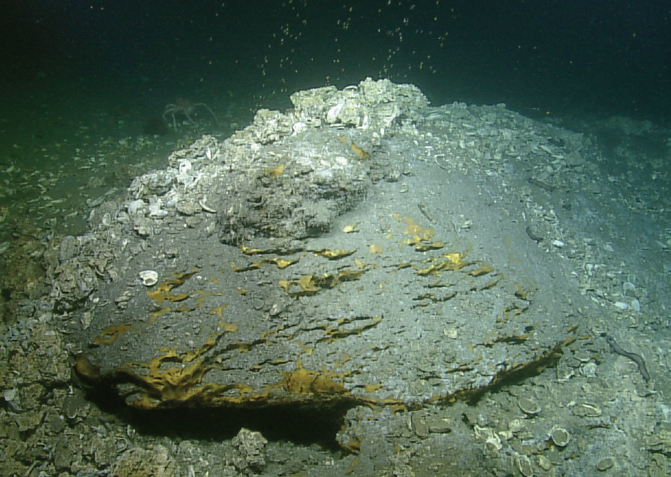
Texas A&M Engineering Experiment Station
Topic Area 2 |
Project: Dynamic Behavior of Natural Seep Vents: Analysis of Field and Laboratory Observations and Modeling
Objective: Use prior NETL-generated lab data (Image) and fieldwork (Acoustic) to address the fate of methane in the water column where hydrate bubble armoring occurs, refine and validate a predictive seep model, and demonstrate interpretation of multibeam echosounder data.
Duration:
36 Months
Total Funding
$452,031
Start:
January 1, 2017
End:
December 31, 2019
High-definition camera images from the Hercules ROV, taken in July 2014.
Winter sky over the Gulf of Mexico. (Source: National Oceanographic and Atmospheric Administration)
Project Partner: U.S. Geological Survey
Notes:
Project Abstract:
Acoustic and in situ observations of methane and gas bubble flares from natural seeps in the oceans increasingly demonstrate that gas hydrate deposits in the sediments and leakage of bubbles into the water column are ubiquitous occurrences on the continental margins around the world, including the coastlines of the United States and the Arctic. Bubbles that enter the water column transport methane vertically upward, and it is important to develop models to predict their dissolution and fate to understand the input of methane to the ocean-atmosphere system from methane hydrate deposits. Models exist in the literature to predict the bubble dynamics in the water column, but they are limited in their ability to predict the formation time for hydrate skins that can coat bubbles in the deep ocean and to understand the appropriate mass transfer rates for hydrate-coated bubbles. This application seeks to address this gap by synthesizing insight from existing high-pressure laboratory and in situ field data to refine and validate an advanced computer model for methane bubble dynamics and to demonstrate the model performance using field acoustic data from the Gulf of Mexico. This work is important to clarify the processes by which gas hydrate deposits, an important reservoir of the global carbon budget, are maintained and evolve within the natural ocean environment. The overarching goal of this project is to develop a computer model to predict the trajectory and dissolution of hydrate-coated methane bubbles originating from natural seeps. The model will be based on a model developed by the PIs, which will be refined and validated to explain fundamental laboratory and field observation of methane bubbles within the gas hydrate stability zone of the ocean water column.
This work responds to Topic Area 2 of the Funding Opportunity Announcement, Response of Methane Hydrate Systems to Natural Environmental Change, and the resulting model is necessary to clarify gas hydrate’s role in the global environment. Our approach will be to synthesize fundamental data from the National Energy Technology Laboratory’s (NETL) High Pressure Water Tunnel (HPWT) and field observations from the Gulf Integrated Spill Research (GISR) seep cruises conducted by the PIs the Gulf of Mexico to determine the dissolution pathways and mass transfer rates of hydrate-coated methane bubbles dissolving in the ocean water column. The validated model will predict the evolution of hydrate coated methane bubbles from the sea floor, including their rates of dissolution into the water column, to their point of maximum rise or the sea surface. This provides a holistic understanding of free methane gas in the ocean water column, which is important to predict dissolved methane input to the oceans from natural seeps, a key element of the global carbon cycle, and potential ventilation to the atmosphere, both under baseline conditions as well as in response to future climate scenarios.
We will obtain the fundamental insight necessary to refine and validate our existing seep bubble model by pursuing the following specific objectives:
Analyze existing data from the NETL HPWT. NETL has an existing state-of-the-art dataset of methane and propane bubble dynamics under a simulated deep ocean environment that was obtained in their HPWT. High-resolution, high-speed camera observations where made for bubbles rising in a counter-flow device under different pressures, pressure-profiles, and background gas concentrations. We will analyze this data using image processing to extract the formation time of hydrate coatings on methane bubbles, the mobility of the bubble-water interface by tracking hydrate crystals during hydrate skin formation, and to validate measurements of bubble shrinkage rates due to dissolution reported in NETL reports. This work will elucidate the fundamental mechanisms of hydrate formation, dissociation, and bubble dissolution and will provide the quantitative metrics needed for validation of the seep model, computed across all experiments in the dataset.
2. Synthesize data from the GISR natural seep cruises. Similar high-speed, high-resolution images were captured by a stereoscopic camera system mounted on a remotely operated vehicle (ROV) during the GISR seep cruises conducted by the PIs in 2014 and 2015 in the Gulf of Mexico. At the same time, two multibeam echosounders monitored the seep bubble flares: a Kongsberg M3 mounted on the ROV and a Kongsberg EM 302 mounted in the haul of the research vessel. The activities of this objective will extract quantitative metric from the image data and synchronize the extracted bubble characteristics with the acoustic datasets.
We will also develop standard algorithms from the literature to obtain quantitative information directly from the acoustic data and the seep model.
Together, these data give field relevance to the fundamental NETL laboratory data and provide an optimal dataset to refine and validate the seep model and demonstrate its utility.
3. Refine and validate the seep model to predict available data. In this objective we will adapt our existing seep model to match the laboratory and field metrics obtained in the prior two objectives for methane bubble dynamics. The model is an extension of standard models in the literature that includes complex hydrocarbon equations of state with an innovative method to predict the formation time for hydrate-coatings on natural gas bubbles. The model has been developed and validated to the limited, and mostly indirect, data in the literature. The major step achieved by this project will be to adapt the model based on the detailed data available the NETL HPWT and the GISR seep cruises.
The resulting modeling system will accurately predict the evolution of hydrate-coated methane
bubbles in the ocean water column.
4. Demonstrate the capability of the seep model to interpret multibeam data. This final objective will
utilize the finalized seep model to interpret bubble concentration from the acoustic data from the
GISR seep cruise. Quantitative algorithms for acoustic data require a prediction of the bubble size
distribution, which will come from the seep model. We will also use a laboratory calibration for
bubbles at low pressure (i.e., no hydrate skins) for the M3 combined with the field data to test for an
acoustic signature of the hydrate coatings on the field bubbles. Because we have simultaneous
measurements of the bubble concentration and sizes from the stereoscopic camera system on the
ROV, we will be able to quantify the performance of the acoustic results and model performance.
Hence, this work will demonstrate and quantify the capability of the new seep model when applied to
interpret remote-sensed acoustic data.
Ultimately, the main outcome and benefit of this work will be to clarify the processes by which hydrate coated methane bubble rise and dissolve into the ocean water column, which is important to predict the
fate of methane in the water column, to understand the global carbon cycle, and to understand how gas
hydrate deposits are maintained and evolve within geologic and oceanic systems, both at present baselines
and under climate-driven warming.
Image sources:
https://www.flickr.com/photos/noaaphotolib/5182062660/in/photolist-8TVqFW-8LSy8J-8UphK4-fHGHFr-fQdRJK-8LPw24-8UpjyX-8UpgWV-8MVgin-8Upjki-fQvr2E-8Usdho-8UsmBN-8UpjmM-8Usneq-93kjwP-8Upjo8-8Usorm-8LSyo7-8UsqRd-93ov37-8Usp1o-8Da47D-8QscHM-8Up9L4-8D9g2P-8DcHFm-8Usmks-fQbBYR-8UpnyK-8UsegE-8UpjwV-8UscFE-8Upirp-8EMq6V-8Da4cr-8UsdX7-8UpgCz-8Usp2j-8Up8sH-8UpktM-8UsmAN-8LSya7-8UpjhT-8Uph1p-8UpjFi-8Usm47-8UpiPa-8Usdeu-fQt61Y

Slide 8
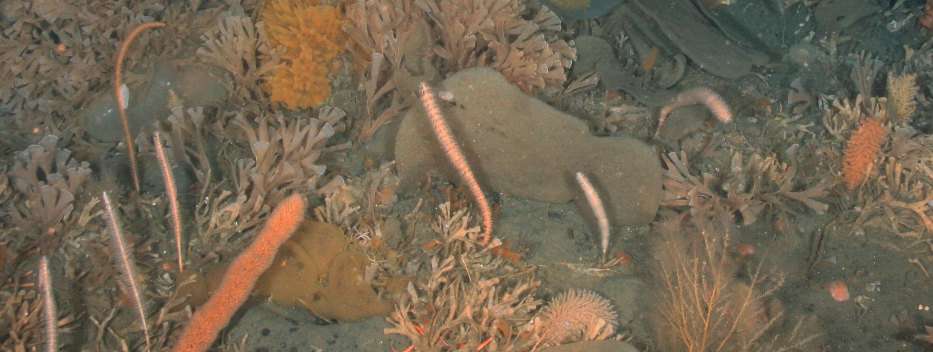
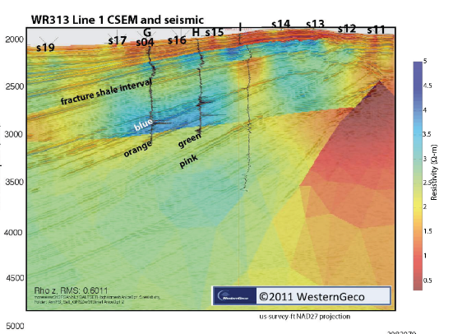
University of California
Topic Area 2 |
Project: Characterizing Baselines and Change in Gas Hydrate Systems using EM Methods
Objective: Collect lab and field data to assess the efficacy of the use of controlled-source electromagnetic (CSEM) technology to contribute to locating and characterizing marine gas hydrate deposits as a complement to other data sources (cores & well logs). Advance understanding of hydrate electrical conductivity as a function of sediment type, gas chemistry, and fluid content. Quantify the conductivity changes associated with hydrate dissociation.
Duration:
36 Months
Total Funding
$755,665
Start:
October 1, 2016
End:
September 30, 2016
Vertical resistivity obtained from anisotropic inversions of seafloor node data.
Partners: Advisian; Scripps Institution of Oceanography; Ocean Floor Geophysics; Lawrence Livermore National Laboratory
Notes:
Project Abstract:
Our knowledge of sub seafloor geology relies largely on seismic data and cores/well logs obtained from vertical boreholes. Both of these methods are important – boreholes provide direct access to seafloor rocks and allow geological, geochemical, and physical properties to be studied, and the resolution and coverage of the seismic method provides structural information, as well as estimates of elastic properties, over large areas. Over the last decade or so a third method, marine controlled source electromagnetic (CSEM) sounding, has emerged as an important exploration tool. Although
of intrinsically lower resolution than the seismic method or well logs, CSEM sounding represents a
complementary method in that it provides estimates of electrical resistivity over significant volumes
of seafloor. Resistivity is an important physical property that varies over many orders of magnitude
in common rocks and is driven by changes in geology that can exhibit little, or no, change in seismic
properties.
As quantified by our own earlier work, gas hydrate is 10,000 times more resistive than pore fluids
typical of seafloor sediments, making electromagnetic methods a useful geophysical approach to
studying its geology. However, the deep ocean CSEM methods that have been developed by both
academia and industry either rely on deployed receivers that are not ideally suited to studying
Near seafloor geology such as hydrate, or surface towed systems that can only operate in water too
shallow for hydrate to form. To address this we have developed a deep towed receiver system (the
“Vulcan” system) specifically to image seafloor gas hydrate. The Vulcan system was originally
designed to supplement deployed nodes, but recent improvements have allowed multiple receivers
to be towed near the seafloor at source–receiver offsets of 1,000 m or more. The system not only
produces data that are more dense and of higher quality than from deployed nodes, but the increased
offsets obviate the need to deploy seafloor instruments, making the system very much cheaper to
use (and certainly cheaper than boreholes or seismics). Unfortunately, the only extensive use of this
new system has been proprietary surveys to image hydrate offshore Japan, and this proposal seeks
to collect similar data in US waters that can be published and shared with the hydrate community.
Much naturallyoccurring
hydrate exists at the edge of thermodynamic stability, and is thus susceptible
to environmental change. Given the relatively low cost of collecting Vulcan data and the
significant electromagnetic signature of hydrate systems, we believe that electromagnetic methods
provide an ideal way to monitor such changes. To determine if this is indeed so, we need to (i)
collect baseline images of natural gas hydrate systems using our CSEM system to determine what
resolution we are capable of and (ii) make laboratory measurements of hydrate conductivity during
changes at the edge of the stability field. We are in an excellent position to do both these things,
since the Vulcan system has been well tested on the Japanese projects and under previous DoE
funding we developed an electrical conductivity cell designed to synthesize hydrate while making
conductivity measurements.
To achieve our objectives we will collect extensive 3D Vulcan data sets over two or three prospects
in the Gulf of Mexico where drilling and coring of hydrate systems have been, or will be, carried
out (Green Canyon 781, Walker Ridge 313, and Orca Basin/WR100). We will use the research
vessel R.V. Pelican, a capable but inexpensive vessel that operates out of Cocodrie, Louisiana, less
than a day’s transit from the proposed study areas. CSEM data will be inverted using a recently
developed, state of the art 2D inversion code (MARE2DEM), using constraints from seismic data to
improve resolution. While towed CSEM data are well suited to 2D inversion, this will be verified
by carrying out 3D forward modeling based on the inversions.
In parallel with the field data collection, we will carry out laboratory measurements of hydrate
conductivity to extend our understanding of what physical and chemical parameters control conductivity.
In our previous studies we made the first ever electrical resistivity measurements on pure
methane hydrate, then measured methane hydrate mixed with quartz sand or silica beads in known
proportions. For the proposed work, we will study the effect of adding silt to clean sand, modifying
the impurities, and measuring the conductivity of CO2 hydrate. Importantly, our cell is capable of
making conductivity measurements while hydrate is destabilized either by increasing temperature
or decreasing pressure, so a high priority will be to measure conductivity changes associated with
small amounts of water generated during destabilization. This work will be carried out at the USGS
gas hydrate laboratory in Menlo Park, California. Follow up analysis of samples to determine the
arrangement and distribution of the phases within them will also be carried out at the USGS in
Menlo Park, using cryogenic scanning electron microscopy. The results of these laboratory studies
will then be used to quantitatively interpret conductivities obtained from inversion of the field data.
Finally, the conductivity studies will be integrated with available data from well logs, coring, and
seismic studies in order to best understand the geological systems.
We have assembled an excellent team to carry out this project. The PI, Steven Constable, runs the
Marine EM Laboratory at the Scripps Institution of Oceanography, the best facility of its type in
the world. The postdoc he will be advising, Peter Kannberg, dedicated his PhD work to developing
CSEM methods to study hydrate. Together they will lead the field data collection. Laura Stern, at
the United States Geological Survey Gas Hydrate Laboratory, will supervise the sample synthesis
and destabilization runs and will conduct all posttest imaging by cryoSEM. Wyatt Du Frane, of Lawrence Livermore National Laboratory, headed up our previous laboratory studies while a
postdoc, and now will be supervising a new postdoc, Davide Novella, to make the conductivity
measurements. Our industry partners, Ocean Floor Geophysics and Advisian, will contribute
personnel who were involved in the Japanese data collection to our work aboard the R.V. Pelican.
Our work will lead to a better understanding of the geological systems associated with gas hydrate,
as well as demonstrate the capabilities of using electromagnetic methods to study environmentallyinduced
changes (and, incidentally, changes during production). Our studies will also lead to better
interpretations of resistivity logs collected in wells.
Image sources:
https://www.flickr.com/photos/noaaphotolib/27388634293/in/photolist-fQbvbe-jdb6wu-fQt5Gu-fQbuMF-9gpEvj-8LPvhX-9gmAwM-HJeULD-HJiJ5S-HJeUwk-JaboGg-Ja9chN-jdakv2-fQsekN-8JHs1H-8Qsdft-jdb6SE-8MVhDc-HJeUDp

Slide 9
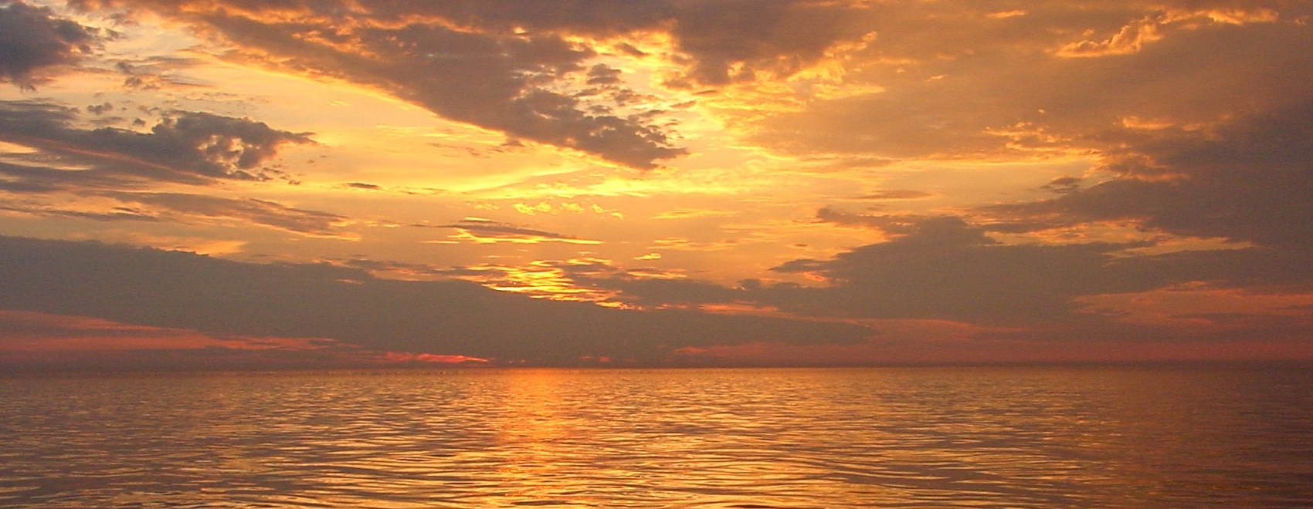
University of Rochester
Topic Area 2 |
Project: Characterizing Ocean Acidification and Atmospheric Emission Caused by Methane Released from Gas Hydrate Systems along the U.S. Atlantic Margin (USAM)
Goal: Conduct new field acoustic surveys, water sampling and geochemical analyses, designed to investigate how methane, potentially released from gas hydrates systems, can impact ocean and atmospheric chemistry.
Duration:
36 Months
Total Funding
$1,111,686
Start:
October 1, 2016
End:
September 30, 2016
Sunset on the Atlantic. (Source: National Oceanographic and Atmospheric Administration)
Notes:
Project Abstract:
Evidence suggests that methane hydrates occurring at the “feather edge” of their stability zone on upper continental slopes of global marine margins are now undergoing dissociation due to the impingement of warming intermediate ocean waters, a process also invoked in the “Clathrate Gun Hypothesis” for the Late Quaternary. Recent studies show that the uppermost ocean has absorbed much of the excess heat associated with Earth’s greenhouse warming over the past few decades. Thus, methane hydrate outgassing now underway on upper continental slopes is expected to continue and eventually affect even deeper parts of the continental slope gas hydrate province. Despite the progress on identifying loci and mechanisms for upper slope gas hydrate degradation, critical questions--indeed even conflicts--remain about the impact of the released methane on the climate system. Some predict that catastrophic methane release to the ocean atmosphere system from dissociated marine hydrates will lead to enhanced global warming due to the elevated greenhouse gas potential of atmospheric methane. Finding no evidence that methane from upper continental slope seep sites crosses the sea-to-air interface, others argue that gas hydrate degradation may be relatively benign for the climate system. Resolving these conflicting perspectives has implications for climate-hydrate interactions, the global carbon cycle, and even the environmental impact of eventual methane production from deepwater gas hydrates.
We propose a three-year project focused on quantifying the impact of gas released from methane hydrates (or, by analogy, from an hypothetical leaking deepwater methane hydrate production well) on the ocean-atmosphere system using hundreds of newly-discovered methane seeps along the northern US Atlantic margin upper slope as a natural laboratory. In the area of highly concentrated seeps south of Wilmington Canyon, methane is not only emitted from the seafloor to the adjacent overlying waters, but also transported southward towards Cape Hatteras, having a cumulative impact on ocean chemistry and potentially sea-to-air methane flux along this trajectory. Building on our previous pilot study in Hudson Canyon, we will measure geochemical parameters in seawater to infer the release rates of methane from gas hydrates systems into seawater, the extent of methane oxidation and conversion into carbon dioxide, and the influence of methane-derived carbon dioxide on dissolved inorganic carbon chemistry, pH, and the buffer capacity of seawater. Our previous work in Hudson Canyon found that the emission and oxidation of methane at the updip limit of gas hydrate stability has minor influences on DIC and pH in that specific region. However, even if similar emissions and oxidation efficiencies exist at other seeps along the northern US Atlantic margin, the southward flowing current has the ability to accumulate these inputs and lead to substantial changes in dissolved carbon dioxide.
We will undertake a 13-day research cruise on the R/V Sharp to acquire samples and geochemical and sea-air flux data and to conduct water column gas plume imaging to support this study. Geochemical sampling will be conducted over more than 300 seeps arrayed in clusters along a 400 km upper continental slope (200-500 m water depth) swath between Wilmington Canyon and Cape Hatteras. Exhaustive hydroacoustic surveys will constrain methane inputs to the water column by providing the precise locations of seeps, characterizing the height of methane bubble plumes above the seafloor, and inferring volumetric flow of methane from these potential sites of gas hydrate degradation. Water sampling for geochemical analyses will be focused on five downslope transects and selected locations between transects.
When combined with the along-slope surveying, the resulting data will provide a three dimensional perspective on the distribution of methane and high-resolution measurements of pH changes and the accumulation of CO2 derived from methane oxidation as a function of depth along the transects. During the cruise we will measure the sea-to-air flux of methane from upper slope emission using a side-by-side comparison of two underway systems, one that will detect general trends and one that can find localized hotspots of methane emissions that may have been missed in previous studies. The research will use two new state-of-the-art techniques, one that enables the ultra-high resolution mapping of dissolved methane concentration gradients in surface waters to correctly identify both regional and local features, and the other that allows for very high sensitivity and precision in the analysis of the natural radiocarbon content of dissolved methane for fingerprinting the methane source. Post-cruise, we will complete the geochemical measurements and use data on the concentration of dissolved methane and CO2 derived from methane oxidation in a numerical model to constrain methane emissions from the top down. The result will be compared with a bottom-up estimate of methane emissions derived from analysis of the hydroacoustic data, with bubble sizes constrained in a few locations by high-definition video that we will collect during the water sampling. Taken together, the geochemical, hydroacoustic, and sea-air flux data acquired for this project will provide the most complete assessment ever undertaken of the true ocean-atmosphere impact of methane emissions that could be sourced in upper slope gas hydrate dissociation, thereby contributing to the resolution of the debate over the synergy between warming climate and gas hydrate breakdown.
Image sources:
https://www.flickr.com/photos/noaaphotolib/5057402575/in/photolist-8GUvA8-8UphkZ-8UphF2-8UpkSx-8UspzN-8UsqLN-8UpjyX-8Upjdg-8Up8sH-8Usrx5-8MVmHv-8Usp1o-w8PcpT-vbWUq4-wp3ra1-93onKf-8UscTh-8Usdoq-8UsoxY-8UphMB-8UpitZ-8MYp9E-itsbC9-8LPwEe-8D9fPi-9gmArT-93kkbB-itrCER-8LSyWf-9fdp2j-93km6a-93kmot-93otHA-93km7p-93otMN-93oszG-93ot5m-93kkh4-93kke2-93otPE-93otKu-93kmbg-93kjZX-8RMBzi-93otCE-93kkmx-93kmg4-8UsoFu-8MVjhD-x4ywUV

Slide 10
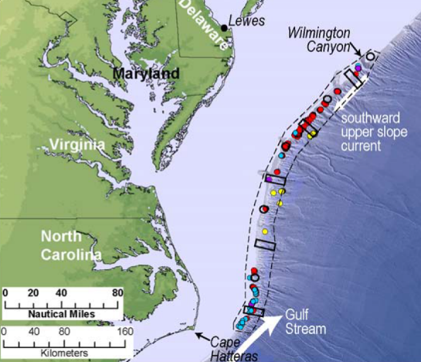
University of Rochester
Topic Area 2 |
Project Title: Characterizing Ocean Acidification and Atmospheric Emission Caused by Methane Released from Gas Hydrate Systems along the U.S. Atlantic Margin (USAM)
Objective (As Proposed): “Determine how methane seepage from the US Atlantic Margin (USAM) upper continental slope near the up dip limit of gas hydrate stability affects ocean chemistry and sea-to-air greenhouse gas flux in three-dimensions and how this seepage interacts with oceanographic phenomena (e.g., southwardly flowing currents) to create hypothesized hotspots of elevated pH (i.e., acidification potential).”
Partners: U.S. Geologic Survey
Occurrence of methane seeps detected hydroacoustically along the northern USAM. (Source: Project Narrative)
Sunset on the Atlantic. (Source: National Oceanographic and Atmospheric Administration)
Notes:
Image sources:
https://www.flickr.com/photos/noaaphotolib/5057402575/in/photolist-8GUvA8-8UphkZ-8UphF2-8UpkSx-8UspzN-8UsqLN-8UpjyX-8Upjdg-8Up8sH-8Usrx5-8MVmHv-8Usp1o-w8PcpT-vbWUq4-wp3ra1-93onKf-8UscTh-8Usdoq-8UsoxY-8UphMB-8UpitZ-8MYp9E-itsbC9-8LPwEe-8D9fPi-9gmArT-93kkbB-itrCER-8LSyWf-9fdp2j-93km6a-93kmot-93otHA-93km7p-93otMN-93oszG-93ot5m-93kkh4-93kke2-93otPE-93otKu-93kmbg-93kjZX-8RMBzi-93otCE-93kkmx-93kmg4-8UsoFu-8MVjhD-x4ywUV

Slide 11
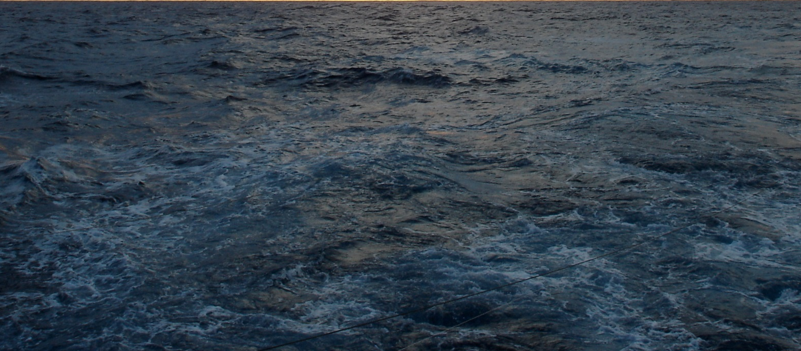
FY2016 Methane Hydrates
Financial Summary
Image Source: National Oceanographic and Atmospheric Administration
Notes:
Image sources:
https://www.flickr.com/photos/noaaphotolib/11468877564/in/photolist-itsZJm-fKf6Z4-93mbZn-8F3Pn2-fNRsY7-93q6nG-8Ussod-93mdC8-93q6B7-8F71LW-93kHdV-8GUvmB-fNyUyp-fNTmkf-8KcFra-8GmSiu-8F714A-8F71Nj-8F6ZQd-8F3QNT-8EMrfT-8D6tdz-8UssWY-8NUYJ8-8F6Z9G-9gnHdD-93pki1-93mbYa-93oFU7-9gFheW-93mouD-8NFupp-93q7wm-93oKUf-8JHs7p-9gEPR9-8TVpMC-8EJ9gH-fNRp2L-8DArcx-8F71DL-8GUvNv-93q6Wj-8U9cye-93pm6y-8GHP5f-93pm1C-CRj1p5-w8LJU2-vRamij

