Slide 1
CSP ELEMENTS: High-Temperature Thermochemical Energy Storage with Redox-Stable Perovskites
Colorado School of Mines & National Renewable Energy Lab
Project Timeline: May 1, 2014 – August 30, 2016
Project Budget: DOE – $1,008,510, Cost Share – $306,111
Prof. Greg Jackson, Principal Investigator CSM
Prof. Robert Braun, Co-Investigator, CSM
Dr. Zhiwen Ma, Co-Investigator, NREL

Slide 2
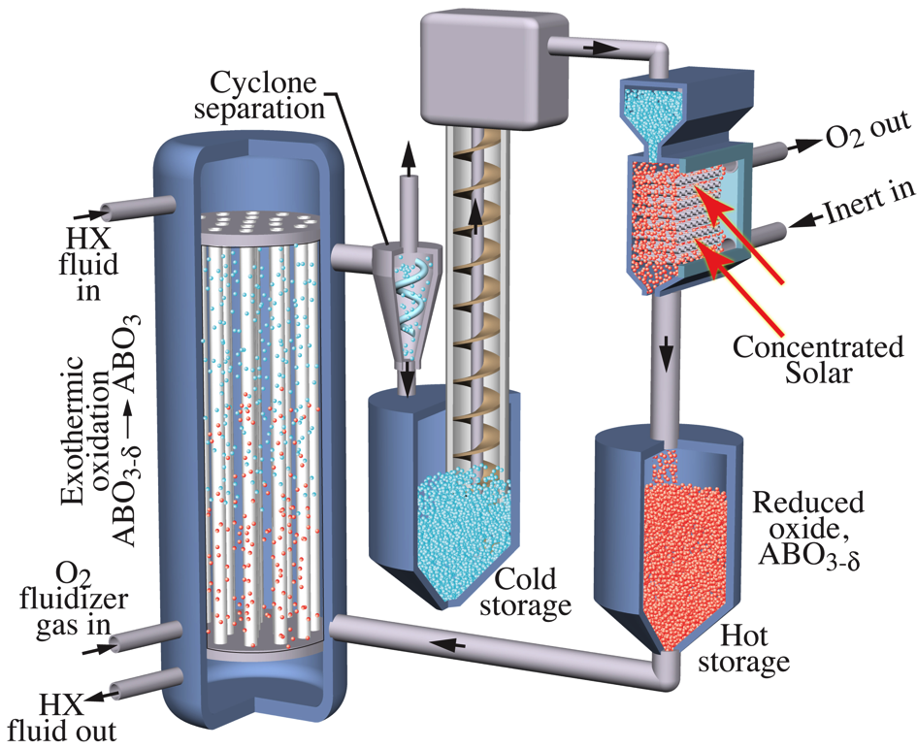
Overview: Concept and Team
Can reducible oxide particles be used for thermochemical energy storage (TCES) at T_{hot} > 700 °C?
Can compositions from earth-abundant cations like Ca and Mn provide high TCES at industrial O₂ pressures, P_{O2} ≥ 10⁻⁴ bar?
Can reactive particle receiver be designed to access TCES effectively?
  CaMnO₃ (@ T_{cool} ≤ 500°C & P_{O2} ≈ 0.2 bar) + heat
  CaMnO_{3-Δδ} (@ T_{hot} ≥ 900°C & P_{O2} = 10⁻⁴ bar) + Δδ/2.O₂
CSM: Profs. Greg Jackson (PI), Rob Braun, & Ryan O-Hayre, Michael Sanders
Students: Kevin Albrecht, Luca Imponenti, Daniel Miller, Rounak Kharait, & Jake Wands
NREL: Zhiwen Ma, Janna Martinek, Judy Netter, Tim Wendelin, & Victor Castillo
Former Abengoa Solar Team Members: Christina Vader, Daniel Cooney

Slide 3
Overview: Value Statement and Project Objectives
High specific TCES needed for dispatchable utility power demands.
  Efficient power blocks (supercritical -CO₂, regenerative Brayton) have T_{cool} (> 400 °C) and T_{hot} (between 800 & 1000 °C above molten NO₃-salt storage limits)
Objective: Demonstrate highly reducible, redox-stable perovskites:
  for ≥ 750 kJ/kg of TCES between T_{hot} = 900 °C and T_{cool} = 500 °C,
  with adequately fast reduction and oxidation kinetics for receiver and reoxidation reactors with ≥ 200 μm diameter particles,
  with stable composition for > 1000 redox cycles between 500 and 900 °C for potential integration with a supercritical CO₂ cycle.
Undoped CaMnO₃ has high reducibility at 900 °C and P_{O2} = 10⁻⁴ bar, but cation doping needed to mitigate phase decomposition.
Objective: Design and demonstrate a 10 X 10 cm particle receiver to achieve 90% storage efficiency at 1000 kW/m² solar energy flux.
B-Site Doping: CaCr_{y}Mn_{1-y}O_{3-δ}
A-Site Doping: Ca_{1-x}Sr_{x}MnO_{3-δ}

Slide 4
Overview: Current Budget Period (Phase II) Tasks
Task 2.1: Identification of Optimal TCES with doped CaMnO_{3-δ}
  2.1.1: Thermodynamic measurements for Δh_{chem} of doped CaMnO_{3-δ}
  2.1.2: Kinetic measurements for Δh_{chem} of doped CaMnO_{3-δ}
  2.1.3: Measurements for redox cycling stability
Task 2.2: Evaluation of Particle Reactor/Receiver Reqs. and Design
  2.2.1: Adapting simulation tools developed for prototype receiver design
  2.2.2: Simulating particle reduction process in full receiver model
Task 2.3: Sub-scale Prototype Receiver Testing at NREL’s HFSF
  2.3.1: Design and assemble receiver test facility for HFSF
  2.3.2: Inert particle receiver testing at HFSF
  2.3.3 – 2.3.4: Reactive particle receiver testing for performance
  2.3.5: Adapting receiver models to compare with experimental measurements

Slide 5
Task 2.1: Optimal TCES with doped CaMnO₃
Simple view of TCES
  Point defect model to equilibrium P_{O2} vs. δ over range of T.
  Point defect reactions:
  Δh and Δs⁰ of R1 and R2 give measure of how overall Δh_{red} varies with δ.
  Fitted values of Δh_{red} compare well to differential scanning calorimetry.
Δh_{sens}
Δh_{chem}

Slide 6
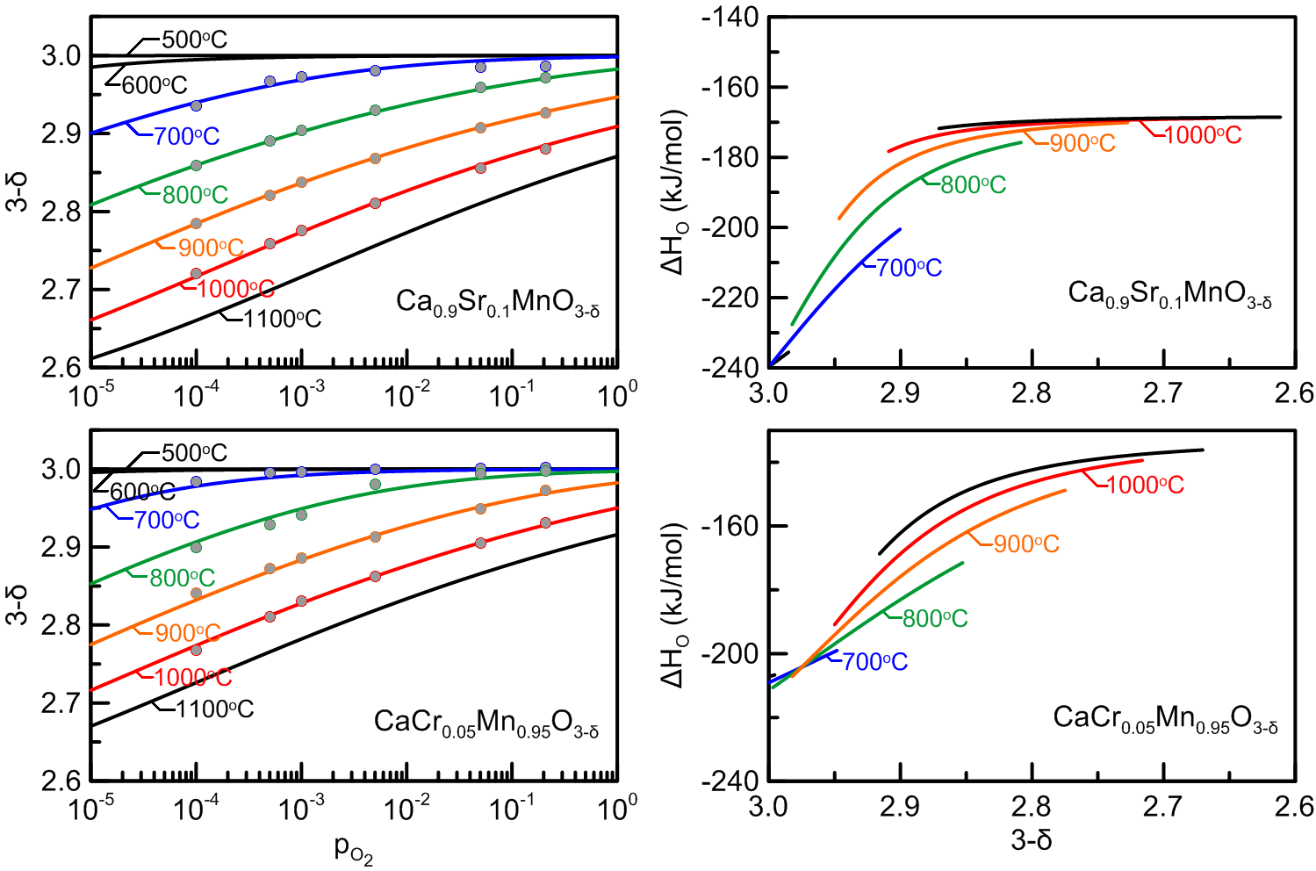
Task 2.1: Optimal TCES with doped CaMnO₃
Examples of point defect fits for promising compositions:
How much of TCES limit can be kinetically achieved in receiver?

Slide 7
Task 2.1: Kinetics of TCES and Release for Doped CaMnO₃
Milestones are defined by kinetic values:
  2.1.1: Δh_{chem} stored ≥ 400 kJ.kg⁻¹ in 60 s at 900 °C & P_{O2} = 10⁻⁴ bar
  2.1.2: Δh_{chem} released ≥ 400 kJ.kg⁻¹ in 60 s at 800 °C & air
  2.1.3: Δδ = 0.25 after heating and 60 s exposure to 900 °C in P_{O2} = 10⁻⁴ bar for ≥ 1000 redox cycles
Kinetic tests performed in annular packed bed reactor in rapid-heating near-IR lamp furnace
  2-cm bed of 250 – 425 μm particles with embedded TCs on central Al₂O₃ tube
  Constant T redox for a range of P_{O2} to fit
  rate parameters for kinetic modes of
  CaCr_{0.10}Mn_{0.90}O_{3-δ,} CaCr_{0.05}Mn_{0.95}O_{3-δ},
  Ca_{0.90}Sr_{0.10}MnO_{3-δ} and Ca_{0.95}Sr_{0.05}MnO_{3-δ}.
  Redox cycle testing for 1000 cycles between
  500 °C in air and 900 °C P_{O2} = 10⁻⁴ bar.

Slide 8
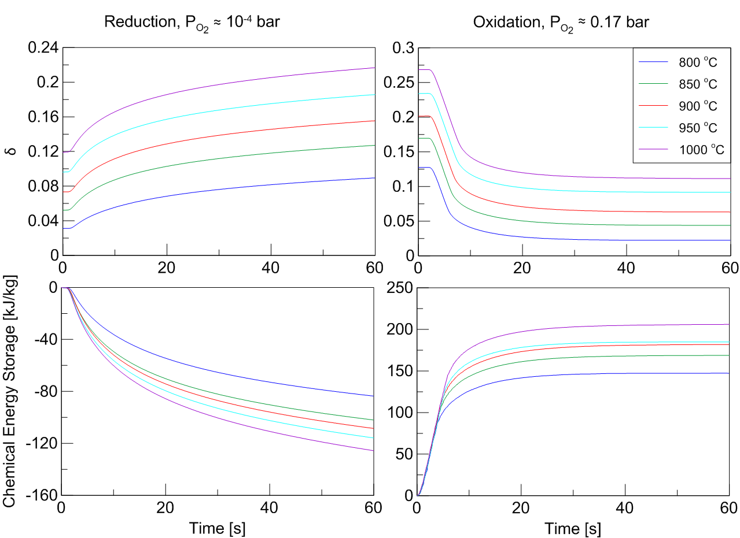
Task 2.1: Kinetics of TCES and Release for Doped CaMnO₃
Integrated change in δ for Ca_{0.9}Sr_{0.1}MnO_{3-δ} particle bed during isothermal reduction and oxidation
  Reduction slower
  than oxidation and
  does not reach
  milestone.
  Sr-doped CaMnO₃
  shows significant
  reduction with
  heating in air.
  Multistep kinetics
  fit to data for
  design models.

Slide 9
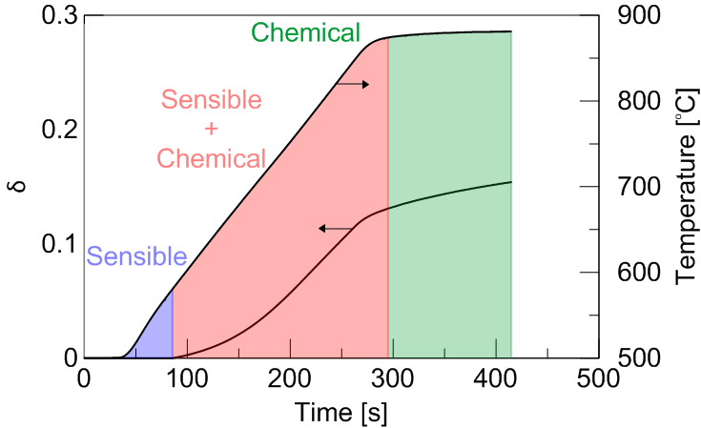
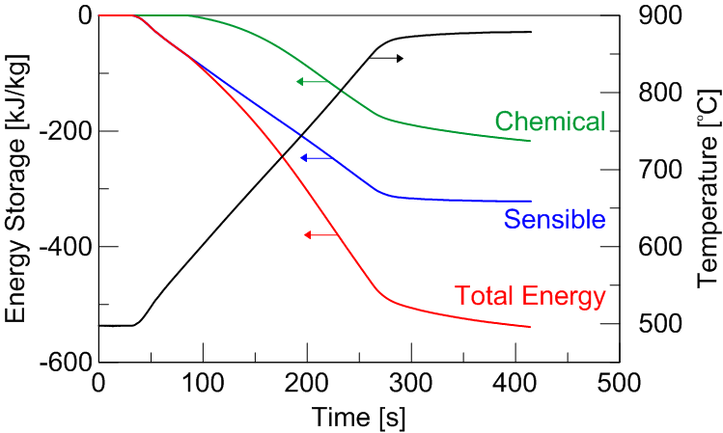
Task 2.1: Kinetics of TCES and Release for Doped CaMnO₃
Breakdown of energy storage during heating and reduction of 2-cm bed of Ca_{0.9}Sr_{0.1}MnO_{3-δ}
Chemical energy storage picks up after T > 700 °C and accounts for ≈ 40% of TCES.
CSP receiver design must manage falling particles to achieve adequate residence time and heat transfer for particle reduction.
Gas management to maintain low P_{O2} environment is critical for success of design.

Slide 10
Task 2.2: Evaluation of Particle Reactor/Receiver Design
Internal receiver particle-reacting flow models to evaluate:
  Gas and particle flowrates
  Operating conditions
  Geometric parameters
Receiver modeling approach:
  1-D, multiphase, multi-region conservation equations with gas and solid in counter flow
  Dusty gas model for convection and diffusion across the mesh
  Solar heat addition has been correlated to NREL CFD calculations of geometry
HFSF prototype receiver design illustrating geometry, near-wall solid-gas emulsion, and internal volume for gas evolution

Slide 11
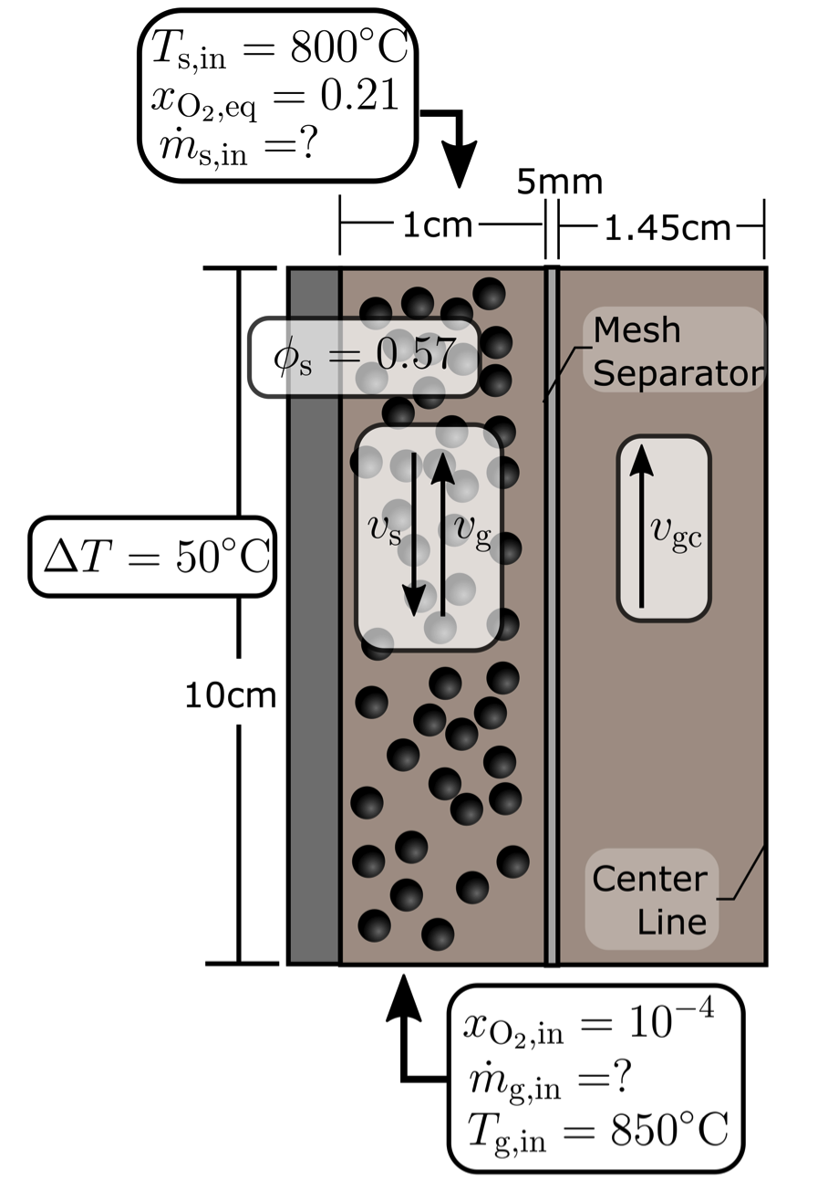
Task 2.2: Evaluation of Particle Reactor/Receiver Design
Receiver model inputs:
  Gas and solid T_{in} and composition
  Solar heat addition from CFD and SolTrace calculation
  Desired ΔT of solids in receiver
  Solids volume fraction fixed at minimum fluidization value
Receiver model outputs:
  Gas velocities in emulsion and central channel regions
  O₂ gas release and change in δ
  Attainable ass flow rate of solids

Slide 12
Task 2.2: Evaluation of Particle Reactor/Receiver Design
Steady-state continuous flow operation simulation results with Ca_{0.9}Sr_{0.1}MnO_{3-δ}
Solid mass flow rate of 25.2 g/s with Δδ = 0.048 and Δh_{tot} = 110 kJ/kg.
Mesh parameters (permeability and location) are studied to specify conditions for gas counter flow that facilitate evolved O₂ flowing to gas channel.

Slide 13
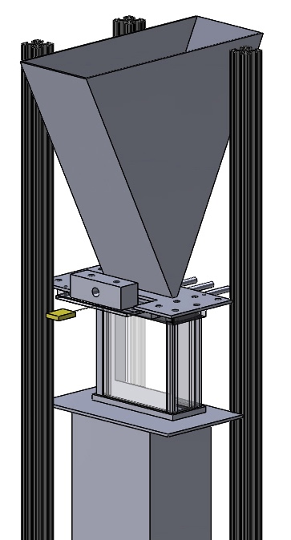
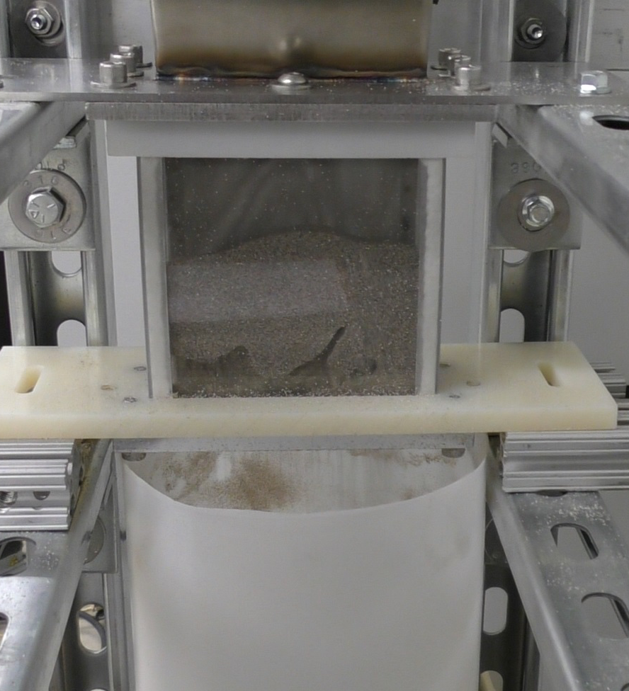
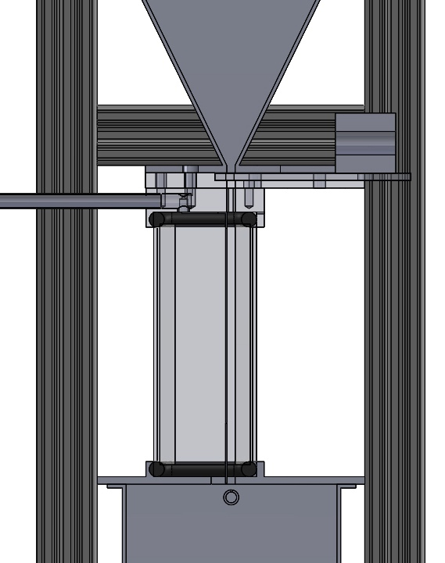
Task 2.2: Evaluation of Particle Reactor/Receiver Design
CSM particle heat-transfer test facility to assess particle flow patterns and heat transfer:
  Low-T tests for convective heat transfer
  Test of gas separating mesh to manage gas flow for particle fluidization and reduction
  High-T tests to study impact of O₂ release on fluidization, heat transfer, and reaction rates
Parameters to be tested to guide HFSF tests include:
  Particle channel width
  Particle and sweep gas flow rates
particle feed from hopper
particle feed hopper
sweep N₂ and evolved O₂ exit
particle flow control gate
sweep gas exit manifold
thermocouple for particle inlet
gas exits particle flow channel through mesh
mesh
test region for particle flow visualization and heat transfer
heated side of test region
mesh with frame to separate off-gas from particles
gas flow
path
particle collection bin
particle flow path
sweep N₂ feed
particle exit to bin below test region

Slide 14
Task 2.2: Evaluation of Particle Reactor/Receiver Design
Milestones are defined by model-simulated receiver performance:
  2.2.1: Calculated 90% of solar energy flux absorbed by particles to at the receiver face for T_{hot} ≤ 900 °C & average flux density = 1000 kW/m².
  2.2.2: Calculated maximum receiver surface temperature < 1050 °C for a T_{hot} = 900 °C & average flux density = 1000 kW/m²
  2.2.3: Modeled TCES > 750 kJ/kg for full-scale design with T_{hot} = 900 °C & T_{cool} = 500 °C & average flux density = 1000 kW/m²
Modeling of receiver with external heat transfer critical for assessing milestones.
  Characterizing flux spreading and predicted thermal performance for prototype receiver
  Receiver design with angled panels to maintain low local absorbed flux despite high surface absorptivity and high incident aperture flux.
  Receiver design/sizing for adapting to the incoming HFSF solar beam in tests.

Slide 15
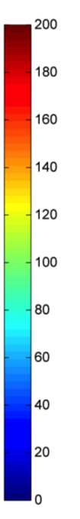
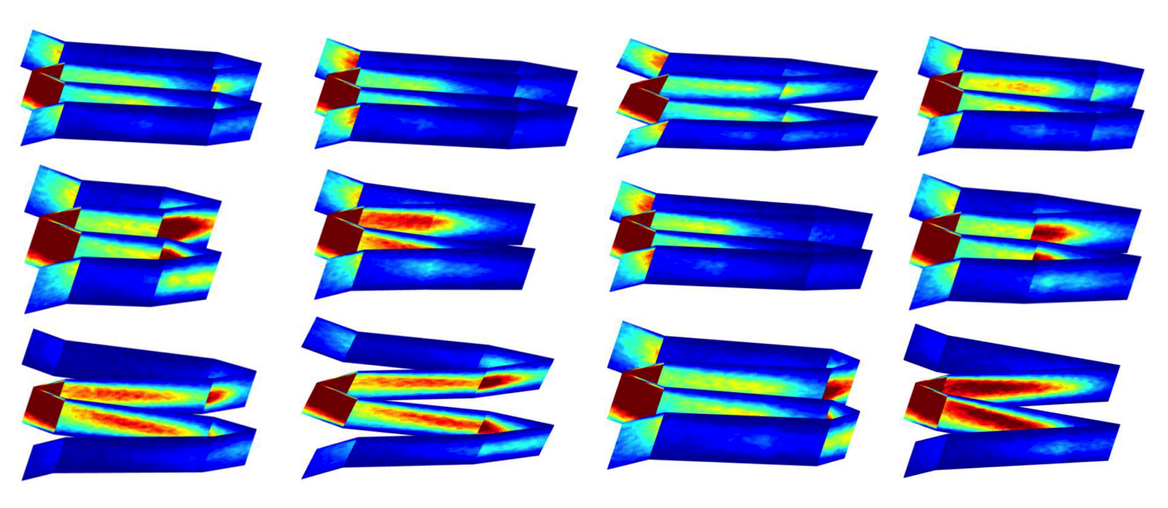
Task 2.2: Evaluation of Particle Reactor/Receiver Design
Simulating solar flux absorption in particle reduction using Monte-Carlo ray tracing (SolTrace) in HFSF prototype receiver.
  Parameters: panel size and placement relative to HFSF focal point
Screening over 100 different designs has shown that best designs have low peak absorbed flux (< 150 kW/m²) and good flux uniformity
  External flux calculations on deep narrow cavity receiver preferred for flux spreading in HFSF tests

Slide 16
Task 2.2: Evaluation of Particle Reactor/Receiver Design
Combining 3D CFD external heat transfer simulations coupled to simple internal heat transfer model based on uniform solids temperature and specified solids-wall heat transfer coefficient
Model includes a cooled front tip and Haynes 230 solid walls with insulated neighboring panel walls.
Simulation of external/internal heat transfer and impact on receiver T_{wall} at peak flux = 1000 kW/m²
 | Design 1 | Design 2
Solids T_{s,in} | 900 °C | 900 °C
Solids heat transfer coefficient | 500 W/m²/K | 500 W/m²/K
Center panel peak T_{wall} | 1069°C | 1060°C
Overall peak T_{wall} | 1117 °C | 1071 °C
Q_{solids} (center) | 2.34 kW | 1.97 kW

Slide 17
Task 2.3: Sub-scale Prototype Receiver Tests at NREL HFSF
Tests at NREL HFSF to determine effectiveness of perovskite material reduction for high specific TCES and high TCES density.
Test module will be designed and fabricated for 10 cm X 10 cm effective aperture area at HFSF with solar flux concentration of 1000.
Particle/gas flow conditions within the panel will be assessed by models and CSM tests.
Sweep gas distribution and off-gas release will be considered in the complete package design.
Schematic of HFSF Test Facility

Slide 18
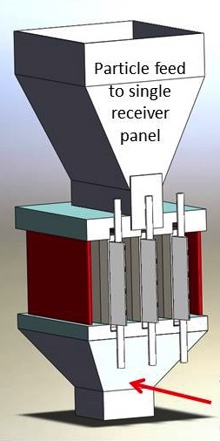
Task 2.3: Sub-scale Prototype Receiver Tests at NREL HFSF
Team currently focused on design, assembly, and instrumentation of prototype receiver for testing at HFSF beginning in May.
Single particle-filled panel surrounded by 2 temperature controlled outer panels.
Haynes 230 panels to sustain T_{wall} up to 1100 °C
Ca_{1-x}Sr_{x}MnO_{3-δ} particle feed to T_{in} = 800 °C
Front tip actively cooled with liquid flow due to HFSF flux distribution
Counterflow N₂ sweep gas to achieve desired reduction.
Particle
collection
for reoxidation

Slide 19
Task 2.3: Sub-scale Prototype Receiver Tests at NREL HFSF
Milestones for prototype receiver are specific to HFSF facility:
  2.3.1: 9.0 kJ/kg captured in perovskite particles in prototype receiver with stable operation in 5 min batch operation and particle T_{in} = 800 °C.
  2.3.2: Maximum T_{wall} = 1050 °C of prototype receiver operating at solar flux of 1000 kW/m² and particle T_{in} = 800 °C.
  2.3.3: < 5% error between measured and modeled energy flux absorbed by particles and TCES efficiency at particle T_{out} between 800 and 900 °C
Prototype receiver tests for both reacting (and inert) particles will provide a basis for using modeling tools to develop full-scale receiver designs and assess feasibility of design scale-up.
Modeling of full-scale particle reoxidation heat recovery reactor for reoxidation will also provide basis for full TCES subsystem cost and efficiency estimations.

Slide 20
Summary of Accomplishments and Path to Market
The team identified perovskites (Ca_{1-x}Sr_{x}MnO_{3-δ}, x < 0.05) with specific TCES ≥ 750 kJ/kg in redox cycles between 500 and 900 °C.
Slower reduction kinetics challenge receiver design to approach thermodynamic limits, but designs to encourage gas separation appear promising to accelerate.
Team has published 2 papers and given 5 conference presentations and one invited talk.
  3 papers currently under preparation and additional conference presentations in May and June.
  Patent applications under development for unique enabling concept features.
Path-to-market suffered from loss of Abengoa Solar but will be explored in full-scale design analysis after prototype tests this summer.

