Slide 1


Thermodynamically Stable, High Temperature Antioxidation Cermet Solar Selective Absorbers from Low-Cost Solution Chemical Processing
FOA: Concentrating Solar Power: Advanced Projects Offering Low LCOE Opportunities
Principle Investigator: Jifeng Liu, Dartmouth College.
Partner: Troy McBride, Joel Stettenheim, Norwich Technologies
Project Duration: 9/01/15 – 8/31/18
Project Budget: $656,831 (DOE); $173,020 (Cost Sharing)
Jifeng Liu,
Xiaoxin Wang, Xiaobai Yu, Katerina Kekalo, Sidan Fu
Thayer School of Engineering, Dartmouth College

Slide 2
Motivation
Problem Statement:
○ The optical performance of solar selective absorber coatings deteriorates when operating at >500 ºC in air, limiting them to vacuum operation environment.
○ Vacuum breaching has become a major failure mechanism of CSP systems.
Value Proposition:
○ A thermodynamically stable, high-temperature antioxidation solar selective coating can potentially
Eliminate expensive and failure-prone vacuum in CSP systems.
Greatly facilitate novel low-cost, high-efficiency receivers for long-term, high-reliability operations

Slide 3
Motivation
Objectives:
○ Air-stable, anti-oxidation cermet solar absorbers at 750 ºC for 1000 h.
○ Thermal efficiency FOM>0.88 for a concentration ratio of C=100; FOM>0.94 for C=1000.
Milestones:
○ Optical design optimization for 750 °C operation incorporating fabrication error analyses
○ Experimentally demonstrate the designed optical performance for area>2x50 cm²
○ Antioxidation behavior for 100 cycles between 750 (10h) and 25°C (3h) with FOM>0.98 of the initial state

Slide 4
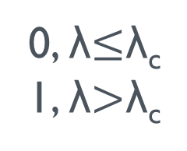
Ideal Reflectance Cut-off Wavelength
Ideal Reflectance (step function):
0, λ$≤$λ_{c}
1, λ$>$λ_{c}
R=1-α
Optimal cutoff wavelength:
C=100, λ_{c}=1.79 μm, FOM=93.2%
C=1000, λ_{c}=2.475 μm, FOM=98.2%
To achieve the milestones of:
FOM>0.88 for C=100 and
FOM>0.94 for C=100,
(compared to Pyromark: FOM=0.39 at C=100 and FOM=0.88 for C=1000)
the plasmonic cermet reflectance spectra should be as close to an ideal step function as possible.

Slide 5
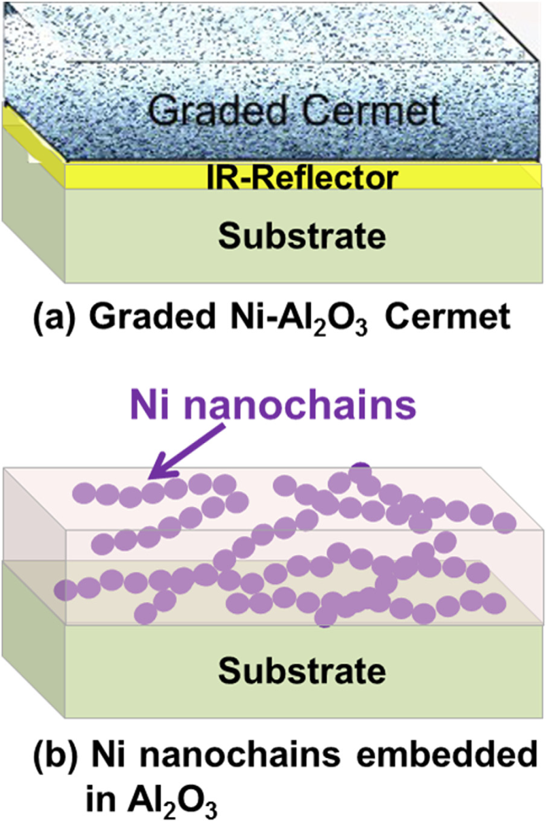
Plasmonic Cermet vs. Graded Cermet Solar Selective Absorbers
Conventional Design
Designed as a graded AR coating in the solar spectrum range
Metal nanoparticles <<λ/n (d<10 nm) dispersed in a ceramic matrix modeled with an averaged index
Typically requires precise control of layer thicknesses by vacuum deposition
Our New Plasmonic Cermet Design
Utilize the intrinsic plasmonic response of transition metal/silicide nanoparticles (d~20-80 nm) as selective absorbers
Performance inherent to metal nanostructures, relatively insensitive to film thickness. Facilitates solution-based fabrication.
Xiaoxin Wang, et al., Applied Physics Letter 101 (2012) 203109

Slide 6
Optical Design Method
Top View
(d=0.8 μm, f=0.13)
Ni D=40nm in air
(d=0.93±0.16 μm, f=0.17±0.06)
Ni D=80nm
d: thickness;
f: nanoparticle volume fraction
Ni D=160nm
X-section View
Calculate Lorenz-Mie scattering parameters of metal nanostructures→ Feed into Four Flux Model to derive the reflectance spectra of the cermet coatings
Model confirmed by experimental results on 80 nm diameter Ni nanoparticles in SiO_{x} (x~1.5)

Slide 7
Effect of Ta IR Reflector/Diffusion Barrier
Top View
Ta coated stainless steel (SS) increases IR reflectance and boosts FOM by ~4% at C=100, and ~2% at C=1000.

Slide 8
Metal Nanoparticle Materials Selection
Top View
Prefer steep transition in the refractive index (n) and extinction coefficient (k) near the desirable cut-off wavelength λ_{cut}

Slide 9
Design Optimization (1): Parameter Mapping for Maximal FOM
Top View
Intrinsic plasmonic response leads to robust design→facilitates solution fabrication.
FOM start to decrease for D>50 nm due to increased reflectance.

Slide 10
Design Optimization (2): Summary of Results for Different Nanoparticle Materials
Particle | Radius(nm) | Substrate | Optimized FOM
 |  |  | C=100 | C=1000
Ni | 10 | Ta/SS | 81.8% | 94.3%
Co | 10 | Ta/SS | 77.9% | 94.2%
Cr | 10 | Ta/SS | 80.9% | 94.5%
NiSi | 10 | Ta/SS | 85.9% | 94.5%
β-FeSi₂ | 10 | Ta/SS | 84.5% | 86.6%
HfSi | 10 | Ta/SS | 70.9% | 94.2%
TiSi₂ | 10 | Ta/SS | 87.0% | 94.8%
Cr₅Si₃ | 10 | Ta/SS | 78.8% | 94.4%
Cr₃Si | 10 | Ta/SS | 82.3% | 94.7%
Top View
2
All these materials except β-FeSi₂ can satisfy FOM>0.94 at C=1000, the best being TiSi.
NiSi and TiSi are the best choices for C=100.

Slide 11
Design Optimization (2): Summary of Results for Different Nanoparticle Materials with Bilayer Coating
Top View
Particle | Layer1 R1,f1, d1 (top) | Layer2 R2,f2,d2 (bottom) | Substrate | C | Optimized FOM
Ni | 7.5 nm, 1%, 10um | 7.5 nm, 5.5%, 62um | Ta/SS | 100 | 82.1%
NiSi | 10 nm, 1.75%,11 um | 12.5nm,1%, 8um | Ta/SS | 100 | 87%
TiSi₂ | 7.5nm , 1%, 24um | 10 nm, 1%, 6.5um | Ta/SS | 100 | 87.3%
TiSi₂ | 5nm, 0.25%,92um | 7.5nm, 1%, 7.6um | Ta/SS | 100 | 87.5%
Ni | 7.5nm,3.5%,100um | 15nm, 2.1%,95um | Ta/SS | 1000 | 94.5%
TiSi₂ | 7.5 nm,1%,100um | 12.5nm,3.4%, 59um | Ta/SS | 1000 | 94.9%
TiSi₂ | 7.5nm, 1%, 100um | 10nm,3.75%, 54um | Ta/SS | 1000 | 94.9%
TiSi₂ | 5 nm, 1%, 100um | 7.5nm, 3%, 68um | Ta/SS | 1000 | 94.9%
TiSi₂ | 5nm,0.40%,100um | 7.5nm,2.5%,100um | Ta/SS | 1000 | 94.9%
TiSi₂ | 5nm, 0.3125%, 50.0um | 7.5nm,2.25%, 94.um | 94.625 | 1000 | 95.2%
2
FOM further increased to 87.5% for C=100 and 95.2% for C=1000

Slide 12
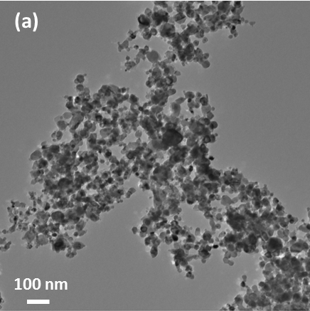
Design Optimization (3): Effect of Nanoparticle Size Distribution
Top View
Experimentally measured Ni NP size distribution (average diameter=17.2 nm) has little affect on the FOM optimization, again indicating the robustness of the design.

Slide 13
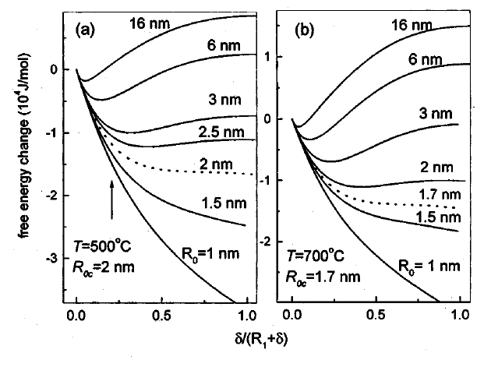
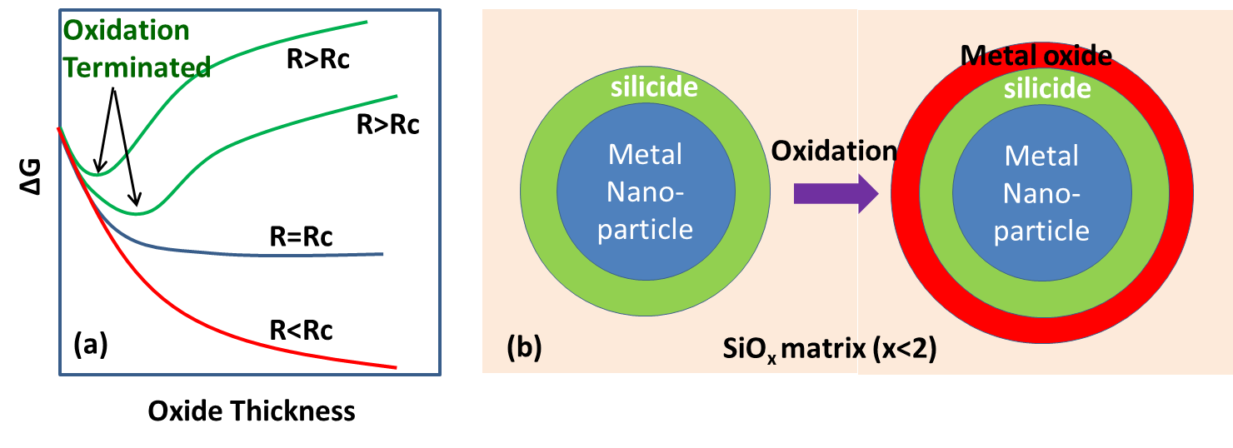
Thermodynamically Stable Anti-Oxidation Mechanism
H. Bi, et al , “Optical study of redox process of Ag nanoparticles at high temperature”, Journal of Applied Physics 92, 7491-7497 (2002).
If the oxidation process induces a big interfacial/strain energy increase and an overall ΔG>0, it will be terminated spontaneously.
Example: oxidation of Ag nanoparticles exceeding a critical radius R_{C}
We extend this mechanism to cermet solar absorbers via interfacial silicide formation between metal NPs and Si-rich SiOx (x<2)matrix upon annealing.

Slide 14
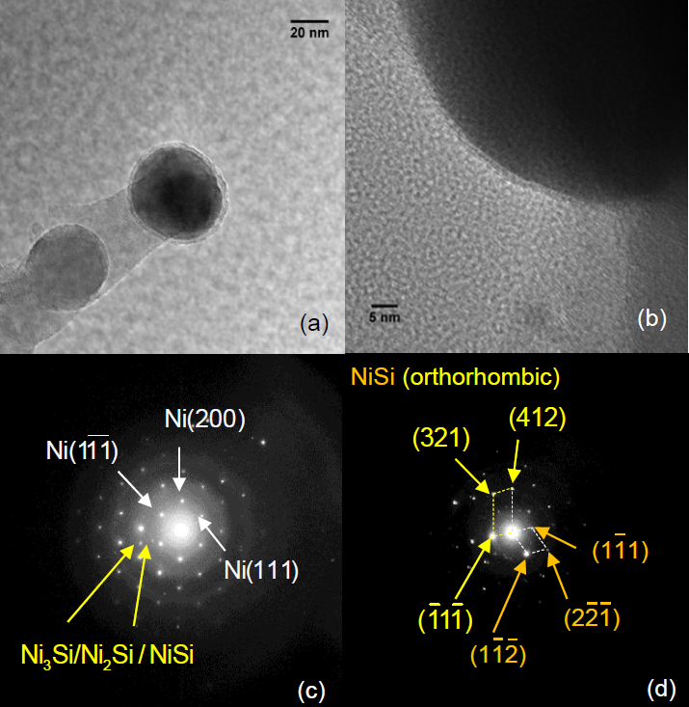
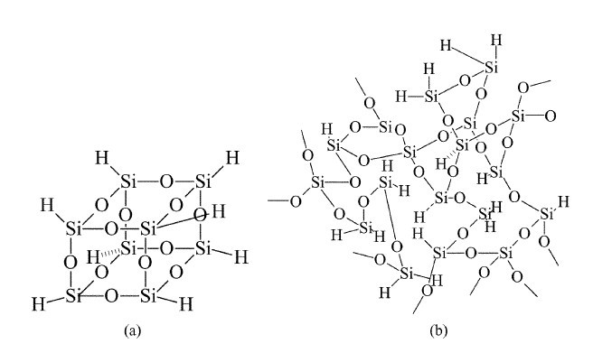
Antioxidation Interfacial Engineering in Ni/SiO_{x}
Chang-Chung Yang, et al., Journal of Materials Chemistry 12 (2002) 1138–1141
X. Yu et al, Journal of Applied Physics 119, 135301 (2016);
X. Yu et al, Journal of Applied Physics 116, 073508 (2014)
HSQ used as the precursor for Si-rich oxide.H₈Si₈O₁₂----Si:O=1:1.5>1:2 (in stoichiometric SiO2)
After annealing in N2 at >750 ºC, chemical structures in HSQ dissociate into SiO1.5. The excess Si can react with metal NPs to form interfacial silicides → Confirmed by TEM analyses

Slide 15
Antioxidation Performance in Ni/SiO_{x}
X. Yu et al, Journal of Applied Physics 119, 135301 (2016); X. Yu et al, Journal of Applied Physics 116, 073508 (2014)
Self-terminated oxidation observed at 550 ºC in air, from both X-ray diffraction and Reflectance spectra analyses. XRD oxidation trend deviate form kinetic model.
Works equally well for Ni NPs with D=40 and 80 nm →confirming the thermodynamic mechanism and indicating R_{C}<20 nm.
Working towards thermodynamic stability at 750 ºC

Slide 16
Antioxidation Performance in Ni/SiO_{x}
X. Yu et al, Journal of Applied Physics 119, 135301 (2016); X. Yu et al, Journal of Applied Physics 116, 073508 (2014)
Self-terminated oxidation observed at 550 ºC in air, from both X-ray diffraction and Reflectance spectra analyses. XRD oxidation trend deviate form kinetic model.
Works equally well for Ni NPs with D=40 and 80 nm →confirming the thermodynamic mechanism and indicating R_{C}<20 nm.
Working towards thermodynamic stability at 750 oC

Slide 17
Conclusions
Robust design of high performance plasmonic cermet solar selective absorbers (FOM=0.87 for C=100 and 0.95 for C=1000) → facilitates low-cost solution-chemical fabrication.
Experimental evidence supports thermodynamic antioxidation mechanism at 550 ºC
Working towards thermodynamic stability at 750 ºC
Path to Market
Supply the coating to Norwich Technologies for its SunTrapTM receiver, either for further licensing or selling the solar selective coating to other CSP market participants

