Slide 1
Beyond LCOE:
The Value of CSP with Thermal Energy Storage
Mark S. Mehos, Program Manager, CSP NREL

Slide 2
Discussion
SunShot and LCOE
Understanding the Value of CSP with Thermal Energy Storage
Net System Cost – A Better Metric

Slide 3
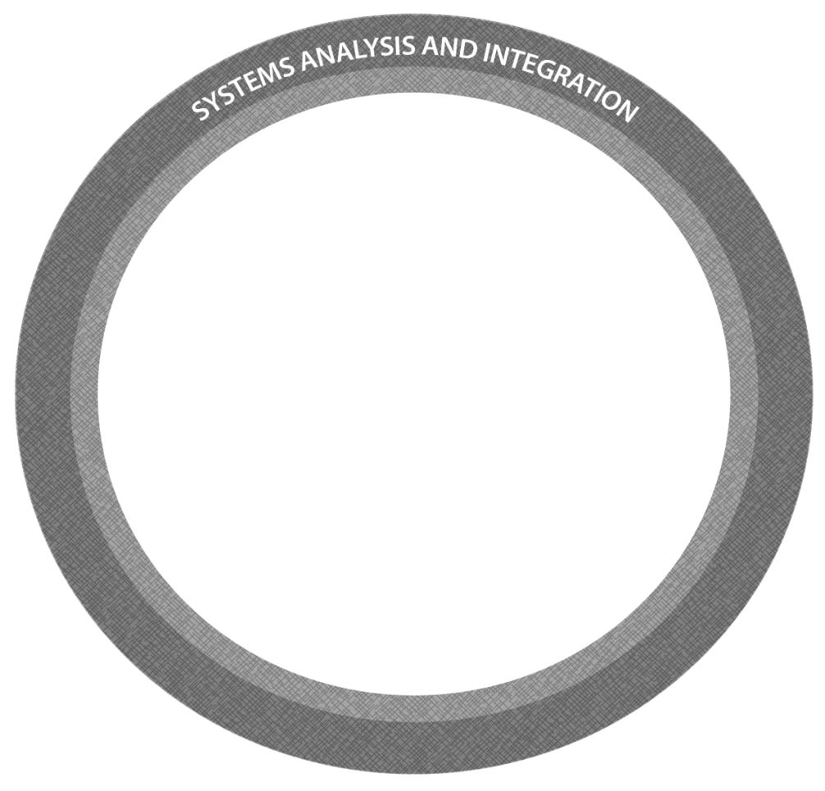
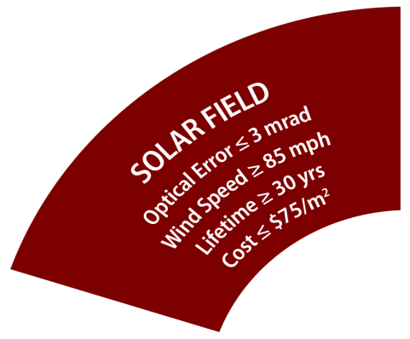
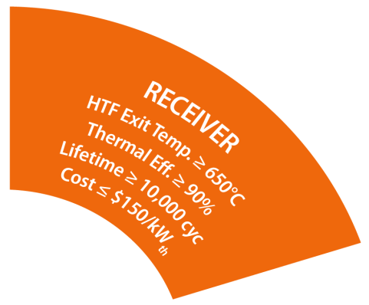
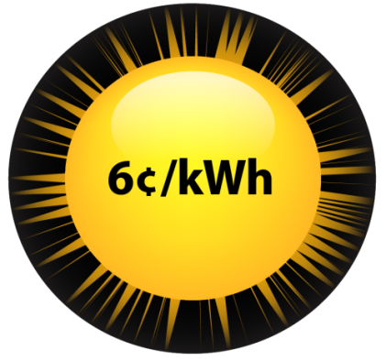
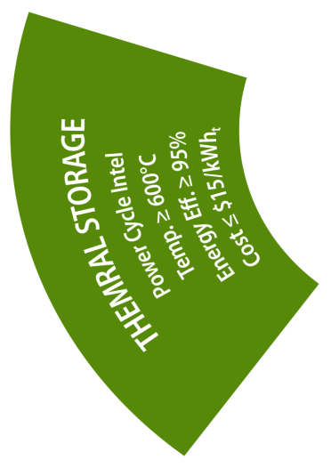
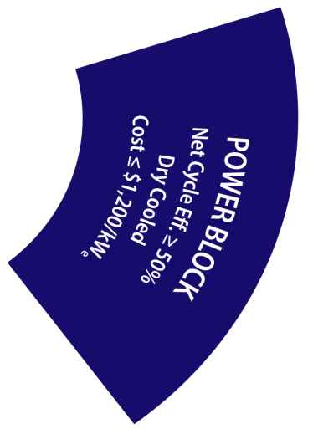
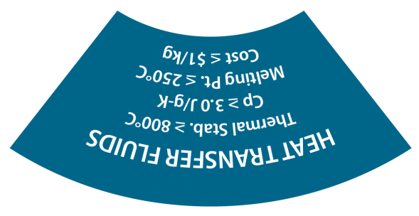
DOE SunShot Initiative – Concentrating Solar Power
6₵/kWh by 2020
Technology and cost objectives for solar field, receiver, thermal storage/HTF, & power block necessary to achieve SunShot 6₵ target.

Slide 4
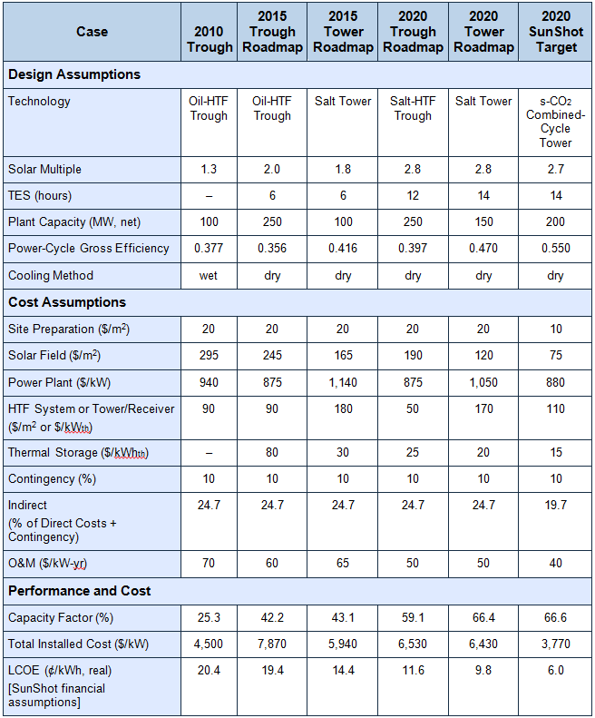
DOE SunShot Initiative – Concentrating Solar Power
6₵/kWh by 2020
Technology and cost objectives for solar field, receiver, thermal storage/HTF, & power block
14 hours of thermal energy storage
Solar Multiple of 2.7
Notes:
NREL developed CSP SunShot targets in support of DOE.
Targets were an extension of existing roadmaps developed by NREL and Sandia prior to SunShot program.

Slide 5
DOE SunShot Initiative – Concentrating Solar Power
6₵/kWh by 2020
Technology and cost objectives for solar field, receiver, thermal storage/HTF, & power block
14 hours of thermal energy storage
Solar Multiple of 2.7
67% Capacity Factor “Baseload” Product
Notes:
Hitting 6 cent target required high capacity factor “baseload” implementation of CSP.

Slide 6
Discussion
SunShot and LCOE
Understanding the Value of CSP with Thermal Energy Storage
Net System Cost – A Better Metric
Notes:
NREL began to further investigate and quantify the value of CSP-TES about 5 years ago.

Slide 7
Simulated Dispatch in California for Summer Day for 0% to 10%PV Penetration
Decreased Capacity Value
Denholm and Mehos, 2012
Increased PV Penetration
Notes:
This and the next slide are intended to show the challenges of increased PV penetration without improving grid flexibility.
This slide is from a simulation of the grid in California. It is the exact same summer day, but with 4 different levels of PV penetration, defined as the fraction of ANNUAL energy met by PV.
This slide shows that at low penetration of PV, it provides high capacity value but this capacity value essentially reaches zero by the time PV is providing about 10% of a systems energy. Some other form of generation will be needed to meet the peak demand in the late afternoon and early evening.

Slide 8
Simulated Dispatch in California for Spring Day for 0% to 10%PV Penetration
Excessive ramp rates
Minimum load constraints
Notes:
This slide is from the same simulation, but on a late spring day. It shows that PV often generates during periods of relatively low demand, and it will be challenging for the grid to use all of this energy, especially if grid flexibility is not dramatically increased.
In all likelyhood, some of the PV generation on this day would be curtailed. While we typically think of curtailment as being a wind problem, our simulations indicate that PV will start having this problem as well.
The next set of slides show this more explicitly

Slide 9
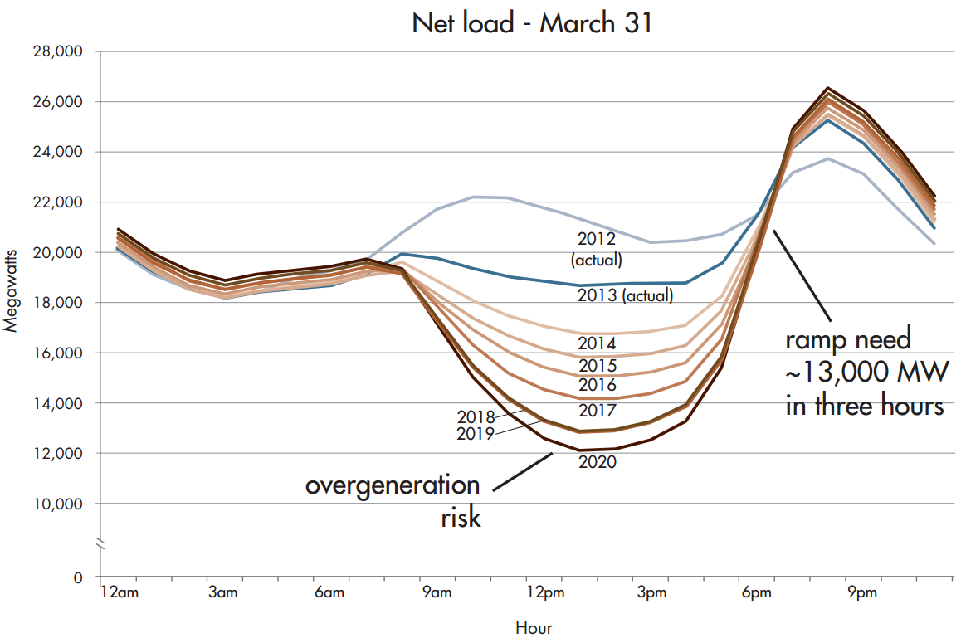
CAISO Duck Curve – Circa 2013
Shifting and narrowing of net peak
Notes:
Key points:
Want to avoid overgeneration risk and large ramp rates
Note that, not pointed out in the CAISO duck chart, is shifting and narrowing of net peak
CSP inherently avoids the duck and maintains high capacity value due to dispatchability
However, we needed to quantify this value for future high PV penetration scenarios

Slide 10
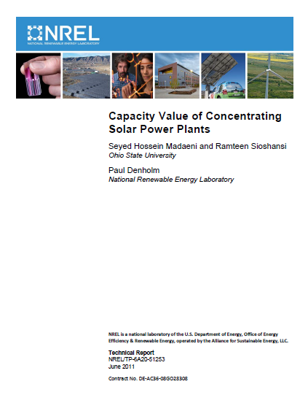
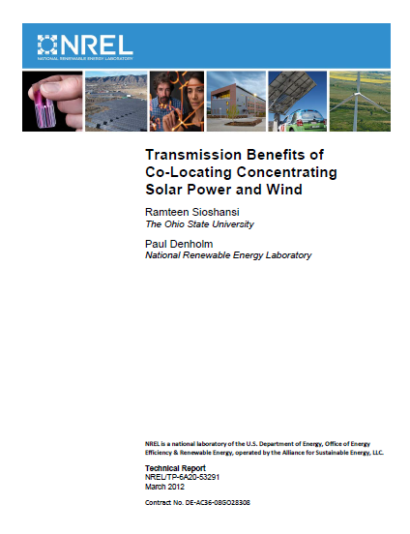
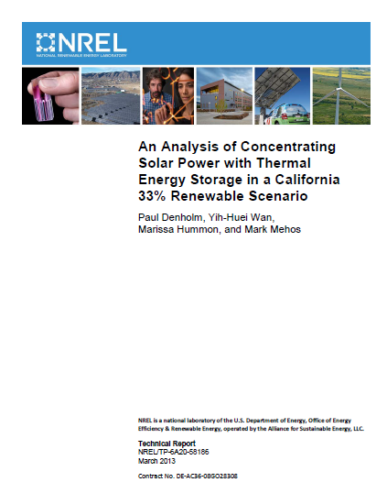
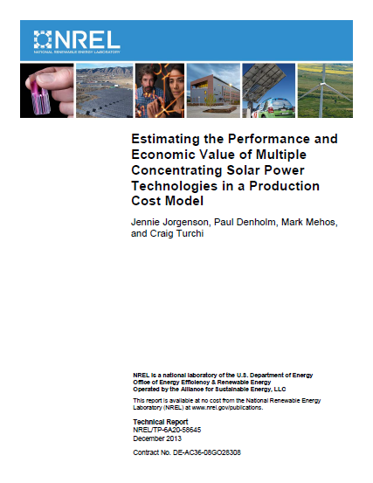
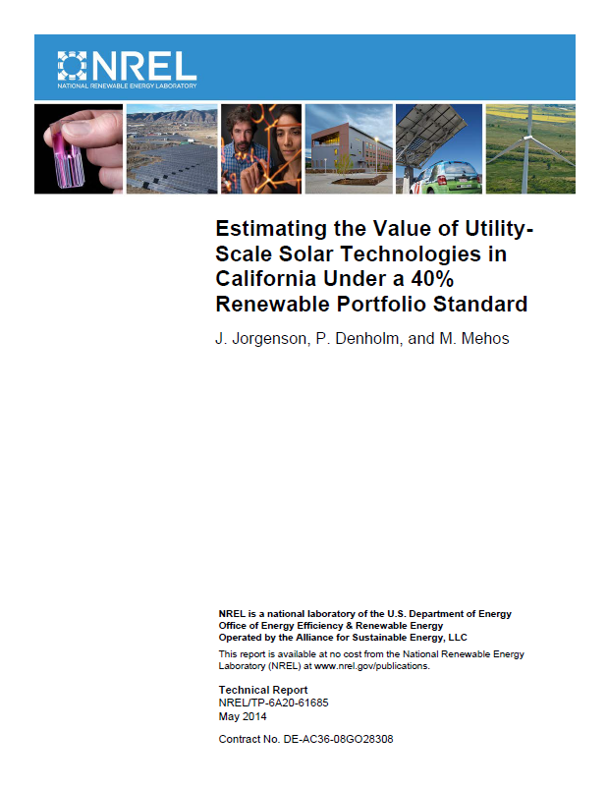
Quantifying the Benefits of CSP with Thermal Energy Storage
Colorado “Test” System
California/WECC
Available at http://www.nrel.gov/publications
Notes:
To this point, all of these results are qualitative. We needed a quantitative methodology for determining the value of CSP-TES and PV at various levels of penetration.
Started analysis using Colorado “test” system in 2012
Once methodology was developed, moved to California and entire WECC (now looking more regionally, e.g. Arizona)

Slide 11
Analysis of Operational and Capacity Benefits of CSP in Southwest Balancing Area
CAISO
Notes:
Focused on Southwest U.S. generally and California (initially) specifically using a full nodal presentation of the CAISO region and a zonal representation of the rest of WECC.

Slide 12
Implementation of CSP with TES in a Commercial Unit Commitment and Economic Dispatch Model (PLEXOS)
CSP Plant Characteristics (Solar Multiple [SM], Storage Size)
Solar Data (Hourly Direct Normal Irradiance [DNI])
Hourly CSP Electricity Profiles
SAM CSP Model (SM = 1.0)
PLEXOS
CSP Operational Characteristics
System Advisor Model Simulations
(Outside PLEXOS)
  CSP has historically not been included in commercial production cost models. Analysts must consider the flexibility of CSP configurations
Notes:
Prior to NREL effort, earlier work at NREL, CAISO, and other organizations used block dispatch (typically SM 2 and 6 hours of storage) to model the CSP configurations.
Such dispatch strategies don’t accurately capture the full benefit of CSP for various configurations.
PLEXOS, a security constrained unit commitment and economic dispatch model can be used to capture operational benefits
Use SAM to generate hourly solar energy to PLEXOS model. PLEXOS disptaches energy maximize system operational benefit
Operational savings is calculated by comparing total costs for a reference system to costs for an incremental additional of new PV or CSP-TES.

Slide 13
California ISO Analysis – 33% Renewable Portfolio Standard
Relative to PV, CSP provides additional operational Value to California grid
 | Marginal Operational Value ($/MWh)
 | CSP-TES (SM = 1.3, 6 hrs TES) | PV
Displaced Fuel | 40.2 | 27.8
Displaced Emissions | 10.3 | 3.1
Reduced Startup & Shutdown | 1.6 | -0.6
Reduced Variable O&M | 0.4 | 1.2
Total | 52.7 | 31.6
Notes:
Important slide for pointing out various value streams.
Displaced fuel is primary value followed by emissions reductions.
Note PV actually increases costs of startup and shutdown due to increased variability.

Slide 14
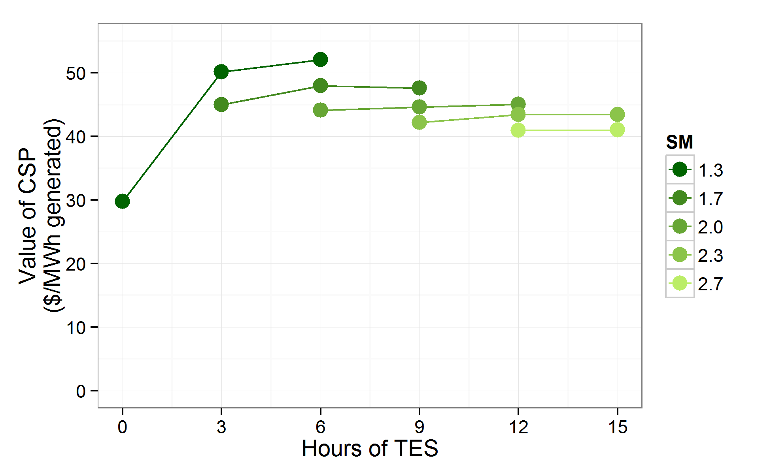
CAISO Analysis – Operational Value
  Lowest solar multiples (lower annual capacity factors) yield the highest operational system value
Notes:
While lower capacity factors yield highest value, this doesn’t take into account the higher LCOE associated with the configuration.
Net system cost accounts for both (and capacity).

Slide 15
CAISO Analysis – Capacity Value
  CSP integrated with thermal energy storage maintains high capacity value
 | Capacity Credit (%)
 | CSP-TES (with > 3 Hrs Storage) | PV
33% RPS Scenario | 92.2% | 22%
40% RPS Scenario | 96.6% | 3.4%
Notes:
For PV, performed full ELCC analysis
For CSP, looked at highest net load hours

Slide 16
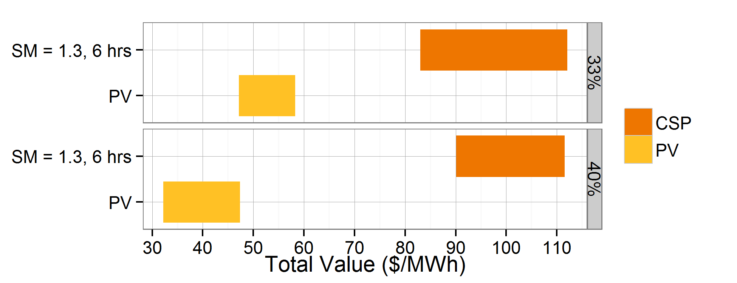
CAISO Analysis – Total Valuation
  Relative value of CSP is $48/MWh greater than PV in the 33% scenario and about $63/MWh greater in the 40% scenario
Notes:
Range of values are due to range of capacity cost for combustion turbine and range of capacity credit for PV.

Slide 17
Discussion
SunShot and LCOE
Understanding the Value of CSP with Thermal Energy Storage
Net System Cost – A Better Metric

Slide 18
Solar as a capacity product
We investigated the following options for procuring firm capacity and renewable energy:
  Combustion Turbine (peaker)
  Combined Cycle (intermediate and baseload)
  CSP-TES Plant (various configurations)
  PV Plant + Long-duration storage device
  PV Plant + Gas combustion turbine (CT)
Annualized Capital Cost of each option
- Avoided Operational Costs
Net Cost of each option
Notes:
We know that, to a large extent, the value of CSP is it’s ability to provide reliable capacity in addition to high value energy.
Compared this value to other products that can provide identical capacity (conventional, PV/NG, and PV/batteries).

Slide 19
Solar as a capacity product
We investigated the following options for procuring firm capacity and renewable energy:
  Combustion Turbine (peaker)
  Combined Cycle (intermediate and baseload)
  CSP-TES Plant (various configurations)
  PV Plant + Long-duration storage device
  PV Plant + Gas combustion turbine (CT)
Annualized Capital Cost of each option
- Avoided Operational Costs
Net Cost of each option

Slide 20
Cost Assumptions – Conventional*
Generator Type | $/kW-yr
Combustion Turbine
- Capital and Financing – Construction | 115.48
- Insurance | 7.90
- Ad Valorem Costs | 11.50
- Fixed O&M | 33.08
- Corporate Taxes | 33.35
Total Fixed Costs (Combustion Turbine) | 201.31
Combined Cycle
- Capital and Financing – Construction | 117.66
- Insurance | 7.91
- Ad Valorem Costs | 11.52
- Fixed O&M | 45.31
- Corporate Taxes | 38.81
Total Fixed Costs (Combined Cycle) | 221.21
*Source: California Energy Commission Cost of Generation (COG) Model – Version 3.98 (2015)

Slide 21
Cost Assumptions – Current and Future CSP-TES Tower Scenarios
Case | CSP-TES Tower (current) | CSP-TES Tower (SunShot)
Location System Costs - Site improvements ($/m2) - Solar field (heliostat and receiver)a ($/m2) - Thermal energy storage ($/kWht) - Power block ($/kWe) - EPC and owners costs - Land costs ($/acre) - Fixed O&M ($/kW-yr) | Daggett, CA 10 260 27 1,550 10% of direct costs 10,000 65 | Daggett, CA 10 160 15 880 10% of direct costs 10,000 40
Construction loan period and interest rate Cycle Performance - Cycle gross efficiency (%) | 24 months at 6% 41.2 | 24 months at 6% 55

Slide 22
Modeling Assumptions
Generator Performance
Generator Type | Heat Rate (Btu/kWh)ª
Combustion Turbine | 9,500
Combined Cycle | 7,500
Operational Analysis
Dollar Year | 2014
Simulation Year | 2025
Natural Gas Price (low/high) | $3.5–$6.1 / MMBtu
Carbon Emissions Cost (low/high) | $13–$32.4 / metric ton

Slide 23
Modeling Scenarios
Technology | Capacity (MW) | Energy (GWh annual) | Capacity Factor (%)
Combustion Turbine | 1,500 | 1,580 (3,350) | 12.0 (25.5)ª
Combined Cycle | 1,500 | 5,690 (11,270) | 43.9 (85.8)
CSP-TES (peaker, SM = 1, 6 h TES) | 1,500 | 3,220 (3,230) | 24.5 (24.6)
CSP-TES (intermediate, SM = 2, 9 h TES) | 1,500 | 6,300 (6,300) | 47.9 (47.9)
CSP-TES (baseload, SM = 3, 15 h TES) | 1,500 | 8,910 (9,240) | 67.8 (70.3)
ª Values in parentheses are results for the high natural gas and emission cost scenario.

Slide 24
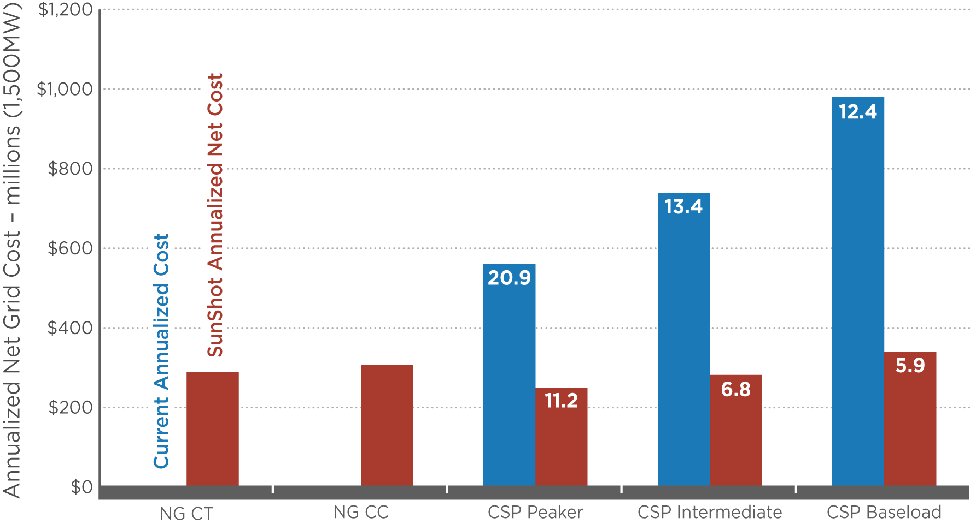
Comparison of annualized net cost of current and SunShot CSP configurations for low natural gas and carbon cost scenarios
Values shown are LCOEs calculated by SAM for each CSP configuration.
Notes:
Key Messages:
Assuming current costs for CSP, peaking configurations show the lowest net cost (but highest LCOE). However, they are still too expensive relative to conventional CTs and CCs (assuming no ITC).
Assuming SunShot cost and performance targets are achieved, CSP peakers are still the lowest cost but both peaking and intermediate load configurations are competitive with conventional systems as a “capacity” product (baseload is questionable).

Slide 25
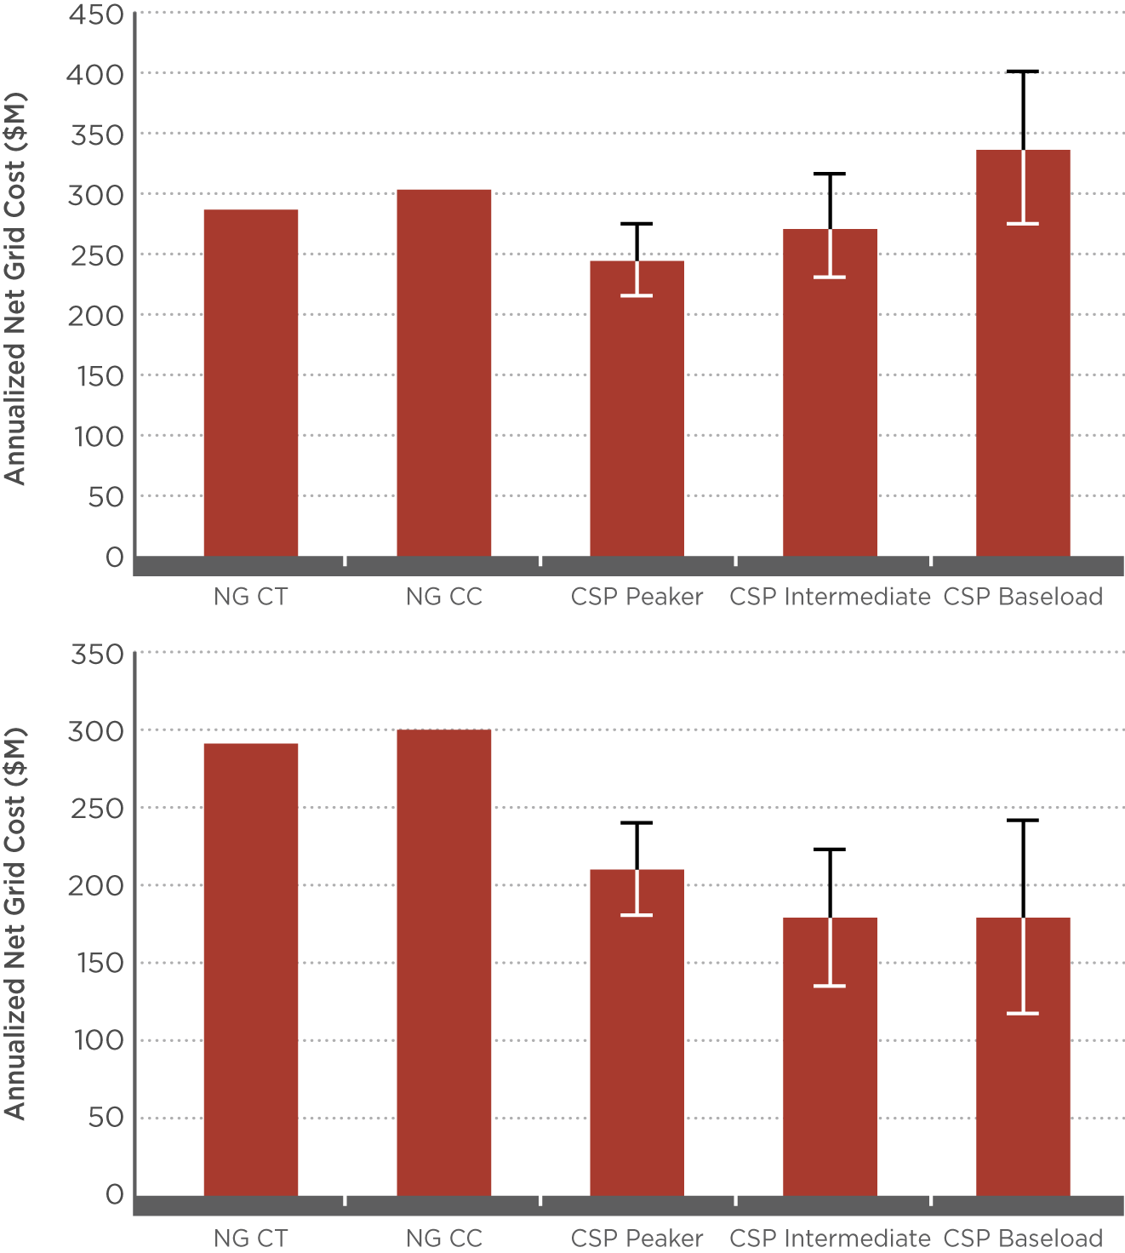
Comparison of annualized net cost of SunShot CSP configurations for low natural gas and carbon cost scenario
Error bars represent ± 10% variation in key SunShot cost and performance parameters

Slide 26
Comparison of annualized net cost of SunShot CSP configurations for high natural gas and carbon cost scenario
Error bars represent ± 10% variation in key SunShot cost and performance parameters

Slide 27
Solar as a capacity product
We investigated the following options for procuring firm capacity and renewable energy:
  Combustion Turbine (peaker)
  Combined Cycle (intermediate and baseload)
  CSP-TES Plant (various configurations)
  PV Plant + Long-duration storage device
  PV Plant + Gas combustion turbine (CT)
Annualized Capital Cost of each option
- Avoided Operational Costs
Net Cost of each option

Slide 28
Cost Assumptions
CSP-TES Cost/Performance Assumptions
System Costs | CSP-TES Tower (current) | CSP-TES Tower (SunShot)
- site improvements - solar field (heliostat and receiver) - thermal energy storage - power block - EPC and owners costs - land costs - fixed O&M | $10/m² $260/m² $27/kWh_{t} $1550/kW_{e} 10% of direct costs $10,000/acre $65/kW-yr | $10/ m² $150/ m² $15/ kWh_{t} $880/kW_{e} 10% of direct costs $10,000/acre $40/kW-yr
Construction loan period and interest rate Cycle Performance - cycle gross efficiency | 24 months at 6% 41.2% | 24 months at 6% 55%
PV Cost/Performance Assumptions
System Costs (total installed) | PV (current) | PV (SunShot)
- fixed-tilt module - one-axis tracking module - non-tracking fixed O&M - one-axis tracking fixed O&M | $1.82/W_{ac} $2.01/W_{ac} $15/kW-yr $18/kW-yr | $1/W_{ac} $1.1/W_{ac} $7/kW-yr $15/kW-yr
Construction loan period and interest rate | 6 months at 4% | 6 months at 4%
Battery Cost/Performance Assumptions
System Costs (total installed) | Battery (current, low) | Battery (current, high) | Battery (future, low) | Battery (future, high)
- power-related costs - energy-related costs - total (for 6 hour capacity) Battery Lifetime | $300/kW $450/kWh $500/kWh 10 years | $600/kW $900/kWh $1000/kWh 5 years | $200/kW $150/kWh $183/kWh 15 years | $400/kW $300/kWh $367/kWh 10 years
Used an annualized capacity cost of $190/kW-yr for a gas CT (CAISO 2012), representing a high-efficiency turbine (heat rate of 8700 Btu/kWh). This cost remains constant due to the mature nature of turbine technology.

Slide 29
Avoided Operational Costs
Jorgensen et.al. 2015
Most configurations of CSP-TES are more ‘valuable’ than
other generation options

Slide 30
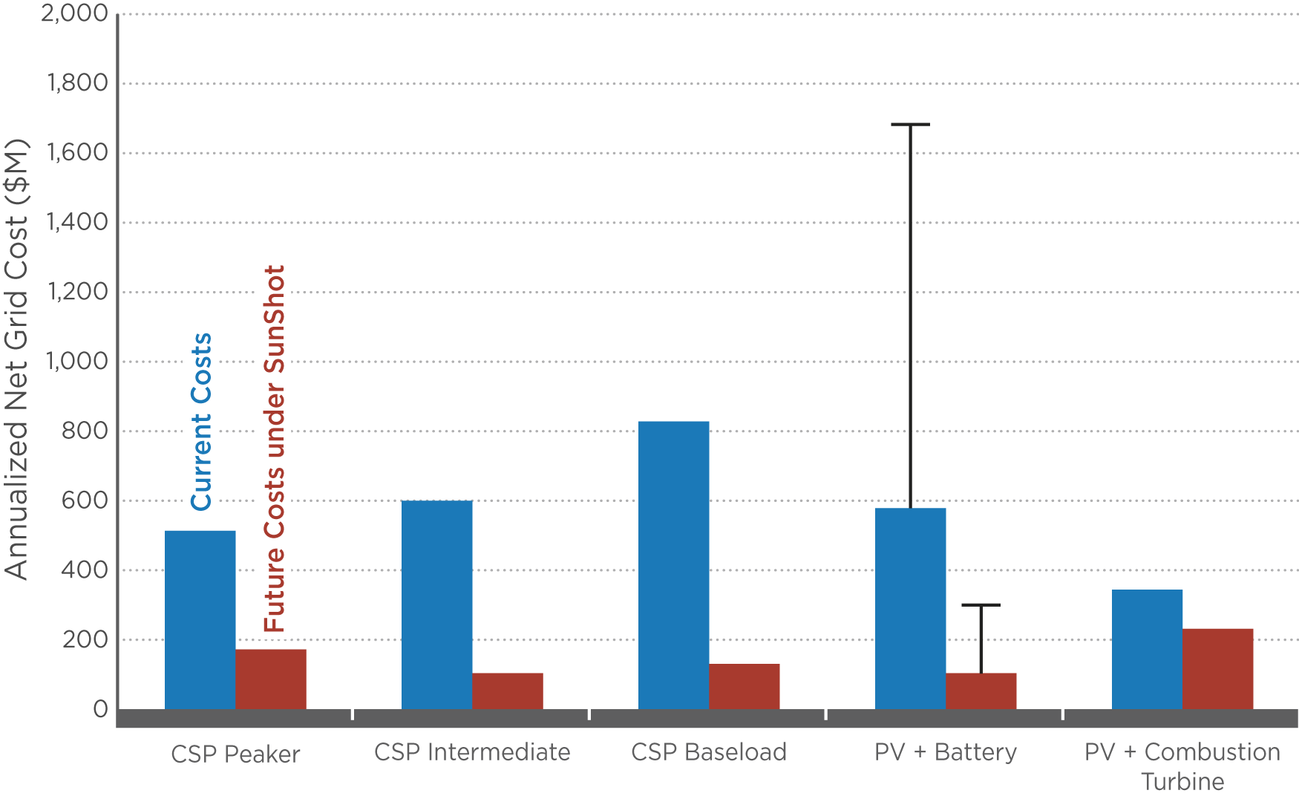
Annualized net cost results for analysis of current and future cost scenarios for CSP, PV with batteries, and PV with combustion turbines

Slide 31
Conclusions
LCOE is an incomplete metric when considering the value of dispatchable CSP
The net system cost, defined as the operational costs minus operational savings, is more appropriate for technology comparisons
For low natural gas and emissions costs, CSP SunShot peakers and intermediate load plants are competitive with conventional NG-fired plants, while baseload CSP is more expensive
Current CSP-TES is more competitive than PV-batteries for providing firm capacity although PV-CTs provide the lowest cost option
Using SunShot projections, CSP-TES is slightly better than PV-batteries but significantly better if batteries don’t meet projections

Slide 32
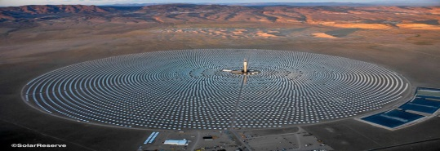
Thank you!

