Slide 1
Apollo High-Efficiency sCO2 Centrifugal Compressor Development
Jeff Moore, Institute Engineer- Southwest Research Institute
Azam Thatte, Lead Research Scientist - GE Global Research

Slide 2
Acknowledgement:
This material is based upon work supported by the Department of Energy under Award Number
DE-EE0007109.
Disclaimer:
This report was prepared as an account of work sponsored by an agency of the United States Government. Neither the United States Government nor any agency thereof, nor any of their employees, makes any warranty, express or implied, or assumes any legal liability or responsibility for the accuracy, completeness, or usefulness of any information, apparatus, product, or process disclosed, or represents that its use would not infringe privately owned rights. Reference herein to any specific commercial product, process, or service by trade name, trademark, manufacturer, or otherwise does not necessarily constitute or imply its endorsement, recommendation, or favoring by the United States Government or any agency thereof. The views and opinions of authors expressed herein do not necessarily state or reflect those of the United States Government or any agency thereof.

Slide 3
Acknowledgements
FOA : APOLLO
Award Number : DE-EE0007109 .
PI : Bugra Ertas ( GE Global Research )
Partners: Southwest Research Institute, GE Oil and Gas
Project Duration: 3 years
3

Slide 4
Project Objectives
Develop high-efficiency sCO2 compression system
  Main Compressor Efficiency of 80%
  Preliminary Design completion June 2016
  Go/no-go decision point after Phase 1 (June 2017)
High efficiency centrifugal impeller
Variable IGV/OGV

Slide 5
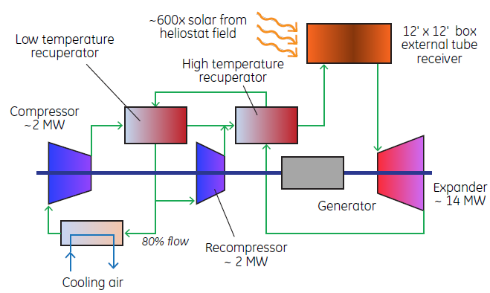

CSP Modular Power Block
Concentrated Solar Power (CSP)
for power extraction
Commercially viable goal
$0.06/kWh (2020 Sunshot vision)
Technology gap → high efficient
compression system
Highly transient operating
conditions
Vendor component – available today
Current active program on development
Paper study / understanding of problem

Slide 6
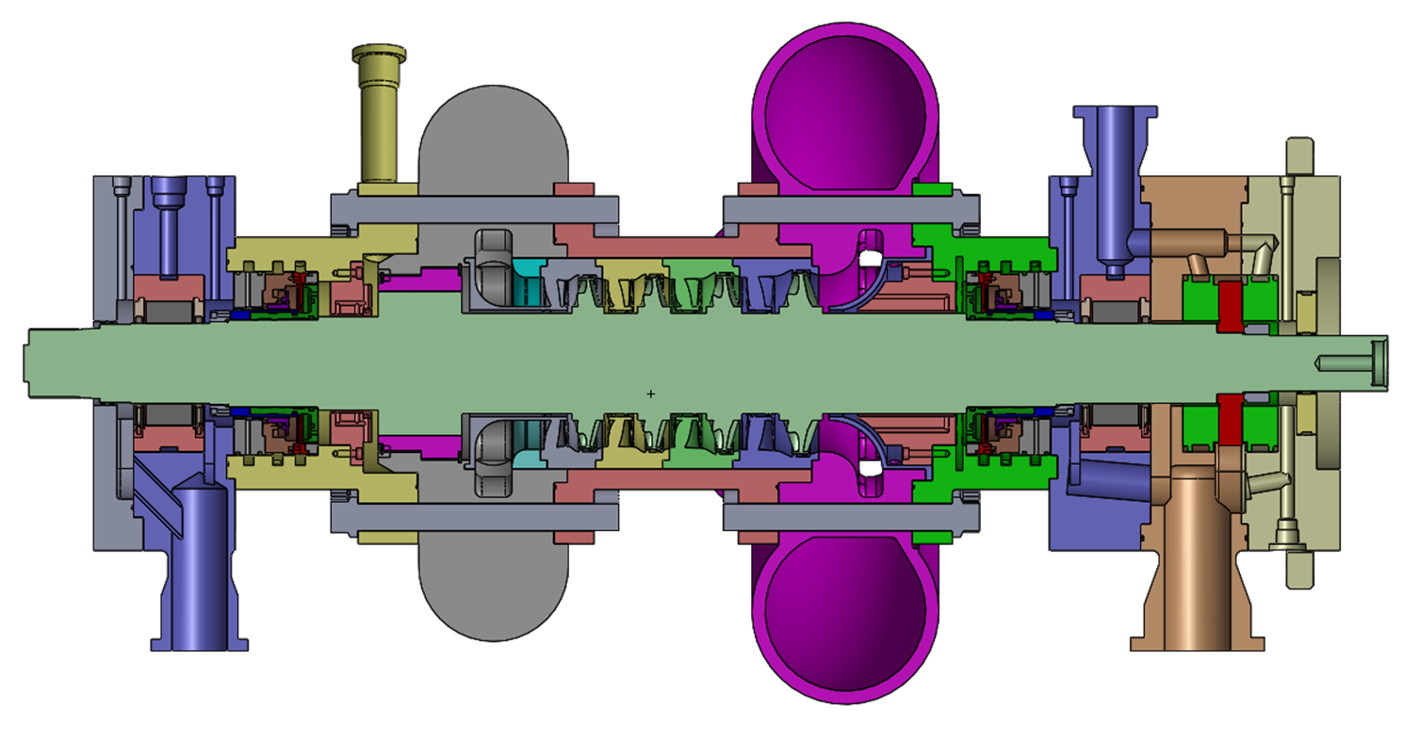
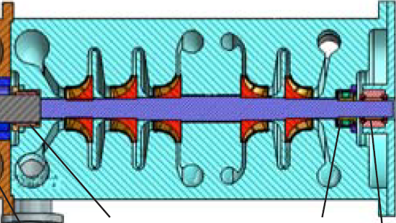
Apollo Program Overview
3 Year Program
Deliverable; 80% eff. 4MW sCO2 compressor loop
  High Main Compressor Efficiency
  Variable Inlet/Exit Guide Vanes (off-design operability)
80C @ 80bar Suction
Discharge = 250bar
27krpm
2013-2016 effort; Testing 2016
4-Stage 14MW SCO2 Expander
27krpm-68kg Shaft-700C @250bar
Re-compressor
Main
Compressor
GB/ Generator

Slide 7
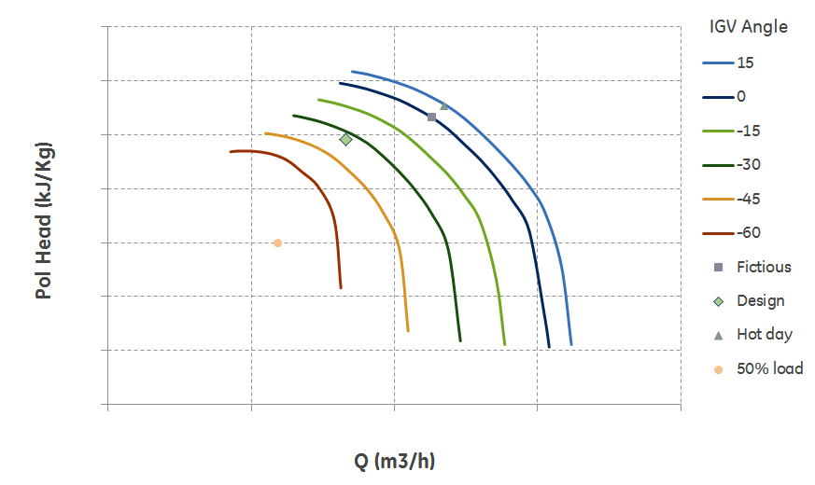
sCO2 Turbomachinery Challenges
High Pressures/Temperatures
-Novel rotor architectures
-Thermal management
Ultra-High Power Density
-Bearing Surface Speeds
-Rotordynamics
-Mechanical Packaging
Operability Range
-Variable IGV/OGV
-Aero design/critical point

Slide 8


Apollo Team
GE GRC
(PI)
GE Oil &Gas
(Supplier)
(SUB-CONTRACTOR)
-Cycle Analysis
-Aero design (IGV/OGV)
-Initial Rotor/Sizing/Layout
-Provide BCL Compressor
Provide Machine
Geometry/Definition
-Compressor detailed design
-Detailed Drawings
-Test loop detailed design
-Impeller testing
-Compressor fabrication
-Test loop fabrication
-Test loop operation & testing
CONCEPTUAL /PRELIMINARY DESIGN
DETAILED DESIGN/
FABRICATE/TEST

Slide 9
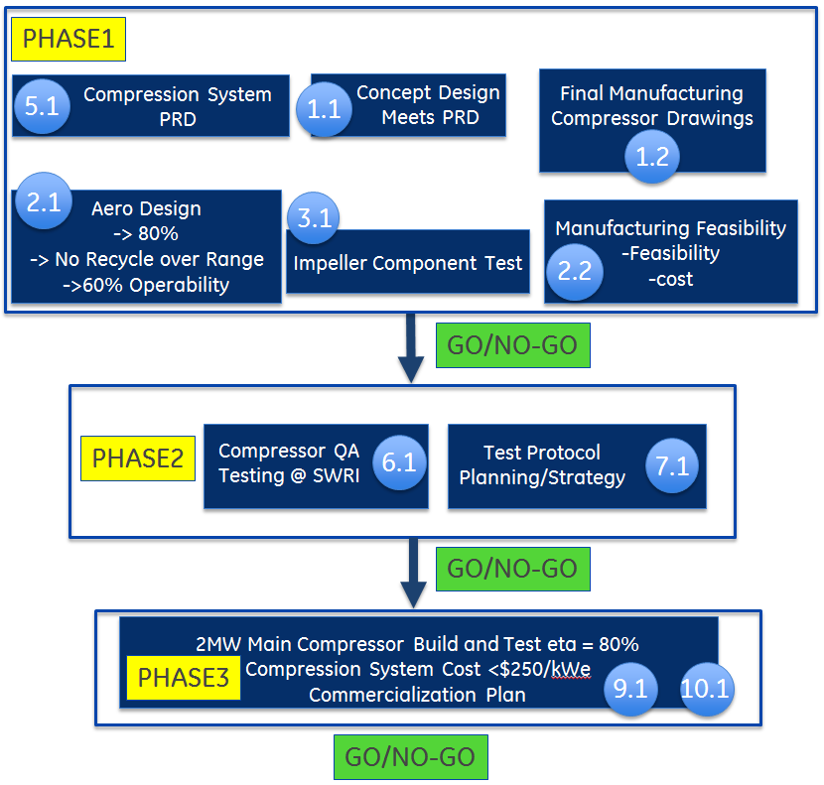
Tasks

Slide 10
Milestone Progress For Phase 1
5.1
1.1
2.1
3.1
2.2
100%
= Complete
= In Progress
% Completed
40%
30%
10%
15%
Tasks
System PRD
Prelim. Design
Aero. Design
Impeller Test
Cost/Manufacturing
1st order magnitude costing
Trade Studies
Trade Studies
Design/Concept
Detailed Costing
Machine Design
3D CFD
Test Rig Layout
Manufacturing Feasibility
Flow Loop Design
Final Design
Hardware mods

Slide 11
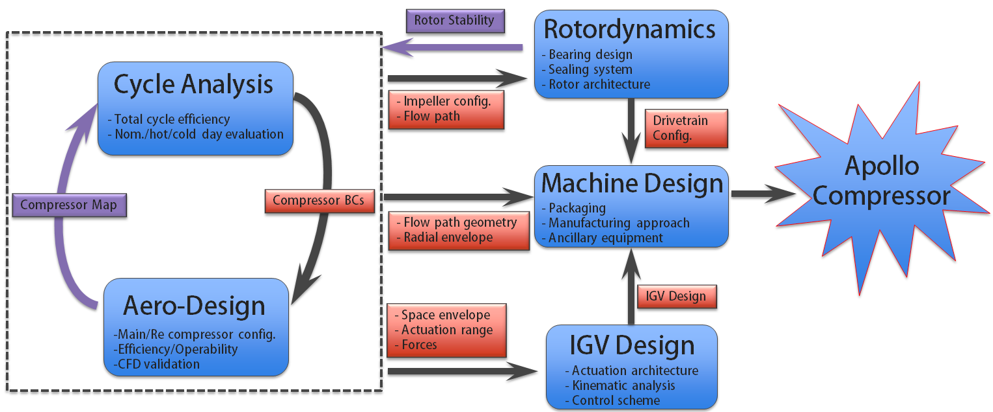
Compressor Design Process
Program Start
October 2015
Configuration
Down-selected
(FW 7 2016)
MILESTONE 1: Hand-Off to
Detailed Design
(June 2016, FW 23)
PHASE 1 COMPLETED
JUNE 2017
(begin fabrication)
Trade-Off Studies
-Cycle analysis
-Aero analysis
-Rotordynamics
Machine Design
-Aero/IGV
-Drivetrain
-Packaging
Detailed Design
-Fits/Assembly
-Finalize Test Strategy
-Ancillary Devices
4.5 Months
3.5 Months
11 Months
Task/Milestone 1.1 Preliminary Compressor Design

Slide 12
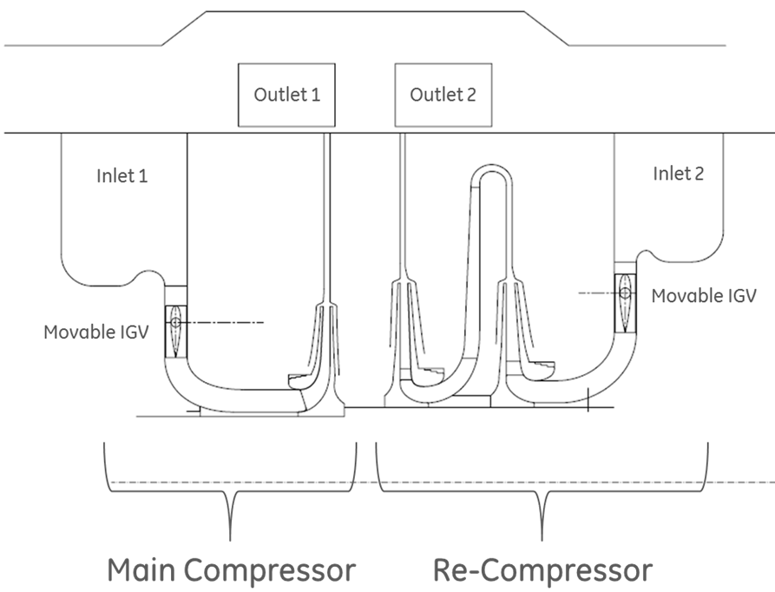
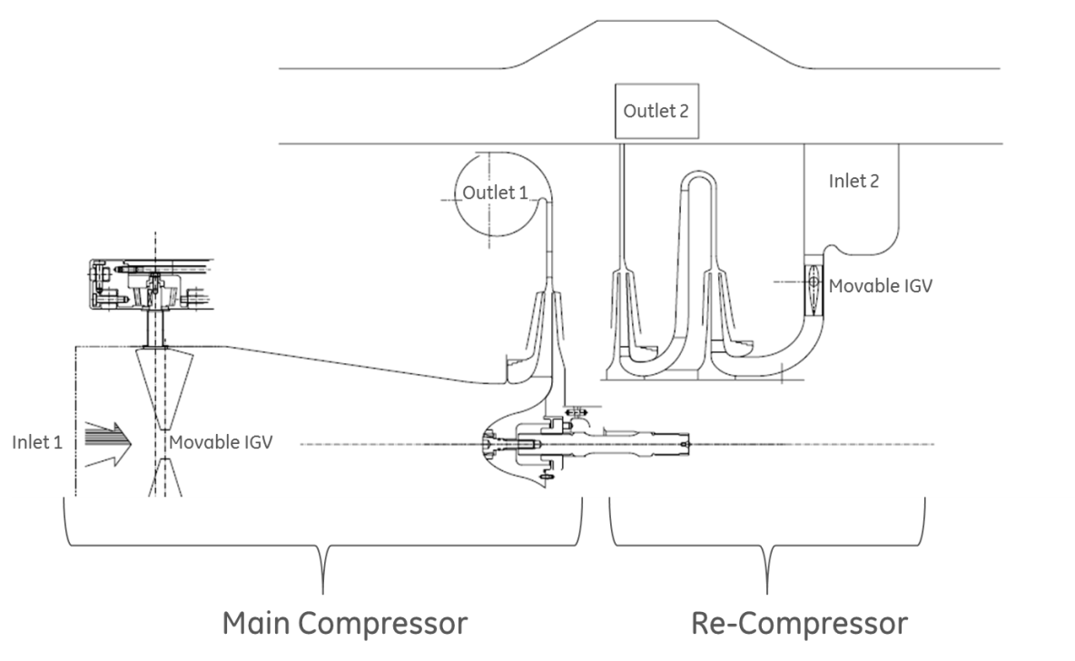
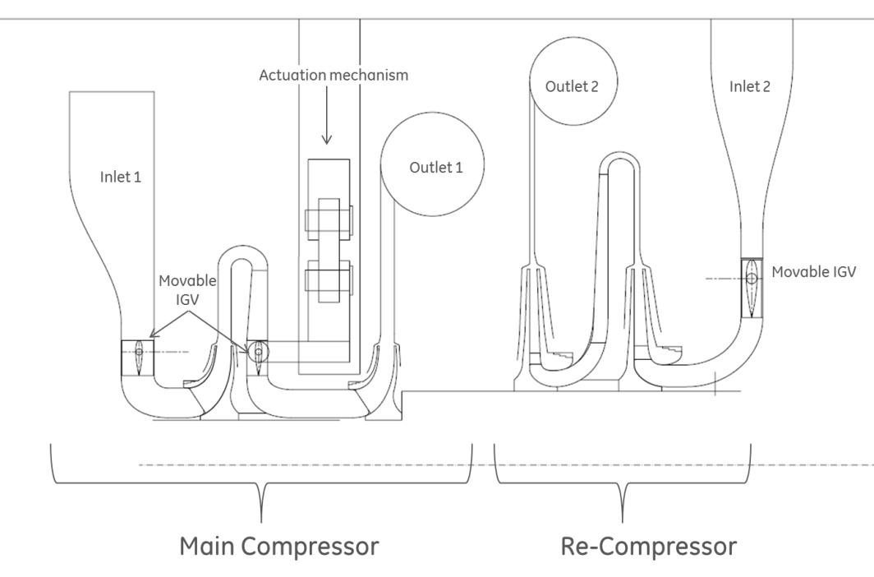
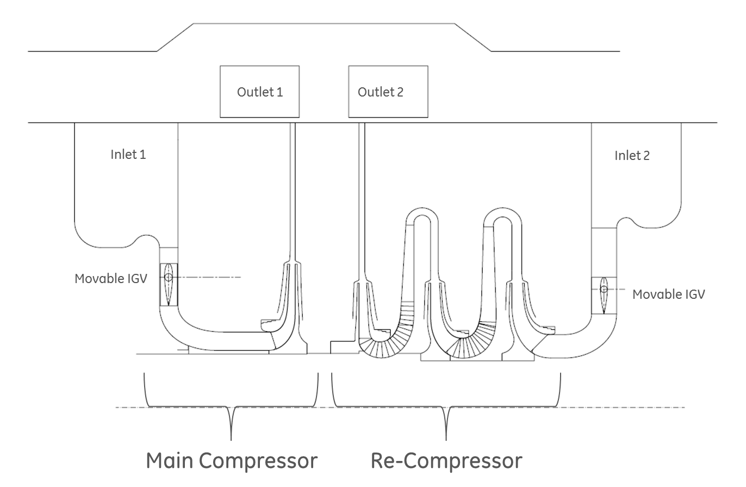
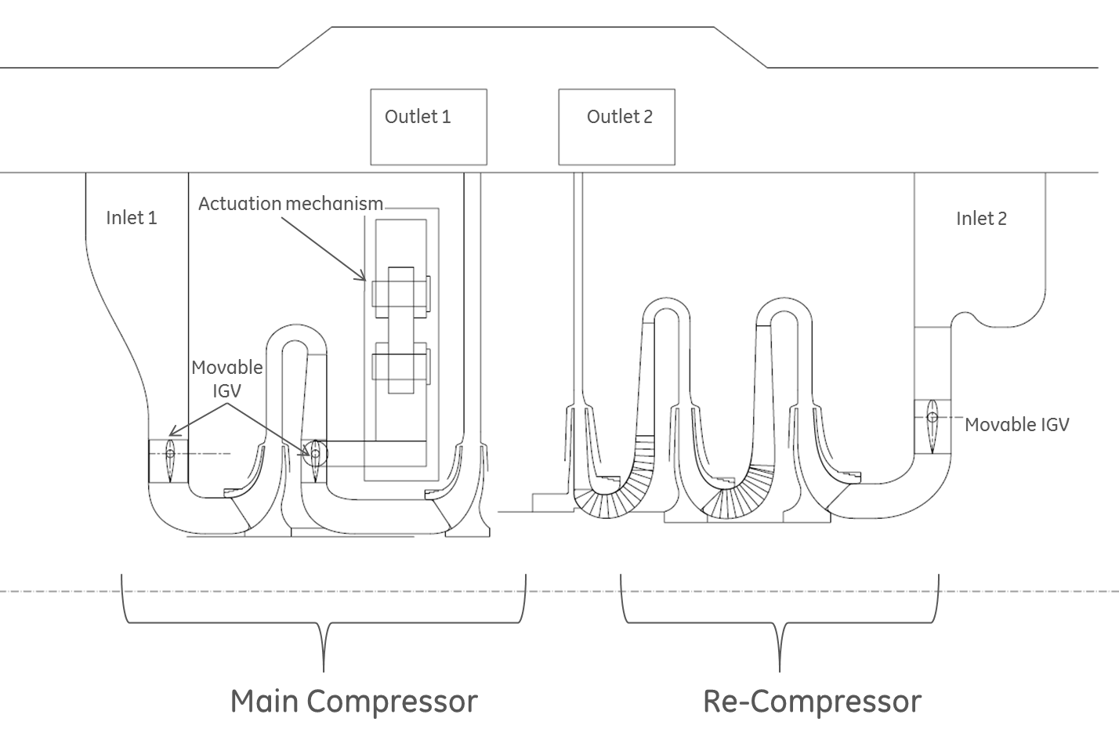
Compressor Stage Aero Architectures
STRADDLE
STRADDLE
OVERHUNG
2
2
1
2
1
2
STRADDLE
STRADDLE
1
3
1
3

Slide 13
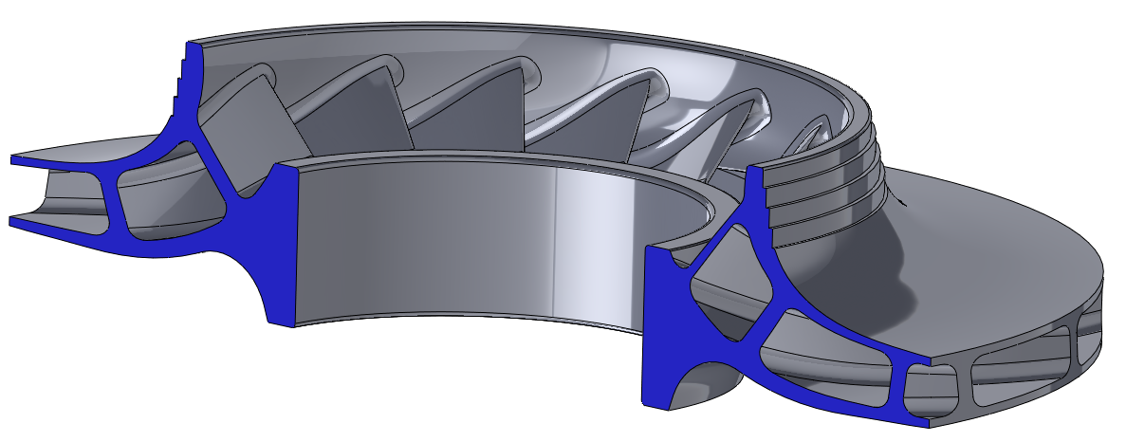
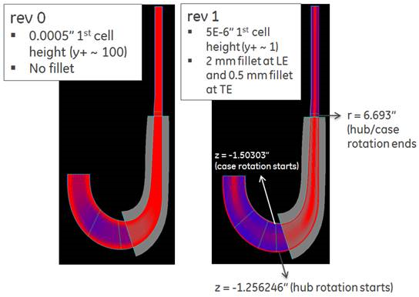
3D Aero Activities
Initial CFD Model
  Using existing impeller geometry
Mesh refinement
  Mesh density and size
  Critical flow path features
  Y+ values acceptable
Next Steps
  Scale down model to Apollo MC
  Re-mesh and run with perfect gas CO2
  Incorporate real gas properties
  Work on optimizing eff. (min. losses)

Slide 14
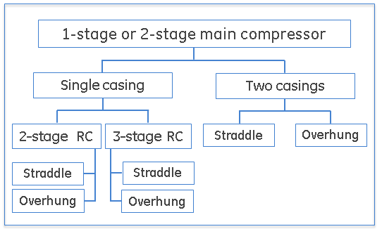
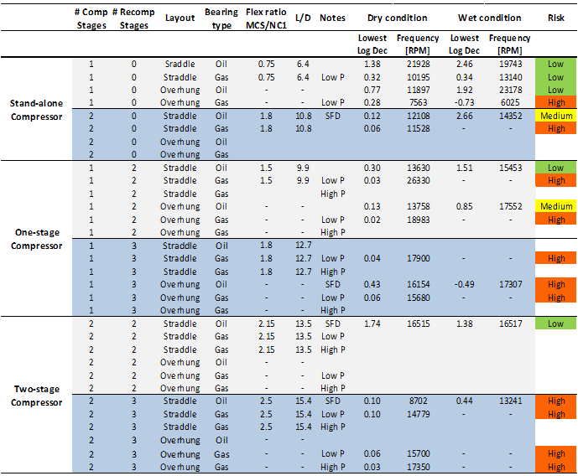
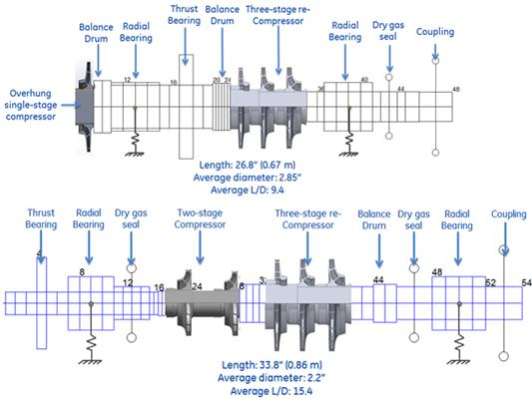
Rotordynamics
Several configurations evaluated
  Straddle mounted
  Overhung
  1-2 stage MC and 2-3 stage RC
  Log Dec of first mode and critical speed location
  Many configurations look challenging

Slide 15
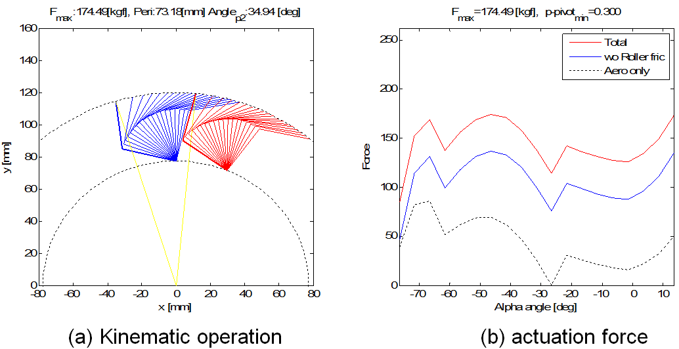
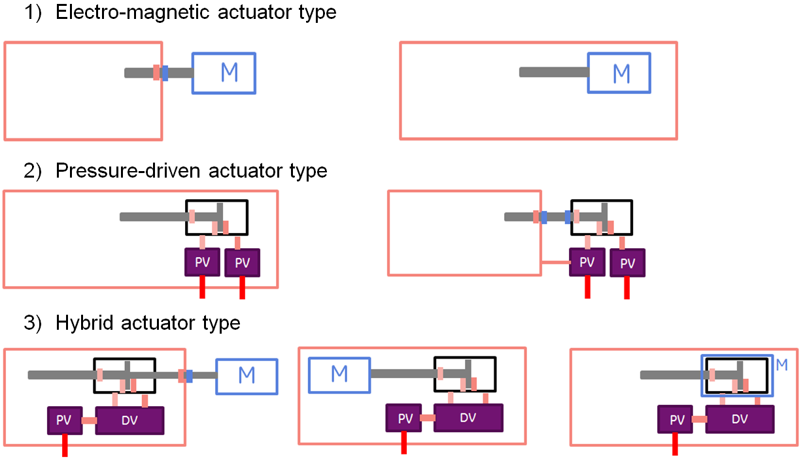
IGV Conceptual Design
Conceptual design analysis
  Using approximate aero loads
    Kinematic operation
    Actuation force requirements
Competing Concepts
  Electro-magnetic
  Pneumatic
  Hybrid (electromagnetic-pneumatic)
  Annular magnetic actuation
Next Steps
  Trade-off studies
  Obtain more accurate aero-loading
  Refined kinematics
  Packaging
  Control Scheme

Slide 16
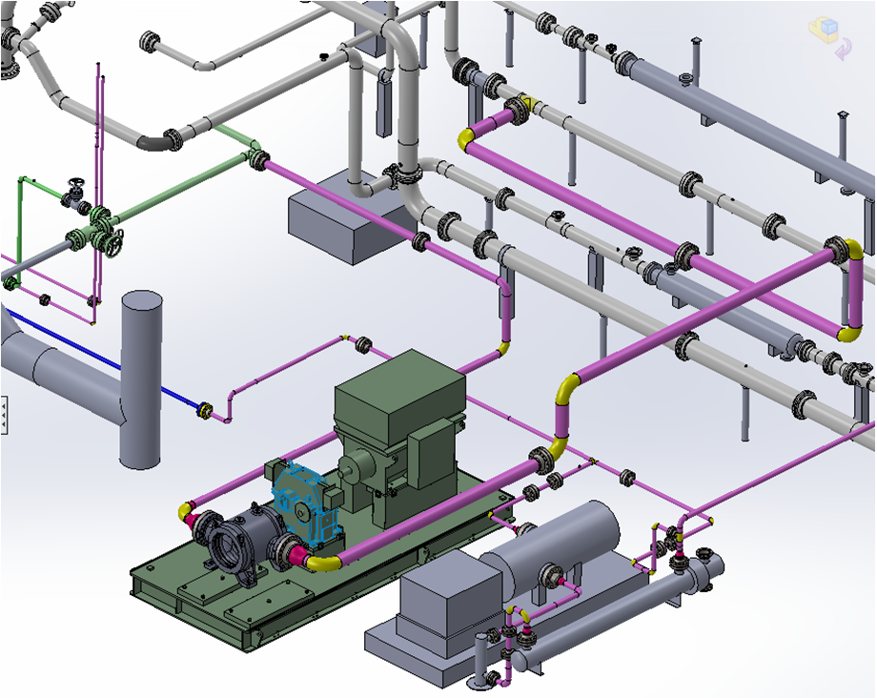
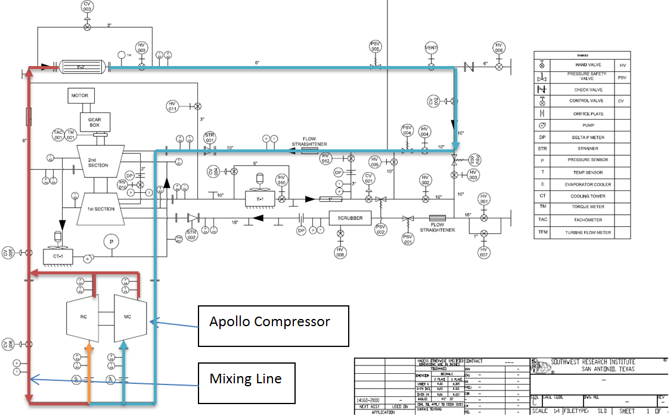
Test Flow loop

Slide 17
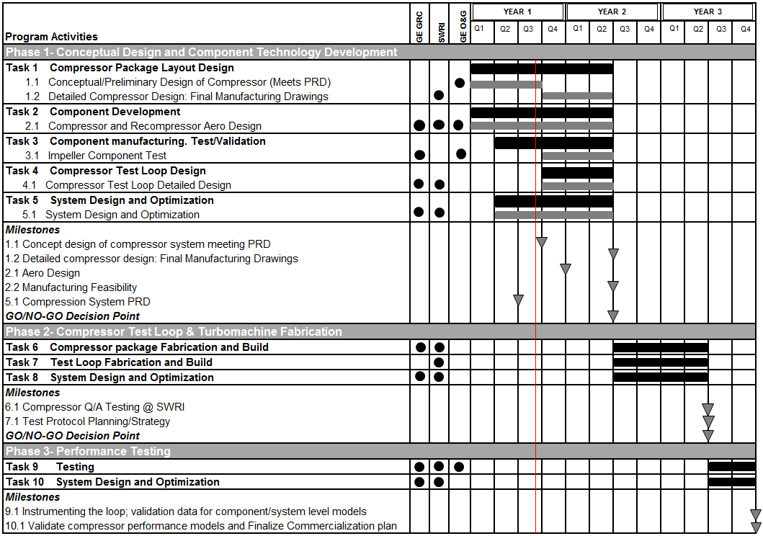
SCHEDULE

