Slide 1
CSP Industry Panel
Hank Price, PE
Solar Dynamics LLC
Notes:
Goal of talk
Describe Stage Gate Process for managing development of a technology
Discuss how McKinsey Three Horizon model Is used to manage a portfolio of products
Show examples of how Abengoa used both.

Slide 2
Stage Gate Process
4 Work Categories in Each Stage
Market/customer assessment
Research, development, demonstration
activities ($$$)
Competitive technology/detailed
technical assessment
Financial assessment
Gate Decisin Criteria: 7 Dimensions
Strategic Fit
Market/customer
Technical feasibility and risks
Competitive advantage
Environmental, legal, regulatory compliance
Critical success factors and showstoppers
Plan to proceed
Source: C. Riley, Stage Gate Management Process, NREL, June 9, 2005
Notes:
Originally proposed as model for product development to reduce costs and time to market
Adapted and extended to basic research for process technology development
Development activities proceeding toward commercialization in 5 stages:
Preliminary Investigation – homework only, no lab
Detailed Investigation – Lab scale, indiv. Unit ops
Development – lab + pilot scalek integration
Validation – Demonstration scale facilities
Commercial Launch
Exploratory Research
Development Research
Technology Support

Slide 3
Abengoa Stage Gated Technologies
Trough Technology
  Parabolic trough collectors
  Oil HTF
  Superheated steam HTF
  Molten-salt HTF
  Indirect molten-salt TES
  Phase change TES
Tower
  Heliostats
  Superheated steam receiver
  Molten-salt receiver
  Air receivers
  Steam storage
PV & CPV
Dish Stirling

Slide 6
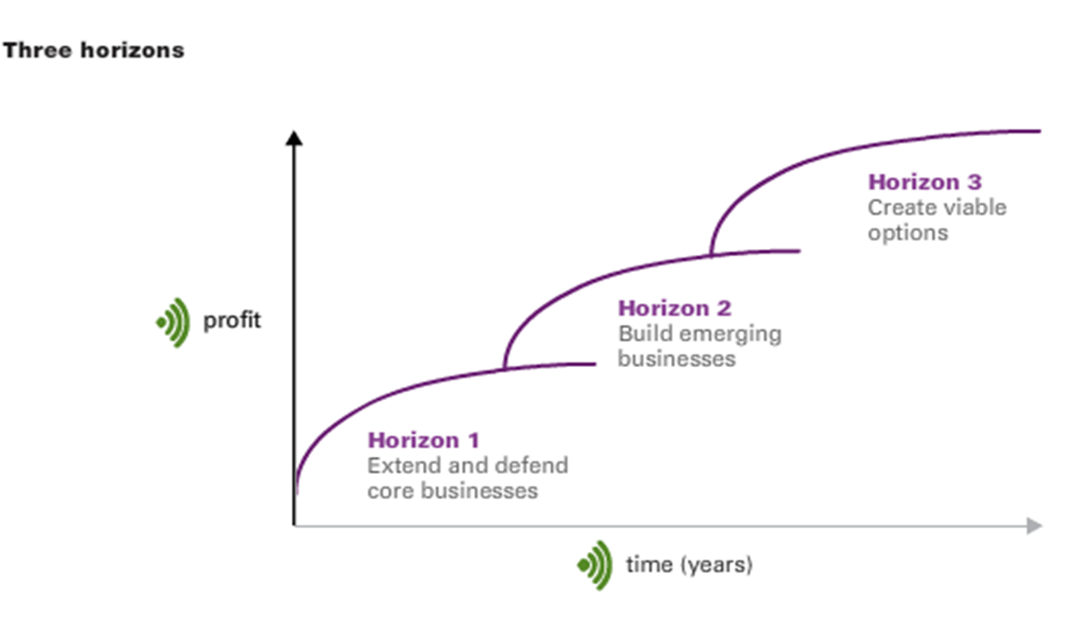
R&D Portfolio Management – McKinsey Three Horizons

Slide 7
R&D Portfolio Management – McKinsey Three Horizons
CSP Technology Portfolio Management
Solugas Air Tower
DSG Trough
Molten-salt Trough
Particle Tower
Superheated Steam Tower
Molten-salt Tower
Oil Trough w/TES
Saturated Steam Tower

Slide 8
R&D Portfolio Management – McKinsey Three Horizons
Parabolic Trough Collector Technology
2007
ASTR0
EuroTrough II - Sanlucar

Slide 9
R&D Portfolio Management – McKinsey Three Horizons
Parabolic Trough Collector Technology
2009
E2
ASTR0
Phoenix - Cameo
EuroTrough II - Sanlucar
ASTR0 – Solnova’s

Slide 10
R&D Portfolio Management – McKinsey Three Horizons
Parabolic Trough Collector Technology
2011
ASTR0
E2
E2
SpaceTube 7.5
E2
Phoenix - Cameo
Phoenix - Cameo
E2.7
ASTR0 – Solnova’s
E2 – Spain & Solana
ASTR0 – Solnova’s

Slide 11
R&D Portfolio Management – McKinsey Three Horizons
Parabolic Trough Collector Technology
2013
ASTR0
E2
SpaceTube 7.5
SpaceTube SM
Phoenix - Cameo
SpaceTube 8.2 - Solucar
E2.7
ASTR0 – Solnova’s
E2.7 – South Africa

Slide 12
R&D Portfolio Management – McKinsey Three Horizons
Parabolic Trough Collector Technology
2015
ASTR0
E2
ATLAS
SpaceTube SM
Phoenix - Cameo
SpaceTube SM
SpaceTube 8.2 - Solucar
SpaceTube 8.2 – South Africa
ASTR0 – Solnova’s

Slide 13
Parabolic Trough Collector Costs
100%
cost including receiver
63%
43%
32%
Notes:
1) Breakdown according to SunShot Vision Study – February 2012, Table 5-1
2) Development partially funded by DOE CSP FOA (2007)
3) Development supported by DOE SolarMat 2 FOA (2013)
4) Proposal to DOE APOLLO FOA (2014)

Slide 14
CSP INDUSTRY COMMENTS AND RECOMMENDATIONS ON DOE/INDUSTRY/LAB/UNIVERSITY ROLES
Improved Collaboration with Stakeholders
Creating a balanced RD&D Portfolio
Project Management
Activities to support development of a mature CSP market in the U.S.
Support for nearer term RD&D
Operation and Maintenance
Laboratory Support for Stakeholders
University R&D
Pilot Projects

