Slide 1
ANTI-SOILING COATINGS FOR CSP COLLECTOR MIRRORS AND HELIOSTATS
Panos Datskos, Distinguished Research Scientist
Barton Smith, Senior Research Scientist
Georgios Polyzos, Research Scientist
Fred List, Senior Research Scientist

Slide 2
Overview
Project name: Advanced Anti-Soiling Coatings for CSP Collector Mirrors and Heliostats
Funding Opportunity: SuNLaMP
Principle Investigator: Panos Datskos (ORNL)
Partners and Organizations: Oak Ridge Nat’l Lab (ORNL) NRG Energy Services, LLC
Project Duration: 36 months
Project Budget: $2,800,000

Slide 3
Problem Statement and Value Proposition
SunShot operation and maintenance (O&M) cost goal for trough and tower technologies is 1.2¢/kWh.
O&M cost for CSP solar field comprises the largest portion of the overall O&M cost.
Decreases in solar field maintenance costs are possible through reductions in mirror washing (water & labor).
Increases in revenue are possible through increased average reflectivity during intervals between mirror washings.
Value proposition of this project is the demonstration and commercialization of anti-soiling coatings that reduce the rate of dust accumulation by half and exhibits self-cleaning during rain events, thereby prolonging the interval between washing events.

Slide 4
Objectives
The project objectives are aimed to demonstrate the efficacy and durability of superhydrophobic coatings that can provide anti-soiling capabilities for trough and heliostat mirrors through field demonstrations at CSP test sites and to advance the proposed technology toward commercial viability via a Technology to Market (T2M) Plan.
Provide increased durability (5 years) while maintaining targeted specular reflectivity.
Develop spray coating technique.
Demonstrate in field tests that mirrors coated using our laboratory spray system have 50% less dust accumulation.
Demonstrate cost savings achieved through increased average mirror reflectivity and generated power output would be ~0.135¢/kWh.
Potential reduction of approximately 0.3¢/kWh in the operations and maintenance costs for the CSP solar field provided by application of the anti-soiling coating. This reduction is about 10% of the 3¢ target reduction (5¢ to 2¢ decrease) in the contribution of the solar field to the LCOE.

Slide 5
Milestones
Budget Period 1 Go/no-go – Demonstrate that anti-soiling coating can reduce LCOE by ∼ 0.2¢/kWh through reduced mirror washing and by ∼ 0.01¢/kWh through reduced water usage.
Budget Period 2 Go/no-go – Demonstrate at CSP plant site that coated test mirrors have a daily degradation rate (DDR) in specular reflectance that is half that of uncoated mirrors and that increased average mirror reflectivity has potential to increase generated power and lower LCOE by ∼ 0.135¢/kWh.
Budget Period 3 Go/no-go – Demonstrate at CSP plant site that coated full-size mirrors have daily degradation rate (DDR) that is half that of uncoated mirrors with no more than a 5% increase in DDR in one year.

Slide 6
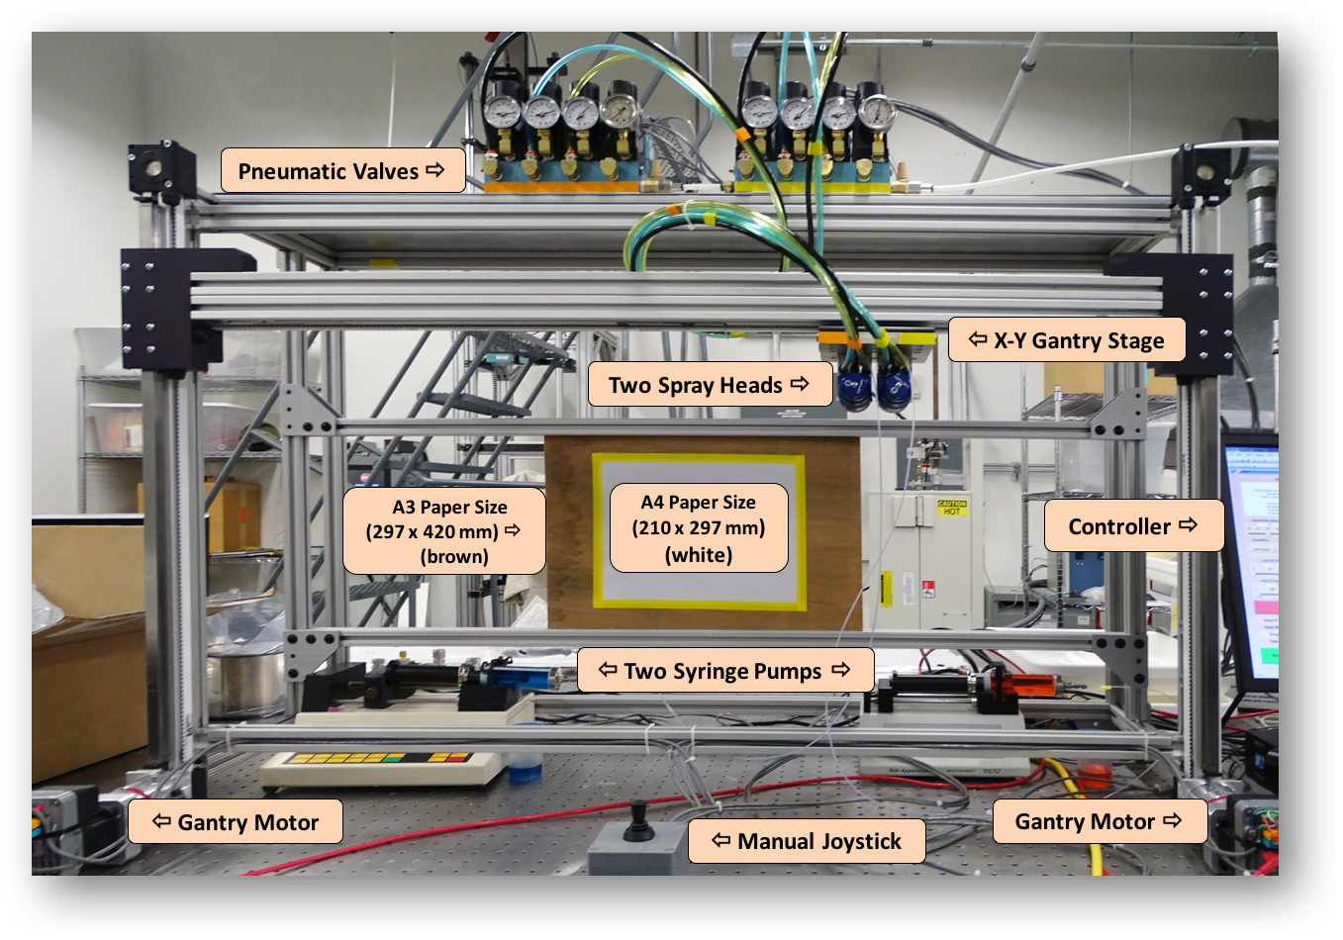
Results in Budget Period 1
Demonstrate semi-automated method for producing anti-soiling coatings on field-testable mirrors and outline process for scaling method to full-size mirrors
  Adapt standard coating technique
  Use reduced factorial design for statistical evaluation of anti-soiling behavior and durability objectives and select optimum coating parameters
  Verify anti-soiling behavior, abrasion resistance and UV durability
Benchtop spray system with XY-translatable spray guns for coating 2nd surface solar mirrors with sizes up to ISO A3 (29.7𐄂42 cm²)

Slide 7
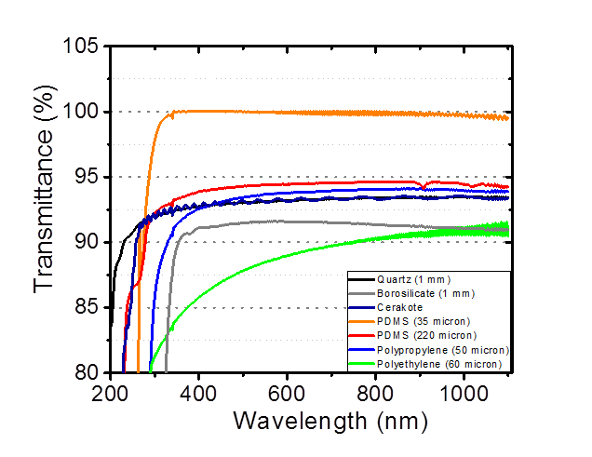
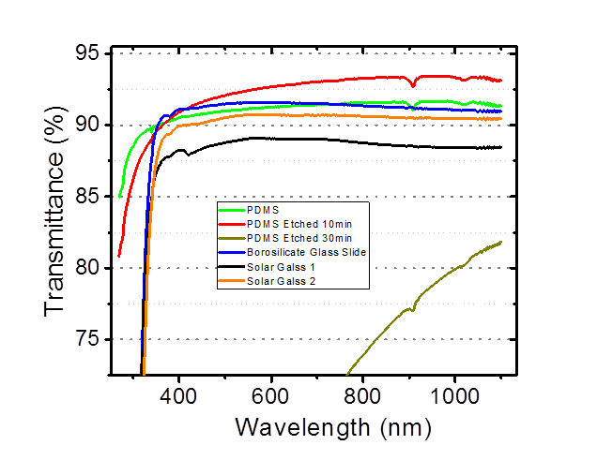
Results: Optical Properties
Structured/etched PDMS has anti-reflective properties. Transmittance nearly 3% greater than an uncoated glass slide.

Slide 8
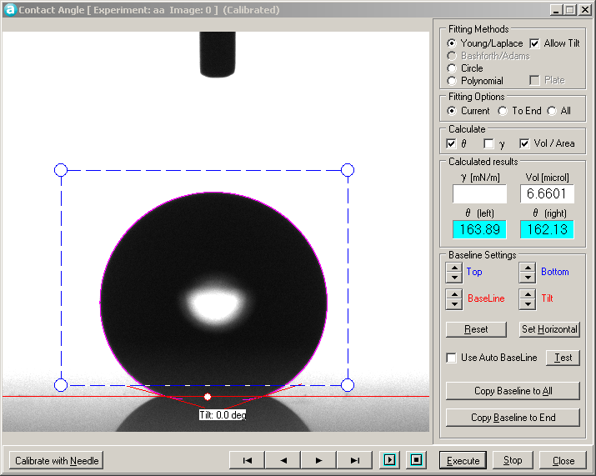
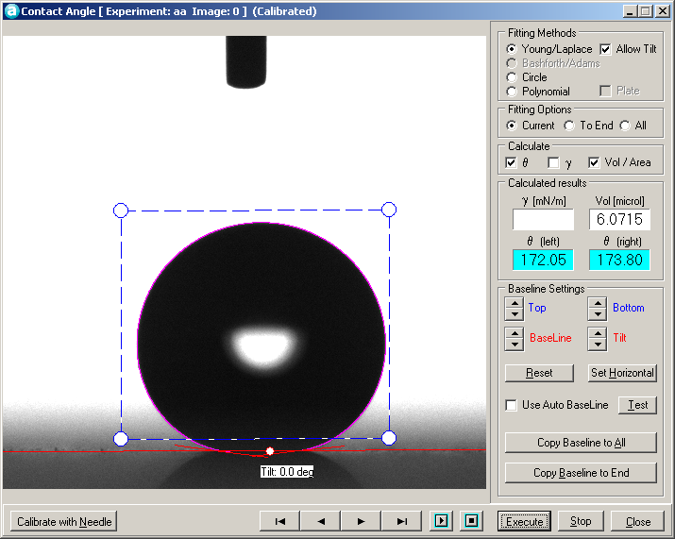
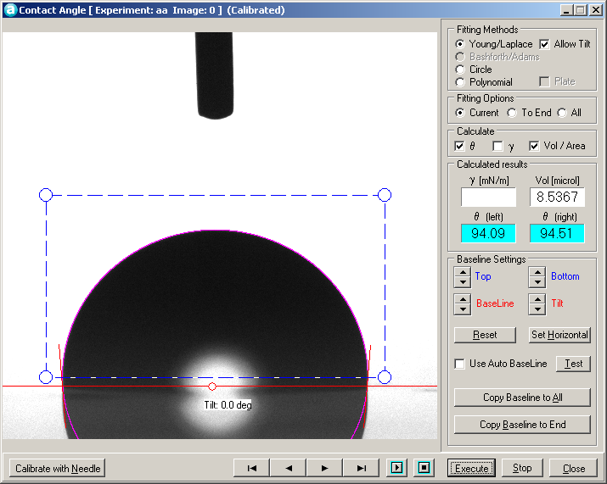
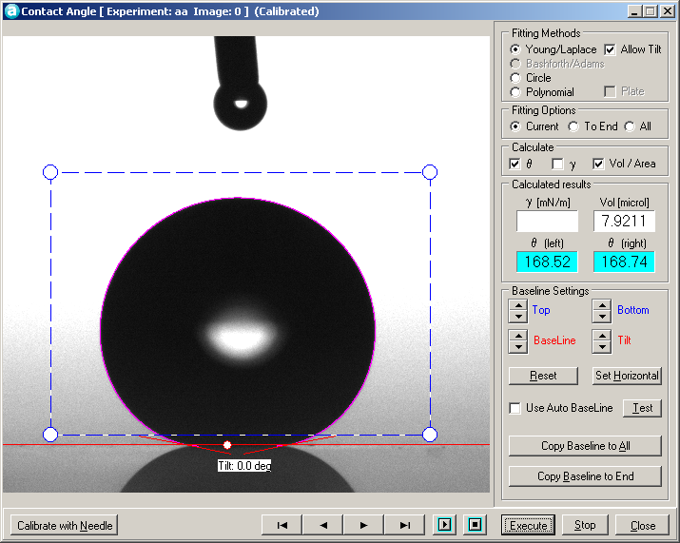
Results: Coating Durability Has Been Increased…
One layer silica particles (70nm) and Aerosil on borosilicate
CA = 163.6±3.2
One layer of silica particles on PDMS etched substrate
CA = 172.6±3.6
PDMS etched for 10min
CA = 94.2 ± 3.6
PDMS etched for 10min with C6 coating
CA = 166.6±3.8
1st week: Test time: 168 hours
Temperature: 60 C, Dose: 211.67 kJ/m²
Irradiance @340nm: 0.35 W/m²
2nd week: Test time: 145.8 hours
Irradiance @340nm: 0.7 W/m²
3rd week: Test time: 168 hours
Irradiance @340nm: 0.7 W/m²

Slide 9
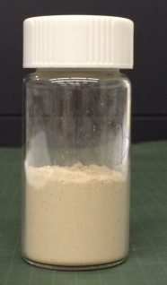
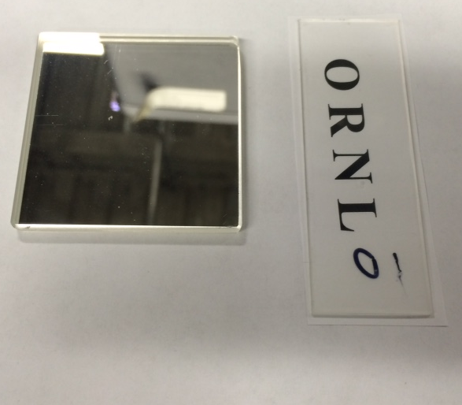
Results: Falling Sand Test
Simulated 5 y of accumulation: 1.3g/2.9 cm2 (10x 5 years = 13g)
Sand Container
Coated mirror (C7)
- Sunshot sample
Abrasive
Flow Gate
13g of sand
Guide Tube
Vertical
Support Post
Viewing
Window
PDMS etched 10 min
3 Layers of C6
45⁰ Sample
Holder
Receptacle
Dust particle average size: 55 μm
Base with
Leveling Feet

Slide 10
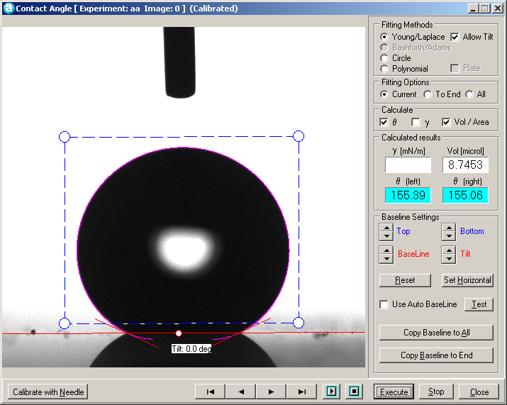
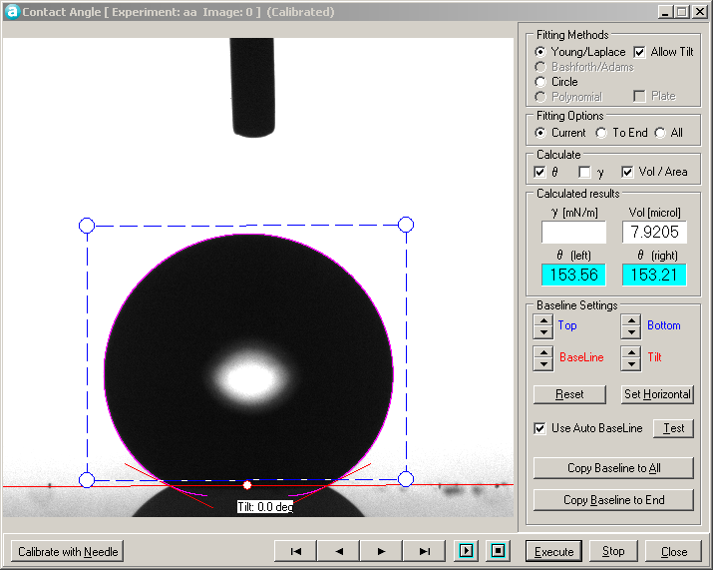
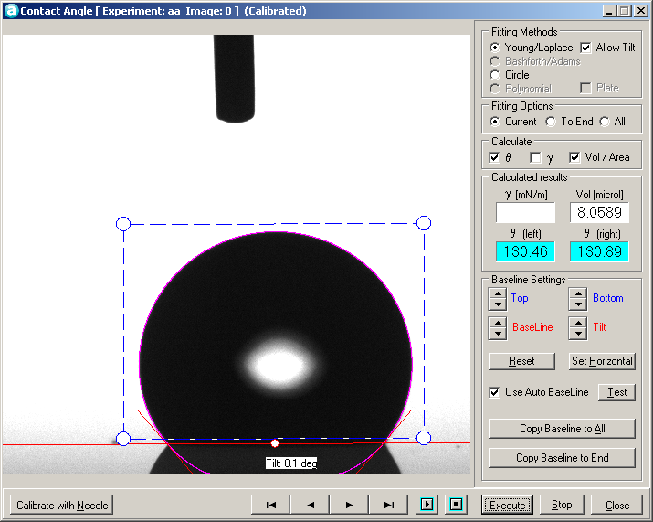
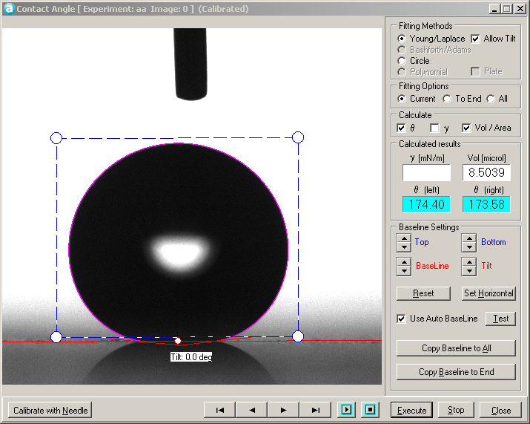
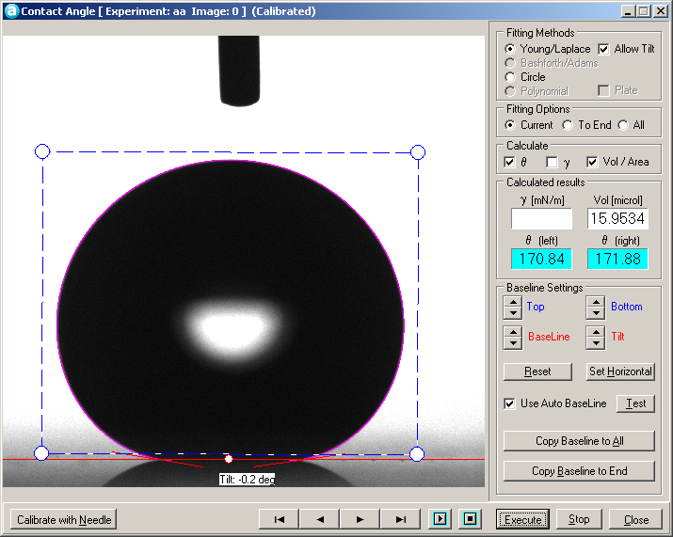
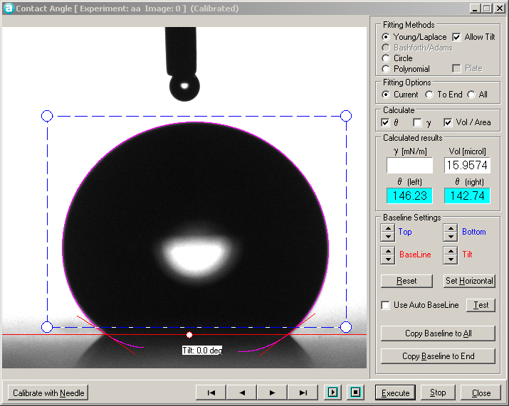
Results: Falling Sand Test
Coated mirror (C7) Sunshot sample
Sand fall: 0g
CA = 155.1 ± 0.3
Sand fall 1.3g:
CA = 152.1 ± 1.9
Sand fall 13g:
CA = 129.6 ± 14.2
PDMS 10 min etched
3 Layers of C6
Sand fall: 0g
CA = 175.2 ± 2.0
Sand fall 1.3g:
CA = 172.8 ± 1.8
Sand fall 13g:
CA = 148.5 ± 15.2

Slide 11
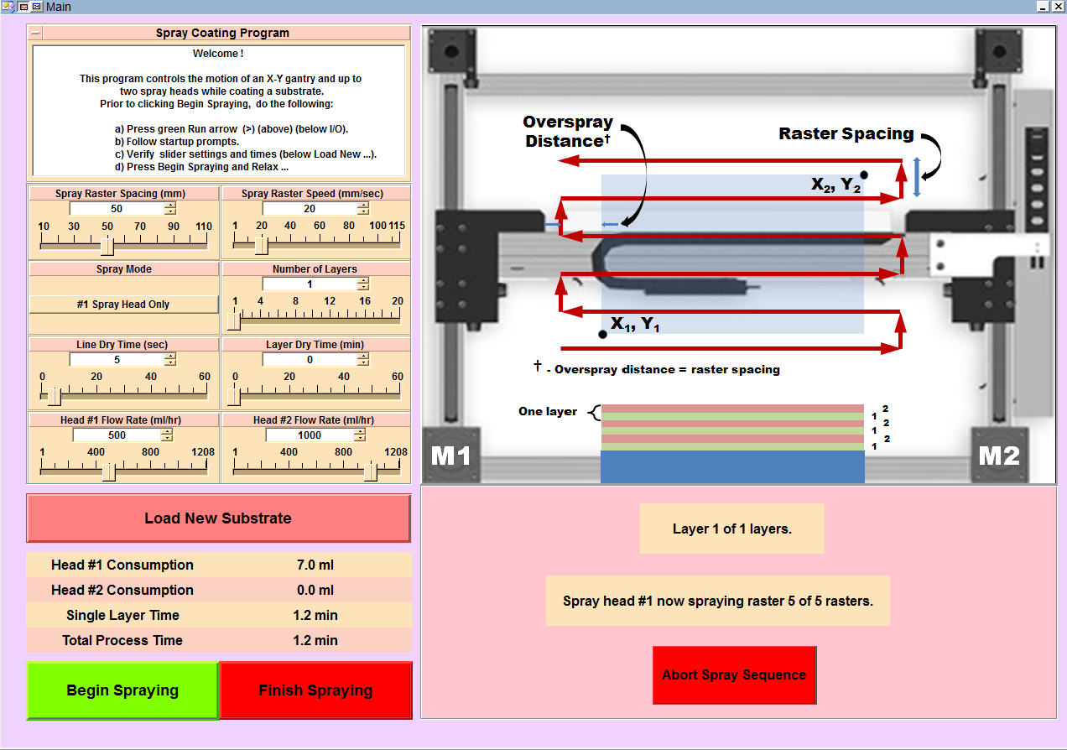
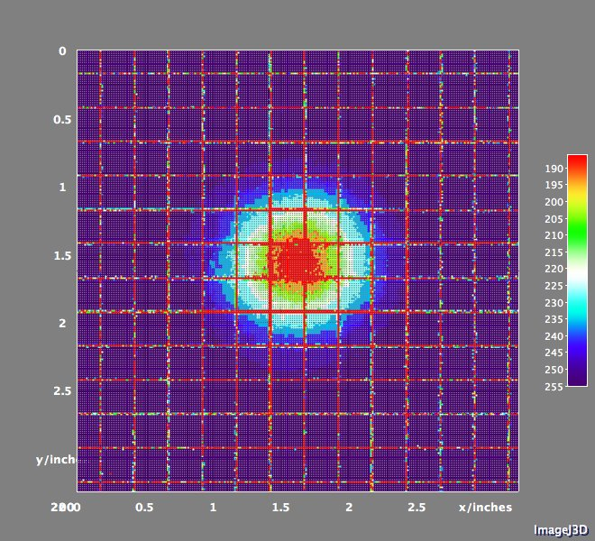
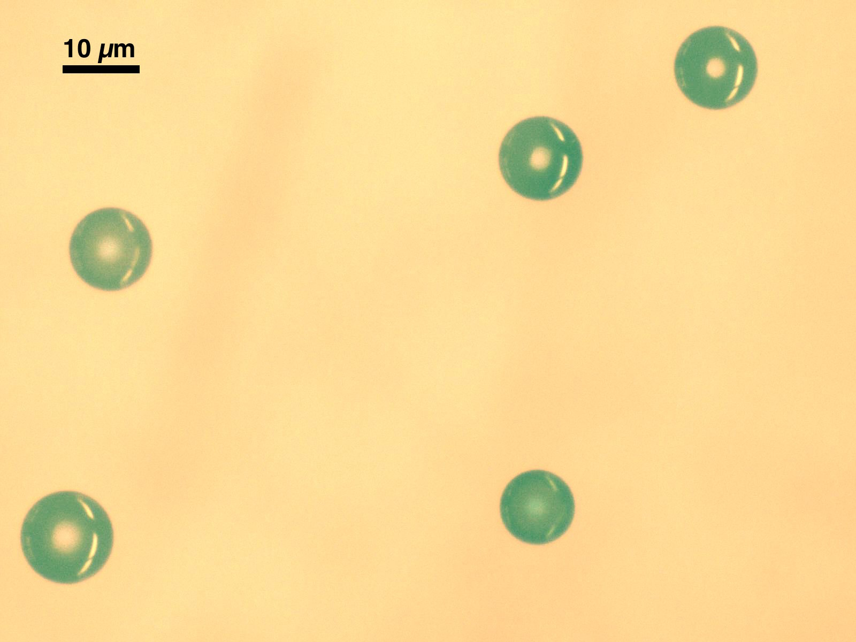
Results: Spray Coating
Spray coating system control interface
Dye density plot shows good symmetry, slight radial gradient.
Optical image of largest diameter water droplets captured on surface of mineral oil.

Slide 12
Results: Cost Model
Case | SunShot
Source | SVS
Design Assumptions
Technology | S-CO₂ combined Cycle Tower
Solar Multiply | 2.7
TES (hours) | 14
Plant Capacity (MW, net) | 200
Power Cycle Gross Efficiency | 0.555
Cooling Method | dry
Cost Assumptions
Site Prep Cost ($/m2) | 10
Solar Field ($/m2) | 75
Power Plant Cost ($/kWh-t) | 880
HTF System or Tower/Rcvr Cost ($/m2 or $/kW-t) | 110
Thermal Storage Cost ($/KWh-t) | 15
Contingency | 10%
Indirect (% of direct costs + contingency) | 19.7%
O&M ($/kWh-t) | 40
SAM Results
Capacity Factor | 66.6%
Total Installed Cost ($/kW) | 3,770
LCOE 9c/kWh, real) [zero ITC, SVS financial assumption) | 6.0
Performance and cost values of CSP tower baseline simulation in SAM 2015.6.30
Mirror reflectance value (R) | 0.95 | 0.90 | 0.88 | 0.85 | 0.83
Annual energy (GWh) | 243.7 | 234.5 | 230.5 | 223.6 | 219.1
Capacity factor (%) | 27.8 | 26.7 | 26.3 | 25.5 | 25.0
PPA price (year 1) (¢/kWh) | 21.90 | 22.74 | 23.13 | 23.88 | 24.36
PPA price escalation (%) | 1.00 | 1.00 | 1.00 | 1.00 | 1.00
Levelized PPA price (nominal) (¢/kWh) | 23.81 | 24.72 | 25.14 | 25.96 | 26.48
LCOE (nominal) (¢/kWh) | 16.93 | 17.57 | 17.87 | 18.41 | 18.79
System Advisor Model (SAM) case study for a tower absorber/heliostat field CSP plant with hypothetical supercritical CO₂ power generation combined with thermal energy storage (TES)

Slide 13
Results: Cost Model
Decreasing value of LCOE as average mirror reflectance increases. The slope of a straight line fit to the data indicates that a 0.155¢ decrease in LCOE per % increase in average reflectance is possible. An increase of 1.5% in average reflectance (from 88.5 to 90.0%) would reduce the LCOE by about 0.23¢/kWh.

Slide 14
Path to Market
Our approach capitalizes on the recent advances at ORNL in superhydrophobic and anti-soiling coatings.
Promising avenue for the amalgamation of cutting-edge nanotechnologies that can be utilized toward DOE’s technical targets.
Manufacturing and testing of scalable anti-soiling coatings, which are anticipated to demonstrate improvements in the antisoiling properties of mirrors in the concentrated solar power (CSP) industry.
The successful implementation of the project will provide processing conditions that can be utilized in advanced mirror coating manufacturing for breakthrough savings.

Slide 15
Path to Market
Our work is part of a demonstration stage research activity. This stage research would last through the end of the project duration.
Following the project, further scale-up activity to pilot production of coatings technology in the manufacturing environment would be necessary.
The scale up phase could take 1-3 years for the material scale-up followed by 2-5 years of materials production trials and field trials of the coating material fro CSP mirrors. This phase would validate the industrial and technical feasibility and address any risks that were identified in the research stage.
Once the feasibility is evaluated, incorporation of the technology into a market project would occur. A typical market project lasts 12-24 months for commercial CSP mirror products.

