Slide 1
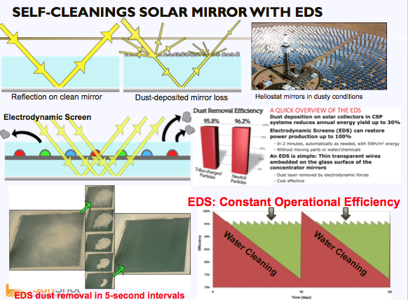
Enhancement of Optical Efficiency of CSP Mirrors for Reducing O&M Cost via Near-Continuous Operation of Self-Cleaning Electrodynamic Screens (EDS)
Boston University
Award # DE-EE0007119
Project Phase – BP-1
FOA 0001186-1599-BU ---------------------------
DOE Phase Funding: $440,188.
Cost-Share Phase Funding: $136,554.
Total Federal Funding: $1,150,000.
Total Cost-share Funding: $440,862
Total Funding: $1,590,862
------------------------------------------
Malay Mazumder (PI)
Mark Horenstein (Co-PI)
Nitin Joglekar (Co-PI)

Slide 2
Team Members (BU, Corning, SNL, ITRI, and Geodrill)
Faculty: Malay Mazumder, Mark Horenstein, Nitin Joglekar, and Mark Kean
Post-Doctoral Fellow: Ryan Eriksen
Graduate Students: Annie Bernard, Carlos Henrique Pinto Coutinho
Undergrad Students: Alecia Griffin, Bill Chaiyasarikul, Dave Crowell, Kevin Rego, Raaid Arshad, Siddhartha Kc, Willem Van Der Vlient, and Steven Maloney
SNL: Julius Yellowhair
Corning: Sean Garner
ITRI: HY Lin
Geodrill (EDS-Chile-SpA): Hugo Acuña O.

Slide 3






Working Partners
Subcontracts, Material Transfer Agreements, Multi-party NDA and IP Management Plan
SNL: Subcontracts approved by both SNL and DOE HQ was
signed on 3/23/16. IP management Plan approved - waiting
for signature
Corning: IP Management Plan, MTA and subcontract approved,
multi-party NDA is being circulated to partners receiving
EDS films with Corning Willow Glass for evaluation for signatures.
ITRI: Signed the subcontracts and the IP Management Plan
Geodrill: Signed all documents, providing $45k as cost-share in
cash. They formed a new subsidiary company EDS Chile SpA
for field application of EDS.
Kodak: CDA, MTA, and NDA with BU are in the process getting
signatures.
MassCEC: is in the process of signing an agreement with BU
for providing $81,917 as cost-share to support a PhD student.

Slide 4
Project Objectives
Describe the overall goals of the project
Develop an advanced operation and maintenance method based on EDS mirror cleaning
Reduce the O&M cost of CSP power plants
Improve efficiency of CSP optics
Improve the reliability and predictability of mirror performance
Conserve water
Highlight the innovative features of the project
The EDS film technology will maintain clean optical surfaces without water or manual labor, which will benefit both CSP and PV industries and enable a potential multi-GW capacity operation without creating an unsustainable demand on the fresh water needed for cleaning solar collectors.

Slide 5
Budget Period Summary BP1
Tasks: Lab and Field Evaluation of EDS with Ag-paste, Ag-reflecting, & AgNW electrodes with encapsulation: Produce lab-scale EDS films laminated on solar mirrors and evaluate (a) specular reflection efficiency, (b) dust removal efficiency, (c) self-cleaning operation @RH 80%+ to < 20%, over a 24-hr cycle, (d) Wh/m²/cleaning cycle and (e) durability
Subtask: Perform accelerated UV radiation resistance testing
Subtask: Investigate the degradation of electrodes caused by photo-oxidation and corrosion studies based on the environmental parameters of solar fields.
Subtask: Measure energy consumption in Wh/m²/cleaning-cycle for EDS based cleaning
Subtask: Low-cost EDS power supply design

Slide 6
Budget Period Summary BP1
Tasks: Field Evaluation of EDS-film laminated mirrors and solar panels for durability and self-cleaning properties
Subtask: Complete field evaluation of lab-scale EDS film laminated on solar mirrors and panels and evaluate (a) SRR, (b) OPR, (c) DRE at RH 80%+ to < 20%, over a 24-hr cycle, (d) Wh/m²/cleaning cycle and (e) durability at SNL and Ivanpah solar fields
Subtask: Perform the above tests at the Ivanpah Plant site or at another solar plant at a desert site. Study environmental durability.
Subtask: Repeat the above tests for EDS film laminated solar panels for OPR measurements at Atacama plant site; study environmental durability as a function of exposure time.
Subtask: Evaluate Power supply units’ performance at the desert sites.
Subtask: Analyze energy requirements per m² and per cleaning cycle.
Subtask: Based on the tests at the solar plant sites, perform a comprehensive analysis on the design and specification of EDS film for engineering scale up.

Slide 7
Budget Period Summary BP1
Task: Cost Analysis of EDS-Based vs. Water-Based Cleaning Methods
Subtask: Analyze Levelized Cost of Mirror/Module Cleaning (LCOMC) for water-based and EDS-film - based cleaning and respective advantages and disadvantages.
Subtask: Make a quantitative determination of water conservation with and without EDS – based cleaning: (a) determine the frequency of water based cleaning for EDS films for removing organic and inorganic pollutants that deposit on the solar collectors but cannot be removed by the EDS activation, (b) Water conservation in global application of EDS-film based CSP and PV module in Terawatt scales.
Subtask: Calculate maximum energy gain by increased PR (Performance Ratio) of the solar plant by EDS operation vs. EDS cost by both modeling and by field measurements with lab-scale EDS film.
Subtask: Measure EDS film failure rate. Perform statistical analysis on EDS film failures at the test sites and carry out improvement of EDS film design and construction in collaboration with industrial partners.

Slide 8
Evaluation of lab-produced EDS Panels
Measurements of DRE, SR, SRR and OPR
Measure DRE defined as the ratio: 100 × (m_{o} – m_{r})/ m_{o}, where m_{o} = original surface mass density of dust on the collector surface before EDS activation and m_{r} = surface mass density of dust remaining after EDS activation.
Measure SR defined as the specular reflection efficiency of the EDS laminated solar mirror.
Measure SRR defined as the percentage restoration of SR efficiency of the EDS mirrors under clean condition. SRR = (SR of the EDS mirror after EDS activation)/(SR of the EDS mirror under clean condition).
Measure OPR defined as the restoration of short circuit current (Isc) of the EDS-solar panel before and after EDS activation: OPR = (I_{sc} after EDS activation for dust removal) ÷ (I_{sc} of the EDS-laminated solar panel under clean conditions).
Basis: Power output of a solar panel is given by P_{out} = V_{oc}I_{sc} × FF where V_{oc} is the open circuit voltage and FF is the Fill Factor of the solar panel. I_{sc} is affected by dust deposition on the front surface of the solar panel. V_{oc} and FF can be considered as constant within the range of operation involved in solar fields.

Slide 9
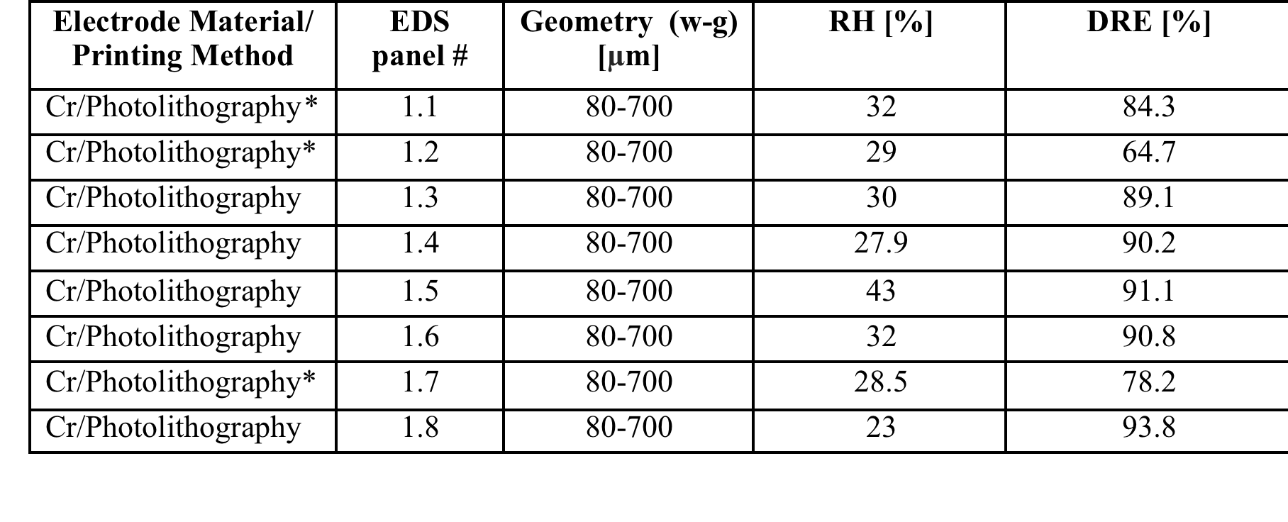
Evaluation of lab-produced EDS Panels for DRE
Measured values of DRE with EDS panels with three phase Cr electrodes with electrode geometry w = 80 μm separation = 700 μm using three-phase 1.5 kV pulsed voltage at 5 Hz. JSC test dust was used with d < 80 μm particle diameter
*Third-phase electrode interconnection performed manually results in inconsistent performance of EDS panels.

Slide 10
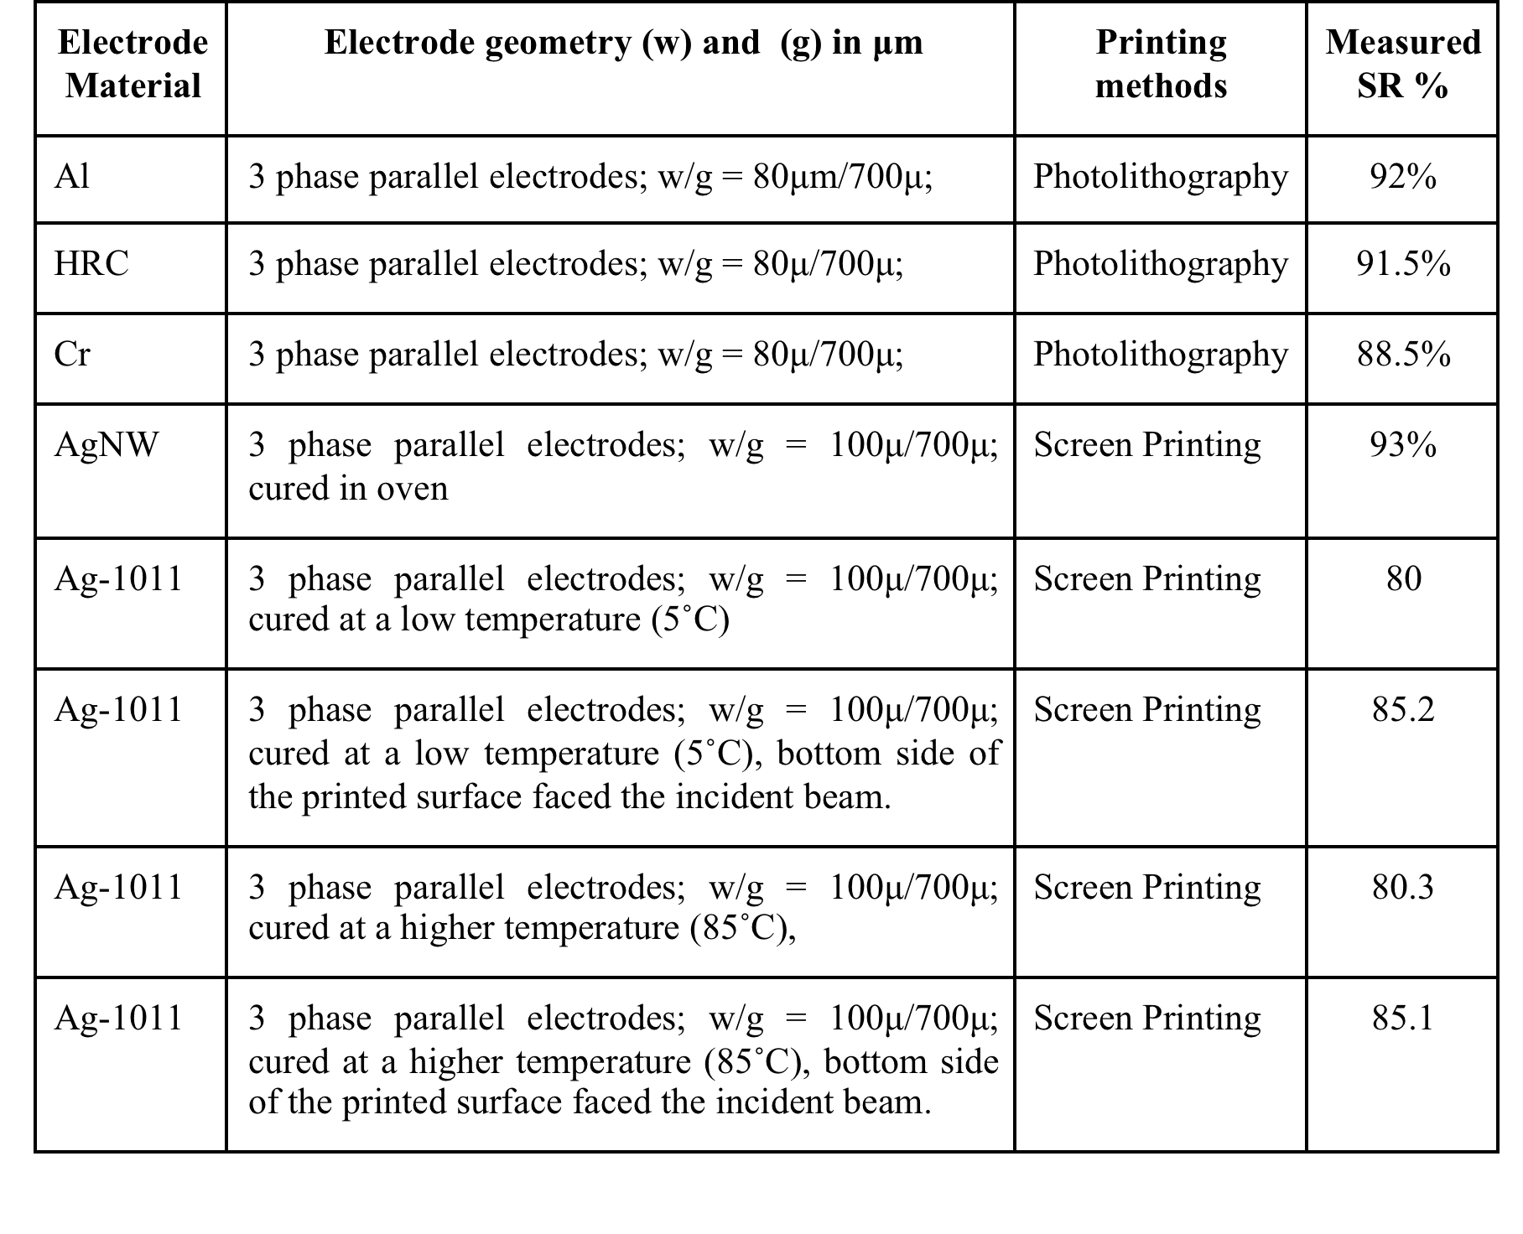
Experimental data on SR measurements with lab-produced EDS Panels with reflecting and transparent electrodes

Slide 11
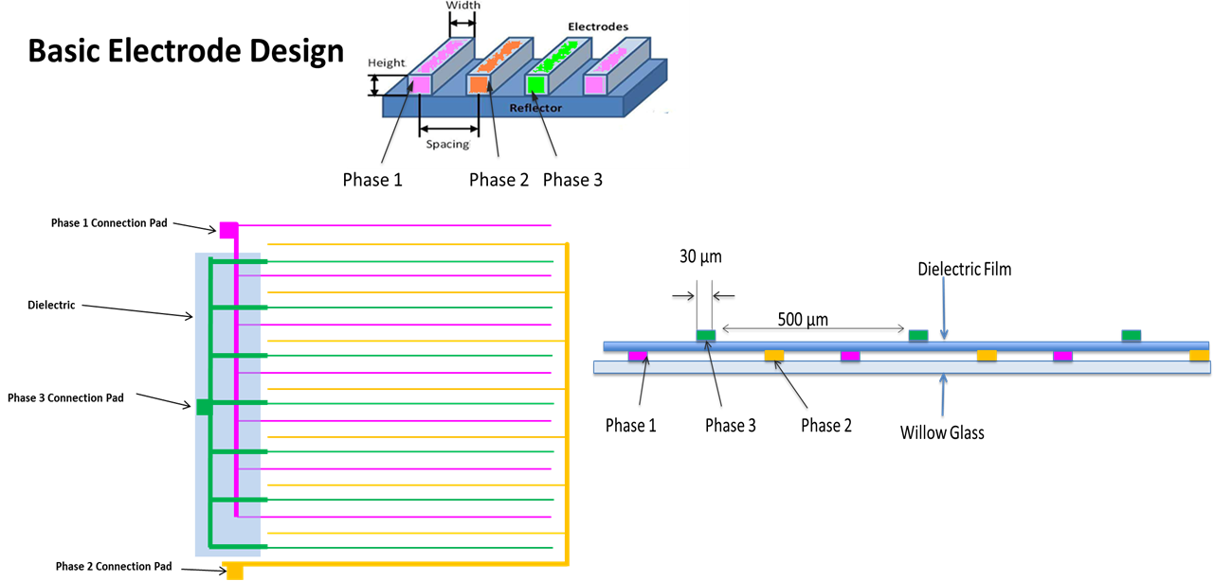
Task 1.2.1: Make interconnections to three electrode phases

Slide 12
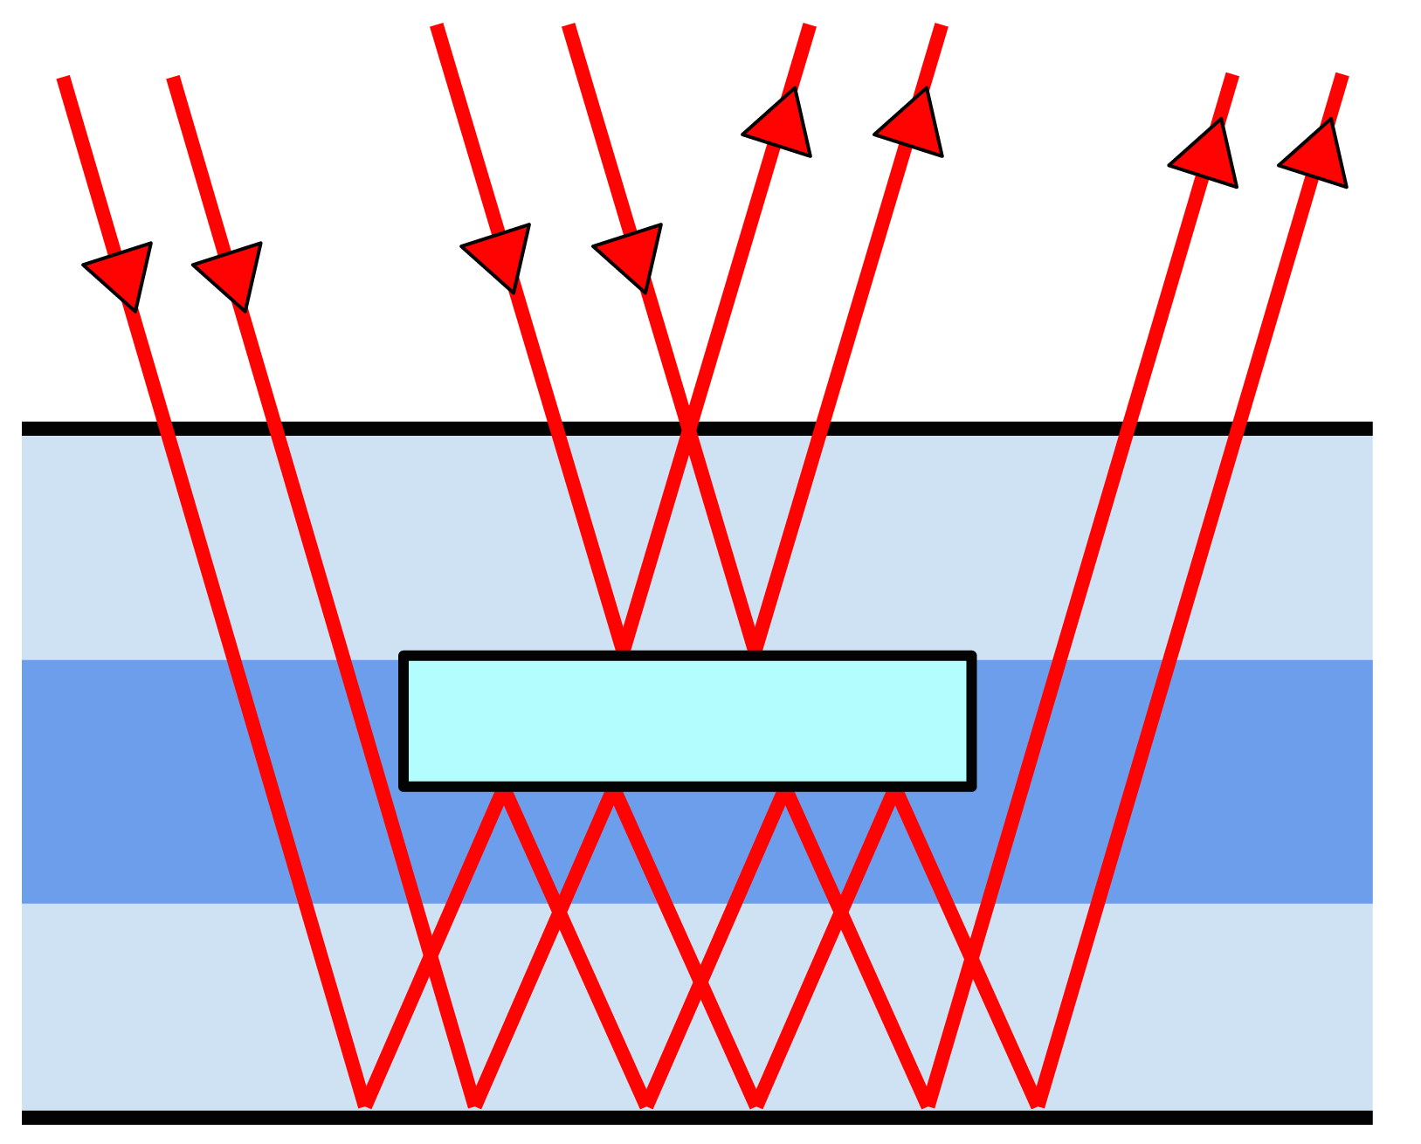
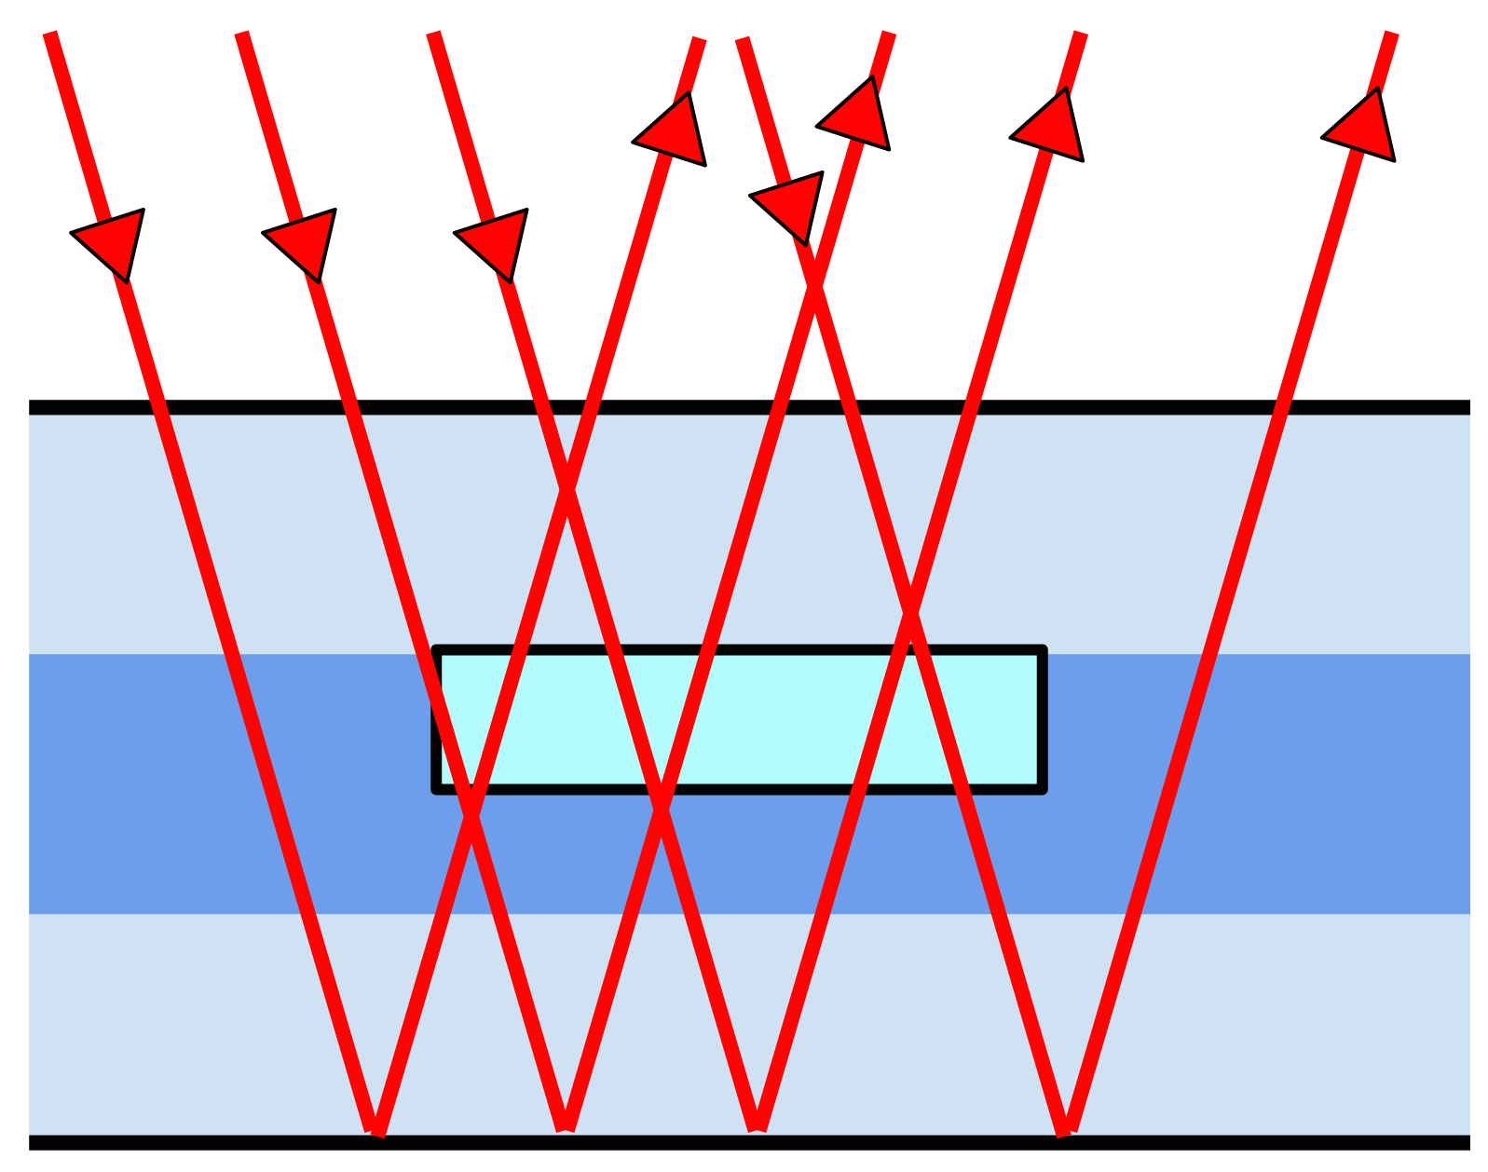
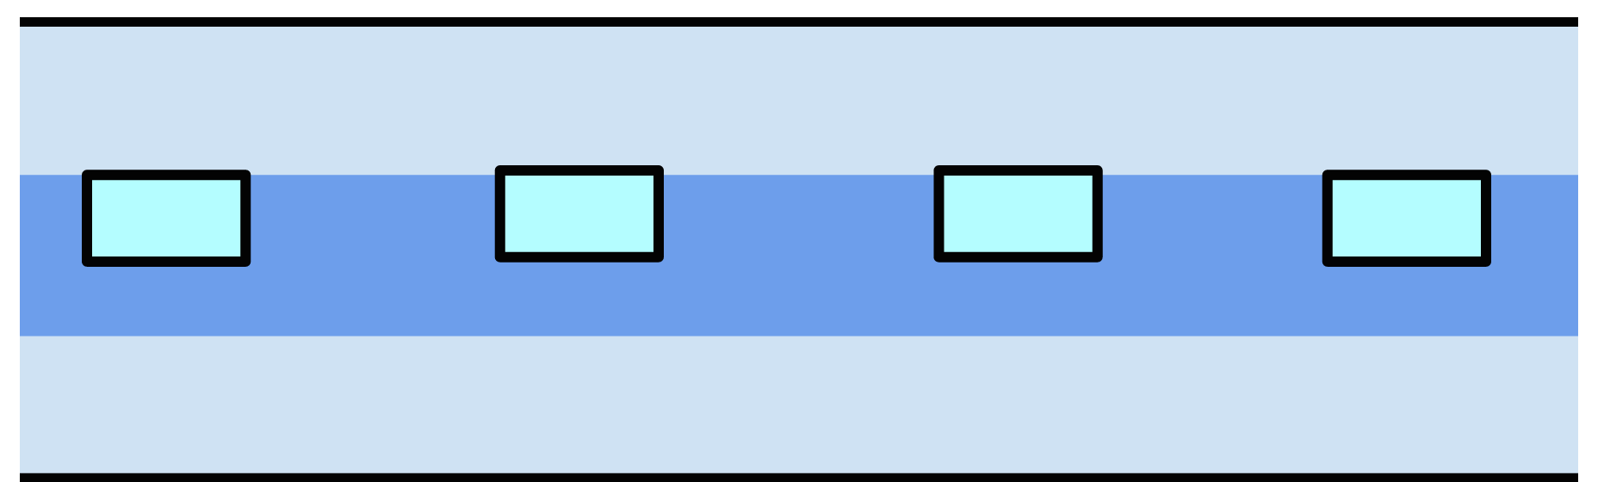
FRED Optical Model Studies
Modeling of SR for transparent and reflecting conductive electrode materials, electrode width (w) and spacing (s)

Slide 13
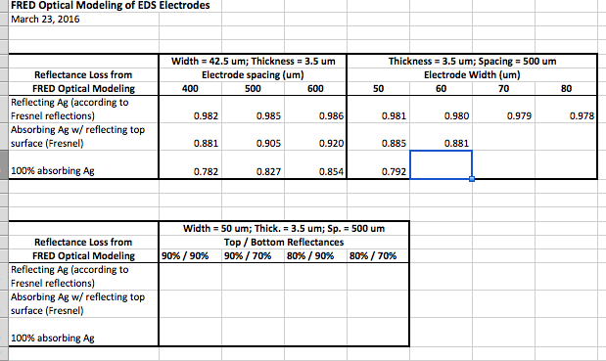
Modeling SR values
Model Predictions as functions of optical properties and geometries of electrodes

Slide 14
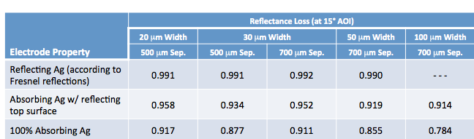
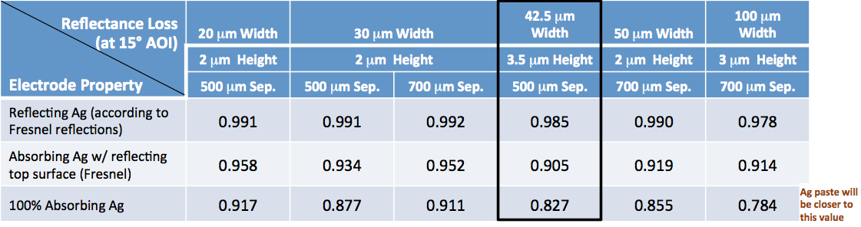
Effects of electrode width on specular reflectance (SR)
Comparison of SR values with reflecting electrodes with
width 30 μm vs. 42.5 μm (minimum electrode width printable by GOP Process

Slide 15
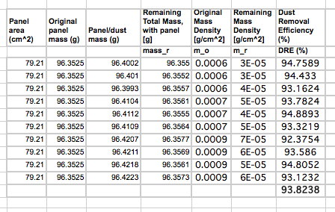
Dust Removal Efficiency Measurements
DRE Measurements with reflecting Cr (HCR) electrodes

Slide 16
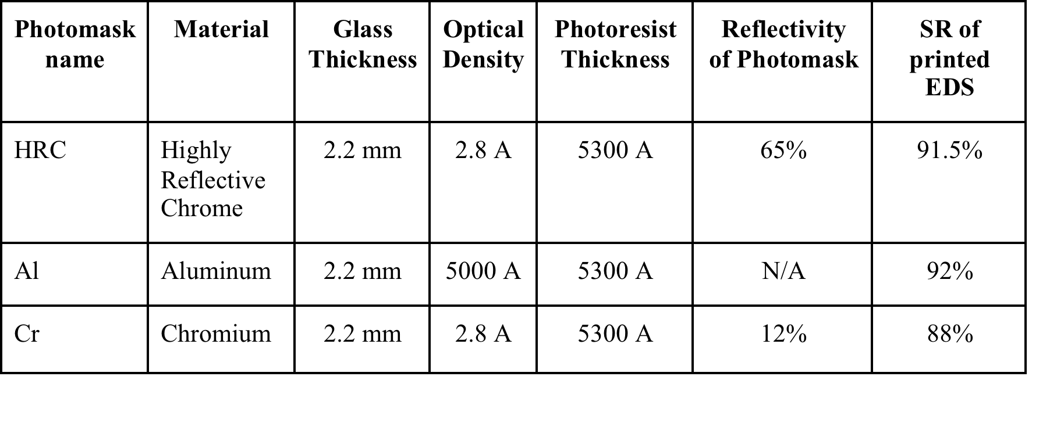
SR measurements with reflecting electrodes
Reflecting Cr and Al electrodes with w = 80 μm and spacing = 700 μm
Thickness << 1 μm.

Slide 17
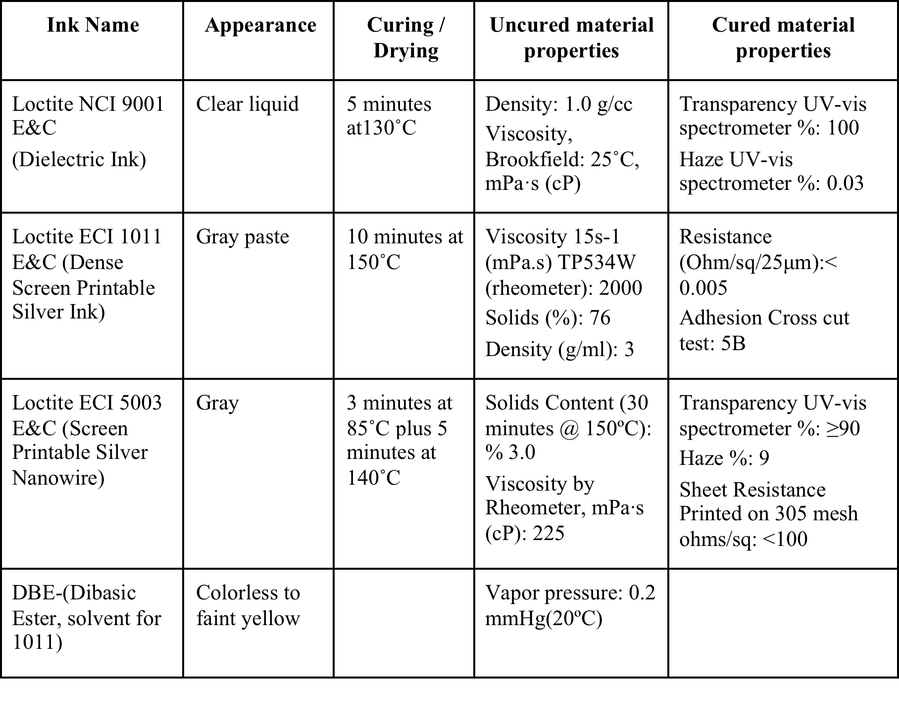
Electrode materials studied
Properties of Henkel Electronics Ink Materials

Slide 18
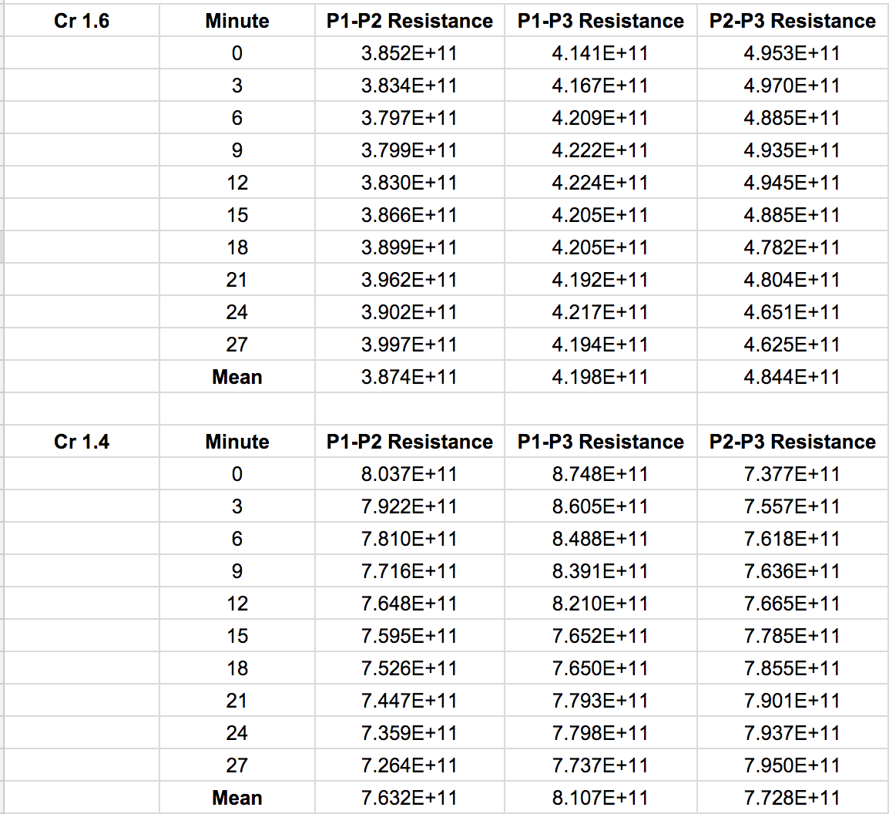
Interphase resistance between Cr electrodes

Slide 19
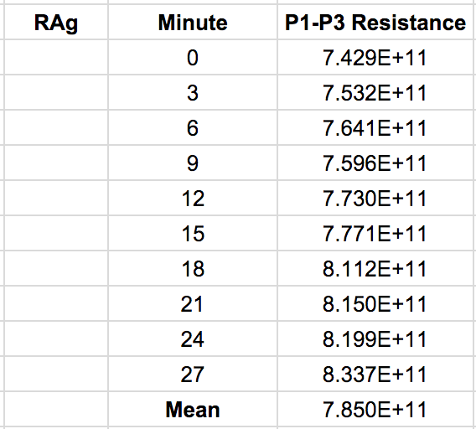
Interphase resistance between AgNW electrodes

Slide 20
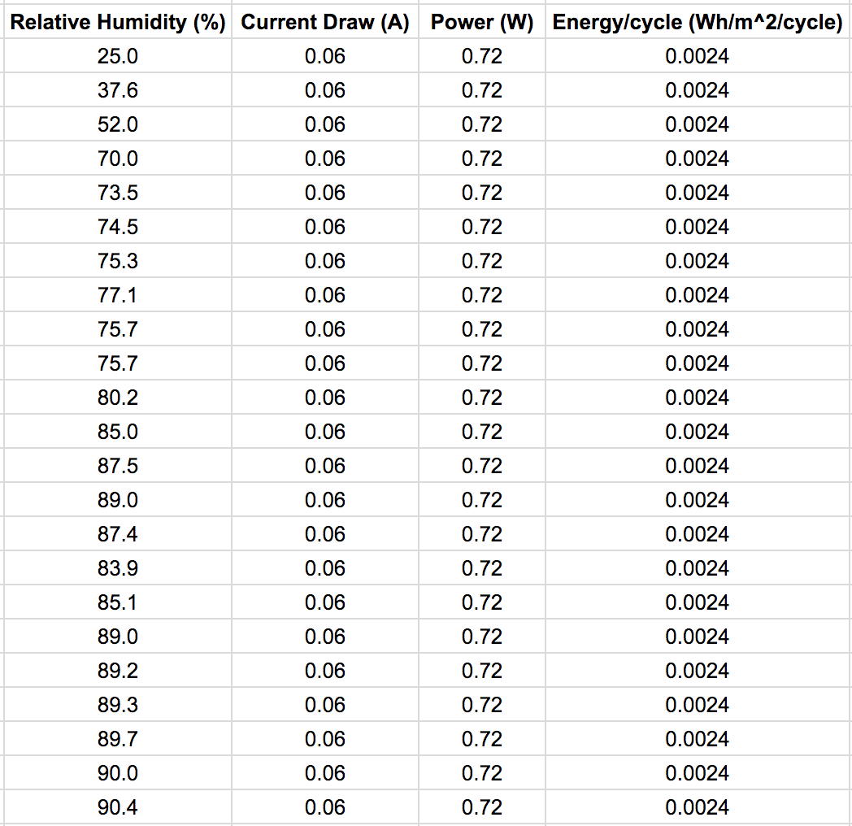
Energy consumption for 2-min EDS cleaning cycles
Energy drawn by EDS film from a 12 V power supply at different RH

Slide 21
Near-continuous operation of EDS electrodes
Surface charge generation on EDS film by repeated activation of electrode by 1.5 kV pulses

Slide 22

Thank You

