Slide 1
SRP Perspective on CSP Chico Hunter Manager, Environmental Policy and Innovation
April 19,2016
DOE CSP Program Summit

Slide 2
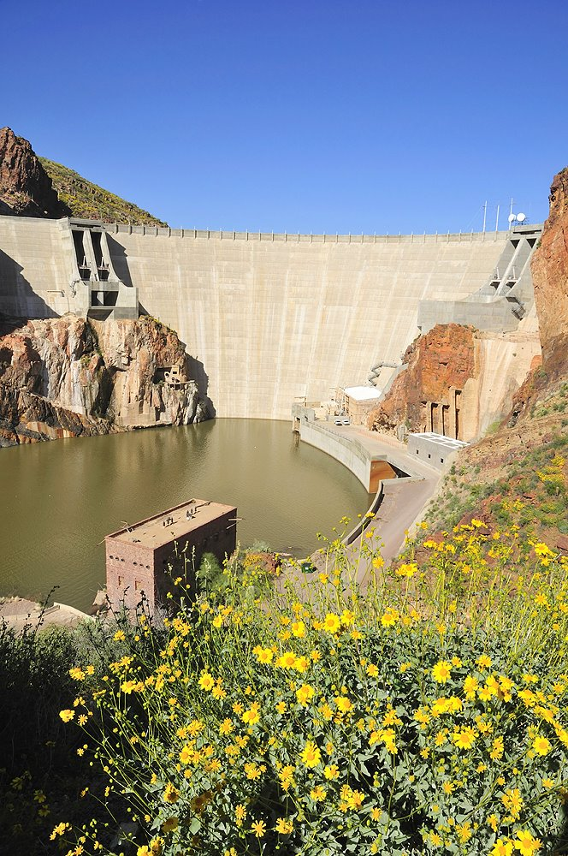
Who is SRP?
Established 1903
Largest water and power supplier to Phoenix metro area
Third largest public power utility
1M customers
6,800 MW peak load
20% by 2020 Sustainable Portfolio

Slide 3
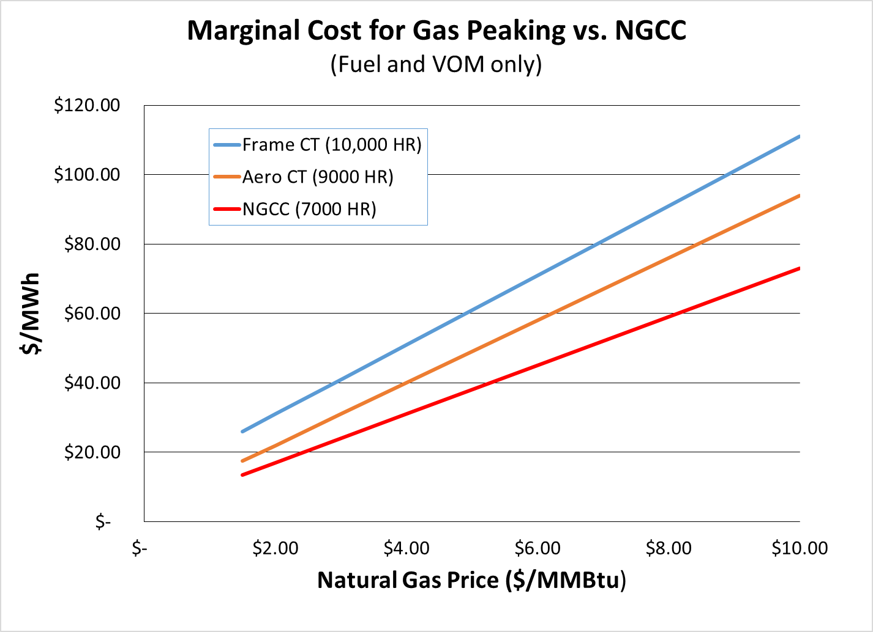
Can CSP + Storage Compete with Solar PV + Gas Peakers or Batteries?
$38
$20

Slide 4
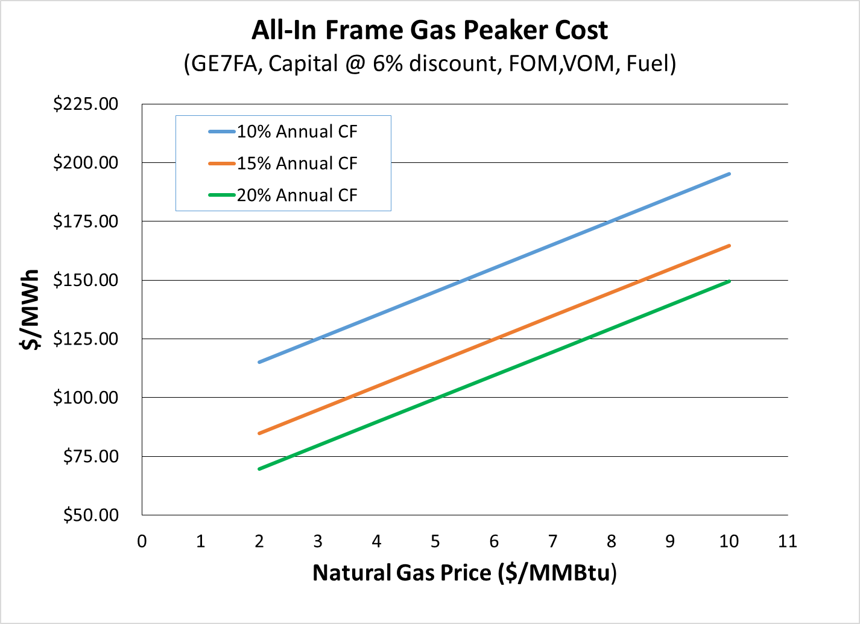
Can CSP Compete as a Peaker?
Notes:
Frame Unit assumptions:
Capital: $800/kW
FOM: $4/kW-yr
VOM: $11/MWh
Aero Assumptions
Capital: $1100/kW
FOM: $18/kW-yr
VOM: $4/MWh

Slide 5
Requirements for CSP as a Peaker
Size: 100-300 MW peak capacity/unit
Run time: 3-8 hrs/day (could be at night or morning)
Annual Capacity Factor: 10%-25%
Ramp rate: ? (can’t compete with CT)
Start-up time: ? (can’t compete with CT)
Storage: need to be ready to run any time of day
Oversize generator?
Put energy into tanks for 8 hours, discharge in 3-4 hours

Slide 6
Challenges for CSP as Peaker
More difficult to site close to load centers
Transmission access?
Transmission cost & siting if need to build
Not as flexible as CTs
Higher capital cost
Technology risk vs. CTs

