Slide 1
Supercritical CO₂ Power Cycles:
Next-Gen Power for CSP?
Craig Turchi
Sr. Engineer, National Renewable Energy Laboratory
craig.turchi@nrel.gov

Slide 2
Outline
History of closed Brayton Cycles
Attributes that are attractive for CSP
sCO₂ Brayton Cycle designs tailored for CSP
Current state of development and the “STEP” initiative

Slide 3
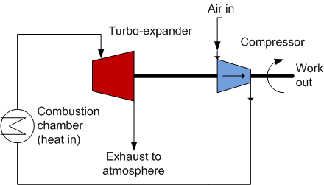

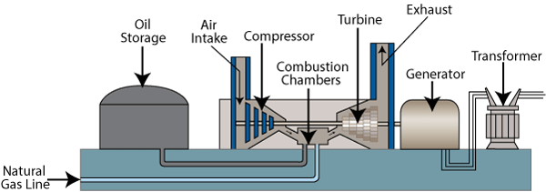
Open Brayton Power Cycle
Fuel
Fossil-fired combustion turbine power plant (www.tva.com)
GE LM6000 Combustion Turbine

Slide 4
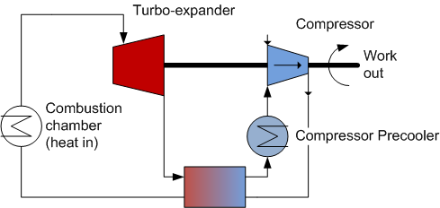
Closed Brayton Power Cycle
Heat
Recuperator
Indirect heating via an external source
Any gas or supercritical fluid can be used
Working fluid circulates in a closed loop

Slide 5
Brief History of the Closed Brayton Cycle (CBC)
1939 First commercial air-CBC at Escher Wyss in Zurich
1949 Air-CBC efficiency greater than contemporary steam cycles
1956 Ravensburg air-CBC comes online. Plant accumulates 120,000 hrs operation at average 91% availability
Notes:
Ernest G. Feher

Slide 6
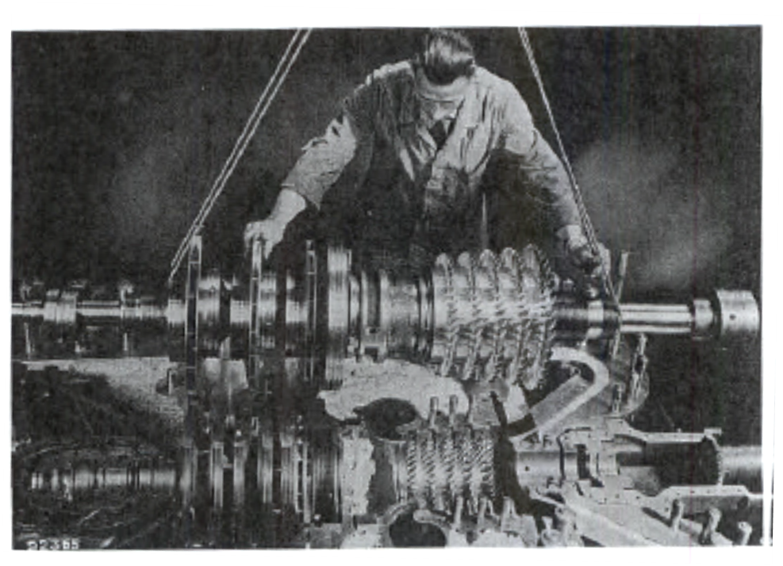
Ravensburg Plant (1956-1977)
10 MW_{th} , 2.3 MW_{e}
660 °C hot gas temp
Representation of the turboset: 3-stage radial compressor and 5-stage axial turbine
Images from Pasch, San Antonio, TX, 2012
Original reference: Frutschi, Closed-Cycle Gas Turbines (2005)
Notes:
All information and pictures are taken from Closed-Cycle Gas Turbines: Operating Experience and Future Potential, By Hans Ulrich Frutschi, 2005, ASME Press

Slide 7
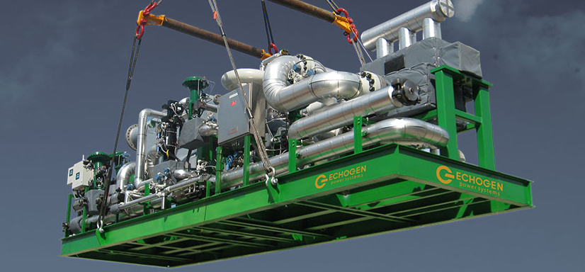
Brief History of the Closed Brayton Cycle (CBC)
1939 First commercial air-CBC at Escher Wyss in Zurich
1949 Air-CBC efficiency greater than contemporary steam cycles
1956 Ravensburg air-CBC comes online. Plant accumulates 120,000 hrs operation at average 91% availability
1967 Feher catalogs candidate supercritical fluids for use in CBC
1968 Angelino proposes the “recompression” sCO₂ power cycle
2004 Dostal rekindles interest in sCO₂-CBC by examining its use for Gen IV nuclear power plants
2009 Sandia National Labs builds 250 kW_{e} recompression cycle at Barber- Nichols in Arvada, CO
2012 Echogen Power Systems designs 7 MW_{e} sCO₂ system for waste heat recovery
2014 DOE forms Supercritical Transformational Electric Power (STEP) cross-cut initiative with Fossil, Nuclear, EERE, and Basic Energy Science programs
Notes:
Ernest G. Feher

Slide 8
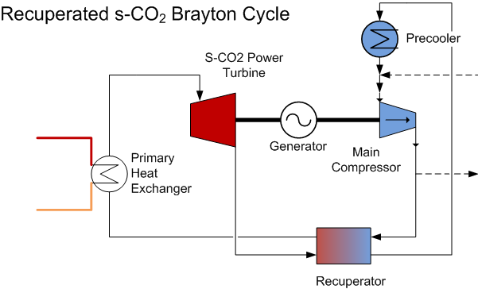
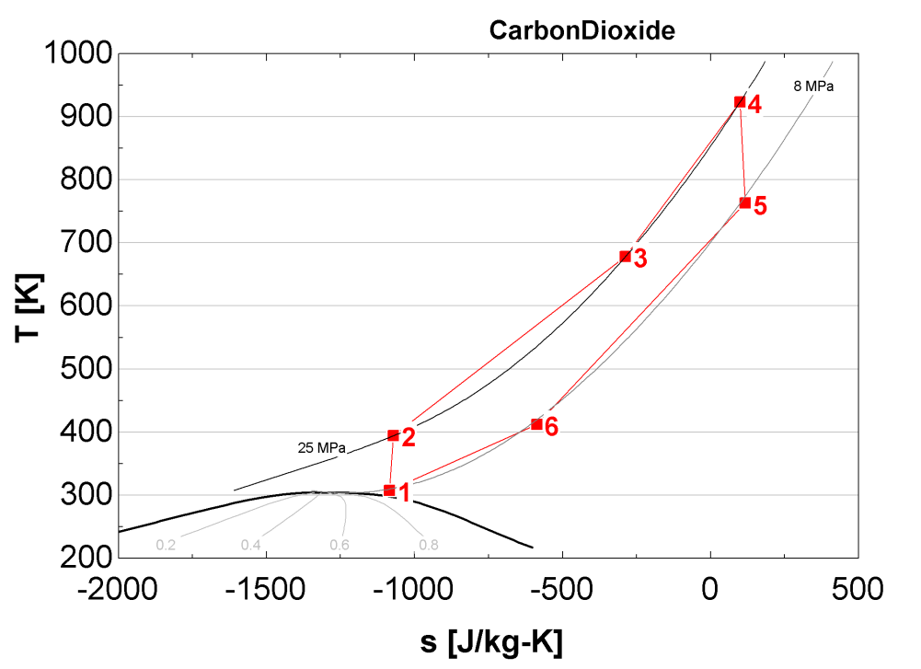
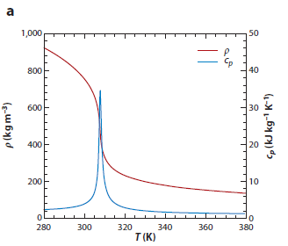
Why sCO₂?
6
1
CO₂ inventory control
4
3
2
5
Density and Heat Capacity
Yoo, 2012
Notes:
The thermophysical properties of CO2 versus temperature at P = 8 MPa: (a) density ρ and specific heat at constant pressure cp;
(b) thermal conductivity k, dynamic viscosity μ, and specific enthalpy h; (c) Prandtl number Pr and thermal expansion coefficient β; and
(d ) kinematic viscosity ν. Figure taken Yoo (2012) who references Bae et al. (2005, 2008).
The critical point is 7.38 MPa at 31.1 °C (304.3 K)

Slide 9
Power Cycle Options for CSP
Typical Engineering Limit (75% Carnot)
Air Brayton Combined Cycle (commercial for NG)
S-CO2 Brayton (recompression)
Supercritical Steam (commercial for coal)
Current Power Tower
Current Parabolic Trough
Power Tower Range

Slide 10
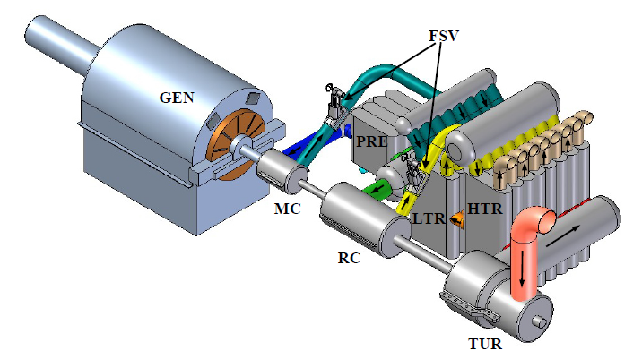
Attractive features of sCO₂ Brayton Cycle
  Higher efficiency than steam Rankine
  High density working fluid yields compact turbomachinery
  Optimum turbine size 10 to 300 MW_{e}
  Low-cost, low toxicity, low corrosivity fluid
  Thermally stable fluid at temperatures of interest to CSP (550 °C to 750 °C)
  Single phase reduces operational complexity; integrates well with sensible heat storage in CSP systems
  Simpler cycle design than steam Rankine
MIT depiction of 150 MW_{e} recompression-cycle power system (2006)

Slide 11
Potential in Multiple Markets → Industry interest
Power Sector | Why? | Who?
Nuclear | Good match to Gen IV sodium fast reactor designs | Sandia, Argonne, INL
Fossil | Next generation coal plants with oxy-fuel combustion and CO₂ capture | NETL, Gas Tech Institute (GTI), Toshiba, NetPower
Marine Power | Compact and fast responding turbomachinery | US Navy via Knolls and Bettis Atomic Power Labs
Waste Heat Recovery | Simple cycle design with high efficiency | Echogen, Dresser-Rand (Siemens), GE
Solar | Allows for higher conversion efficiency in high-temperature power towers | GE, Samsung, CSIRO, NREL
Grid Electricity Storage | Reversible cycle: heat pump/power turbine | ABB, GE, others

Slide 12
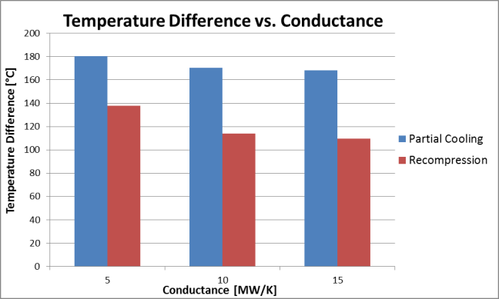
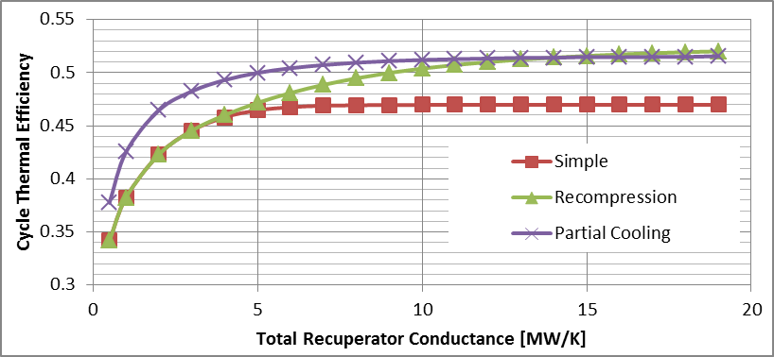
sCO₂ Cycle Design Considerations for CSP Conditions
Optimize for molten-salt thermal storage by maximizing ΔT across turbine and storage system
Neises and Turchi, “A comparison of supercritical carbon dioxide power cycle
configurations with an emphasis on CSP applications,” Energy Procedia 2014.
Notes:
All cycles want to minimize heat exchanger area (Conductance) while maximizing thermal efficiency.
CSP-specific conditions are shown here.

Slide 13
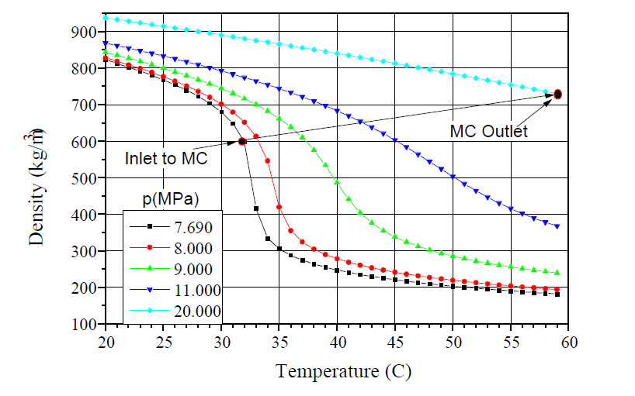
sCO₂ Cycle Design Considerations for CSP Conditions
Most sCO₂ cycle designers plan for a wet-cooled system:
CIT ≈ 32 °C
CIP ≈ 7.7 MPa
CSP will likely require a dry-cooled system, for example CIT ≈ 50 °C.
Compressor (and cycle) efficiency is optimized by increasing
CIP ≈ 10 MPa
MC = Main compressor
CIT = Compressor Inlet Temperature
CIP = Compressor Inlet Pressure
Gong, et al, “Analysis of Radial Compressor Options for
Supercritical CO₂ Power Conversion Cycles,” 2006
Notes:
All cycles want to minimize heat exchanger area (Conductance) while maximizing thermal efficiency.
CSP-specific conditions are shown here.

Slide 14
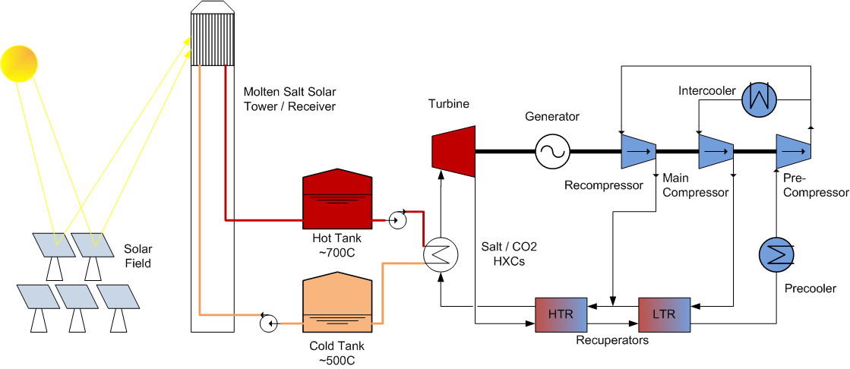
CSP with sCO₂ Conceptual Design – example one
Dry-cooled, “partial-cooling” cycle coupled to high-temperature molten salt power tower (or particle receiver)

Slide 15
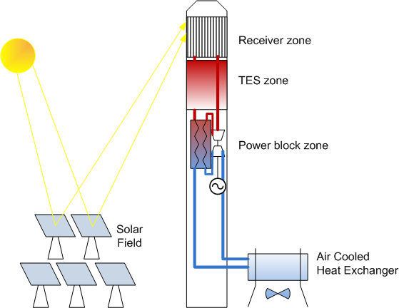
CSP with sCO₂ Conceptual Design – example two
Direct-heated, small-capacity, tower-mounted “simple recuperated” cycle coupled to PCM thermal energy storage
Utilizes compact size of the sCO₂ power system at ≈10 MW_{e} capacity
Allows for factory-fabrication of power block
PCM or thermochemical storage with narrow ∆T

Slide 16
sCO₂ Brayton Cycle Research Activities
  Corrosion and materials compatibility data at high T, P
  Cost-effective and durable recuperators
  Design and validation of primary heat exchangers; understanding of sCO₂/HTF interactions
  Validation of power turbine bearings, seals, stop-valves
  Modeling start/stop, off-design and other transient operations
  Cycle operating methodology for dry-cooled systems
  Demonstration of cycle operations and equipment durability at commercially relevant scale (10 MW_{e})

Slide 17
Journal Publications
Web of Science search for: “supercritical brayton” OR “supercritical CO2 power cycle”
Notes:
From Web of Science
You searched for: TOPIC: (supercritical brayton) OR TOPIC: (supercritical CO2 power cycle)

Slide 18
Supercritical Transformational Electric Power (STEP)
Cross-program DOE initiative to demonstrate the sCO₂ power cycle at commercial scale.
Up to $80M federal contribution, 20% industry cost share, and 6-year duration (see DE-FOA-0001457, released March 2016)
10 MW_{e} Pilot Plant Test Facility:
  sCO₂ Recompression Brayton Cycle at turbine inlet operating temperatures of 700°C,
  Reconfigurable facility to support testing a variety of components or subsystems, and
  Capability to monitor and characterize primary components or subsystems (turbomachinery, heat exchangers, recuperators, bearings, seals, etc.)
Map pathway towards an overall power cycle efficiency of 50% or greater
Demonstrate steady-state, dynamic, transient load following, and limited endurance operations
Notes:
The U.S. Department of Energy’s Supercritical Transformational Electric Power (STEP) program awarded a total of $3.9 million to three competitively-selected teams to develop conceptual plans to support the design, cost and schedule for a 10 MWe sCO2 Brayton Cycle test facility. The awardees selected for funding are Echogen Power Systems in Ohio, the Gas Technology Institute in Illinois, and the Southwest Research Institute in Texas.

Slide 19
Summary
The sCO₂ power cycle is potentially simpler and more efficient than steam-Rankine cycles in many applications
  Applications include: advanced nuclear, fossil, solar-thermal, and waste-heat recovery heat sources
Major research institutions and power companies from around the world are engaged in its development
  E.g., GE, Dresser-Rand, Toshiba, Samsung
  The STEP initiative plans to demonstrate a commercial-scale system in five years
sCO₂ power cycles optimized for CSP could provide the CAPEX and efficiency needed to achieve SunShot

Slide 20

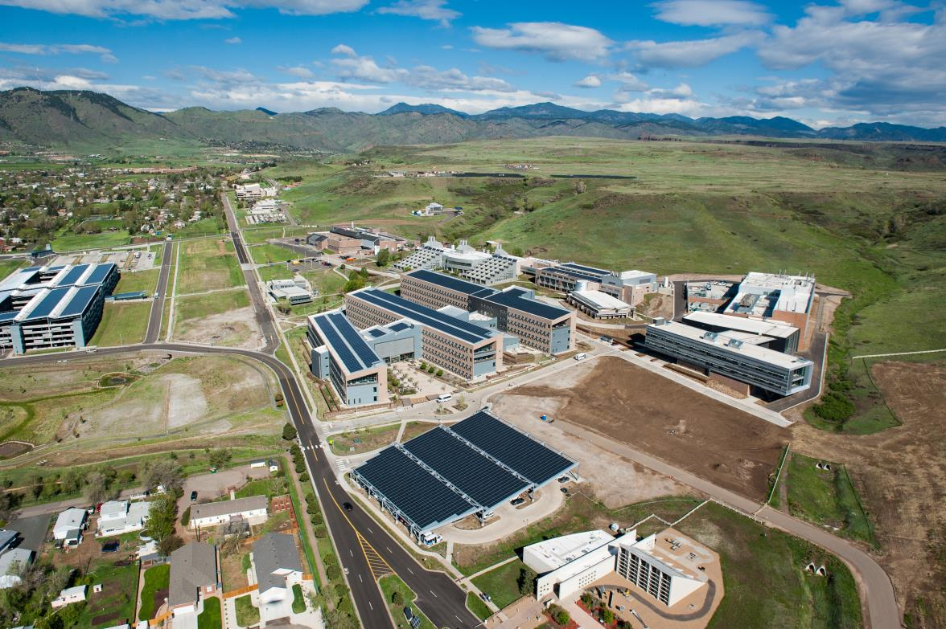
Thank you!

Slide 21
Brief History of the Closed Brayton Cycle (CBC)
1939 First commercial air-CBC at Escher Wyss in Zurich
1949 Air-CBC efficiency greater than contemporary steam cycles
1956 Ravensburg air-CBC comes online. Plant accumulates 120,000 hrs operation at average 91% availability
1967 Feher catalogs candidate supercritical fluids for use in CBC
1968 Angelino proposes the “recompression” sCO₂ power cycle
2004 Dostal rekindles interest in sCO₂-CBC by examining its use for Gen IV nuclear power plants
2009 Sandia National Labs builds 250 kW_{e} recompression cycle at Barber- Nichols in Arvada, CO
2012 Echogen Power Systems designs 7 MW_{e} sCO₂ system for waste heat recovery
2014 DOE forms Supercritical Transformational Electric Power (STEP) cross-cut initiative with Fossil, Nuclear, EERE, and Basic Energy Science programs
Notes:
Ernest G. Feher

Slide 22
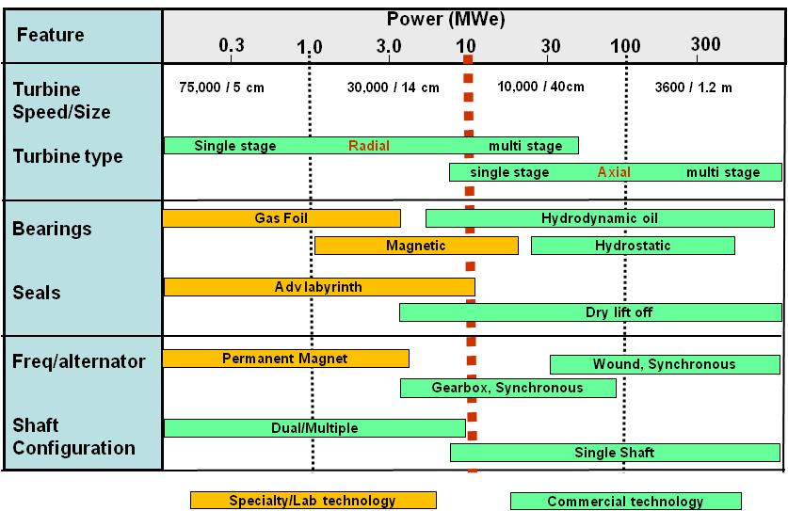
10 MW_{e} Turbomachinery: Threshold for commercial viability
Notes:
Lower radial efficiency due to:
The sharp turn in flow direction at the inlet
Vulnerability to secondary flows in their long passages
High outlet velocity and only moderate diffuser efficiency
Larger wetted area than axial machines

