Slide 1

Utility Bill Analysis
WEATHERIZATION ENERGY AUDITOR SINGLE FAMILY
WEATHERIZATION ASSISTANCE PROGRAM STANDARDIZED CURRICULUM – December 2012

Slide 2
Learning Objectives
UTILITY BILL ANALYSIS
By attending this session participants will be able to:
Discuss the heat values for different fuel types.
State the advantages of analyzing utility bills.
Define the terminology and categories of information used in a typical fuel bill.
Demonstrate how to use utility bill analysis to determine base load vs. seasonal usage.
Notes:
By attending this session, participants will be able to:
Discuss the heat values for different fuel types.
State the advantages of analyzing utility bills.
Define the terminology and categories of information used in a typical fuel bill.
Demonstrate how to use utility bill analysis to determine base load vs. seasonal usage.

Slide 3

Why Analyze Fuel Bills?
UTILITY BILL ANALYSIS
To measure:
Energy consumption
Seasonal vs. base load use
Potential energy savings
And drive:
Targeted investment strategies
Customer education strategies
Photo courtesy of Tech Journal
Copyright © 2007 Solair Energy, Inc. and Pure Energy
Notes:
To measure:
Energy consumption – An important tool for measuring overall energy use for the purpose of setting priorities for various types of energy-efficient retrofits.
Seasonal vs. base load use – Examining a billing history may be used to account for differences in monthly consumption related to seasonal heating and cooling compared to base load use which occurs all year.
Potential energy savings – To determine normalized energy use before and after weatherization.
And drive:
Targeted investment strategies – Making comparisons between high-energy users and low-energy users for the purpose of targeting investments to those homes with relatively higher energy bills.
Customer education strategies – To assist customers in being able to interpret their energy-use patterns and identify energy savings measures they can implement on their own.
Q: Why is it difficult to analyze seasonal usage in oil or propane heated homes?
A: Because oil and propane are unmetered fuels and are refilled based on customer demand whereas electricity and natural gas is metered, billed, and archived at regular intervals (monthly, yearly etc.).

Slide 4
Heat Values of Fuels
UTILITY BILL ANALYSIS
Natural gas – 100,000 BTUs/CCF @ 1.40/CCF
#2 Fuel Oil – 140,000 BTUs/gal. @ $3.80/gal.
Propane – 92,500 BTUs/gal. @ $2.60/gal.
Electricity – 3,412 BTUs/Kwh @ $0.12/Kwh
Wood – 10-24 million BTUs/cord @ $130/cord
(Prices are approximate and subject to fluctuation and regional differences)
Notes:
Natural gas – 100,000 BTUs/CCF @ 1.40/CCF
#2 Fuel Oil – 140,000 BTUs/gal. @ $3.80/gal.
Propane – 92,500 BTUs/gal. @ $2.60/gal.
Electricity – 3,412 BTUs/Kwh @ $0.12/Kwh
Wood – 10-24 million BTUs/cord @ $130/cord
Understanding the heat values and prices for different fuels is a useful metric when considering the value for the price of the fuel and cost effectiveness of energy retrofits. For instance, based on 2012 prices, natural gas at approximately $1.40 per CCF is much cheaper for the same amount of BTUs than oil at $3.80/gal.
Compare the amount of heat value for natural gas and oil above. Then compare the unit prices for each.
Q: How many BTUs are contained in 25 cubic feet of natural gas?
A: 25 X 1,000 =25,000 BTUs
Q: What’s the cost of 25,000 BTUs in natural gas?
A: 25,000 /100,000 = .25 (25%)
.25 X $1.40 = $.35
Q: What’s the cost of 25,000 BTUs in #2 fuel oil?
A: 25,000 /140,000 = .18 (18%)
.18 X $3.80= $.68
One may conclude that natural gas is roughly half the price of heating oil. And because oil (at 2012 prices) is that much more expensive than natural gas for the same amount of heat value, adding insulation will be more cost effective and save more money in an oil-heated home vs. a gas-heated home.
Legend:
BTU: British Thermal Unit
CCF – 100 cubic feet
Kwh – kilowatt hour

Slide 5
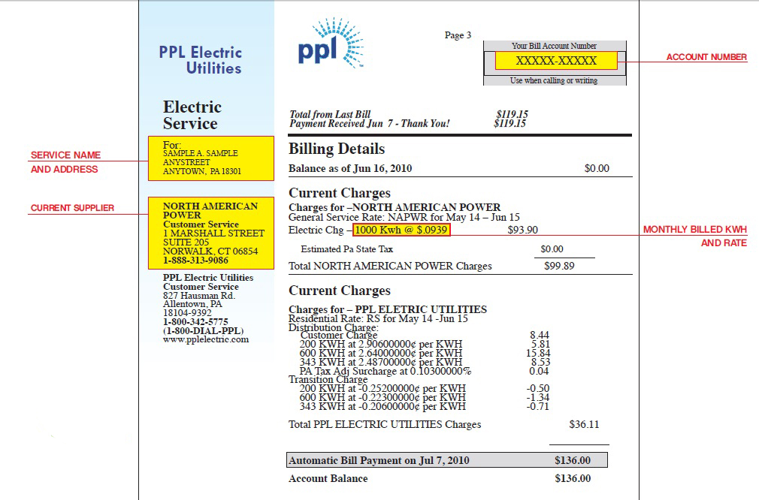
Sample Electric Bill
UTILITY BILL ANALYSIS
Picture and information courtesy of PPL Electric Utilities
Notes:
This sample bill is broken out into the major categories of generation and distribution, where two distinct companies are involved, North American Power and PPL Electric Utilities. The sample of an electric utility bill shows the following:
Rate in kilowatt hours (Kwh):
Most residential customers receive electric services under the same rate class and some have special rates. This is also true for commercial and industrial customers.
Generation Charge:
The amount the supplier charges for generating electricity.
Distribution Charge:
The price for delivering electricity to a home or business.
Customer Charge:
The monthly charge to cover PPL Electric Utilities’ basic costs for billing, metering, and meter reading.
Transmission Charge:
The cost of moving electricity from a generating plant (North American) to the PPL distribution system. When a customer selects an electric generation supplier, that supplier, not PPL, will bill for transmission charges.
Transition Charge:
A charge on every customer’s bill to cover an electric utility’s transition or stranded costs, as allowed by the PA Public Utility Commission. (Transition costs are those costs a utility would have been able to collect in a regulated environment, but will not be able to collect in a competitive environment.)
Q: There are 3,412 BTUs per KWH. How many BTUs are contained in 50 Kwh?
A: 50 X 3,412= 170,600 BTUs

Slide 6
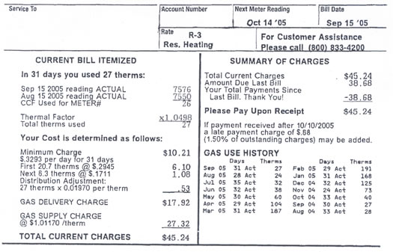
Sample Gas Bill
UTILITY BILL ANALYSIS
Start and End Date
Usage and Cost
Picture and information courtesy of New Hampshire Office of Consumer Advocate (OCA)
Notes:
Basic Definitions:
Monthly usage is measured in CCF’s (1 CCF = 100 cubic feet of gas ) at the meter and then converted to therms for bill calculation purposes. One therm is equal to 100,000 BTUs, and there is 1 therm contained in every 100 cubic feet of natural gas.
How A Bill is Organized:
While each gas utility has its own specific bill design, a natural gas bill is typically organized as follows.
Current Bill Itemized: This portion of the bill shows usage in CCFs for the number of days between meter readings. The usage is then converted to therms for billing purposes. The bill then identifies the supply and delivery charges charges, taxes, and services.
Account Summary: This gives the current status of a customer’s account including previous balance, new charges, past due amount, payment due date, and any payment received by the company.
Gas Use History: The number of days in the current billing period and the total number of therms. For comparison, this information is provided for each of the last 12-14 months.
Q: How many therms are contained in 1,575 cubic feet of natural gas?
A: 1,575/100= 15.75 therms
Q: How many CCF of natural gas must be burned to generate 2.5 million BTUs?
A: 2,500,000/100,000 = 25 CCF (Remember: 1 therm contained in every 100 cubic feet of natural gas and 1 therm is equal to 100,000 BTUs)

Slide 7
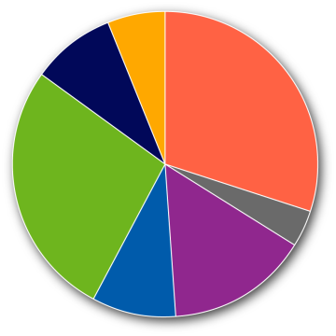
Household Energy Costs?
UTILITY BILL ANALYSIS
Percent of Total Energy Costs by End Use
in Income Eligible Households
Lighting 6%
Refrigerator 9%
30% Space Heating
Appliances 27%
(other) ….
4% Cooking
15% Water Heating
Space Cooling 9%
Chart courtesy of Energy Information Administration, U.S. Department of Energy
Notes:
The graph represents the percent of total energy costs by end use of households.
Space heating and cooling make up 39% of the energy use in weatherization-eligible homes and is known as seasonal use. That means 61% of the total energy use is base load and can be reduced by modifying or replacing existing appliances to increase efficiency.

Slide 8

Usage as a
Function of Fuel type
UTILITY BILL ANALYSIS
About half of the electricity used by households with electric heat is for base loads.
Many homes heated with
fossil fuel have higher
annual electric bills than
gas or oil bills.
Photo courtesy of PG&E
Notes:
About half of the electricity used by households with electric heat is for base loads.
Many houses heated with fossil fuel have higher annual electric bills than gas or oil bills.
Q: Why might the situation in the second bullet occur?
A: Fossil fuel heated homes will experience additional electrical usage because of the electro mechanical use associated with the heating system (distribution fans, oil burners, etc).

Slide 9
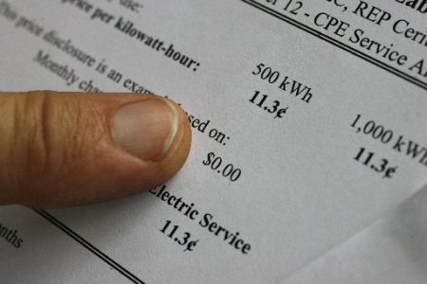


Consumption Analysis
UTILITY BILL ANALYSIS
1. Analyze Bill
2. Survey Site
3. Reconcile
the Two
#1 Photo courtesy of National Energy Deregulation Information
#2 Photo courtesy of National Home inspection Services of New England
#3 Photo courtesy of Life123 Inc.
Notes:
Consumption analysis includes three steps:
Analyze bill – How much energy is going to base load uses?
Survey site – What are the main base and seasonal loads?
Reconcile the two – Do the utility bills make sense in light of the site survey?

Slide 10
Simple Bill Analysis Method
UTILITY BILL ANALYSIS
Analyze Bill
Review previous 12 months.
Average three lowest months.
Multiply by 12 to estimate
annual base load usage.
Photo courtesy of National Energy Deregulation Information
Notes:
Analyze Bill
Review the previous 12 months of the client’s energy bills. This reveals seasonal loads associated with heating and cooling.
Average the three lowest months, which are those with little-to-no heating or cooling costs. These months provide a picture of the total base load of the home. Averaging the three months together helps to account for vacations when the home was empty or high-use weeks that are out of the ordinary.
Multiply by 12 to estimate annual base load usage.
Discuss ways of accessing client utility bills in the program.
Q: Does the grantee require access as part of the weatherization application?
Q: Are local electricity and delivered fuel (oil, propane) providers sympathetic to agency needs to access the information?
If auditors are not conducting bill analysis, try to determine the reasons and seek to overcome any hurdles.

Slide 11
Bill Analysis Examples
UTILITY BILL ANALYSIS
Month | Bill kWh | Ave. Base Load | Heat? | Cool?
Jan
Feb
Mar
Apr
May
June
July
Aug
Sept
Oct
Nov
Dec
Total
% Base Load Use
Record:
Lowest Reading
2nd Lowest
3rd Lowest
Average Monthly Base Load
Notes:
The auditor can use a simple table like this to arrange utility bills by month, separate base load, and guesstimate heating and cooling loads.

Slide 12
Bill Analysis Example #1
UTILITY BILL ANALYSIS
Date | # of Days | Reading | kWh
5/7/99 | 29 | 06248 | 1031
4/8/99 | 30 | 05217 | 1968
3/9/99 | 29 | 03249 | 3143
2/8/99 | 31 | 00106 | 3356
1/8/99 | 32 | 96750 | 3648
12/7/98 | 33 | 93102 | 2206
11/4/98 | 29 | 90896 | 1327
10/6/98 | 32 | 86569 | 576
9/4/98 | 29 | 88993 | 442
8/6/98 | 29 | 88551 | 874
7/8/98 | 30 | 87667 | 522
6/8/98 | 32 | 87155 | 538
5/7/98 | 30 | 86617 | 941
Notes:
This table is typical of the information utility companies will provide. For bill analysis, the critical facts are:
Month.
Amount of kWh used that month.
Q: Based on the information shown here, is this sample home in a heating-dominated or cooling-dominated climate?
A: Click twice to reveal that it’s heating-dominated. The highest-use months are in the winter: January, February, and March, indicating electric heating in a cold climate.

Slide 13
Bill Analysis Example #1
UTILITY BILL ANALYSIS
Month | Bill kWh | Ave. Base Load | Heat? | Cool?
Jan | 3,356
Feb | 3,143
Mar | 1,968
Apr | 1,031
May | 538
June | 522
July | 874
Aug | 442
Sept | 576
Oct | 1,327
Nov | 2,206
Dec | 3,648
Total | 19,631
% Base Load Use
Lowest Reading
2nd Lowest
3rd Lowest
Average Monthly Base Load
442
522
538
1,502/3
= 501
Notes:
Here is that same information, inserted into the bill analysis table.
Q: Which are the three lowest months for energy use?
A: Click to reveal the three lowest readings, from August, June, and May, and the average monthly base load calculation.
In this example, approximately 501 kWh/month is used for base load.
Extrapolated over one year, the approximate base load use is 501 Kwh.

Slide 14
Bill Analysis Example #1
UTILITY BILL ANALYSIS
Month | Bill kWh | Ave. Base Load | Heat? | Cool?
Jan | 3,356 | 501
Feb | 3,143 | 501
Mar | 1,968 | 501
Apr | 1,031 | 501
May | 538 | 501
June | 522 | 501
July | 874 | 501
Aug | 442 | 501
Sept | 576 | 501
Oct | 1,327 | 501
Nov | 2,206 | 501
Dec | 3,648 | 501
Total | 19,631 | 6,008
% Base Load Use |  | 31%
Lowest Reading | 442
2nd Lowest | 522
3rd Lowest | 538
Average Monthly Base Load | 501
Notes:
Click to highlight the annual percentage of the energy bill that is base load.
501 kWh makes up 31% of this home’s total energy bill.

Slide 15
Bill Analysis Example #1
UTILITY BILL ANALYSIS
Month | Bill kWh | Ave. Base Load | Heat? | Cool?
Jan | 3,356 | 501 | 2,855
Feb | 3,143 | 501 | 2,642
Mar | 1,968 | 501 | 1,467
Apr | 1,031 | 501
May | 538 | 501
June | 522 | 501 |  | 21
July | 874 | 501 |  | 373
Aug | 442 | 501 |  | -59
Sept | 576 | 501
Oct | 1,327 | 501
Nov | 2,206 | 501 | 1,705
Dec | 3,648 | 501 | 3,147
Total | 19,631 | 6,008
% Base Load Use |  | 31%
Lowest Reading | 442
2nd Lowest | 522
3rd Lowest | 538
Average Monthly Base Load | 501
Notes:
The remaining 69% can then be separated into suspected heating and cooling loads.

Slide 16
Summary
UTILITY BILL ANALYSIS
Utility bill analysis is a useful metric for estimating energy consumption and targeting retrofit strategies.
About half of home energy use is for base load requirements.
Utility bill assessment helps the auditor determine
base load vs. seasonal usage and related savings potential in each.
Notes:
Utility bill analysis is a useful metric for estimating energy consumption and targeting retrofit strategies.
About half of home energy use is for base load requirements.
Utility bill assessment helps the auditor determine base load vs. seasonal usage and related savings potential in each.
Present this slide as an interactive discussion, soliciting personal examples from the trainees. Add your own personal examples and knowledge to supplement.

