Slide 1
WEATHERIZATION ASSISTANCE PROGRAM
Uniform Administrative Requirements, Cost Principles, and Audit Requirements For Federal Awards
March 2015

Slide 2
Workshop Goals
To introduce participants to the Uniform Administrative Requirements, Cost Principles, and Audit Requirements for Federal Awards
To review subsections and key changes from the previous regulations.
To highlight the impact the key changes will make to Department of Energy subgrantees.

Slide 3
Breaking Down the Regulations
The regulations are located in 2 CFR Parts 200 and 910.
2 CFR Part 200 replaces 10 CFR 600, OMB A-87, A-122, A-21 and A-133.
2 CFR Part 200 is broken down into six parts.
2 CFR Parts 200 and 910 were published in the Federal Register on Dec. 19, 2014.
If you have questions about regulations, always refer to the full text of the regulations.

Slide 4
2 CFR Part 200
The following slides will cover 2 CFR Part 200 which includes:
Financial Management Regulations.
Cost Principles.
Audit Requirements for Federal Awards.
Department of Energy additions detailed in 2 CFR Part 910.

Slide 5
2 CFR Part 200
Subpart A: Acronyms and Definitions
Subpart B: General Provisions
Subpart C: Pre-Federal Award Requirements and Contents of Federal Award
Subpart D: Post Federal Award Requirements and Standards for Financial and Program Management
Subpart E: Cost Principles
Appendices

Slide 6
2 CFR Part 200
SUBPART A: Acronyms and Definitions

Slide 7
Subpart A: Acronyms and Definitions
200.0, Acronyms
Acronyms are at the beginning
200.1, Definitions
2 CFR Part 200 has 99 definitions. 2 CFR Part 910 expanded the definition of Non Federal Entity to include for profits.
Terms are broad to encompass all requirements (administrative, cost principles, audit) and all types of entities receiving Federal awards

Slide 8
Subpart A: Acronyms and Definitions
Key Definitions
Fixed Amount Awards
Micro-Purchase
Performance Goal
Protected Personally Identifiable Information

Slide 9
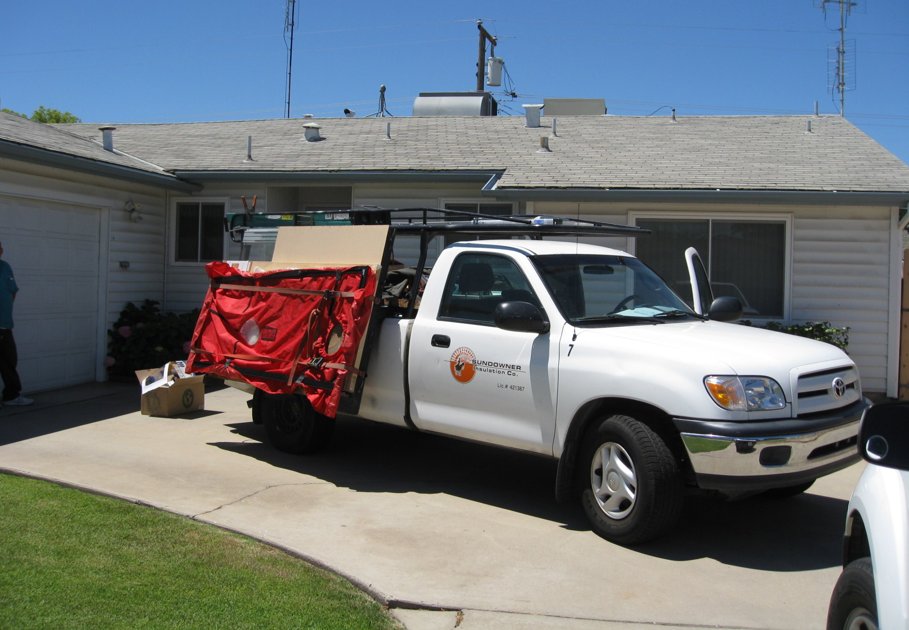
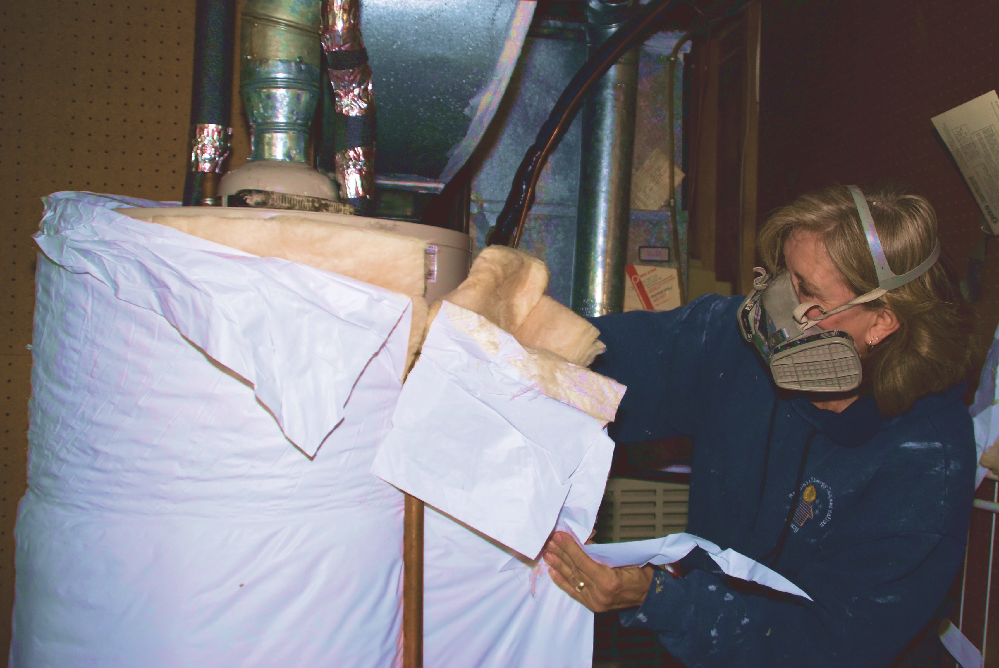
2 CFR Part 200
SUBPART B: General Provisions

Slide 10
Subpart B: General Provisions
PURPOSE:
2 CFR Part 200 establishes uniform administrative requirements, cost principles, and audit requirements for all types of non-Federal entities.
Department of Energy awarding agencies must not impose additional or inconsistent requirements, unless
Requirement based on Federal statute, regulation, or Executive Order,
OMB permits an exception in accordance, or
OMB approves information in the Federal award.

Slide 11
2 CFR Part 200
SUBPART C: Pre-Federal Award Requirements and Contents of Federal Award

Slide 12
Subpart C: Pre-Federal Award Requirements and Contents of Federal Award
200.201, Use of grant agreements, cooperative agreements & contracts.
200.203, Notices of funding opportunities.
200.204, Federal agency review of merit.
200.205, Federal agency review of risk.
Financial Stability.
Management Systems.
History of performance.
Reports and audit findings.
Ability to implement statutory, regulatory and other requirements.

Slide 13
Subpart C: Pre-Federal Award Requirements and Contents of Federal Award
200.206, Standard application requirements and forms
200.207, Special award conditions
200.210, Information contained in a federal award
200.211, Federal Spending Transparency
200.212, Suspension and Debarment

Slide 14
2 CFR Part 200
SUBPART D: Post Federal Award Requirements and Standards for Financial and Program Management

Slide 15
Subpart D: Post Federal Award Requirements and Standards for Financial and Program Management
200.301, Performance Measurement. Relate financial data to performance accomplishments.
Require the recipient to relate financial data to performance accomplishments of the Federal award.
When applicable, recipients must also provide cost information to demonstrate cost effective practices.
Performance should be measured in a way that will help the Federal awarding agency and other non-Federal entities to improve program outcomes, share lessons learned, and spread the adoption of promising practices.

Slide 16
Subpart D: Post Federal Award Requirements and Standards for Financial and Program Management
200.302, Financial Management System must provide for:
Retention, methods of transfer, transmission and storage of information.
Identification, in its accounts, of all Federal awards received and expended and the Federal programs under which they were received.
Accurate, current, and complete disclosure of financial results of each Federal award or program.
Records that identify the source and application of funds.
Effective control and accountability for all funds, property, and other assets.

Slide 17
Subpart D: Post Federal Award Requirements and Standards for Financial and Program Management
200.302, Financial Management System must provide for:
Comparison of expenditures with budget amounts.
Written procedures to implement the payment requirements.
Written procedures for determining the allowability of costs in accordance with the cost principles.

Slide 18
Subpart D: Post Federal Award Requirements and Standards for Financial and Program Management
200.303, Internal Controls
Standards for Internal Control
Risk Assessment
Control Activities
Information and Communications
Monitoring
200.305, Payments
Minimizing the time elapsing between the receipt and disbursement of funds.
Interest earned threshold raised to $500.

Slide 19
Subpart D: Post Federal Award Requirements and Standards for Financial and Program Management
200.306, Cost Sharing or Matching
Verifiable.
Not included for other Federal awards.
Necessary and reasonable.
Allowable under Cost Principles.
Provided for in the budget.

Slide 20
Subpart D: Post Federal Award Requirements and Standards for Financial and Program Management
200.307, Program Income
Three methods for treatment:
Deduction
Addition
Cost sharing or matching
There are no Federal requirements governing the use of income earned after the period of performance unless regulations or terms or conditions state otherwise.

Slide 21
Subpart D: Post Federal Award Requirements and Standards for Financial and Program Management
200.308, Revisions of Budget and Program Plans
Change in scope or objective of the project.
Change in key personnel.
Key personnel absent for more than 3 months or 25% of time.
Costs that require prior approval.
Transfer of funds budgeted for participant support costs.
Transfer or contracting out of work not approved in application.
Changes in the amount of approved cost-sharing or matching.

Slide 22
Subpart D: Post Federal Award Requirements and Standards for Financial and Program Management
200.308, Revisions of Budget and Program Plans
DOE awarding agencies may waive certain prior approvals.
Approval of costs incurred 90 days prior to award.
Initiate an extension of the period of performance.
Carry forward unobligated balances.
HHS awarding agencies may restrict the transfer of funds if the amount exceeds Simplified Acquisition Threshold or 10% of the total budget amount.
Need for additional funds.

Slide 23
Subpart D: Post Federal Award Requirements and Standards for Financial and Program Management
200.313, Equipment
Insurance
Use of equipment
Management and maintenance of equipment
Property records
Control system
Disposition

Slide 24
Subpart D: Post Federal Award Requirements and Standards for Financial and Program Management
200.314, Supplies
Title to supplies vest with NFE
Supplies inventory exceeds $5,000 up project completion must get disposition from HHS awarding agency
200.315, Intangible Property
Definition of intangible property
Federal Government Use

Slide 25
Subpart D: Post Federal Award Requirements and Standards for Financial and Program Management
200.318, Procurement Standards
Written procurement procedures.
Written standards of conduct covering organizational conflicts of interest.
Purchase complies with the NFE’s documented procedures.
Purchases are necessary.
Encouraged to enter into state and local intergovernmental agreements.
Open competition (to the extent required by each method).
Conflict of interest policy.
Proper documentation for the purchases.
Maintenance of records to detail the history.

Slide 26
Subpart D: Post Federal Award Requirements and Standards for Financial and Program Management
200.319, Competition
All procurement transactions must be conducted in a manner providing full and open competition.
Examples of situations considered to be restrictive of competition:
Placing unreasonable requirements on firms.
Requiring unnecessary experience and excessive bonding.
Non competitive pricing practices between firms or between affiliated companies.
Noncompetitive contracts to consultants on retainer contracts.
Organizational conflicts of interest.
Specifying only a “brand name” product instead of allowing “an equal”.
Any arbitrary action in the procurement process.

Slide 27
Subpart D: Post Federal Award Requirements and Standards for Financial and Program Management
200.320, Methods of Procurement
Micro-purchase, equal to or less than $3,000 (new).
Small purchase, between $3,000 and $150,000 (Simplified Acquisition Threshold).
The small purchase threshold must be supported by the NFE’s financial policies and procedures.
Sealed bids purchases (more than $150,000).
Competitive proposal purchases (more than $150,000).
Noncompetitive purchases (special circumstances which are applicable to all purchase levels).

Slide 28
Subpart D: Post Federal Award Requirements and Standards for Financial and Program Management
Large Purchases – Sealed Bid Proposals
Made early in the procurement cycle.
Allows vendors time to prepare their bids to meet the specification of the solicitation.
Solicitation information includes:
What is being purchased.
Terms & conditions the vendors must meet.
Where & when sealed bids well be opened.

Slide 29
Subpart D: Post Federal Award Requirements and Standards for Financial and Program Management
Large Purchases – Sealed Bid Proposals (continued)
Awards are made to the lowest priced responsible vendor:
Capable of compliance will all bid specification
Capability of performing the work
Has administrative capacity
Award becomes a firm, fixed price contract.

Slide 30
Subpart D: Post Federal Award Requirements and Standards for Financial and Program Management
Large Purchases – Sealed Bid Proposals (continued)
Vendor payments:
Lump sum – paid for successful performance.
Unit price – paid for each deliverable unit is completed in the contract.
Must have at least 2 responsive suppliers competing for contract.

Slide 31
Subpart D: Post Federal Award Requirements and Standards for Financial and Program Management
Large Purchases – Competitive Proposals
Proposal Types.
Request for Proposal (RFP).
Request for Quotations (RFQ).

Slide 32
Subpart D: Post Federal Award Requirements and Standards for Financial and Program Management
Large Purchases – Competitive Proposals (continued)
Publicized method same as sealed competitive process.
All evaluation factors publicized & their importance.
All vendor submittals received and evaluated.
Proposals must be solicited from a number of qualified sources.
Organization must have a method for conducting technical evaluation.

Slide 33
Subpart D: Post Federal Award Requirements and Standards for Financial and Program Management
Large Purchases – Competitive Proposals (continued)
Award made to the most responsive firm whose proposal is most advantageous to the program.
Price and other factors considered to determine most advantageous offer.
Must have at least 2 responsive suppliers competing for contract.

Slide 34
Subpart D: Post Federal Award Requirements and Standards for Financial and Program Management
Large Purchases – Non Competitive Procurement
Non competitive procurements must be approved by funding agency before awarding.
Organization must devise & document its own analysis process to ensure fair prices are being charged.
Non competitive contracts become negotiated contracts.
Organizations determines what level of organizational leadership is required to approve this method.

Slide 35
Subpart D: Post Federal Award Requirements and Standards for Financial and Program Management
Large Purchases – Non Competitive Procurement (continued)
May be used only when it is not feasible for:
Small purchase procedures.
Sealed bid or competitive proposals.
AND ONE OF THE FOLLOWING CONDITIONS EXIST:
Item only available from a single source.
Emergency exist that will not permit a delay resulting from competitive bidding.

Slide 36
Subpart D: Post Federal Award Requirements and Standards for Financial and Program Management
Large Purchases – Non Competitive Procurement (con’t)
Organization authorized noncompetitive proposals.
After solicitation of a number of sources, competition is determined as inadequate.
Cost analysis is required which verifies:
Proposed cost data.
Projection of the data.
Evaluation of costs and profits.

Slide 37
Subpart D: Post Federal Award Requirements and Standards for Financial and Program Management
Procurement (continued)
Grantees are to encourage minority firms, women’s business enterprises, and labor surplus area firms – 200.321
Procurement of recovered materials – 200.322
There must be a cost price analysis in connection with every procurement – 200.323
Grantees must make available proposed procurement technical specifications upon request by the awarding agency – 200.324
The NFE contracts must contain the applicable provisions described in Appendix II – 200.326

Slide 38
Subpart D: Post Federal Award Requirements and Standards for Financial and Program Management
200.327, Financial Reporting Current OMB financial report is SF 425. Reports required no less frequently than annually and no more frequently than quarterly.
200.328, Monitoring & Reporting Program Performance Must monitor to assure compliance and performance expectations are being achieved. Reports required no less frequently than annually and no more frequently than quarterly.
200.329, Reporting on Real Property

Slide 39
Subpart D: Post Federal Award Requirements and Standards for Financial and Program Management
Subrecipient Monitoring and Management
200.330, Subrecipient and contractor determinations.
Requirements for pass-through entities.
Required information.
Requirements imposed so that the Federal award is used in accordance with Federal statutes, regulations and the terms and conditions.
Subrecipient must permit pass-through entity and auditors access to records.
Evaluate each subrecipient’s risk of noncompliance.
Monitor the activities of the subrecipient.

Slide 40
Subpart D: Post Federal Award Requirements and Standards for Financial and Program Management
200.333, Records Retention
200.334-337, Methods for Collection, Transmission and Storage of Info
Encourages that info be in open, machine-readable format
200.338, Remedies for Noncompliance
200.339, Termination
200.343, Closeout

Slide 41
2 CFR 200
SUBPART E: Cost Principles

Slide 42
Subpart E: Cost Principles
200.401, Application
Determining the allowable costs of work.
200.403, Factors affecting allowability of costs
Must be necessary and reasonable.
Conform to cost principles of the federal award.
Be accorded consistent treatment.
In accordance with Generally Accepted Accounting Principles.
Be adequately documented.

Slide 43
Subpart E: Cost Principles
Updated policies on Indirect Costs.
Reduces administrative burden through consistent and transparent treatment government wide.
Allows for one extension (up to four years) or any current indirect cost (IDC) rate.
For smaller organizations that do not have an IDC rate, allow for a de minimis rate of 10%.

Slide 44
Subpart E: Cost Principles
Subsections 200.421 to 200.475, Selected Items of Cost.
Costs are classified in one of three ways:
ALLOWABLE
Compensation, Fringe Benefits
Conferences
Depreciation
Transportation Costs
ALLOWABLE WITH PRIOR APPROVAL
Equipment, Capital Expenditures
Fundraising, Investment Costs
Organization Costs
Sales & Marketing
NOT ALLOWABLE
Commencement/Convocation
Idle Facilities, Capacity, some exceptions
Goods and Services for Personal Use
Contributions, Donations

Slide 45
Subpart E: Cost Principles
Limits some Allowable Costs to make the best use of federal resources.
Conferences
Morale
Relocations
Student Activities

Slide 46
2 CFR 200
SUBPART F: Audit Requirement

Slide 47
Subpart F: Audit Requirements
200.501, Raises the threshold to $750,000. A NFE that expends more during the fiscal year must conduct an audit that meets requirements of this section.
200.504, Audits must be conducted annually with two exceptions.
200.512, Audits must be submitted within 30 days from the receipt of the audit report or within nine months after the end of the audit period.

Slide 48
Subpart F: Audit Requirements
… on the greatest risks of wastes, fraud and abuse.
Federal agencies should rely on single audit.
Audit made public (Tribes can opt out).
Cooperative approach to audit resolution.
Targets Federal oversight resources where most risk is.

Slide 49
2 CFR 200
Appendices

Slide 50
Appendix: I, II, III, IV
Appendix I, Full text of Notice of Funding Opportunity.
Appendix II, Contract Provisions for Non-Federal Entity Contracts Under Federal Awards.
Appendix III, Indirect (F&A) Costs Identification & Assignment, and Rate Determination for Institutions of Higher Education (IHE).
Appendix IV, Indirect (F&A) Costs Identification & Assignment, and Rate Determination for Nonprofits.

Slide 51
Appendix: V, VI, VII, VIII, IX
Appendix V, State/Local Government and Indian Tribe-Wide Central Service Cost Allocation Plans.
Appendix VI, Public Assistance Cost Allocation Plans.
Appendix VII, State and Local Government and Indian Tribe Indirect Cost Proposals.
Appendix VIII, Nonprofit Organizations Exempted from Subpart E — Cost Principles.
A list of 33 NPOs that are exempt.
Appendix IX, Hospital Cost Principles.

Slide 52
Effective Date
Fed. agencies required to implement Dec. 26, 2014.
Applied to any awards made on or after that date.
Continuation (incremental) funding up to agency to modify terms and conditions to the new standards.
Audits on fiscal years that begin on or after Dec. 26.

Slide 53
Impact of New Guidance
Clean audits are very important.
Implementation of all Federally funded projects successfully very important.

Slide 54
Summary of Key Points
There is one set of regulations for all NFEs.
New regulations clarify a number of areas.
Risk assessments will be conducted prior to grant awards.
Performance accomplishments must be related to financial data.
Adds a new type of award “Fixed Amount Awards”.
Intellectual property is addressed in detail.

