Slide 1
Materials for Harsh Service Conditions Workshop
Mark Johnson
Director
Advanced Manufacturing Office
www.manufacturing.energy.gov
November 19th, 2015

Slide 2
Motivation and Goals
Motivation
  There are a number of key energy applications (systems) that operate in extreme (temperature, pressure, corrosive, etc.) environments that rely on robust materials. Advanced materials able to withstand these conditions will enable new and more energy efficient technologies and processes.
Challenge
  To accelerate the applied research, development and diffusion of such materials. DOE is focused not on just solving individual / specific technical problems, but on identifying strategic horizontal or platform investments in technologies, capabilities, infrastructure or other resources that will broadly benefit a number of sectors operating in harsh service conditions.
Goal
  Bring together diverse set of stake holders to identify common barriers, technical pathways to addressing these barriers, and where DOE / EERE / AMO can play a facilitating and enabling role through strategic investments.

Slide 3
Example Results from Workshop
What are ambitions but feasible metrics for success?
  Materials last twice as long in operation at same cost of production
  Materials can operate at significantly higher temperature, pressure, etc. at a competitive price point (for system)
  Discovery-to-market time scale cut in half
What are the technical pathways needed to achieve this?
  Shared facilities to address manufacturing challenges of novel materials
  Targeted R&D investments in novel material systems
  Techniques (e.g. HPC, modeling) for rapid testing and certification
Where are the gaps?
  Industry won’t invest in shared infrastructure
  Novel materials have high technical uncertainty limiting investment in scale-up
  Lack of confidence in modeling or predictive simulation approaches: data into action

Slide 4
Overview of the Advanced Manufacturing Office at the U.S. Department of Energy

Slide 5
Clean Energy and Manufacturing: Nexus of Opportunities
Security
  Energy self-reliance
  Stable, diverse energy supply
Clean Energy Solutions
Economy
Environment
  Competitiveness in clean energy
  Domestic jobs
  Clean air
  Climate change
  Health
Clean Energy Manufacturing
Making Products which Reduce Impact on Environment
Advanced Manufacturing
Making Products with Technology as Competitive Difference
Notes:
5
If Energy is at the nexus of economy, security, and the environment, then Clean Energy is at the nexus of solutions to these challenges.
5

Slide 6
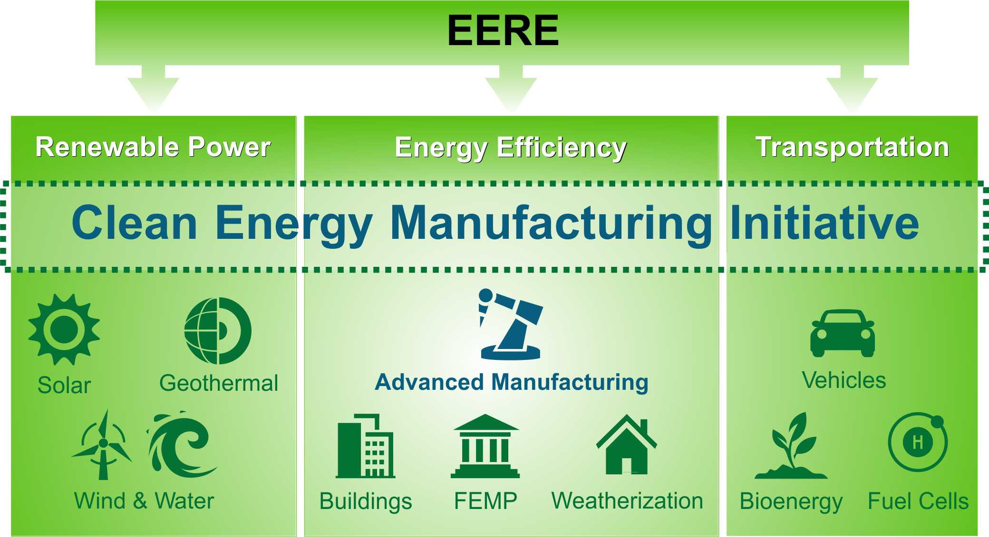
Clean Energy Manufacturing Initiative – Across DOE
Fossil Energy
O&G
CCS
Nuclear Energy
ARPA-E
Science
EM
NNSA
EPSA

Slide 7

Advanced Manufacturing – Strategic Inputs
Climate Action Plan
(EOP / CEQ / OSTP 2014)
1) Broadly Applicable Efficiency Technologies for Energy Intensive and Energy Dependent Manufacturing
Advanced Manufacturing
Partnership (AMP2.0)
(NEC / PCAST / OSTP 2014)
Quadrennial Energy Review
(DOE / EPSA 2015)
2) Platform Materials & Processes Technologies for Manufacturing Clean Energy Technologies
Quadrennial Technology Review
(DOE / Science and Technology 2015)

Slide 8
DOE QTR: Manufacturing Technology
Efficiency
Technologies
Enabling Platform
Technologies
(6)
Critical Materials
(4)
(5)
Flow of Material thru Industry (Sustainable Manufacturing)
Direct Energy Conversion Materials
(Magnetocaloric, Thermoelectric, etc)
(3)
(10, 11)
Combined Heat and Power
Wide Bandgap Power Electronics
Materials for Harsh Service Conditions
(5)
(3)
Waste Heat Recovery
Advanced Materials & their Manufacture
(5)
(1)
Advanced Sensors, Controls, Modeling & Platforms
(2)
Additive Manufacturing
(8)
Process Heating
(2)
Composite Materials
(7)
Process Intensification
Roll-to-Roll
Processing
(9)
Information & Data
Processes
Materials
Energy & Resource Management
Advanced Manufacturing Processes
Materials Development

Slide 9
Advanced Manufacturing Topical Priorities
Efficiency Technologies for Manufacturing Processes (Energy, CO₂)
  (1) Advanced Sensors, Controls, Modeling and Platforms (HPC, Smart Manf.)
  (2) Advanced Process Intensification
  (3) Grid Integration of Manufacturing (CHP and DR)
  (4) Sustainable Manufacturing (Water-Energy, New Fuels & Feedstocks)
Platform Materials & Technologies for Clean Energy Applications
  (5) Advanced Materials Manufacturing
  (incl: Extreme Mat’l., Conversion Mat’l, etc.)
  (6) Critical Materials
  (7) Advanced Composites & Lightweight Materials
  (8) 3D Printing / Additive Manufacturing
  (9) 2D Manufacturing / Roll-to-Roll Processes
  (10) Wide Bandgap Power Electronics
  (11) Next Generation Electric Machines (NGEM)
QTR Manufacturing Focus Areas Mapped to Advanced Manufacturing
Topical Areas for Technology Development

Slide 10
Materials for Harsh Service Conditions
Connections to other QTR Chapters and Technology Assessments
Ch. 6 - Materials for Harsh Service Conditions Technology Assessment
3
4
5
7
8
Scope
Materials for extreme environments including high temperatures, high pressures, corrosive chemicals, heavy mechanical wear, nuclear radiation, and hydrogen exposure
Grid
Electric Power
Buildings
Fuels
Transportation
Flow of Materials through Industry (Sustainable Manufacturing)
Critical Materials
Thermoelectric Materials, Devices and Systems
Combined Heat and Power
Wide Bandgap Power Electronics
Waste Heat Recovery
Materials for Harsh Service Conditions
Materials challenges and energy savings opportunities for selected harsh service condition application areas*
Advanced Sensors, Controls, Platforms and Modeling
Advanced Materials Manufacturing
Additive Manufacturing
Process Heating
Composite Materials
Process Intensification
Roll-to-Roll Processing
Key Extra-Chapter Connections
Fuels: corrosion in offshore drilling equipment; ash fouling in biomass conversion equipment; hydrogen embrittlement in H₂ pipelines
Electric Power: radiation-resistant fuel cladding; high-temperature alloys for nuclear reactors and gas and steam turbines
Transportation: corrosion-resistant lightweight materials
*Source: internal analyses (see Technology Assessment for assumptions)

Slide 11
Advanced Materials DOE-Wide Challenges
11
Mission: Material challenges are at the core of many DOE imperatives - advances in energy generation and use as well as our national nuclear security
Drivers: The past decade has seen tremendous progress in tools development for materials research along with need for accelerated pace of materials advancement
  The confluence of new theories, novel synthesis and characterization capabilities, and new computer platforms that extend capabilities to the atomic and nano-scale with the urgent demand for new and improved energy technologies
  2015 Quadrennial Technology Review, National Lab Summit, Materials Genome Initiative, AMP 2.0, Stockpile Stewardship and Management Plan
Challenge Focus: Materials RDD&D that involves close coordination between Office of Science, Technology Offices, and National Security Offices to form a cohesive network of capabilities:
(2) Functional (Applied) Design
(5) Data Management & Informatics
(4) Qualification
(3) Process Scale-up
(1) Materials Design & Synthesis
Unprecedented opportunity to impact the materials development cycle from scientific discovery to technological innovation and deployment
Notes:
Reference FY16 Manufacturing Tech Team proposal on additive and materials.
In FY16 we launched individual program efforts in EERE, FE, and NE for accelerated materials development.
There wasn’t a crosscutting focus at the time between basic sciences and applied.

Slide 12
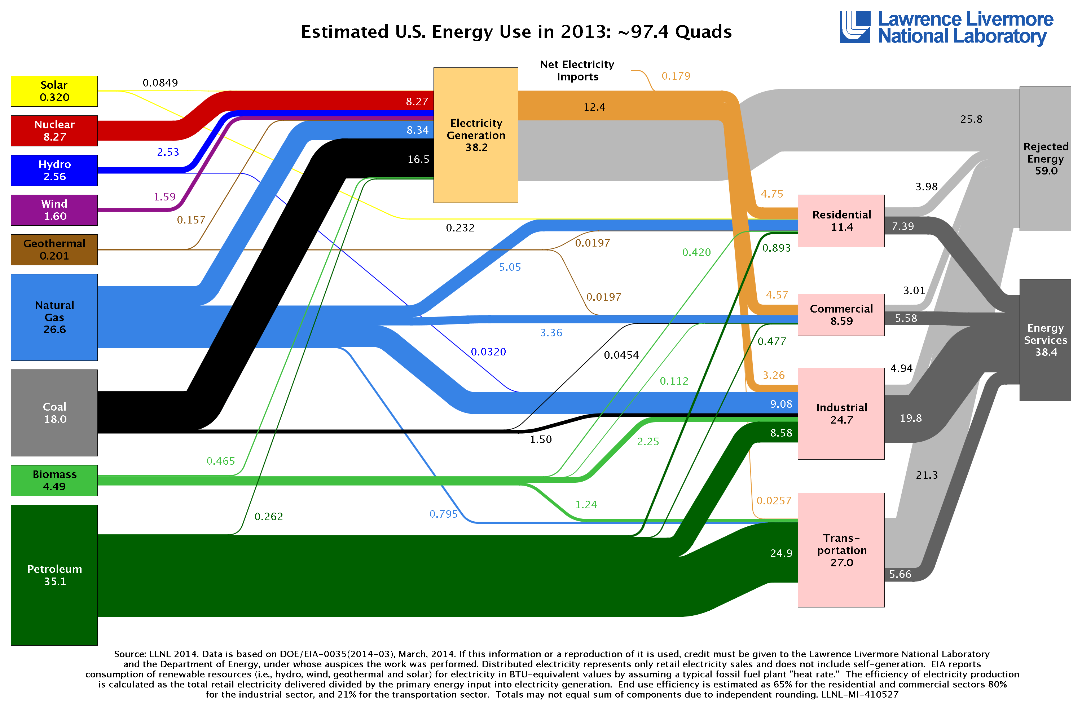
Energy Consumption by Sector
Notes:
Source:
https://flowcharts.llnl.gov/

Slide 13
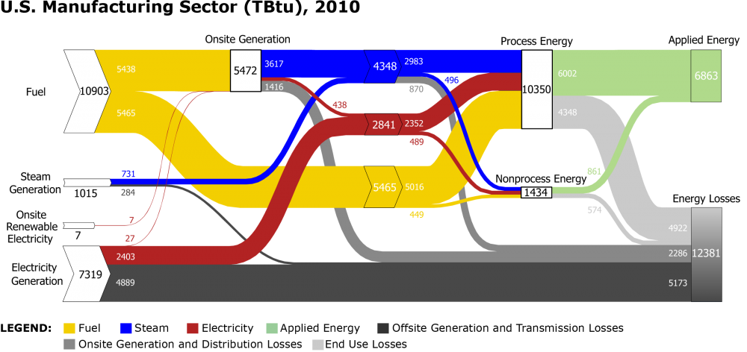
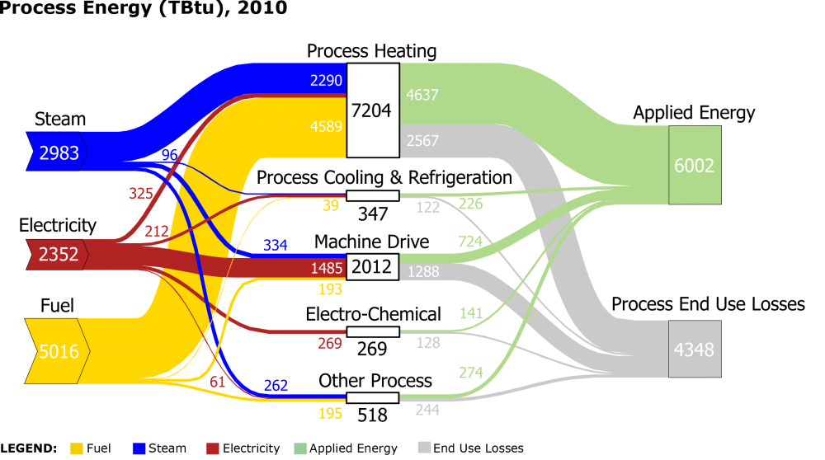
Energy Use in the Manufacturing Sector
Separations and Reactions

Slide 14
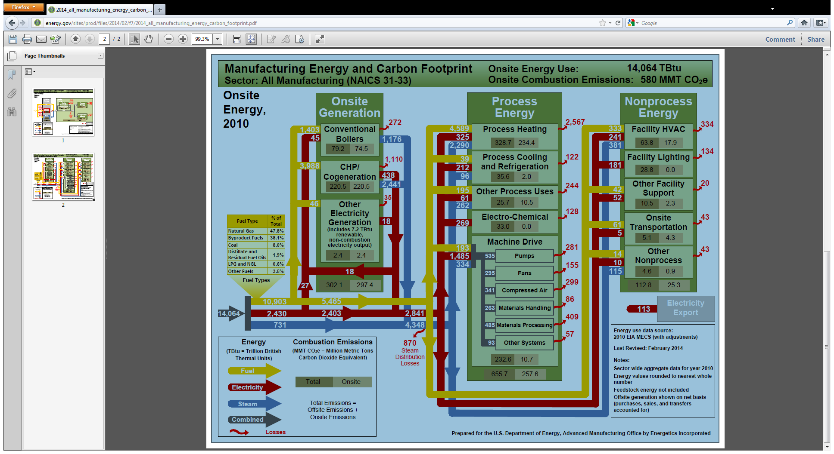
Deeper Look at Energy in Manufacturing

Slide 15
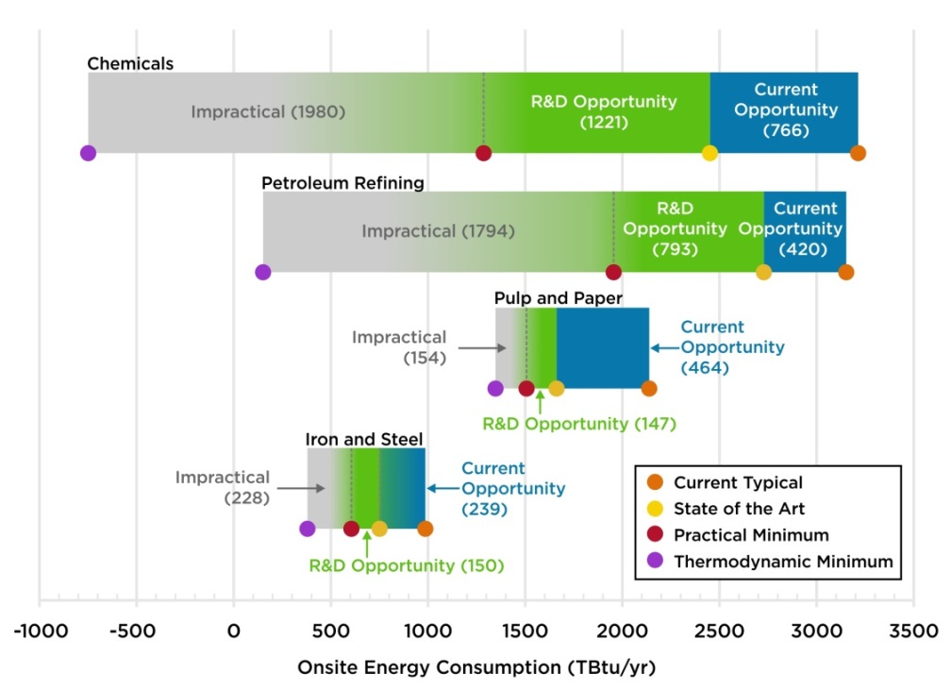
Bandwidth Studies: Energy Savings Potentials
Current opportunities represent energy savings that could be achieved by deploying the most energy-efficient commercial technologies available worldwide. R&D opportunities represent potential savings that could be attained through successful deployment of applied R&D technologies under development worldwide
AMO: September 2015

Slide 16
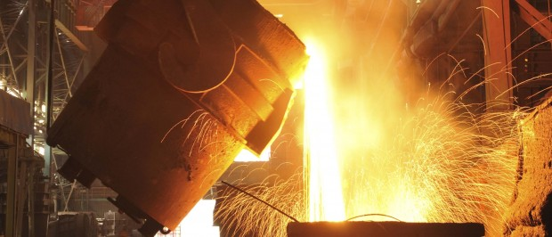

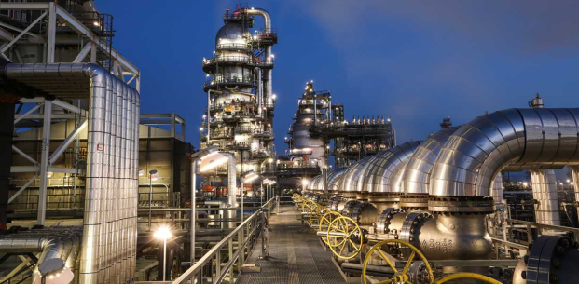
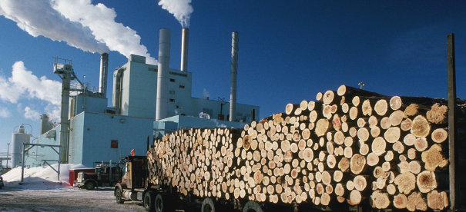
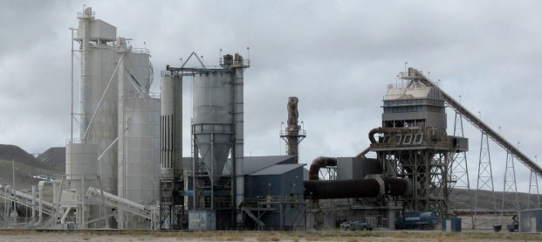
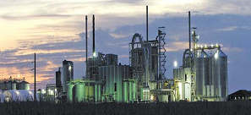
Energy Intensive Industries
Primary Metals
1608 TBTU
Petroleum Refining
  6137 TBTU
Chemicals
4995 TBTU
Wood Pulp & Paper
2109 TBTU
Glass & Cement
716 TBTU
Food Processing
1162 TBTU

Slide 17
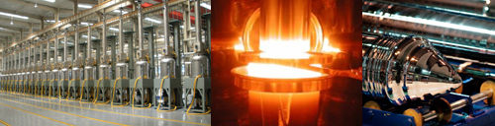
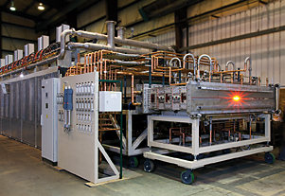
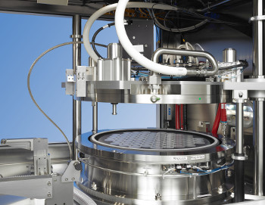
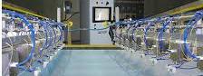
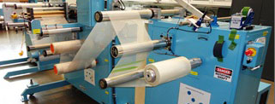
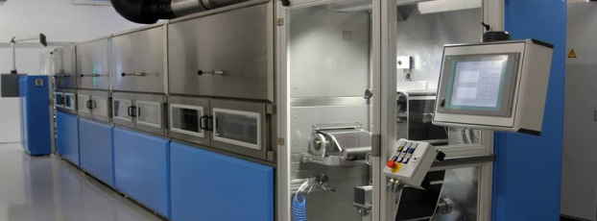
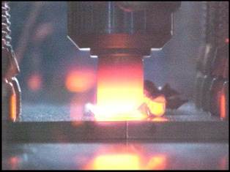
Processes for Clean Energy Materials & Technologies
Energy Dependence: Energy Cost Considered in Competitive Manufacturing
Solar PV Cell
Carbon Fibers
Light Emitting Diodes
Electro-Chromic Coatings
Membranes
EV Batteries
Multi-Material Joining

Slide 18
Possible Impact Areas of Cross-Cutting Technology for Energy Intensive Industry Sectors
 |  | Chemicals & Bio-chemicals | Petroleum Refining | Primary Metals | Forest & Food Products | Clean Water
SMART Manufacturing
Process Intensification
CHP & Grid Integration
Sustainable Manufacturing

Slide 19
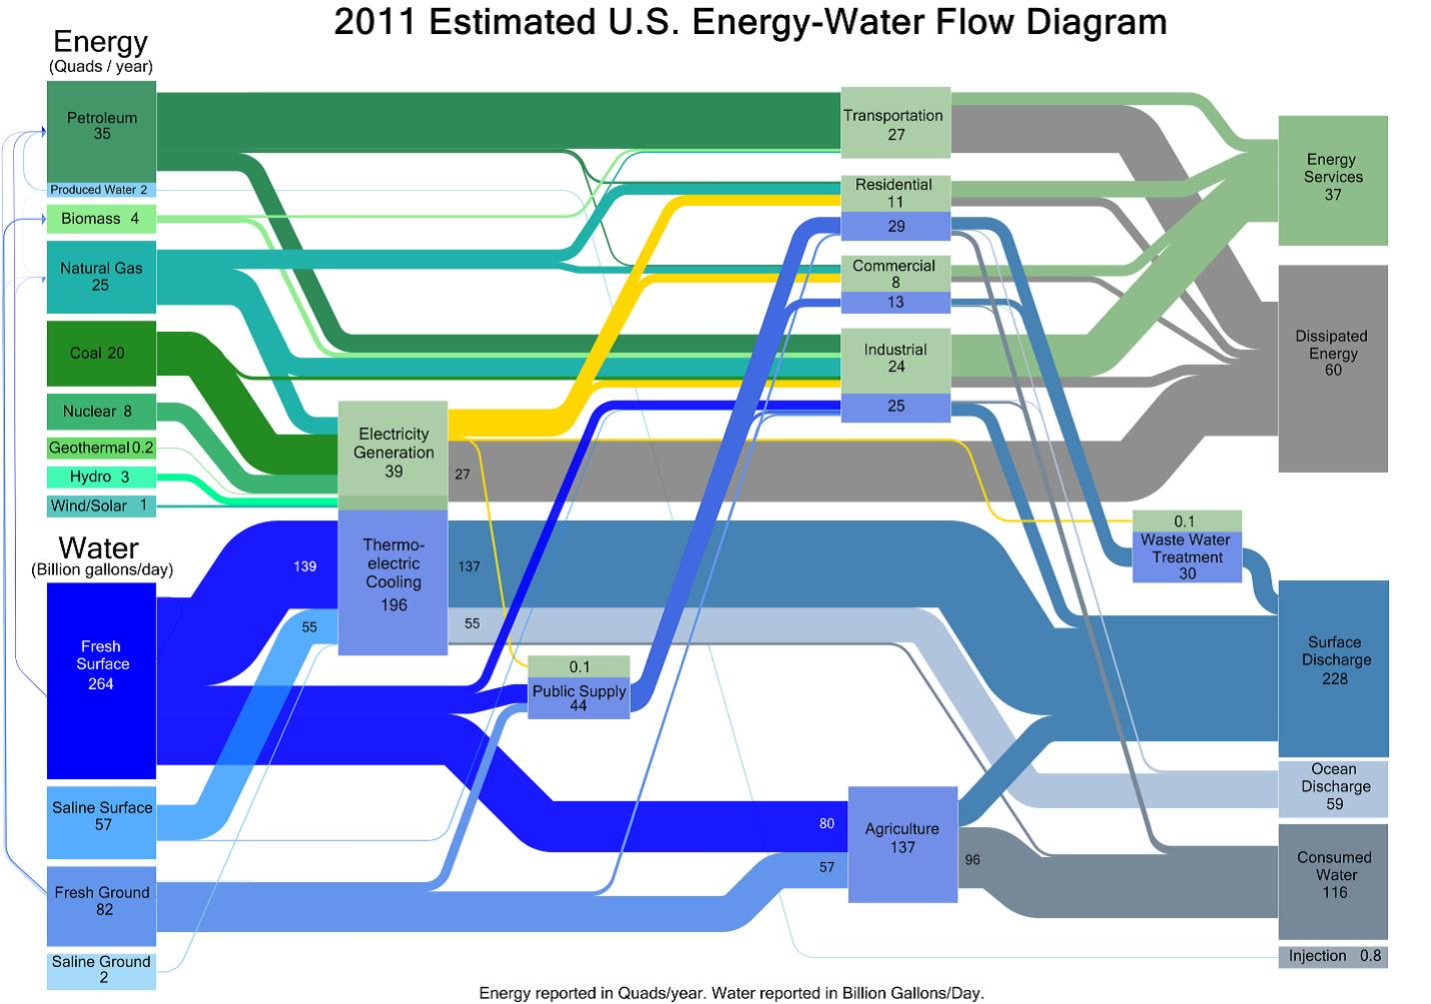

Water and Energy in Sustainable Manufacturing
Water Energy Uses
Water for Energy
Energy for Water

Slide 20
Bridging the Gap to Manufacturing
AMO: Advanced Manufacturing Office
Gap
DOE Energy Innovation Hubs
AMO
R&D Projects
R&D Investment Level
NIST Manufacturing Extension Partnership
NSF Engineering Research Centers
R&D Facilities
Technical Assistance
NSF IUCR Centers
SBIR/STTR
Governments and Universities
Private sector
Technology Maturity (TRL; MRL; etc.)
Concept
Proof of Concept
Lab scale development
Demonstration and scale-up
Product Commercialization

Slide 21
Modalities of Support
Technology Assistance: (Dissemination of Knowledge)
Better Plants, ISO-50001 / SEP, Industrial Assessment Centers, Combined Heat and Power Tech Assistance Centers, Energy Management Tools & Training
Technology Development Facilities: (Innovation Consortia)
Critical Materials Hub, Manufacturing Demonstration Facility (Additive), Power America NNMI, IACMI NNMI, CyclotronRoad, HPC4Manufacturing
Technology Development Projects: (Individual R&D Projects)
Individual Projects Spanning AMO R&D Space - University, Small Business, Large Business and National Labs. Each a Project Partnership (Cooperative Agreement).

Slide 22
AMO Elements
Three partnership-based approaches to engage industry, academia, national labs, and state & local government:
  Technical Assistance – driving a corporate culture of continuous improvement and wide scale adoption of proven technologies, such as CHP, to reduce energy use in the industrial sector
  Research and Development Projects
  Shared R&D Facilities
Notes:
Repeated slide for navigation

Slide 23




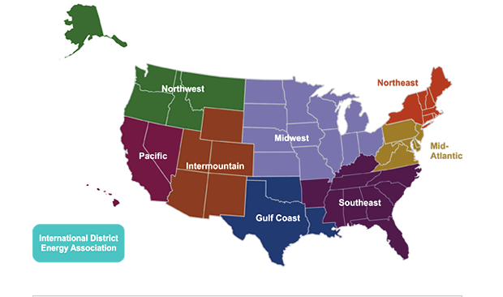







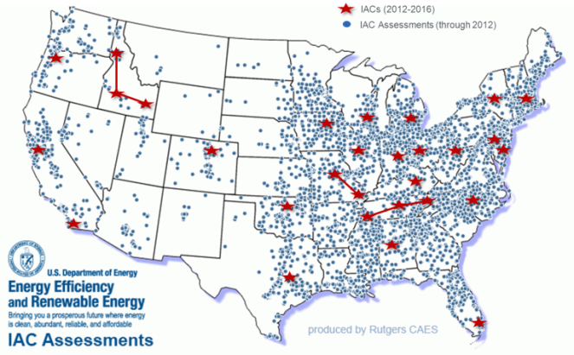

Industrial Technical Assistance
Efficient On-Site Energy
Clean Energy Application Centers
(to be called Technical Assistance Partnerships
since in FY14)
Energy-Saving Partnership
Better Buildings, Better Plants,
Industrial Strategic Energy Management
Student Training &
Energy Assessments
University-based Industrial Assessment Centers
Notes:
One of AMO’s major thrusts focuses on targeted partnerships that help U.S. industry save energy and reduce costs today, using currently available technologies.
In general, AMO's Technical Assistance programs address market barriers that limit the adoption of available technologies.
A few examples of this include:
Regional Clean Energy Application Centers that provide market assessment, education and outreach, and technical assistance to increase the adoption of energy-savings Combines Heat and Power technologies.
Industrial partnership programs like the Better Plants Program & Challenge that work with industry to commit to, take action and report results from energy saving measures.
Industrial Assessment Centers that train the energy engineers of tomorrow while simultaneously providing free energy assessments to small and medium sized manufacturers who may not be able to allocate overhead to energy management programs as easily as large firms.

Slide 24
AMO Elements
Three partnership-based approaches to engage industry, academia, national labs, and state & local government:
  Technical Assistance
  Research and Development Projects - to support innovative manufacturing processes and next-generation materials
  Shared R&D Facilities

Slide 25
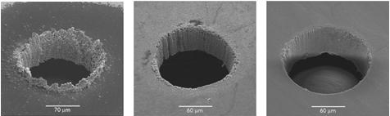
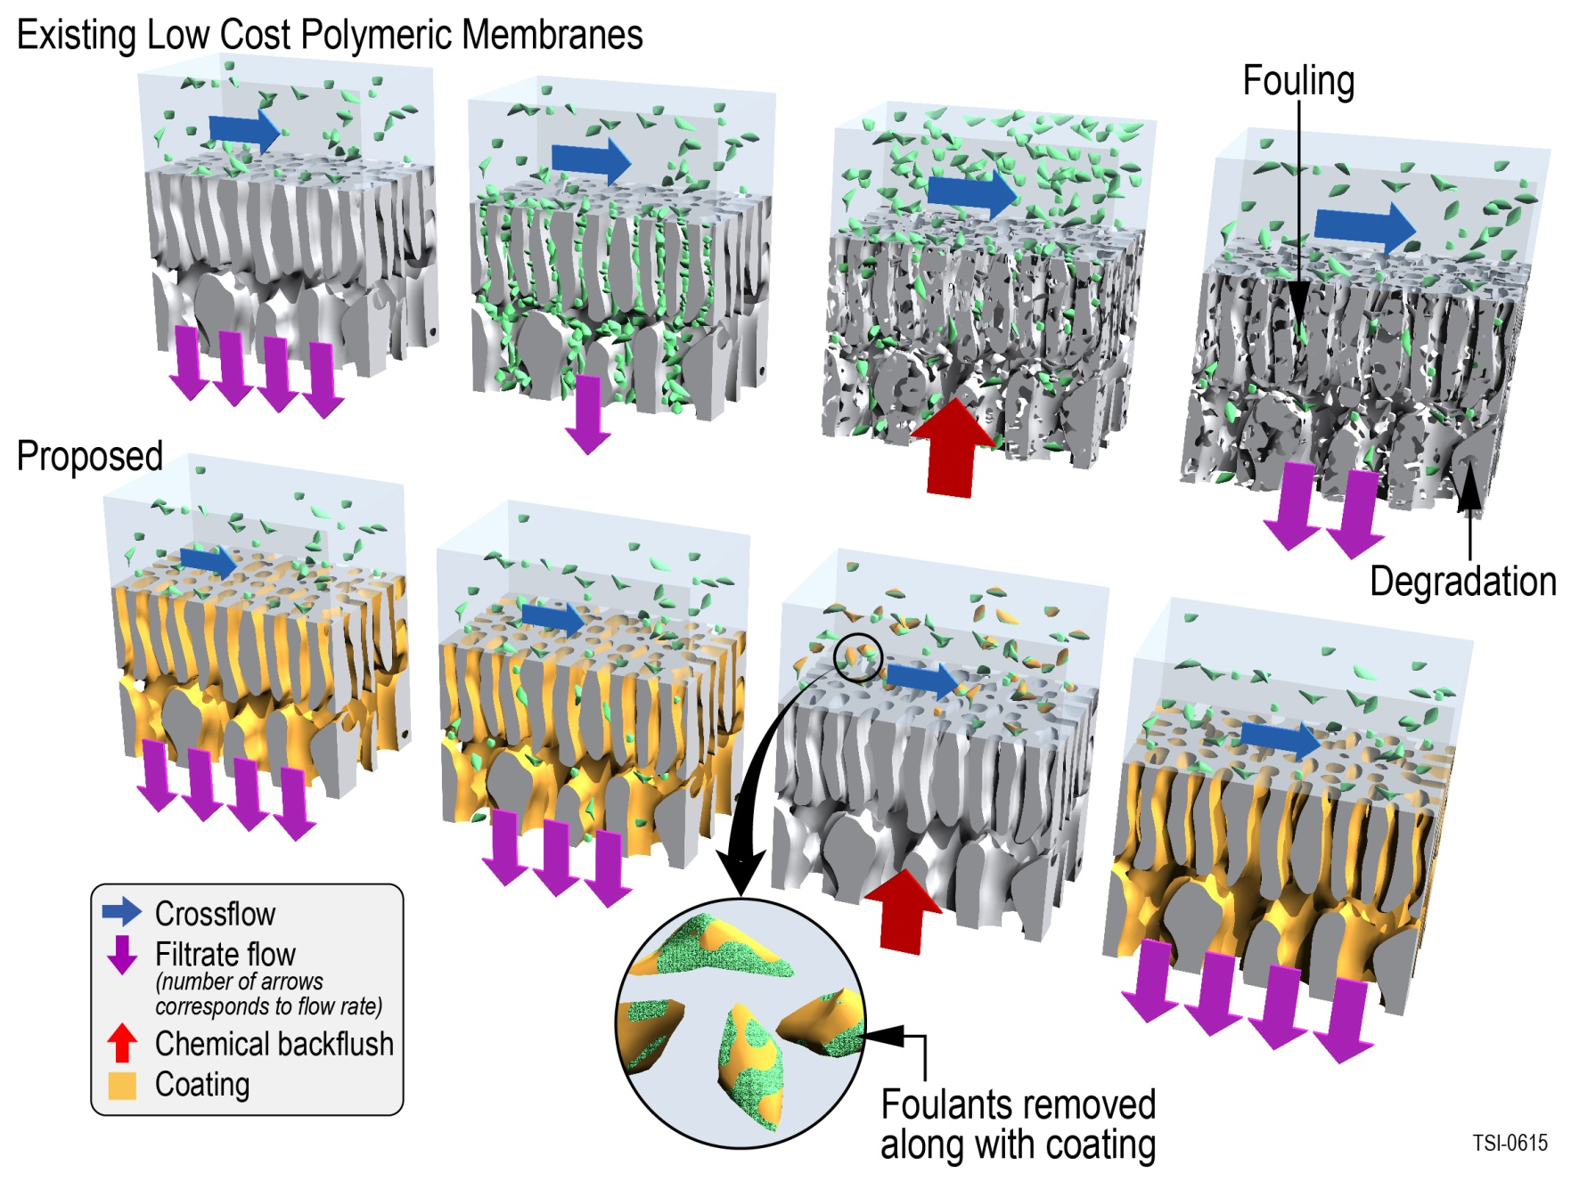
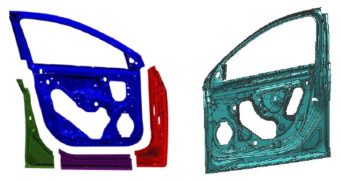
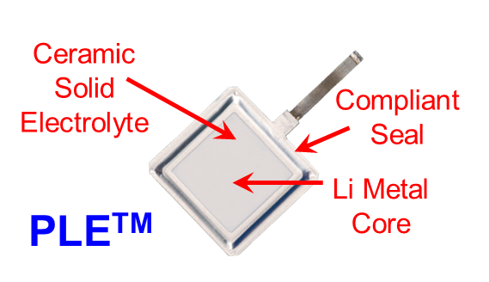
R&D Projects: Manufacturing Processes
Ultrafast, femtosecond pulse lasers (right) will eliminate machining defects in fuel injectors.
Image courtesy of Raydiance.
Protective coating materials for high-performance membranes, for pulp and paper industry.
Image courtesy of Teledyne
Energy-efficient large thin-walled magnesium die casting, for 60% lighter car doors.
Graphic image provided by General Motors.
A water-stable protected lithium electrode.
Courtesy of PolyPlus

Slide 26
AMO Elements
Three partnership-based approaches to engage industry, academia, national labs, and state & local government:
  Technical Assistance
  Research and Development Projects
  Shared R&D Facilities - affordable access to physical and virtual tools, and expertise, to foster innovation and adoption of promising technologies

Slide 27
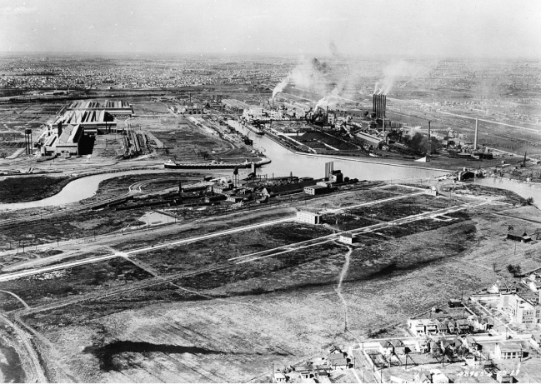
Shared R&D Facilities & Consortia
Address market disaggregation to rebuild the industrial commons
How could we get innovation into manufacturing today?
- RD&D Consortia based Eco-Systems
- Public-private partnership to scale
Then
Now
OEM
Tier 1
Tier 2
Tier 2
Tier 1
Tier 2
Tier 3
Tier 3
Tier 3
Ford River Rouge Complex, 1920s
Photo: Library of Congress, Prints & Photographs Division, Detroit Publishing Company Collection, det 4a25915.
Notes:
Ford River Rouge Complex: http://www.nps.gov/nr/travel/detroit/d38.htm
“By 1927, when Ford shifted its final assembly line from Highland Park to the Rouge, the complex included virtually every element needed to produce a car: blast furnaces, an open hearth mill, a steel rolling mill, a glass plant, a huge power plant and, of course, an assembly line.”
Address Market Barriers by providing:
Proving ground – to demonstrate the costs and efficiency gains of new technologies
Affordable access – to capital-intensive technologies and capabilities
Focus – to a sector, or set of sectors, around common technical challenges
Accelerated partnership development and supplier relationships
Workforce training location for advanced manufacturing
Positively Impact U.S. competitiveness:
Increased domestic manufacturing capabilities and expertise
Increased manufacturing collaboration between small, medium and large businesses, and university and government
Positive feedback loop – between production and research/design accelerates both
Accelerated adoption – of energy efficient technologies and manufacturing processes in existing U.S. manufacturing

Slide 28
Manufacturing Technology Maturation
Industry
Partnerships
End-Use Adoption
Deployment
TRL 6/7: System Testing in Production Relevant Environment
MRL 6/7: System Components made in Pilot Environment
Demonstration
TRL 5/6: Hardware-in-Loop System Testing in Laboratory
MRL 5/6: Investigate Pilot Environment to Make Systems
TRL 4/5: System Technology Tested in Laboratory
MRL 4/5: Investigate Pilot Environment to Make Components
Development
Applied
Research
TRL 3/4: Enabling Technology Tested in Laboratory
MRL 3/4: Enabling Components Made in Laboratory
Technology Needs and Requirements
Technology Capabilities and Opportunities
Basic
Research
TRL 1-3:
MRL 1-3:
Foundational
Science
Lab
Facilities

Slide 29

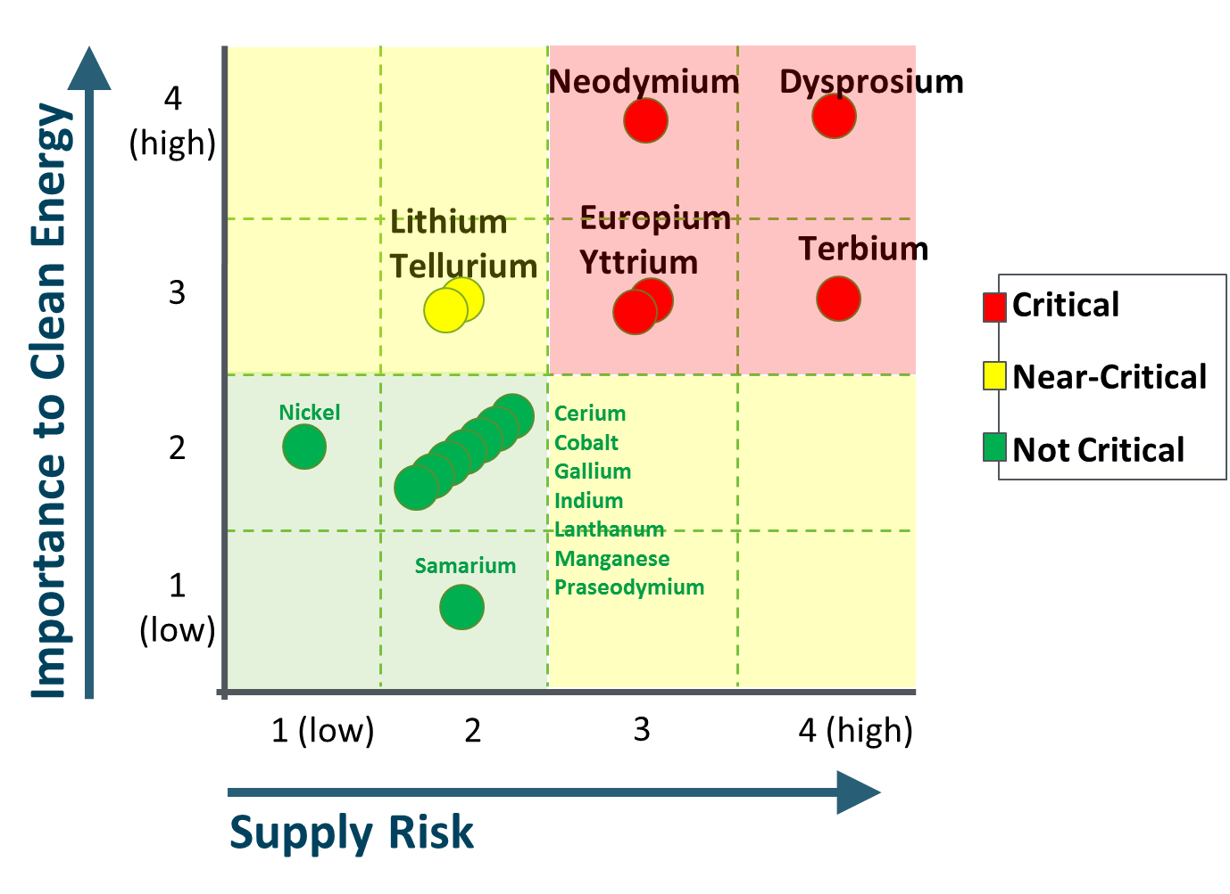
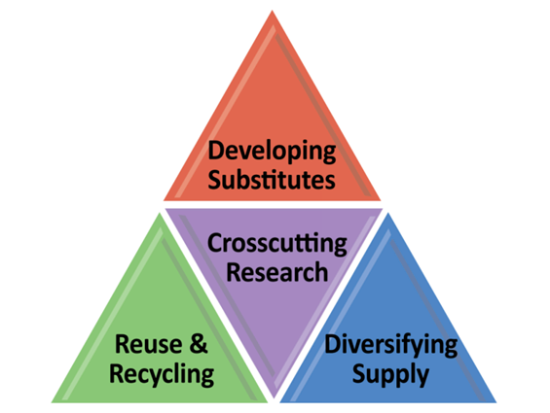
A DOE Energy Innovation Hub
Consortium of 7 companies, 6 universities, and 4 national laboratories
Led by Ames National Laboratory
Dy | Eu | Nd | Tb | Y | Li | Te
 |  |  |  | 
 |  |  |  |  | 
 |  |  |  |  |  | 
 |  | 
Lighting
Vehicles
Solar PV
Wind
Critical Materials - as defined by U.S. Department of Energy, Critical Materials Strategy, 2011.
Notes:
This is the 1-slide summary of the Critical Materials Institute.
Sources: http://www1.eere.energy.gov/manufacturing/rd/critical_materials_hub.html
And: DOE 2011 Critical Materials Strategy
Goal (from FOA): To reduce materials criticality and prevent criticality of new materials that are essential for energy technologies. The Critical Materials Hub will coordinate Research and Development across the entire materials lifecycle. Research and Development will combine basic and applied research with engineering to accelerate scientific discovery utilizing highly collaborative teams across multiple scientific and engineering disciplines.

Slide 30
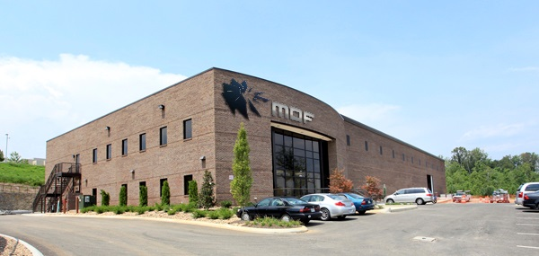

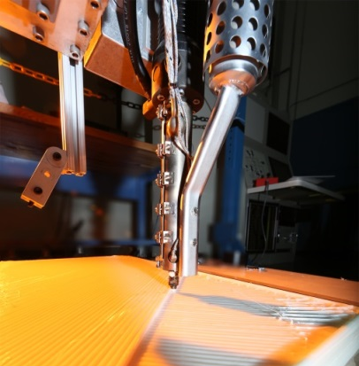

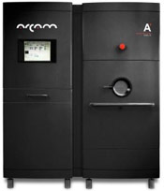

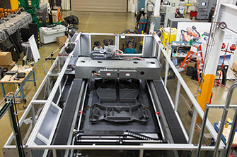
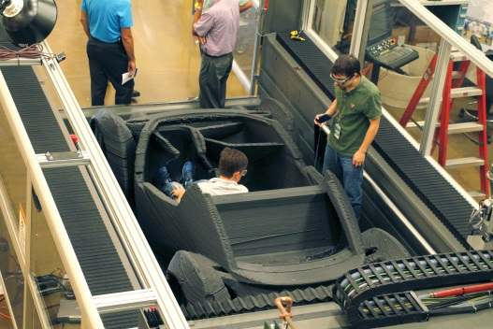
Manufacturing Demonstration Facility
Supercomputing Capabilities
Spallation Neutron Source
Additive Manufacturing
Program goal is to accelerate the manufacturing capability of a multitude of AM technologies utilizing various materials from metals to polymers to composites.
Arcam electron beam processing AM equipment
POM laser processing AM equipment

Slide 31
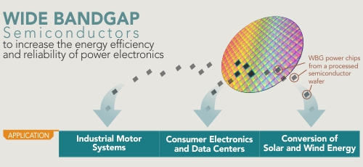
PowerAmerica:
Next Generation Power Electronics Manufacturing Institute
Institute Mission:
Develop advanced manufacturing processes that will enable large-scale production of wide bandgap semiconductors
Higher temps, voltages, frequency, and power loads (compared to Silicon)
Smaller, lighter, faster, and more reliable power electronic components
  $3.3 B market opportunity by 2020.¹
Opportunity to maintain U.S. technological lead in WBG
Poised to revolutionize the energy efficiency of electric power control and conversion
¹ Lux Research, 2012.

Slide 32
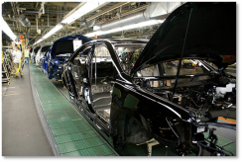
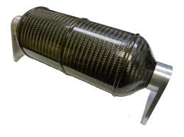

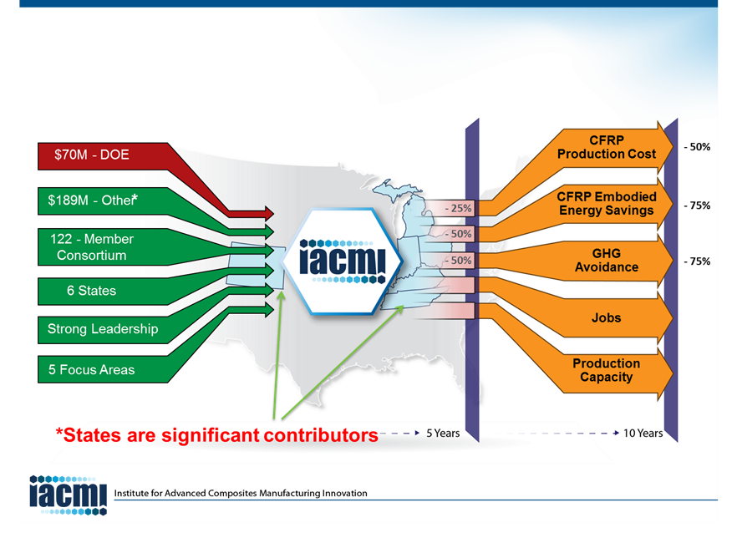
Institute for Advanced Composite Materials Innovation (IACMI)
Objective
Develop and demonstrate innovative technologies that will, within 10 years, make advanced fiber-reinforced polymer composites at…
50% Lower Cost
Using 75% Less Energy
And reuse or recycle >95% of the material

Slide 33
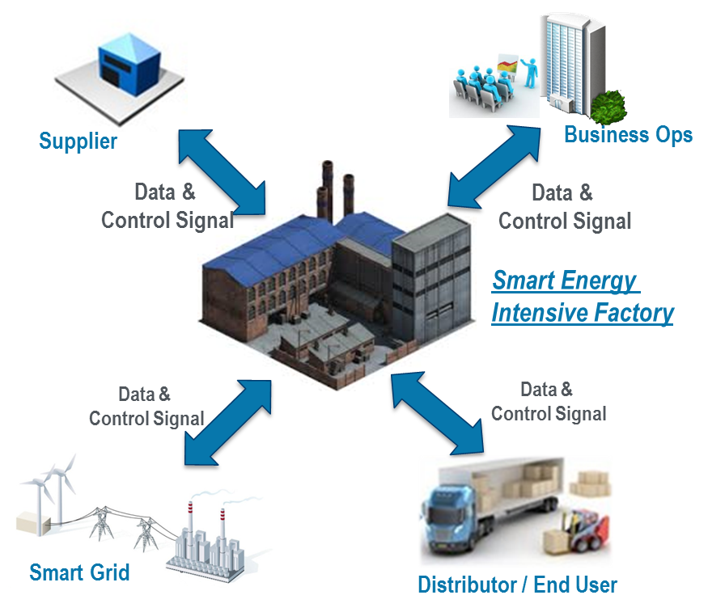
SMART Manufacturing: Advanced Controls, Sensors, Models & Platforms for Energy Applications
Focus on Real-Time
For Energy Management
Encompass machine-to-plant-to-enterprise real time sensing, instrumentation, monitoring, control, and optimization of energy (>50% improvement in energy productivity)
Enable hardware, protocols and models for advanced industrial automation: requires a holistic view of data, information and models in manufacturing at Cost Parity (>50% reduction in installation cost)
Significantly reduce energy consumption and GHG emissions & improve operating efficiency – (15% Improvement in Energy Efficiency)
Increase productivity and competitiveness across all manufacturing sectors:
  Special Focus on Energy Intensive &
  Energy Dependent Manufacturing Processes
Leverage AMP 2.0 and QTR

Slide 34
Topical Engagment with Industry
Materials in Extreme Conditions
Sustainable Materials in Manufacturing
Process Intensification (Chemical)
Process Intensification (Thermal)
Functional Membrane Structures
Smart Manufacturing
Advanced Materials
Process Intensification
Roll-to-Roll Processing
Advanced Sensors, Controls,
Models, Platforms

Slide 35
Technical Challenge Hierarchy
Multi-Disciplinary Technology Translation
Application 1
Application 2
Application
Domain
Demo
Demo A
Demo B
TRL 6/7
Validated System
Capabilities
System
Requirements
Lab Test Bed 2
System Test-Beds
Lab Test Bed 1
Lab Test Bed 3
Qualified New
Technologies
TRL 5/6
Technical
Needs
Technical Capability II
Technical Capability IV
Technical Capability I
Technical Capability III
Technical
Insight &
Understanding
TRL 4/5
Enabling Technologies
Knowledge
Gaps
Underlying
Knowledge A
Underlying
Knowledge B
Underlying
Knowledge C
Scientific Foundation
TRL 3/4
LIKE QUANTIFICATION OF POSSIBLE REQUIREMENTS, NEEDS & GAPS

Slide 36



What does Success Look Like?
Energy Products
Invented Here…
…And Competitively Made Here!

Slide 37
Materials for Harsh Service Conditions
Harsh Service Conditions include
  High temperatures
  High pressures
  Corrosive chemicals
Examples
  Waste heat recovery can provide major efficiency gains at manufacturing sites, but many sources of industrial waste heat are unrecoverable because existing heat exchanger alloys and power conversion materials are incompatible with corrosive, high-flow-rate, and/or high-temperature flue gases. New geometries.
  Gas and steam turbine power plants could achieve higher efficiencies if they operated at higher inlet temperatures, but operating temperatures are constrained by the thermal stability of existing turbine alloys at high temperatures and pressures.
  Conventional nuclear fuel cladding materials are unstable at very high temperatures and may contribute to nuclear core meltdowns in loss-of-coolant accidents.
  Mechanical wear
  Neutron irradiation
  Hydrogen attack

Slide 38
Workshop on Materials for Harsh Service Conditions
Three cross-cutting materials challenges areas of interest:
High Temperature and Corrosion Conditions
  Phase-stable materials that are stable in ultra-high temperature (>1200°C) conditions
  Advanced coatings and surface treatments that provide outstanding material properties at surfaces in corrosive conditions.
Mechanical Wear in Gas Turbines, Rotary Machinery and Non-Rotating Machinery
  Superalloy that are stable at extreme high temperatures, either steam-side (or other working fluid) oxidation and erosion resistance high-temperature fireside corrosion resistance over component lifetime, while easy to fabricate and join.
  Advanced coatings and surface treatments that provide outstanding material properties at surfaces such as wear and corrosion resistance.
Radiation and Hydrogen Embrittlement Environments
  Embrittlement-resistant materials are needed to resist material aging effects in certain extreme environments, including exposure to hydrogen (which can cause hydrogen embrittlement) and radiation (which can cause neutron embrittlement and radiation-induced swelling).

Slide 39
Breakout Topics, Focus Areas, and Materials Challenges
BREAKOUT TOPIC
High Temperature & Corrosion Conditions
Mechanical Wear in Turbines, Rotary Machinery & Non-Rotating Machinery
Radiation & Hydrogen Embrittlement Environments
FOCUS
AREA
Phase-Stable Materials,
Advanced Surfaces
Advanced Alloys, Advanced Surfaces
Material Aging
High Temperature and Pressure Stability
Wear Resistance
Neutron Embrittlement
MATERIALS
CHALLENGES
Corrosion Resistance
Corrosion Resistance
Hydrogen Embrittlement
Industrial Waste Heat Recuperator
Oil & Gas, Mining, and Agriculture Equipment
Nuclear Fuel Cladding
EXAMPLE APPLICATIONS
Ultra-Supercritical
Steam Turbine
Turbine & Rotary Eq, e.g., Geothermal Turbomchinery
Hydrogen Pipelines and Storage Tanks
Desalination Systems
Low Friction Coatings & Surface Modifications for Vehicles
New Materials will Enable Numerous Clean Energy Applications Provide Opportunities for Energy Savings & Emissions Reductions

Slide 40
Thank You

