Slide 1
Overview
The purpose of this analyses was to:
Understand what users are searching for
Learn the words they use in their searches
Searches from the EERE home page and the sub-sites
The search logs were from February 2011
We analyzed 12,914 entries from the home page and 24,128 entries from the sub-sites

Slide 2
What are users searching for?
Home page
Top 10 searches
Energy (14%)
Find similar (2%)
Lighting (2%)
LED (2%)
Insulation (1%)
Nuclear (1%)
Ethanol (1%)
Geothermal (1%)
Webinar (1%)
Renewable energy (0.9%)
Notes:
What are users searching for?
We entered the keywords into a visualization tool called TagCrowd which creates a tag cloud. The larger words mean the more times it was searched.
What you see here is a tagcloud of the top 100 words from the home page. The words are arranged in alphabetical order and so though some words like “led” and “lighting” may seem to be a search phrase they are counted individually. Using the visualization we pulled out the top 10 words. The most popular search is for energy, find similar comes in a far second.
From report
Energy 1809
Find similar 248
Lighting 209
LED 196
Insulation 178
Nuclear 148
Ethanol 143
Geothermal 142
Renewable Energy 115
Webinar 123
Biomass 111
Energy Efficiency/Efficient 102
Solar Energy 96
Heat Pump 84
Hcl 82

Slide 3
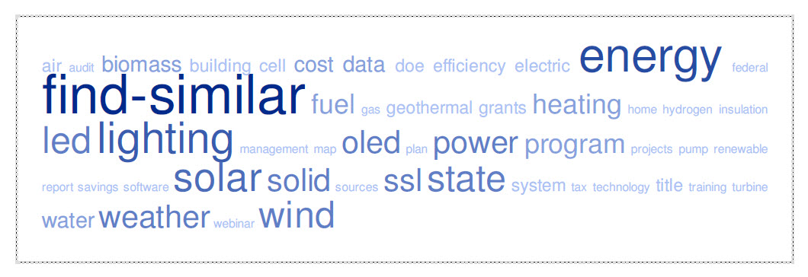
What are users searching for?
Top 10 searches
Across sub-sites
Find similar (11%)
Energy (8%)
Solar (4%)
Wind (3%)
LED (3%)
Lighting (3%)
State (2%)
Power (2%)
OLED (2%)
Weather (2%)
“OLED SSL solid Lighting lighting LED state” was searched for 409 times
Notes:
Similarly to the home page we entered the search terms from the program pages into TagCrowd . These are the top 50 words. Again, using the visualization we pulled out the top 10 words. This time the most common words were “find similar” followed by “energy”. While looking at the results we noticed that “OLED SSL solid Lighting lighting LED state”, was a searched for a lot and may have inflated frequencies for LED, lighting, state power and OLED.
From Report
Top 10 searches
Find similar 2684
Energy 1902
Solar 913
Wind 745
Led 689
Lighting 687
State 557
Power 522
OLED 453
Weather 428

Slide 4
What are users searching for?
Without “OLED SSL solid Lighting lighting LED state”
Top 10 searches
Find similar (11%)
Energy (8%)
Solar (4%)
Wind (3%)
Power (2%)
Weather (2%)
Fuel (2%)
Data (1%)
Program (1%)
Cost (1%)
Dropped down in frequency
LED (1%), Lighting (1%), State (0.6%) and OLED (0.2%)
Notes:
So we took out that search phrase to see what impact it had on the results. After removing that phrase there was a total of 23,718 words and we put them tagcloud as well as pulled out the top 10 searches. Without that phrase we are able to see words that may have been overshadowed.
Top words with out Without “OLED SSL solid Lighting lighting LED state”, total keywords is 23,718
From Report
Find similar (2684)
Energy (1902)
Solar (913)
Wind (745)
Power (522)
Weather (428)
Fuel (368)
Data (314)
Program (307)
Cost (294)
LED (280)
Lighting (278)
Biomass (226)
System (205)
Efficiency (201)

Slide 5
What are users searching for?
Energy
Included in energy-related searches
“alternative energy efficient”
“energy audit”
“Energy Saving performance”
“pros and cons of solar energy”
Find similar
Indicates frequent use of an advanced feature in the search results
Notes:
As we have seen in both on the home page and sub-sites, “energy” and “find similar” were the most used search terms. Energy was included in 14% of home page searches and 8% of searches across sub-sites.
Also popular, was “find-similar” which was typically followed by a url which we took to mean use of this link in the search results (image), therefore indicating that this feature was being utilized frequently.

Slide 6
How do users go about finding information?
“led”, “hcl”, “renewable energy”
Cast a wide net
Ask basic questions
Home page
“What does solar energy power plants do?”
“how is ethanol is made”
Program sites
“What is bioenergy?”
“What makes a wind turbine work”
Use specific searches
Home page
“nuclear powered capture and stored until needed”
“Top value added chemicals from biomass volume”
Program sites
“ASHARE energy models”
“Dual clutch transmission 2010”
“Routing telecom and data centers toward efficient energy use”
Notes:
We dug a little deeper into the search terms by looking for themes across the top search terms and learned that there were 3 types of strategies being utilized:
The first we termed as “casting a wide net” where users entered broad terms such as led, hcl and renewable energy, perhaps in effort to learn about the type of content that is available to them on the site.
Another strategy used was asking basic questions about a certain subject area such as (see slide), indicating that users may have little to some domain knowledge. These types of questions represented 26% of searches on the home page, and while it was not a majority of searches on the sub-sites pages it captures an idea of the words visitors use and an interest in particular subject area.
The third strategy used was the use of specific search phrases or technical terms, these were aimed at retrieving narrowly focused information or resource. Users who conducted these searches seemed to have a higher level of domain knowledge than in the previous categories. On the home page, these type of searches accounted for 16% of all searches while visitors to half of the sub-sites searched for specific information.

Slide 7
What are users interested in?
Financial information
Geographical
Type of information searched differed between the home page and programs
Home page:
“renewable energy unit costs”
“is induction lighting eligble for tax credit”
Program (WIP)
“EECBG Competitive Grants application”
“kansas grants for going green”
Searches were related to energy or weather
“california renewable energy”
“house insulation Massachusetts”
“haiti weather data”
“Weatherization in Shreveport Louisiana”
Federal government
Training and Education
More searches on the FEMP site than other programs.
“Federal Guiding Principles for High Performance Buildings”
“federal technology alert 286”
“Energy Policy Act 1992 general motor full text”
Represented 12% of all home page searches.
“summer internship for high school students”
“Residential Building Energy Codes webinar”
“personnel training energy efficiency”
Notes:
What are users interested in? Here are a couple of areas of interests that bubbled up from the searches.
-Financial information, which include search terms such as “funding”, “tax credit”, “cost”, “incentive”, “grants” or “apply” represented 4% of all home page searches. Among the sub-sites, the Weatherization & Intergovernmental Program (WIP) received the highest interest in financial related searches with terms that included “apply” or “application” or “grants”
-Geographical information on the home page accounted for 3% of searches and were often paired with energy related words. While on the program sites, geographical information was typically paired with weather type of inquiries.
-Information related to policies and government was more frequent on the FEMP sub-site than other sub-sites.
“Federal” accounted for 3% (81) of all searches on the FEMP site, for example, “Federal Guiding Principles for High Performance Buildings” and “federal technology alert 286”. “Policy” accounted for 1% (39) of the searches, “Energy Policy Act 1992 general motor full text”.
-Training and Education represented 12% of searches and included terms such as training, internships and webinars. Specific searches for internships were in particular for high school students which could be related to the time period that these searches were captured.
From the report
Home page
Geographic related searches (3%)
There were 64 searches where a user looked for information related to a specific location.
“house insulation Massachusetts”
“california renewable energy”
“Nuclear Energy in new jersey”
“louisiana solar power”
“vermont biomass”
Financial related information (4%)
There were 73 searches for information on funding, tax credits/incentives as well as cost.
“renewable energy unit costs”
“Energy Efficiency and Conservation Block Grant”
“Solar energy approximate costs”
“federal tax incentives biomass”
“is induction lighting eligble for tax credit”
Training and Educational Resources (12%)
There were 220 searches for training, internships and webinars. It should be noted that many of searches for internships and webinars were general. Specific searches for internships were in particular for high school students which could be related to the time period that these searches were captured.
Examples of these searches include:
“summer internship for high school students”
“Residential Building Energy Codes webinar”
“personnel training energy efficiency”
Programs
Searches about financial related information were popular on the WIP sub-site.
Among the top 5 frequent searches were “apply” or “application” and “grants”. “Apply” or “application” accounted for 5% (101) of all search terms and of those 38% were specifically in reference to grants. “Grants” (70) accounted for 3% of all searches. Some examples include:
“2011 application forms for grants”
“EECBG Competitive Grants application”
“kansas grants for going green”
Weather type searches is often paired with a location
Searches for “weather” or “weatherization” were top keywords for the Buildings and WIP sub-sites. For the Buildings sub-site it was the top search term accounting for 7% (179) of all searches and when coupled with “data” accounted for 3%(88) of all searches. Geographical information was paired in particular with “weather data” for example: “haiti weather data”, “local weather data s” and “weather data Madrid”.
For the WIP sub-site, “weatherization” accounted for 7% (154) of all searches, 26%(40) included geographical information. For example, “Weatherization in Shreveport Louisiana”, “weatherization surveys atlanta Georgia” and “what are michigan guidlines for weatherization”.
Information related to policies and government was more frequent on the FEMP sub-site than other sub-sites.
“Federal” accounted for 3% (81) of all searches on the FEMP site, for example, “Federal Guiding Principles for High Performance Buildings” and “federal technology alert 286”. “Policy” accounted for 1% (39) of the searches, in particular “Energy Policy Act 1992 general motor full text”.

