Slide 1
Crazy Egg Analysis: Usage Trends
Agenda
Review usage trends
Recommendations based on data
EERE’s plans to address template-level findings
Notes:
Today we wanted to share with you some of the usage trends that are starting to emerge for sites in the new program template.
Then we’ll provide some recommendations for you to consider when developing content for your pages based on the click analytics.
Chris will talk about some of the ways EERE is planning to address some of the template-level findings.

Slide 2
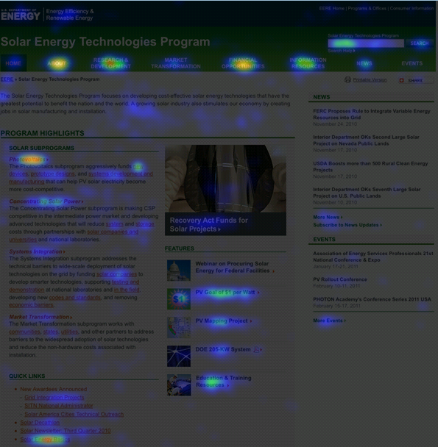
Crazy Egg Analysis: Usage Trends
Notes:
Let’s start by taking a look at a typical usage heat map of a program home page. The brighter areas indicate more clicks, dark areas indicate less clicks. In general, you can see that the top navigation and the center content area receives the most traffic; the right column gets less.

Slide 3
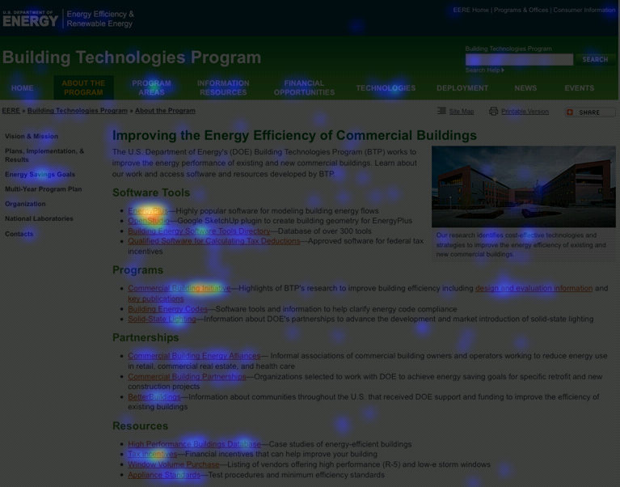
Crazy Egg Analysis: Usage Trends
Notes:
Here’s a typical second level page. Again, links in the center content receive the most traffic. The left navigation and the top navigation also draw some clicks, but generally less than on home pages (in the case of top navigation). Elements in the right column consistently draw less traffic.
Now let’s look in more detail at the click traffic to different areas of the page, and talk about implications for design.

Slide 4
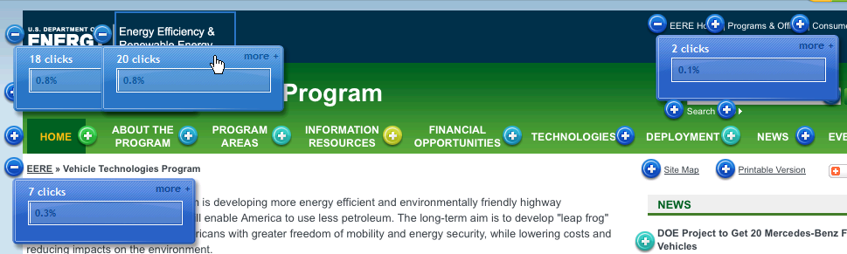

Crazy Egg Analysis: Usage Trends
Navigating to DOE/EERE
Few visitors navigate back to DOE/EERE from program sites.
Those that do primarily use left side of blue banner (fewer use breadcrumb, right side of blue banner, footer).
Visitors click on “Home” even on program home pages (0.4-0.7%).
Notes:
Few visitors navigate back to DOE/EERE from program sites.
Those that do primarily use left side of blue banner (fewer use breadcrumb, right side of blue banner, footer).
Visitors click on “Home” in the top navigation on the program home pages (0.4-0.7%) – could be because they expect this will take them back to EERE/DOE (requires further investigation).

Slide 5
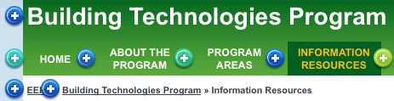
Crazy Egg Analysis: Usage Trends
Navigating Back to Program Home
Most visitors use the “Home” button in the top navigation (can receive up to 7% of click traffic)
The green bar and the breadcrumb are used less often (generally less than 1% each).
Notes:
Most common way for people to navigate from second levels back to home page is by using the “home” button in the green bar (can receive up to 7% of click traffic).
The program name in the green bar and the breadcrumb are used less often (generally less than 1% each).

Slide 6
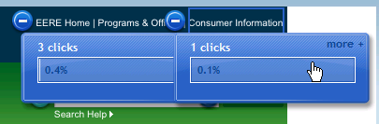
Crazy Egg Analysis: Usage Trends
Global Navigation
Not drawing much attention.
Preliminary evidence suggests that this trend also extends to subsites.
Notes:
Not drawing much attention (Programs & Offices, Consumer Information each get 0-0.5% of clicks.
Preliminary evidence suggests that this trend also extends to subsites.
This was also something Chris and his team observed in the template usability study they did in the fall.

Slide 7
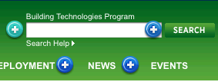
Crazy Egg Analysis: Usage Trends
Search
~2-4% of visitors perform searches from home or second level pages.
Search help is rarely used.
Notes:
Generally we’re finding that approximately 2-4% of visitors are doing searches from home or second level pages.
Search help is not being used at all.

Slide 8
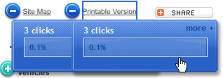
Crazy Egg Analysis: Usage Trends
Site Map, Printable Version, Share
Visitors do interact with these features (usually draw 0-0.5% of page clicks).
Share is rarely used.
Notes:
Visitors do interact with these features (usually draw 0-0.5% of page clicks).
Share is rarely used.

Slide 9
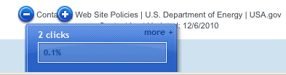
Crazy Egg Analysis: Usage Trends
Footer
Receives 0-1% of page traffic.
Contacts is most popular; Policies, DOE get some traffic.
Notes:
Receives 0-1% of page traffic.
Contacts is most popular; Policies, DOE get some traffic.

Slide 10
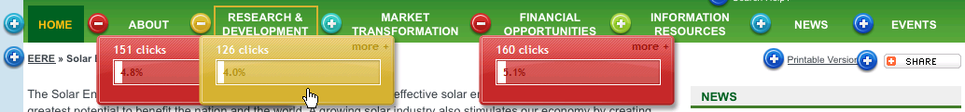
Crazy Egg Analysis: Usage Trends
Top Navigation
Primarily used on home pages (can constitute 15-25% of page traffic).
Usage on second levels varies considerably (6-26%).
Most popular: About, Financial Opportunities, Information Resources
Least popular: News, Events, and Deployment
Notes:
Primarily used on home pages (can constitute 15-25% of page traffic).
Usage on second levels varies considerably (6-26%).
About, Financial Opportunities, and to some degree, Information Resources are the most utilized top navigation items on home pages. In addition to these items, Program Areas and some of the program-specific buttons are popular on second levels.
News, Events, and Deployment are the least popular top navigation choices on both home and second level pages.

Slide 11
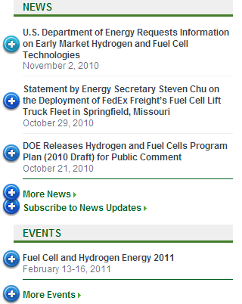
Crazy Egg Analysis: Usage Trends
Right Column
Consistently draws less traffic.
Particular news stories or features draw more traffic than others (depends on subject).
A few visitors use the “Subscribe to News, More News” links.
Notes:
The right column consistently draws less traffic than the center or the navigation.
Particular news stories or features draw more traffic than most (this seems to depend on content of the story/feature).
A few visitors use the “Subscribe to News, More News” links.

Slide 12
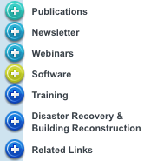
Crazy Egg Analysis: Usage Trends
Left Navigation
Receives up to 43% of the page clicks (second levels)
Effectively draw people’s attention.
Consistently gets more clicks than the top navigation on second level pages.
Notes:
The left navigation receives up to 43% of the page clicks, and seems to effectively draw people’s attention on second levels.
It consistently gets more clicks than the top navigation on second level pages.

Slide 13
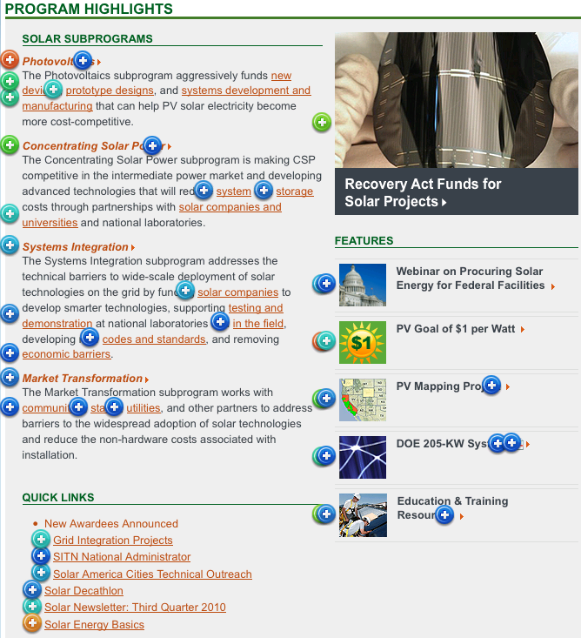
Crazy Egg Analysis: Usage Trends
Center Content
Attracts more clicks than other areas of page.
Info above the fold is more clicked than info below the fold.
Tops of lists get more clicks than bottoms of lists.
Visitors click on program descriptions.
Rotators draw attention.
Traffic to feature graphics depends on content/design.
Visitors click on unlinked graphics.
Notes:
Content in the center area (especially underlined links) generally attracts more clicks than other parts of the page.
Generally information above the fold is more clicked than information at the bottom of the page, but you can see here that visitors will scroll down and click on content that is of interest to them at the bottom of the page.
Generally links near the top of lists get more clicks than links at the bottom of lists (but not always).
A surprising number of visitors attempt to click on the program descriptions found on most program home pages. These are blocks of text that contain no links.
Visitors interact with rotators (~2-4% of clicks). They click on the text and on the image.
Traffic for feature graphics seems to depend on the content of the feature graphic (state-specific or financial content is drawing attention; bright colors draw attention).
Visitors try to click on unlinked graphics sometimes.

Slide 14
Crazy Egg Analysis: Usage Trends
Recommendations Based on Data
Gain an understanding of your visitors’ top tasks and program goals; use that to streamline and simplify pages.
Put important content into the center above the fold.
Place links you want to promote at the top of the list.
Consider adding a link to About from program taglines.
Link graphics advertising particular content; provide visual cues so visitors know which graphics are links.
Use bright colors, images of maps, images of money to draw attention.
If a program click through rate is lower than average (70-80%), investigate why.
Notes:
Based on these usage trends, we can make a few recommendations for how we’re implementing the content on our sites:
While there are obvious trends in traffic based on visibility/graphical treatment/location on the page, the subject matter appears to be an important factor in determining popularity of a particular piece of content. Because of that, it’s really important that we gain a clear understanding of visitors’ top tasks and program Web site goals so we can streamline and simplify our pages, and provide only the content that is going to further the program’s goals and help our users accomplish their top tasks.
Put important content into the center content area, above the fold.
Place links you want to promote at the top of the list.
Consider streamlining/shortening program descriptions and place text links to appropriate content so users clearly see where they can click to get more information about the program.
People click on graphics. So to help your users, link graphics that are advertising particular content to that content. Provide obvious visual cues so visitors know which graphics are linked and which are not. Crazy Egg can help you get a sense for what graphics users may be clicking on on your site.
Use bright colors to attract the user’s eye to a particular item; use images of maps to indicate state-specific information, and images of dollar signs/money to indicate funding opportunities.
If a program click through rate is lower than average, which is 70-80%, investigate why (Does the page effectively address user tasks? Are users looking for a different site instead?).

Slide 15
Crazy Egg Analysis: Usage Trends
Future Research
Why is the global navigation drawing so little attention?
Why are visitors clicking on “Home” in the top navigation on home pages?
Do EERE visitors tend to visit one or multiple programs when they come? Can users easily go between program sites?
How do visitors feel about the rotators?
What accounts for the great popularity of certain feature graphics?
Why are visitors clicking on the home page program descriptions?
Can visitors clearly distinguish between images that are clickable and those that are static?
Do visitors understand what they will find in Information Resources?
Do visitors understand and find value in the content found under labels like Deployment and Market Transformation, since they are often not heavily clicked on?
Do users understand what site they are searching?
How are users interacting with the right column? How much content is useful vs overwhelming ?
Notes:
This data has generated a number of questions that require further research. Chris and his team will be doing additional usability work so we can better understand how people are using the template, and continue to refine it. But we’ll be looking to you guys to help us with this by gathering data on template usage when you do your own program usability studies.
Here are some of the questions we’d like to get more feed back on:
Why is the global navigation drawing so little attention? (Is it not visible enough? Are people finding consumer information a different way instead? Do people generally have a need to view multiple program sites at each visit, or do they stick to one program?)
Why are visitors clicking on “Home” in the horizontal navigation on home pages? (Are they confused by the purpose of this button on home pages? Do they expect it to take them back to DOE/EERE?)
Do EERE visitors tend to visit one or multiple programs when they come? If so, are they able to successfully go between program sites using the new template?
How do visitors feel about the rotators? (Do they like them or find they annoying? How do they interact with them – do they like to know how many features there are? Do they like having a pause button?)
What accounts for the great popularity of a select few feature graphics? (Are visitors overwhelmed by number of features? Are certain features effectively capturing user top tasks, while the rest do not? Do visitors find the graphical treatment of particular features more compelling than others?)
Why are visitors clicking on the home page program descriptions? (Do they expect them to be linked? What are they trying to find when they do this?)
Can visitors clearly distinguish between text/images that are clickable and those that are static?
Do visitors understand what they will find in the Information Resources section (this section is often clicked on, but the click rate could be due to the fact that this is a very broad and general label as was shown in the ITP usability study)?
Do visitors find value in the content found under labels like Deployment and Market Transformation, since they are often not heavily clicked on? (Do people not click on these items because they don’t find value in the topics, or because the labels are jargony and confusing?)
Do users understand what site they are searching?
How are users interacting with the right navigation, and what is the right number of stories to draw attention but not overwhelm?
Chris and I will be working together to develop some questions/follow ups that you could add to your usability studies in order to help us answer these questions.

