Slide 1
Snippet 3-9: Schedule Risk Assessment (SRA)
U.S. Department of Energy
Office of Project Management (PM)
Notes:
This Training Snippet is sponsored by the United States Department of Energy’s Office of Project Management. This Snippet provides an overview of the Schedule Risk Assessment process, and how the results assist in project management. The purpose is to provide a common understanding within DOE and among DOE contractors, and to provide consistency.

Slide 2
Schedule Risk Assessment
An industry best practice and expectation in DOE Order 413.3B, IPMR, and Clause DOE-H-2024, the SRA:
Identifies the high-risk areas of the project;
Determines the likelihood of risk materializing;
Assesses the impact of possible risk.
Conducted by the Contractor, the Initial SRA assessment should begin as soon as the project baseline is implemented.
The SRA uses Statistical techniques in the form of Monte Carlo simulations to quantify the impact of duration uncertainties, and technical, programmatic, and schedule risk on the project’s schedule.
Notes:
A Schedule Risk Assessment, or SRA, is an analysis tool which uses the integrated master schedule to identify the high-risk areas of the project, determine the likelihood of risks materializing, and then assessing the impact of each possible risk.
While an SRA is an Industry best practice, it is also a requirement of the Integrated Project Management Report or IPMR, which is cited in DOE Order four thirteen point three B and in the Corporate Clause DOE dash H dash 2024 when EVMS is required.
The initial SRA should be conducted by the Contractor as soon as the project baseline is implemented.
In general, the SRA uses statistical techniques in the form of Monte Carlo simulations to quantify the impact of uncertainties in duration estimates along with technical, programmatic, and schedule risks on the project’s schedule, and the probability of meeting the schedule objectives.

Slide 3
Traditional Scheduling
In a project’s Integrated Master Schedule, there are single dates chosen for the start and finish for each activity.
This is called a “Deterministic” approach.
15-Days of Duration
Activity A
May 1
May 15
Project Duration, however, has Uncertainty
Notes:
Traditional scheduling, which results in the Integrated Master Schedule for most projects, uses a standard Critical Path methodology, or CPM. In the process of determining the start and finish dates for each activity in the schedule, a single duration is determined. This is called the deterministic approach. While these durations are based on estimates, and may themselves be optimistic or pessimistic, the input into the scheduling tool is a single set of dates for each finish and start rather than a range.
In the case shown, this activity is planned to start on May first and finish on May fifteenth, resulting in a 15 day duration activity. This is rather specific information being used for the scheduling process, however, in reality, project duration has a degree of uncertainty.

Slide 4
Probabilistic Scheduling
Approaches duration estimates with uncertainty; Forms a Distribution Curve for each activity
Most Likely Duration
Best Case
(optimistic)
Worst Case
(pessimistic)
25
35
90
Activities are assigned a duration uncertainty range
Durations are not “random” but assigned a 3-point estimated duration
Critical, Near Critical, and High-Risk activities should have a range determined by the Control Account Manager
Remainder of activities can have ranges determined globally: Banding
Notes:
Probabilistic Scheduling introduces the application of a date range. This process approaches duration estimates with a degree of uncertainty, and forms a distribution curve for each activity based on the evaluated best, worst, and most likely duration estimates.
Think about your drive into work each morning. If you had to pick a single duration, you might say 35 minutes. Now if you think about the absolute fastest it’s taken you to make that commute, the best case, you might say 25 minutes. Finally think back to your worst day of commuting, the snow storm last year, and you remember a 90 minute drive. These three values would form your Most Likely, Best and Worst cases, respectively. You’ll also notice that there is a greater area of this curve to the right, or worst case side, of the curve as compared to the left, or best case side. This indicates that, for this activity, there the duration curve assessment resulted in a higher likelihood for a late finish than an early finish. In other words, given your own assessment, there’s a greater chance that your commute will take more than 35 minutes as compared to less than 35 minutes, even though the most common duration is still 35 minutes.
The critical, near critical and high-risk activities in the schedule are assigned a duration uncertainty range with a 3-point estimated duration. In a project using Earned Value Management, this estimating is generally performed by the Control Account Manager. The remainder of the activities can be assigned a duration range using a banding approach, meaning a group of activities are given the same probability distribution without individual assessment.

Slide 5
SRA Process and Results
Process
SRA process uses the same “Forward / Back” Critical Path Calculations
Specialized software repeats this analysis thousands of time
Software randomly assigns different durations using distribution curve, between the Best and Worst Case
Results
Notes:
The basic process for conducting an SRA is to first have a healthy Integrated Master Schedule with a meaningful critical path. The SRA process uses the same logic network for its calculations, except instead of calculating a project duration based on a single set of dates it repeats the forward and backward calculations hundreds or thousands of times. For each of these iterations the software randomly assigns different activity durations, between the best and worst cases, based on the associated distribution curve.

Slide 6
SRA Process and Results
Process
SRA process uses the same “Forward / Back” Critical Path Calculations
Specialized software repeats this analysis thousands of time
Software randomly assigns different durations according to distribution curve, between the Best and Worst Case
Results
The completion date of each iteration is logged
Summation of results produce the probability of completion across the range outcomes
Notes:
As a result, a completion date associated with each iteration is logged, and a summation of these results reports on the probability of achieving each date within the range of the total outcomes.

Slide 7
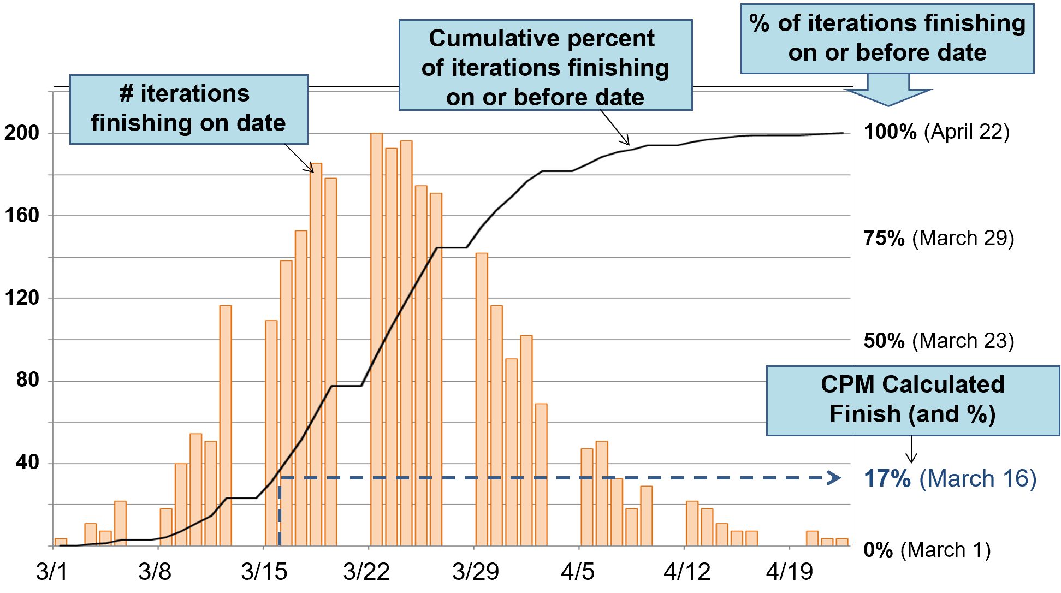
SRA Histogram Results
The IMS Critical Path Finish Date has a 17% Chance of Success
Notes:
The results of the SRA are often depicted using graphics generated by the SRA software. This is a sample histogram, which plots the number of predicted completion forecasts hitting each given date in the date range. In the output shown here, for example, the SRA results report that the project is predicted to finish anywhere between March first and the week of April 22. On the top right, the modeling reached 100% on April 22, which means that, given the range inputs for each activity in the network schedule, there is a 100% chance for the project to be finished by that date. We can compare this to the project finish date currently calculated by the deterministic critical path method schedule, which is March 18th. According to the output of the modeling, there is a 17% chance of the project being finished on or before that date.

Slide 8
SRA Histogram Results
The IMS Critical Path Finish Date has a 17% Chance of Success
A 50% probability of completion isn’t until March 23rd
Notes:
Statistically, the project doesn’t reach even a 50% probability of completion until March 23 which is a full week past the current finish date.
It’s a common observation that the dates forecasted by the deterministic schedule often are below the 50% probability of success in the SRA modeling. To understand this, think back to our example of your commute to work. The most likely case was 35 minutes, while on a good day you might be 10 minutes early, however on a bad day 55 minutes late. In other words, the distribution curve for this activity skews to the late side of the most likely case. This is not uncommon in an SRA distribution analysis. If the most likely case was used as the deterministic duration for each activity in the integrated master schedule, most activities have more days between the most likely and worst case than between the most likely and best case. The overall results, therefore will often report a less than 50% probability for the deterministic outcome. As in the case shown in this histogram.

Slide 9
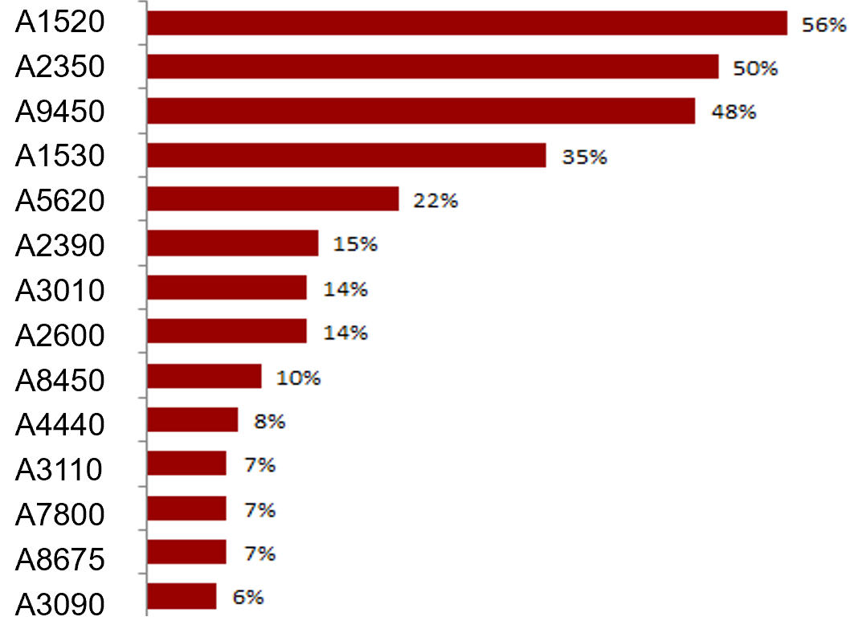
SRA Tornado Chart
Tornado Charts identify (by decreasing significance) the tasks whose duration estimates and logic are most likely to impact target milestone completion dates
% of iterations when an increase in this task’s duration resulted in a delay to the project finish
Notes:
This graphic is called a Tornado Chart and coordinates with the Histogram on the previous slide. The tornado chart lists the tasks whose duration estimates and logic are most likely to impact the project’s end dates.
In this case, Task A fifteen twenty resulted in a delay to the project’s finish date in 56% of the iterations. These results allow the project team to take action on the specific tasks which are most responsible for the results of the SRA.

Slide 10
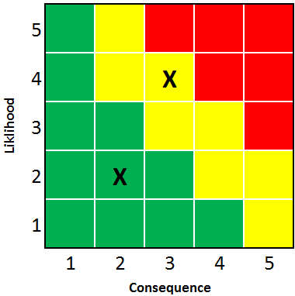
Schedule Risk and Risk Events
A Risk Event is a problem that may or may not occur, but if it does, will cause an impact to technical, cost and/or schedule goals.
Risks are categorized in terms as their Likelihood of Occurring and the Consequence (or Impact) if they do occur.
The goal of considering Risk Events in Scheduling is to have a plan to Mitigate, or reduce the likelihood or impact, of the Event…or Both!
One goal of a disciplined Risk Management process is to identify potential Risk Events and create Mitigation Plans for them.
Likelihood
Notes:
The statistically-based SRA focuses on duration uncertainty in the schedule. Another source of schedule risk is unplanned project events. There are an endless set of examples for unplanned risks such as material shortages, weather delays, and subcontracting to name a few. Risk Events are typically quantified in 2 dimensions, likelihood and consequence. Risk events have a less than 100 percent likelihood of occurring, or else they would have been planned in the baseline schedule, but if they do occur there will be a consequence to downstream tasks, an increased cost or a change to the technical expectations of the project.
The goal of considering risk events in scheduling is to have plans in place which reduce the likelihood or impact of the event…or both.
Overall, one of the primary goals of a disciplined risk management process is to identify these risk events and develop mitigation plans to deal with them.
However, not all risk events are mitigated to zero likelihood. For those that are not, and for which a time impact to downstream activities is possible, they need to be factored into the Monte Carlo analysis in a similar manner for uncertainty as how accounted for in determining cost contingency and confidence.

Slide 11
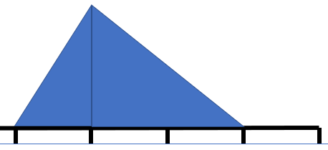
The SRA Overview
Input
A. Distributions of Remaining Tasks
B. Remaining Risk Events Post-Mitigation, such as
event, what task does it impact, likelihood, time impact
Next event . . ., etc.
Notes:
To summarize the SRA process, the project team takes the remaining tasks in the integrated master schedule and assigns a 3-point estimate distribution to each. They do this by evaluation from subject matter experts for the critical, non-critical, and high-risk tasks, but may allow the software to use a probability distribution band for the remaining to establish each activity’s range of values.
For risk events following mitigation which have some remaining likelihood of occurrence and impact, the risk events, the activities they are tied to, the probability of occurrence, and the time impact if it occurs are also included in the Monte Carlo analysis along with normal duration uncertainties to determine overall schedule impact and confidence.

Slide 12
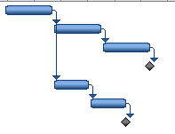
The SRA Overview
Input
Method
A. Distributions of Remaining Tasks
Monte Carlo Analysis
B. Remaining Risk Events Post- Mitigation, such as
event, what task does it impact, likelihood, time impact
Next event . . ., etc.
Simulates the project thousands of times
Notes:
These values are fed into the SRA software, which, using a Monte Carlo statistical analysis, calculates the results over and over, each time using a different set of random values from the probability range of each activity.

Slide 13
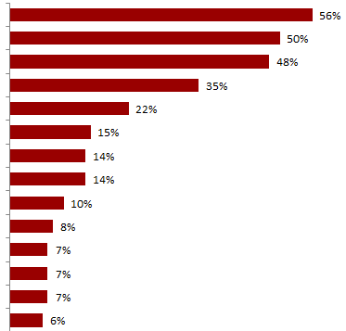
The SRA Overview
Input
Method
Results
A. Distributions of Remaining Tasks
Monte Carlo Analysis
Total Project Possible Durations
B. Remaining Risk Events Post- Mitigation, such as
event, what task does it impact, likelihood, time impact
Next event . . ., etc.
Simulates the project thousands of times
Notes:
The modeling simulation produces a distribution of the possible outcome values and reports the probability of any given date being successful. Plus, it reports a prioritized listing of the activities in the schedule which have the greatest impact to the project’s outcome.

Slide 14
Using the Results
The SRA should result in actions such as:
Reviewing logic and durations
Revising plans
Building Work-Around (mitigation) plans
Revising Approaches
Evaluating Schedule Margin
Technical Scope Changes
Budget and/or EAC Changes
Notes:
It is important that the project team use the results of the SRA, and the analysis should evoke action to mitigate risks and improve project success probabilities. Potential responses to the SRA results are: Reviewing logic and durations, revising plans, Building Work-Around or mitigation plans, Revising Approaches to completing the work scope, Evaluating the use of Schedule Margin in the IMS, Technical Scope Changes that would allow for less risky project execution, and potentially changes to the budget or the forecast of costs associated with the project.

Slide 15
Reporting the Results
The DOE Integrated Program Management Report (IPMR) Data Item Description:
3.6.11.2. Schedule Risk Assessment (SRA). Include the results of the SRA if one has been performed within the reporting month. The SRA report is in contractor format and includes assumptions; probability of result to the specified target; analysis of results; actions taken as a result of the analysis; and results, if any, of the steps taken. Discuss changes to the schedule and most likely EAC based on the results of the SRA.
SRAs should be performed on all initial baselines, and after significant changes to the baseline or project execution.
SRAs should also be performed periodically as the schedule is updated to reflect progress on activity durations and sequences, and the risks retire or change.
Notes:
Finally, the results of all SRAs are to be reported in the contractor’s Integrated Program Management Report, or IPMR. This reporting includes not only the results of the analysis, but the actions taken based on those results.
The SRA process is a valuable management tool which greatly increases the usefulness of the project schedule. They should be performed on all initial baselines and after any significant change to the baseline. In addition, regardless of baseline changes, it is a best practice to periodically perform the analysis as the schedule is updated with performance. The SRA is often used as a probability test of the critical path schedule’s forecasted finish date, plus finish dates of critical interim milestones, and these date forecasts and the nature of the critical path often change during the course of a project schedule. Periodically running an SRA analysis can keep the project team continually aware of the shifting risks to schedule during the life of the project.

Slide 16
Summary
Schedule Risk Assessments are analysis tools used to identify and manage the high-risk areas of the project in the Integrated Master Schedule.
The SRA process assumes a duration uncertainty for each activity in the IMS and runs a probabilistic analysis of the likelihood of project and critical milestone completions.
The SRA reporting also identifies the highest risk activities so that mitigation plans can be considered.
SRAs should always be performed on newly planned baselines, but also at frequent intervals during a project so that risks are continually understood.
Notes:
Schedule Risk Assessments, or SRAs, are analysis tools used to identify and manage the high-risk areas of the project in the Integrated Master Schedule, and the likelihood of these risks materializing.
The SRA process assumes a duration uncertainty for each activity in the IMS by estimating the Most Likely, Best and Worst Cast durations, and runs a probabilistic analysis of the likelihood of project and critical milestone completions.
The SRA reporting also identifies the highest risk activities, these are activities whose duration estimates and logic are most likely to impact planned completion dates. With this information, the project can develop mitigation plans.
SRAs should always be performed on newly planned baselines, but also at frequent intervals during a project so that risks are continually understood. These intervals can be driven by significant contract changes, but also periodically as the schedule is statused.
In addition to statistical-based SRAs, the project’s Risk Management program identifies potential Risk Events, and develops Risk Mitigation strategies to reduce their Likelihood and Impact.

Slide 17
For additional information, please browse our library at the following Project Management Earned Value Management websites.
External:
https://www.energy.gov/projectmanagement/services-0/earned-value-management
Internal:
https://community.max.gov/display/DOEExternal/PM+EVM+Guidance
Notes:
For additional information relative to project controls procedures, templates, helpful references, more Snippets, and training materials, please refer to DOE PM’s external EVM Home page or the internal Max.Gov PM Library. Check back periodically for updated or new information.
Thank You for using the Snippet Library.

