Slide 1

U.S. Department of Energy
Office of Project Management (PM)
Snippet 1-4:
Self Governance
Notes:
This Training Snippet is sponsored by the United States Department of Energy’s Office of Project Management. This Snippet provides an overview of Self-Governance, and how the results benefit both the contractor and DOE. The purpose is to provide a common understanding within DOE and among DOE contractors, and to provide consistency.

Slide 2
What is Self Governance
An approach to ensure long-term sustainability of a continuously improving EVMS
Visible
Structured
Management Endorsed
Self-Governance Plan
Decision Making Framework
Logical
Robust
Repeatable
Preferred path following EVMS Certification
Notes:
Self-governance is an objective approach to ensure long-term sustainability of a continuously improving Earned Value Management System, or EVMS, through implementation of a visible, structured, and management endorsed process. Self Governance is the preferred path following EVMS Certification.
The self-governance commitment for the contractor’s EVMS implementation, maintenance and data sharing is codified in the contractor’s EVM System Description or in a Self-Governance Plan. An EVMS self-governance plan is critical to provide a decision-making framework that is logical, robust and repeatable to govern an organization’s EVMS. In this way, an organization will have a structured approach to the proper ongoing implementation of the EVMS by providing necessary internal controls and formal project management processes.

Slide 3
Superior to only contractor annual surveillance
Ensures contractual requirements are met
Provides for:
Current, Accurate, Complete, Repeatable, Auditable, and Compliant information
Informed contract and project management decision making
Engenders a Transparent and Collaborative Environment
Notes:
The Self Governance method is superior to only contractor annual surveillance while ensuring contractual requirements are met in the provision of current, accurate, complete, repeatable, auditable, and compliant information, available for informed contract and project management decision making. This approach is intended to engender a more transparent and collaborative environment.

Slide 4
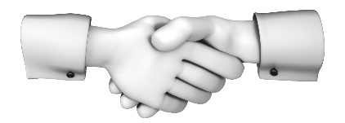
Reduces DOE Oversite
Shifts compliance EVMS oversite back to the Contractor
Allows for contractor course correction
Minimizes DOE involvement
Requires a Commitment
Notes:
Self-governance looks to shift EVMS compliance oversight back to the contractor, allowing the contractor to take the initiative to course correct and minimize further DOE involvement. Self-Governance requires a commitment from the contractor.

Slide 5
Key Features
Leadership Engagement
Chartered Authority Structure
Notes:
Key characteristics and features of Self-Governance should include:
First, Leadership engagement which via routine and transparent oversight, progress assessment, and open dialogue, demands continuous improvement, and defines and enforces project management excellence;
Next, a chartered authority structure, for example a Governance Board, with cross-organizational engagement from the financial office, procurement, quality assurance, et cetera, to establish effective processes which are repeatable and enduring, implement corrective and improvement actions, and report to and interact with institutional leadership.

Slide 6
Transparency and Openness
Learning Organization
Documented Methodology with Program Surveillance Officer
Notes:
The next key feature of Self Governance is a documented methodology to routinely monitor, assess and report system health and corrective actions via dashboards and metrics, as well as a clearly defined and independently positioned Program Surveillance Officer that has a clear line to senior management.
Another key feature is to have a learning organization capable of:
Maintaining and improving workforce skill via proven techniques such as peer-to-peer mentoring;
Prioritizing and executing process improvements; and
Reporting improvement progress to the Governance Board.
Above all. and incorporated throughout, should be transparency and an openness to critical feedback.

Slide 7
CONTROLS & PROCESSES
Ensures all stakeholders receive accurate and reliable progress & performance data
Helps ensure performance information and financial records are complete, accurate, and reliable
EVMS remains EIA-748 compliant i.a.w. contract and DOE O 413.3B
Notes:
These controls and processes ensure that both contractor and government project managers, as well as other stakeholders, receive accurate and reliable project progress and performance data. Effective controls reduce the risk of EVMS non-compliance and help ensure that performance information is complete and accurate, financial records and reports are reliable, and that the EVMS complies with the EIA-748 Guidelines in accordance with contract requirements and DOE O 413.3B.

Slide 8
DIGITAL DASHBOARD
PARS
Available 24/7 via internet
Available to DOE and Contractor personnel
Shows compliance and health status of EVMS
Improved Capability and Insight
Monthly Refresh of Risk Indicators
Surveillance Roles are Evolving
Shifts contractual compliance oversight back to Contractor
Allows contractor to course correct
Notes:
The digital dashboard in PARS Empower is available to DOE and contractor personnel via internet access, 24/7. The dashboard shows the compliance as well as the monthly health status of the EVMS performance data upon which DOE and contractor personnel make financial and other programmatic decisions.
With this improved capability and insight using risk indicators updated monthly, the DOE and contractor roles in surveillance are evolving. Self-governance shifts the contractual EVMS compliance oversight back to the contractor, allowing the contractor to take the initiative to course correct before DOE steps in.

Slide 9
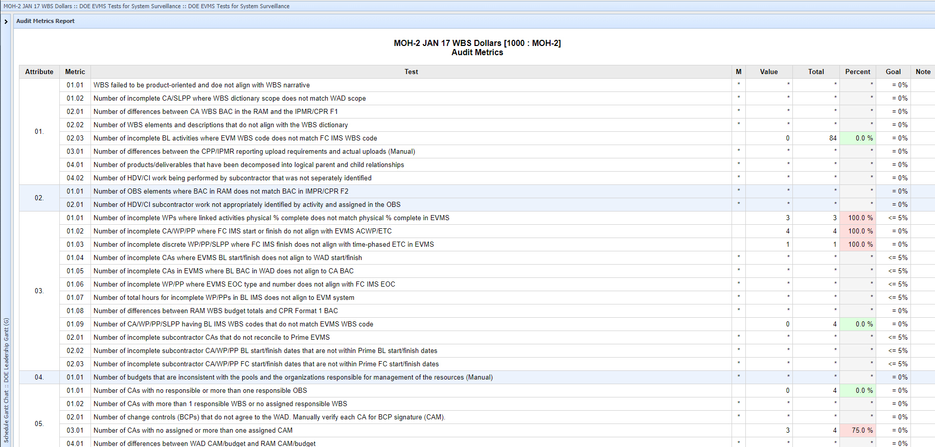
PARS Empower Audit Metrics Report
Notes:
This report from PARS Empower is updated monthly based on contractor data uploads in the Comma Separated Value (CSV) format; contractors who continue to upload in the Access database (MDB) format will not be able to use this feature. The Attributes and Metrics are located in the Guidelines Attributes and Tests or GAT located in the PM EVMS Compliance Review Standard Operating Procedure, Appendix A.
Any measurement that falls outside historic norms or deviates from a predetermined threshold will be flagged with a red or yellow background. Within minutes, both the contractor and the government will know what issues to focus on. In a Self-Governance environment, the contractor accepts responsibility to take the action of investigation and analysis.

Slide 10
DOE PM-30’s Engagement
Stage 3: Corrective Action
Stage 2: Investigation
Stage 1: Limited Engagement
Notes:
DOE PM-30’s Oversight and level of engagement with a contractor will be carried out through a three-stage process, beginning with a less formal approach where the contractor has an opportunity to remedy any non-compliances before the matter is elevated to a PM Surveillance Team. This engenders a more collaborative approach, ensures consistency, and obtains results faster, thus ensuring the earned value (EV) data remains valid for managers to make informed project performance decisions and produce quicker results.
Stage 1 is Limited Engagement. When the tests do not exceed thresholds, PM-30 minimizes additional surveillance activities.
Stage 2 is Investigation. When any test exceeds the thresholds, PM-30 will discuss the issue with the contractor, which will investigate whether a breach has occurred. Based on the investigation, PM-30 may issue advice to clarify and/or interpret the relevant provisions of the attribute interpretation for the contractor to follow.
Stage 3 is Corrective Action. If the issue continues, PM-30 will require a more formal investigation by the contractor that will include a root-cause analysis and corrective action plan. Throughout this process, government personnel will ensure that concerns are promptly considered by the contractor and that any necessary action is taken as swiftly as possible.

Slide 11
Allows the DOE/NNSA Program Office and DOE PM to:
Act in a true oversight role
Focus on projects and sites that need it most
Minimizes need for Future On-Site PM-30 EVMS Surveillance Reviews assuming Contractor
Submits EVMS data and information into PARS
Submits Quarterly EVMS Ribbon runs
Remains within acceptable compliance thresholds
BENEFITS ALL PARTIES
Notes:
Self-governance allows DOE and National Nuclear Security Administration, or NNSA, Program Offices and DOE Office of Project Management full and immediate access via PARS Empower and to act in a true oversight role. It also allows them to focus on projects and sites that require their focused attention based on data and surveillance results.
Self-governance minimizes the need for future on-site DOE PM-30 EVMS surveillance reviews, assuming submittal of EVMS data and information in PARS, inclusive of quarterly EVMS ribbon runs, remain within acceptable compliance thresholds, and absent DOE or NNSA Program or Site Office, or Project Team request.

Slide 12
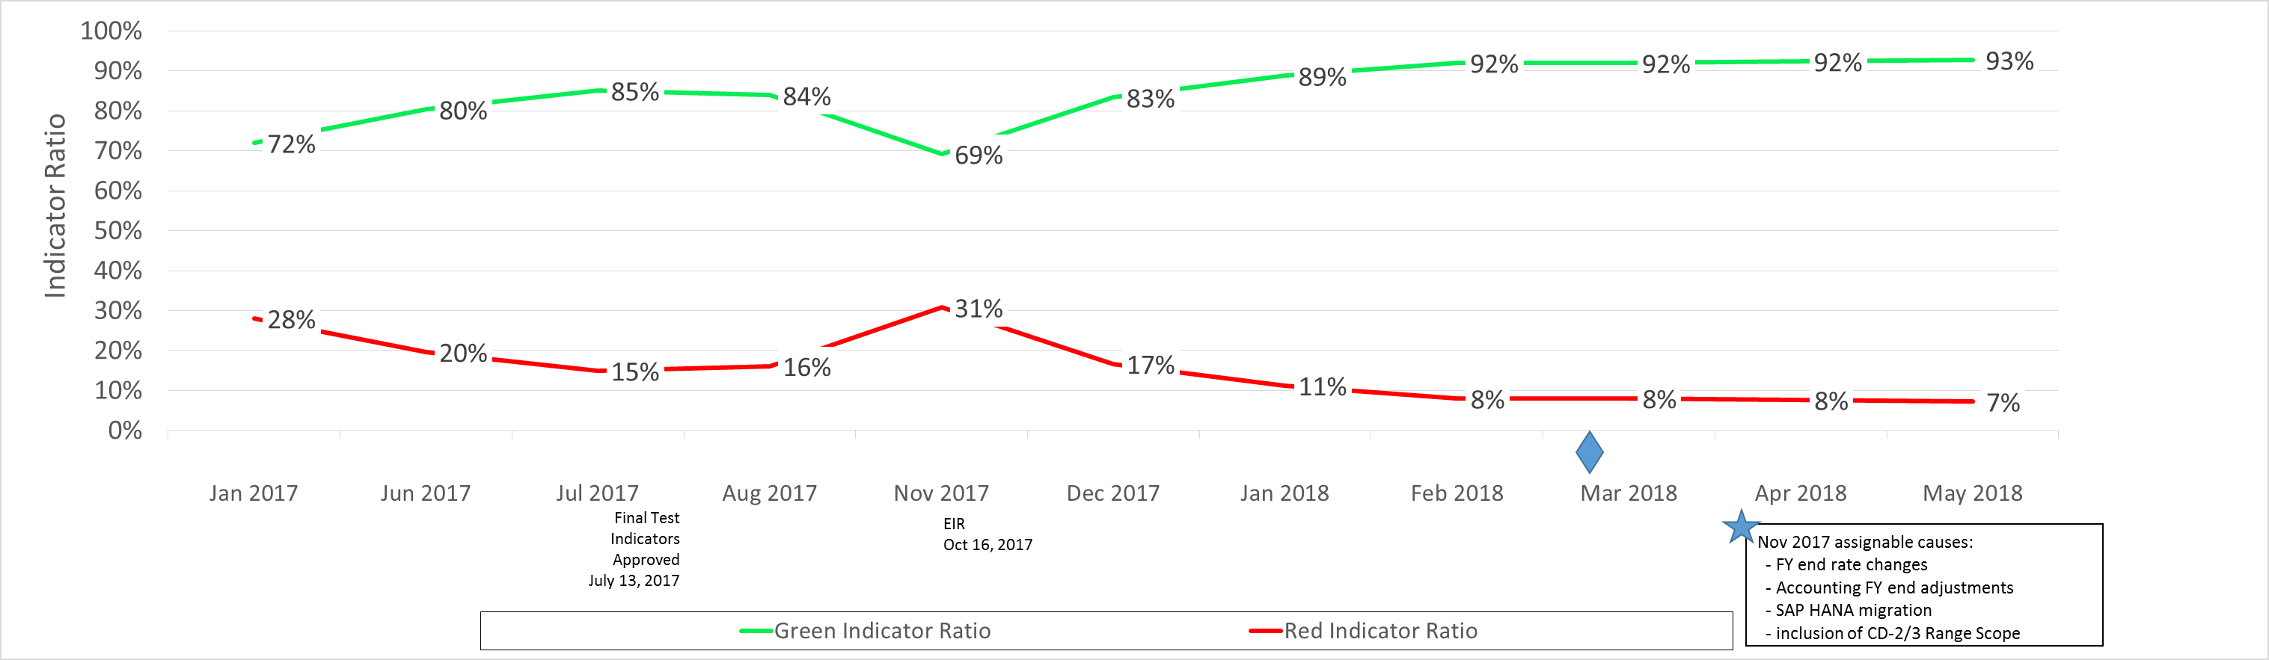
Effective Self-Governance Results
Continuous Improvement!
Notes:
Here we see performance improvements over time when concerns were identified in November by the contractor as a result of a formal Self-Governance program. Immediate action on their part brought this issue under control.

Slide 13
Key Takeaways
Best Practices
Partner with Industry to Improve the Compliance Process
Automate to Max. Extent Possible
Puts Onus on the Contractor; Reduces Government Oversight
Tips & Tricks?
Be patient throughout the improvement process
Be thorough and committed to the continuous improvement process
Engage in collaborative and transparent manner with PM-30
Plan
Do Check Act
Notes:
The key takeaways from this Snippet are that Self-Governance is a best practice which allows the Government to partner with Industry to improve the contractor’s EVMS compliance process. DOE PM has automated the process to the maximum extent possible and has provided 24/7 access to the results via PARS Empower. The process puts the onus of maintaining a compliant EVMS on the contractor which in turn reduces government oversight.
As with any big change, both the contractor and the Government partner needs to be patient while remaining committed to the continuous improvement process.

Slide 14
For additional information, please browse our library at the following Project Management Earned Value Management websites.
External:
https://www.energy.gov/projectmanagement/services-0/earned-value-management
Internal:
https://community.max.gov/display/DOEExternal/
PM+EVM+Guidance
Notes:
For additional information relative to EVMS procedures, templates, helpful references, more Snippets, and training materials, please refer to DOE PM’s external EVM Home page or the internal Max.Gov PM Library. Check back periodically for updated or new information.
Thank You for using the Snippet Library.

