Slide 1

EWAB Public Meeting 6
February 20, 2024
2:00 pm -3:30pm

Slide 2
Meeting 6 Agenda
Report writing updates and current timeline (Pam and Maya)
Subcommittee report-outs, as needed. (Missy)
Brief remarks on the Battery Workforce Initiative (Betony)
Discussion of components of the statute that can be especially strengthened. (Missy)
Public comment section​ (3:10 pm) (Maya)
Looking forward. (Missy)
Closing reflections. (Missy and Maya)

Slide 3
Current plan for report production timeline:
  February 26: Draft shared with EWAB members
    March 4: Members are encouraged to send back feedback, with (hard deadline March 11)
  March 21: DOE shares with Energy Workforce Strategy Council (feedback, not concurrence)
  2nd week of April: DOE team briefs Secretary Granholm.
  Early April: Next public virtual meeting.
  TBD: Draft 2 shared with EWAB members
  TBD: In-person full Board meeting to present final findings to Secretary Granholm.

Slide 4
Subcommittee: Scope Prioritization and Industry Targeting Needs (Targeting)
Subcommittee members:
Girard Melancon (Chair)
Allison Ziogas
Anne McMonigle
Kay Seven
Tom Kriger

Slide 5
Subcommittee Update: Scope Prioritization and Industry Targeting Needs (Targeting)
Recommendation 1: Invest in training and related infrastructure in order to meet energy workforce demands, broaden the talent pipeline, and support upskilling.
Recommendation 2: Facilitate relationships between energy and workforce stakeholders
Recommendation 3: DOE projects and funding opportunities should require meaningful identification and enactment of activities that reduce barriers to the energy sector for historically underrepresented populations. DOE should collect and report data related to efforts to support equitable access to energy careers.

Slide 6
Battery Workforce Initiative
The Battery Workforce Initiative (BWI) is convening a broad group of industry leaders and collaborators to develop nationally accepted training guidelines to support the rapid development of a globally competitive U.S. advanced manufacturing industry. The U.S. Department of Energy (DOE) is sponsoring this initiative, in coordination with the U.S. Department of Labor, Working for America Institute, Li-Bridge alliance, and other organizations. The BWI is designed to strengthen the domestic economy and clean energy supply chains by helping employers meet the increasing demand for skilled workers that has been spurred by private investment in this emerging domestic industry.

Slide 7

Battery Workforce Initiative (BWI)
Betony Jones
Labor Advisor to Secretary Granholm
Director, Office of Energy Jobs

Slide 8
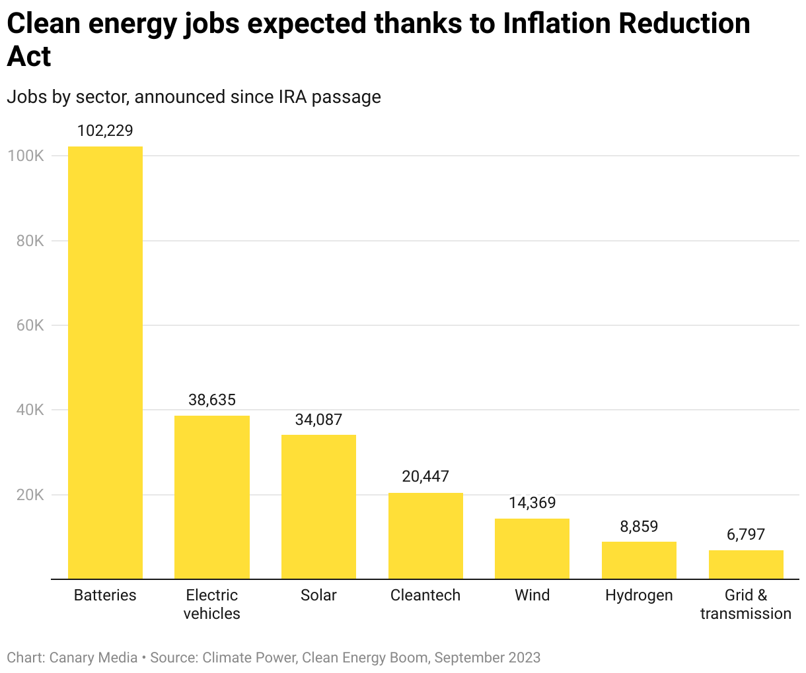
Number of jobs announced in advanced battery manufacturing industry
Notes:
Number of jobs announced in advanced battery manufacturing industry since passage of the IRA are the highest of the clean energy sectors.

Slide 9
Creation of BWI
Challenge
Strategic Solution
Battery manufacturing is projected to grow nearly 20x by 2021 and 2030,* creating unprecedented demand for skilled workers.
In advanced manufacturing, there is no coherent national system for workforce development.
Each employer is on their own, driving excessive competition for skilled workers in the labor market.
Broad collaborative approach to battery workforce development.
Develop national training guidelines leading to industry-recognized credentials.
Unleash workforce funding from the Department of Labor to support the rapid growth of this industry.
Grow the pool of capable workers who have skills that are responsive to the needs of employers.
*Source: DOE’s VTO

Slide 10
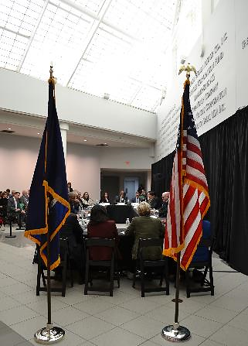
BWI by the Numbers: Industry Consensus
14 months
$5 million
Since kickoff
Commitment by DOE
22 employers
2 dozen+
Engaged (and growing)
Industry roundtables and 1:1 meetings
3 federal agencies
5 community colleges
Working in partnership
Visited or consulted

Slide 11





















Slide 12
Content of the Job Training Program Guidelines and Testing
Curricula: classroom lessons and on-the-job training guidelines
Pilots and validation: testing at 3-5 employers to confirm effectiveness
Job task analysis: skills and knowledge requirements for each occupation
Notes:
Job Book. The data on skills and knowledge will be used to prepare a Job Book consisting of the skill requirements grouped by competencies to enable mentors to direct and document the shop floor skills obtained by training program participants. This volume will include instructions for its usage, specific duties and tasks to achieve competencies, and a checklist enabling mentors to verify skill acquisition for the occupations of machine operator/production operator and machine repair technician.
Training Materials. In 2024 the BWI will produce a version of the Job Training Program Guidelines that is structured according to the outline and is expected to include PPT slides to convey necessary knowledge and other materials (e.g. videos showing how particular machined operate) be used by instructors and mentors.
Pilots and Validation. The draft version of the JTPG will be used by the BWI and contractors to oversee 3-5 “pilot projects” to test the materials in real world, advanced battery manufacturing factories. The effectiveness of the JTPG will be validated and the findings used to produce a final product that will be circulated widely in cooperation with the US Department of Labor and educational institutions such as community colleges.
The AFL-CIO Working For America Institute’s Industrial Manufacturing Technician (IMT) Apprenticeship Training Guidelines represents a model of the sort of Job Book to emerge from the BWI. A copy of the volume is available online at: https://www.imtapprenticeship.org/system/files/imt_job-book_final_020917.pdf .

Slide 13
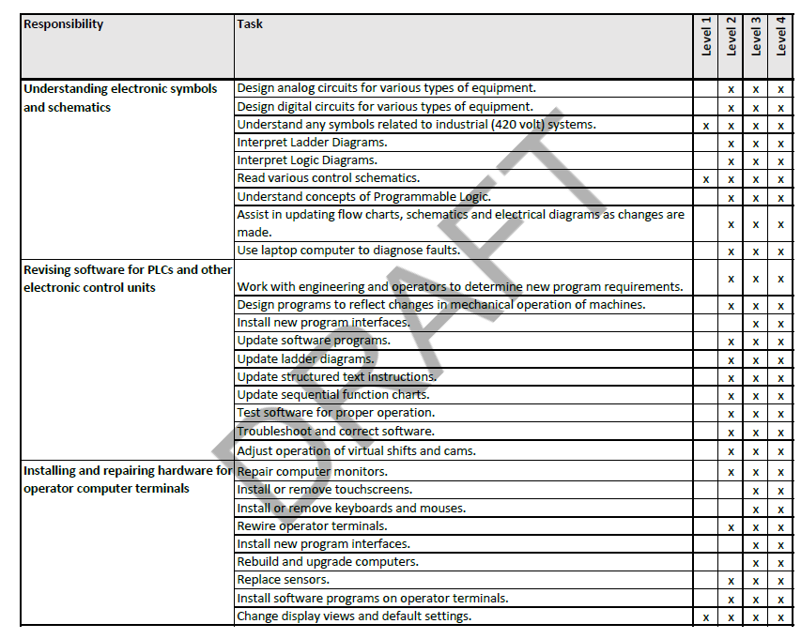
Job Task Analysis
Notes:
Structure and Resources. With funding from the US Department of Energy (DOE), and guidance from the DOE’s Office of Energy Jobs and the National Energy Technology Laboratory, the BWI raised adequate funding, hired experienced contractors and sub-contractors, and formed a Project Implementation Team to oversee it activities.
Industry-Driven Research. Consulting with those with a stake in the clean energy economy, the BWI gathered information from more than 40 employers and unions through roundtable meetings, interviews with company executives, and consultations with labor and workforce development experts. Sources agreed that workers in advanced battery production required a holistic understanding of the cell manufacturing process and the maintenance and repair of complex machinery.
Spreadsheets. The BWI compiled detailed spreadsheets based on a systematic Job Task Analysis (JTA) that lists hundreds of tasks associated with the production of cylindrical, pouch and prismatic batteries. The JTA was conducted in employer factories and included confidential observation of work being performed there. The BWI team conducted an analysis of data on the skills and knowledge required for the occupations machine operator/production operator and machine repair technician.

Slide 14
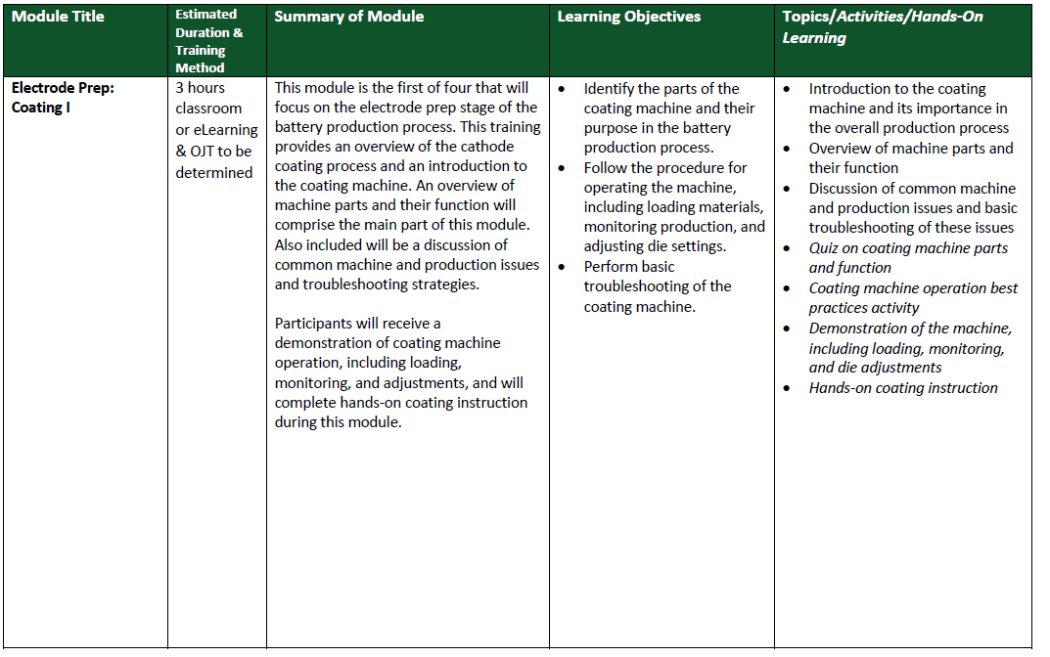
Training Guidelines
Notes:
Job Book. The data on skills and knowledge will be used to prepare a Job Book consisting of the skill requirements grouped by competencies to enable mentors to direct and document the shop floor skills obtained by training program participants. This volume will include instructions for its usage, specific duties and tasks to achieve competencies, and a checklist enabling mentors to verify skill acquisition for the occupations of machine operator/production operator and machine repair technician.
Training Materials. In 2024 the BWI will produce a version of the Job Training Program Guidelines that is structured according to the outline and is expected to include PPT slides to convey necessary knowledge and other materials (e.g. videos showing how particular machined operate) be used by instructors and mentors.
Pilots and Validation. The draft version of the JTPG will be used by the BWI and contractors to oversee 3-5 “pilot projects” to test the materials in real world, advanced battery manufacturing factories. The effectiveness of the JTPG will be validated and the findings used to produce a final product that will be circulated widely in cooperation with the US Department of Labor and educational institutions such as community colleges.
The AFL-CIO Working For America Institute’s Industrial Manufacturing Technician (IMT) Apprenticeship Training Guidelines represents a model of the sort of Job Book to emerge from the BWI. A copy of the volume is available online at: https://www.imtapprenticeship.org/system/files/imt_job-book_final_020917.pdf .

Slide 15
What is Next for BWI!
Establishing a cohort of education providers to use the materials and help refine the instructional approach
  Ask: If you are working with a community college or technical school, send them our way
Recruiting upstream materials suppliers and recycling firms to develop industry workforce standards
  Ask: If your company makes battery-grade materials, please let us know and come to our kickoff webinar
Developing a cell manufacturing safety module
  Ask: If you can contribute material or expertise, please let us know and we'll be in touch

Slide 16

BWI Vision for Industry Sucess
Provide the tools and resources to develop a skilled workforce for a competitive domestic battery industry.
Visit netl.doe.gov/bwi

Slide 17
Delving deeper on key areas of the statute (emphasis added)
In developing the strategy required under subsection (a), the Board shall—
(B) identify ways in which the Department could work with other relevant Federal agencies, States, units of local government, institutions of higher education, labor organizations, Indian Tribes and tribal organizations, and industry in the development of a skilled energy workforce, subject to applicable law;
(C) identify ways in which the Department and National Laboratories can—
(i) increase outreach to minority-serving institutions; and
(ii) make resources available to increase the number of skilled minorities and women trained to go into the energy and energy-related manufacturing sectors;
(iii) increase outreach to displaced and unemployed energy sector workers; and
(iv) make resources available to provide training to displaced and unemployed energy sector workers to reenter the energy workforce; and
(D) (i) identify the energy sectors in greatest need of workforce training; and
  (ii) in consultation with the Secretary of Labor, develop recommendations for the skills necessary to develop a workforce trained to work in those energy sectors.

Slide 18
Combating Barriers to Energy Employment Subcommittee:
Identifying energy sectors in greatest need of workforce training
Recommendation: Evaluate which energy sectors are awarded the greatest number of investments as a metric of job creation and workforce training needs.
Consideration on Skills Needed: Determine which foundational skills are required; do not focus on specialized skills for specific energy positions.
Recommendation: Ensure core skills are part of the national K-12 curriculum as well as technical schools and higher education facilities.
Recommendation: Teaching should be a necessary skill to ensure a successful to transfer of knowledge in succession planning.

Slide 19
Discussion questions
Other responses to these parts of the statute?
What capacities should be built up for National Labs to increase outreach and resources to various populations? Should National Labs do this work directly or fund external organizations to play this function? What are the general observations about National Labs’ role in workforce development?
What are ways to increase outreach to displaced and unemployed energy sector workers? How can the Department leverage activities it already does, such as collaboration with DOL, Interagency Working Group on Coal & Power Plant Communities & Economic Revitalization?
What would be a strategy for the Department to identify the energy sectors in greatest need of workforce training in a long-term, iterative way?
How could the Department work with States, units of local government, institutions of higher education, labor organizations, Indian Tribes and tribal organizations, and industry in the development of a skilled energy workforce?

Slide 20
Sectoral Workforce Development Guiding Discussion Questions
  How should DOE’s sectoral workforce development activities build in a focus on job quality? What are best practices to engage employers in improving job quality in advanced manufacturing?
  Beyond the battery workforce (see Battery Workforce Initiative), what are key energy sub-sectors where you see a need for DOE to facilitate sectoral workforce strategies?
  What ways can DOE in consultation with DOL determine the skills necessary to develop a workforce trained to work in these programs?

Slide 21
Public Comment section
3-minute time limit per speaker.

Slide 22
Discussion questions continued
Board members are encouraged to think about how they want to leverage the statute to continue informing the Department on its energy workforce strategy.
Statute:
Report
(A) In general
Not later than 1 year after the date on which the Board is established under this section, and biennially thereafter until the date on which the Board is terminated under subsection (f), the Board shall submit to the Secretary a report containing, with respect to the strategy required under subsection (a)—
  (i) the findings of the Board; and
  (ii) the proposed energy workforce strategy of the Board.

Slide 23
Future Meetings
Next meeting: Early April (virtual. Look out for email from EWAB to coordinate scheduling)

