Slide 1

EWAB Public Meeting
October 31, 2023
12-1:30pm

Slide 2
Meeting 2 Objectives
Discuss subcommittee and report-writing work plans​
Begin to provide members with an understanding of DOE’s National Labs​.
  “…develop a strategy for the Department that, with respect to the role of the Department in the support and development of a skilled energy workforce… strengthens and engages the workforce training programs of the Department and the National Laboratories in carrying out the Equity in Energy Initiative of the Department and other Department workforce priorities” ​
Continue group discussion of​:
  What are leading observations about DOE’s current strategy to support the development of the energy workforce? Where are there pronounced gaps?​
  What should be an effective role be for DOE to address current and future energy workforce needs?

Slide 3
Meeting 2 Agenda
Member discussion about subcommittees and report.
Presentations and discussions on National Labs​.
Public comment section​ (1:15pm).
Closing reflections from the group.

Slide 4
From the EWAB’s Charter:
Subcommittees
(13) SUBCOMMITTEE(S): To facilitate the functioning of the Advisory Board, subcommittees may be formed with DOE approval. In consultation with DOE, EWAB may establish subcommittees which may include ad hoc groups and technical advisory groups, as it considers necessary for the performance of its functions. The objectives of the subcommittees are to make recommendations to the full Advisory Board with respect to particular matters related to the responsibilities of the full Advisory Board. All subcommittees must report back to the full Advisory Board for full deliberation and discussion and may not work independently of the chartered advisory board. Subcommittees have no authority to make decisions on behalf of the parent Advisory Board, EWAB, and may not report directly to the Office of Policy or DOE.

Slide 5
Subcommittees Created:
Subcommittee:​ | Scope:​
Combatting Barriers to Energy Employment.​ | Identify common barriers. ​ Assess effectiveness of existing DOE workforce training investments in terms of the provision of financial and non-financial wraparound supports. ​ Support the provision of wraparound support services (e.g. child care, eldercare, transportation, housing, career navigation services, etc.). ​ How to effectively embed these supports and activities in DOE workforce programs and investments.​
Measuring and Addressing Job Quality.​ | How are DOE’s workforce investments currently measuring its job quality outcomes? ​ As it relates to DOE-directed workforce development investments, how is job quality an expectation for applicants? ​ How can DOE leverage existing data to better assess its workforce investments’ job quality impact?​
Scope Prioritization and Industry/Training Needs (Targeting).​ | What sectors and occupations should DOE focus on? How should it forecast this need to support alignment between supply and demand? ​ Where does DOE have a footprint and how can it strategically engage? Geographic differences. ​ What skills? Retraining? Pre-training? What technical needs? How to address the portability and stackability of valued credentials? ​ Retraining people who have been displaced, older workers, younger workers, under-represented and marginalized populations.​
Effectiveness of Existing DOE Programs.​ | What do we know about how DOE supports the energy workforce? Where are there especially pronounced effectiveness gaps? ​ How can DOE leverage its existing capacities and assets (e.g. National Labs)? ​ Big picture strategy on DOE’s role in workforce development? ​ If Congress were to give DOE $1 billion annually for energy workforce development, what would be the most effective use of those funds? Should the funds go to a central workforce/jobs office or to each individual program or technology office? How should those funds be distributed? To whom? For what? Who should be the target beneficiaries?​

Slide 6
Report Plan
Key part of statute​ | Designated subcommittee that is primarily responsible​
​(1). meets the current and future industry and labor needs of the energy sector; | Scope Prioritization and Industry/Training Needs (Targeting) Subcommittee​
(2). provides opportunities for students to become qualified for placement in traditional energy sector and emerging energy sector jobs;​ | Scope Prioritization and Industry/Training Needs (Targeting) Subcommittee​
(3). identifies areas in which the Department can effectively utilize technical expertise to support the workforce activities of other Federal agencies; | Scope Prioritization and Industry/Training Needs (Targeting) Subcommittee​ Effectiveness of existing DOE programs Subcommittee
(4). strengthens and engages the workforce training programs of the Department and the National Laboratories in carrying out the Equity in Energy Initiative of the Department and other Department workforce priorities; | Effectiveness of existing DOE programs Subcommittee
(5). develops plans to support and retrain displaced and unemployed energy sector workers; and | Combatting Barriers to Energy Employment Subcommittee
(6) prioritizes education and job training for underrepresented groups, including racial and ethnic minorities, Indian Tribes, women, veterans, and socioeconomically disadvantaged individuals. | Combatting Barriers to Energy Employment Subcommittee

Slide 7
In developing the strategy to address the objectives listed above, the Advisory Board shall…
A. determine whether there are opportunities to more effectively and efficiently use the capabilities of the Department in the development of a skilled energy workforce;​ | Effectiveness of Existing DOE Programs Subcommittee​
B. identify ways in which the Department could work with other relevant Federal agencies, States, units of local government, institutions of higher education, labor organizations, Indian Tribes and tribal organizations, and industry in the development of a skilled energy workforce, subject to applicable law;​ | Scope Prioritization and Industry/Training Needs (Targeting) Subcommittee​
C. identify ways in which the Department and National Laboratories can—​ increase outreach to minority-serving institutions; and​ make resources available to increase the number of skilled minorities and women trained to go into the energy and energy-related manufacturing sectors; increase outreach to displaced and unemployed energy sector workers; and​ make resources available to provide training to displaced and unemployed energy sector workers to reenter the energy workforce; and | Combatting Barriers to Energy Employment Subcommittee​
D. The Advisory Board shall also:​ identify the energy sectors in greatest need of workforce training; and​ in consultation with the Secretary of Labor, develop recommendations for the skills necessary to develop a workforce trained to work in those energy sectors. | Scope Prioritization and Industry/Training Needs (Targeting) Subcommittee​
Additionally, in developing the required strategy, the Advisory Board shall analyze the effectiveness of existing Department-directed support, and existing energy workforce training programs.​ | Effectiveness of Existing DOE Programs Subcommittee​

Slide 8
Report Plan
Gather Foundational Information​
Analyze Information – Develop Findings​
Apply Expertise – Develop Strategy​
Refine Report

Slide 9
Report Timeline
By November 20th​ meeting:
  Subcommittees should come back to the full EWAB ready to report about:​
    Key questions of information that is needed (noting that the Labor Center/DOE may or may not be able to provide this information).​
    The key objectives of their subcommittee.​
  All subcommittees and members should begin compiling/identifying good examples of models that DOE could pursue.​
By December 12th meeting​:
  Subcommittees should report back on findings to key questions and example models.​
By (late) January meeting:​
  Subcommittees should provide draft components of report

Slide 10
Derek Passarelli
Principal Deputy Under Secretary for Science and Innovation,
U.S. Department of Energy

Slide 11


Slide 12
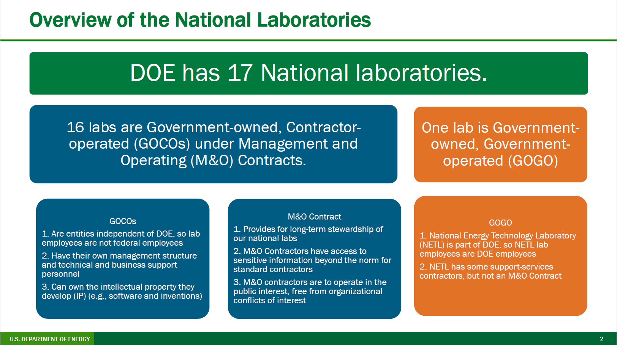

Slide 13
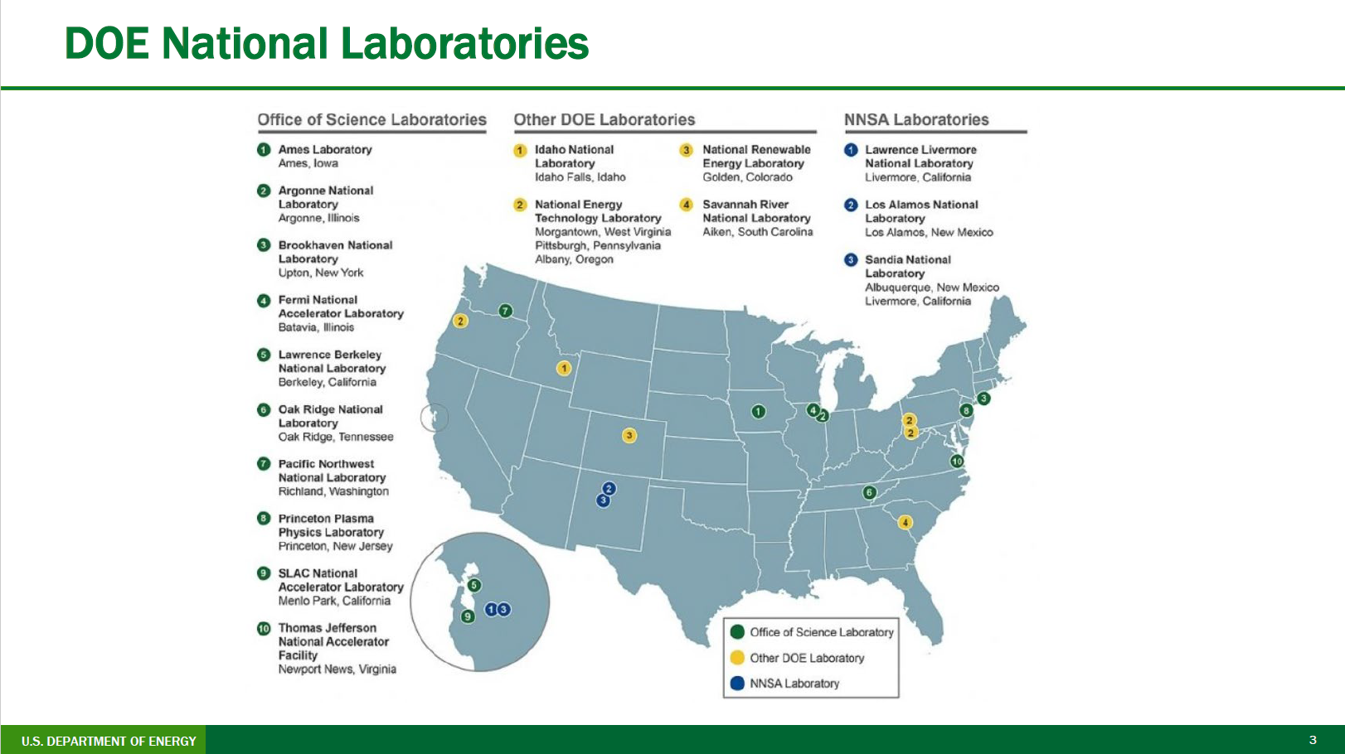

Slide 14
Anthony Armaly
Partnerships Manager & Regional Workforce Initiative Federal Coordinator,
National Energy Technology Laboratory (NETL)

Slide 15

NETL RWFI- Measuring Our Impact - People First
Key Metrics are Levels of Engagement and Outreach
800+
400+
1500+
300+
individual stakeholders
institutions and organizations represented
registrants to the NETL RWFI Webinar Series
subscribed to the NETL RWFI e-Note Monthly Newsletter
Catalyzed over 1M in energy/advanced manufacturing workforce & economic development funding

Slide 16
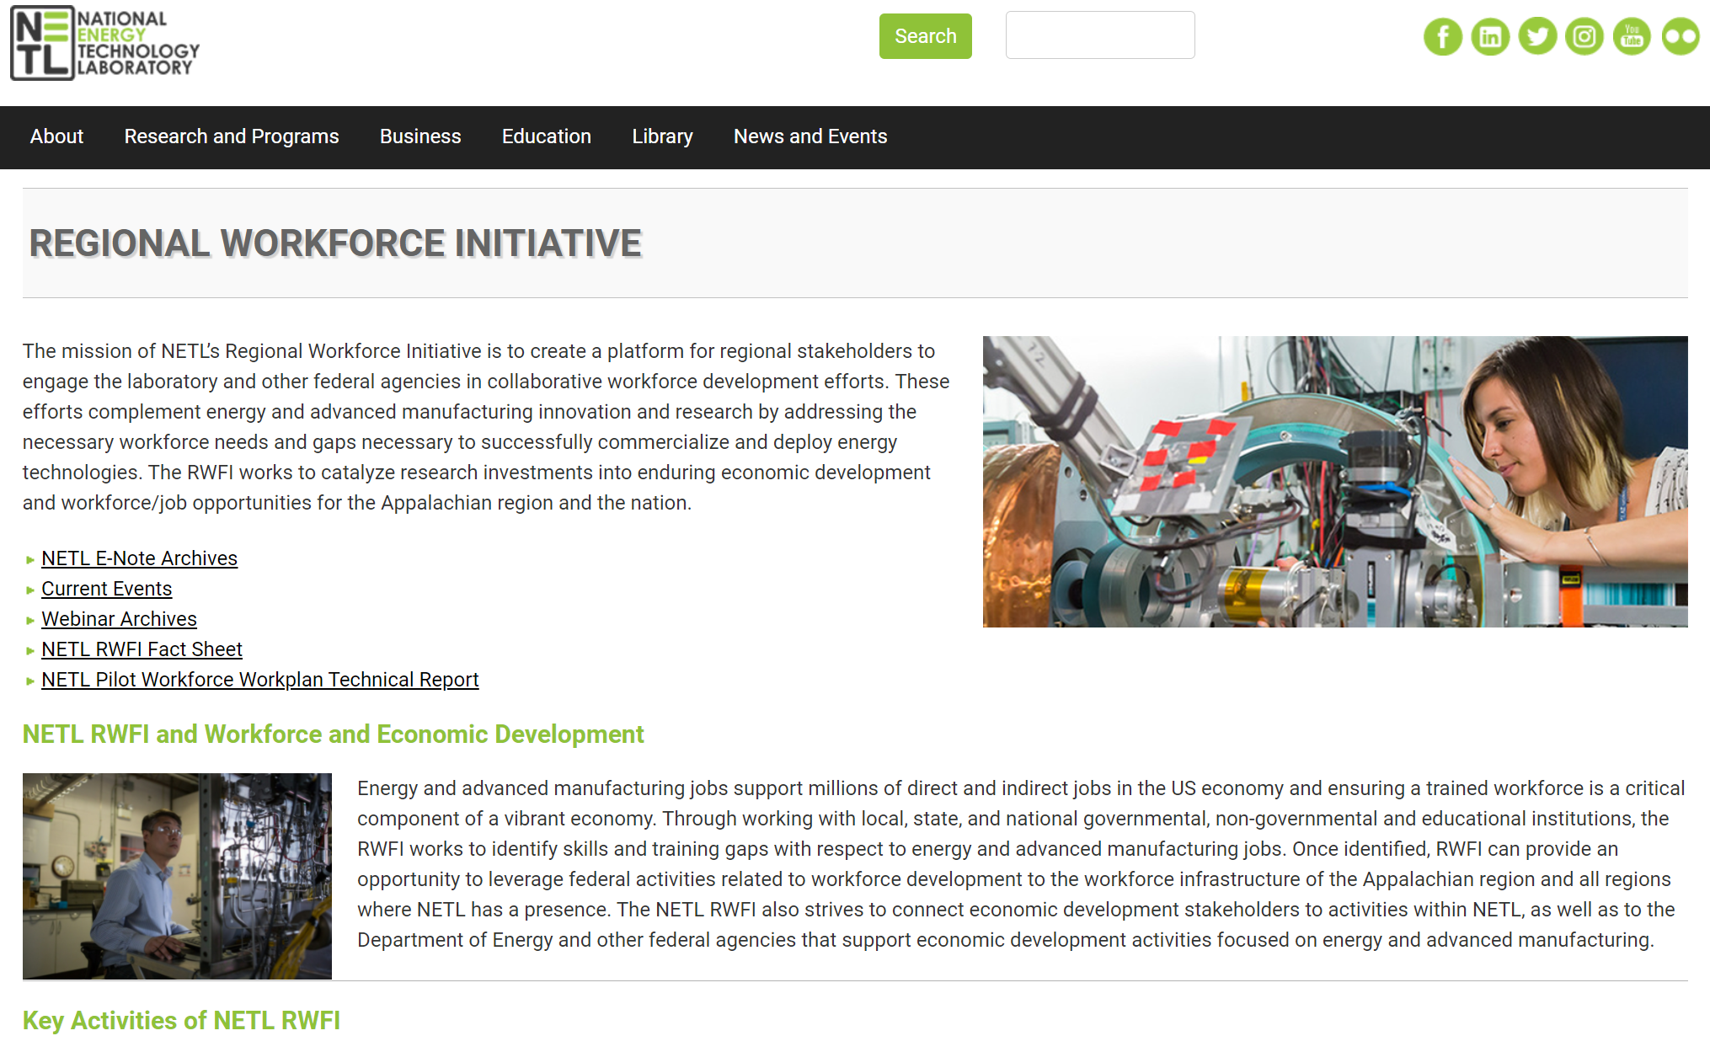
Consistent Engagement & Output
Outreach Tools
Webinars (Energy 101 Series)
Networking (meetings, lab tours, site visits)
E-note (monthly) Webinars Archive
RWFI website and archives
www.netl.doe/gov/rwfi

Slide 17
Examples of collaborative efforts across stakeholder groups
Training/Comm. College Engagement: ARC Adv. Welding Workforce Initiative
Regional Stakeholder Engagement: Regional Adv. Mfg. & Energy Innovation Group (R-AME)→ New focus groups/special topics
Training/University Engagement: Univ. of Pittsburgh Applied Data Driven Methods Grad. Certificate Program (ADDM)
Other National Laboratory Engagement: 2023 TCF- MSI Connect Program with Brookhaven National Lab to improve MSI engagement with labs

Slide 18
NETL RWFI Workforce Readiness Plan
Skills Identification - Pilot Program
Available and accessible training programs
Ongoing or planned collaborations with education and training providers
Identify necessary certifications or other educational attainment involved in technology/activity
Identify Economically Distressed Communities or state or federal designated Opportunity Zones or other geographically defined empowerment zones where this activity may occur
Originated from conversations with stakeholders and through ARC workshop participation (2017-18)
Prevalent questions were:
  What are the occupations needed?
  What skills/education is required for those occupations? “Future casting”
NETL technologies 3-5 years from commercialization
Effort to understand occupations and skills necessary for the present and the future
DOE now requires a statement of job creation on FOAs

Slide 19
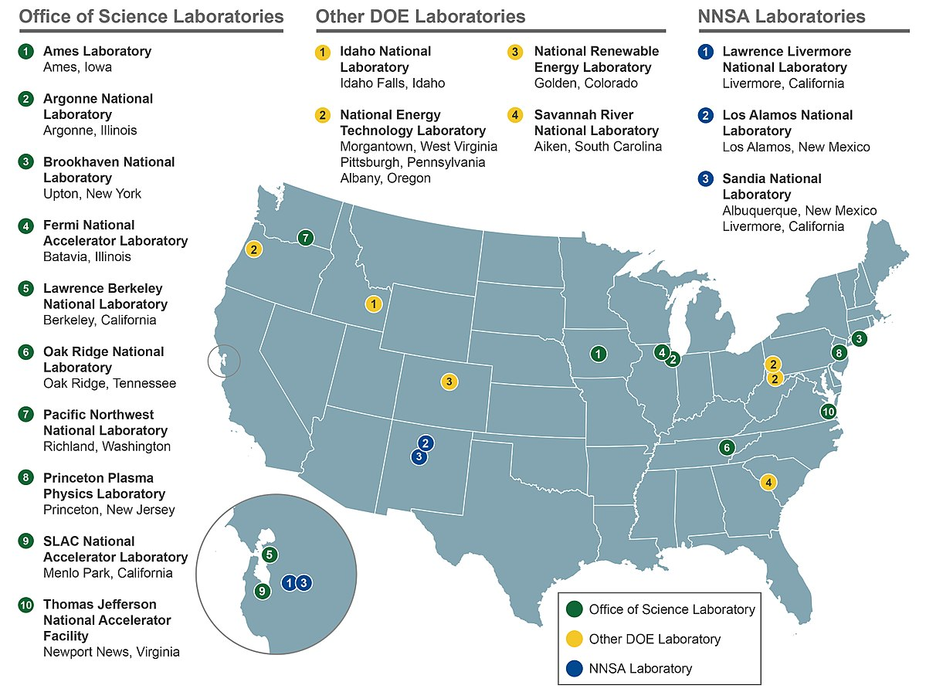
National Labs - Opportunity?
Report Findings: www.netl.doe.gov/rwfi
What if the Workforce Readiness Plan could be implemented at other labs?
Indirect benefits and support of occupations and skills being supported by DOE funding
Clearer picture of future industrial sector needs
More collaborative efforts with NETL and the National Lab Network
Worked with NREL on ML/AI energy workforce skills taxonomy project
Discussions with DOE labs on joint funding opportunities

Slide 20
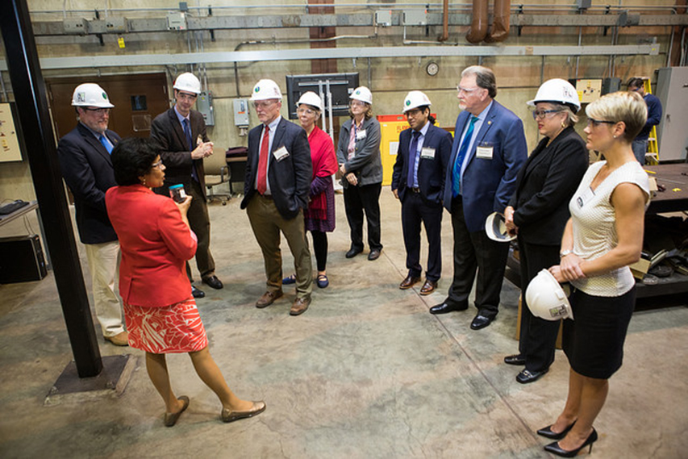
NETL RWFI- Next Steps
Let's Connect, Communicate and Collaborate!
Pursuing external funding with stakeholders for opportunities to amplify our impact
Developing new focus groups regionally around emerging technical areas such as DAC, Hydrogen, Manufacturing, etc.
Continuing to work closer with the other national labs, creating a National Lab community of practice and to be collaborative on commercialization, economic development and workforce projects
www.netl.doe.gov/rwfi
netl.rwfi@netl.doe.gov
Anthony.Armaly@netl.doe.gov
Notes:
Successes
JH Fletcher
Pitt
Catalyst Connection
Agile Additive
Siemens
N91

Slide 21
Elizabeth (Liz) Doris
Director of Joint Institute for Strategic Energy Analysis,
National Renewable Energy Lab (NREL)

Slide 22

Your National Laboratories
and Workforce
Elizabeth Doris
Director, Joint Institute for Strategic Energy Analysis
October 31, 2 23

Slide 23
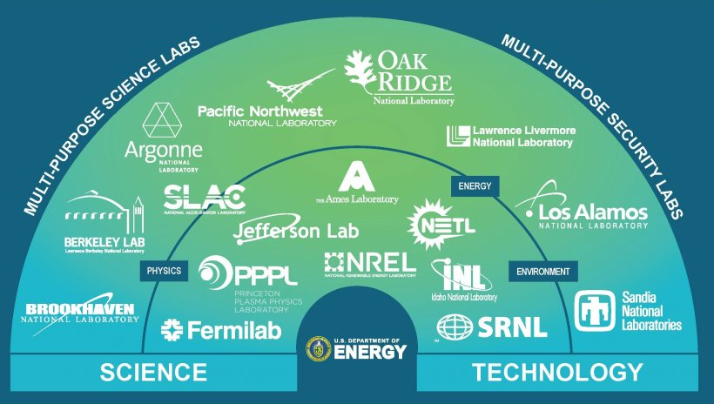
Mission Spaces of National Laboratories
Graphic source and for more information: https://www.energy.gov/laboratory-operations-board
Factsheet: https://nationallabs.org/site/wp-content/uploads/2021/01/DOE-National-Labs-At-A-Glance-Jan-2021-1.pdf

Slide 24
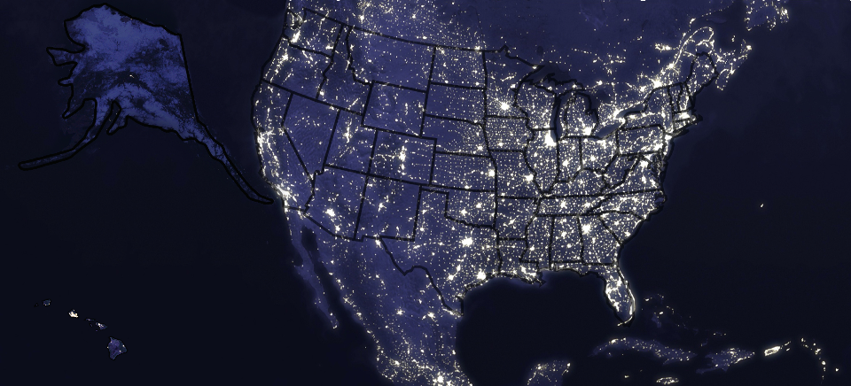
Alaska
Pacific Northwest National Laboratory
National Energy
Technology Laboratory
NREL’s Fairbanks Campus
Ames Laboratory
Argonne National Laboratory
Brookhaven Laboratory
Idaho National Laboratory
Princeton Plasma Physics Laboratory
Lawrence Berkeley National Laboratory
National Energy
Technology Laboratory
SLAC National Accelerator Laboratory
National Renewable Energy Laboratory
Lawrence Livermore National Laboratory
Fermilab
Jefferson Lab
Sandia National Laboratories
Los Alamos National Laboratory
Oak Ridge National Laboratory
Sandia National Laboratories
Savannah River National Laboratory
Hawaii
Coast to Coast
The 17 national laboratories have served as the leading institutions for scientific innovation in the United States for more than 90 years.

Slide 25
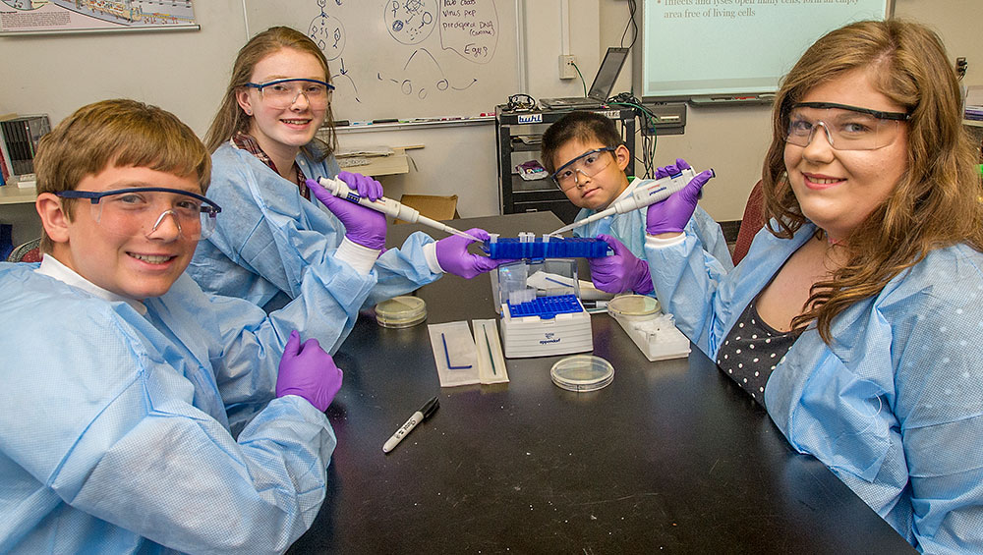
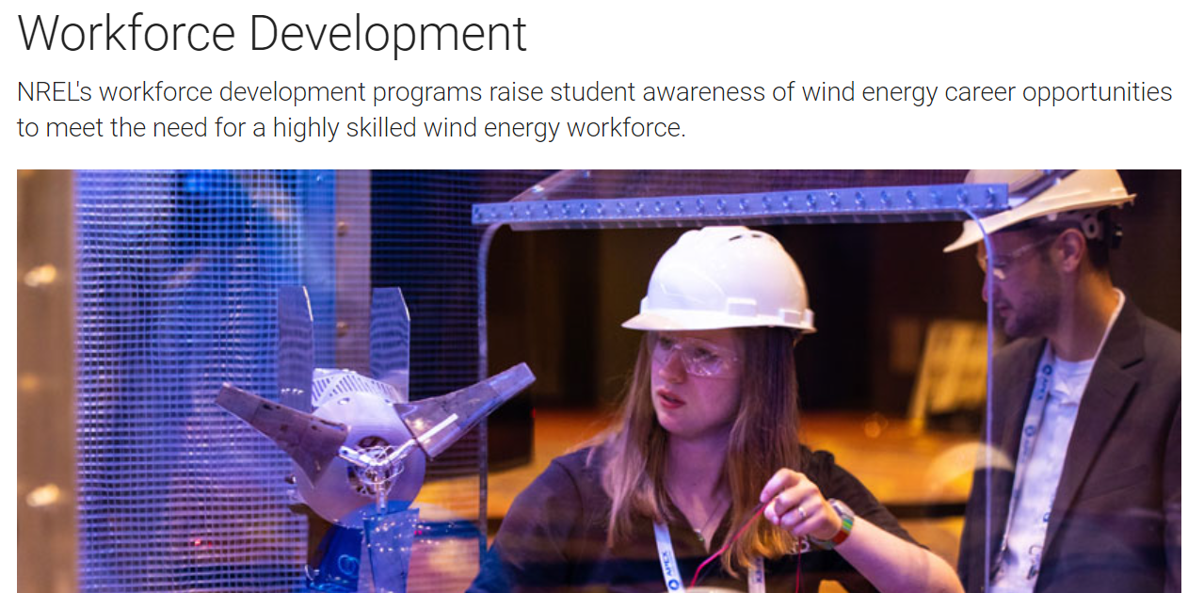
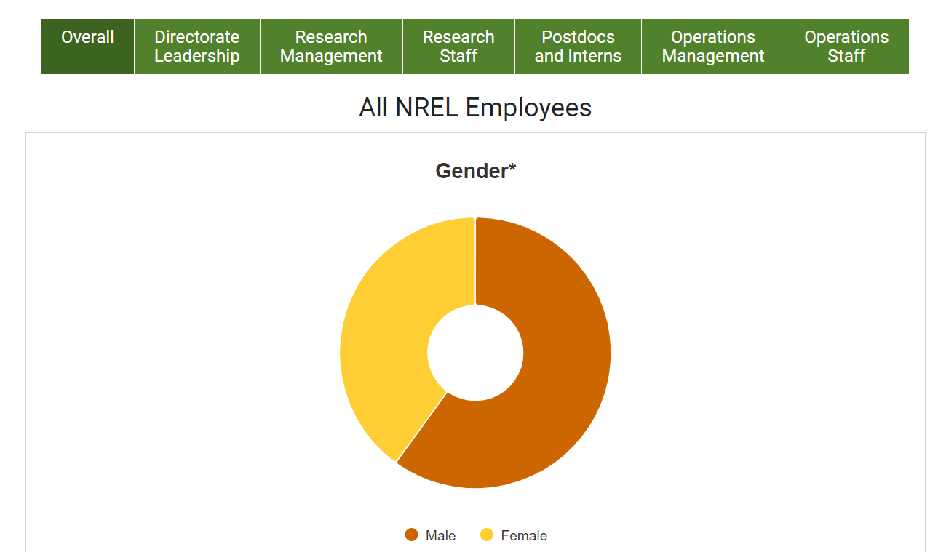
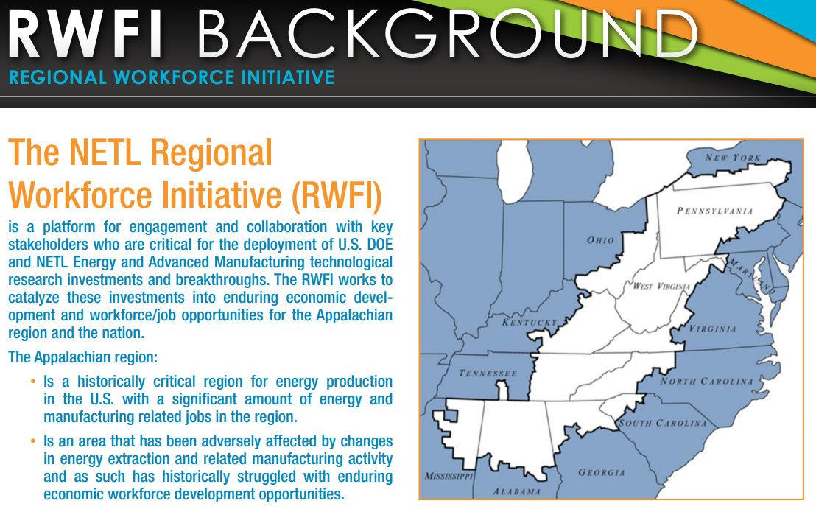








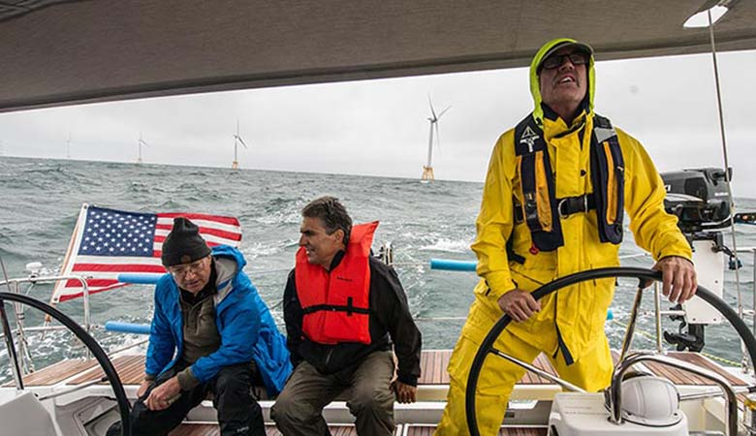
National Laboratory Workforce Framework
Lab Workforce
Pathways: STEM Workforce
Energy Workforce: Research Program
Hiring Practices, retention
K-14 Programming
Summer Teacher Programs
HS and Collegiate Competitions
Workforce American Made Program
Regional Workforce Development Efforts
Training: Internships, post-doctoral, Fellowships, Trade Apprenticeship Programs
Workforce Analysis
Nuclear Workforce Training
Diversity, Equity, and Inclusion
Workforce Impacts
Program Measurement
Emerging:
Contract workers and priorities
Exploring workforce implications in early stage R&D
America Made Program Implications
Joint Appointments with Universities and academic institutions
Each National Lab has its own programs and goals for workforce development
Practices are shared through the National Laboratory Directors’ Council Workforce, DEI, Communications, Education, and Community Engaged Research Crosscutting Committees

Slide 26
Public Comments

Slide 27
Next Steps
We will follow up with the Subcommittees.
Feel free to reach out to OEJ with questions.

