Slide 1
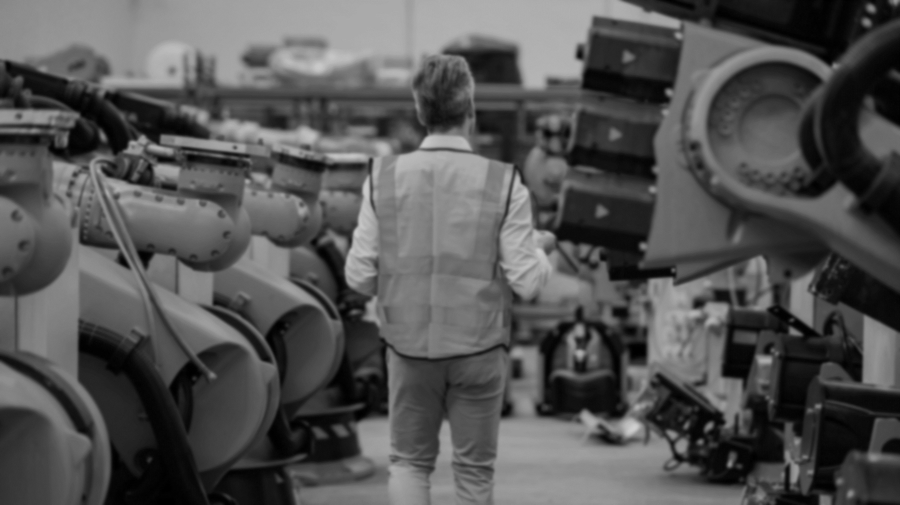



U.S. Department of Energy’s
Office of Manufacturing and Energy Supply Chains (MESC)
MESC is the frontline of clean energy capital deployment to accelerate America’s transition to a resilient, equitable energy future via $20B+ of direct investment in manufacturing capacity and workforce
Workforce Investing
Develop a skilled, diverse workforce by funding cutting-edge energy manufacturing training and advancement
Industrial Assessment Centers expansion
EV conversion workforce
Heat pump workforce development
Manufacturing Investing
Secure supply chains to modernize the nation's energy infrastructure and support an equitable energy transition
Battery/EV Manufacturing, Materials, & Recycling
48C investment tax credits
Advanced Energy Manufacturing & Recycling
Supply Chain Analytics
Build models to support DOE strategy and investments, and collaboration with industry
Supply chain vulnerability modeling
Industrial tech investment analysis

Slide 2
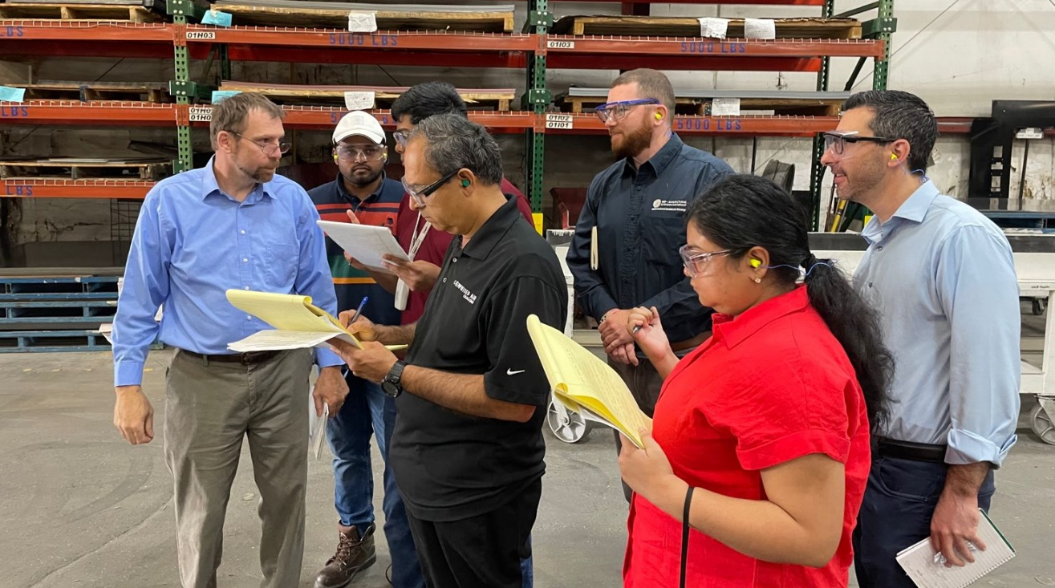
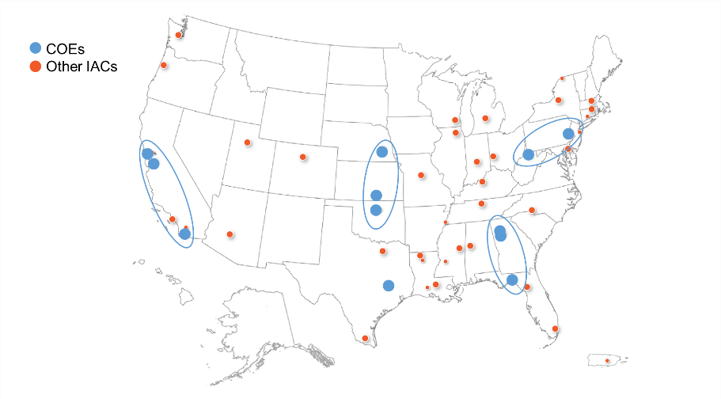
The Industrial Assessment Centers comprise MESC’s primary workforce program
Annually-funded “Traditional” IAC program
37 university-based IACs provide hands-on energy management training for engineers and no-cost TA to small & midsize manufacturers
IACs have conducted ~21k assessments in ~45 years, typically identifying more than $150k/year in savings opportunities per client
Graduates are 2.5x more likely to work in energy than their academic peers
$550M BIL-funded IAC expansion
5 Regional Centers of Excellence (COE) to accelerate innovation, spur collaboration, and expand outreach
New IACs at community colleges, trade/technical schools, and labor-management programs
New non-BA pathways (e.g., machinist, HVAC technician, welder, industrial mechanic) – feedback/ideas welcome!
Apprenticeships and upskilling/continuing education
Grants to manufacturers to act on IAC recommendations

Slide 3


MESC’s battery and EV investments, and a major tax credit program, also incorporate and help drive significant workforce activities
BIL 40207 and IRA 50143: Battery and EV Manufacturing, Conversion, and Recycling
$6B for a viable North American battery supply chain, incl. critical materials; $3.5B Round 2 soon
$2B to convert domestic manufacturing to support EV production, with emphasis on job retention at similar or higher-wages
MESC also chairs the Federal Consortium for Advanced Batteries, including its Workforce Task Group collaborating with the National Advanced Battery Workforce Council
Qualifying Advanced Energy Project Credit (48C) Program
$10B competitive investment tax credit funded by the Inflation Reduction Act
Supports projects related to clean energy manufacturing/recycling, critical materials, and industrial greenhouse gas emissions reductions
6% credit, quintupling to 30% if prevailing wage and apprenticeship requirements are met
40% of credits targeted to coal communities
$4B under review now; Round 2 is forthcoming

Slide 4
Contact:
Jeremy Avins jeremy.avins@hq.doe.gov

