Slide 1
EERE Solar Energy Technologies Office – Workforce Overview
Over the past 5 tears, SETO’s workforce portfolio has included 30+ awards ($30M) designed to support diverse training programs for a variety of careers in solar energy/related industries. Programs are intended to support solar deployment targets, by helping to meet rapidly growing demand for workers, while creating Quality Jobs and advancing equity goals.
Career Type | Roles
Solar Installation | Entry level installation/construction Electrician/technician Operations and Maintenance (O&M) Business Career Track
Power System Workers | Utility engineers RTO/ISOs Public Utility Commission staff Cyber Security professionals
Adjacent Careers | Architects Firefighters and First Responders Real Estate Regulators/policymakers
Engagement | Training Type
Early Career | K12 Community Colleges Universities Fellowships
Mid-Career | Upskilling Modules Continuing Education
Disadvantaged Communities | Community Based Organizations Mission-driven Programs Pre-apprenticeships On-the-Job Training Wrap around services
Demand Driven
Worker Centric
Equity Focused
Notes:
ANDREW
Thanks Sarah.
So this is our recently released Funding Opportunity Announcement – “Advancing Equity Through Workforce Partnerships”
This is the culmination of a lot of stakeholder outreach and input over the past year or so – and we are really excited about it.
We are looking to support workforce development programs and partnerships that fill an industry need, while improving job quality, and fostering an inclusive workforce.
Total funding is going to be $10M, spread between 8-16 awards, for 2-3 year projects.
As you can see, we just announced this FOA at the end of July. We held a webinar about it on August 4th, walking through the details of the application process and various requirements – but if you missed the webinar, we have copies of the slides and a recording of the webinar on the EERE Exchange Website.
Again, we are really hoping to get a significant response to this, and applications from lots of new organizations and entities that maybe we haven’t always heard from the in the past.
So if you are interested in this, you still have time to apply. But you are going to need to submit a Letter of Intent by September 13th. And the key date for Concept Paper submissions is going to be September 20th.
Next slide

Slide 2

Advancing Equity through Workforce Partnerships FOA
The FOA was published in July 2022 and awards were announced on June 13, 2023
  Projects will advance the goals of the Biden Administration by supporting workforce programs that enable the growth of the solar industry, while fostering an inclusive workforce, improving job quality, and building new partnerships with labor unions.
Total Funding | $13.5M 10M (BIL) $3.5M (FY22)
Number of awards | 12
Award Size | $750K - 1.5M
Award Period | 24-36 months
Topic areas:
  Union-lead Pre-apprenticeship
  Community-led training partnerships
  Clean energy sector partnerships
Notes:
ANDREW
Thanks Sarah.
So this is our recently released Funding Opportunity Announcement – “Advancing Equity Through Workforce Partnerships”
This is the culmination of a lot of stakeholder outreach and input over the past year or so – and we are really excited about it.
We are looking to support workforce development programs and partnerships that fill an industry need, while improving job quality, and fostering an inclusive workforce.
Total funding is going to be $10M, spread between 8-16 awards, for 2-3 year projects.
As you can see, we just announced this FOA at the end of July. We held a webinar about it on August 4th, walking through the details of the application process and various requirements – but if you missed the webinar, we have copies of the slides and a recording of the webinar on the EERE Exchange Website.
Again, we are really hoping to get a significant response to this, and applications from lots of new organizations and entities that maybe we haven’t always heard from the in the past.
So if you are interested in this, you still have time to apply. But you are going to need to submit a Letter of Intent by September 13th. And the key date for Concept Paper submissions is going to be September 20th.
Next slide

Slide 3
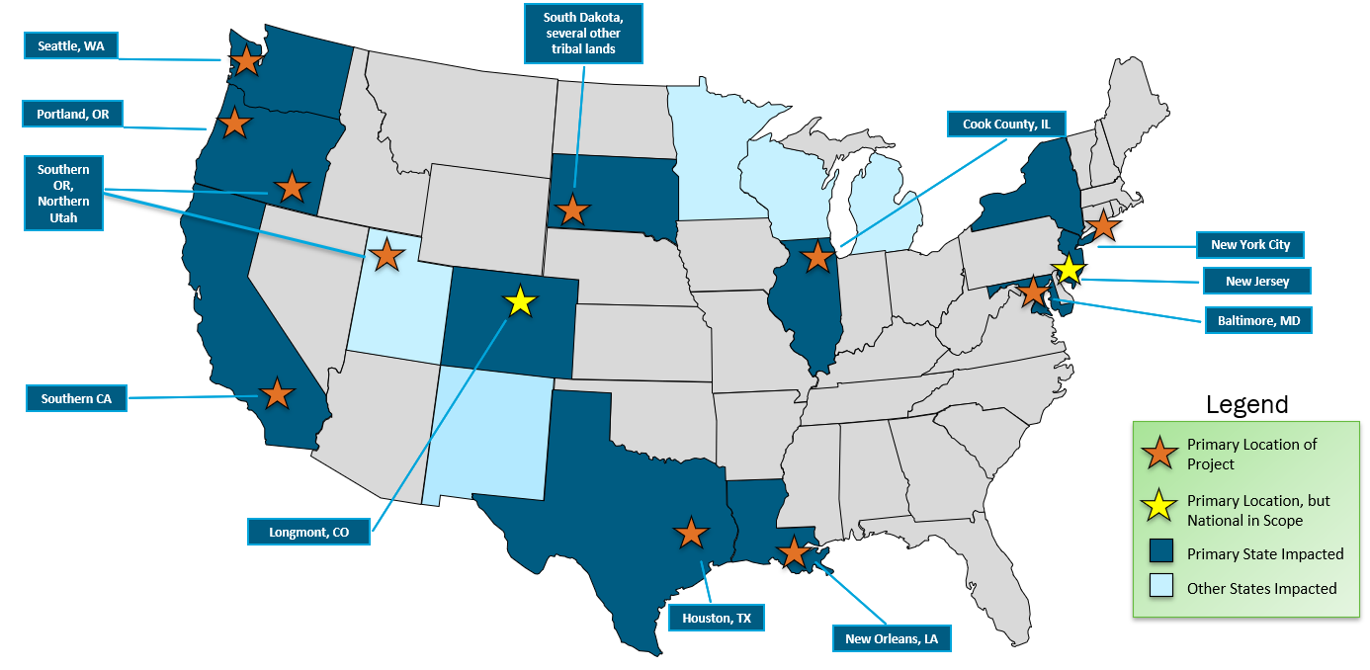
Portfolio of New Workforce Awards
Emerald Cities
Emerald Cities
Solar installer training for entry-level workers and a new union electrical pre-apprenticeship program.
Red Cloud
Solar installation training for Native American woman through a mobile educational unit and hands-on training on the Red Cloud Reservation.
Red Cloud Renewables
Solar ONE
Expands solar curriculum in WF training for CC/K12 programs and provides resources for MWB
Cook County Local Govt
Sector partnership to align diverse stakeholders around an ecosystem to create quality jobs
Work Systems
Work Systems
Regional workforce board creating training and placement resources for installation and related occupations, including union electricians.
Crater Lake JATC
Solar Landscape
Provides short-course solar installation training for community solar arrays for multiple companies in multiple states
Crater Lake JATC
Union pre-apprenticeship program for K12 students in underserved rural and tribal communities, with a mobile educational unit.
Power52
Kern Community College
Power52
Expands a successful partnership model to provide solar training and placement for Opportunity Youth in 3 new locations around Baltimore, MD.
Kern CC
Provides electrical apprenticeship-readiness training, career-track business training, with DEIA-focused outreach.
Amicus O&M
Provides solar O&M training and a new NABCEP certification, and job placement through a network of employers.
Amicus O&M Cooperative
University of Louisiana
Expands statewide solar corp. and creates an open-source curricula for 8 new degree programs at 5 CC and 4 universities across the state.
Adaptive Construction Solutions
Creates pre-apprenticeship programs for employer-sponsored DOL Registered Apprenticeship Programs for the utility-scale solar industry
Adaptive Construction Solutions
University of Louisiana
Notes:
ANDREW
Now to provide a little more details on the FOA and the types of applications we are expecting:
We have these three areas of interest, that represent 3 different types of applications we expect to fund.
The first is apprenticeship or pre-apprenticeship programs. For example, a labor union could apply perhaps in a partnership with an underserved high school or community college, and propose a new recruitment or pre-apprenticeship program focused on creating new pathways for members of disadvantaged communities to get the initial training they need to enter an existing apprenticeship program.
Second would be a community led training program. For example, a community-based organization, local government, or Tribal entity could propose to create, expand, or replicate a successful training program to help create more pathways into various types of jobs in the solar industry.
Then third, we have this idea of clean energy sector partnerships. Here, we are thinking about a larger regional or national non-profit, serving as an intermediary, to bring together all the stakeholders in a particular region, from solar companies, training providers, labor unions, local governments, community colleges, etc. and help create better strategies for coordination and placement, develop ways to really help individuals from these communities navigate the different programs and resources that are out there, and building consensus as to the most effective ways to recruit, support, and connect job seekers with workforce development pathways.
And again, these are just a few example project ideas, we will review and evaluate other applications that propose other innovative strategies that meet the objectives and requirements stated in the FOA.
But for all these different topics, we are really going to be looking for some key elements:
One is multi-stakeholder teams, to the extent possible, really creating new partnerships, and involving employers, training providers, labor unions, non-profits and other groups, working together to figure out the best ways to achieve common goals. We look at this funding, as a way to seed new partnerships that ideally can go on even beyond this award’s period of performance to continue working together on these important challenges.
We want the training programs to be demand-driven, that is we want to see that they are going to training people for the types of jobs that are most in-demand, and the skill sets that employers say are most needed to fill these jobs.
But also, we want programs that are worker centric, that are not focus exclusively on employer needs, but are also oriented around improving job quality, giving trainees multiple types of skills sets so that they can transition between sectors; providing the wrap around services they need to get started in the industry; or looking at stackable credentials, upskilling strategies, and mentoring so employees can pursue upwardly mobile career trajectories.
We want to see projects that leverage existing resources, existing certifications, curriculum, and training resources; but also other existing infrastructure, particularly programs with the Department of Labor, or other local, state, or federal resources and programs.
Like all our projects, we want to see that applicants are proposing ways to start a program is ultimately going to be sustainable beyond the period of performance for this award, or maybe replicated in other parts of the country, so that this funding can have the greatest possible longer term impact.
And then finally, as I’ve mentioned, the goal of the FOA really being built around advancing our equity goals and priorities and creating a more inclusive workforce, and meeting the goals of the Presidents Justice 40 initiative. And so you can see here the different types of communities and individuals that we are looking to support with this program.
So I hope that is a helpful summary. I encourage everyone to fully review and read the FOA document in its entirety, and I do have to point out that the FOA is always the controlling document, in the event of any discrepancies between that and what you’ve heard here today.
Unfortunately, SETO staff isn’t going to be permitted to answer questions about the FOA directly, we have to work through our public Q&A process. So if you have any questions, you can email them to this address – SETO.workforceFOA22@ee.doe.gov – we’ll get your questions answers and post the results of all Q&A to the FOA website on EERE Exchange. And this is just because we want to be very sure that we have a free and open process, and everyone has access to the same information.
Next slide

Slide 4
Contact:
Andrew Graves andrew.graves@ee.doe.gov
Sarah Wilder Sarah.Wilder@ee.doe.gov

Slide 5
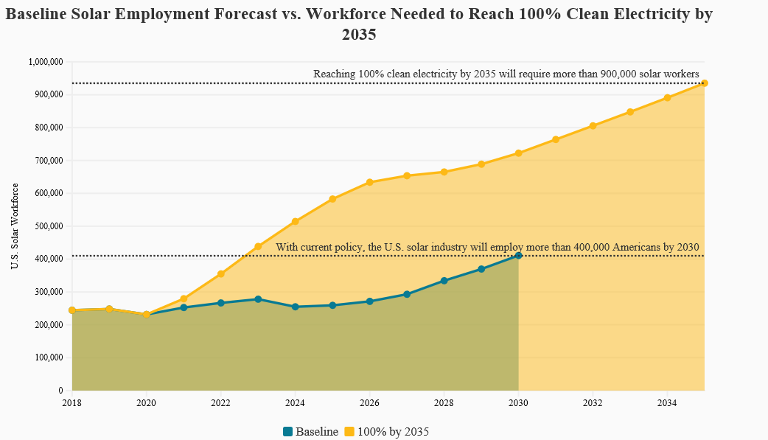
Solar Workforce Needs
In SETO's 2022 Request for Information on the solar workforce, employers reported an urgent need for more workers of all types, but especially for installation jobs and electricians
IRA will further increase demand on labor markets, particularly for skilled trades and apprentices
Source: National Solar Jobs Census 2020, Solar Energy Industries Association, May 2021

Slide 6
Other SETO Workforce Program Activities
Topic | Awardees | Description | Time
Solar Ready Vets | IREC, SunSpec | Multiple training programs and activities to facilitate veteran solar careers | 2016-2026
Grid-training | EPRI, multiple universities | New university courses in power systems engineering and continuing education courses | 2006-2025
First Responders | IAFF, NFPA, IREC | Research and training for firefighters and first responders in fire suppression for solar+storage systems | 2021-2024
Building-Integrated PV | Architectural Solar Association | Online modules and outreach activities to architects on building-integrated PV. | 2021-2024
Minority Serving Institution (MSI) R&D Consortium | University of Arizona | Partnership with MSI to develop new training programs | 2023-2024
Labor Market Analysis | NREL | Analysis on solar labor market and impact on union participation and prevailing wage requirements | 2021-2023
Solar District Cup | NREL | Competition for university students to design campus micro-grids | 2020-2024

