Slide 1
DOE Office of Science
STEM Workforce Development
Meeting of the
September 18, 2023
Dr. Julie Carruthers, Director
julie.carruthers@science.doe.gov
DOE Office of Science (SC), Office of Scientific Workforce Diversity, Equity, and Inclusion
https://science.osti.gov

Slide 2


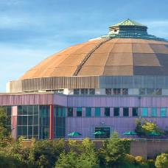
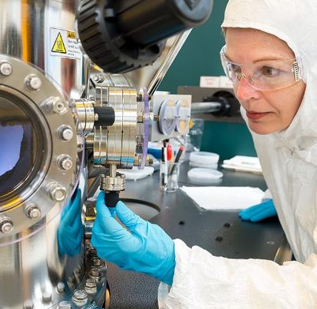
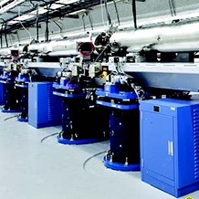

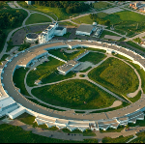
More than 34,000 researchers supported at more than 300 institutions and 17 DOE national laboratories
Our Mission:
Deliver scientific discoveries and major scientific tools to transform our understanding of nature and advance the energy, economic, and national security of the United States.
Steward 10 of the 17 DOE national laboratories
More than 37,000 users of 28 Office of Science scientific user facilities
$8.1B
(FY 23 enacted)
https://science.osti.gov

Slide 3
Overview of SC Workforce Development Investments
SC’s largest contribution to STEM workforce development occurs through the support of undergraduates, graduate students, postdocs, and technical professional on R&D Awards:
Over 4,500 graduate students, 3,400 postdocs supported annually
Targeted Workforce Development through Research awards (all SC mission areas)
Office of Science Early Career Research Program (SC ECRP): supports outstanding scientists during their crucial early career years when many scientists do their most formative work, and to stimulate research careers in the areas supported by SC. ($135M in FY 2023)
Reaching a New Energy Sciences Workforce (RENEW): builds capacity for undergraduate and graduate training, particularly for students at institutions historically underrepresented in the SC portfolio. ($70M in FY 2023)
Funding for Inclusive, Accelerated Research (FAIR): building research capacity, infrastructure, and expertise at Minority Serving Institutions. ($37M in FY 2023)
Visiting Faculty Program (VFP): Supports faculty from underrepresented institutions to build their research capability and strengthen STEM teaching through research collaborations with DOE Lab scientists.
All SC programs are externally evaluated on a periodic basis for effectiveness and impact.

Slide 4
Student Training and Workforce Programs
WDTS Programs leverage the long-standing relationships and capabilities of the DOE National Laboratories, SC supports over 1,400 undergraduates and graduate students each year in paid research experience at the DOE Labs.
Office of Science Graduate Student Research Program (SCGSR) - graduate student thesis research, 3-12 months.
Science Undergraduate Laboratory Internships (SULI) - students from 2-year and 4-year institutions, 10 or 16 weeks.
Community College Internships (CCI) - community college students, 10 or 16 weeks.
RENEW Pathways (targeted projects to broaden participation in STEM fields at the high school and undergraduate level)
Targeted training programs to address workforce development needs not well addressed in academia:
Computational Sciences Graduate Fellowship (ASCR [w/NNSA]) - Supports graduate students obtaining a Ph.D. in high performance computational science and engineering. Requires a DOE lab practicum.
Nuclear Chemistry & Radiochemistry Summer School (BES and NP) - An intensive 6-week undergraduate course. Classroom and laboratory work covers areas of nuclear chemistry and radiochemistry no longer part of university chemistry departments.
U.S. Particle Accelerator School (HEP[lead], BES, and NP) - An intensive 2-week course curriculum for graduate students, postdocs, and DOE laboratory staff, and industry to learn the latest in accelerator and detector research and development. Held 2 times per year.

Slide 5
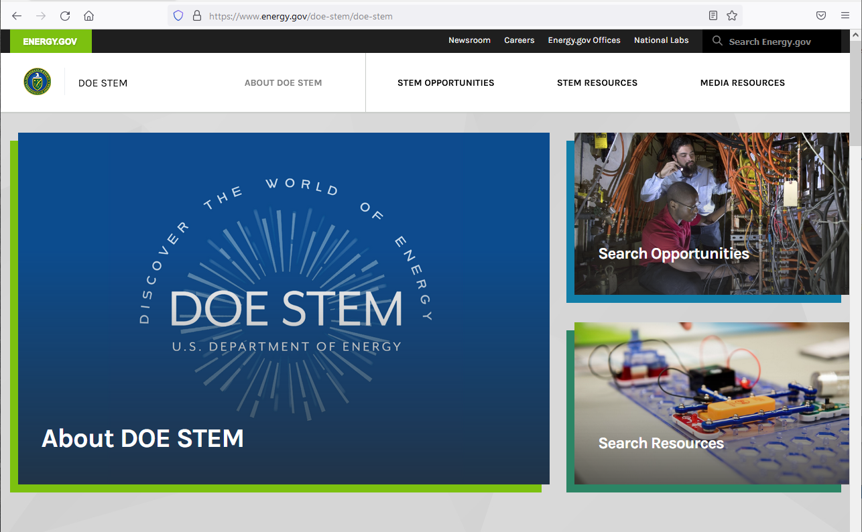
DOE STEM – Discover the World of Energy!
The DOE STEM site is a collaborative effort across all of DOE’s R&D Programs.
For the first time ever, all STEM training opportunities representing all of DOE’s mission areas can be found on a single site.
Searchable list of all DOE STEM training and educational programs.
Funding opportunities for institutions to create STEM training and workforce development programs.
Calendar of Events and Application Deadlines
Searchable list of STEM Resources (free courses/workshops, career maps, materials for the classroom).
Recently launched page focused on Entrepreneurship opportunities.

Slide 6
Additional Background

Slide 7
SC Research Program Offices
Advanced Scientific Computing Research
  Delivering world-leading computational and networking capabilities to extend the frontiers of science and technology
Each SC Research Program Office:
Supports research and scientific facilities
Supports a portfolio of research at universities and DOE laboratories.
Supports targeted workforce development programs.
Competitively awards all research.
Also includes:
The SBIR/STTR Programs Office.
The Office of Workforce Development for Teachers and Scientists (WDTS)
Basic Energy Sciences
  Understanding, predicting, and ultimately controlling matter and energy flow at the electronic, atomic, and molecular levels
Biological and Environmental Research
  Understanding complex biological, earth, and environmental systems
Fusion Energy Sciences
  Building the scientific foundations for a fusion energy source
High Energy Physics
  Understanding how the universe works at its most fundamental level
Nuclear Physics
  Discovering, exploring, and understanding all forms of nuclear matter
Isotope R&D and Production
  Developing and producing critical isotopes for scientific, medical, national security, and industrial applications
Accelerator R&D and Production
  Supporting new technologies for use in SC’s scientific facilities and in commercial products
https://science.osti.gov/Programs

Slide 8
DOE-wide Coordination on STEM Training/Workforce Development
In 2020, DOE established a DOE-wide working group (STEM SETT) that now reports to the Under Secretary for Science and Innovation (S4)
Co-chaired by Office of Science and Office of Nuclear Energy
The primary goal of the working group is to establish enduring mechanisms to foster greater collaboration and coordination across DOE program elements to advance DOE STEM training and education efforts.
To this end, the working group established a DOE STEM Framework planning document, and is now focused on:
Developing a new public presence for DOE STEM, including a new website where all information about DOE’s STEM activities and opportunities can be found. (https://energy.gov/stem)
Developing resources to support areas of mutual interest across programs: 1) advancing DEIA in DOE programs and activities; 2) methods of assessing mission-critical STEM workforce development and training needs; 3) measuring program effectiveness and impact; and 4) collaborative outreach and recruitment.

