Slide 1
Supporting Tribal Energy Sovereignty
Stephanie Bostwick, TCU Coordinator
stephanie.bostwick@hq.doe.gov

Slide 2

Office of Indian Energy Policy and Programs

Slide 3
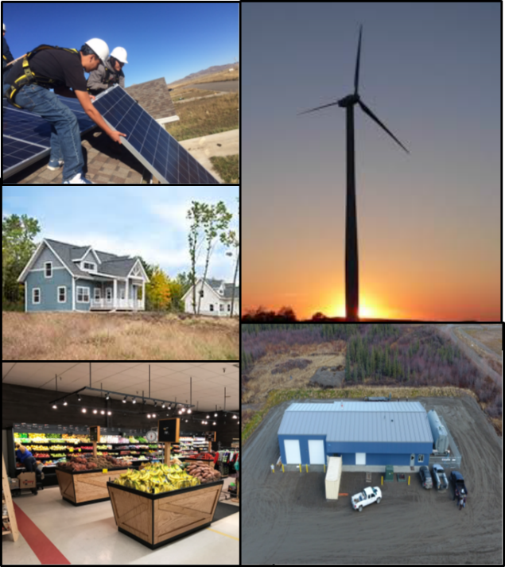
Office of Indian Energy
The DOE Office of Indian Energy is charged by Congress under the Indian Tribal Energy Development and Self Determination Act of 2005 (Title V of the Energy Policy Act of 2005) to “provide, direct, foster, coordinate, and implement energy planning, education, management, conservation, and delivery programs that –
(1) promote Indian tribal energy development, efficiency, and use;
(2) reduce or stabilize energy costs;
(3) enhance and strengthen Indian tribal energy and economic infrastructure relating to natural resource development and electrification; and
(4) bring electrical power and service to Indian land and the homes of tribal members located on Indian lands or acquired, constructed, or improved (in whole or in part) with Federal funds.”
Clockwise from right: Seneca Nation’s (NY) 1.5-MW wind turbine, Sokaogon Chippewa Community (WI) Housing Project, and Chippewa Cree Tribe’s (MT) Residential Solar.
Notes:
--------------------------------------------------------------------------------------------------------------------------------------------------------------
Alternative images notes:
And, we have a few of the projects the office has funded highlighted in the collage to the right. Specifically,
Seneca Nation in New York on the right side, who installed a 1.5 MW wind turbine.
Continuing clockwise, you have the Sokaogon Chippewa Community housing project, and
Finally in the upper left corner, a solar photovoltaic installation on a low-income home on the Rocky Boy Reservation.
Next slide, please.

Slide 4


Office of Indian Energy – TCU funding announcement
Closed July 27, 2023
Clean Energy Project and Curriculum Planning (Topic Area 1) - $100,000-250,000;
-project planning studies/analysis
-curriculum development/updates
and,
(2) Clean Energy Technology and Curriculum Deployment (Topic Area 2) - $250,000-4M.
-solar plus storage, wind energy devices
-training equipment
Awards for 2-4 year periods of performance
(1) Clean Energy Project and Curriculum Planning (Topic Area 1); and, (2) Clean Energy Technology and Curriculum Deployment (Topic Area 2).
(1) Clean Energy Project and Curriculum Planning (Topic Area 1); and, (2) Clean Energy Technology and Curriculum Deployment (Topic Area 2).
(1) Clean Energy Project and Curriculum Planning (Topic Area 1); and, (2) Clean Energy Technology and Curriculum Deployment (Topic Area 2).

Slide 5
Office of Indian Energy – TCU Engagement
Outreach to TCUs regarding FOAs and clean energy needs/education and training needs
Campus visits
listening sessions
2. Workforce Development – Native Energy Workforce Education Consortium (NEWEC)
TCUs working on clean energy workforce training programs
Open-source curriculum with incorporation of TK and language
(1) Clean Energy Project and Curriculum Planning (Topic Area 1); and, (2) Clean Energy Technology and Curriculum Deployment (Topic Area 2).
(1) Clean Energy Project and Curriculum Planning (Topic Area 1); and, (2) Clean Energy Technology and Curriculum Deployment (Topic Area 2).
(1) Clean Energy Project and Curriculum Planning (Topic Area 1); and, (2) Clean Energy Technology and Curriculum Deployment (Topic Area 2).

Slide 6
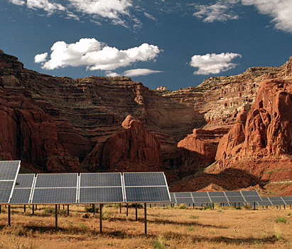


Engage with us to learn more
Office of Indian Energy
(240) 562-1352
indianenergy@hq.doe.gov
energy.gov/indianenergy
Subscribe to get our email updates
energy.gov/indianenergy/contact-us-and-staff
Social Media
facebook.com/DOEIndianEnergy
twitter.com/DOEIndianEnergy

