Slide 1
2020 DOE Sustainability Awards
August 20, 2020
Sustainability Performance Division
U.S. Department of Energy

Slide 2
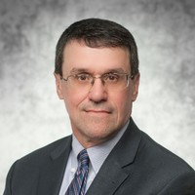
Welcome!
Scott Whiteford
Director, Office of Asset Management

Slide 3
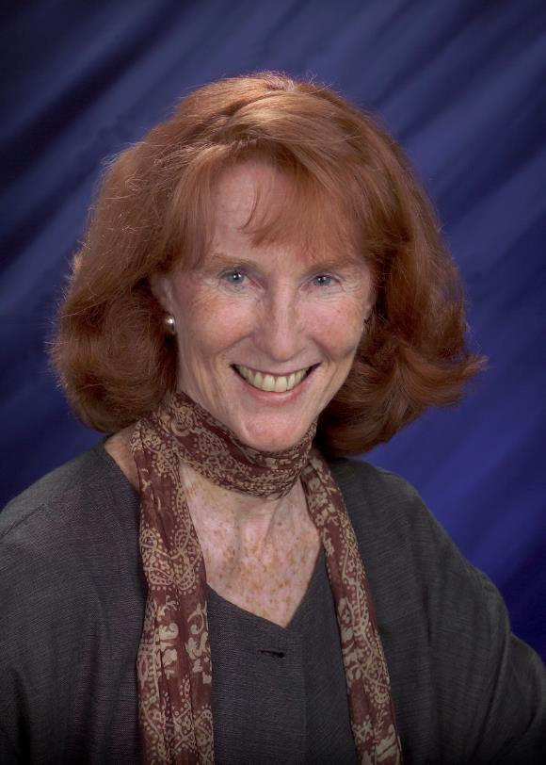
Lifetime Achievement Award
Sandra Cannon
DOE Sustainable Acquisition Program

Slide 4
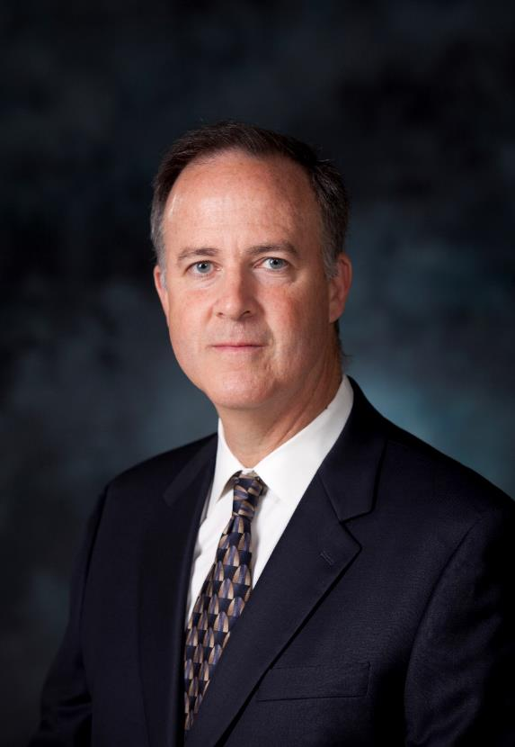
Lifetime Achievement Award
James Donnelly
Y-12 National Security Complex

Slide 5
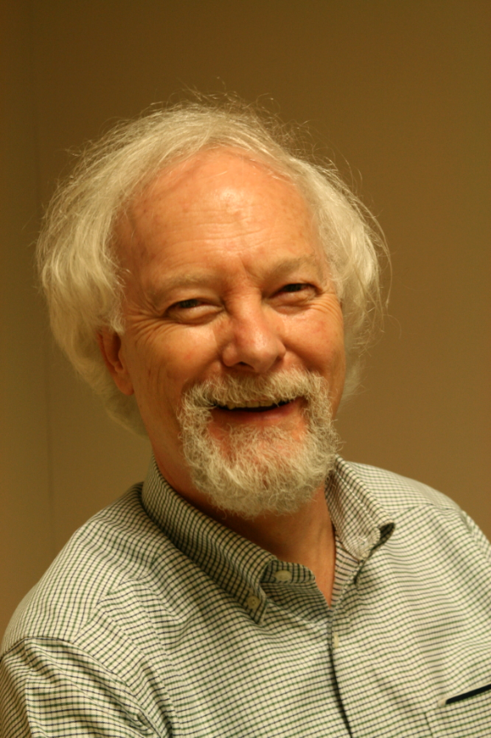
Lifetime Achievement Award
Dale Sartor
Lawrence Berkeley National Laboratory

Slide 6
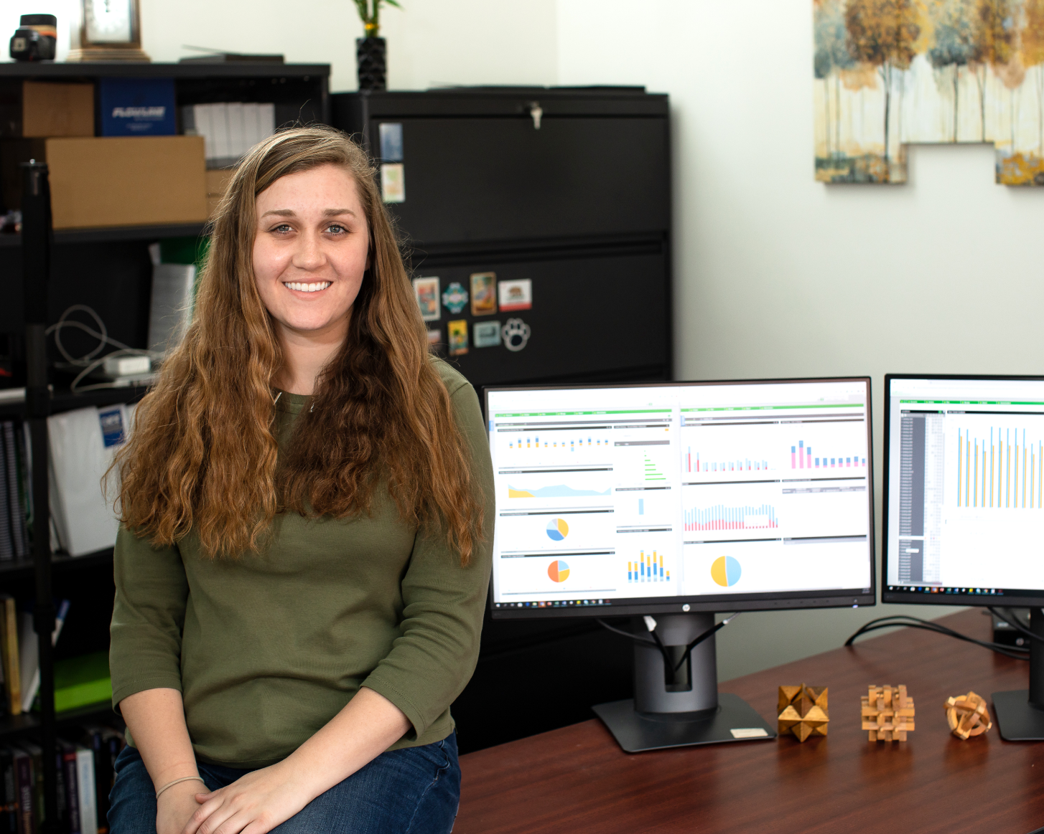
Sustainability Champion
Amy Albaugh
Oak Ridge National Laboratory

Slide 7
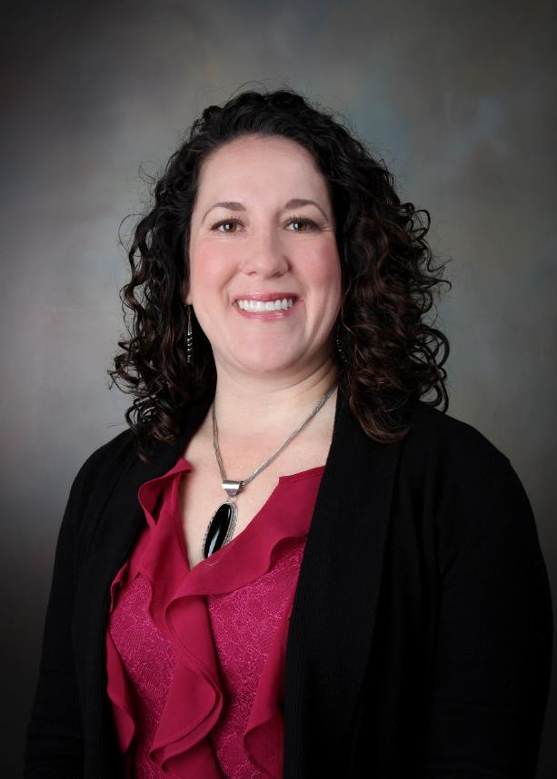
Sustainability Champion
Selina Santiago
Sandia National Laboratories

Slide 8
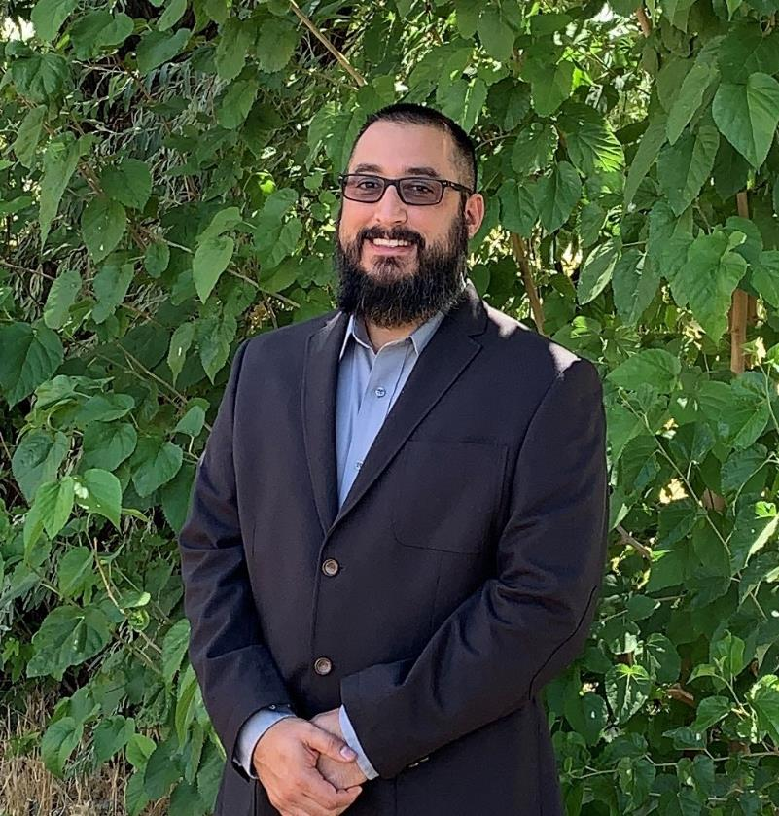
Sustainability Champion – Honorable Mention
Jerry Gallegos
Sandia National Laboratories

Slide 9
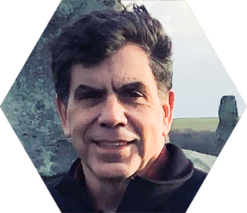
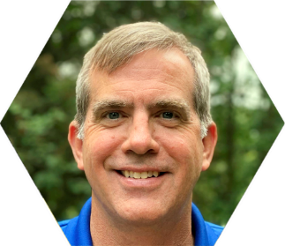
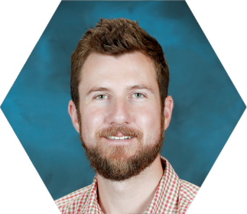
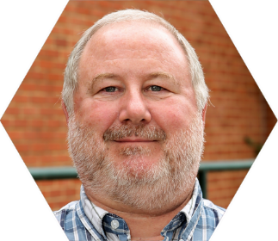
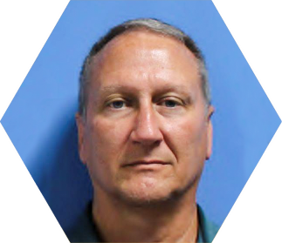
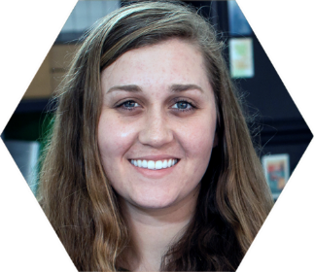
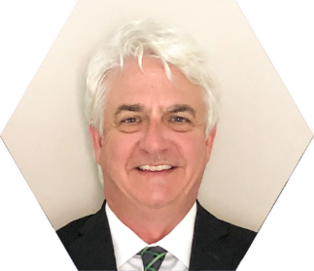
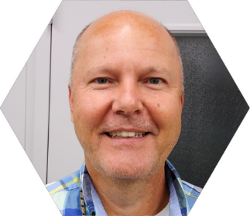
Outstanding Sustainability Program/Project
Oak Ridge National Laboratory’s Water Use Reduction, Facility & Research Cooperation
Project Team (left to right) - Top Row: Rob Crowell, Peter Wiegand, Bryce Hudey, Mike West.
Bottom Row: Darryl Dowling, Amy Albaugh, Dave Bozich, Mark Goins.

Slide 10
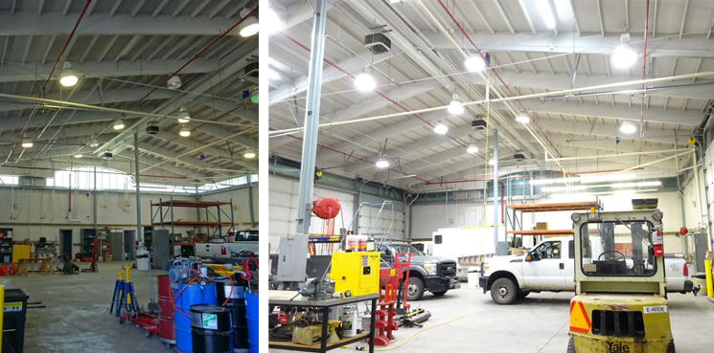
Outstanding Sustainability Program/Project
Bonneville Power Administration’s Utilities Management Program
Project Team: Jennifer Hollenbeck and Jenni Driskill.

Slide 11
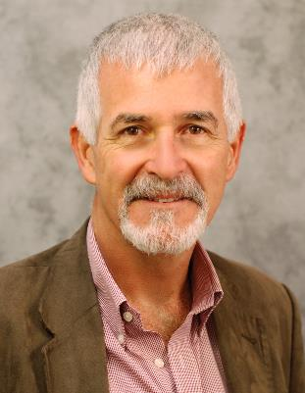
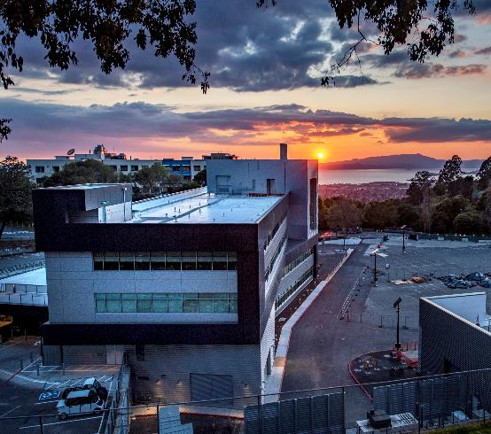
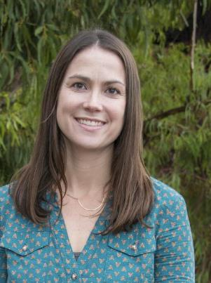
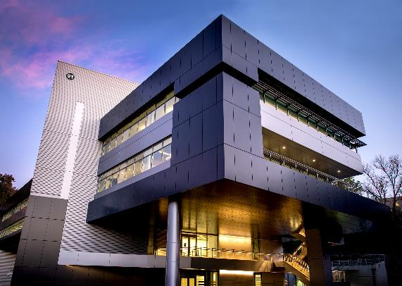
Outstanding Sustainability Program/Project – Honorable Mention
Lawrence Berkeley National Laboratory’s Integrative Genomics Building
Project Team - Top Row: Joe Harkins.
Bottom Row: John Elliott, Deirdre Carter.
Not Pictured: Jack Heffernan, Hemant Patel.

Slide 12
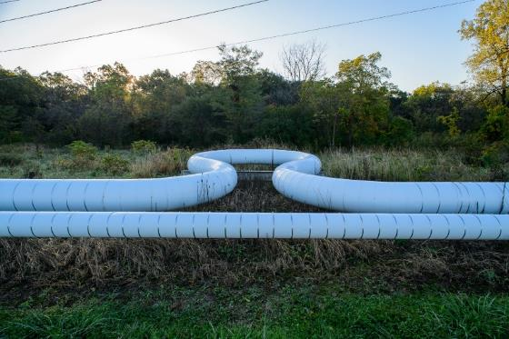
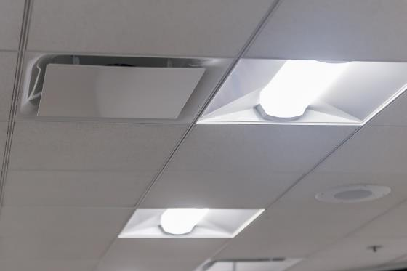

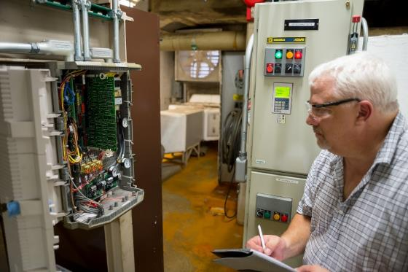
Outstanding Sustainability Program/Project – Honorable Mention
Argonne National Laboratory’s ESPC 1 & 2 Deliver Energy Savings and Efficiency
Project Team: Catherine Hurley, Karen Hellman, John J. Busch, Randall P. Mirabelli, Josh Koons, Christopher Jablonski, George J. Doktorczyk, Edward F. Russell, Ronald L. Tollner, Ron S. Moore, Christine A. Adams, Jurgis Paliulionis, Jug Uppal, James E. McKiernan.

Slide 13
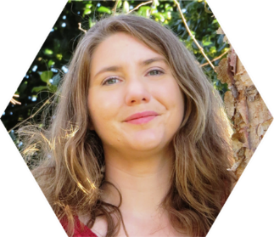
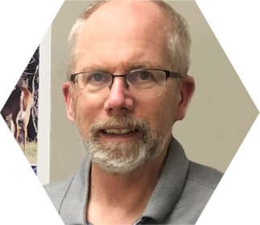
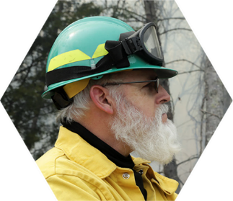
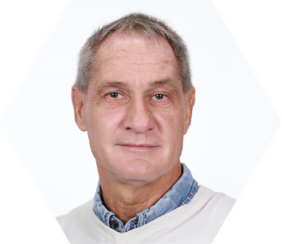
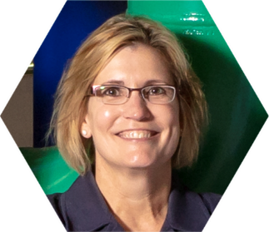
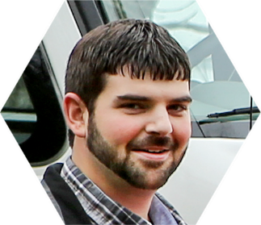
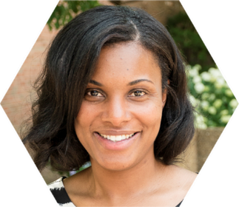
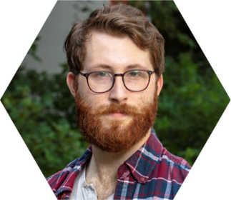
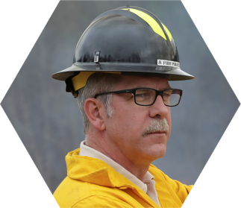
Strategic Partnerships for Sustainability
Oak Ridge National Laboratory’s
Arboretum Accreditation: Wisdom is Stored in Trees
Project Team (left to right) – Top Row: Jamie Herold, Neil Griffin, Greg Byrd, Jimmy Stone, and Melissa Lapsa from ORNL.
Bottom Row: Herman Radke from the ORNL Site Office; Sharon Jean Philippe and Nick Oldham from the University of Tennessee; Bruce Miller from the State of Tennessee.

Slide 14
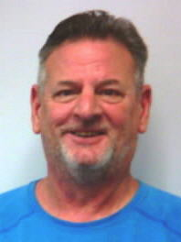
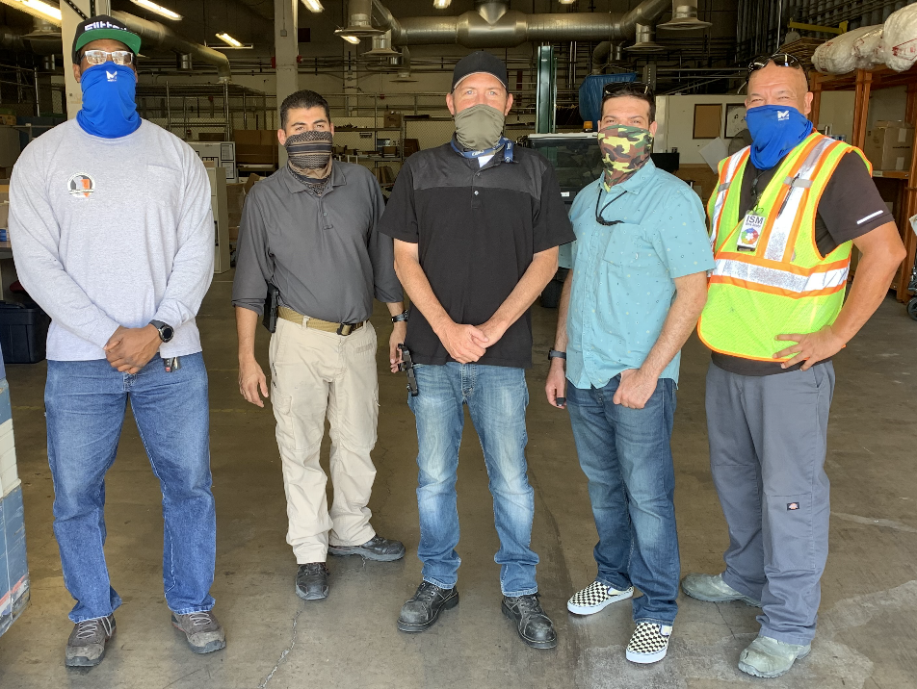
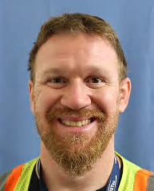
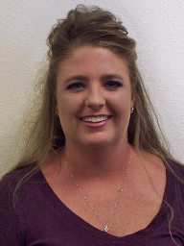
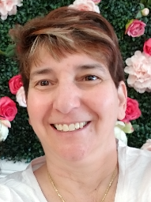
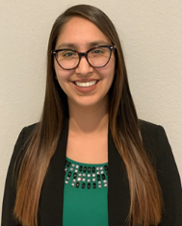
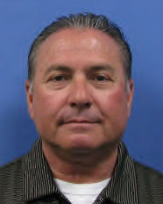
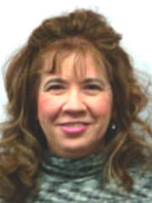
Strategic Partnerships for Sustainability
Nevada National Security Site’s Asset & Material Management E-Recycle
Project Team: Top Row (left to right): Ronald Duplex Sr., Miguel Ramos, Brian Delanty, Christopher Fitapelli, Charles Kandt, Michael Vest.
Middle Row: Amber Gould,
Michele Arcade.
Bottom Row: Erin Sandoval,
Craig Mercadante, Yvette Mason.

Slide 15
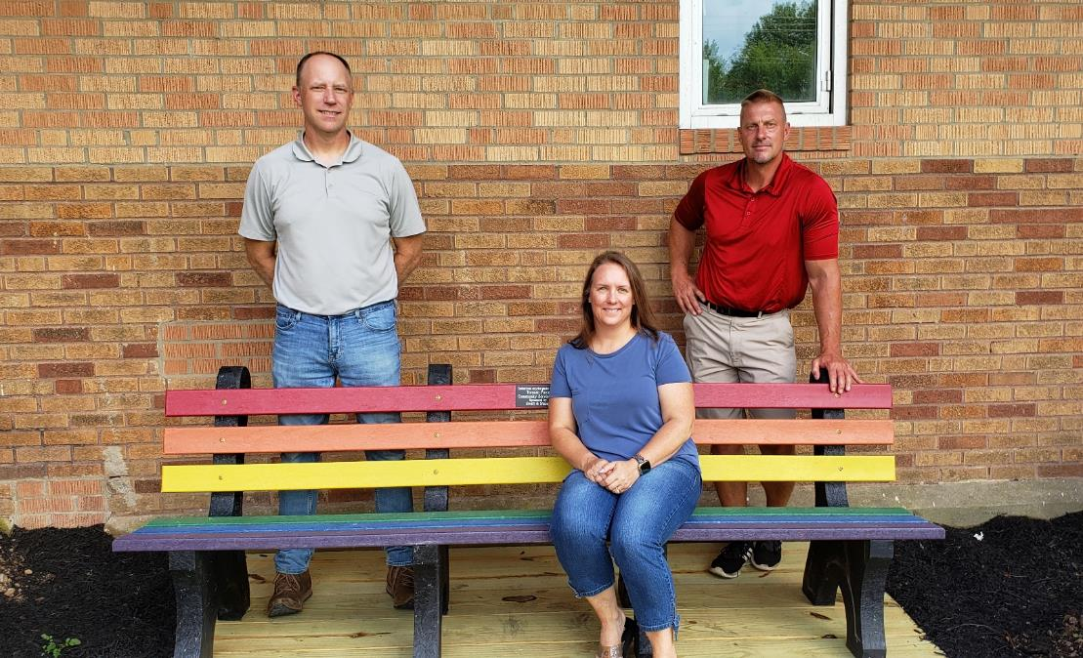
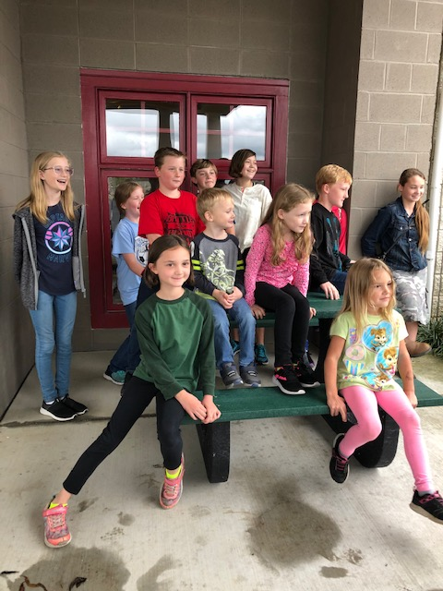
Strategic Partnerships for Sustainability – Honorable Mention
Paducah Gaseous Diffusion Plant’s Plastic Cap Recycling
Project Team (left to right): Mike Golightly, Christa Armstrong, and Morgan Elementary Principal Dr. Mark Fenske are shown with the 8 ft. bench placed in the specially prepared garden area in front of the school.
Members of the 4Rivers 4-H Homeschool Club with the 4 ft. Picnic Table to be placed at the new Easter Seals Senior Center.

Slide 16
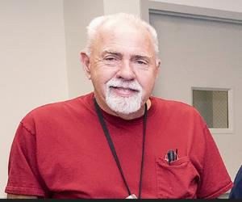
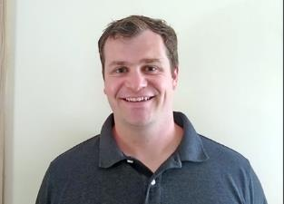

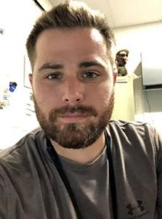
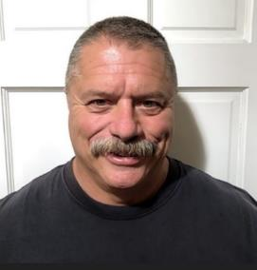
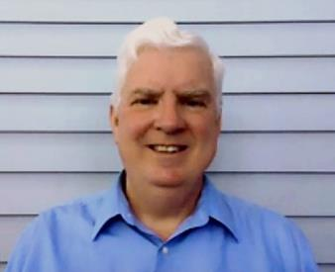
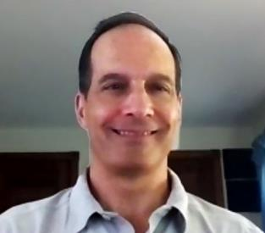
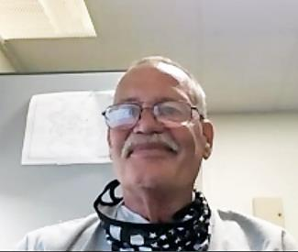
Innovative Approach to Sustainability
Princeton Plasma Physics Laboratory’s PAA: Alternative to Chlorine as a Biocide
Project Team (left to right) - Top Row: Tom Ward, Mark Hughes, Chuck Herbert.
Middle Row: Jason Niatas, Brett Hudnett.
Bottom Row: Martin Donohue, Rob Sheneman, Jeff Bennett.

Slide 17
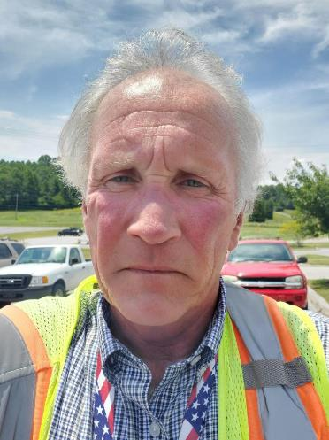


Innovative Approach to Sustainability
Y-12 National Security Complex’s Pervious Paving Minimizes Stormwater Runoff & Closes Sustainable Product Loop
Project Team (left to right): Bill James, Chris Pruett, Scott Vance, David West.

Slide 18


Innovative Approach to Sustainability – Honorable Mention
SLAC National Accelerator Laboratory’s Swap
Project Team (left to right): Josh Sanghvi, Rohendra Atapattu, and Emily Chow.
Cindy Patty, Molly Glover, Maia Coladonato, Wendy Greene and Oliver Hickman.

Slide 19















Sustainable HPC/Data Center
Lawrence Berkeley National Laboratory’s NERSC Efficiency Optimization Team
Project Team Headshots (left to right) – Top Row: Walker Johnson, Brent Draney, Sadie Joy, Raphael Vitti.
Middle Row: Cary Whitney, Deirdre Carter, Jeff Broughton, Norm Bourassa, Ernie Jew, Jeff Grounds.
Bottom Row: Mark Friedrich, John Elliott, Steve Greenberg, Tom Davis, Jingjing Liu.
Not shown: Mary Gross, Ben Maxwell.

Slide 20


Sustainable HPC/Data Center
Sandia National Laboratories’ 725 Data Center Addition LEED v.4 Gold BD+C: Data Center Certification
Project Team: Paul Schlavin and Casiano Armenta help to inspect the fans after construction. These fans are part of the energy saving economizer system that helps cool the data center using outside air most of the year.
Not Pictured: Alicia Brown, Carol Meincke, Marc Ghattas, Josh DeReu, Gail Granot, David Martinez, David Smith, Doug Vetter, Vance Leggett, Jim Corcoran, Mike Rocco, Mike Rymarz.

Slide 21




Sustainable HPC/Data Center – Honorable Mention
Hanford Site’s Datacenter Modernization & Closure Project
From left to right: Erik Anderson, Kenny Ferguson, Todd Eckman, Brad Ferguson, Phil Budde, Jason Lacher, Dennis Rains, Cristal Robinson, Anel Suarez.
Project Team – Top: Mike Eddy.
Bottom: Todd Eckman, Dennis Rains.

Slide 22

Congratulations!
Congratulations on your outstanding achievements and keep up the great work!

