Slide 1
Flux Coupling Machines and Switched Reluctance Motors to Replace Permanent Magnets in Electric Vehicles
Part I:
Novel Flux Coupling Machine Without Permanent magnets and
Integration of Novel Flux
Coupling Machine and Current
Source Inverter
John Hsu
Oak Ridge National Laboratory
865-946-1325
hsujs@ornl.gov
Trans-Atlantic Workshop,
December 3, 2010, MIT, Cambridge
Prepared by Oak Ridge National Laboratory, managed by UT-Battelle, LLC, for the U.S. Dept. of Energy under contract DE-AC05-00OR22725. The submitted viewgraph has been authored by a contractor of the U.S. Government under contract DE-AC05-00OR22725. Accordingly, the U.S. Government retains a nonexclusive, royalty-free license to publish or reproduce the published form of this contribution, or allow others to do so, for U.S. Government purposes.

Slide 2
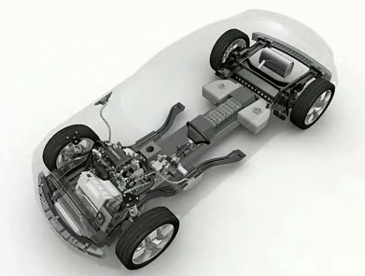
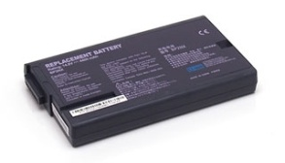

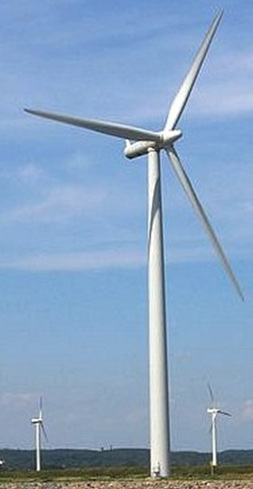
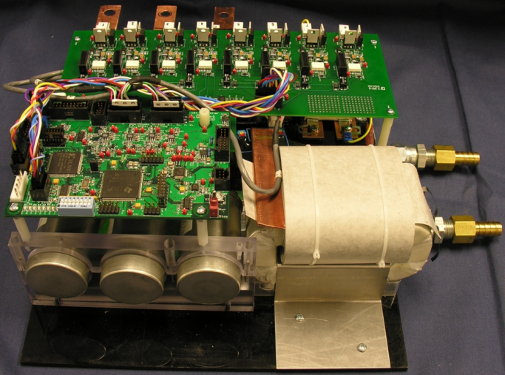

The Problems of Motor Drive and Generation Systems:
Rare earth permanent magnets (PM) are a major cost item in present day permanent magnet (PM) machines.
These magnets have operating temperature limitations.
The cost of electric vehicle traction drive systems (motor + power electronics) is too high ($36.6/kW -- 2006 Camry versus $8/kW -- DOE 2020 target). Same for the PM generation system.
Voltage source inverters (VSIs) need bulky, expensive and temperature limited DC bus capacitors.
As operational temperatures increase, the ability of film capacitors to handle ripple currents decreases, necessitating the addition of even more capacitance.
The Novel Flux Coupling Machine’s core can be utilized to eliminate the inductor of a current source inverter for further cost reduction and performance improvement.
Managed by UT-Battelle
for the U.S. Department of Energy
Notes:
2
2
2

Slide 3
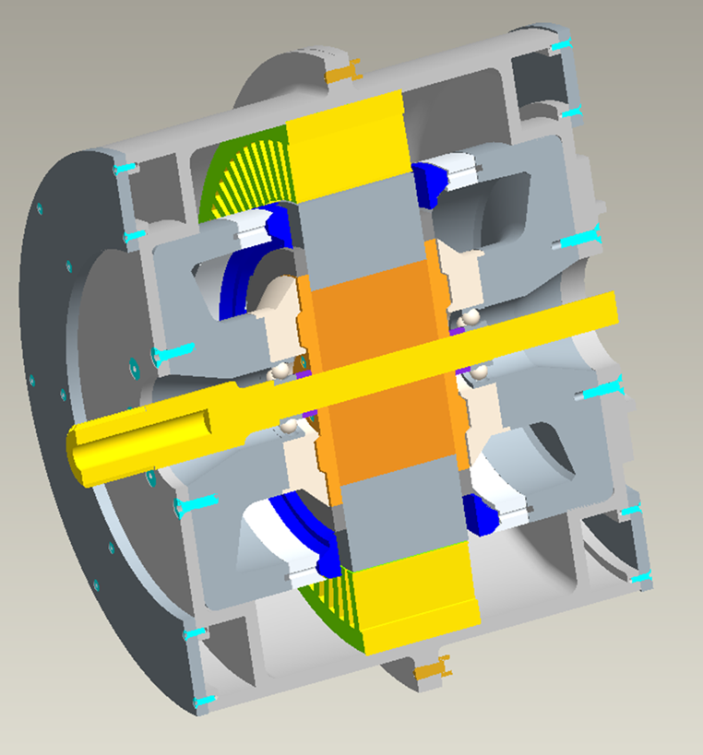
A Novel Flux Coupling Machine
Managed by UT-Battelle
for the U.S. Department of Energy
Notes:
3
3
3

Slide 4
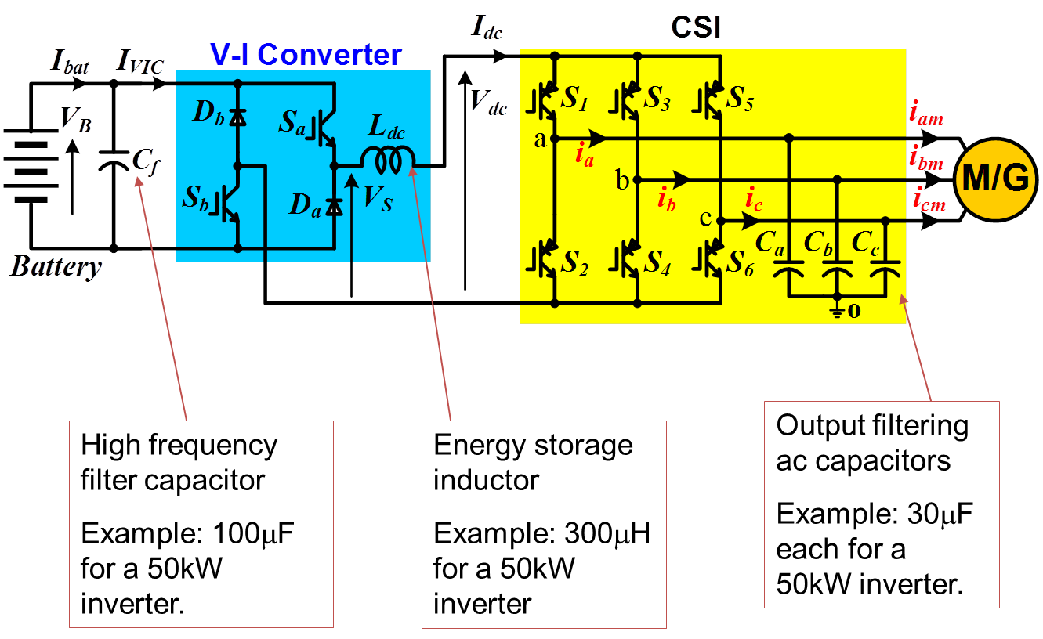
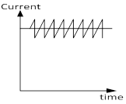
ORNL Current Source Inverter
Notes:
4

Slide 5
Conclusions
Brushless electric motors and generators can be built without permanent magnets.
The excitation core of this new electric machine can be used as the inductor of a current source inverter to further reduce the system (i.e., machine + Inverter) cost and increase power density and performance.
New soft magnetic core materials need to be further developed to optimize both the DC and AC flux carrying capabilities.

