Slide 1

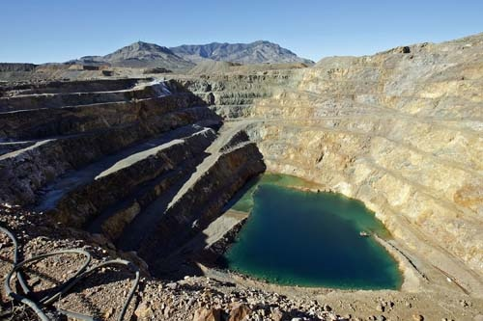
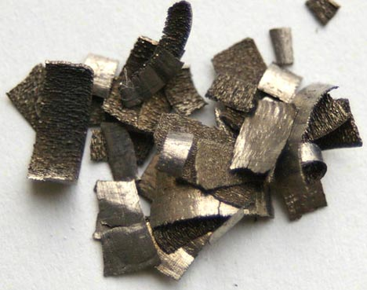
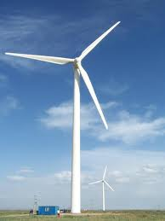
DOE’s Critical Materials Strategy
U.S. Department of Energy
Office of Policy and International Affairs
Diana Bauer
US Department of Energy
Office of Policy and International Affairs
November 3, 2010

Slide 2
Motivation
The global deployment of energy efficiency and renewable energy technologies implies an increased demand for rare earth elements and other materials.
This is one of the many challenges we face in advancing a clean energy agenda.
The Strategy is one step towards addressing this challenge.

Slide 3
Approach to Address the Challenge
Supply chain globalization
Material substitution in clean energy applications
Recycling, re-use, and more efficient use
Notes:
First, we must globalize supply chains for these materials. To manage supply risk, we need multiple, distributed sources of clean energy materials in the years ahead. This means taking steps to facilitate extraction, refining and manufacturing here in the United States, as well as
encouraging our trading partners to expedite the environmentally-sound creation of alternative supplies.
Second, we must develop substitutes for these materials. Doing so will improve our flexibility as we address the materials demands of the clean energy economy. In order to meet this objective, we will need to invest in R&D to develop transformational magnet, battery electrodes and other technologies that reduce our dependence on rare earths. DOE’s Office of Science, Office of Energy Efficiency and Renewable Energy, and the ARPA-E program are currently conducting research along these tracks.
Third, we must explore opportunities to promote recycling, re-use and more efficient use of strategic materials in order to gain more economic value out of each ton of ore extracted and refined. Widespread recycling and re-use could significantly lower world demand for newly extracted rare earths and other materials of interest. For example, we could develop a process to recycle terbium and europium in the phosphors of compact and conventional fluorescent light bulbs. Neodymium could be recycled from hybrid and electric vehicles. Additionally, recycling and re-use could reduce the lifecycle environmental footprint of these materials, another critical priority.

Slide 4
Critical Materials Strategy Aims to
U.S. Department of Energy
Office of Policy and International Affairs
Forge a common understanding within DOE of short- and medium-term issues related to critical materials in clean energy technologies.
Build on existing work within DOE.
Assess DOE’s priorities and policy options.
Contribute to a public dialogue.

Slide 5
Strategy Scope
Material demand for 4 energy technologies:
  Wind turbines: magnets
  Electric vehicles: batteries, magnets
  Solar cells: PV films
  Energy efficient lighting: phosphors
Energy Deployment Scenarios
  Moderate Deployment: IEA Baseline, Reference
  Rapid Deployment: IEA Blue Map, 450 Scenario
Challenges and opportunities in the short and medium term
Notes:
Focusing on a subset of clean energy technologies that use rare earths and other less common elements and are likely to see a significant ramp up in demand
Global clean energy deployment (not just US) affects global mineral markets. Thus, we are looking at technology deployment scenarios from the International Energy Agency combined with ranges for technology material content and market share.
Moderate commercialization: IEA Reference
Rapid commercialization: blue map and 450 scenario
We are looking at the short term: 0-5 years and medium term 5-15 years.

Slide 6

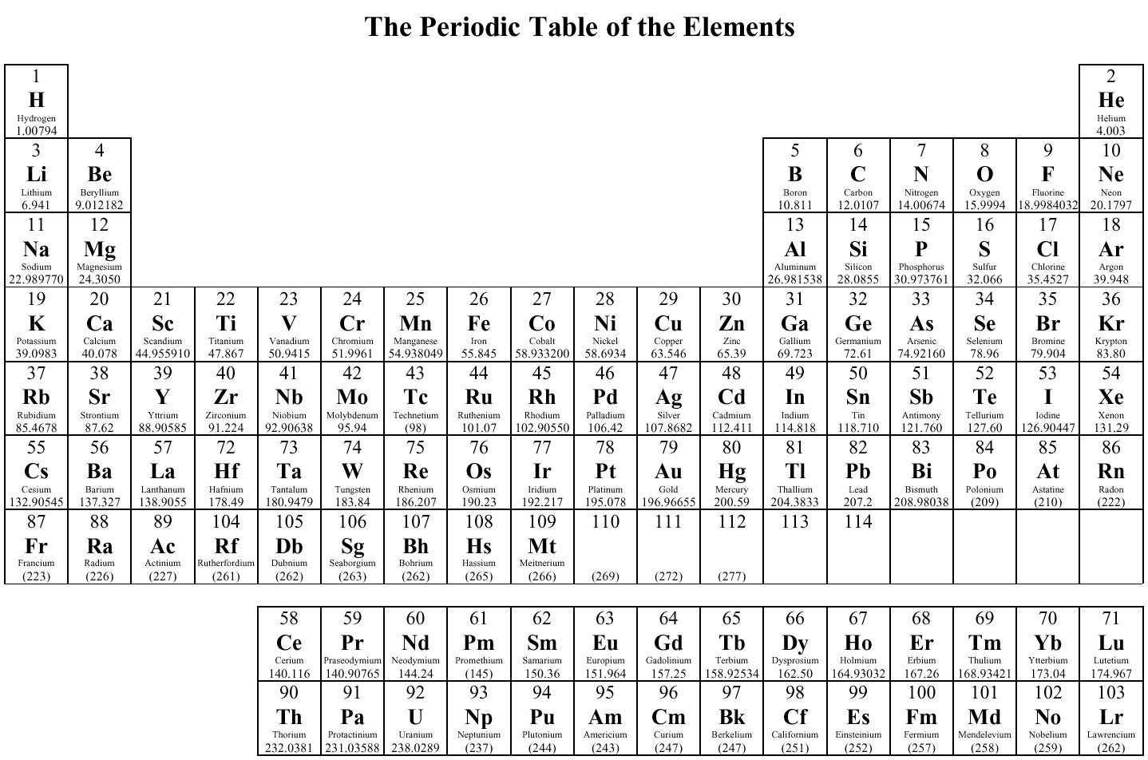


Priority Elements
U.S. Department of Energy
Office of Policy and International Affairs
Notes:
Go over each technology.
Criticality assessment:
Importance to clean energy
Clean energy demand
Substitution limitations
Supply risk
Basic availability
Competing technology demand
Political, regulatory, and social factors
Co-dependence with other markets
Producer diversity

Slide 7


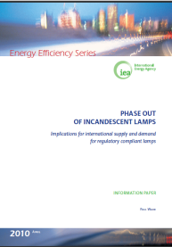
Technology High Deployment Scenarios
Global CFL Demand
Notes:
International Energy Agency (IEA) Energy Technology Perspectives (ETP) for EV/PHEV/HEV Reference and Blue map (focuses on deployment of new technologies)
IEA World Energy Outlook for Wind & PV Baseline & 450 Stabilization case
IEA Phase Out of Incandescent lamps information paper for phosphors

Slide 8
Project Timeline
TO DATE
March 17 – Assistant Secretary Sandalow announces plan to develop DOE’s Critical Materials Strategy
May 6 – Request for Information (RFI) released
June 7 – RFI closed
June- present – Analysis and drafting
----------------------------------------------------------------------------------
Report will be available later this year
Notes:
RFI asked questions on demand, supply, technology applications, costs and availability, substitutes, recycling, and intellectual property.

Slide 9
The Strategy is Addressing the Entire Supply Chain
U.S. Department of Energy
Office of Policy and International Affairs
Extraction
Processing
Components
End Use Applications
UUPSTREAM DOWNSTREAM
Recycling and Re-Use
Notes:
This is not just about mining.
We must consider all stages of the supply chain: from environmentally-sound material extraction to purification and processing, the manufacture of chemicals and components, and ultimately end uses.
Addressing each stage, there are risks and constraints, opportunities, and direct policy tools.

Slide 10
Factors Complicating Materials Markets
  Large mining capital requirements
  Material coproduction
  Bottlenecks and lag times across the supply chain
  Price volatility
  Lack of market transparency
  Geopolitical aspects of mining and manufacturing
  Uncertain future demand profiles
Notes:
Coproduction: E.g. rare earths, also tellurium, indium
Takes a while to bring a mine on line, but also a while to ramp up demand, research and deploy substitutes
Price volatility makes future planning difficult
Uncertain future demand. Much demand is new

Slide 11
Topics Explored in Connection with the Strategy
Information
Financial Incentives
R&D
Education and Training
Notes:
Information: e.g. material supply and demand
Financial incentives: loan and tax policy, grants
R&D: from basic to applied
Ed & training: building the expertise of the next generation

Slide 12
Related Government Activities
GAO Report: Rare Earth Materials in the Defense Supply Chain
CRS Report: Rare Earth Elements: The Global Supply Chain
DOD – Forthcoming study identifying defense applications of rare earths
OSTP– Rare Earth Elements Interagency Workgroup

Slide 13
Questions?
http://www.pi.energy.gov/
diana.bauer@hq.doe.gov

