Slide 1
Presentation to Regional Coalition of LANL Communities
December 21, 2018
Joe Legare
Acting Chief Operating Officer
N3B Los Alamos

Slide 2
Agenda
N3B Overview
RDX Campaign Project Overview

Slide 3
N3B Los Alamos: How We Support LANL
Triad National Security
Notes:
Los Alamos National Laboratory is managed by two Department of Energy organizations:
National Nuclear Security Administration
Environmental Management
EM has been responsible for cleanup work at LANL for several years, with the lab M&O contractor doing the work – until May of 2018, when the work was spun off from the M&O to form the Los Alamos Legacy Waste Contract, which N3B manages.
Our sole purpose at Los Alamos is to clean up the site’s legacy waste.

Slide 4
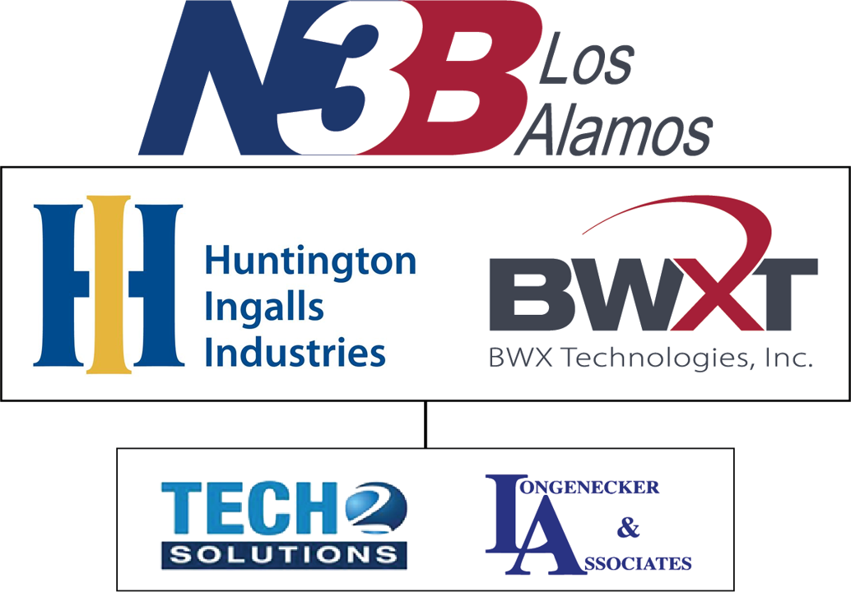
N3B Los Alamos: Who We Are
Cleanup up the Environment – Protect our Future
Notes:
N3B is a limited liability company that is owned by Huntington Ingalls Industries and BWX Technologies.
Our major teaming subcontractors are Tech 2 Solutions and Longenecker & Associates.

Slide 5
N3B Mission – Values - Scope
N3B Mission
To manage and execute the Los Alamos Legacy Cleanup Contract (LLCC) safely, securely, compliantly and efficiently to the satisfaction of our customers and stakeholders while adhering to disciplined operations principles.
Core Values
Safety
Integrity
Quality
Performance
Stewardship
Communication & Collaboration
Major Scope Areas
Excavate, treat, package and ship waste
Excavate soil and buried components, package and dispose
Close landfills
Comply with groundwater and surface water permits
Treat groundwater
Decontaminate and demolish facilities
Communicate with Regulators, Stakeholders and local elected officials
Notes:
We are organized to safely, securely, compliantly and efficiently:
Manage groundwater and surface water and treat as necessary
Clean up and close waste sites
Demolish facilities
Excavate, treat, package and ship waste for dispsoal

Slide 6
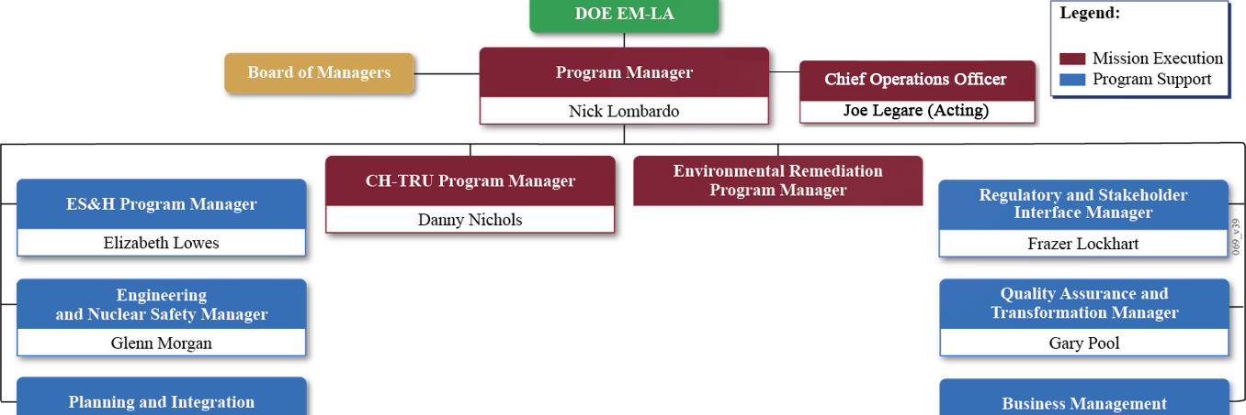
N3B Organization
Erich Evered (Acting)
Adam Barras
Mike Helpenstill (Acting)
Notes:
We report directly to the Department of Energy and not to the Lab or the Lab M&O.
Nick Lombardo is president of N3B and Program Director for the Los Alamos Legacy Cleanup Contract.
You may already have met several of our senior leadership, including Frazer Lockhart and others who have added meetings and presented to this group.

Slide 7
RDX Campaign Project Overview
December 21, 2018
Pat McGuire
RDX Project Lead
N3B Los Alamos

Slide 8
Presentation Topics
Background
Groundwater setting
Source and history
Remediation and monitoring conducted to date
Extent of RDX in groundwater
Water supply wells do not contain RDX
DOE has a program in-place with the goal that RDX will not be present in the water supply wells
Upcoming Activities

Slide 9
Groundwater beneath Los Alamos
Perched Groundwater Monitoring Well
Regional Aquifer Monitoring Well
Spring
Water-Supply Well
~1300 feet

Slide 10
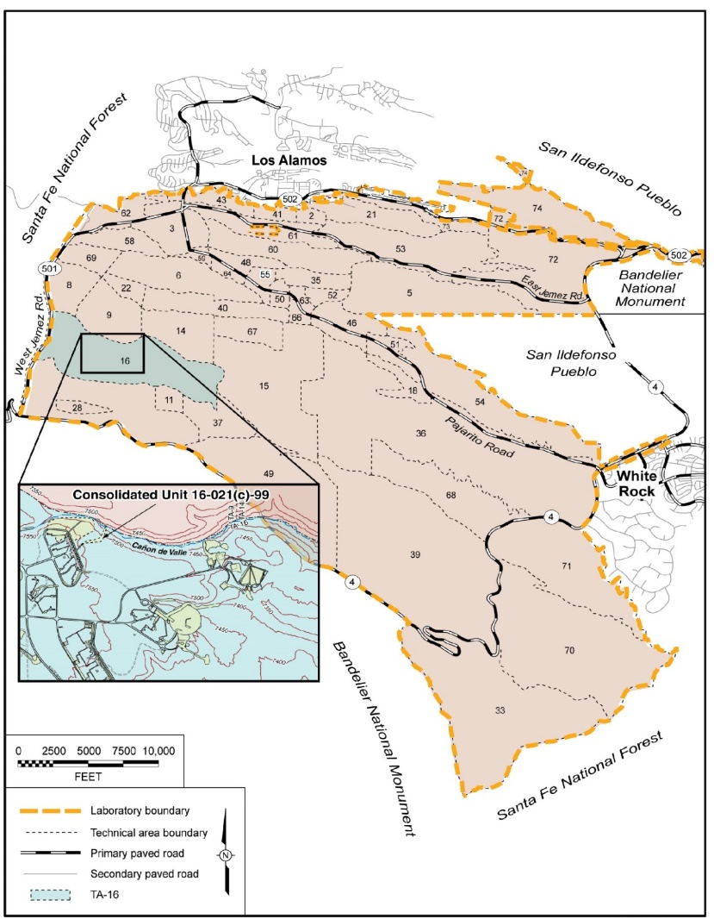
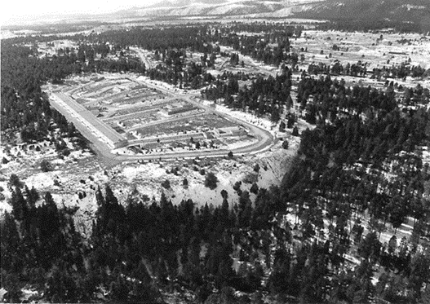
Background
TA-16 facilities established in early 1950s to develop high explosive (HE) formulations
Explosives (RDX, HMX, TNT) were casted and machined for nuclear weapons
Building 260 used since 1951 to machine HE
Several million gal/yr of HE-contaminated water discharged to Ca$ñ$on de Valle (CdV) between 1951 – 1996
The 260 Building outfall was primary source of RDX
Other potential sources include operations in other buildings at TA-16 and at TA-09.
First investigations of RDX in soils occurred in the mid 1990s
Groundwater investigations first identified RDX (below standards) in perched and regional groundwater in the late 1990s
Present-day RDX contamination is low in nearby springs, surface water, and shallow groundwater
TA-16
TA-9
260 Outfall

Slide 11
Remediation Activities Conducted
Surface soil cleanup conducted in outfall area in 2000–2001 under an Interim Measure, and in 2009–2010 under a Corrective Measures Implementation
More than 1500 yd³ HE-contaminated soil excavated and disposed offsite
Significantly reduced contamination in surface soils
Excavations backfilled with clean soil and covered with a stone cap
Completed Surface Corrective Measures Activities
Included documentation of no further requirements for cleanup for RDX in surface setting
Included Long-Term Monitoring Plan and reporting requirements
Surface water, springs, shallow alluvial wells

Slide 12
Deep Groundwater Activities
Installation of monitoring wells to investigation “nature and extent” of contamination
Including the latest monitoring well, R-69, there are 9 wells used to monitor the regional groundwater underlying TA-16 and TA-9
Intermediate-depth wells screened in perched groundwater (~600-1000 ft bgs)
Deep wells screened in the regional aquifer (~1200-1400 ft bgs)
Studies to understand the hydrology and “fate and transport” of contamination
Tracer studies
Aquifer tests
All investigation activities performed with NMED’s approval

Slide 13
Groundwater Flow Conceptual Model
RDX SOURCE

Slide 14
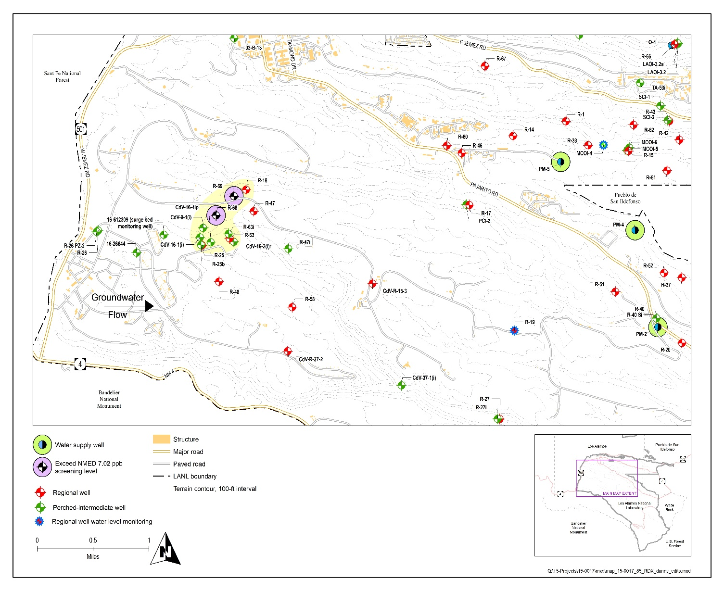
RDX in the Regional Aquifer
RDX is present in several regional groundwater monitoring wells
Known since 1998
Two monitoring wells (R-68 and R-69) have RDX above the NMED’s 7.02 ppb screening level (protective risk based concentration)
RDX is not present in LAC water-supply wells (approx. 3 miles away)
DOE collects groundwater samples from water-supply wells for RDX analysis
sampled since 1998
Current semi-annual sampling supplements LAC’s sampling efforts
DOE will continue to monitor for RDX in water-supply wells and in upgradient monitoring wells closer to the RDX project site

Slide 15
Upcoming Activities
Deep Groundwater Investigation Report (DGIR)
Due in August 2019 (Consent Order “Appendix B” Deliverable)
Field Activities to support DGIR
R-69 installation of sampling equipment, monitoring
DGIR Path Forward
DGIR will include a groundwater model that will
Model long-term fate of RDX in regional aquifer
Determine whether groundwater remediation is necessary at this time to protect regional aquifer
Long-term monitoring will follow
All activities performed in collaboration with NMED

