Slide 1
RDX Project
Los Alamos National Laboratory’s RDX Groundwater Project
Los Alamos County Council
Danny Katzman
Technical Manager, Water Programs – N3B
February 5, 2019

Slide 2
RDX Project – Presentation Topics
Presentation Topics
Background
Groundwater setting
Source and history
Remediation conducted to date
Extent of RDX in groundwater
Next Steps

Slide 3
Groundwater beneath Los Alamos
Perched Groundwater Monitoring Well
Regional Aquifer Monitoring Well
Spring
Typical Water-Supply Well
~1300 feet to the water table

Slide 4
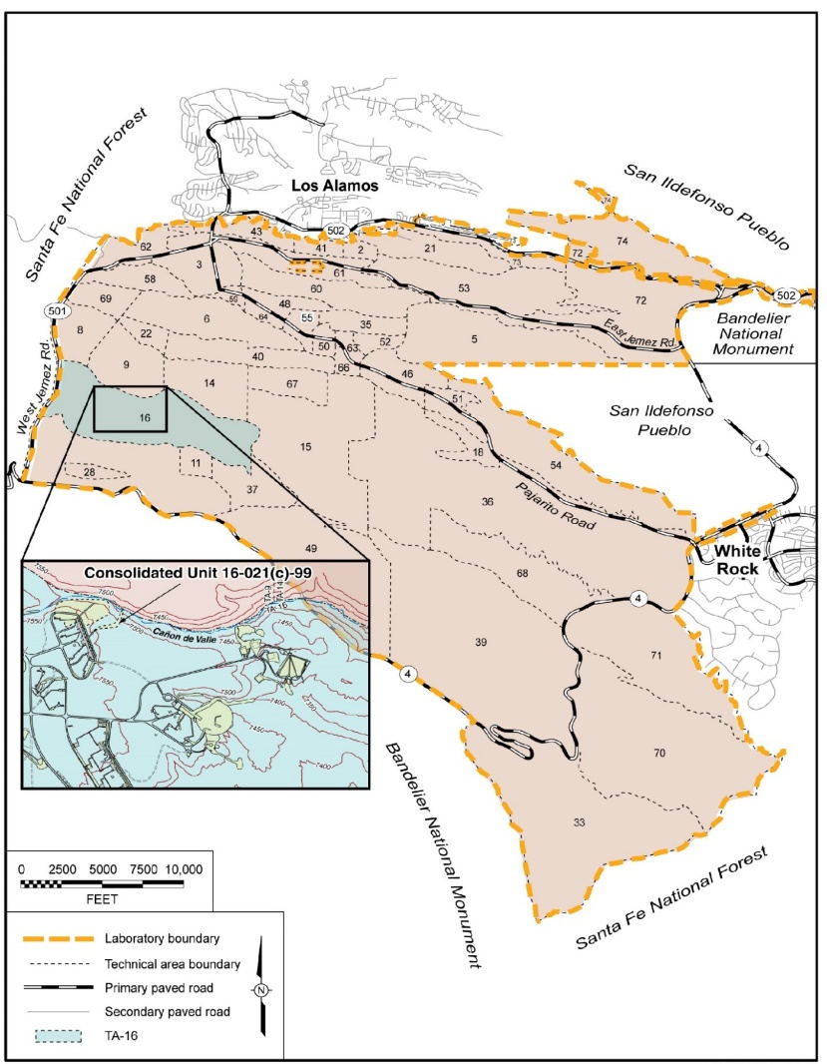
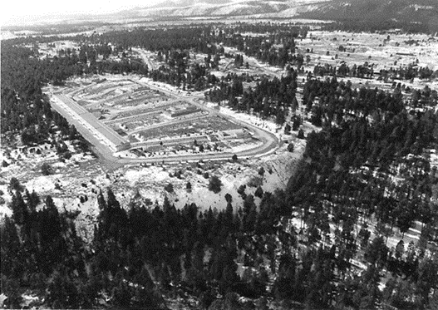
Background
TA-16 facilities established in early 1950s to develop high explosive (HE) formulations
Explosives (RDX, HMX, TNT) were casted and machined for nuclear weapons in 260 Bldg starting in 1951
Several million gal/yr of HE-contaminated water discharged to Ca$ñ$on de Valle (CdV) between 1951 – 1996
First investigations of RDX in soils occurred in the mid 1990s
Groundwater investigations first identified RDX (below standard) in perched and regional groundwater in the late 1990s
Present-day RDX contamination is low in nearby springs, surface water, and shallow groundwater
Current estimates of RDX in environment:
~ 1500 – 3600 kg total;
~ 35 – 415 kg in regional aquifer
TA-16
TA-9
260 Outfall

Slide 5
RDX Remediation Activities
Surface soil cleanup conducted in outfall area in 2000 – 2001 under an Interim Measure, and in 2009 – 2010 under a Corrective Measures Implementation
More than 1500 yd³ HE-contaminated soil excavated and disposed offsite
Significantly reduced contamination in surface soils
Injected grout in permeable rock layers to cut off infiltration pathways
Remedy Completion Report - 2017
Documentation of no further action necessary for cleanup for RDX in surface setting
Long-Term Monitoring Plan and reporting requirements for surface water, springs, shallow alluvial wells

Slide 6
Deep Groundwater Activities
Installation of monitoring wells to investigate “nature and extent” of contamination
Depth to regional aquifer is approximately 1300’ below ground surface in the TA-16 area because of the elevation of the mesas in the area
Including the latest monitoring well, R-69, there are 9 wells used to monitor the regional groundwater in the RDX area
Intermediate-depth wells screened in perched groundwater (~600-1000 ft bgs)
Deep wells screened in the regional aquifer (~1200-1400 ft bgs)
Studies to understand the hydrology and “fate and transport” of contamination
Tracer studies
Aquifer tests
Groundwater flow ~20 – 40 ft/yr; RDX in groundwater slightly slower
All investigation activities performed with NMED’s approval

Slide 7
Conceptual Model
RDX Pathway

Slide 8
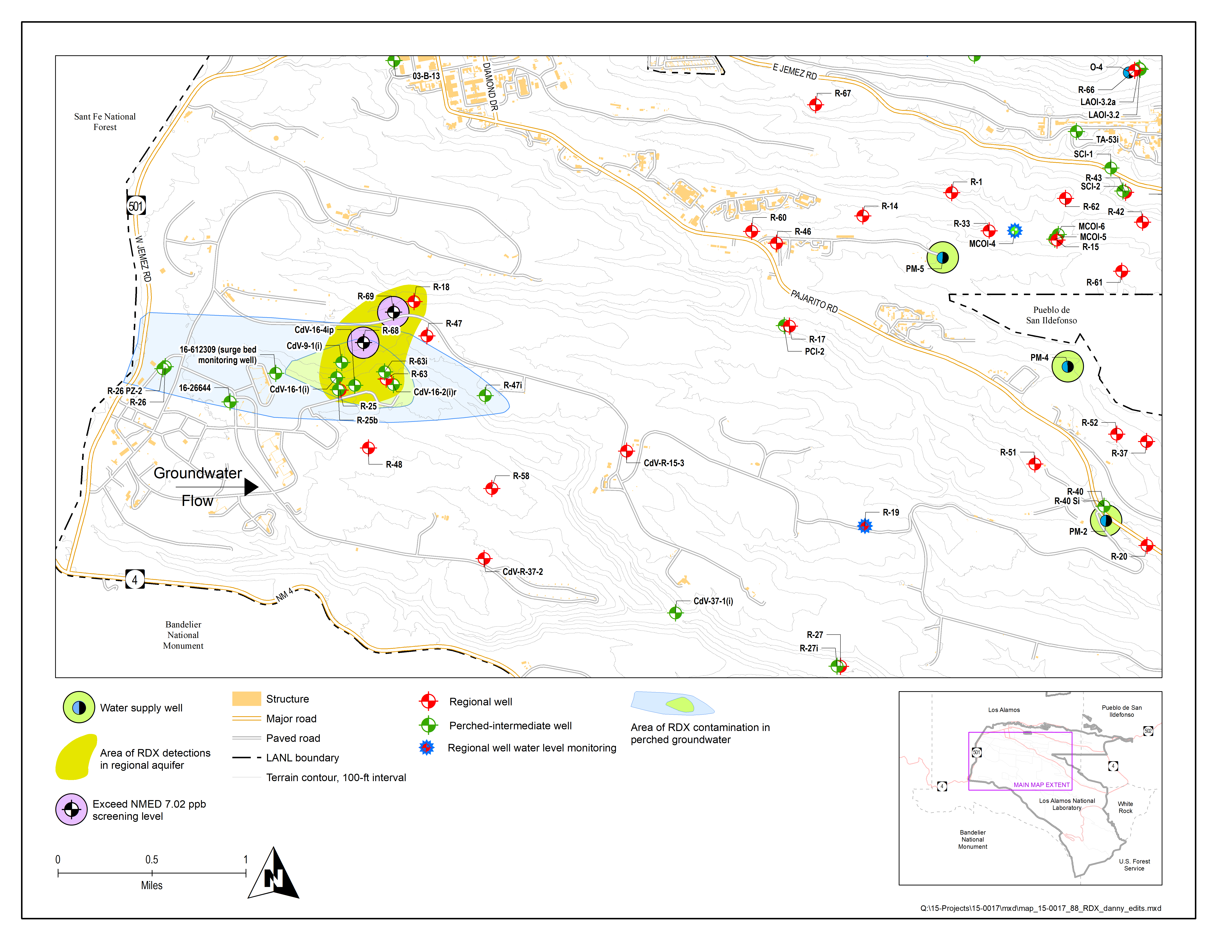
RDX in Regional Aquifer
RDX is present in several regional groundwater monitoring wells
Known since 1998
Two monitoring wells (R-68 and R-69) have RDX above the NMED’s 7.02 ppb tap-water screening level
R-68 ~ 14 ppb
R-69 TBD
RDX is not present in LAC water-supply wells (approx. 3 miles away)
DOE collects groundwater samples from water-supply wells for RDX analysis
sampled since 1998
Current semi-annual sampling supplements LAC’s sampling efforts
DOE/N3B will continue to monitor for RDX in water-supply wells and in monitoring wells closer to the RDX project site
~ 3 miles

Slide 9
Upcoming Activities
Deep Groundwater Investigation Report (DGIR)
Due to NMED in August 2019
DGIR Objectives
Is the contamination sufficiently characterized?
A groundwater model will evaluate
Potential for long-term migration of RDX in regional aquifer (i.e., predictions for whether the footprint could grow)
whether groundwater remediation is necessary
If remediation is necessary, a plan will be developed to propose the approach
Long-term monitoring to ensure protection of LAC water-supply wells will be part of any path forward
All activities conducted under the Consent Order with NMED

Slide 10
Approximate Schedule of Activities
Ongoing Monitoring
Long-Term Monitoring
?
Investigation Report
NMED Review
8/19
~ 2/20
?
Corrective
Measures Evaluation
8/20
Corrective
Measures Implementation Plan
9/21

Slide 11
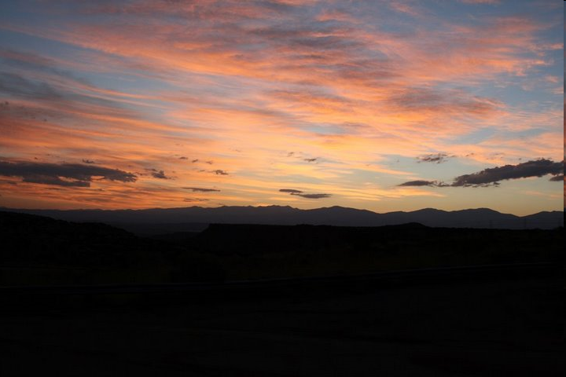
Questions?

