Slide 1
Los Alamos National Laboratory’s Chromium Project
Doug Hintze, Manager
Environmental Management Los Alamos Field Office
January 9, 2018

Slide 2
Presentation Outline
Frequently asked questions
Chromium facts
Background
Where is the chromium plume?
What is being done about it?
What’s next?
Summary

Slide 3
Frequently Asked Questions
Is the County’s drinking water safe?
Where did the chromium contamination come from?
Is it still being released to the environment?
Do we know where it is?
What is the Laboratory doing about it?
How does chromium treatment work?
How will the contamination be fully remedied?
What is the timeframe?

Slide 4
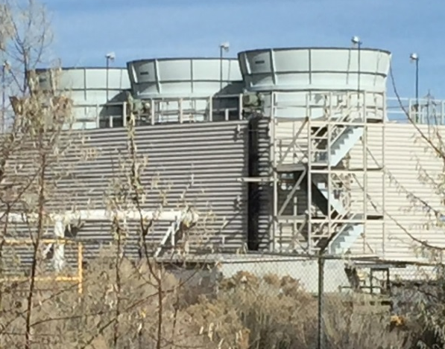
Chromium Facts
Chromium occurs naturally in two forms:
“Trivalent”
Considered an essential nutrient (found in vitamins and food)
Doesn’t move in groundwater
“Hexavalent”
“Dissolves” in water and can move in groundwater
Can change to trivalent chromium either naturally or using remediation approaches
LANL Chromium plume is hexavalent form
Chromium was once used to prevent corrosion in power plant cooling towers
Cooling towers at LANL power plant

Slide 5
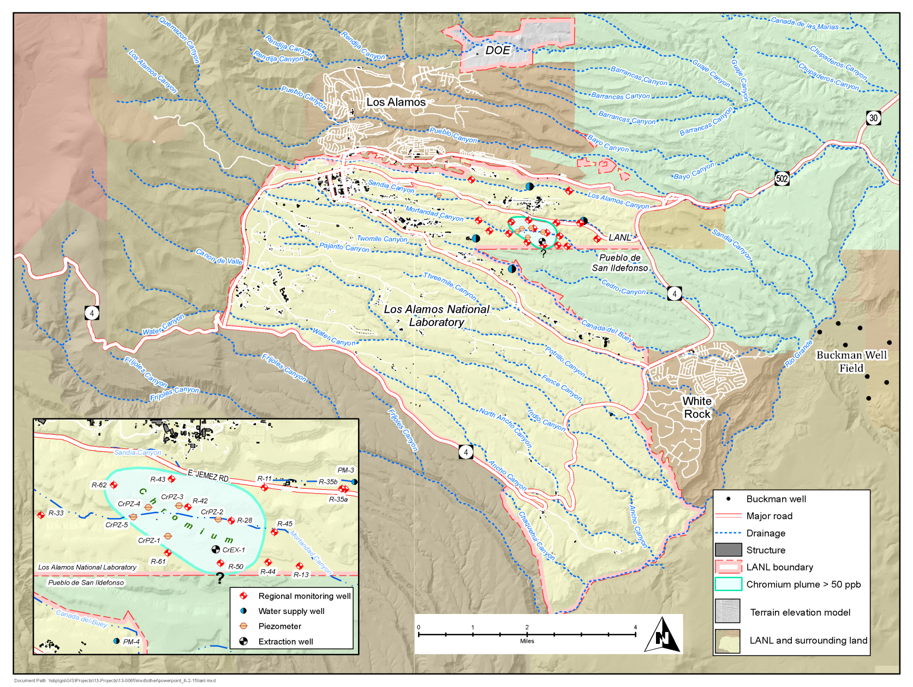
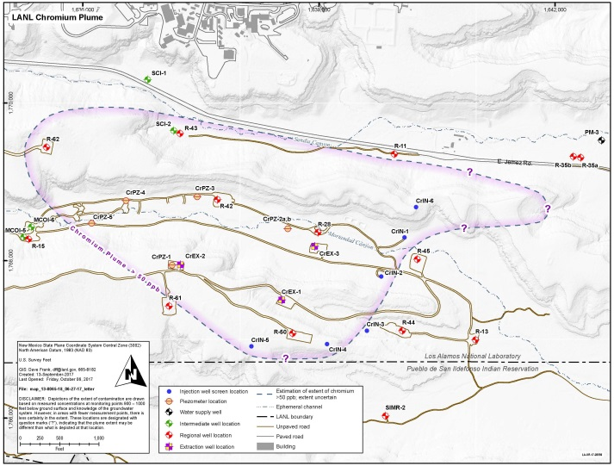
Chromium in Groundwater Beneath LANL
Potassium dichromate used in cooling towers at a Laboratory power plant
Up to 72,000 kg released from 1956-72 in hexavalent form [Cr(VI)]
Potassium dichromate used in cooling towers at a Laboratory power plant
Up to 72,000 kg (159,000 lb) released from 1956-72 in hexavalent form [Cr(VI)]
Chromium (Cr) contamination in the regional aquifer is in hexavalent form
3 groundwater zones
Plume is 900–1,000 feet below canyon bottom in deepest zone
Size is approximately 1 mile x 1/2 mile x <50 feet thick
Estimated downgradient plume edge is approximately 1/4 mile from the closest drinking water well
Plume
Power Plant
- - - - -
? ? ? ? ? ?

Slide 6
Where is the plume?
Monitoring Well
~1000 feet
Water Supply Well
Cr Plume

Slide 7
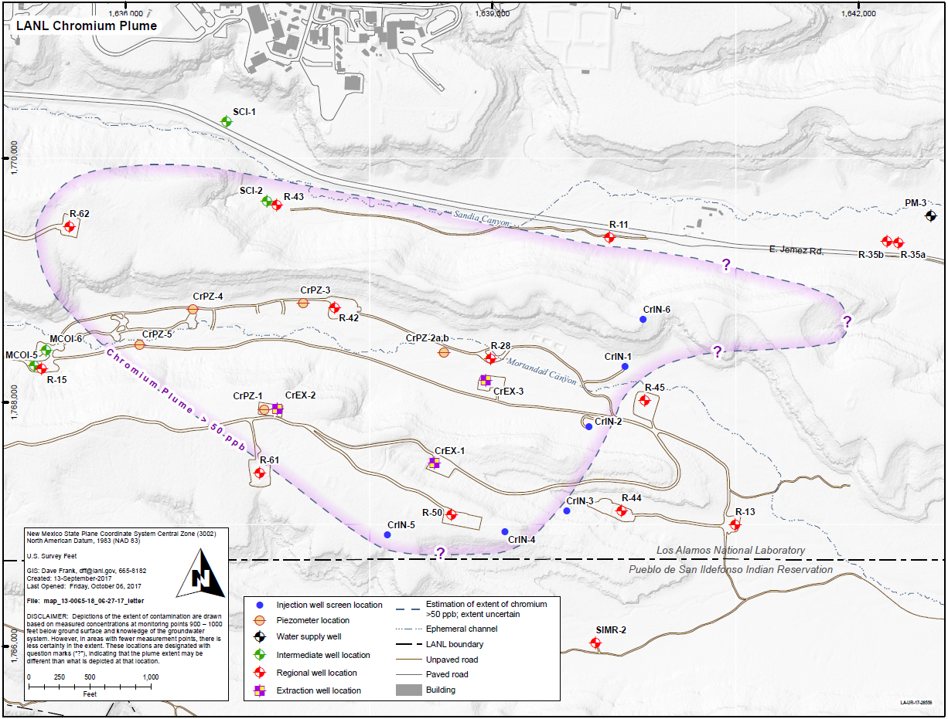
Where is the plume? (cont.)
Water-supply well

Slide 8
What is being done about it?
Hydraulic Control to Prevent Migration
Extract →
→
Treat
Inject
I?
E
T
I?
E
E
E
I
I
I
I

Slide 9
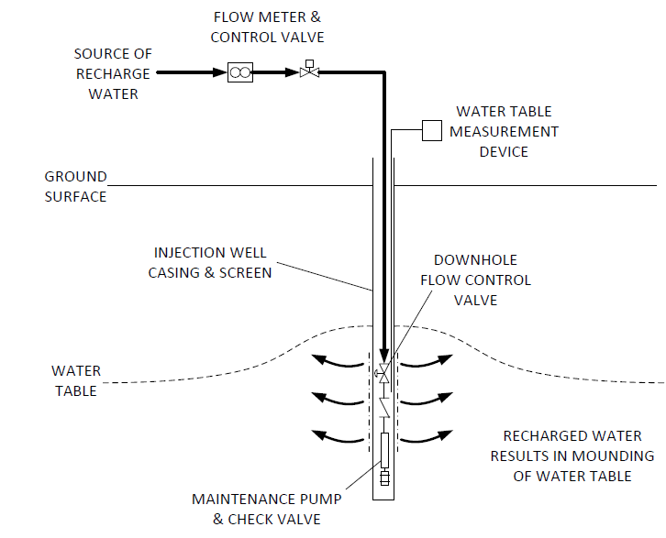
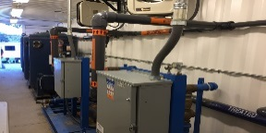
Extraction, Treatment & Injection Loop
Ion Exchange Treatment Unit
Contaminated groundwater is pumped from extraction wells
Groundwater is treated using a method called ion exchange
Clean water is delivered via buried thick-walled piping to injection wells
Water exits the injection wells within the aquifer
Extraction Well
Injection Well
INJECTED WATER RESULTS IN MOUNDING OF THE WATER TABLE

Slide 10
What is being done about it? (cont.)
Approximation of potential plume edge 2-3 years after start up of full system operation of Interim Measure
Groundwater Flow

Slide 11
What’s next?
Restart operations along Laboratory boundary with Pueblo de San Ildefonso in January
Full system operation summer/fall
Continued studies to evaluate final remedy

Slide 12
Questions?

