Slide 1
Los Alamos National Laboratory’s
Chromium Project
Buckman Direct Diversion
Doug Hintze
Manager
Environmental Management Los Alamos Field Office
October 4, 2018

Slide 2
Presentation Topics
Groundwater Setting
Where did the chromium come from and where is it now?
What is being done to address the plume?
Recent changes
Project status
What’s next?
Summary

Slide 3
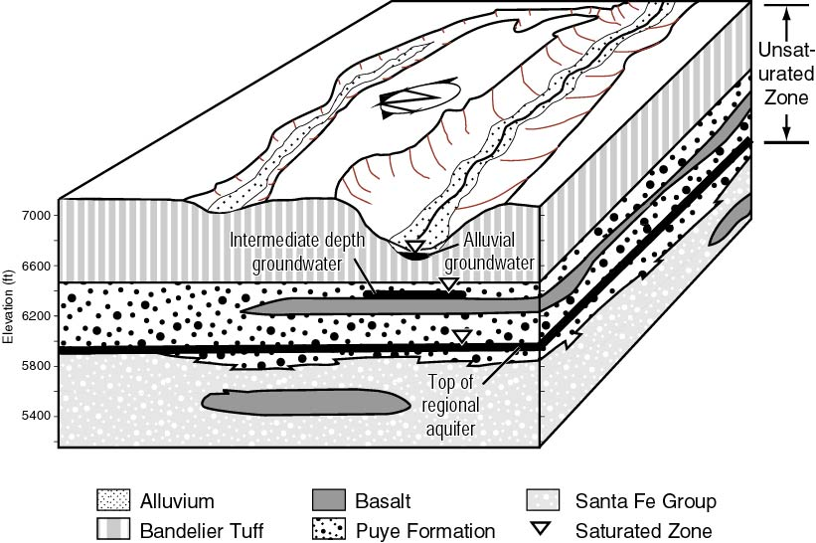
Groundwater beneath
Los Alamos
Typical Monitoring Well
Typical Water-Supply Well
~1000 feet
Cr Plume

Slide 4
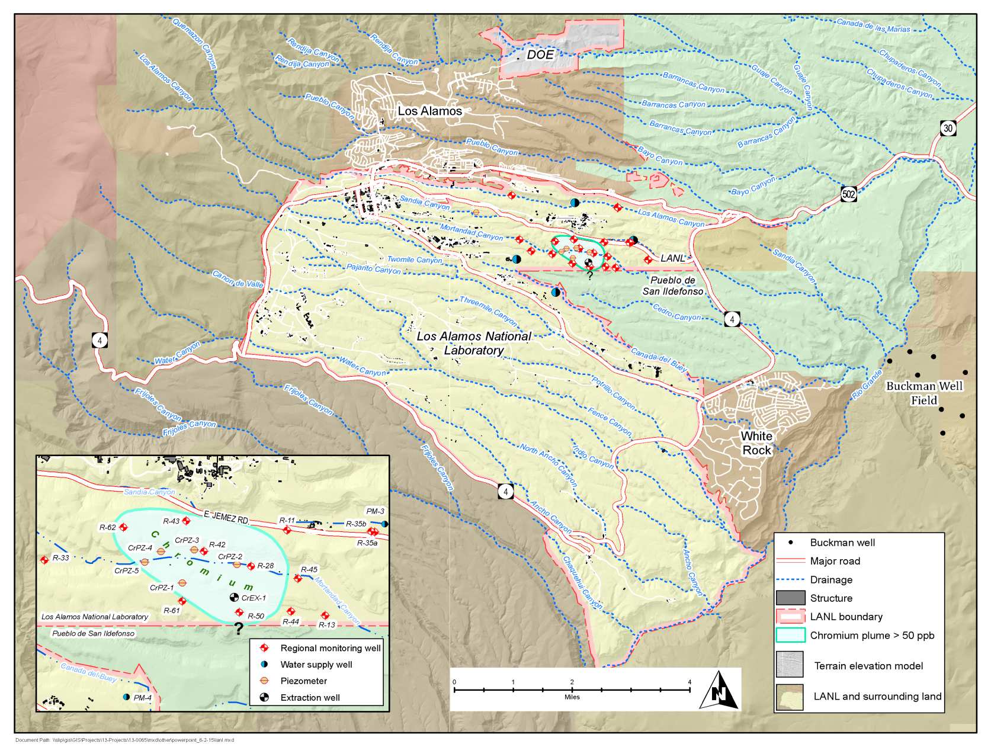
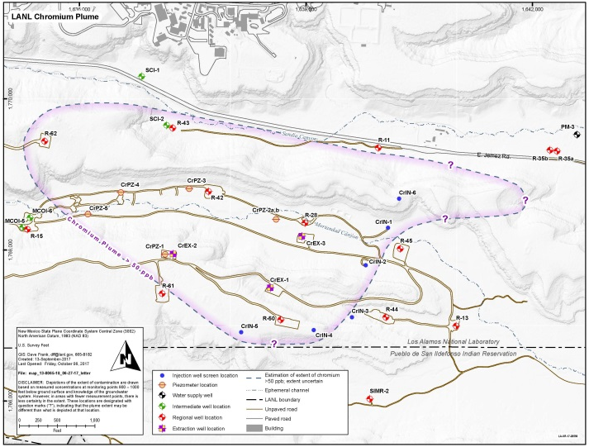
Chromium in Groundwater Beneath LANL
Potassium dichromate used in cooling towers at a Laboratory power plant
Up to 72,000 kg released from 1956-72 in hexavalent form [Cr(VI)]
Potassium dichromate used in cooling towers at a Laboratory power plant
Up to 160,000 lb released from 1956-72 in hexavalent form [Cr(VI)]
Chromium (Cr) contamination in the regional aquifer is in hexavalent form
  3 groundwater zones
  Plume is 900–1,000 feet below canyon bottom in deepest zone
  Size is approximately 1 mile x 1/2 mile x <75 feet thick
  Estimated downgradient plume edge is approximately 1/4 mile from the closest drinking water well
Plume
Power Plant
- - - - -
? ? ? ? ? ?

Slide 5
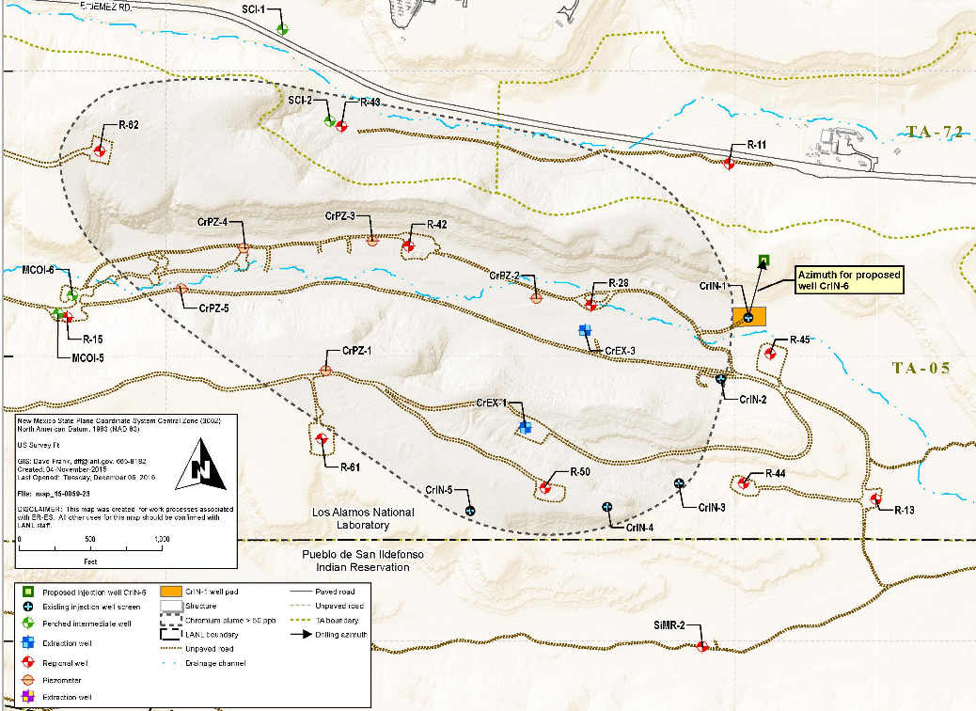
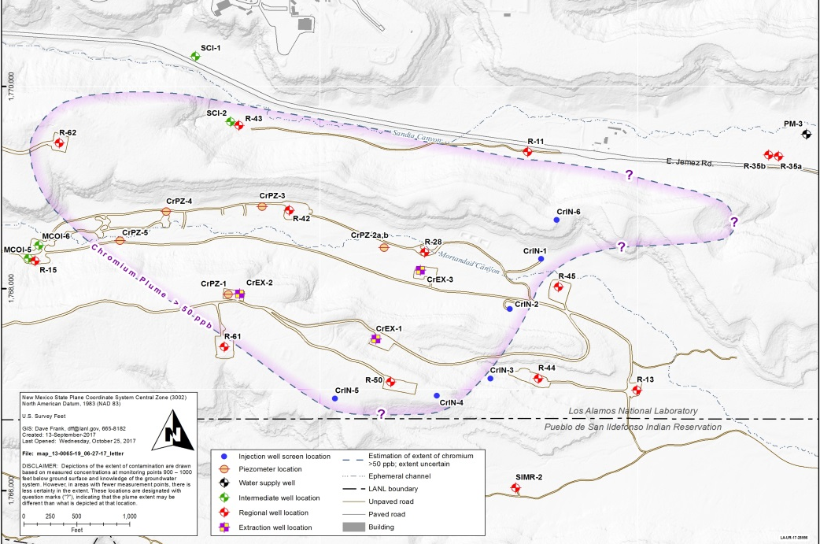
Updates to Plume Definition: CrIN-6
From 2016 CrIN-6 Drilling Work Plan
CrIN-6
Installation of injection well CrIN-6 completed in July 2017
Concentration of Cr in CrIN-6 is ~270 ppb
  Consistent with model predictions of plume in the CrIN-6 area
Updated depiction of plume is based on CrIN-6 data and models that were consistent with CrIN-6 Cr concentration
Specific location of 50 ppb edge is uncertain.
Plume did not suddenly expand
Continued coordination with Los Alamos County to ensure protection of drinking water (PM-3)
Updated based on CrIN-6 Cr concentrations and model estimations
CrIN-6
PM-3

Slide 6
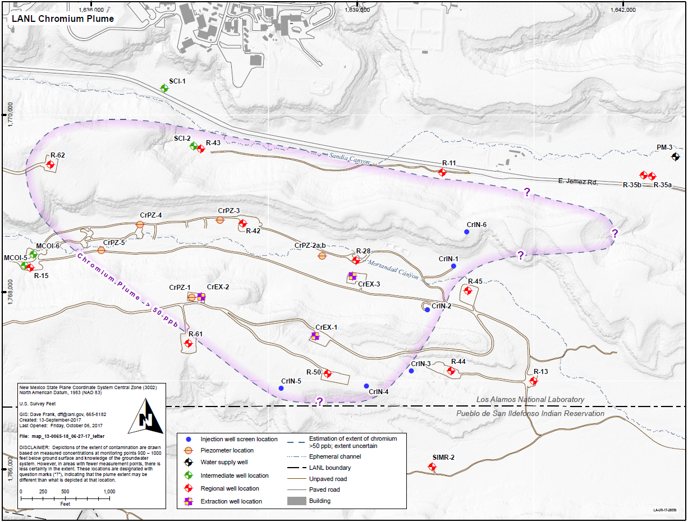
Interim Measure Technical Approach
Hydraulic Control to Prevent Migration
Extract →
→
Treat
Inject
E
E
T
Second Phase
I
E
E
E
I
Initial Phase
I
I
I

Slide 7
Recent Changes to IM Approach
April 26, 2018 Submittal to NMED - Evaluation of Chromium Plume Control Interim Measure Operational Alternatives for Injection Well CrIN-6
Evaluated injection vs. extraction scenarios for CrIN-6
Primary considerations:
Establish control of plume edge
Protect PM-3
Rate of reduction of Cr downgradient (east) of CrIN-6
Conclusion:
Convert CrIN-6 to extraction well
Install additional monitoring well
June 6, 2018 NMED Approval to convert CrIN-6 to CrEX-5
Approximate location of new monitoring well
Groundwater Flow

Slide 8

Goal of the Interim Measure
Approximation of plume edge 2-3 years after start up of full system operation of Interim Measure
Groundwater Flow

Slide 9
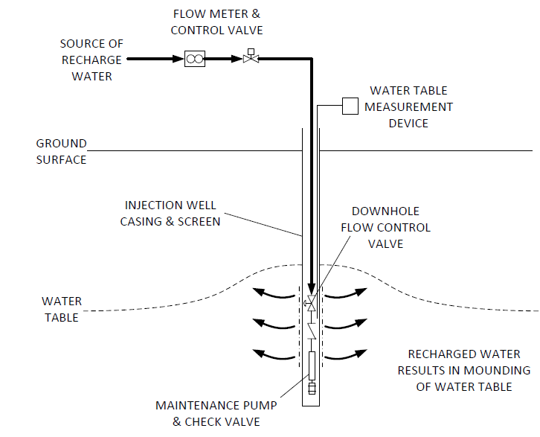
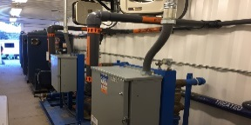

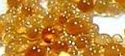
Extraction, Treatment & Injection Loop
Contaminated groundwater is pumped from extraction wells
Groundwater is treated using a method called ion exchange
Clean water is delivered via buried thick-walled piping to injection wells
Water exits the injection wells within the aquifer
Ion Exchange Treatment Unit
Extraction Well
Injection Well
INJECTED WATER RESULTS IN MOUNDING OF THE WATER TABLE

Slide 10
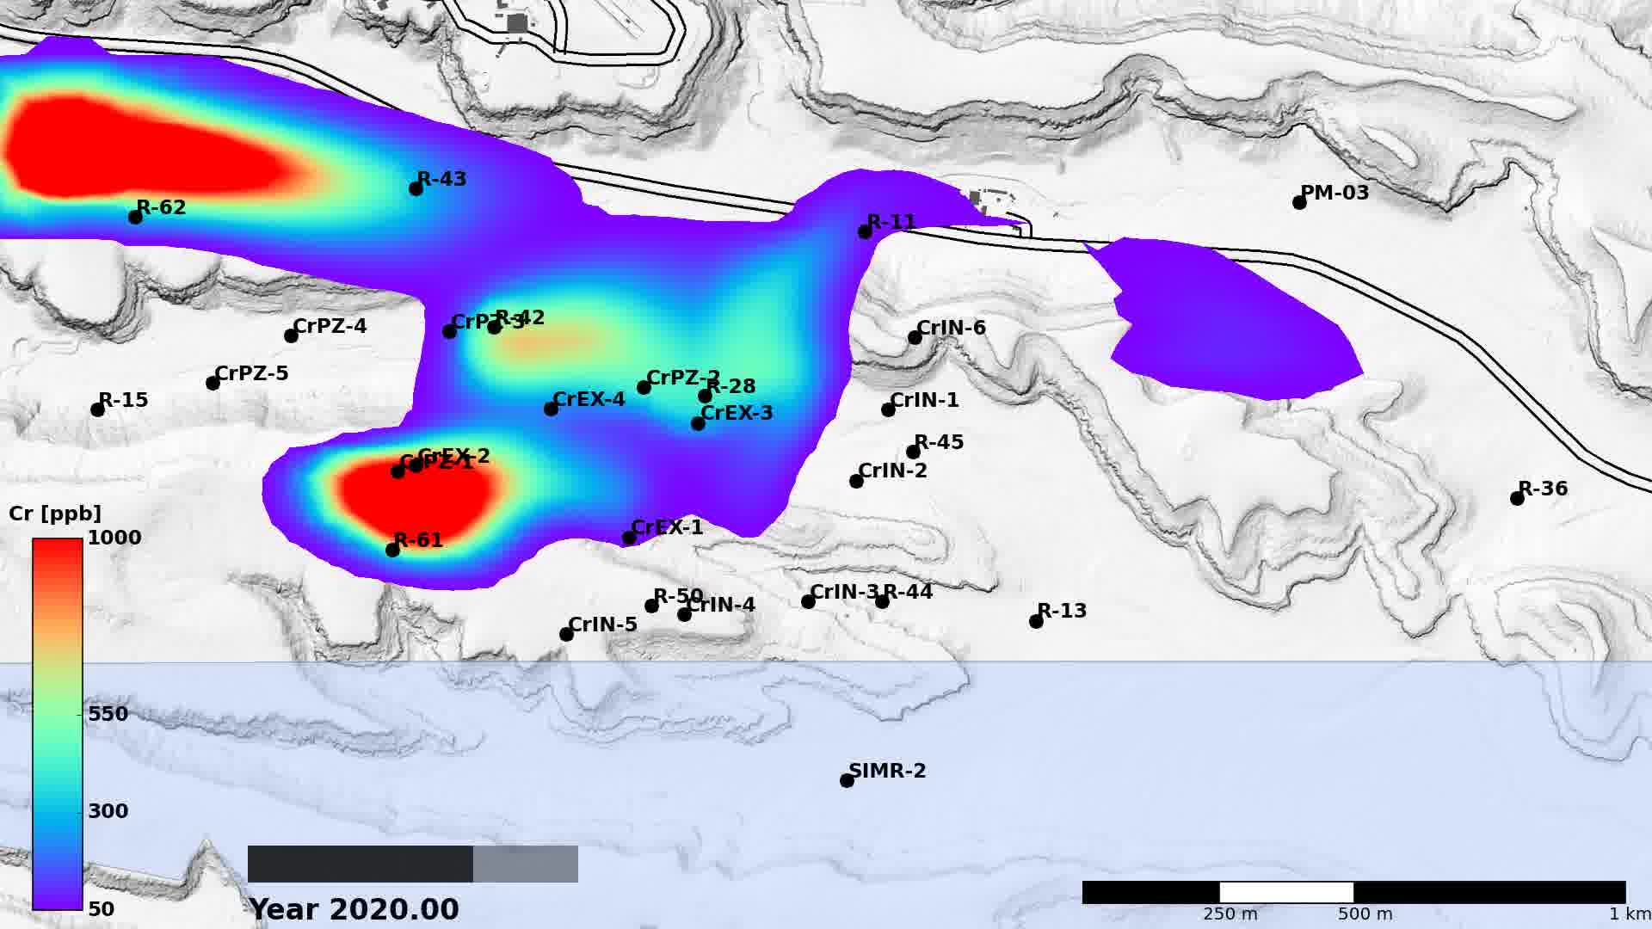
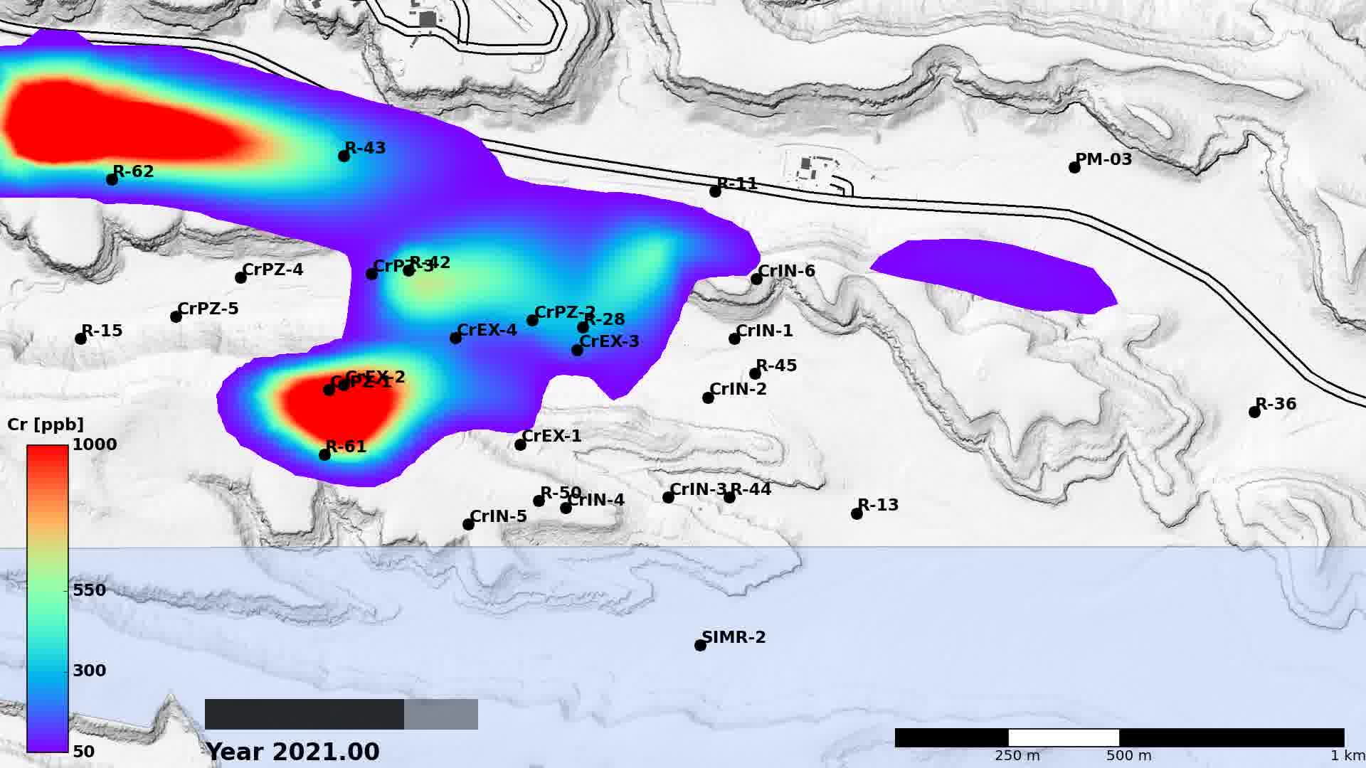
Modeling Results
Scenarios evaluated included continuous extraction at CrEX-1, CrEX-2 and CrEX-3, and continuous injection at all injection wells
Injection Scenarios
“pushes” contamination to the north and possibly towards PM-3
Extraction Scenarios
“captures” contamination from the north
more protective of PM-3

Slide 11
Groundwater Modeling Animations
Insert movies here

Slide 12
Project Status
Operated pumping and injection system for ~ 5 months in early 2017
Full-time operations along Laboratory boundary with Pueblo de San Ildefonso restarted late May 2018 and will run continuously for forseeable future
CrIN-6 reconfiguration activities July – December 2018
  Converting CrIN-6 into an extraction well (“CrEX-5”)
  Design/install infrastructure to connect to treatment system
Full system operation (inclusive of CrEX-5) expected to start in early 2019
Continue studies to evaluate final remedy

Slide 13
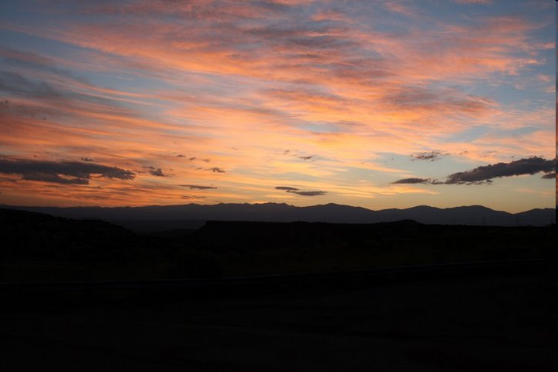
Questions?

