Slide 1
Los Alamos National Laboratory Environmental Management Legacy Cleanup
Doug Hintze, Manager
Environmental Management Los Alamos Field Office
March 20, 2018

Slide 2
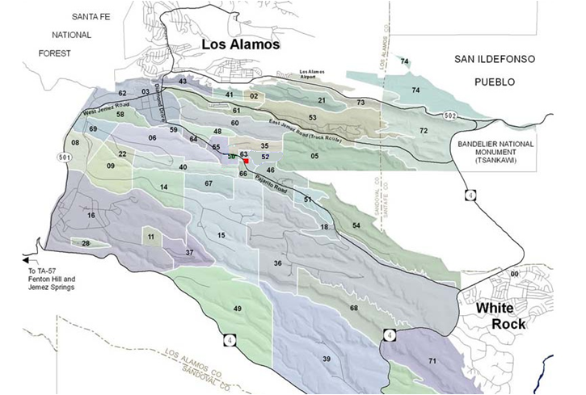
Environmental Management Mission at LANL
The EM-LA mission is to safely, efficiently, and with full transparency complete the cleanup of legacy contamination and waste (pre-1999) resulting from nuclear weapons development and government-sponsored nuclear research at the Los Alamos National Laboratory.
Environmental restoration across LANL conducted in accordance with 2016 Consent Order
Legacy waste is primarily located in Area G at Technical Area 54 (TA-54)
TA-54, Area G
Los Alamos National Laboratory

Slide 3
Los Alamos National Laboratory Organizational Structure
National Nuclear Security Administration Los Alamos Field Office
Environmental Management Los Alamos Field Office
NNSA/EM/LANS
Management Steering Committee
Los Alamos
National Laboratory
Los Alamos
National Security, LLC
Weapons Programs
Global Security
Science, Technology & Engineering
Operations & Business
Capital Projects
WP
GS
STE
OPS
Associate Directorate Environmental Management
Institutional Programs and Business Systems
Waste Disposition PBS 13
Soil and Water
& D&D
PBS 30
Management & Operating
Contract
Bridge Contract
4

Slide 4
LCE Integrated 2016 Consent Order
2016 Consent Order, Section VIII: Campaign Approach
Subsection A:
“[…] the Parties agree to use a structure called the "campaign approach." […] Corrective action activities required by this Consent Order will be organized into campaigns, generally based upon a risk-based approach to grouping, prioritizing, and accomplishing corrective action activities at SWMUs and AOCs.”
“A campaign may consist of one or more projects; campaigns and projects consist of one or more tasks and deliverables. Campaigns, projects, tasks, and deliverables may be subject to two types of deadlines: milestones, which are enforceable; or targets, which are not enforceable.”
Subsection B:
“The Parties agree that DOE's project plans and tools will be used to identify proposed milestones and targets. These project plans and tools will also be used to evaluate changes to milestones and targets.”
“The Parties further agree to identify and utilize a list of other submittals that are associated with the milestones listed in Appendix B and facilitate implementation of the campaigns by enabling the Parties to allocate resources.”
17 Campaigns Identified in the 2016 Consent Order

Slide 5
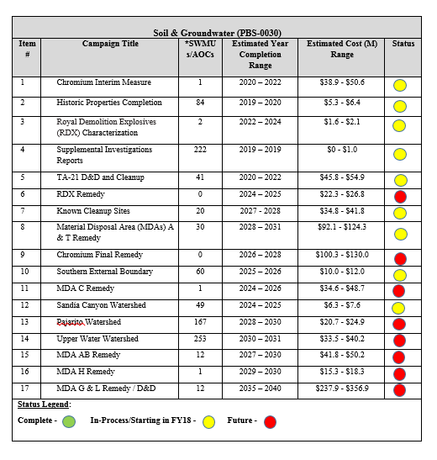
Consent Order Campaigns List

Slide 6
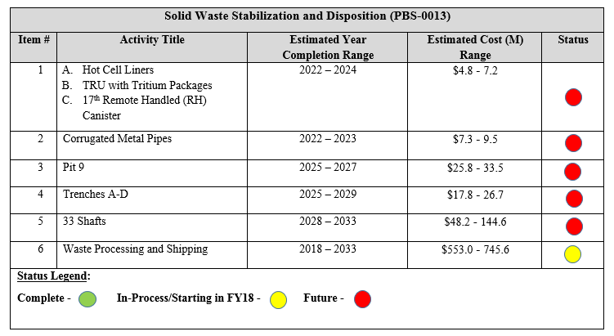
Waste Management Campaign List

Slide 7
Lifecycle Schedule for
Legacy Cleanup at LANL
FY17
FY19
FY21
FY23
FY25
FY27
FY29
FY31
FY33
FY35
Remediation and D&D
RDX
Groundwater
Characterization
Final Remedy
Chromium
Interim Measure
Final Remedy
7 – Major Material
Disposal Areas
C
A
AB
T
L
H
G
Decommission & Demolition
TA-21
TA-54
1
2
3
4
5
6
7
8
Aggregate Cleanups
Supplemental Investigation Reports
Historical Properties
TA-21 Site Cleanup
Southern Boundary
Sandia Watershed
Known Sites Cleanup
Pajarito Watershed
Upper Water Watershed
Aggregate Cleanups
Institutional/Regulatory
Waste Disposition
Hot Cell Liners
CMPs
Pit 9
Trenches A-D
33 Shafts
Retrievals
TRU Operations
Base Program
Complete
Activity Complete
Critical Path

Slide 8
Conclusion
Campaign approach to legacy cleanup and waste management
As one campaign completes, the next scheduled campaign commences
Multiple campaigns underway simultaneously
Safe, efficient and transparent execution

