Slide 1
Environmental Management Los Alamos Field Office Activities and Programs at Los Alamos National Laboratory
Doug Hintze, Manager
Environmental Management Los Alamos Field Office
March 19, 2018

Slide 2
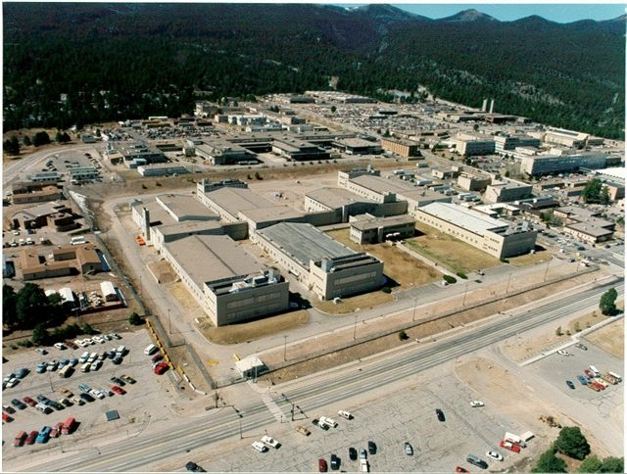
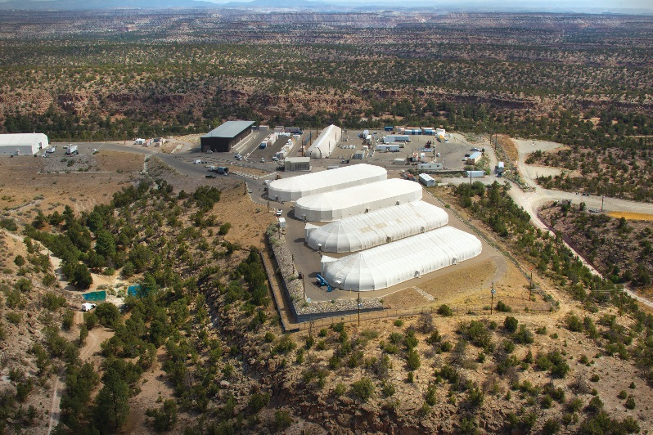
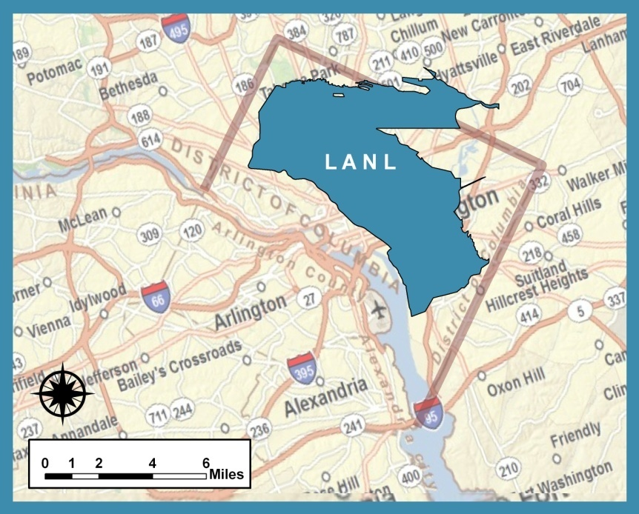
Los Alamos National Laboratory at a Glance
Los Alamos National Laboratory (LANL) is the oldest, most complex, and second largest National Nuclear Security Administration site
~ 40 square miles
11,171 federal employees and contractors
1,169 buildings
9 million gross square feet
268 miles of roads (100 paved)
128 radiological facilities
2

Slide 3
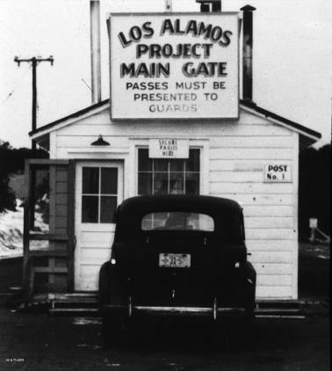
What Is Los Alamos National Laboratory?
Established in 1943 as Site Y of the Manhattan Project to design/build the atomic bomb
Formerly owned by the Federal Department of War, then the Atomic Energy Commission, then the Energy R&D Administration (ERDA), now the U.S. Department of Energy (DOE)
Operated by the University of California from 1943 through 2005
NNSA was established by Congress in 2000 as a separately organized agency within DOE focused on Defense Programs; DOE transitioned oversight of 8 sites to the NNSA, including LANL
Los Alamos National Security LLC (LANS) won the Management and Operating (M&O) contract in 2005 to present
Responsible for implementation of NNSA mission and environmental cleanup activities at LANL
LANS = Bechtel National Inc., Babcock & Wilcox Technical Services Group Inc., University of California, and AECOM (formerly URS)

Slide 4
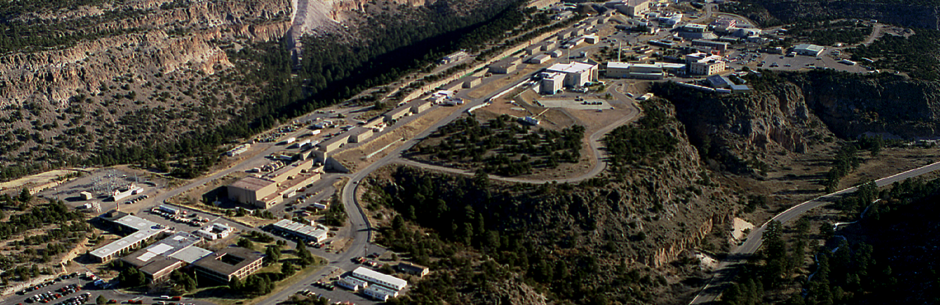
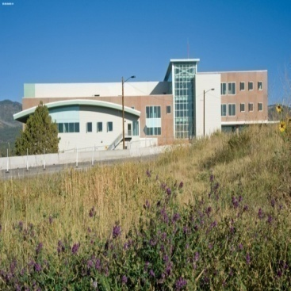
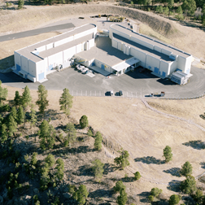
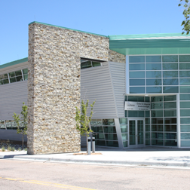
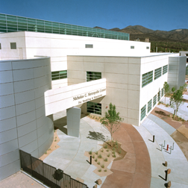
Los Alamos National Laboratory: Unique Facilities
Nuclear facilities address critical stockpile stewardship challenges
Supercomputing facilities
DARHT allows researchers to study weapons performance
Nanotechnology center drives critical research programs
LANSCE draws international scientists studying materials
Radiological Laboratory Utilities/Office Building
Dual Axis Radiographic Hydrodynamic Test Facility
Center for Integrated
Nanotechnologies
Nicholas C. Metropolis Center

Slide 5
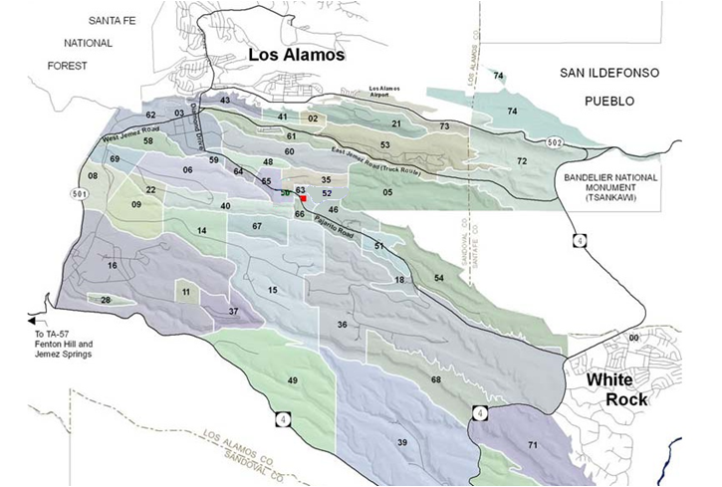
Environmental Management Mission at LANL
The EM-LA mission is to safely, efficiently, and with full transparency complete the cleanup of legacy contamination and waste (pre-1999) resulting from nuclear weapons development and government-sponsored nuclear research at the Los Alamos National Laboratory.
Environmental cleanup conducted in accordance with 2016 Consent Order
Legacy waste is primarily located in Area G at Technical Area 54 (TA-54)
TA-54, Area G
Los Alamos National Laboratory

Slide 6
Los Alamos National Laboratory Organizational Structure
National Nuclear Security Administration Los Alamos Field Office
Environmental Management Los Alamos Field Office
NNSA/EM/LANS
Management Steering Committee
Los Alamos
National Laboratory
Los Alamos
National Security, LLC
Weapons Programs
Global Security
Science, Technology & Engineering
Operations & Business
Capital Projects
WP
GS
STE
OPS
Associate Directorate Environmental Management
Institutional Programs and Business Systems
Waste Disposition PBS 13
Soil and Water
& D&D
PBS 30
Management & Operating
Contract
Bridge Contract
4

Slide 7
LANL FY17 Programmatic Funding Portfolio
FY17 LANL
Budget Authority = $2.5B
3
Notes:
Updated October 5, 2016 (CFO-Menefee)

